Slide 1
Classic Matlab
Learning Outcomes
Issue MATLAB commands in the Command Window
Create vector and matrix variables
Create character arrays
Access and manipulate data stored in variables using row-column indexing
Save and load MATLAB variables to and from disk programmatically

Slide 2
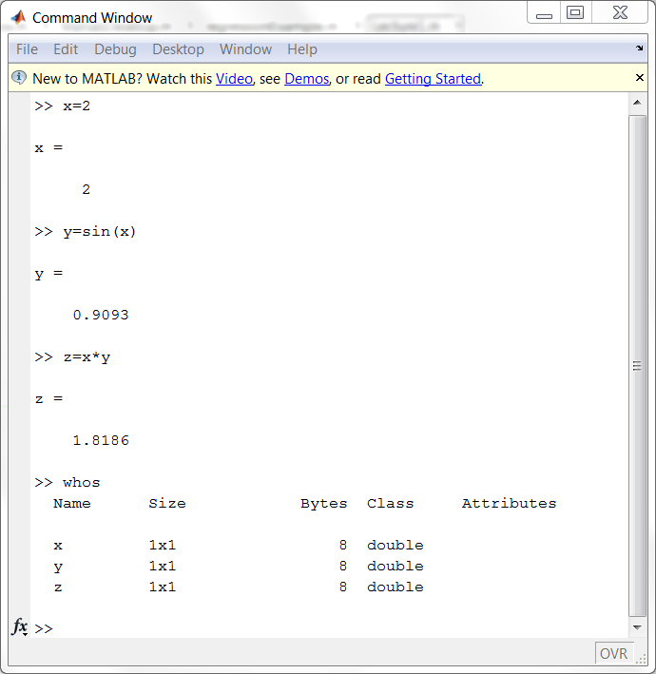
Entering commands:

Slide 3
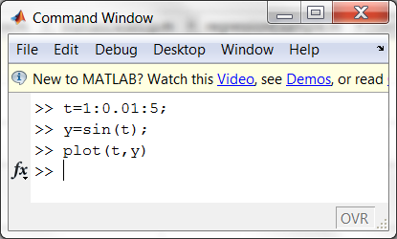
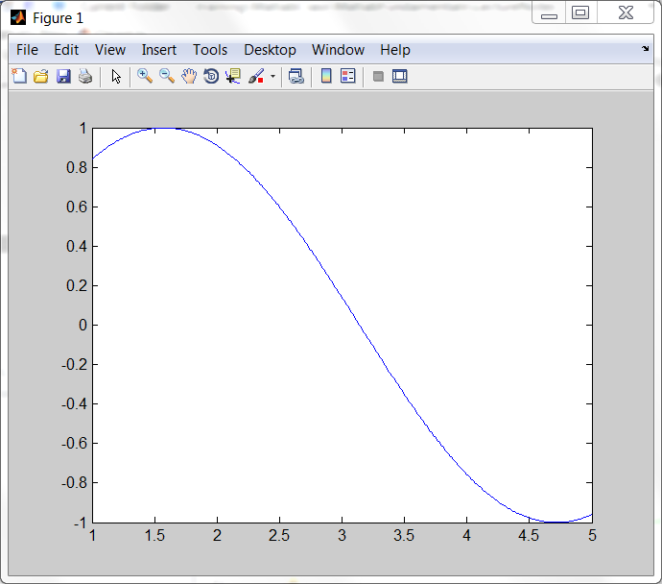
Entering vectors
plot

Slide 4
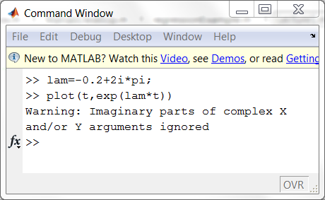
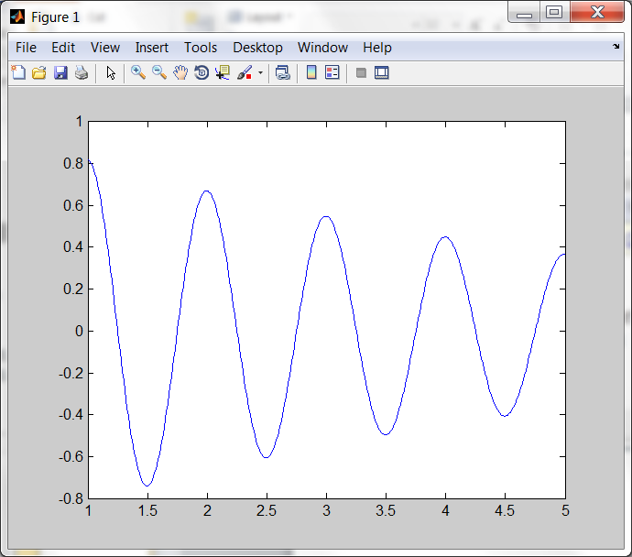
Complex numbers can be used

Slide 5
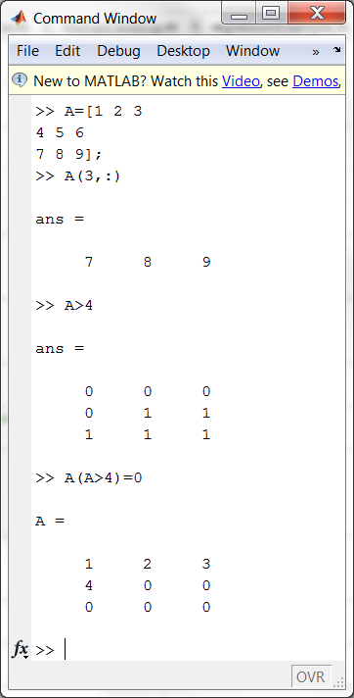
Matrices
Indexing
Logical indexing

Slide 6
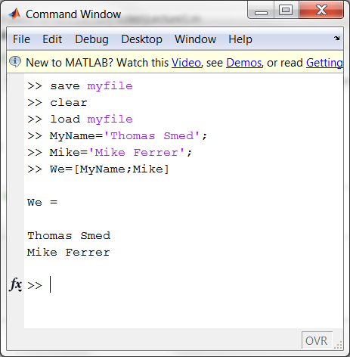
Save and Load
Strings

Slide 7
Lecture1.m and Exercise 1
Run thru the stuff in Matlab (Lecture1.m)
Exercise 1

Slide 8
Answers to Exercise 1
Run ../ans/Exercise1.m
Or click the link below
..\ans\html\Exercise1.html

Slide 9
Test
Select all that apply: Which of the following will create a matrix with three rows:
A=[zeros(2,4);ones(1,4)];
A=[1;2;3,4;5;6];
A=[1,2;3,4;5,6]';
A=rand(3);
Given a 5-by-5 matrix A, A(4:end,3:4) will produce a matrix of what size?
1-by-2
2-by-2
2-by-3
D. 3-by-2

Slide 10
Summary Classic Matlab
Entering commands
Creating variables
Accessing and modifying values in variables
Creating character variables

