Slide 1
Introduction Matlab Class
Idaho Falls, March 2-
Thomas Smed
Bo Berggren
Shaun Tarves
Studsvik Scandpower
Idaho Falls, March 2-4

Slide 2
Overview
Day 1 Matlab Fundamentals, Simple Models I
Will be able to write a basic Matlab program
Day 2 Read/Write, CMS Tools, Handle Graphics
Will be able to build a GUI and use the CMSSuite
Day 3 Matstab, Regression, Simple Models II
Will be able to do regression, understand how to build large applications

Slide 3
Detailed Overview
TS = Thomas Smed
ST = Shaun Tarves
 | Day 1 | Day 2 | Day 3
8-10 | MATLAB Desktop ST Classic MATLAB TS | Basic read and write from files ST | Matstab TS Svd, \, Regression TS
10-12 | Variables, commands TS Scripts and Logic ST | CmsRead CmsTools TS | Svd, \, Regression TS
12-13 | Lunch | Lunch | Lunch
13-15 | MATLAB Data Types ST Writing Functions ST | Handle Graphics ST | Simple models II: Point Kinetics TS
15-17 | Simple models I: Eig TS | CmsPlot S3kPlot TS | Deployment Wrapup, Evaluation

Slide 4
Detailed Overview
TS = Thomas Smed
ST = Shaun Tarves
 | Day 1 | Day 2 | Day 3
8-10 | MATLAB Desktop ST Classic MATLAB TS | Basic read and write from files ST | Svd, \, Regression TS
10-12 | Variables, commands TS Scripts and Logic ST | CmsRead,CmsTools, CmsPlot TS | Handle Graphics ST
12-13 | Lunch | Lunch | Lunch
13-15 | MATLAB Data Types ST Writing Functions ST | More CmsSuite ST | S3K post-processing, Matstab TS
15-17 | Simple models I: Eig TS | Simple models II: Point Kinetics TS | Deployment Wrapup Evaluation

Slide 5
Day 2 Read/Write from file, CMSSuite, Simple Models II
Read/Write from/to file
CmsRead, CmsTools
LUNCH
Handle Graphics
CmsPlot, S3KPlot

Slide 6
Detailed Overview
TS = Thomas Smed
ST = Shaun Tarves
 | Day 1 | Day 2 | Day 3
8-10 | MATLAB Desktop ST Classic MATLAB TS | Basic read and write from files ST | Svd, \, Regression TS
10-12 | Variables, commands TS Scripts and Logic ST | CmsRead,CmsTools TS | Handle Graphics ST
12-13 | Lunch | Lunch | Lunch
13-15 | MATLAB Data Types ST Writing Functions ST | Handle Graphics ST | S3K post-processing, Matstab TS
15-17 | Simple models I: Eig TS | CmsPlot, S3kPlot TS | Deployment Wrapup Evaluation

Slide 7
Day 3 Regression, Handle Graphics, S3K Post, Example of a full blown program in Matlab (Matstab)
Lecture 11: Regression, svd, \
Lecture 12: Handle Graphics
LUNCH
Lecture 13: S3K Postprocessing, Matstab
Lecture 14: Deployment, Wrapup, evaluation

Slide 8
Detailed Overview
TS = Thomas Smed
ST = Shaun Tarves
 | Day 1 | Day 2 | Day 3
8-10 | MATLAB Desktop ST Classic MATLAB TS | Basic read and write from files ST | Matstab TS Svd, \, Regression TS
10-12 | Variables, commands TS Scripts and Logic ST | CmsRead,CmsTools, CmsPlot TS | Svd, \, Regression TS
12-13 | Lunch | Lunch | Lunch
13-15 | MATLAB Data Types ST Writing Functions ST | Handle Graphics ST | Simple models II: Point Kinetics TS
15-17 | Simple models I: Eig TS | CmsPlot, S3kPlot TS | Deployment Wrapup Evaluation

Slide 9
Wrapup
The MATLAB Desktop
Classic Matlab
Analysis and visualization with vectors and matrices
MATLAB Scripts and Logic
MATLAB Data Types
Writing MATLAB Functions
Simple models I, eig
MATLAB File I/O
CmsSuite
Handle Graphics
CmsPlot, S3kplot
Matstab
Regression, the singular value decomposition
Simple Models II, point kinetics, function handles, function functions
Deployment

Slide 10
Course assessment
Particularly, focus on what to increase (more of) and what to decrease (less of)

Slide 11
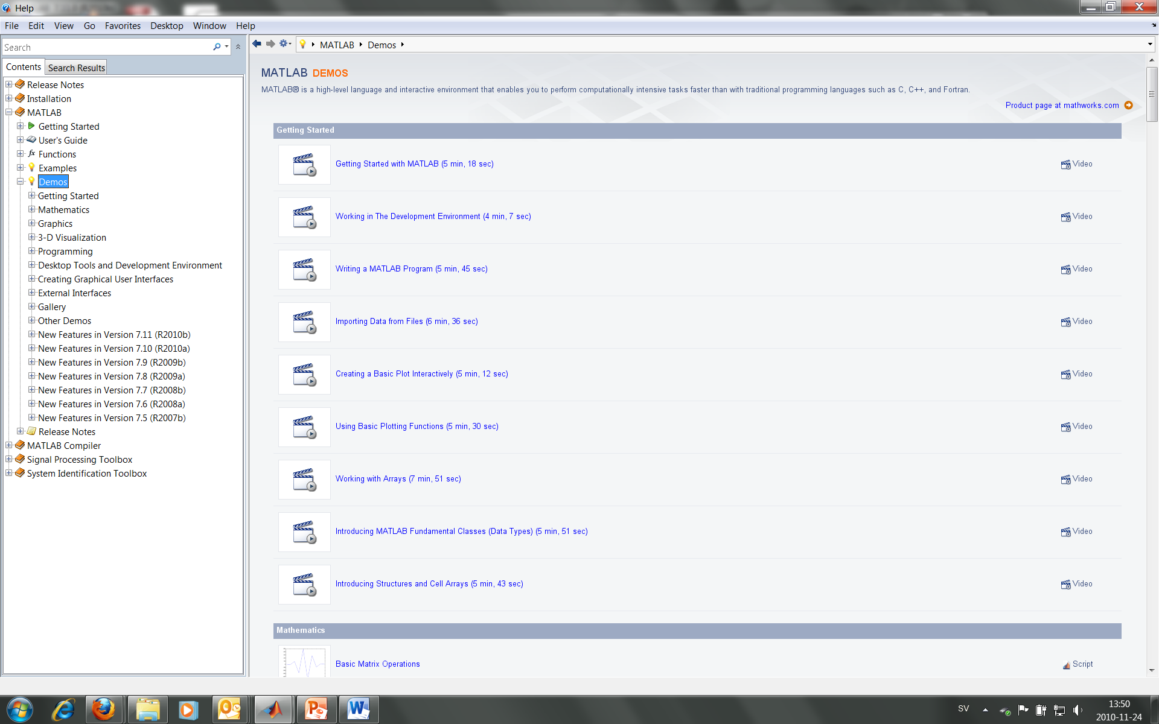
Link for self-studies
http://www.mathworks.com/academia/student_center/tutorials/ml_onramp/player.html
You can also run similar demos from Matlabs Help

Slide 12
Self-Studies
http://www.mathworks.com/academia/student_center/tutorials/programming/player.html

Slide 13
Preferred architecture for new applications
HDF5
JAVA
C5
MATLAB
S5
S5K

