Slide 1
Lecture 3a Analysis and Visualization with Vectors and Matrices
Statistics with matrix data
Create new variables by applying arithmetic operations and functions to existing variables
Label and annotate plots

Slide 2
Data Analysis
Operates on columns:

Slide 3
Data Analysis
Operates on columns:

Slide 4
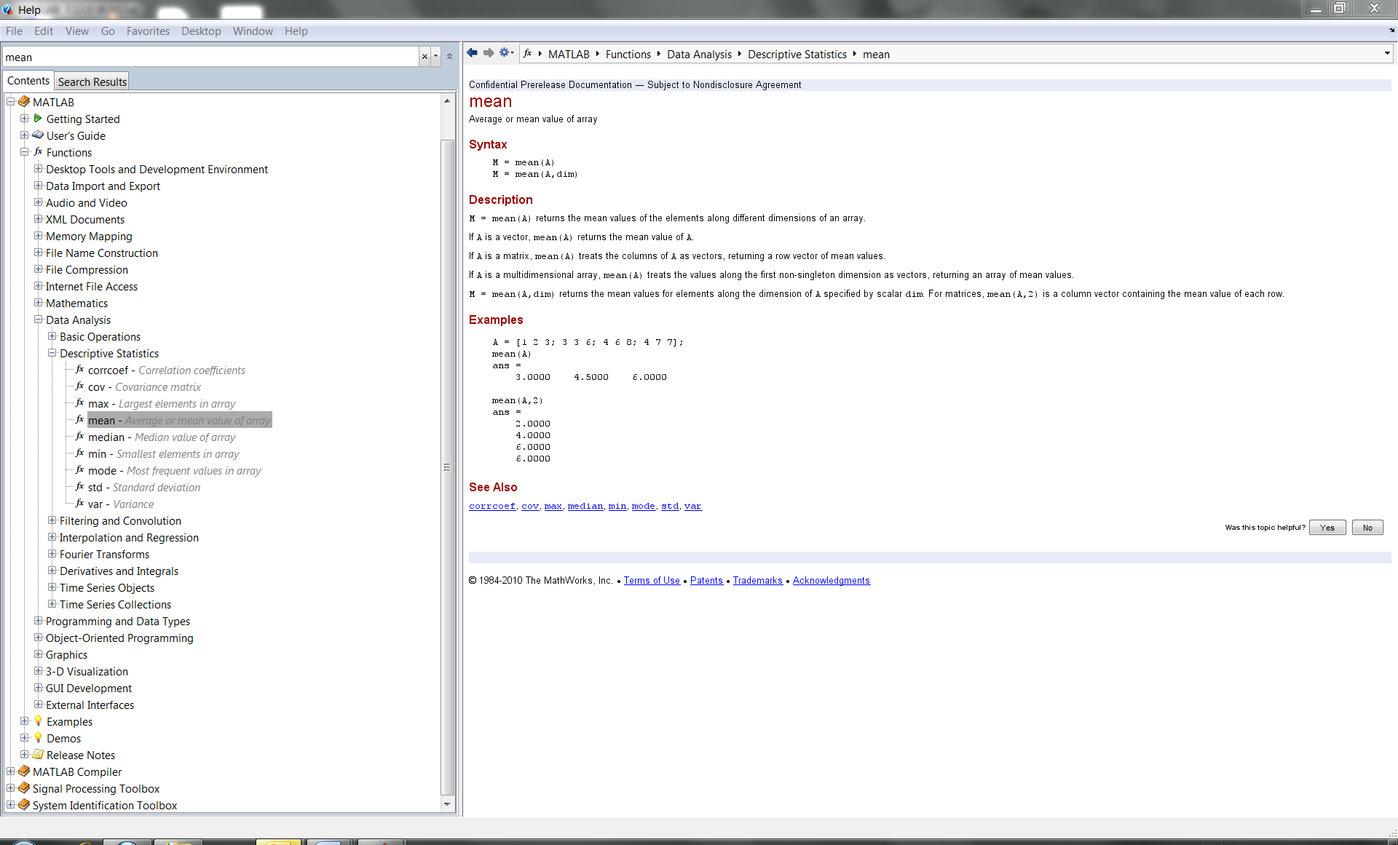

Slide 5
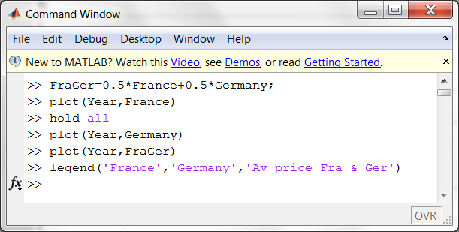
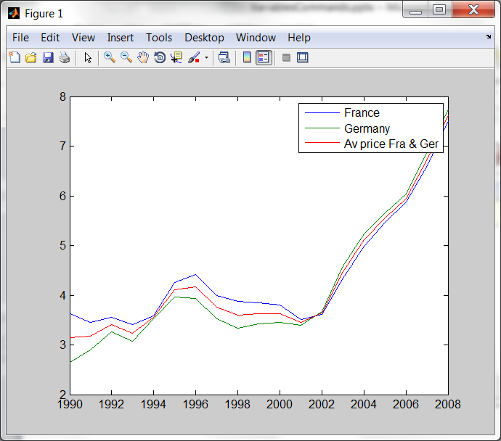
Arithmetics on vectors
Label and annotate plots

Slide 6
Matlab practice
Lecture3a.m
Exercise3

Slide 7
Answers to Exercise 3
Run ../ans/Exercise3.m
Or click the link below
..\ans\html\Exercise3.html

Slide 8
Lecture 3b Analysis and visualization with matrices
Size and dimensionality
Calculation with matrices
Plotting multiple columns
Reshaping and linear indexing
Multidimensional arrays

Slide 9
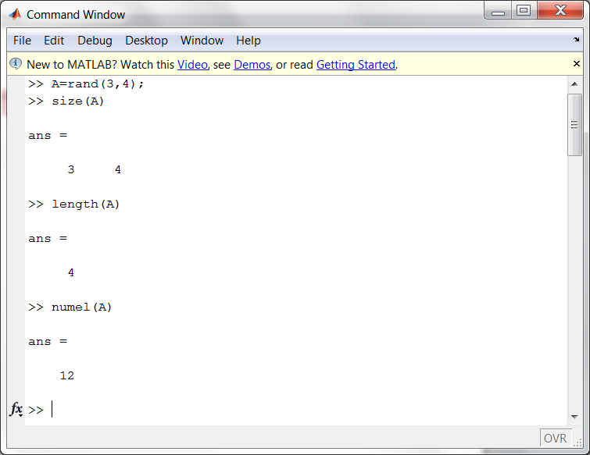
Size and dimensionality

Slide 10
Matlab practice
Lecture3b.m
Exercise3b

Slide 11
Answers to Exercise 3b
Run ../ans/Exercise3b.m
Or click the link below
..\ans\html\Exercise3b.html

Slide 12
Summary Lecture 3
Calculation with vectors
Plotting vectors
Basic plot options
Annotating plots
Size and dimensionality
Calculation with matrices
Statistics with matrix data
Plotting multiple columns
Reshaping and linear indexing
Multidimensional arrays

