Slide 1
MATLAB Graphics
Shaun Tarves
Studsvik Scandpower
Idaho Falls, March 2-4

Slide 2
MATLAB Graphics Outline
Handle Graphics
Using GUIDE
Creating the GUI layout
Writing GUI code
Modifying GUIs

Slide 3
MATLAB Graphics Learning Outcomes
Use Handle Graphics techniques to manipulate graphics objects
Use GUIDE to create a GUI

Slide 4
Handle Graphics
MATLAB figures consist of various graphics objects
Figure Window
Axes
Text
UI Controls
Each object has a unique numeric identifier called a handle
Each object type has a fixed set of properties
Users can modify the values of the properties to control the appearance of the figure

Slide 5
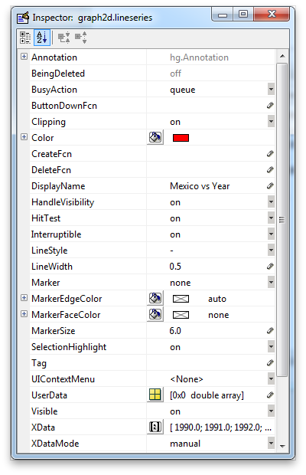
Property Browser
Try:
Open the .fig file you saved during the MATLAB Desktop lecture
Open Plot Tools
Click on various graphics objects and explore the properties
Hint: Use the More Properties… button on the Property Editor panel

Slide 6
Graphics Structure
Graphics objects are arranged in a natural hierarchy
The root object is the MATLAB Desktop, and is given handle 0
Figure windows are children of the root
Figure k has a handle value of k

Slide 7
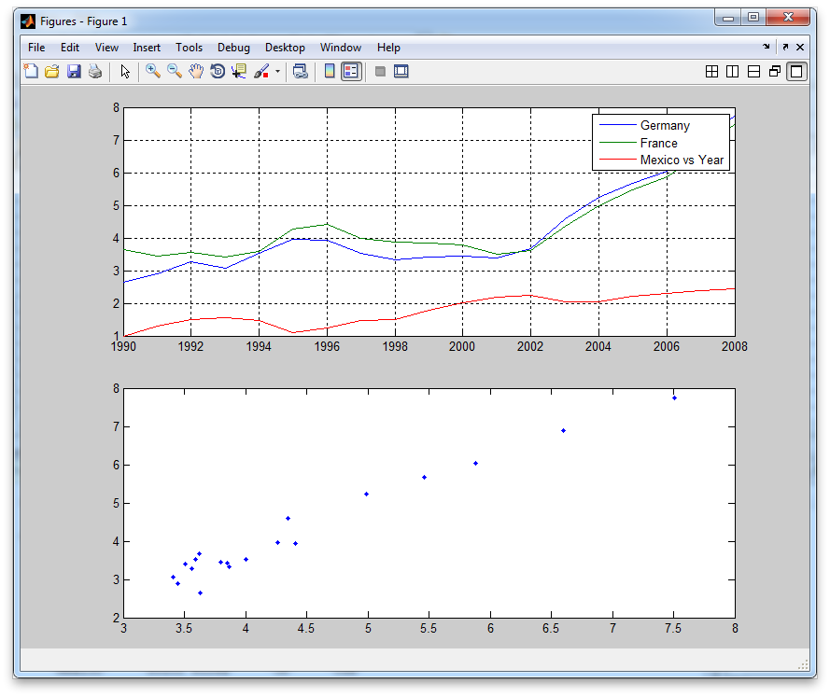
Graphics Structure
Figure

Slide 8
Graphics Structure
Graphics objects are arranged in a natural hierarchy
The root object is the MATLAB Desktop, and is given handle 0
Figure windows are children of the root
Figure k has a handle value of k
Axes and UI Objects are children of figures
Axes are used for displaying graphics
UI Objects are used to control the GUI (buttons, sliders, etc.)

Slide 9
Graphics Structure
Figure
Axes

Slide 10
Graphics Structure
Graphics objects are arranged in a natural hierarchy
The root object is the MATLAB Desktop, and is given handle 0
Figure windows are children of the root
Figure k has a handle value of k
Axes and UI Objects are children of figures
Axes are used for displaying graphics
UI Objects are used to control the GUI (buttons, sliders, etc.)
Plot objects are children of axes
They include lines, surfaces, patches, text, and legends

Slide 11
Graphics Structure
Legend
Plot objects
Figure
Axes

Slide 12
Working with Handles
Interactive modification of graphics objects is usually not what you want.
To modify graphics programmatically, use the get and set functions:
The get command lets you get the value of any property
The companion set command lets you set new property values
Before you can use these functions, you have to point MATLAB to the graphics object you are working with
Once you know the handle(s), you can begin to manipulate the graphics

Slide 13
Working with Handles
Refer to it directly with known values
0 is the root handle
1,2,… for Figure 1, Figure 2,…
Use special gcX functions to retrieve the last object created or clicked
gcf: Current figure handle
gca: Current axes handle
gco: Current object handle
Ask for it when you execute a graphics-related command
f = figure;
h = plot(x,y);

Slide 14
Working with Handles
Try: Close all open figure windows and type get(0)
What are we looking at here?
Every object also has two non-editable properties that show its location within the hierarchy: Parent and Children
The values of these properties are handles to the objects above and below the current object in the hierarchy

Slide 15
Using the get() and set() Commands
get(handle)
Returns all of the property/value pairs associated with handle
get(handle,’Property’)
Returns the value of property for handle
set(handle,’Property’,’Value’)
Sets the value of property to value for handle
Try: Create a figure window and programmatically (from the Command Window) add text to the figure window title bar
Hint: Try searching the MATLAB help for “Figure Properties” to determine which property to set

Slide 16
Handle Properties
To query properties using get or change their value using set, you need to know the names of the property-value (PV) pairs that are relevant to the object
You also need to know what the acceptable values are for a given property
There is a whole section of the MATLAB documentation just for this purpose
Try: Open the MATLAB help and navigate to MATLAB➔User Guide➔Handle Graphics Property Browser

Slide 17
Exercise 1: Create the lower plot from our gasprices figure
Load the gasprices data from the mat file
Plot Germany vs. France
Set the LineStyle property to remove the line
Set the Marker property to create data markers
How do you get the handle to the lineseries object?
get(gca,’Children’); % Get the handle(s) to the child(ren) of the current axes

Slide 18
Passing Handles to Graphics Functions
Almost all MATLAB graphics-related functions will accept and return handles
f = figure; % Returns handle to a figure object with no axes
g = axes; % Returns handle to a figure object with an axes
h = plot(x,y); % Plots x,y on the gca and returns handle to a lineseries object
h = plot(g,x,y); % Plots x,y on axes g and returns handle to a lineseries object
This function syntax is important as you build complex plots or GUIs

Slide 19
Exercise 2: Create the upper plot from our gasprices figure
Load the gasprices data from the mat file
Plot Germany vs. Year
Plot France vs. Year
What happens to the plot?

Slide 20
The hold Function
By default, MATLAB replaces objects in the current figure when a new plot command is issued
We have to use the hold command to tell MATLAB we want to retain the current graph in the figure
Try: doc hold
Try: get(gca,’NextPlot’)
hold is the key to plotting multiple data series on a single axes
hold on; % doesn’t retain the color order/line style
hold all; % retains all figure properties, including color order and line style

Slide 21
Exercise 2, continued
Plot Germany vs. Year
Hold the current figure
Plot France vs. Year
Plot Mexico vs. Year

Slide 22
Controlling Axes
You can control the range, tick marks, labels, and gridding using various properties of the axes object
Try: Explore the following properties of the figure:
XLim
XTick
XTickLabel
XLabel
XGrid
Each property returns a different type of value

Slide 23
Setting Axes Limits
get(gca,’XLim’) returns a 2-element vector containing the lower and upper limits of the axes
To set new limits, simply issue a set command and feed in the new vector
set(gca,’XLim’,[1992 2006])

Slide 24
Setting Axes Tick Marks
get(gca,’XTick’) returns a vector containing each value where a tick mark will be displayed on the axes
get(gca,’XTickLabel’) returns a cell array containing the strings that accompany each tick mark
These should contain the same number of elements
To set new ticks, issue a set command and feed in the new vector
set(gca,’XTick’,[1994 1998 2002])
For different tick labels, you must feed in a cell array
set(gca,’XTickLabel’,{‘Year 3’,’Year 7’,’Year 11’})

Slide 25
Setting Axes Labels
get(gca,’XLabel’) returns a handle to another graphics object
This handle is itself a text object
To set new labels, you have to issue a set command on the string property of the handle to the text object, and feed in a new string
set(get(gca,’XLabel’),’String’,’Year’)

Slide 26
Turning on the Grid
get(gca,’XGrid’) returns a string indicating the status of the gridlines
To toggle the gridlines, issue a set command and feed in the desired status
set(gca,’XGrid’,’on’)

Slide 27
Annotating Plots
You can produce a legend for a plot using the legend command
As with other graphics-related commands, it can accept and return handles
legend(string1,string2,string3) will add a legend to the current plot, labeling each Child object in order with the strings provided
legend([handles],{strings}) allows you to directly link a label with a lineseries handle

Slide 28
Multiple Axes
Plot commands automatically generate a single set of axes within the current figure window
Multiple axes within the same figure window are generated using the subplot functions
subplot doesn’t actually plot anything, it just creates the axes
subplot returns an axes handle, as expected
The command takes the form subplot(m,n,k) where
m is the number of rows in the grid
n is the number of columns in the grid
k is the active plot (moving across rows)
Try: Create a 3x3 plot grid and activate the center axes

Slide 29
Exercise 3: Putting it All Together
Create a figure with an upper and lower axes.
In the upper axes:
Plot the gas prices in Australia, Italy, and the United States from 1996 to 2004
Data from the US should appear as a solid black line, data from Australia should appear as a dotted blue line, and data from Italy should appear as a dotted red line
Add a legend labeling the data from Italy and Australia
Put reasonable labels on the x- and y-axes, and turn on the x- and y-grid
In the lower axes:
Show how the gas prices in Japan during the 1990s are related to gas prices in the US

Slide 30
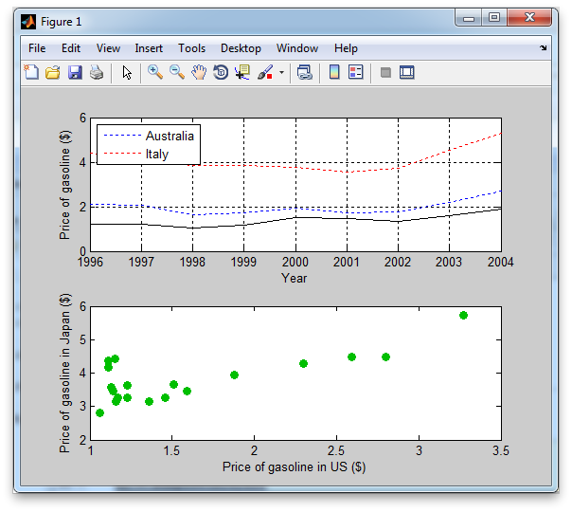
Exercise 3

Slide 31
Quiz
Given a figure handle f, which of the following will return a list of properties for the figure?
recall(f)
retrieve(f)
get(f)
handles(f)
T/F: By default, MATLAB will add lines from additional plot commands to an existing figure window
FALSE
The command plot(x,y,Marker,’k’) produces 2 errors. Why?

Slide 32
Using GUIDE
GUIDE is the MATLAB “Graphical User Interface Development Environment”
Allows you to build GUI tools in a point-and-click environment
Two-step process:
Lay out the interface (create the figure file)
Write the callbacks (create the code file)

Slide 33
GUI Concept
We will build a GUI that looks like this:
Plot
Checkboxes to select countries to plot

Slide 34
Using GUIDE
To open GUIDE, type
guide
Choose to begin form a blank GUI. You will see a blank layout grid
Buttons along the left are various graphics objects
Buttons along the top indicate formatting options

Slide 35
Creating the Layout
To select and position objects in GUIDE:
Click a button in the left-hand pane to toggle it down
Move the mouse into the layout grid. It becomes a cross-hair
Click and hold the left mouse button and drag the mouse until the box that appears encloses the approximate extent of the object you want to position
Release the mouse button
To reposition an object, select it with the left mouse button then drag or use the arrow keys
You can align and distribute objects by using Ctrl key to activate a multi-object select

Slide 36
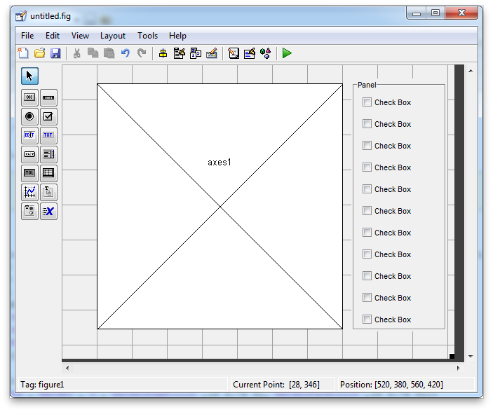
Exercise 4: Create the Layout

Slide 37
Exercise 4: Create the Layout
The box around the checkboxes is made with a “Panel” object
Use the layout tools to left-align the checkboxes horizontally and distribute them vertically (use a spacing of 8 pixels)

Slide 38
Using the Property Inspector
After you create the layout, you set PV pairs for each of the objects so they look and behave the way to want
GUIDE provides an interactive get and set tool to make this easy
Double-click an object to open the Property Inspector
One property that is important to set is the Tag. It is the unique identifier you will use to interact with the object
When the GUI runs, the handle of each object is stored in a structure array called handles, with a field name given by tag

Slide 39
Exercise 4, continued
Set the properties of the objects in the gas price plotting GUI using the Property Inspector
Set:
The String of each checkbox should be set to the country name (be sure to use the correct order)
The Tag of each object to a short, descriptive string
The HandleVisibility of the axes and the checkboxes to callback

Slide 40
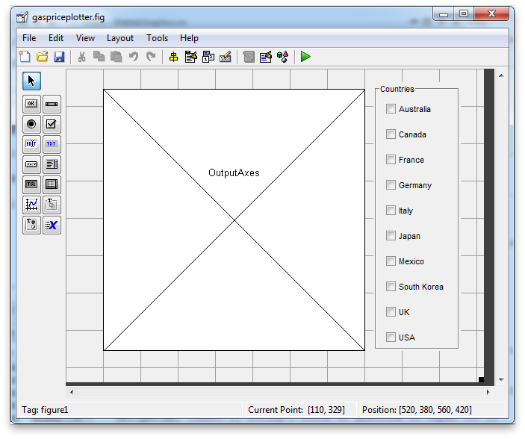
Exercise 4, continued

Slide 41
Activating the GUI
When you are satisfied with the layout, and set the properties of your graphics objects, you can activate your GUI
Try: Choose Tools➔Run from the top menu
GUIDE prompts you to name your GUI and then creates a .fig file and a .m file with that name.

Slide 42
Activating the GUI
The figure file implements the layout and serves as the UI
The UI is now functional in the sense that you can select things, push buttons, etc.
However, nothing happens when you do because you have not written the callbacks that tell MATLAB how to respond to UI events

Slide 43
Activating the GUI
The code file opens in the MATLAB Editor
It contains a supervisor functions for the GUI, two initialization subfunctions, and a sequence of callback stubs.
To make the GUI operational, you have to fill in the callback stubs with the code that implements your design

Slide 44
The GUI Code File
The code created by GUIDE is supervised by the primary or main function, with the name you chose
Every time your GUI is opened or interacted with, this function is called and passed event information, which it uses to call the appropriate callback subfunctions
Do not ever edit this part of the code file

Slide 45
Callbacks
Callbacks are implemented as subfunctions to the main function
They are named Tag_Callback, where Tag is the string assigned to the object by the Property Inspector
GUIDE also creates callback stubs for events other than object callbacks
filename_OpeningFcn is quite useful for setting initial values of controls, creating initial plots, etc. It is called when the GUI opens

Slide 46
Callbacks
Every callback is passed an input argument named handles that is a structure array with field names given by Tag of every graphics object in the GUI
This provides a convenient way to access the handles of objects in callback code.
Each callback is also passed a variable hObject, which is a handle to the specific object that triggered the callback
You can add other utility subfunctions to the GUI code to streamline common callback activities

Slide 47
Writing Callbacks
Callbacks often have a similar structure:
Gather information about the current state of the interface using get commands
Compute something based on the current information
Update the interface with the set command
Try: Open gaspriceplotter.m

Slide 48
Writing Callbacks
The callbacks in this file are all pretty simple
The OpeningFcn callback loads the data and plots all the lines, but sets their visibility to off
Each checkbox callback behaves the same way. If a checkbox is selected, its Value is 1, otherwise, its Value is 0
The callback determines the Value and sets the Visible property of the line accordingly

Slide 49
Running the GUI
To run the GUI, you don’t have to have the layout open in GUIDE or the code open in the Editor
Simply type the name of the code file
gaspriceplotter

Slide 50
Modifying the GUI
You can easily modify the layout or behavior of your GUI after it’s been created
Open GUIDE again by right-clicking the figure file and selecting Open in GUIDE
Any time you modify the layout and choose File➔Save, the code file is automatically updated to reflect the newest layout
To edit just the behavior, simply open the code file and begin editing

Slide 51
Exercise 5
Modify the gaspriceplotter program to initially plot all lines and then change the line width to highlight the selected countries

