Slide 1
Matstab
Matlab Class
Thomas Smed

Slide 2
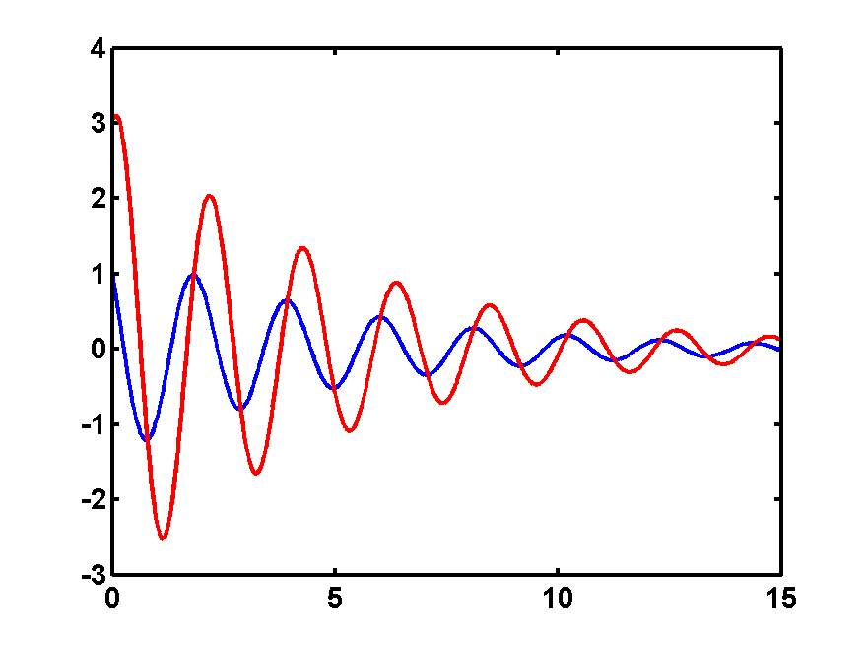
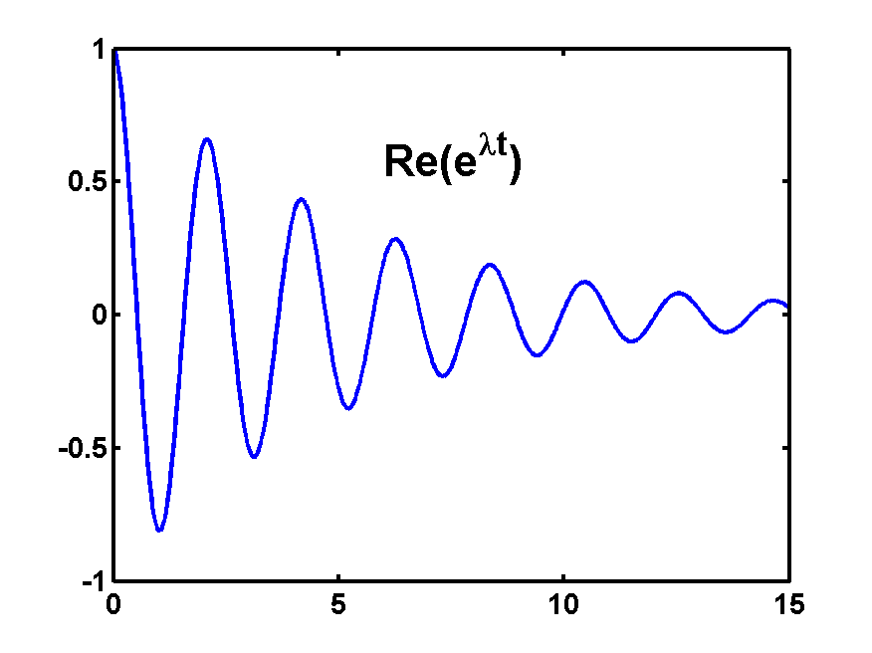
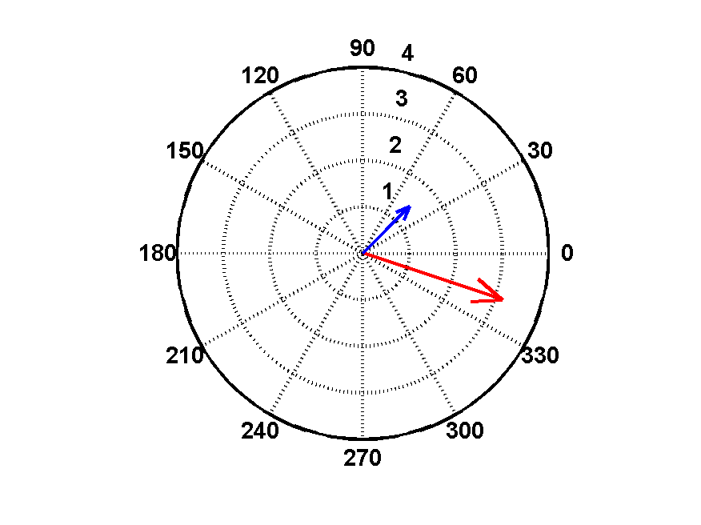
Ideas of Frequency Domain Analysis
2
All variables have the same shape and can be represented by a single number:
Individual variables represented by a complex number:
1+j
3-j

Slide 3
How it’s done (1)
Problem:
Linearize:
with
Solve:
for only one eigenvalue
Time domain response:

Slide 4
Interpretation
Global parameters
Eigenvalue:
Decay ratio:
Frequency:
Spatial variation
Amplitude:
Phase:

Slide 5
Matstab
Example of a full program of large complexity that runs well in matlab
Try (on MatlabClass/S3kMatstab/Matstab)
>> profile on
>> matstab c13-2.inp
>> profreport

Slide 6
Matstab
>> matstab s3k.inp
init_msopt: parse options
get_inp_sim3: read from .inp, .res
steady_state: interpolate xs by reading from .lib
solve power-void
build_A: Linearize and build A
newt: solve
Uses complex and sparse matrix technology

Slide 7
Matstab
Using read_cms, cmsplot and PlotS3k
Comparing with other codes (point kinetics, Bison etc) and measurements
Detailed comparison with Matstab by generating phasors with FFT and direct parametric methods

