Slide 1
Simple Models I Matlab Class
Thomas Smed
Studsvik Scandpower

Slide 2
Simple Models I
Eigenvalues and eigenvectors
Spring Mass Example

Slide 3
Matrix multiplication
2-by-2
2-by-1
2-by-1
These have to be the same

Slide 4
The Matrix multiplication can also be interpreted as a linear combination of the columns of A
Note that in this equation, c₁ and c₂ are column vectors, whereas r₁ and r₂ they were row vectors on the previous slide

Slide 5
Matlab Practice
LectureSimpleModelsI.m
eigdemo (Type eigshow in the command window)

Slide 6
Spring-Mass example
Spring-mass analogy
where
Assume
then
x

Slide 7
Characteristic equation:
or
, where

Slide 8
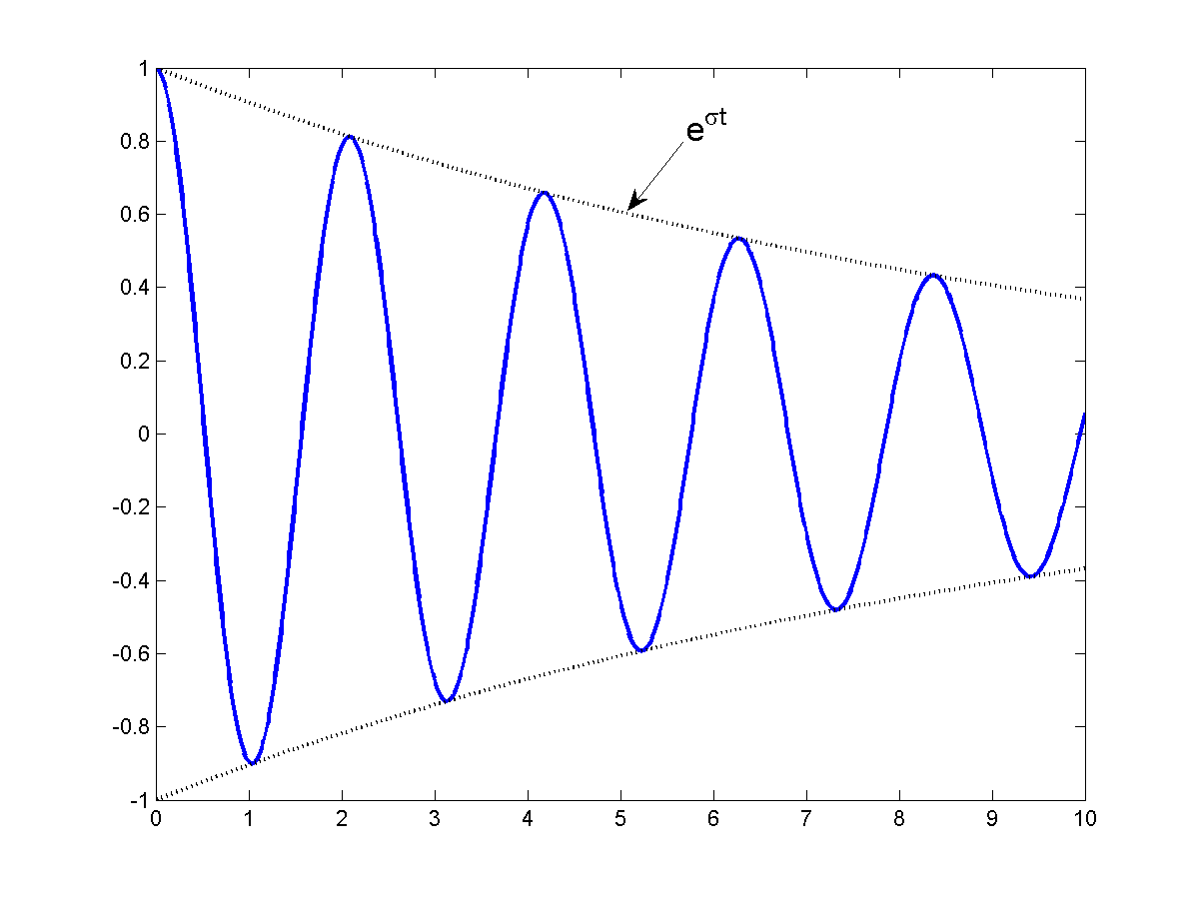
For some complex constant c

Slide 9
For a big case, we need the state-space form:
Postulate
Then

Slide 11
(1)
Postulate
(2)
Then
(3)
Insert (2) and (3) in (1):

Slide 13
Interpretation (to be used in the exercise)
Eigenvalue:
Decay ratio:
Frequency:
April 12-15, 2009

Slide 14
Matlab practice
Exercise Simple Models I

Slide 15
Answers to Exercise Simple Models
Run ans/Exercise9.m
Or click the link below
ans\html\Exercise9.html

Slide 16
The classical argument is based on spectral decomposition, i.e. diagonalizing A. Note that if the columns of V consists of the eigenvectors of A, then:
Multiply from the right by
Multiply from the left by
and make the substitution
This is a diagonal system!

Slide 17
Another way to see that eigenvalues are important for dynamic systems is to make the analogy with the first order system:
Has the solution
Wouldn’t it make sense if the matrix version works the same?
Indeed, if you remember the definition of e (go Wiki), use the diagonalization and mock around a bit, you can convince yourself that:
This equation says a lot. In short, the columns of V are the eigenvectors, the rows of are the left eigenvectors. The left eigenvectors (adjoint fluxes are left eigenvectors) can be used for sensitivity analysis and understanding controllability. One application would be to find an optimal disturbance to provoke an out-of phase in a time-domain simulation.

Slide 18
Power Iteration finds the largest eigenvalue:

Slide 19
Inverse Iteration finds the smallest eigenvalue:

Slide 20
Find one eigenvalue close to
via Inverse Iteration with shift:

Slide 21
Matlab practice
Exercise Inverse Iteration

Slide 22
Answers to Exercise Inverse Iteration
Run ../../SimpleModelsI/ans/Exercise9b.m
Or click the link below
..\..\SimpleModelsI\ans\html\Exercise9b.html

Slide 23


