Slide 1
Control Theory System Identification Continuous-Discrete
Thomas Smed

Slide 2
Some motivational words
“There is nothing more practical than a good theory”, Kurt Lewin

Slide 3
Control Theory
Is really about dealing with linear ordinary differential equations
Transfer function representation:
G(s)
Where Y(s) is the Laplace transform of y(t)

Slide 4
How to go between Laplace and time domain in practice?
Replace s by dy/dt to get to the time domain:
Typically you use capital U and Y in the Laplace (or frequency) domain and u and y in the time domain

Slide 5
System Identification

Slide 6
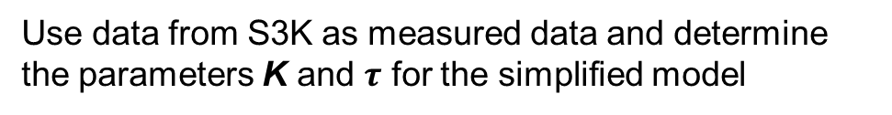
System Identification
Is the total fission power
Is the power transferred to the coolant
Use data from S3K as measured data and determine the parameters K and $τ$ for the simplified model

Slide 7
Continuous to discrete
Multiply by integrating factor:

Slide 8
Continuous to discrete
Integrate from t=kT to t=kT+T and assume that u is kept constant:

Slide 9
Simple translation continuous to discrete for first-order system
Continuous system:
Discrete system:

Slide 10
Continuous to discrete
In the general case, the linear ordinary differential equation (ode)
With corresponding characteristic equation
Has roots (so called poles)
The shape of the time-domain response is

Slide 11
Continuous to discrete
These poles are mapped to:

Slide 12
Continuous to discrete transformation of poles
s-plane
z-plane
= stable area

Slide 13
Bode Diagram
A classic and very practical way to attack a system is with the so called Bode diagram.
In the next few slides we will attack that.

Slide 14
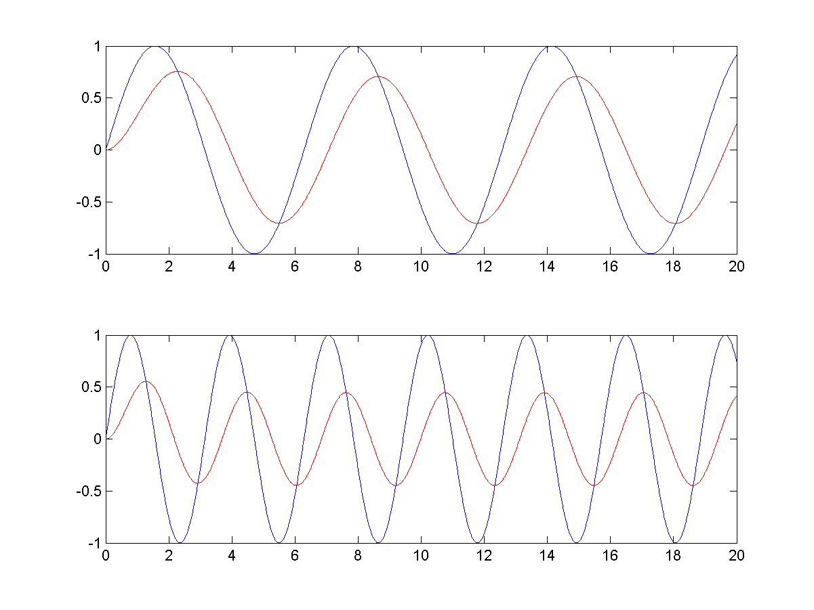
Sinus response for
ω=1 rad/s
ω=2 rad/s

Slide 15
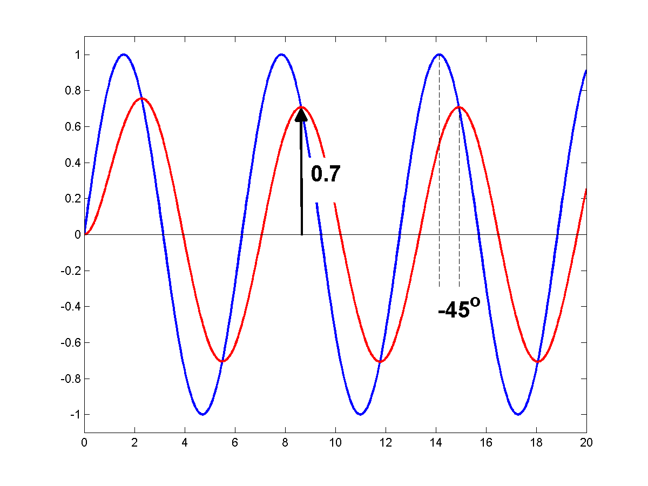
How a Bode-diagram works
ω=1 rad/s

Slide 16
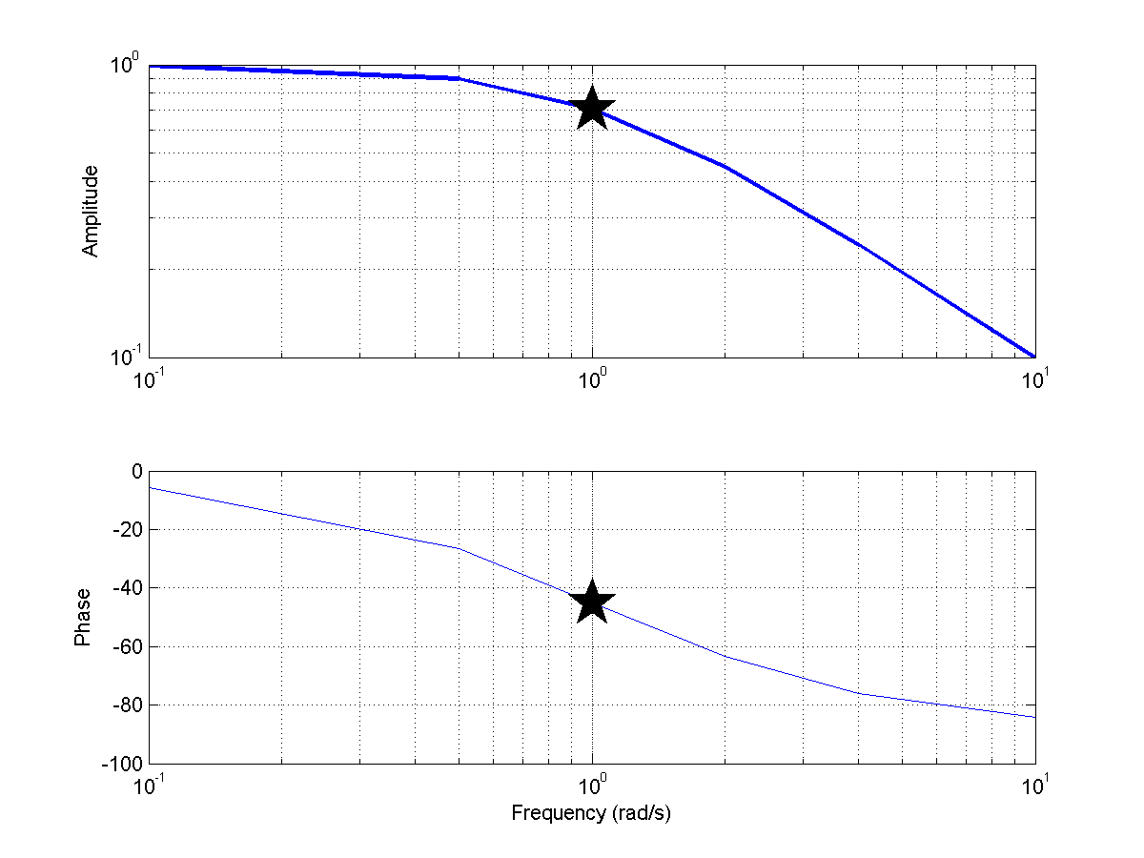
How a Bode-diagram works
0.7
-45⁰

Slide 17
How do you evaluate stability for a system?
+
U
Y
Yref
Go
-

Slide 18
How to evaluate stability
You make a Bode diagram for the Open system Go
First you conclude that since you have negative feedback, you will add -180 degrees to the output before it is fed back to the input. This means that if you have an amplification of 1 and a phase shift of 180 degrees for the open system, you are on the limit to instability.
For this reason, you are particularly interested in two points:
First, the so-called cross-over frequency ωc, the frequency at which the amplification is 1. The distance to -180 degrees is a measure of stability and this measure is called the phase margin
Second, you are interested in the frequency at which you have a phase shift of 180 degrees. The inverse of the amplification at this point, (1/abs(G(jw)), is called the gain margin (sometimes amplitude margin). The gain margin is sometimes expressed in db, which is 20*log(GM), where GM denotes the ‘raw’ number. The ‘20’ rather than a ‘10’ as you might anticipate has to do with the fact that energy often is the square of the measured quantity, e.g. P=R*I*I
In practice, the phase margin is more useful, since the amplitude margin has to be determined at frequencies where you may have trouble to get meaningful information out of the measured data.

Slide 19
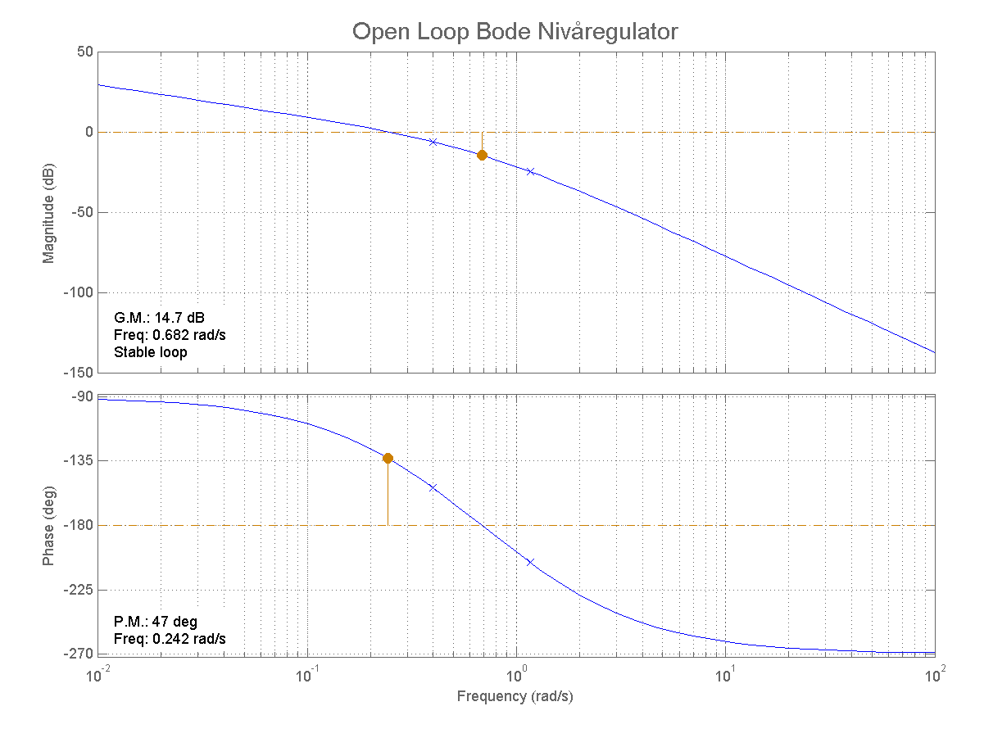

Slide 20
