Slide 1
Convolutional Neural Networks
Convolution Example
Each layer combines (merges, smoothes) patches from previous layers
Typically tries to compress large data (images) into a smaller set of robust features
Basic convolution can still create many features
Pooling – Pooling Example
This step compresses and smoothes the data
Usually takes the average or max value across disjoint patches
Often convolution filters and pooling are hand crafted – not learned, though tuning can occur
After this hand-crafted/non-trained/partial-trained convolving the new set of features are used to train a supervised model
Requires neighborhood regularities in the input space (e.g. images, stationary property)
Natural images have the property of being stationary, meaning that the statistics of one part of the image are the same as any other part
Notes:
http://ufldl.stanford.edu/wiki/index.php/UFLDL_Tutorial
http://ufldl.stanford.edu/wiki/images/6/6c/Convolution_schematic.gif – adds corners and itself
http://ufldl.stanford.edu/wiki/images/0/08/Pooling_schematic.gif - average/max ??

Slide 2
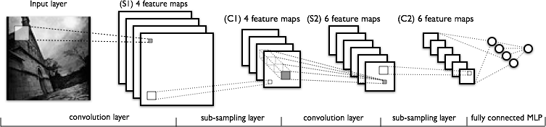
Convolutional Neural Network Examples
C layers are convolutions, S layers pool/sample
(C1)
(S2)
(C3)
(S4)

Slide 3
Training Deep Networks
Difficulties of supervised training of deep networks
Early layers of MLP do not get trained well
Diffusion of Gradient – error attenuates as it propagates to earlier layers
Leads to very slow training
Exacerbated since top couple of layers can usually learn any task "pretty well" and thus the error to earlier layers drops quickly as the top layers "mostly" solve the task– lower layers never get the opportunity to use their capacity to improve results, they just do a random feature map
Need a way for early layers to do effective work
Often not enough labeled data available while there may be lots of unlabeled data
Can we use unsupervised/semi-supervised approaches to take advantage of the unlabeled data
Deep networks tend to have more local minima problems than shallow networks during supervised training
Notes:
Exacerbate -악화시키다

Slide 4
Greedy Layer-Wise Training
One answer is greedy layer-wise training
Train first layer using your data without the labels (unsupervised)
Since there are no targets at this level, labels don't help. Could also use the more abundant unlabeled data which is not part of the training set (i.e. self-taught learning).
Then freeze the first layer parameters and start training the second layer using the output of the first layer as the unsupervised input to the second layer
Repeat this for as many layers as desired
This builds our set of robust features
Use the outputs of the final layer as inputs to a supervised layer/model and train the last supervised layer(s) (leave early weights frozen)
Unfreeze all weights and fine tune the full network by training with a supervised approach, given the pre-processed weight settings
Notes:
If do supervised, we may not bet the benefits of building up the incrementally abstracted feature space

Slide 5
Greedy Layer-Wise Training
Greedy layer-wise training avoids many of the problems of trying to train a deep net in a supervised fashion
Each layer gets full learning focus in its turn since it is the only current "top" layer
Can take advantage of the unlabeled data
When you finally tune the entire network with supervised training, the network weights have already been adjusted so that you are in a good error basin and just need fine tuning. This helps with problems of
Ineffective early layer learning
Deep network local minima
We will discuss the two most common approaches
Stacked Auto-Encoders
Deep Belief Networks

Slide 6
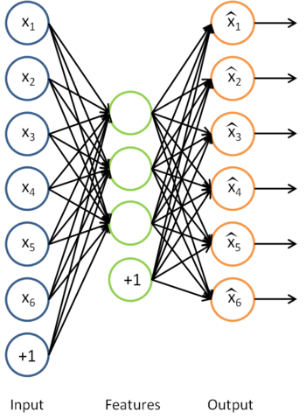
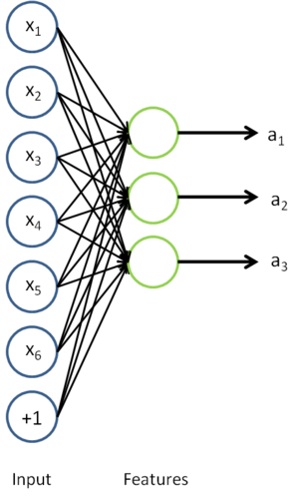
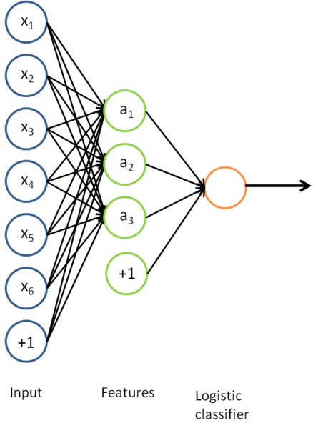
Auto-Encoders
Auto-associator or Diabolo network
A type of unsupervised learning which tries to discover generic features of the data
Same as Back Propagation MLP with target output being same as input. So it extracts important features in the input by learning identity function.
Hidden layer output abstracts compressed structure of input space.
With sigmoid or linear activation of hidden node, it resembles PCA. (dimensionality reduction achieved when # of hidden nodes < # of input nodes)
Notes:
Mention Zipser auotencoder with reverse engineering, then Cottrell compression where unable to reverse engineer
Point out that don't have to have less hidden nodes in the next layer, but careful, if train too long, will just learn to pass through, more on that in a bit

Slide 7
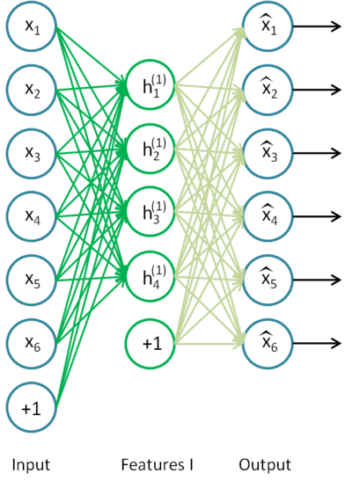
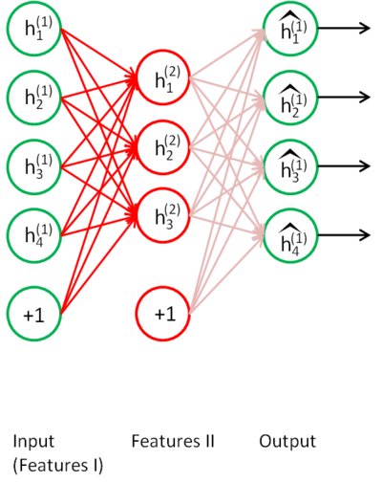
Stacked Auto-Encoders
Bengio (2007) – After Deep Belief Networks (2006)
Stack many (sparse) auto-encoders in succession and train them using greedy layer-wise training
Drop the decode output layer each time

Slide 8
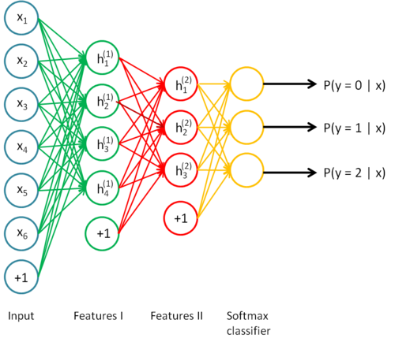
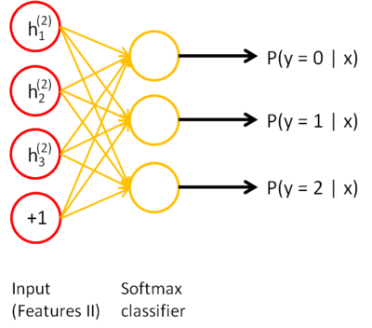
Stacked Auto-Encoders
Change <input, target> pair as you go up.
<x, t> → <h⁽¹⁾, t> → <h⁽²⁾, t>
Do supervised training with <h⁽²⁾, t> on the last layer using final features
Then do supervised training with <x, t> on the entire network to fine- tune all weights
Notes:
Shows softmax, but could use BP or any other variation

