Slide 1
REPOSITORY OVERVIEW
Galaxium Travels
One booking journey.
REST and MCP side by side.
01
Notes:
Introduce the project as a runnable comparison for developers and architects. The central question is where REST and MCP fit in an AI-ready application. Local checkout inspected on 7 September 2026, commit 200951e. Suggested duration: 12–15 minutes.
[Sources]
/Users/thomassuedbroecker/Documents/dev/ibm_bob/galaxium-travels-infrastructure-tsuedbro/README.md
/Users/thomassuedbroecker/Documents/dev/ibm_bob/galaxium-travels-infrastructure-tsuedbro/ARCHITECTURE.md
[/Sources]

Slide 2
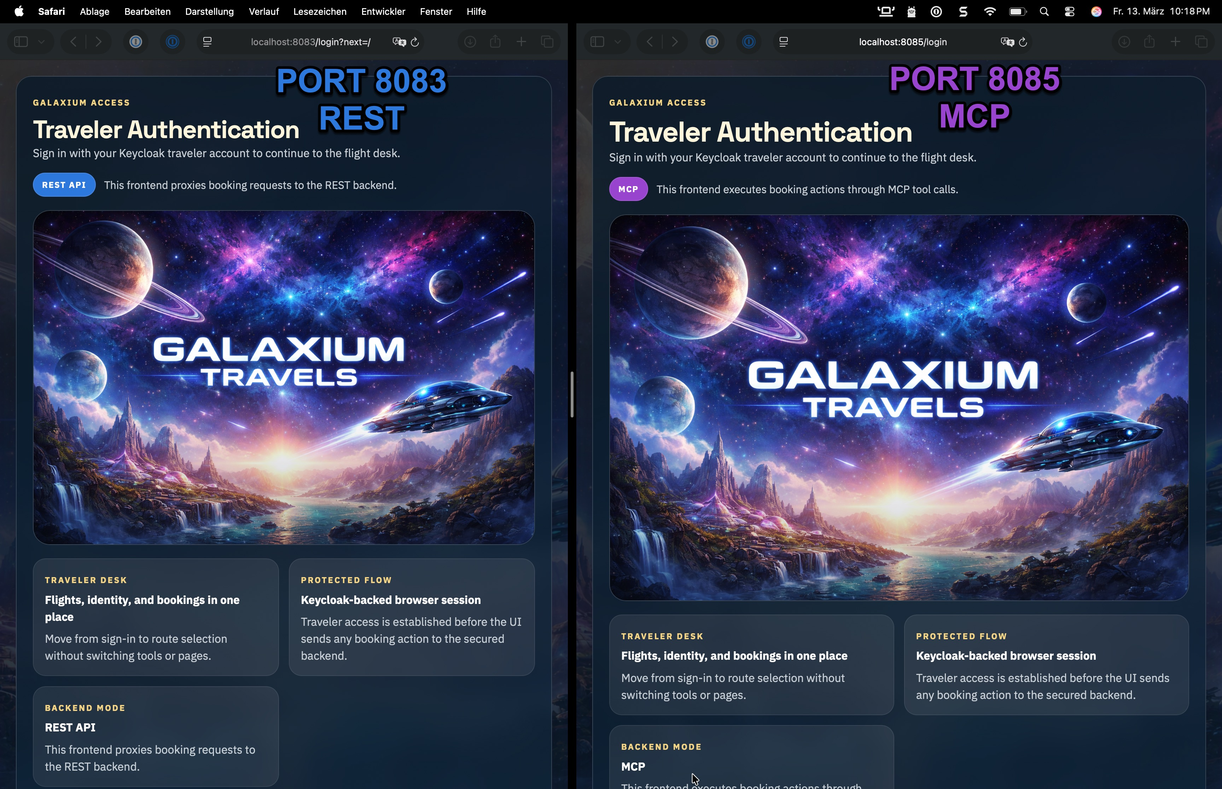
The same traveler journey
Two ways to book
Browse flights, identify a traveler, book a seat, view bookings, and cancel.
Keep the business case familiar while comparing the integration.
02
Notes:
The screenshot is a repository illustration of the two login screens, not a live capture from this session. Both UIs support the equivalent traveler flow. Introduce the comparison before discussing implementation.
[Sources]
/Users/thomassuedbroecker/Documents/dev/ibm_bob/galaxium-travels-infrastructure-tsuedbro/README.md
/Users/thomassuedbroecker/Documents/dev/ibm_bob/galaxium-travels-infrastructure-tsuedbro/images/galaxium-travels-login.jpg
[/Sources]

Slide 3
Three paths with separate data
REST UI :8083
→
FastAPI :8082
→
REST SQLite
MCP UI :8085
→
FastMCP :8084
→
MCP SQLite
HR portal :8090
→
HR API :8081
→
Markdown data
OAuth option: Keycloak :8086 • Direct MCP clients: :8084/mcp
Bookings and employee data are not synchronized across variants.
03
Notes:
REST and MCP use equivalent domain models but independent SQLite databases. HR is separate from both booking request paths. External MCP clients can connect directly. Keycloak participates in the OAuth variant. The default Compose HR backend is Python; a standalone Java alternative also exists.
[Sources]
/Users/thomassuedbroecker/Documents/dev/ibm_bob/galaxium-travels-infrastructure-tsuedbro/ARCHITECTURE.md
/Users/thomassuedbroecker/Documents/dev/ibm_bob/galaxium-travels-infrastructure-tsuedbro/local-container/docker_compose.yaml
[/Sources]

Slide 4
Booking requests follow two parallel paths
Browser action
HTTP JSON
SQL
Browser
REST journey
Flask UI
:8083
FastAPI
:8082
REST
SQLite
Browser action
MCP tool call
SQL
Browser
MCP journey
Flask UI
:8085
FastMCP
:8084/mcp
MCP
SQLite
MCP client
Direct tool access
REST uses HTTP JSON; MCP uses Streamable HTTP.
Independent databases; responses return along the same request path.
04
Notes:
Read each lane left to right. Browser requests terminate at the Flask UI; each UI invokes its own backend. REST uses HTTP JSON, while the MCP UI uses a direct Python client over Streamable HTTP. Both booking services access independent SQLite databases. An external MCP client reaches the same FastMCP server and MCP database as the MCP UI. Authentication is omitted here and shown separately. The external client need not be an autonomous agent.
[Sources]
/Users/thomassuedbroecker/Documents/dev/ibm_bob/galaxium-travels-infrastructure-tsuedbro/ARCHITECTURE.md
/Users/thomassuedbroecker/Documents/dev/ibm_bob/galaxium-travels-infrastructure-tsuedbro/booking_system_rest/app.py
/Users/thomassuedbroecker/Documents/dev/ibm_bob/galaxium-travels-infrastructure-tsuedbro/booking_system_mcp/mcp_server.py
/Users/thomassuedbroecker/Documents/dev/ibm_bob/galaxium-travels-infrastructure-tsuedbro/local-container/docker_compose.yaml
[/Sources]

Slide 5
REST and MCP expose equivalent actions
REST endpoints
MCP tools
HTTP requests to FastAPI
GET /flights
POST /book
JSON responses and OpenAPI docs
Tool calls over Streamable HTTP
list_flights()
book_flight(user_id, name, flight_id)
Structured tool results
05
Notes:
Use these examples to show interface differences. Both services also support user lookup or registration, listing bookings, and cancellation. Do not imply response and error contracts are identical: REST business errors can return HTTP 200 with success=false.
[Sources]
/Users/thomassuedbroecker/Documents/dev/ibm_bob/galaxium-travels-infrastructure-tsuedbro/booking_system_rest/app.py
/Users/thomassuedbroecker/Documents/dev/ibm_bob/galaxium-travels-infrastructure-tsuedbro/booking_system_mcp/mcp_server.py
[/Sources]

Slide 6
MCP access is explicit in this example
Application
Tool server
Agent integration
Each UI action selects a fixed tool through the Python MCP client.
FastMCP exposes booking operations at /mcp over Streamable HTTP.
An external MCP client can use the server. The booking UI has no LLM planner.
06
Notes:
Explain AI-ready as the availability of a tool interface. The current UI is deterministic application integration; it is not an autonomous agent. Active server entry point is mcp_server.py; app.py is legacy reference.
[Sources]
/Users/thomassuedbroecker/Documents/dev/ibm_bob/galaxium-travels-infrastructure-tsuedbro/ARCHITECTURE.md
/Users/thomassuedbroecker/Documents/dev/ibm_bob/galaxium-travels-infrastructure-tsuedbro/galaxium-booking-web-app-mcp/README.md
/Users/thomassuedbroecker/Documents/dev/ibm_bob/galaxium-travels-infrastructure-tsuedbro/booking_system_mcp/mcp_server.py
[/Sources]

Slide 7
Authentication changes the boundary
OAuth
Basic Auth
Mixed MCP
Keycloak browser login.
Backends validate bearer tokens. Local and LAN variants.
Guest browser session.
UIs send shared credentials to the REST and MCP backends.
Keycloak browser login.
The MCP UI uses Basic Auth when calling its backend.
07
Notes:
These are the supported comparison configurations. Browser identity and backend credentials are separate in the mixed mode. LAN OAuth must advertise reachable host URLs; the internal Keycloak container port remains 8080.
[Sources]
/Users/thomassuedbroecker/Documents/dev/ibm_bob/galaxium-travels-infrastructure-tsuedbro/ARCHITECTURE.md
/Users/thomassuedbroecker/Documents/dev/ibm_bob/galaxium-travels-infrastructure-tsuedbro/QUICKSTART.md
[/Sources]

Slide 8
Browser identity and backend auth can differ
OAUTH
Traveler via
Keycloak
Login
REST / MCP UI
Bearer
Bearer-protected
REST / MCP
BASIC AUTH
Guest traveler
Guest
REST / MCP UI
Basic Auth
Basic-protected
REST / MCP
MIXED MCP
Traveler via
Keycloak
Login
MCP UI
Basic Auth
Basic-protected
MCP backend
OAuth protects both layers; mixed MCP separates their credentials.
Keycloak is used for OAuth login. Basic-only mode uses a guest browser session.
08
Notes:
These lanes summarize credential boundaries, not the detailed OAuth protocol exchange. OAuth mode: Keycloak establishes browser identity and backends validate bearer tokens. Basic-only mode: the browser has a guest session and the UI sends shared Basic Auth credentials. Mixed MCP: Keycloak authenticates the browser user, while the MCP UI sends shared Basic Auth credentials to the MCP backend. Browser credentials are not forwarded as Basic Auth user credentials. Internal Keycloak URL uses port 8080; local public access uses 8086.
[Sources]
/Users/thomassuedbroecker/Documents/dev/ibm_bob/galaxium-travels-infrastructure-tsuedbro/ARCHITECTURE.md
/Users/thomassuedbroecker/Documents/dev/ibm_bob/galaxium-travels-infrastructure-tsuedbro/local-container/docker_compose.yaml
/Users/thomassuedbroecker/Documents/dev/ibm_bob/galaxium-travels-infrastructure-tsuedbro/local-container/docker_compose.basic-auth.yaml
/Users/thomassuedbroecker/Documents/dev/ibm_bob/galaxium-travels-infrastructure-tsuedbro/local-container/docker_compose.mcp-ui-keycloak-basic.yaml
[/Sources]

Slide 9
HR adds a separate service example
Portal and default API
Alternative Java backend
Quarkus + React portal
Host port 8090 in Docker
Python FastAPI backend on 8081
Employee CRUD through a proxy
Standalone Quarkus API on 8089
Each backend stores employee data in its own Markdown file.
HR is outside the booking flow.
09
Notes:
The full Compose stack selects the Python HR service. The standalone HR launcher accepts --backend python or --backend java. Local frontend development uses 8088. Neither HR variant synchronizes its data with the other.
[Sources]
/Users/thomassuedbroecker/Documents/dev/ibm_bob/galaxium-travels-infrastructure-tsuedbro/ARCHITECTURE.md
/Users/thomassuedbroecker/Documents/dev/ibm_bob/galaxium-travels-infrastructure-tsuedbro/hr_database_frontend_java/README.md
/Users/thomassuedbroecker/Documents/dev/ibm_bob/galaxium-travels-infrastructure-tsuedbro/README.md
[/Sources]

Slide 10
Run the comparison locally
Start the full OAuth stack
docker compose -f local-container/docker_compose.yaml up --build
REST UI
localhost:8083
MCP UI
localhost:8085
MCP endpoint
localhost:8084/mcp
Setup variants and login details: QUICKSTART.md
10
Notes:
Prerequisite: Docker Engine with Compose v2. Run the command from the repository root. First builds can take time. The default option includes Keycloak. Use the demo traveler login documented in QUICKSTART.md. Follow that guide for Basic Auth or LAN settings.
[Sources]
/Users/thomassuedbroecker/Documents/dev/ibm_bob/galaxium-travels-infrastructure-tsuedbro/QUICKSTART.md
[/Sources]

Slide 11
Demonstrate one booking in each path
1 REST booking
2 MCP booking
3 Compare
Open the REST UI.
Choose a traveler and flight.
Create and view a booking.
Use the MCP UI for the same actions.
Show the corresponding tool names.
Cancel in each path.
Discuss credentials and results.
Observe independent state.
11
Notes:
Suggested live demonstration sequence, not a claim that these actions were executed while making the presentation. Choose available demo data. Keep the backend processes running: startup reseeds each database and removes booking changes.
[Sources]
/Users/thomassuedbroecker/Documents/dev/ibm_bob/galaxium-travels-infrastructure-tsuedbro/QUICKSTART.md
/Users/thomassuedbroecker/Documents/dev/ibm_bob/galaxium-travels-infrastructure-tsuedbro/ARCHITECTURE.md
/Users/thomassuedbroecker/Documents/dev/ibm_bob/galaxium-travels-infrastructure-tsuedbro/booking_system_mcp/mcp_server.py
[/Sources]

Slide 12
Local runtime and a cloud deployment path
Docker Compose
IBM Code Engine
Primary demo runtime
Full stack or individual paths
OAuth, Basic Auth, mixed MCP
VM / LAN configuration options
Bash scripts + IBM Cloud CLI
Source builds or prebuilt images
Basic Auth is the default
Public URLs configure dependencies
12
Notes:
The supported cloud package is deployment/ibm-code-engine/deploy-stack.sh. It deploys the five Python Galaxium services, with Keycloak for OAuth; do not imply the Java HR portal is included in that package. Repository documentation records local checks but no completed live-cloud validation.
[Sources]
/Users/thomassuedbroecker/Documents/dev/ibm_bob/galaxium-travels-infrastructure-tsuedbro/ARCHITECTURE.md
/Users/thomassuedbroecker/Documents/dev/ibm_bob/galaxium-travels-infrastructure-tsuedbro/deployment/ibm-code-engine/README.md
[/Sources]

Slide 13
Clients reach three deployment environments
LOCAL MACHINE
Local browser
or MCP client
HTTP
localhost
Published ports
Ports
Docker Compose
Local containers
VM / LAN
VM / LAN client
HTTP
Host IP / DNS
Published ports
Ports
Docker Compose
Host containers
IBM CLOUD
Cloud client
HTTPS
Public HTTPS
Application URLs
Route
Code Engine
App instances
LAN OAuth needs a reachable public issuer; cloud apps use generated URLs.
Code Engine: five Python services, optional Keycloak; live cloud validation remains open.
13
Notes:
This is a client-reachability deployment view. Local and LAN clients can target the same host stack with different addresses; localhost from a VM refers to the VM itself. OAuth on LAN must use a reachable public issuer and MCP base URL. The internal container Keycloak port remains 8080. The default local full Compose stack includes the Java HR portal, but the Code Engine deployment package deploys the five Python services: HR API, REST backend, MCP server and two Flask UIs. Keycloak is optional for OAuth. Code Engine exposes generated HTTPS application URLs, not fixed public 808x ports. Basic Auth is the cloud template default. The cloud package is documented but not live-cloud verified.
[Sources]
/Users/thomassuedbroecker/Documents/dev/ibm_bob/galaxium-travels-infrastructure-tsuedbro/ARCHITECTURE.md
/Users/thomassuedbroecker/Documents/dev/ibm_bob/galaxium-travels-infrastructure-tsuedbro/QUICKSTART.md
/Users/thomassuedbroecker/Documents/dev/ibm_bob/galaxium-travels-infrastructure-tsuedbro/local-container/docker_compose.vm-oauth.yaml
/Users/thomassuedbroecker/Documents/dev/ibm_bob/galaxium-travels-infrastructure-tsuedbro/deployment/ibm-code-engine/README.md
[/Sources]

Slide 14
Verification has a clearly recorded limit
Latest recorded contracts
Runtime evidence
27 passed / 4 failed
31 tests on 7 September 2026
Recorded against commit 12867a5
HR expectations and env parsing account for the four failures.
Historical smoke and matrix runs
Runtime checks were not rerun in the latest recorded review.
Live Code Engine deployment is not verified in the repository.
14
Notes:
Source: testing/README.md latest verified state. This presentation was prepared from checkout 200951e; these are recorded results for 12867a5, not a new test run or a passing claim for this checkout. Three contract failures concern old HR frontend expectations; one parser does not recognize export assignments in the Basic Auth template.
[Sources]
/Users/thomassuedbroecker/Documents/dev/ibm_bob/galaxium-travels-infrastructure-tsuedbro/testing/README.md
/Users/thomassuedbroecker/Documents/dev/ibm_bob/galaxium-travels-infrastructure-tsuedbro/testing/results/LATEST-VALIDATION.md
/Users/thomassuedbroecker/Documents/dev/ibm_bob/galaxium-travels-infrastructure-tsuedbro/deployment/ibm-code-engine/README.md
[/Sources]

Slide 15
Keep the demo boundaries visible
Data lifecycle
Operational scope
Comparison value
Backend startup deletes booking data and reloads the seed. Each path has its own SQLite file.
This is a learning project. Durable multi-instance storage and production hardening need further work.
Use equivalent actions to examine protocol, client integration, and authentication choices.
15
Notes:
Keep these constraints visible in a presentation to avoid suggesting production readiness. The project is useful precisely because it makes integration choices observable in a small domain.
[Sources]
/Users/thomassuedbroecker/Documents/dev/ibm_bob/galaxium-travels-infrastructure-tsuedbro/ARCHITECTURE.md
/Users/thomassuedbroecker/Documents/dev/ibm_bob/galaxium-travels-infrastructure-tsuedbro/README.md
[/Sources]

Slide 16
EXPLORE THE REPOSITORY
Which boundary fits
your application?
Run both paths. Compare the evidence.
Start with QUICKSTART.md and ARCHITECTURE.md.
16
Notes:
Close by inviting the audience to run both paths and explain which boundary they would choose for their own application. Use README.md as the repository entry point, QUICKSTART.md for setup, ARCHITECTURE.md for runtime boundaries, and docs/AI_ENGINEER_GUIDE.md for external tool integration.
[Sources]
/Users/thomassuedbroecker/Documents/dev/ibm_bob/galaxium-travels-infrastructure-tsuedbro/README.md
/Users/thomassuedbroecker/Documents/dev/ibm_bob/galaxium-travels-infrastructure-tsuedbro/QUICKSTART.md
/Users/thomassuedbroecker/Documents/dev/ibm_bob/galaxium-travels-infrastructure-tsuedbro/ARCHITECTURE.md
/Users/thomassuedbroecker/Documents/dev/ibm_bob/galaxium-travels-infrastructure-tsuedbro/docs/AI_ENGINEER_GUIDE.md
[/Sources]

