Slide 1

IBM Watsonx and a simple question-answering pipeline using Python and fastAPI
Developer view

Slide 2
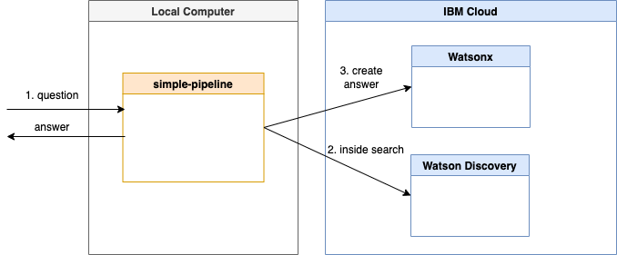

Slide 3
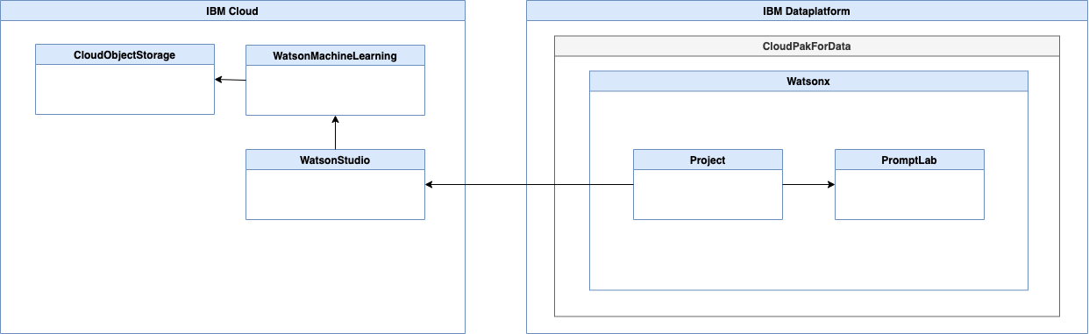

Slide 4
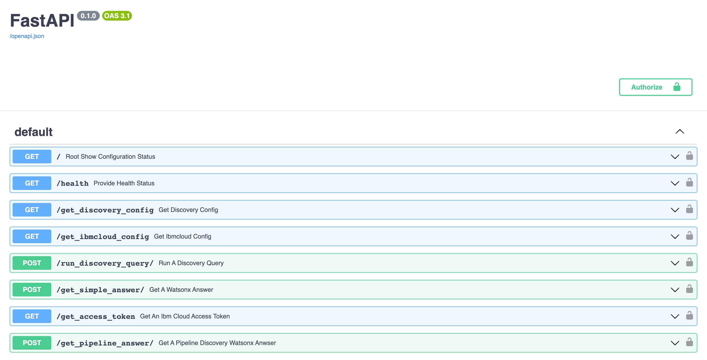

Slide 5
Available Runtimes in the Project
As a Python application running locally
As a Python application in a container running locally
As a Python application in a container running in Code Engine on IBM Cloud

