Slide 1

IBM Watsonx and a simple question-answering pipeline using Python and fastAPI
Developer view

Slide 2
Topics of the livestream
The example
Run the example locally as a Python application
Run the example locally as a container
Run the container on IBM Cloud Code Engine

Slide 3
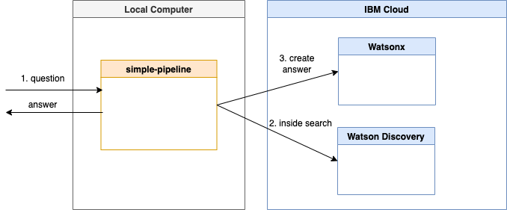

Slide 4
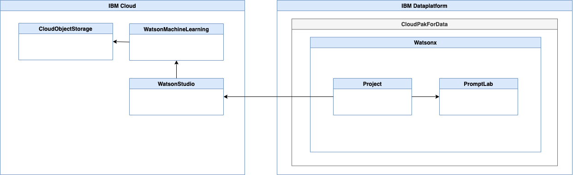

Slide 5
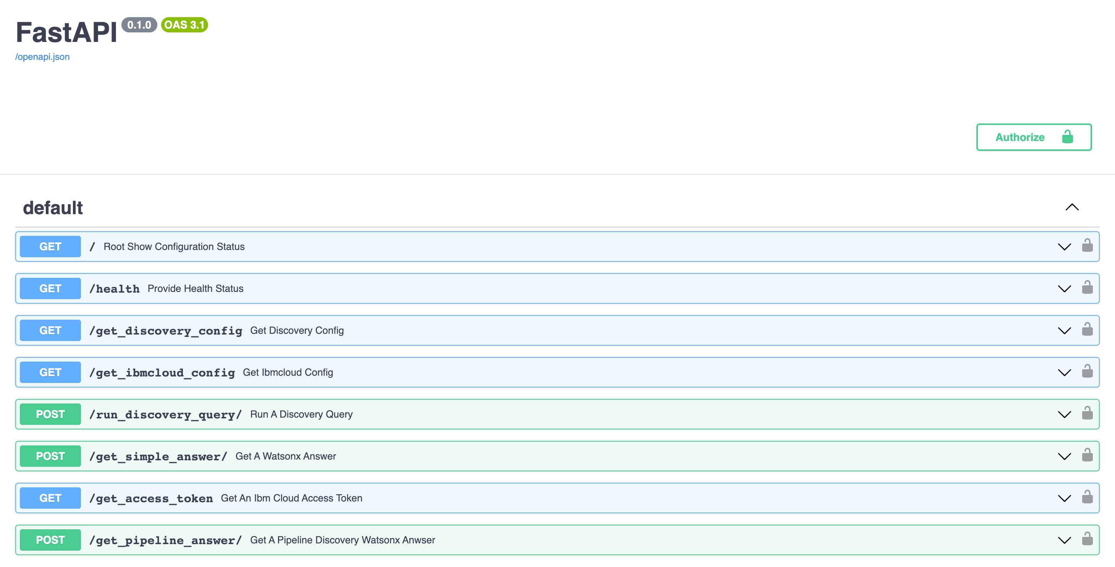

Slide 6
Available Runtimes in the Project
As a Python application running locally
As a Python application in a container running locally
As a Python application in a container running in Code Engine on IBM Cloud

