Slide 1
Azure DevOps:- Templating Your Pipelines and Keeping Them Dry
Thomas Thornton, Kainos

Slide 2

About Me – Thomas Thornton
Azure Technical Specialist @ Kainos
Microsoft MVP
Azure Certified
Azure Blogger – https://thomasthornton.cloud
Twitter - https://twitter.com/tamstar1234
LinkedIn - https://www.linkedin.com/in/thomas-thornton-21a86b75/

Slide 3
Initial Questions
Copy & pasting the same stage between different pipelines?
Creating the same task several times?
Copy and pasting the same job or stage?
Noticing reptition over time?

Slide 4
What will be cover?
DRY – what does it mean?
Why DRY?
Keeping Azure DevOps Pipelines DRY
Azure DevOps – Templating
Example Scenario
Questions

Slide 5
DRY – What does it mean?

Slide 6

Don’t Repeat Yourself (DRY)
"Don't repeat yourself" (DRY) is a principle of software development aimed at reducing repetition of software patterns,^{[1]} replacing it with abstractions or using data normalization to avoid redundancy © Steven Foote
https://en.wikipedia.org/wiki/Don%27t_repeat_yourself#cite_note-1

Slide 7
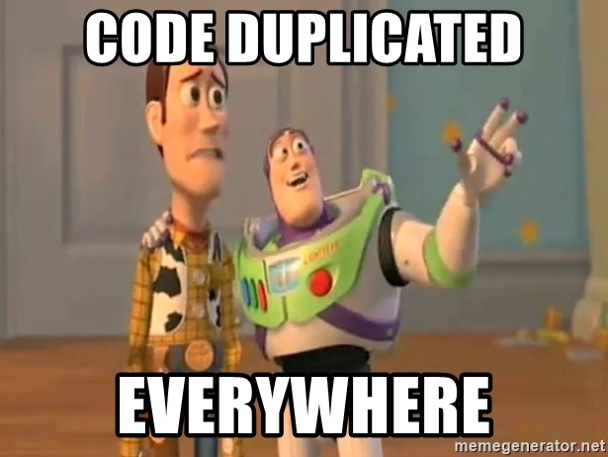
To me, what does DRY mean?
Avoid duplication if possible
Don’t copy & paste
Structure, structure and more structure!
Create logic within your pipelines
Think reusability

Slide 8
Questions to consider when creating an Azure DevOps Pipeline
Repetition
How many times has the configured been repeated?
Less code
Can I write this pipeline with less code?
Duplication
Is duplication needed?
Reusability
Should I refactor?

Slide 9
How can I keep my Azure DevOps Pipeline Dry?
Parameters & Variables
Utilise the use of parameters and variables
Avoid duplication
Don’t copy & paste
Expressions
Create expressions and conditions within your pipeline
Templating
More on that soon ☺
Recommended Blog Post: https://thomasthornton.cloud/2021/01/20/azure-devops-pipelines-keeping-your-pipelines-dry/

Slide 10
Azure DevOps Pipeline Templates

Slide 11
Azure DevOps Pipeline Templates - What are they?
Templates let you split your pipelines into several files (templates)
Templates let you split your pipeline into several files (Templates)
You be aware of the Separation of Concerns principle

Slide 12
Azure DevOps – Creating Pipelines
Multi-Stage
DRY
YAML
This is where pipeline templating becomes super useful
Always a situation where we need to reuse the same task, stage etc in several pipelines
We want to avoid copy and pasting, adhering to DRY
Can bloat over time, what can we do?
Template Pipelines

Slide 13
Azure DevOps Pipeline Templates
Pipeline templates allow us to define usable code blocks within your YAML
Making maintenance a lot easier and less prone to errors!
We can define steps, jobs, stages etc

Slide 14
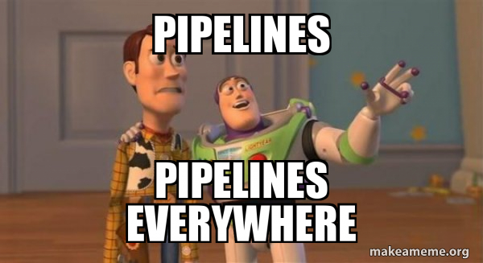
Azure DevOps Pipeline Structure
Now to spend sometime on pipeline structure, we can define the below in our templates
Parameters
Variables
Steps
Jobs
Stages
Conditions

Slide 15
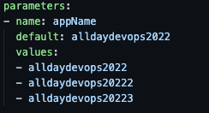
Pipeline Structure – Parameters
Parameters help to pass values from main pipeline into our templates
Parameters must be defined with a name and a type, a default value is optional

Slide 16
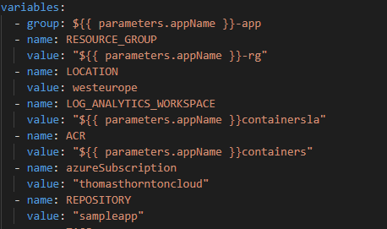
Pipeline Structure – Variables
Variables in a pipeline template are used similarly as we would as a Variable Group
Variables can be used throughout your pipeline and templating
Parameters can be referenced in variables

Slide 17
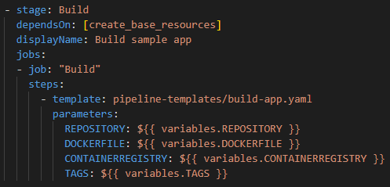
Pipeline Structure – Stages, Jobs & Templates
This is where the fun begins!
Creating a stage, we can begin to reference templates pre-made!
Notice the job reference “build”? It is deploying a templated step

Slide 18
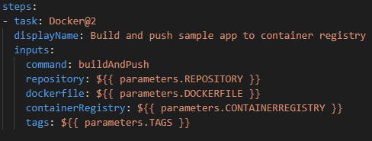
Pipeline Structure – Steps
When creating a template to reuse, we usually want to create one or more steps in a job of a pipeline.
Simply define the steps in the template, as you would in a YAML pipeline.

Slide 19
Pipeline Structure – Steps Template
Following on, looking at the steps task within a template
Notice the reference of parameters?
Steps task Docker@2 uses these parameters
No copy/pasting

Slide 20
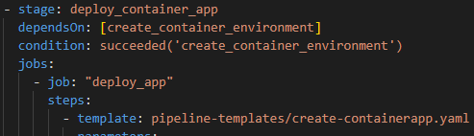
Pipeline Structure – Conditions
Conditions are written as expressions in YAML pipelines
You can specify the conditions under each stage, job or step runs

Slide 21
Example Scenario

Slide 22
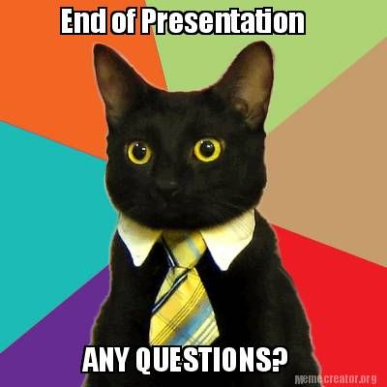
Some final thoughts
Less code, means less code to maintain
Try to avoid duplication
DRY!
Make your pipelines reusable
Make it easy to re-use
Enjoy the journey ☺

