Slide 1
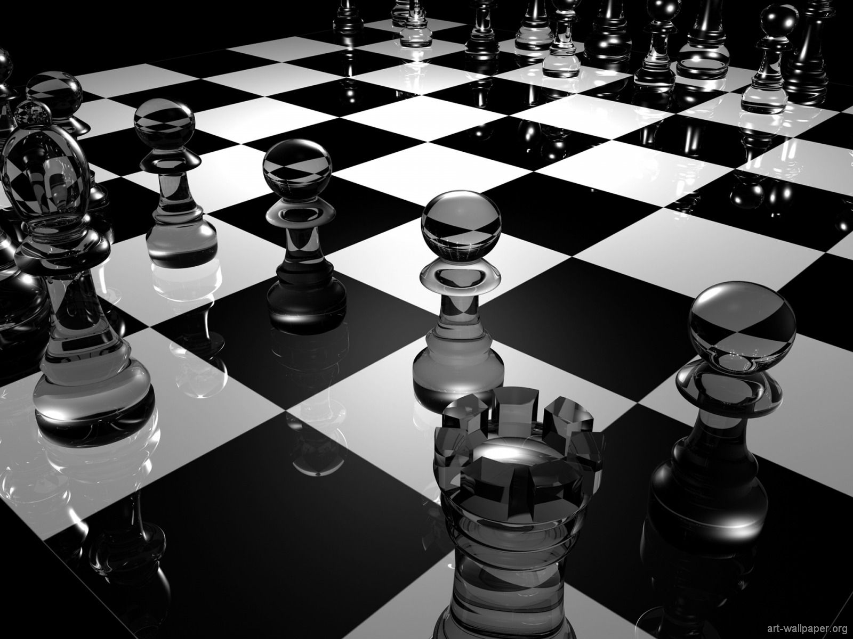
Group M8
Presents
ShakeMate

Slide 2
„Every time I’m on a networking event I meet so may interesting people, but most of the time I’m not able to contact them afterwards as I can’t remember their full names” IF SB CAN MAKE IT BETTER PLEASE DO!!
Sally Technology Analyst

Slide 3

Solution is simple

Slide 4
SCREENSHOTS/SCREENCAPTURE one slide per page?

Slide 5

Security
Your data is very important for us, this is why ShakeMate is a safe and secure platform.
NEEEEED IMPROVMENT

Slide 6
… and see you at
Thank you for listening …

