Slide 1
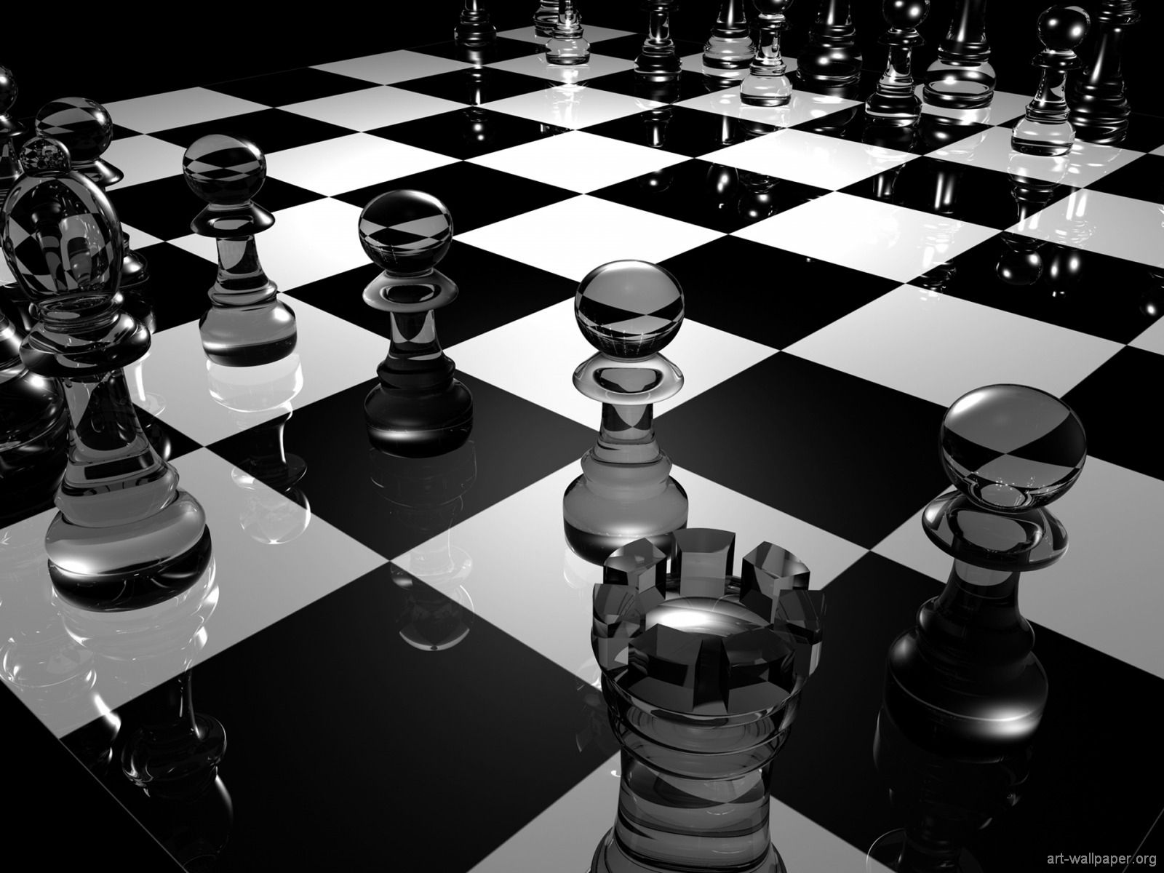
Group M8
Presents
ShakeMate

Slide 2
„Every time I’m on a networking event I meet so may interesting people, but most of the time I’m not able to contact them afterwards as I can’t remember their full names”
Sally Technology Analyst

Slide 3

Solution is simple

Slide 4
… and see you at
Thank you for listening …

Slide 5
Security

Slide 6
Security
Icons
Moc profiles
Presentations, intro screenshots, screen capture?, conclusion

