Slide 1
Dapps
Tibin Thomas
Asst Prof.
Dept of CSE
Saintgits College of Engineering

Slide 2
Dapps
A decentralized application is a computer application that runs on a distributed ledger technologies (DLT) such as the Ethereum Blockchain
Dapp.com
https://github.com/dappuniversity

Slide 3
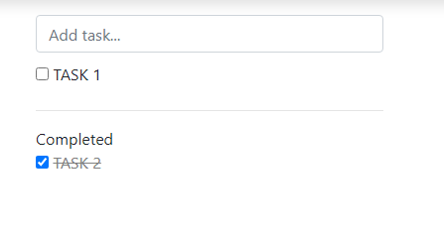
Todo list
An app to monitor task

Slide 4
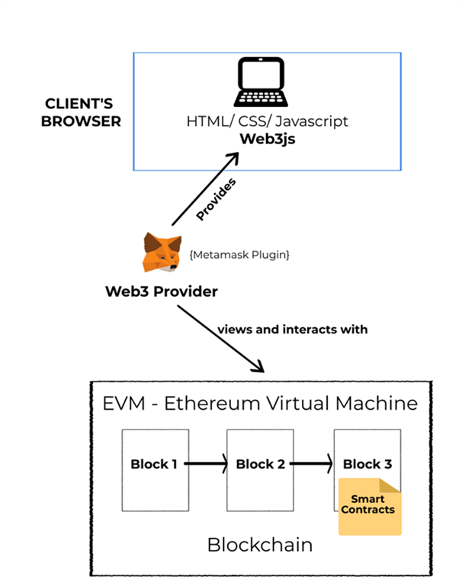
Architecture of Ethereum Dapp
https://www.c-sharpcorner.com/article/build-your-ethereum-dapp-on-windows-with-truffle-ganache-and-metamask-beginne/

Slide 5
Prerequsite
Ganache – setup local ethereum network
Metamask - setup web3 interface
Nodejs- for creating JS applications
Truffle framework- Development environment, Testing, deploying any dapps on EVM
npm install -g truffle

Slide 6
Ganache- https://www.trufflesuite.com/ganache
Nodejs --https://nodejs.org/en/download/
Truffle - npm install truffle -g

Slide 7
https://github.com/thomastibin/todo

