Slide 1
❄
Big Mountain Resort
A Data-Driven Approach to Ticket Pricing
Guided Capstone Project

Slide 2
The Problem: Pricing Without Evidence
$81
$1.54M
350K
current adult weekend ticket, set by adding a premium to the local market average
new annual operating cost from the recently installed chair lift
visitors per season, each buying about 5 day tickets
Leadership needs answers to three questions:
Is $81 justified by what Big Mountain actually offers?
How much room is there to change the price?
Which facility investments or cuts best support revenue?

Slide 3
Recommendation & Key Findings
Facilities justify a premium
The model supports
Big Mountain ranks near the top on the features that drive price: vertical drop, fast quads, runs, snow making.
$95.87
Best investment identified
Adding a run, 150 ft of vertical, and a chair lift supports +$1.99/ticket, about $3.47M per season, exceeding the lift's $1.54M cost.
vs. $81.00 today • a $14.87 gap, larger than the model's $10.39 MAE
Avoid low-value spending
Extra snow making and lengthening the longest run add no supportable price.
Recommendation: raise the ticket in monitored steps toward ~$91, tracking visitation and season-pass renewals.
Safe cost cuts exist
Up to 4 runs can close with no penalty beyond that of closing 3.

Slide 4
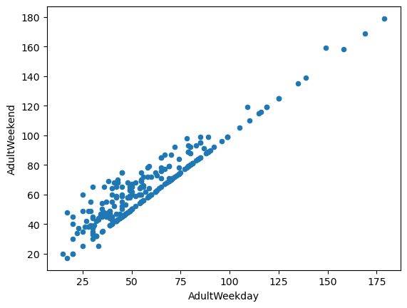
Data & Exploratory Analysis
330 resorts, 27 columns to start. Dropped fastEight (mostly missing) and the ~14% of rows with no price, leaving 277 resorts.
Weekday and weekend prices are nearly perfectly correlated, so AdultWeekend became the single target: more business-relevant, fewer missing values.
State identity doesn't predict price. PCA of state summaries (2 components ≈ 77% of variance) showed no price clustering, so raw state labels were replaced with engineered ratios: resorts per capita, share of state skiable area, terrain parks, night skiing.
Multicollinearity flagged for modeling: summit vs. base elevation; state-share ratios vs. resorts per state.
Weekday vs. weekend ticket price across 277 US resorts

Slide 5
Model Selection
70/30 train/test split. Big Mountain held out entirely for scenario analysis.
Baseline (mean price)
Test MAE ≈ $19. The bar to beat.
Linear regression
SelectKBest k=8. CV MAE $10.50 (±1.62), test $11.80. Top drivers: vertical drop, snow making.
Random forest ✓ selected
Grid-search tuned. CV MAE $9.64 (±1.35), test $9.54. Lower, more stable error. Top features: fastQuads, Runs, Snow Making, vertical drop.
Learning curve plateaus at current sample size; more data collection is not a priority.

Slide 6
What the Market Would Support
Model refit on all resorts except Big Mountain, then asked to price Big Mountain's facilities.
Supported price: $95.87. That's $14.87 above today's $81.00, a gap larger than the model's $10.39 MAE, so it is unlikely to be noise.
Why the gap? Historic pricing benchmarked only nearby competitors. Nationally, resorts with Big Mountain's vertical drop, lift stock, and snow-making coverage charge more.
Suggested path: step toward ~$91 first, monitor visitation and pass renewals, then continue toward the modeled range.

Slide 7
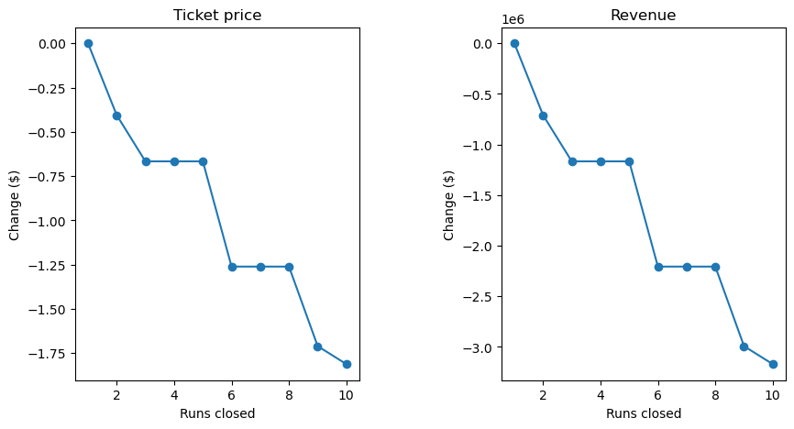
Scenario Analysis: Where to Invest, Where to Cut
Close up to 4 runs
Safe cost cut: no penalty beyond the 3-run level
Add run + 150 ft vertical + chair lift
+$1.99/ticket ≈ $3.47M per season, covers the lift's $1.54M cost
… plus 2 acres snow making
Identical result. Extra snow making adds nothing
Closing 4–5 runs costs no more than closing 3; deeper cuts get expensive
Longest run +0.2 mi, +4 acres snow making
$0.00 price impact. Skip

Slide 8
Summary & Conclusion
Big Mountain is underpriced relative to its facilities.
1
Raise the weekend ticket in monitored increments toward the modeled range (start near $91).
2
Proceed with the run + vertical drop + chair lift expansion; it pays for itself.
3
Decline the extra snow-making and longest-run investments.
4
If cutting costs, pilot 1–2 low-traffic run closures before going further.
Future work: add operating-cost data to judge profit rather than revenue; package the model as a self-serve dashboard for analysts, retrained annually, with MAE shown beside every prediction.

