Slide 1

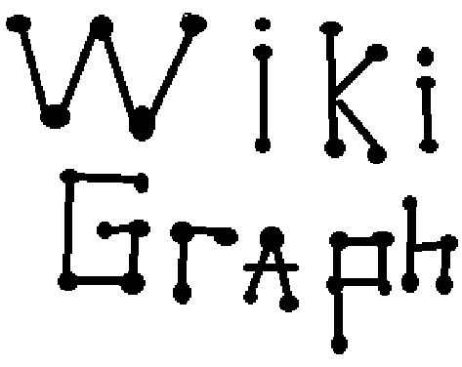
Mark Jordan, Jeremy Lenz, Robert McClure,
Austin Nakamura, Michael Rush, Khanh Tran,
Thomas Van Doren

Slide 2
What is WikiGraph?
  A simple tool to visualize relationships between various Wikipedia articles
  Easy traversal of the graph
  Quickly view abstracts
  Ability to open up selected Wikipedia articles

Slide 3
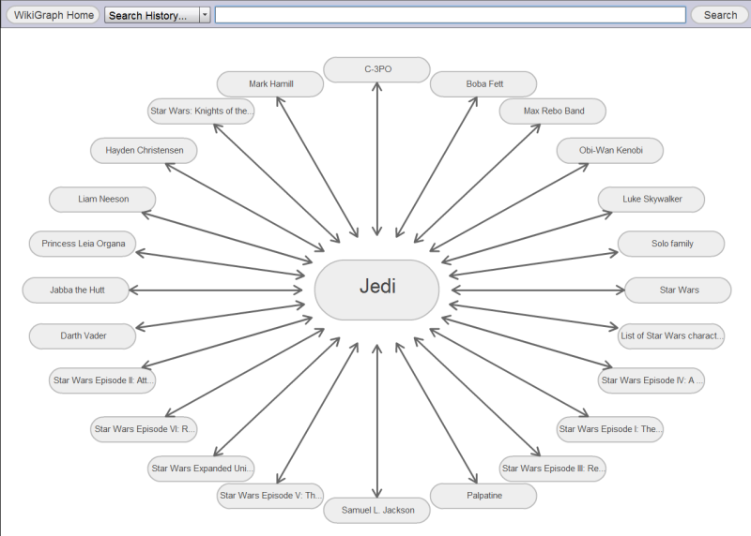
Demo!

Slide 4
Final Features
Frontend
  Cleaner interface (styling)
  Animated graph actions
  Graph history
  Unique graph URLs
  Double clicking graph node opens article
  Display both inbound and outbound links for an article
Services
  Custom, relevant, forgiving search
  Return graph on exact search matches
  Cached graph rankings

Slide 5
Lessons Learned
  ﻿Large team dynamics
    Communication
    Time management
  Flash development
    Open source
    Easy to learn
    Optimized performance
  Distributed source control
    Merging
    Conflicts

Slide 6
WikiGraph
Questions?

