Slide 1
SurveyBoom
Diego Merida
Luis Lavieri
Thomas Watters
Danny Karuli

Slide 2
TECHNOLOGY
WEB ( HTML, CSS, jQuery, JavaScript, Bootstrap)
.NET( C#, razor views , web-services asmx , entity framework, azure cloud services)
Android(ksoap ,java)

Slide 3


IDE
ANDROID STUDIO
VISUAL STUDIO

Slide 4
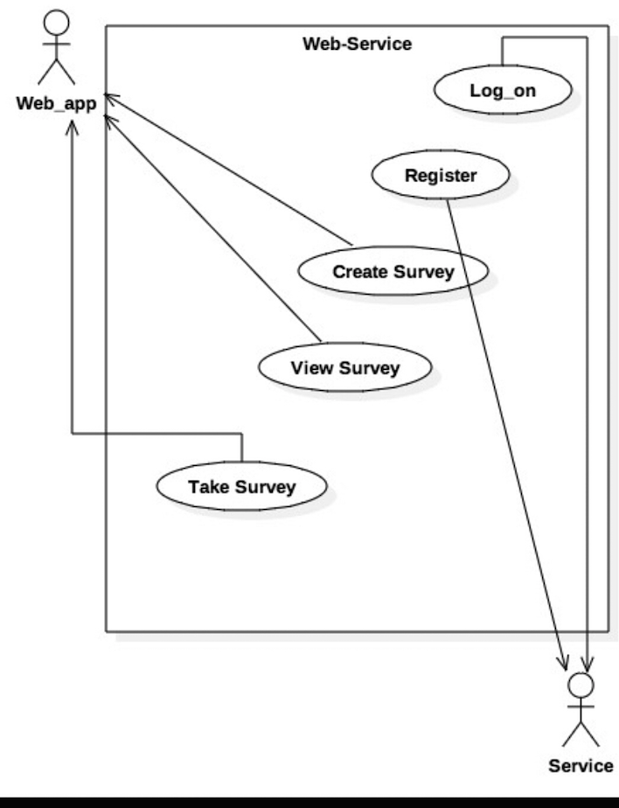
UML
Use Case Diagram

Slide 5
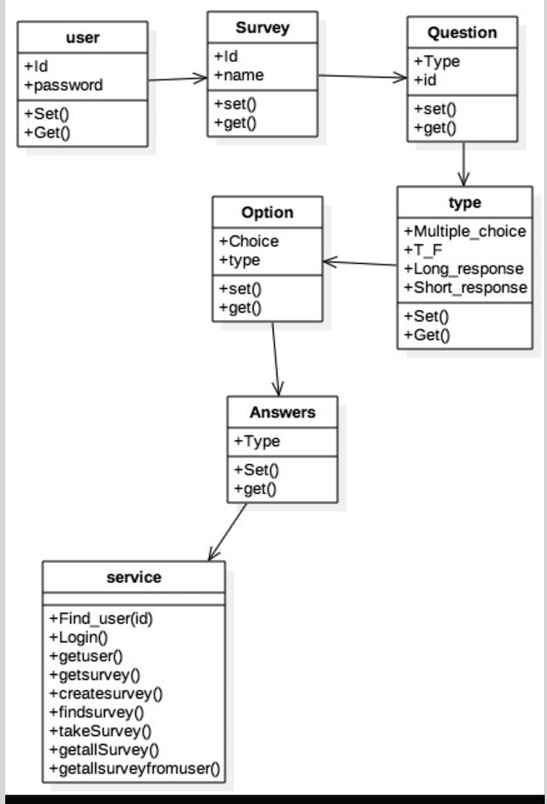
CLASS DIAGRAM

Slide 6
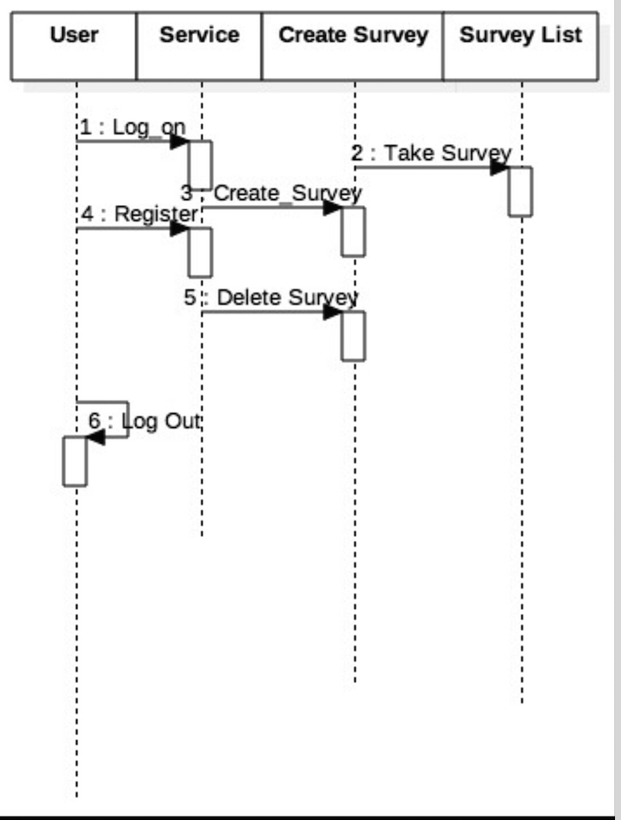
SEQUENCE DIAGRAM

Slide 7
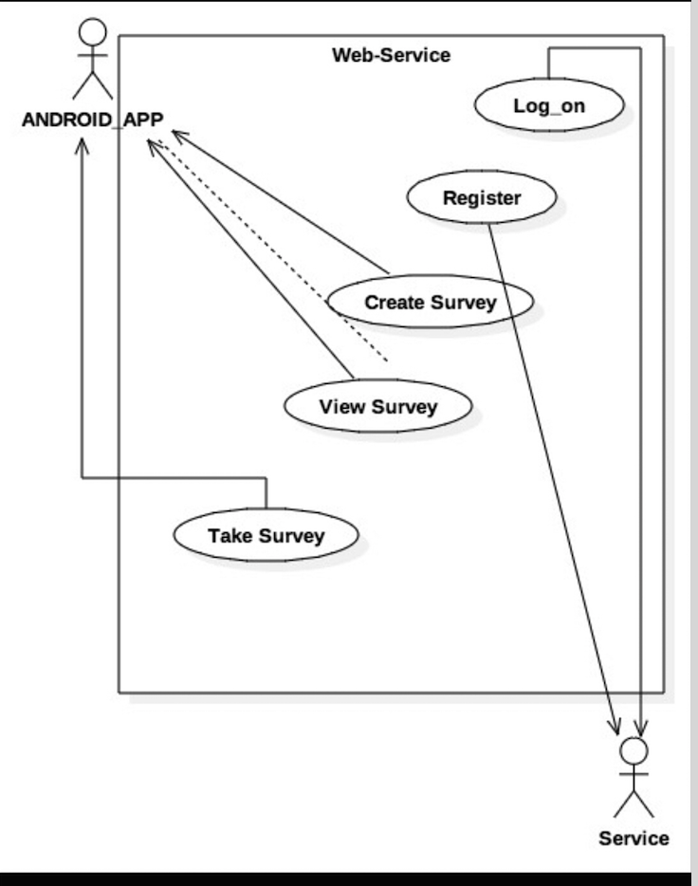
USE CASE DIAGRAM
FOR ANDROID
APP

Slide 8

DIFFICULTIES
SCHEDULING
INTEGRATING WORK
BAD ORGANIZATION
WORKING REMOTELY
LACK OF EXPERIENCE

Slide 9

DEMOSTRATION

