Slide 1
Sound and blah

Slide 2
Code quality

Slide 3
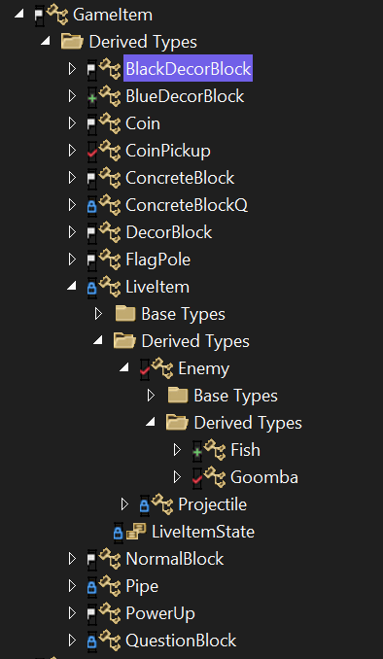
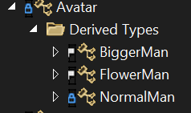
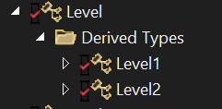




Classes

Slide 4



Feedback
Try to create separate cpp and header files for all classes. Don't dump it all in 1 file.
Done
Minus points for: not using const & where it is necessary.
Lesson learned
Time constraint / worry to introduce at this stage
To much copying data around rule of 3 not used. Make sure you implement rule of 5 everywhere for the next version.
Lesson learned
Introducing at this stage without use doesn’t add much unfortunately
But, introduced for 1 class to illustrate

