Slide 1
Global Medical Affairs Cover Sheet
Asset Name | <Generic Name: Title> | Unmet Needs in Asthma
Intended Use | <Reactive or Internal use> | Proactive
Approved for Distribution |  | Yes, pending local market approval |  |  |  | Therapy Area | Respiratory
Asset Owner | Norbert Feigler/Leslee Falls |  |  |  |  | New or Updated | New
Document Number | ML-3010-ALL-0069 |  |  |  |  | Based on Asset (include Vault MedComms or PromoMats document number or N/A for not applicable) | Asthma Unmet Need MSL Reactive Slide Deck (Z4-15650)
Approved Date | 3/2019 |  | Expiration Date |  | 3/2020
Technical Review/Fact Check Completed by Global Medical Information (Yes/No) |  |  |  | No |  | Applicable Copyright Permissions Obtained for Graphics (Yes/No)
This material is globally approved for use by AstraZeneca Medical Affairs Scientific Personnel only. The local market is responsible for interpreting, reviewing, and approving the content according to their local label, rules, and regulations.
AstraZeneca does not, under any circumstances, promote its products for off-label or unapproved uses.
External use of any of the content must be approved for release by your local nominated signatory/local medical process to ensure compliance with local regulations.
Refer to the General Properties for this asset in GMIP Content (Veeva Vault MedComms) for additional details.
Questions on this asset should be directed to asset owner.

Slide 2
Guidance on the usage of these slides
Remove slide before external use
Objectives:
To provide a basis for a proactive discussion with healthcare providers regarding the urgent unmet medical need in asthma
Highlighting the persisting problem of severe asthma attacks
Drilling down on the reason for this ongoing problem
Setting the stage for discussion and insight gathering on the possible solution of the anti-inflammatory reliever concept
Usage instructions
This slide deck has been designed as a narrative and should not be extensively altered
Local data on the unmet need in your country should be added if available
Approval by your local Nominated Signatory is required prior to using these slides or any other presentations derived from this deck

Slide 3
Global Medical Affairs
Unmet Needs in Asthma
ML-3010-ALL-0069
03/19
03/20

Slide 4



Reducing inflammation is the foundation of asthma care
All asthma patients
are at risk of
severe exacerbations
176 million asthma exacerbations globally per year;¹ exacerbations are physically threatening and emotionally significant for patients²
Risk of exacerbation is associated with disease severity and poorer asthma control, regardless of adherence to treatment^{3,4}
Asthma is a chronic, variable, inflammatory disease
In a RWE study, patients used their SABA reliever at the onset of symptoms; ICS use was increased later and to a lesser extent when symptoms were at their worst⁵
SABA does not address the underlying inflammation.⁶ Alternative treatment strategies early in the course of asthma should be considered to avoid the need for OCS⁷
Budesonide/formoterol as needed reduces risk of exacerbation compared with SABA
Bud/Form anti-inflammatory reliever as-needed + maintenance therapy reduced the risk of severe asthma exacerbations by 45% compared with Bud/Form maintenance + a β₂-agonist reliever; demonstrating the benefit of both budesonide and formoterol as-needed in reducing asthma exacerbations^{*8}
ICS/LABA prescribed as a reliever allows titration of ICS according to need; this ensures increased ICS use as soon as asthma worsens⁹
Taking ICS/LABA when at high risk of exacerbation reduces the number of severe exacerbations and OCS treatment days compared with ICS maintenance plus SABA reliever¹⁰
*Patients with exacerbations, n(%) – 143 (13%) in the Bud/Form anti-inflammatory reliever plus maintenace group versus 245 (22%) in the Bud/Form maintenance plus SABA as a reliever group. Bud = budesonide; Form = formoterol; ICS = inhaled corticosteroid; LABA = long-acting β₂-agonist; OCS = oral corticosteroid; RWE = Real-World Evidence; SABA = short-acting β₂-agonist. 1. AstraZeneca Pharmaceuticals. Data on file. Budesonide/formoterol: Annual Rate of Exacerbations Globally (ID:SD-3010-ALL-0017); 2. Sastre J et al. World Allergy Organ J. 2016;9:13; 3. Papi A et al. J Allergy Clin Immunol Pract. 2018;6:1989-1998; 4. Price D et al. NPJ Prim Care Respir Med. 2014;24:14009; 5. Partridge MR et al. BMC Pulm Med. 2006:13;6; O’Byrne PM et al. Eur Respir J. 2017;50:1701103; 7. Price DB et al. J Asthma Allergy. 2018;11:193-204; 8. Rabe KF et al. Lancet. 2006;368:744-753; 9. Beasley R et al. J Allergy Clin Immunol. 2014;133:39-41; 10. Kuna P et al. Int J Clin Pract. 2007;61:725-736.

Slide 5





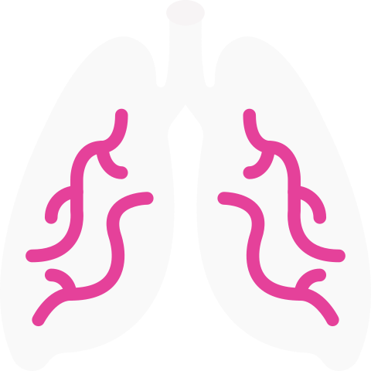
What is a severe asthma exacerbation?
Episodic flare ups of asthma that may, if severe, be life threatening and carry a significant burden¹
Exacerbation presentation¹
Defining severity of exacerbation^{a2}
Symptoms increase
Wheezing
Shortness of breath or dyspnoea
Chest tightness
Cough
Severe
Moderate
Mild
Use of OCS^{c}
ER visit or
hospitalisation requiring OCS
Lung function declines
Symptoms worsening^{b}
Lung function worsening^{b}
Increased SABA use^{b} ER visit not requiring OCS
FEV₁
Symptoms and flow rates just outside normal range
ªFor use in a clinical trial setting; ^{b}For a period of ≥2 days; ^{c}For a period of ≥3 days. ER = emergency room; FEV₁ = forced expiratory volume in 1 second; OCS = oral corticosteroid; SABA = short-acting β₂-agonist.
1. Global Initiative for Asthma. Updated 2018. www.ginasthma.org. Accessed March 2019; 2. Reddel HK et al. Am J Respir Crit Care Med. 2009;180:59-99.
Notes:
Key points:
Exacerbations in severe cases can be life threatening and carry a significant burden to patients¹
Severe asthma exacerbations require urgent action to prevent serious outcomes such as hospitalisation²
References
Global Initiative for Asthma (GINA). Global strategy for asthma management and prevention, 2018. Available from: http://ginasthma.org/2018-gina-report-global-strategy-for-asthma-management-and-prevention/ (Accessed March 2019)
Reddel HK, Taylor DR, Bateman ED, et al. An official American Thoracic Society/European Respiratory Society statement: asthma control and exacerbations: standardizing endpoints for clinical asthma trials and clinical practice. Am J Respir Crit Care Med. 2009;180:59-99.

Slide 6

Globally, 176 million asthma exacerbations occur per year¹
Asthma attacks are physically threatening and emotionally significant for patients; one-third of patients reported having an asthma episode so bad that they thought their lives were in danger² There are 339 million patients in the world with asthma^{1,3}
In 2015, in the UK alone, asthma exacerbations accounted for:⁴
70,888 hospitalisations
1428 deaths
Replace text with country- specific data and remove instructions and red box
1. AstraZeneca Pharmaceuticals. Data on file. Budesonide/formoterol: Annual Rate of Exacerbations Globally (ID:SD-3010-ALL-0017); 2. Sastre J et al. World Allergy Organ J. 2016;9:13; 3. The Global Asthma Report. 2018. Auckland, New Zealand: Global Asthma Network 2018. Available at http://www.globalasthmareport.org/. Accessed 6 March, 2019; 4. Asthma UK. www.asthma.org.uk/get-involved/campaigns/data-visualisations/. Accessed March 2019.
Notes:
Key points:
There are 339 million patients in the world with asthma¹
Globally, 176 million asthma exacerbations occur per year¹
References
In House Data, AstraZeneca Pharmaceuticals LP. Budesonide/formoterol: annual rate of exacerbations globally, SD-3010-ALL-0017

Slide 7
Asthma patients of all ages and severities are at risk of an exacerbation
Time to first asthma exacerbation during follow up by age groups and severities
5–17 years of age (n=82,707)
18–54 years of age (n=210,724)
55 years of age and older (n=113,575)
1.00
1.00
1.00
0.75
0.75
0.75
Proportion with an exacerbation
0.50
0.50
0.50
0.25
0.25
0.25
0.00
0
2
6
0.00
0.00
0
2
4
6
8
4
8
0
2
4
6
8
Years
Years
Years
BTS Step 6
BTS Step 5
BTS Step 4
BTS Step 3
BTS Step 2
BTS Step 1
Median time to first exacerbation for patients in BTS Step 4
A population-based cohort study, from April 2007 and September 2015, used linked primary and secondary care electronic healthcare records of 424,326 patients with asthma; over 60% of the total study population had mild asthma (BTS Step 1/2). BTS = British Thoracic Society.
Bloom CI et al. Thorax. 2018;73:313-320.
Notes:
Key points:
Each increase in BTS step was associated with shorter median times to first exacerbation
Each increase in BTS step was associated with a significantly increased rate of exacerbations compared with BTS Step 1
Additional points:
UK population-based cohort study using national electronic health records from Clinical Practice Research Datalink (CPRD)-linked practices for patients with asthma. CPRD includes 674 general practices and coverage for 11.3 million UK patients
Patient cohorts were divided by age (<5 years, 5–17 years, 18–54 years, and 55 years and older)
Asthma severity was classified according to the 2016 British Thoracic Society’s guidelines (Step 1 least severe; Step 6 most severe)
The main outcome was asthma exacerbations, defined as ≤300 mg oral corticosteroids (≤150 mg in children younger than 5 years) not prescribed during an annual asthma review, or an emergency department visit, or a hospital admission. Exacerbation rates were adjusted for age, sex, socioeconomic deprivation, select comorbidities (ie, atopy, rhinitis, reflux, depression, anxiety, chronic obstructive pulmonary disease), smoking, and body mass index
Reference:
1. Bloom CI, Nissen F, Douglas IJ, et al. Exacerbation risk and characterisation of the UK's asthma population from infants to old age. Thorax. 2018;73:313-320.

Slide 8
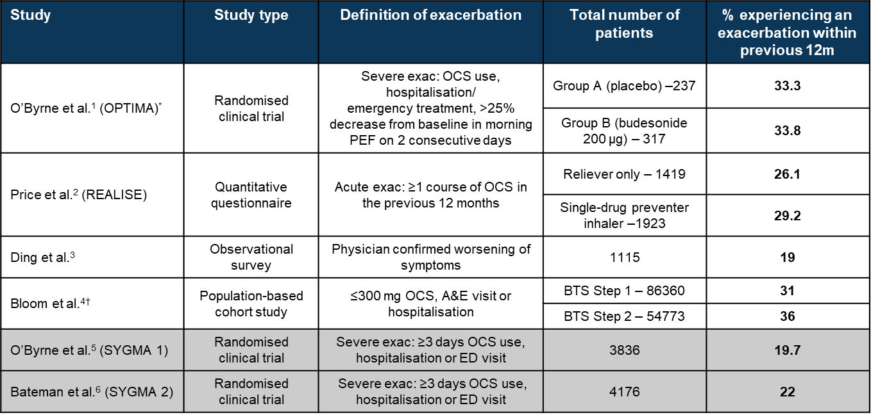
Patients with mild asthma are at risk of exacerbations^{1–6}
19–36% of patients with mild asthma experience a exacerbation every year^{1–6}
*Group A patients (n=698) were prescribed daily placebo, budesonide 200 µg or budesonide 200 µg + formoterol 9 µg. Group B patients (n=1272) were prescribed budesonide 200 µg with or without formoterol 9 µg, or budesonide 400 µg with or without formoterol 9 µg. The table presents the results for one group in each arm – Group A (placebo) and Group B (budesonide 200 µg).
†Patients were stratified according to age – <5 years, 5–17 years, 18–54 years and ≥55 years. The table reports the results for the 18–54 years group.
A&E = Accident & Emergency; ED = Emergency Department; exac = exacerbation; m= month; OCS = oral corticosteroid; PEF = peak expiratory flow
1. O’Byrne PM et al. Am J Resp Crit Care Med. 2001;164:1392-1397; 2. Price D et al. NPJ Prim Care Resp Med. 2014;24:14009; 3. Ding B et al. Adv Ther. 2017;34:1109-1127; 4. Bloom CI et al. Thorax. 2018;73:313-320; 5. O’Byrne PM et al. N Engl J Med. 2018;378:1865-1876; 6. Bateman ED et al. N Engl J Med. 2018;378:1877-1887.
Notes:
Key points:
As demonstrated in a number of studies, 19–36% of patients at GINA Step 1 and 2 have experienced at least one asthma exacerbation in the previous 12 months^{1–6}
Additional points:
O’Byrne et al (2001) assessed the effects of adding a LABA to low doses of ICS for 1 year in patients with mild asthma¹
Patients were divided into two groups (Group A received placebo and Group B had ICS-containing treatments)
In Group A, 33.3% of patients had a severe asthma exacerbation
In Group B, 33.8% of patients had a severe asthma exacerbation
Price et al (2014) assessed symptoms and levels of asthma control in a real-life setting; 8000 respondents with asthma completed the online survey²
In total, 29.2% of patients who were prescribed a single-drug preventer inhaler had received OCS at least once in the previous 12 months
Ding et al (2017) was a cross-sectional survey that assessed the burden of illness and treatment patterns among patients with a confirmed diagnosis of mild asthma in 8 countries³
In total, 19% of all patients, at GINA Step 1 or 2, experienced one or more exacerbation in the past 12 months
Bloom et al (2018) assessed the characteristics of the UK’s asthma population based on four age cohorts between under 5 years old and over 55 years old⁴
Patients were stratified according to age and BTS Step 1–6
In total 13.4–47.3% of patients at BTS Step 1 had experienced exacerbations in the previous year (patients under 5 years old had a lower rate of exacerbations, while patients aged ≥55 years had the highest rate)
Overall 31–36% of patients aged 18–54 years experienced exacerbations
O’Byrne et al (2018) assessed the long-term efficacy and safety of budesonide/formoterol used as needed among patients with mild asthma⁵
Patients were eligible if they had been assessed by the investigator for needing GINA Step 2 treatment 30 days before Visit 2
In the year preceding enrolment, 19.7% of patients had a severe exacerbation
Bateman et al (2018) assessed whether budesonide/formoterol used as needed would be noninferior to regular budesonide maintenance treatment in preventing severe exacerbations in patients with mild asthma⁶
Patients were eligible if they had been assessed by the investigator as needing GINA step 2 treatment
A total of 22% of the patients had severe exacerbations previously
References:
O'Byrne PM, Barnes PJ, Rodriguez-Roisin R, et al. Low dose inhaled budesonide and formoterol in mild persistent asthma: the OPTIMA randomized trial. Am J Respir Crit Care Med. 2001;164:1392-1397.
Price D, Fletcher M, van der Molen T. Asthma control and management in 8,000 European patients: the REcognise Asthma and LInk to Symptoms and Experience (REALISE) survey. NPJ Prim Care Respir Med. 2014;24:14009.
Ding B, Small M. Disease Burden of Mild Asthma: Findings from a Cross-sectional real-world survey. Adv Ther. 2017;34:1109-1127.
Bloom CI, Nissen F, Douglas IJ, et al. Exacerbation risk and characterisation of the UK's asthma population from infants to old age. Thorax. 2018;73:313-320.
O'Byrne PM, FitzGerald JM, Bateman ED, et al. Inhaled combined budesonide-formoterol as needed in mild asthma. N Engl J Med. 2018;378:1865-1876.
Bateman ED, Reddel HK, O'Byrne PM, et al. As-needed budesonide-formoterol versus maintenance budesonide in mild asthma. N Engl J Med. 2018;378:1877-1887.

Slide 9
Exacerbation history is associated with exacerbation frequency
Increased disease severity is associated with higher exacerbation frequency, hospital re-admissions and healthcare costs
Proportion of patients with ED/hospital readmission following an index admission with an UK database
30 days
60 days
Increased risk of re-admission in more frequent exacerbators
~25% of patients with mild asthma re-admitted within 90 days
90 days
GINA step
History of exacerbations in the prior 12 months
A retrospective cohort study of 211,807 patients with asthma within a UK database. Exacerbations defined as a worsening of asthma requiring an ED/hospital admission or OCS treatment within 2 weeks of an asthma medical code. ED = emergency department; GINA = Global Initiative for Asthma; OCS = oral corticosteroid.
Suruki R et al. BMC Pulm Med. 2017;17:74.
Notes:
Key points:
In a report of two large database studies in the USA and UK (each involving >200,000 patients with asthma) it was demonstrated that exacerbation history was associated with higher asthma exacerbation frequency
In total, 21.2–27.7% of patients at GINA Step 1 and 2 were re-admitted to hospital within 90 days
Re-admissions were also higher in patients who had ≥2 exacerbations in the previous 12 months compared with patients with <2 exacerbations
Additional points:
In addition, increased disease severity defined by GINA Step and medication was associated with higher asthma exacerbation frequency
Reference:
Suruki RY, Daugherty JB, Boudiaf N, et al. The frequency of asthma exacerbations and healthcare utilization in patients with asthma from the UK and USA. BMC Pulm Med. 2017;17:74.

Slide 10
Two RWE studies show the risk of exacerbation exists regardless of adherence to ‘preventer’ therapy or general level of asthma control^{1,2}
The percentage of patients with exacerbations stratified by adherence to ICS therapy*
The percentage of patients with >1 course of OCS used in acute exacerbations in previous 12 months, stratified by control†
1 severe exacerbation (% of patients)
≥2 severe exacerbations (% of patients)
21.4% total
(n=4948)
26.2% total
(n=1214)
*A prospective study of 7195 patients with moderate-to-severe asthma with >2 ICS prescriptions during the year before clinical review. Adherence was based on prescription refills and self-reported. Severe exacerbations were defined as asthma-related hospital admissions, A&E attendances or prescriptions for acute courses of OCS
†Online survey conducted in 11 European countries in 8000 patients, in which patients self-reported asthma symptoms/management (these were not clinically verified). Acute exacerbation defined as OCS use, ED visit or hospitalisation. GINA-defined control was based on daytime symptoms, normal activities affected by symptoms, night-time awakenings and reliever inhaler use A&E = Accident & Emergency; ED = emergency department; GINA = Global Initiative for Asthma; OCS = oral corticosteroids; RWE = Real-World Evidence .
1. Papi A et al. J Allergy Clin Immunol Pract. 2018;6:1989-1998; 2. Price D et al. NPJ Prim Care Respir Med. 2014;24:14009.
Notes:
Key points:
Despite adherence to ICS therapy patients experience exacerbations¹
In addition, patients with both GINA-defined controlled and uncontrolled asthma experience exacerbations²
References:
Papi A, Ryan D, Soriano JB, et al. Relationship of Inhaled Corticosteroid Adherence to Asthma Exacerbations in Patients with Moderate-to-Severe Asthma. J Allergy Clin Immunol Pract. 2018;6:1989-1998.
Price D, Fletcher M, van der Molen T. Asthma control and management in 8,000 European patients: the REcognise Asthma and LInk to Symptoms and Experience (REALISE) survey. NPJ Prim Care Respir Med. 2014;24:14009.

Slide 11
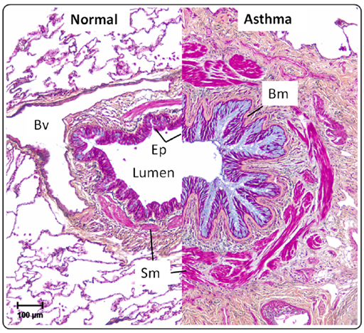
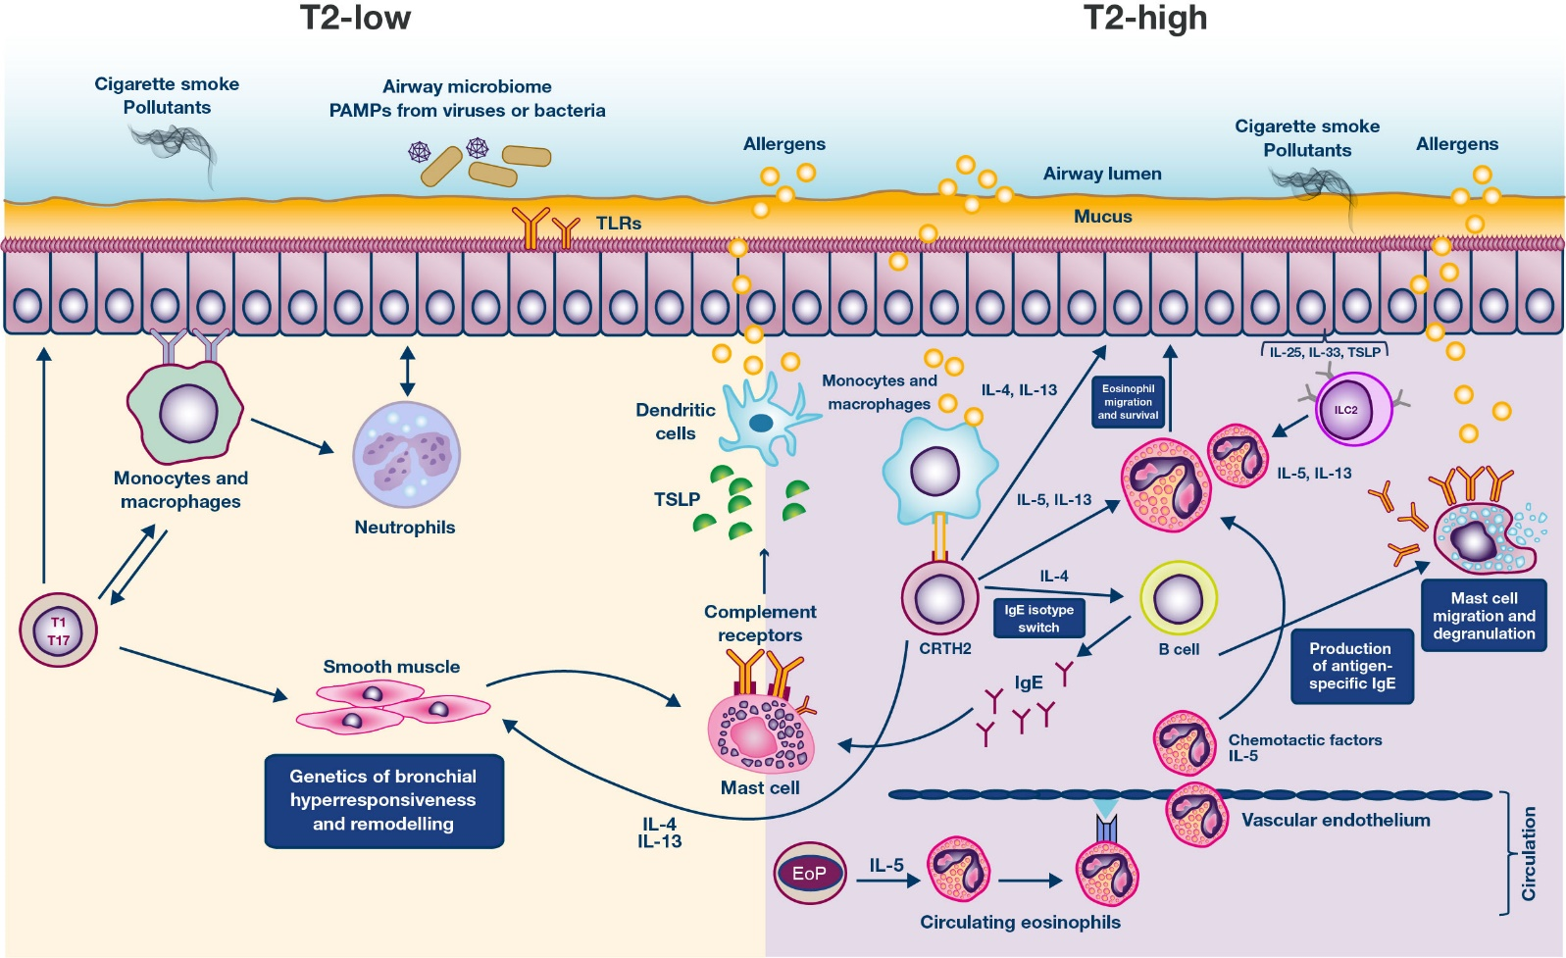
Asthma is a chronic inflammatory disease; inflammation is central to exacerbations¹
Healthy vs. severe asthmatic airway²
Key inflammatory pathways in asthma^{3–5}
INFLAMMATION
Mucus hypersecretion
Smooth muscle thickened
Bm = basement membrane; Bv = blood vessel; CRTH2 = chemoattractant receptor-homologous molecule expressed on Th2 cells; EoP = eosinophilopoiesis; EOS = eosinophils; Ep = epithelium; IgE = immunoglobulin E; IL = interleukin; ILC2 = type 2 innate lymphoid cells; PAMP = pathogen-associated molecular pattern; SM = smooth muscle; T1 = Type 1 cell; T2 = Type 2 cell; T17 = Type 17 cell; TLR = toll-like receptor; TSLP = thymic stromal lymphopoietin. 1. Global Initiative for Asthma. Updated 2018. www.ginasthma.org. Accessed March 2019; 2. Holgate ST et al. Nat Rev Dis Primers. 2015;1:15025; 3. Wenzel SE. Nat Med. 2012;18:716-725; 4. Peters SP et al. J Allergy Clin Immunol Pract. 2017;5:S15-S24; 5. Mukherjee M et al. World Allergy Organ J. 2014;7:32.
Notes:
Key points:
Asthma is a chronic inflammatory disease; inflammation is central to exacerbations.¹ Exacerbations may occur in patients across the spectrum of disease²
Inflammation has been shown to be a distinctive feature of asthma, from mild allergic asthma to severe asthma, and histopathologic features are similar across the spectrum³
Marked tissue disruption may occur in early asthma³
The implications of these findings are that management of asthma should be directed toward resolving this inflammatory process, regardless of disease severity³
References:
Global Asthma Report. The Global Asthma Report 2018. Global asthma report website. http://www.globalasthmareport.org/. Accessed March, 2019.
Dusser D, Montani D, Chanez P, et al. Mild asthma: an expert review on epidemiology, clinical characteristics and treatment recommendations. Allergy. 2007;62:591-604.
Beasley R, Weatherall M, Shirtcliffe P, et al. Combination corticosteroid/β-agonist inhaler as reliever therapy: a solution for intermittent and mild asthma? J Allergy Clin Immunol. 2014;133:39-41.

Slide 12
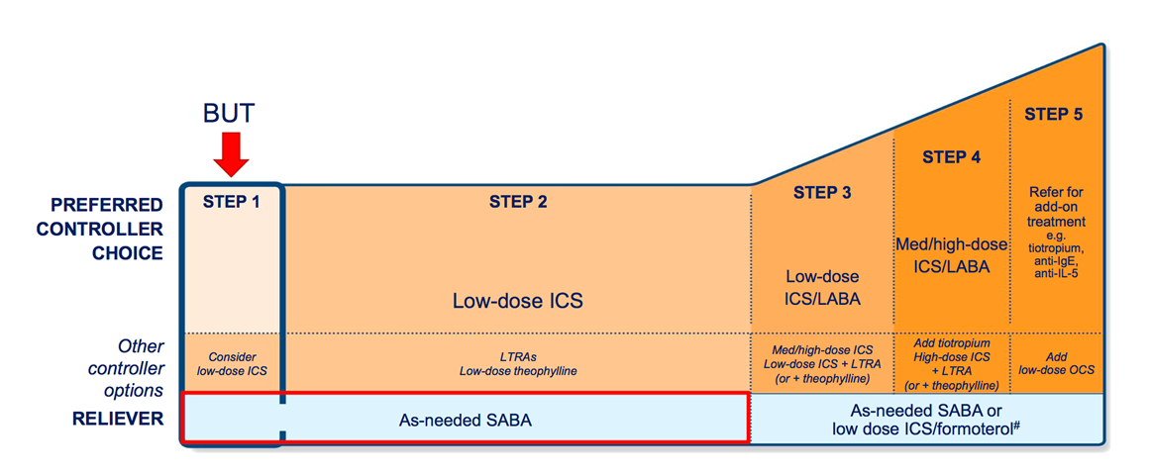
Asthma is caused by airway inflammation; yet, the initial medication prescribed has been as-needed SABA^{1,2}
Replace with local guidelines per local nominated signatory guidance
© 2018 Global Strategy Asthma Management and Prevention, all rights reserved. Use is by express license from the owner
ICS = inhaled corticosteroid; IL = interleukin; LABA = long-acting β₂-agonist; LTRA = leukotriene receptor antagonist; OCS = oral corticosteroid; SABA = short-acting β₂-agonist. 1. O’Byrne PM et al. Eur Respir J. 2017;50:1701103; 2. Global Initiative for Asthma. Updated 2018. www.ginasthma.org. Accessed March 2019.
Notes:
Key points:
Asthma is caused by airway inflammation, yet at GINA step 1 the initial medication prescribed was SABA as needed¹
A SABA has no inherent anti-inflammatory properties²
Additional points:
A review reported the paradoxes of asthma management²
It was noted that at GINA Step 1, patients are prescribed a reliever medication only, yet asthma is a disease of chronic inflammation
References:
Global Asthma Report. The Global Asthma Report 2018. Global asthma report website. http://www.globalasthmareport.org/. Accessed March, 2019.
O'Byrne PM, Jenkins C, Bateman ED. The paradoxes of asthma management: time for a new approach? Eur Respir J. 2017. http://dx.doi.org/ 10.1183/13993003.01103-2017. Accessed April 18, 2019.

Slide 13
In patients with asthma, FeNO was increased in those who were steroid-naïve after inhalation of albuterol versus those treated with ICS
Bronchodilator effects on FeNO levels in steroid-naïve patients
FeNO levels in steroid-naïve and ICS-treated patients
P<0.001, N=30
P<0.05
P<0.05
200
200
200
62.5 (41.5–85.0)
81.0 (55.0–108.0)
150
150
100
FeNO (ppb)
FeNO (ppb)
FeNO (ppb)
100
100
50
50
50
0
0
0
Prebronchodilator
Postbronchodilator
Steroid-naïve
ICS-treated
Steroid-naïve
ICS-treated
Asthma (steroid-naïve)
Prebronchodilator
Postbronchodilator
Disclaimer: The relationship between pharmacological properties and clinical efficacy has not been established An observational, prospective study was carried out in 30 steroid-naïve patients, 25 ICS-treated patients with asthma and 20 patients with COPD. The COPD population is not presented here. FeNO, fractional exhaled nitric oxide; ICS, inhaled corticosteroid Zhao H et al. Clin Respir J. 2017;11:328–336
Notes:
Reference(s):
1. Zhao H, Li R, Lv Y, et al. Albuterol inhalation increases FeNO level in steroid-naive asthmatics but not COPD patients with reversibility. Clin Respir J. 2017;11:328-336.

Slide 14
Patients typically seek immediate symptom relief
Patient attitudes to asthma management (%, n=3415)
39% of patients
90% of patients
believe there is no need to take medication every day when they feel well
want treatments that provide immediate relief
The INSPIRE study examined the attitudes and actions of 3415 physician-recruited adults with asthma in 11 countries. Patients were prescribed regular maintenance therapy with ICS or ICS plus LABA ICS = inhaled corticosteroid; INSPIRE = International Asthma Patient Insight Research; LABA = long-acting β₂-agonist Partridge MR et al. BMC Pulm Med. 2006;6:13.
Notes:
Key Points:
Patients’ greatest focus is on immediate relief of symptoms and “as-needed” use of relievers, eg, short-acting β₂-agonists
The INSPIRE study demonstrates patients’ collective attitudes to asthma medication management
Addditional points:
The INSPIRE study examined the attitudes and actions of 3415 physician-recruited adults aged ≥16 years, in 11 countries, with asthma, who were prescribed regular maintenance therapy with inhaled corticosteroids or inhaled corticosteroids plus long-acting β₂-agonists. Structured interviews were conducted to assess medication use, asthma control, and patients' ability to recognise and self-manage worsening asthma
Reference:
Partridge MR, van der Molen T, Myrseth SE, et al. Attitudes and actions of asthma patients on regular maintenance therapy: the INSPIRE study. BMC Pulm Med. 2006;6:13.
Partridge 2006 p6 table2
Partridge 2006 p6 table2
Partridge 2006 p1 para1 line1-3
Partridge 2006 p6 table2
Partridge 2006 p2 c1 para3 line2-7; c1 para5 line1-6; c2 para2 line4-8; p3 c1 para3 line1-9; c2 para2 line2-4

Slide 15
Symptom worsening drives patients to use SABA as a reliever
Asthma symptoms drive SABA use until exacerbation^{*1}
Mean total as-needed medication use in the 14 days before and after an exacerbation
5
100
PEF morning
PEF evening
4
80
Symptoms night
Symptoms day
60
Rescue night
3
Percentage
Rescue day
Total number of as-needed inhalations
40
2
20
1
Budesonide/formoterol maintenance and as needed
Budesonide/formoterol maintenance plus SABA as needed
0
Fluticasone/salmeterol plus SABA as needed
0
-15
-10
-5
0
5
10
15
BL
–12
–9
–6
–3
0
3
6
9
12
15
Day
Day relative to start of exacerbation
*A descriptive study of 425 severe exacerbations PEF = peak expiratory flow; SABA = short-acting β₂-agonist. 1.Tattersfield AE et al. Am J Respir Crit Care Med. 1999;160:594-599; 2. AstraZeneca Pharmaceuticals. Data on file. Budesonide/formoterol: COMPASS as needed medication use and exacerbations (ID:SD-3010-ALL-0019)
Notes:
Key points:
As seen in the COMPASS study, with immediate intervention, ie with an ICS/fast-acting β₂-agonist to target both the symptoms and inflammatory flare-up in a timely manner, the time to an exacerbation is prolonged compared with maintenance treatment plus SABA as needed
References:
Kuna P, Peters MJ, Manjra AI, et al. Effect of budesonide/formoterol maintenance and reliever therapy on asthma exacerbations. Int J Clin Pract. 2007;61:725-736.

Slide 16
Patients use reliever therapy over ICS
Replace with country-specific data on SABA and ICS prescribing patterns as available and appropriate
Within a 1-month period, nearly two-thirds of patients had used reliever inhalers whereas only 23% had used ICS regularly
100
β₂-agonist
ICS
80
60
Patients (%)
40
20
0
SP
MOP
MP
MI
SP
MOP
MP
MI
Children (n=753)
Adults (n=2050)
In the AIRE study, telephone screening was carried out in 7 countries in 1999. Patients with asthma were identified in 3488 households and 2803 patients (80.4%) completed the survey. AIRE = Asthma Insights and Reality in Europe; ICS = inhaled corticosteroid; MI = mild intermittent; MOP = moderate persistent; MP = mild persistent; SP = severe persistent. Rabe KF et al. Eur Respir J. 2000;16:802-807.
Notes:
Key point:
Within a 1-month period, nearly two-thirds of patients had used reliever inhalers whereas only 23% had used ICS regularly
Additional points:
The AIRE study investigated the behaviours and attitudes of 2803 patients with asthma

Slide 17
SABA use and need for future acute asthma health care
Patients prescribed ≥3 SABAS per year have an increased risk of hospitalisation/OCS prescriptions compared with patients prescribed 0–2 SABAs
Reference
Reference
*Adjusted for year 2002 use in the predictive validity cohort (n=62369)
Study based on survey of 2250 maintenance organisations members (construct validity sample) and predictive validity sample (n=62369) from the Southern California Kaiser Permanente asthma database. Number of hospitalisations and ED visit were compared against SABA canisters dispensed in 12 months. Asthma ED visits and hospitalisations were combined into the single outcome of emergency hospital care for asthma, defined as at least one hospitalisation or ED visit for asthma ED = emergency department; OCS = oral corticosteroid; SABA = short-acting β₂-agonist. Schatz M et al. J Allergy Clin Immunol. 2006;117:995-1000.
Notes:
Key points:
Patients prescribed >3 SABAs per year had a increased risk of hospitalisations/OCS prescriptions compared with patients prescribed 0–2 SABAs
Additional points:
This study linked surveys containing validated asthma control tools with pharmacy and medical claims data to validate an asthma control scale based on β-agonist canister dispensing and assess the predictive validity of this scale for subsequent exacerbations
A random sample of 2250 health maintenance organisation members aged 18 to 56 years with persistent asthma participated
Patients were stratified into four groups based on number of β-agonist prescriptions (0–2, 3–6, 7–12, >12)
Reference:
Schatz M, Zeiger RS, Vollmer WM, et al. Validation of a beta-agonist long-term asthma control scale derived from computerized pharmacy data. J Allergy Clin Immunol. 2006;117:995-1000.

Slide 18
High SABA use per quarter is associated with increased risk of severe exacerbation in the next quarter
Relationships of critical SABA use values to asthma-related outcomes in the 12-month follow-up period
Cohort | Critical SABA use and optimal assessment period | Asthma-related exacerbations
 |  | Hospitalisation/ ED visit | Hospitalisation | ED visit | OCS-dispensing event
Commercial
Children (n=41,753) | ≥3 in 12 months | 2.23 (1.94, 2.56) | 2.63 (1.85, 3.74) | 2.16 (1.87, 2.49) | 1.60 (1.49, 1.71)
Adults (n=59,684) | ≥2 in 6 months | 2.21 (1.98, 2.47) | 2.08 (1.64, 2.65) | 2.23 (1.98, 2.50) | 1.45 (1.38, 1.53)
Medicaid
Children (n=25,048) | ≥3 in 12 months | 1.80 (1.60, 2.02) | 1.84 (1.36, 2.51) | 1.78 (1.57, 2.01) | 1.38 (1.28, 1.50)
Adults (n=8745) | ≥2 in 3 months | 1.84 (1.57, 2.15) | 1.84 (1.18, 2.85) | 1.81 (1.53, 2.13) | 1.15 (1.03, 1.28)
Odds of asthma-related hospitalisation or ED visit by number of SABA canisters (commercial cohort)
Adults (n=59,684)
Children (n=41,753)
Number of SABA canisters
A retrospective study in 33,793 Medicaid and 101,437 commercial patients. ED = emergency department; OCS = oral corticosteroid; SABA = short-acting β₂-agonist. Stanford R et al. Ann Allergy Asthma Immunol. 2012;109:403-407.
Notes:
Key points:
Increased risk of severe exacerbation ≥3 SABA/year (children) and ≥2 SABAs/quarter (adults) compared with patients using <3 SABA/year or <2 SABA/quarter, respectively
References:
Stanford RH, Shah MB, D'Souza AO, et al. Short-acting β-agonist use and its ability to predict future asthma-related outcomes. Ann Allergy Asthma Immunol. 2012;109:403-7.

Slide 19
Inappropriate SABA use associated with progression to more severe disease
Mild asthma
Moderate asthma
Severe asthma
100
20
20
Inappropriate SABA use
Appropriate SABA use
95
15
15
Population-averaged probability (%)
Population-averaged probability
Population-averaged probability
90
10
10
85
5
5
80
0
0
0
2
4
6
8
10
0
2
4
6
8
10
0
2
4
6
8
10
Follow-up years since incident year of mild asthma
Follow-up years since incident year of mild asthma
Follow-up years since incident year of mild asthma
The odds of patients with inappropriate SABA use* transitioning to more severe disease in the next 12-month period was 1.79 (1.68, 1.90)
*Defined as high dose of SABA and low dose of ICS; ≥2 puffs/week without ICS use or ≥9 SABA canisters with <100 µg of ICS daily doses A prospective cohort study included 70,829 patients with incident of mild asthma.
ICS = inhaled corticosteroid; SABA = short-acting β₂-agonist. y-axis denotes the population-averaged probability of being in a specified severity state. Chen W et al. J Allergy Clin Immunol Pract. 2018;6:2024-2032.
Notes:
Key point:
Inappropriate SABA use is associated with progression to more severe disease
The odds of patients with inappropriate SABA use transitioning to more severe disease in the next 12-month period was 1.79 (1.68, 1.90)
Additional points:
A prospective cohort study of 70,829 patients (14–45 years old) with newly diagnosed mild asthma between January 1997 and December 2012 from administrative health data in Canada
The primary objective was to examine the long-term trajectories of mild asthma and the effects of early-stage risk factors on the subsequent disease course
Inappropriate prescription of SABA in first year of diagnosis
2 or more puffs/week without ICS in first year of diagnosis or
9 or more SABA cannisters with ICS under 100 µg daily
Reference:
Chen W, FitzGerald JM, Lynd LD, et al. Long-term trajectories of mild asthma in adulthood and risk factors of progression. J Allergy Clin Immunol Pract. 2018;6:2024-2032.
Chen 2018 p2029 figure3
Chen 2018 p2025 c1 para3 line1-3; c2 para2 line1-3; p2027 c1 para4 line2-4
Chen 2018 p2029 figure2
Chen 2018 p2025 c1 prar2 line13-18

Slide 20
Budesonide demonstrates anti-inflammatory activity as early as 6 hours after a single dose
Budesonide treatment resulted in a significantly lower sputum eosinophil count compared with placebo (p=0.01)*
Budesonide resulted in a 2.2-fold improvement in airway responsiveness to hypertonic saline†
After 6 hours mean percentage predicted FEV₁ tended to be higher after budesonide than placebo§
60
100
68
Placebo
Budesonide
50
40
10
66
Sputum eosinophils, %
PD₂₀ NaCI, ml
Mean % predicted FEV₁
30
20
1
64
10
0
0
62
Placebo
Budesonide
Placebo
Budesonide
0
1
2
3
4
5
6
Hours post dose
Disclaimer: This study used an unlicensed dose of budesonide 2400 µg; the relationship between pharmacological properties and clinical efficacy has not been established.
*The difference between budesonide and placebo was 12.2% †The difference between budesonide and placebo was −0.79 (P=0.0020)
§Did not reach significance A randomised, double-blind, placebo-controlled crossover study was conducted to determine the effects of a single-dose of 2400 µg budesonide. Patients with asthma (n=41) were randomised (n=26) to receive a single dose of budesonide 2400 µg or placebo on two separate days. Lung function and symptoms were followed for 6 hours, and then sputum was induced and airway responsiveness to hypertonic saline determined. FEV₁ = forced expiratory volume in 1 second; NaCl = sodium chloride Gibson PG, et al. Am J Respir Crit Care Med. 2001;163:32–36
Notes:
Key points:
Budesonide demonstrates anti-inflammatory activity as early as 6 hours after a single dose of 2400 µg
Budesonide treatment resulted in a significantly lower sputum eosinophil count (p=0.01)
The difference between treatments was 12.2%
Additional points:
A randomised, double-blind, placebo-controlled crossover study was conducted to determine the effects of a single-dose of budesonide 2400 µg
In total, 26 patients were randomised to receive a single dose of budesonide 2400 µg or placebo on two separate days
Lung function and symptoms were followed for 6 hours, and then sputum was induced and airway responsiveness to hypertonic saline determined
Budesonide resulted in a 2.2-fold improvement in airway responsiveness to hypertonic saline
After placebo PD₂₀ saline was 1.4 (3.3) ml and improved to 3.0 (4.2) ml after budesonide treatment (p=0.0020)
After 6 hours mean percentage predicted FEV₁ tended to be higher after budesonide than placebo, but this failed to reach significance
This study used an unlicensed dose of budesonide 2400 µg
The relationship between pharmacological properties and clinical efficacy has not been established

Slide 21
Patients with asthma experience a higher onset of AEs after their first SCS prescription
Adjusted hazard ratio (95% CI) for each AE in the SCS arms for categorised, cumulative SCS exposures versus reference category (>0–<0.5 g cumulative exposure)
 | ≥10 |  | 3.98 (3.09, 5.14)
 | 5-<10 |  | 3.36 (2.65, 4.26)
 | 2.5-<5 |  | 2.52 (2.02, 3.14)
 | 1.0-<2.5 |  | 1.70 (1.41, 2.05)
 | 0.5-<1.0 |  | 1.17 (0.97, 1.42)
 | >0-<0.5 – Pneumonia |  | Reference
 | ≥10 |  | 2.47 (1.25, 4.85)
 | 5-<10 |  | 2.59 (1.41, 4.75)
 | 2.5-<5 |  | 1.55 (0.89, 2.68)
 | 1.0-<2.5 |  | 1.17 (0.75, 1.84)
 | 0.5-<1.0 |  | 1.20 (0.80,1.81)
 | >0-<0.5 – Sleep apnoea |  | Reference
 | ≥10 |  | 1.56 (1.11, 2.20)
 | 5-<10 |  | 1.54 (1.17, 2.02)
 | 2.5-<5 |  | 1.33 (1.07, 1.65)
 | 1.0-<2.5 |  | 1.30 (1.12, 1.51)
 | 0.5-<1.0 |  | 1.15 (1.01, 1.31)
 | >0-<0.5 – Depression/anxiety |  | Reference
 | ≥10 |  | 2.68 (1.41, 5.10)
 | 5-<10 |  | 2.10 (1.14, 3.85)
 | 2.5-<5 |  | 2.12 (1.26, 3.57)
 | 1.0-<2.5 |  | 1.48 (0.96, 2.30)
 | 0.5-<1.0 |  | 1.17 (0.77, 1.77)
 | >0-<0.5 – Peptic ulcer |  | Reference
 | ≥10 |  | 1.85 (1.55, 2.21)
 | 5-<10 |  | 1.34 (1.14, 1.57)
 | 2.5-<5 |  | 1.23 (1.07, 1.42)
 | 1.0-<2.5 |  | 1.20 (1.08, 1.34)
 | 0.5-<1.0 |  | 1.05 (0.95, 1.16)
 | >0-<0.5 – Renal impairment |  | Reference
‘‘Patients should be evaluated and considered for alternative treatment strategies early in the course of their asthma to avoid the need for OCS’’
0.7
0.8
1
0.9
1.5
2
2.5
3
4
5
6
7
8
9
10
A historical matched cohort study of 24,117 pairs of patients with first SCS prescription (SCS arm) and non SCS exposure (non-SCS arm) were followed until first outcome event AE = adverse event; CI = confidence interval; OCS = oral corticosteroid; SCS = systemic corticosteroid. Price DB et al. J Asthma Allergy. 2018;11:193-204.
Hazard ratio
Notes:
Key points:
SCS prescriptions lead to a higher onset of AEs
As 1 g SCS is equivalent to four short courses of OCS, alternative treatment strategies early in the course of asthma should be considered to avoid the need for OCS
Additional points:
A historical cohort study was carried out to investigate the impact of initiating SCS, and of SCS exposure, on the onset of known SCS-associated adverse outcomes
Patients were aged ≥18 years
The majority of SCS prescriptions (98%) were for OCS
Reference:
Price DB, Trudo F, Voorham J, et al. Adverse outcomes from initiation of systemic corticosteroids for asthma: long-term observational study. J Asthma Allergy. 2018;11:193-204.

Slide 22
Adverse event risks are higher with cumulative OCS doses in patients with asthma
Odds ratio of AEs associated with use of ≥4 OCS prescriptions in 1 year (n=72,063 for each cohort)*†
Osteoporosis
Hypertension
Obesity
Type 2 diabetes
Cataracts
Gastrointestinal
Fractures
0.900
1.100
1.300
1.500
1.700
*The cut-offs used in this study as current OCS use were 0, 1–3, and ≥4 prescriptions. Although the magnitude of the odds ratio was highest for exposure to ≥4 OCS prescriptions/year, exposure to 1–3 OCS prescriptions/year was also associated with the development of current and future AEs . †Retrospective cohort study of adult patients with asthma from 2000–2014 data from an insurance claims set (N=228,436); results of logistic regression controlling for age, sex, geographic region, years since index date, insurance type, use of immunosuppressive medication other than OCS and general comorbidity burden. AEs that were not significantly different are not included (eg, metabolic syndrome, avascular necrosis, dyslipidemia, glaucoma, and tuberculosis). AE = adverse event; OCS = oral corticosteroid.
Sullivan PW et al. J Allergy Clin Immunol. 2018;141:110-116.
Notes:
Key points:
≥4 OCS bursts in a year resulted in new AE risk due to cumulative dosage¹
These data suggest that each OCS prescription may result in a cumulative burden on current and future health, regardless of dose and duration¹
Additional points:
The data presented on the forest plot are results of a retrospective cohort study of adult patients with asthma from 2000–2014 data from an insurance claims set (MarketScan) (N=228,436) before propensity score matching; patients had continuous enrolment for ≥12 months and ≥24 months after the index date¹
Patients taking ≥4 prescriptions within the current year had 1.29 times the odds of experiencing a new AE within that year vs. those in the no-OCS cohort; the odds of experiencing a new AE in the current year were 1.11 times higher for each year of prior exposure to ≥4 OCS prescriptions¹
Each year with ≥4 prescriptions (current and past) exposure resulted in 1.2 times the odds of new AEs during the current year¹
References:
Sullivan PW, Ghushchyan VH, Globe G, et al. Oral corticosteroid exposure and adverse effects in asthmatic patients. J Allergy Clin Immunol. 2018;141:110-116.
Sullivan 2018 p113 c2 figure2
Sullivan 2018 p114 c1 tableIV
Sullivan 2018 p113 c2 figure2
Sullivan 2018 p113 c2 para2 line1-3; c2 figure2
Sullivan 2018 p111 c1 para2 line1-5; c1 para3 line1-3
Sullivan 2018 p112 c1 para2 line1-11; c2 para1 line 1
Sullivan 2018 p112 c2 para1 line1-3
Iribarren 2012 p1017 table3; 1019 c1 para2 line1-6

Slide 23
Unmet needs in asthma – conclusions
Globally, 176 million asthma exacerbations occur per year;¹ exacerbations are physically threatening and emotionally significant for patients²
Patients with mild asthma are at risk of exacerbations on current therapeutic medications;^{3–7} risk of exacerbation increases with disease severity and worse asthma control, regardless of adherence to treatment^{4,8}
Asthma is a chronic inflammatory disease; inflammation is central to exacerbations⁹
As symptoms worsen, patients use their SABA reliever;¹⁰ patients prescribed ≥3 SABAs per year were associated with an increased risk of hospitalisation/OCS prescriptions compared with patients prescribed 0–2 SABAs¹¹
Budesonide demonstrates anti-inflammatory activity as early as 6 hours after a single dose¹²
Cumulative exposure to systemic corticosteroids increases the risk of associated AEs^{13,14}
SABA does not address the underlying inflammation,¹⁵ and alternative treatment strategies early in the course of asthma may need to be considered to help reduce the need for OCS¹³
AE = adverse event; OCS = oral corticosteroid; SABA = short-acting β₂-agonist. 1. AstraZeneca Pharmaceuticals. Data on file. Budesonide/formoterol: Annual Rate of Exacerbations Globally (ID:SD-3010-ALL-0017); 2. Sastre J et al. World Allergy Organ J. 2016;9:13; 3. O’Byrne PM et al. Am J Resp Crit Care Med. 2001;164:1392-1397; 4. Price D et al. NPJ Prim Care Resp Med. 2014;24:14009; 5. Bloom CI et al. Thorax. 2018;73:313–320; 6. O’Byrne PM et al. N Engl J Med. 2018;378:1865-1876; 7. Bateman ED et al. N Engl J Med. 2018;378:1877-1887; 8. Papi A et al. J Allergy Clin Immunol Pract. 2018;6:1989-1998; 9. Global Initiative for Asthma. Updated 2018. www.ginasthma.org. Accessed March 2019; 10. Tattersfield AE et al. Am J Respir Crit Care Med. 1999;160:594-599; 11. Schatz M et al. J Allergy Clin Immunol. 2006;117:995-1000; 12. Gibson PG, et al. Am J Respir Crit Care Med. 2001;163:32–36; 13. Price DB et al. J Asthma Allergy. 2018;11:193-204; 14. Sullivan PW et al. J Allergy Clin Immunol. 2018;141:110-116; 15. O’Byrne PM et al. Eur Respir J. 2017;50:1701103.

Slide 24
Back-up slides

Slide 25
Adherence to controller therapy correlates with fewer severe exacerbations
An overview of the range risk estimates for the association between adherence and asthma exacerbation
Reference | Participants, n | Outcome | Adherence | OR | Adherent vs. nonadherent
Stern et al. (2006) | 97,743 | Comb:ED/hosp | MPR: 75th perc vs. less | 0.86
Delea et al. (2008) | 12,907 | OCS Comb:ED/hosp | Mean MPR: +25% Mean MPR: +25% | 0.97 0.90
Balkrishnan et al. (2000) | 751 | Comb:ED/hosp | Refills: 2 vs. 0 | 0.62
Williams et al. (2004) | 405 | OCS | Median CMA: +25% | RR 0.75
Williams et al. (2011) | 298 | Comb:ED/hosp/OSC | MPR: >75% vs. <25% | 0.58
McMahon et al. (2000) | 4535 | Hosp+OCS Hosp | Adh: 90 vs. 1–89 days Adh: 90 vs. 1–89 days | 1.02 0.91
Smith et al. (2009) | 3013 | Comb:ED/hosp | MPR: >80% vs. <50% | 0.47
0
1
2
Stern, et al (2006) found that patients achieving the 75th percentile of adherence experienced the fewest exacerbations
A systematic literature review of 23 publications in medication adherence and the risk of severe exacerbations Adh = adherence; CMA = continuous measure of availability; Comb = Combined; ED = emergency department visit; hosp = hospitalisation; MPR = medication possession rate; OCS = oral corticosteroids; OR = odds ratio; perc = percentile; RR = relative risk. Engelkes M et al. Eur Respir J. 2015;45:396-407.
Notes:
Key point:
Higher adherence to controller therapy correlates with fewer severe exacerbations
Additional points:
Extensive literature search of PubMed from inception to 1 January 2014 to identify studies that 1) assessed medication adherence to asthma controller therapy; 2) had severe asthma exacerbation as outcome of interest and 3) evaluated association between adherence and exacerbation as primary or secondary endpoint. 2319 articles were identified and 23 were included in the review
Differences in design, exposure, outcome, cut-off values, assessments and definitions precluded a formal meta-analysis

Slide 26
Editable table to be removed before use
Study | Study type | Definition of exacerbation | Total number of patients | % experiencing an exacerbation within previous 12m
O’Byrne et al.¹ (OPTIMA)* | Randomised clinical trial | Severe exac: OCS use, hospitalisation/ emergency treatment, >25% decrease from baseline in morning PEF on 2 consecutive days | Group A (placebo) –237 | 33.3
 |  |  | Group B (budesonide 200 µg) – 317 | 33.8
Price et al.² (REALISE) | Quantitative questionnaire | Acute exac: ≥1 course of OCS in the previous 12 months | Reliever only – 1419 | 26.1
 |  |  | Single-drug preventer inhaler –1923 | 29.2
Ding et al.³ | Observational survey | Physician confirmed worsening of symptoms | 1115 | 19
Bloom et al.^{4†} | Population-based cohort study | ≤300 mg OCS, A&E visit or hospitalisation | BTS Step 1 – 86360 | 31
 |  |  | BTS Step 2 – 54773 | 36
O’Byrne et al.⁵ (SYGMA 1) | Randomised clinical trial | Severe exac: ≥3 days OCS use, hospitalisation or ED visit | 3836 | 19.7
Bateman et al.⁶ (SYGMA 2) | Randomised clinical trial | Severe exac: ≥3 days OCS use, hospitalisation or ED visit | 4176 | 22

Slide 27
Notes pages

