Slide 1
Global Medical Affairs Cover Sheet
Asset Name | <Generic Name: Title> | Benralizumab: ZONDA Medical Reactive Deck
Intended Use | <Reactive or Internal use> | Reactive
Approved for Distribution |  | Yes |  |  |  | Therapy Area | Respiratory
Asset Owner | Bhavini Parikh |  |  |  |  | New or Updated | Updated
Document Number | ML-3034-ALL-0012 |  |  |  |  | Based on Asset (include Vault MedComms or PromoMats document number or N/A for not applicable)
Approved Date | 05/19 |  | Expiration Date |  | 05/20
Technical Review/Fact Check Completed by Global Medical Information (Yes/No) |  |  |  |  |  | Applicable Copyright Permissions Obtained for Graphics (Yes/No) | Yes
This material is globally approved for use by AstraZeneca Medical Affairs Scientific Personnel only. The local market is responsible for interpreting, reviewing, and approving the content according to their local label, rules, and regulations.
Additional Disclaimers or Special Instructions:
External use of any of the content must be approved for release by your local nominated signatory/local medical process to ensure compliance with local regulations.
Refer to the General Properties for this asset in GMIP Content (Veeva Vault MedComms) for additional details.
Questions on this asset should be directed to asset owner.

Slide 2

Oral Glucocorticoid-Sparing Effect of Benralizumab in Severe Asthma
ML-3034-ALL-0012
05/19
05/20

Slide 3
Corticosteroid-Induced Morbidities are Common in Severe Asthma
GC-associated co-morbidities increase with increasing asthma severity
Odds of OCS related morbidity: severe vs. mild/moderate asthma
Patients with ≥1 comorbidities, (n=7195) | Non-asthma | Mild/Moderate (GINA Tx Step 2/3) | Severe asthma (GINA Tx Step 5 + ≥4 OCS Rx/yr)
 | 64% | 78% | 93%ª
ªp<0.001 for severe vs. non-asthma
OPCR Database
Cataracts 9% vs. 5% (OR, 1.89; p<0.001)
BTS Registry OCS Cohort (n=770)
Similar disease rates observed as OPCR database, in addition to: high rates of osteopenia (35%) and obstructive sleep apnea (8%)
GI (incl. ulcers) 65% vs. 34% (OR, 3.99; p<0.001)
Diabetes 10% vs. 7% (OR, 1.46; p=0.006)
Osteoporosis 16% vs. 4% (OR, 5.23; p<0.001)
BTS = British Thoracic Society (Difficult Asthma); GC = glucocorticoid; GI = gastrointestinal; GINA = Global Initiative for Asthma; OCS = oral corticosteroids; OPCR = Optimum Patient Care Research; OR = odds ratio; Rx = prescriptions; Tx = treatment.
Sweeney J et al. Thorax. 2016;71:339-346.
Notes:
Notes:
Present slide.
This was a cross-sectional observational study based on data from the primary care Optimum Patient Care Research Database (OPCRD) and the British Thoracic Society (BTS) Difficult Asthma Registry
Participants in the OPCRD included 7195 patients in three age- and gender-matched groups
The BTS Registry collects data from the UK dedicated Specialist Difficult Asthma Services
A formal statistical comparison of prevalence rates between the OPCRD and the BTS Registry was not thought to be appropriate because of the differing ascertainment methods used in the two sources
In the BTS Difficult Asthma Registry, similar prevalence rates were found, although, additionally, high rates of osteopenia (35%) and obstructive sleep apnea (11%) were identified
Additional Information
The OPCRD is a UK respiratory database containing anonymized primary care data supplemented with information from patient-reported questionnaires
Reference(s):
Sweeney J, Patterson CC, Menzies-Gow A, et al. Comorbidity in severe asthma requiring systemic corticosteroid therapy: cross-sectional data from the Optimum Patient Care Research Database and the British Thoracic Difficult Asthma Registry. Thorax. 2016;71:339-346.

Slide 4

WINDWARD Program in Asthma: Benralizumab Phase III Clinical Trials
ZONDA³ Efficacy and safety study of benralizumab to reduce OCS use in patients with uncontrolled asthma on high-dosage ICS/LABA and chronic OCS therapy
CALIMA² Efficacy and safety study of benralizumab in adults and adolescents with asthma inadequately controlled on medium- to high-dosage ICS/LABA
Six Phase III trials in ~3068 patients and at 798 sites across 26 countries¹
The largest Phase III development program for a biologic in respiratory disease¹
SIROCCO⁴ Efficacy and safety study of benralizumab added to high-dosage ICS/LABA in patients with uncontrolled asthma
BORA⁷ Safety extension study of benralizumab in asthmatic adults and adolescents on ICS/LABA
BISE⁵ Efficacy and safety study of benralizumab in adults with mild to moderate persistent asthma
GREGALE⁶ Functionality and reliability of the APFS in an at-home setting and performance of the APFS after use
APFS = accessorized pre-filled syringe; ICS = inhaled corticosteroid; LABA = long-acting beta-agonist; OCS = oral corticosteroid.
1. AstraZeneca Pharmaceuticals LP press release. Published May 17, 2016; 2. FitzGerald JM et al. Lancet. 2016;388:2128-2141; 3. Nair P et al. N Engl J Med. 2017; 376:2448-2458; 4. Bleecker ER et al. Lancet. 2016;388:2115-2127; 5. Ferguson GT et al. Lancet Respir Med. 2017;5:569-576; 6. Ferguson GT et al. J Asthma Allergy. 2018;11:63-72; 7. Busse WW et al. Lancet Respir Med.2019;7:46–59
Notes:
Notes:
The WINDWARD clinical development program consists of 6 Phase III clinical trials evaluating the efficacy and safety of benralizumab in asthma.¹ The program includes the following studies:
Two pivotal studies (CALIMA and SIROCCO) in severe asthma inadequately controlled with an ICS plus a LABA with or without oral corticosteroid (OCS) therapy^{2, 4}
A steroid-sparing study (ZONDA) in patients inadequately controlled with a high-dose ICS plus a LABA and chronic OCS therapy³
A safety extension study (BORA) of CALIMA, SIROCCO, and ZONDA in severe asthma⁷
A study in mild to moderate persistent asthma (BISE)⁵
An accessorized prefilled syringe administration study (GREGALE) in severe asthma⁶
Reference(s):
AstraZeneca. AstraZeneca announces positive results from benralizumab phase III programme in severe asthma [press release]. https://www.astrazeneca.com/media-centre/press-releases/2016/astrazeneca-announces-positive-results-from-benralizumab-phase-iii-programme-in-severe-asthma-17052016.html. Published May 17, 2016. Accessed April 3, 2018.
FitzGerald JM, Bleecker ER, Nair P, et al. Benralizumab, an anti–interleukin-5 receptor α monoclonal antibody, as add-on treatment for patients with severe, uncontrolled, eosinophilic asthma (CALIMA): a randomised, double-blind, placebo-controlled phase 3 trial. Lancet. 2016;388:2128-2141.
Nair P, Wenzel S, Rabe KF, et al. Oral glucocorticoid-sparing effect of benralizumab in severe asthma. N Engl J Med. 2017;376:2448-2458.
Bleecker ER, FitzGerald JM, Chanez P, et al. Efficacy and safety of benralizumab for patients with severe asthma uncontrolled with high-dosage inhaled corticosteroids and long-acting β₂-agonists (SIROCCO): a randomised, multicentre, placebo‑controlled phase 3 trial. Lancet. 2016;388:2115-2127.
Ferguson GT, FitzGerald JM, Bleecker ER, et al. Benralizumab for patients with mild to moderate, persistent asthma (BISE): a randomised, double-blind, placebo-controlled, phase 3 trial. Lancet Respir Med. 2017;5:568-576.
Ferguson GT, Mansur AH, Jacobs JS, et al. Assessment of an accessorized pre-filled syringe for home-administered benralizumab in severe asthma. J Asthma Allergy. 2018;11:63-72.
Busse WW, Bleecker ER, FitzGerald JM, et al. Long-term safety and efficacy of benralizumab in patients with severe, uncontrolled asthma: 1-year results from the BORA phase 3 extension trial. Lancet Respir Med.2019;7:46–59.

Slide 5
ZONDA: Study Objectives
To assess the ability of benralizumab to reduce OCS dosage in patients with severe refractory asthma and elevated eosinophils who are OCS dependent
To further confirm the safety and clinical benefit of benralizumab on standard measures of asthma control, including asthma exacerbation reduction
OCS = oral corticosteroid.
Nair P et al. N Engl J Med. 2017;376:2448-2458.
Notes:
Note:
Present slide.
Reference(s):
Nair P, Wenzel S, Rabe KF, et al. Oral glucocorticoid-sparing effect of benralizumab in severe asthma. N Engl J Med. 2017;376:2448-2458.

Slide 6
ZONDA: Study Design Two Dosing Regimens of Benralizumab Versus Placebo x 28 Weeks
Enrollment
Benralizumab 30 mg
SC every 4 weeks
Benralizumab 30 mg
SC every 4 weeks
Primary endpoint at Week 28: % reduction in final OCS dose
Run-in
Benralizumab 30 mg
SC every 4 weeks
Benralizumab 30 mg
SC every 8 weeks with placebo SC at 4 week interim
Randomization
1:1:1
Placebo SC every 4 weeks
Placebo SC every 4 weeks
OCS optimized up to
6 weeks
V2 → → V5
↓ 1st dose IP
V8 ← attempt OCS reduction → V13
V14 (EOT)
Week
-10
-8
-2
Week 0
Week 4
Week 28
Week 36
Run-in
(2 weeks)
OCS Optimization up to 6 weeks
Run-in
(2 weeks)
Treatment Period
V1 V2
Induction (Weeks 0-4)
OCS Reduction (Weeks 4-24)
Maintenance (Weeks 24-28)
Follow-up
(Weeks 28-36)
Extension Study
V5 V6
Week 4
Week 24
baseline for
optimization
EOT = end of treatment; IP = investigational product; OCS = oral corticosteroid; SC = subcutaneous; Tx = treatment; V = visit.
Nair P et al. Article and protocol. N Engl J Med. 2017;376:2448-2458.
OCS stable run-in: Tx baseline
V6 - every 4 week dosing
Notes:
Notes:
This was a global, randomized, double-blind, placebo-controlled study that evaluated the efficacy and safety of a fixed 30 mg dose of benralizumab administered SC in 2 dosing regimens (Q4W throughout the treatment period vs. Q4W for the first 3 doses and then Q8W thereafter) in patients with severe asthma (ie, uncontrolled asthma while receiving high-dose ICS/LABA and chronic OCS with or without additional asthma controllers)
From Visit 1 to Visit 2, the baseline for the electronic patient-reported outcome (ePRO) parameters was established
Dose optimization could be omitted if the patient had already failed OCS reduction within the 6 months prior to Visit 1
The OCS dose titration must have been initiated at Visit 2; the Investigator was to follow the titration schedule
The reductions could occur at 2-week intervals according to the titration schedule
The optimized dose of OCS was defined as the lowest dose of OCS at which the patient met all 5 control criteria.
In cases where a patient was optimized on the OCS dose prior to Visit 5 (Week -2), that visit was to be combined with Visit 5 (eg, Visit 3 would be combined with Visit 5).
The patient would then be maintained at the optimized dose of OCS for at least 2 weeks and then randomized at Visit 6.
Reference(s):
Nair P, Wenzel S, Rabe KF, et al. Oral glucocorticoid-sparing effect of benralizumab in severe asthma [protocol]. N Engl J Med. 2017;376:2448-2458. http://www.nejm.org/doi/suppl/10.1056/NEJMoa1703501/suppl_file/nejmoa1703501_protocol.pdf. Accessed April 3, 2018.

Slide 7
ZONDA: OCS Optimization and Dose Reduction Decisions Anchored to Baseline Level of Asthma Control
Control considered maintained at a scheduled optimization/reduction visit if ALL 5 criteria were met¹
Pre-BD FEV₁ ≥80% of baseline
Meanª morning PEF ≥80% of baseline^{b}
Meanª nighttime awakenings ≤50% increase compared with baseline^{b}
Meanª SABA rescue medication use of ≤4 inhalations/day above baseline^{b}
Rescue use >12 inhalations/day → failed criterion for optimization/reduction
No requirement to increase dose of OCS for asthma symptoms since last visit
If YES
Decrease OCS as per protocol^{c}
every 2 weeks (optimization) or every 4 weeks (treatment period reduction)
Reevaluate eligibility for further OCS titration at next visit
If NO
OCS dose returned to previous effective dose - no further OCS dose reductions allowed
= optimized dose after screening/run-in (baseline)
= final dose after treatment period reduction^{b}
^{c}Refer to backup slide for titration schedule
ªMean based on 2-week period prior to the scheduled study visit²; ^{b}Baseline OCS dose defined as the dose upon which patient is stabilized at randomization (Week 0); final dose generally defined as the dose at Week 28²; ^{c}If the patient was discontinued prior to V14 (Week 28) or required an OCS burst during the maintenance period after V13, the final dose = the previous higher dose level.³
BD = bronchodilator; FEV₁ = forced expiratory volume in 1 second; OCS = oral corticosteroid; PEF = peak expiratory flow; SABA = short-acting beta-agonist.
1. Nair P et al. Supplemental content. N Engl J Med. 2017;376:2448-2458; 2. Nair P et al. N Engl J Med. 2017;376:2448-2458; 3. Nair P et al. Protocol content. N Engl J Med. 2017;376:2448-2458.
Notes:
Notes:^{2,3}
Optimization Phase:
Dose optimization could be omitted if the patient had already failed OCS reduction within the 6 months prior to Visit 1
OCS dose titration must have been initiated at Visit 2; the Investigator was to follow the titration schedule
The reductions could occur at 2-week intervals according to the titration schedule
The optimized dose of OCS was defined as the lowest dose of OCS at which the patient met all 5 control criteria. In cases where a patient was optimized on the OCS dose prior to Visit 5 (Week -2), that visit was to be combined with Visit 5 (eg, Visit 3 would be combined with Visit 5). The patient would then be maintained at the optimized dose of OCS for at least 2 weeks and then randomized at Visit 6
Reduction Phase
The first reduction of OCS dose was to occur at Week 4 (Visit 8). Visit 8 was the only titration visit in the reduction phase that was not based upon a protocol-captured set of baseline data as the patient was already on an optimized OCS dose. At all other visits in the reduction phase, the OCS dose reduction was to take place only when all the titration criteria were met
Only patients with optimized baseline OCS dosages ≤12.5 mg/d were eligible for 100% dosage reduction (placebo, n = 42; benralizumab Q4W, n = 39; benralizumab Q8W, n = 42)
If a patient discontinued from the study during a given dose reduction period prior to Visit 14, then the patient’s final OCS dose was to be defined as 1 dose level higher than the dose at which the discontinuation occurred
If a patient’s asthma deteriorated during the stable maintenance period (Weeks 24-28) and the patient required an increase in the daily dose of OCS, or if the patient experienced an asthma exacerbation, the final dose was deemed to be 1 dose level higher than the dose at which the asthma exacerbation or deterioration started
Additional Information:^{2,3}
Patients who experienced an asthma exacerbation requiring evaluation in an urgent care center or emergency department, hospitalization, or a temporary increase in systemic steroids (bolus/burst dosing) were to be returned to the previous effective OCS dose (ie, the higher dose level prior to the titration criterion not being met) after returning to their baseline level of asthma control. This dose was to be maintained until the EOT (Visit 14).
Reference(s):
Nair P, Wenzel S, Rabe KF, et al. Oral glucocorticoid-sparing effect of benralizumab in severe asthma [supplementary appendix]. N Engl J Med. 2017;376:2448-2458. http://www.nejm.org/doi/suppl/10.1056/NEJMoa1703501/suppl_file/nejmoa1703501_appendix.pdf. Accessed April 3, 2018.
Nair P, Wenzel S, Rabe KF, et al. Oral glucocorticoid-sparing effect of benralizumab in severe asthma. N Engl J Med. 2017;376:2448-2458.
Nair P, Wenzel S, Rabe KF, et al. Oral glucocorticoid-sparing effect of benralizumab in severe asthma [protocol]. N Engl J Med. 2017;376:2448-2458. http://www.nejm.org/doi/suppl/10.1056/NEJMoa1703501/suppl_file/nejmoa1703501_protocol.pdf. Accessed April 3, 2018.

Slide 8
ZONDA: Major Inclusion/Exclusion Criteriaª
Inclusion Criteria
Exclusion Criteria
Age 18-75 years with a history of physician-diagnosed asthma requiring treatment with medium- to high-dose^{b} ICS and LABA 12 months prior to Visit 1
Treatment with high-dose ICS and LABA for ≥6 months prior to Visit 1
Additional controllers allowed (eg, LTRA, LAMA, xanthine)
Elevated peripheral blood eosinophil level ≥150 cells/µL at Visit 1^{c}
Chronic OCS therapy (7.5-40 mg/day of prednisolone/ prednisone equivalents) for ≥6 continuous months preceding Visit 1
Optimized OCS dose reached ≥2 weeks prior to randomization
Weight ≥40 kg
Morning pre-BD FEV₁ <80% predicted at Visit 2 + screening or historical evidence of variable airflow obstruction^{d}
History of ≥1 asthma exacerbations in the previous 12 months
Asthma control reached at an OCS dose of ≤5mg during run-in/OCS optimization phase
Clinically important pulmonary disease other than asthma
Qualified for 3 consecutive dose reductions at Visits 2-4 and continued to meet OCS dose reduction criteria at Visit 5
Current smokers or former smokers with a smoking history of ≥10 pack-years
ªSelect inclusion and exclusion criteria are listed; ^{b} Total daily ICS doses: medium:>250 µg; high dose >500 µg; ^{c}Amendment 1 changed the inclusion eosinophil cutpoint from >300 cells/µL to >150 cells/µL (April 10, 2015)²; ^{d}Screening or documented historical (within 12 months) reversibility or hyperresponsiveness or variation in FEV₁ ≥20%.
BD = bronchodilator; FEV₁ = forced expiratory volume in 1 second; ICS = inhaled corticosteroid; LABA = long-acting beta-agonist; LAMA = long-acting anti-muscarinic; LTRA = leukotriene receptor antagonists; OCS = oral corticosteroid.
Nair P et al. Supplemental content. N Engl J Med. 2017;376:2448-2458.
Notes:
Notes:
The ZONDA study population included patients aged 18 to 75 years with baseline blood eosinophil counts ≥150 cells/µL and a history of physician-diagnosed asthma requiring the following:
Medium- to high-dosage inhaled corticosteroids (ICS; equivalent to >250 μg fluticasone propionate dry powder inhaler [DPI]) plus long-acting beta₂-agonists (LABA) at least 12 months prior to Visit 1
Treatment with high-dosage ICS (equivalent to >500μg fluticasone propionate DPI) and LABA for at least 6 months prior to Visit 1
With or without an additional asthma controller medication
Patients had to be receiving chronic oral corticosteroid (OCS) therapy for ≥6 continuous months directly preceding enrollment (equivalent to 7.5-40 mg/d of prednisolone or prednisone) and a stable OCS dosage for at least 2 weeks prior to randomization
Patients had to have a morning prebronchodilator FEV₁ of <80% predicted at Visit 2 (Week -8)
Patients also had to have a history of one or more exacerbations in the previous year
Additional Information:
Additional asthma controller medications that were allowed included: leukotriene receptor antagonists, tiotropium, cromone, and theophylline
Asthma was defined by either:
Airway reversibility (FEV₁ ≥12% and ≥200 mL) demonstrated at Visit 1, Visit 2, or Visit 3 using the Maximum Post-bronchodilator Procedure OR
Documented reversibility in the previous 24 months prior to informed consent OR
Airway hyperresponsiveness (provocative concentration of methacholine causing a 20% drop in FEV₁ methacholine concentration ≤8 mg/mL) documented in the previous 12 months prior to the planned date of randomization OR
Airflow variability in clinic FEV₁ ≥20% between 2 consecutive clinic visits documented in the 12 months prior to the planned date of randomization (FEV₁ recorded during an exacerbation was considered for this criterion)
Reference(s):
Nair P, Wenzel S, Rabe KF, et al. Oral glucocorticoid-sparing effect of benralizumab in severe asthma [supplementary appendix]. N Engl J Med. 2017;376:2448-2458. http://www.nejm.org/doi/suppl/10.1056/NEJMoa1703501/suppl_file/nejmoa1703501_appendix.pdf. Accessed April 3, 2018.

Slide 9
ZONDA: Efficacy and Safety Endpoints
Endpoint | Description
Primary endpoint | Median percentage change in final OCS dose compared with baseline, while maintaining asthma control
Secondary OCS endpoints | Proportion of patients with ≥50% reduction in average daily OCS dose
 | Proportion of patients with 100% reduction in average daily OCS dose
 | Proportion of patients with average final OCS dose ≤5.0 mg/d
Secondary clinical endpoints | AAER
 | Time to first asthma exacerbation
 | Proportion of patients with ≥1 asthma exacerbation associated with an emergency department visit or a hospitalization
 | Change from baseline in pre-BD FEV₁
 | Total asthma symptom score
 | ACQ-6 score
 | AQLQ(S) + 12 score
Exploratory efficacy endpoints | Blood eosinophil counts Sputum eosinophil counts
Safety assessments | AEs and serious AEs
AAER = annual asthma exacerbation rate; ACQ-6 = Asthma Control Questionnaire 6; AE = adverse events; AQLQ(S) + 12 = Asthma Quality of Life Questionnaire for patients 12 years and older; BD = bronchodilator; FEV₁ = forced expiratory volume in 1 second; OCS = oral corticosteroid.
Nair P et al. N Engl J Med. 2017;376:2448-2458.
Notes:
Note:
Present slide.
Please note that these are the secondary endpoints listed in the publication.
Additional Information¹
Secondary endpoints also included the proportion of patients with ≥25% reduction in average daily OCS dose
Exploratory efficacy endpoints included blood and sputum eosinophil counts
Definitions²
An asthma exacerbation was defined as worsening of asthma that led to any of the following:
a temporary bolus/burst of systemic corticosteroids (≥3 days) to treat symptoms of asthma worsening, or
an emergency room visit due to asthma that required systemic corticosteroids, or
an inpatient hospitalization due to asthma
The total asthma symptom score is a composite of the following: a morning assessment of asthma symptoms, night-time awakenings, and rescue medication use, and an evening assessment of activity impairment, scored on a 0-6 scale. A higher score indicates a more severe symptom³
The ACQ-6 is a 6-item questionnaire to assess daytime and night-time symptoms and rescue beta₂-agonist use on a 0-6 scale. Low numbers represent better control³
The AQLQ(S)+12 is a 32-item questionnaire to assess asthma-related quality of life scored on a 1-7 scale. Higher scores indicate better asthma-related quality of life³
Reference(s):
Nair P, Wenzel S, Rabe KF, et al. Oral glucocorticoid-sparing effect of benralizumab in severe asthma. N Engl J Med. 2017;376:2448-2458.
Nair P, Wenzel S, Rabe KF, et al. Oral glucocorticoid-sparing effect of benralizumab in severe asthma [protocol]. N Engl J Med. 2017;376:2448-2458. http://dx.doi.org/10.1056/NEJMoa1703501. Accessed May 22, 2017.
Nair P, Wenzel S, Rabe KF, et al. Oral glucocorticoid-sparing effect of benralizumab in severe asthma [supplementary appendix]. N Engl J Med. 2017;376:2448-2458. http://dx.doi.org/10.1056/NEJMoa1703501. Accessed May 22, 2017.

Slide 10
ZONDA: Statistical Methodology
It was estimated that 70 patients per treatment arm were required for the primary endpoint of percentage reduction from baseline in OCS dose^{1,a}
Patients were randomized 1:1:1 and stratified by eosinophil count (≥150 to <300 cells/μL vs. ≥300 cells/μL) and country
Primary analysis: Wilcoxon rank sum (type I error controlled using Hochberg procedure)¹
A sensitivity analysis for the primary endpoint assessment was conducted with a proportional odds model
The study was not powered to assess secondary endpoints¹
All secondary endpoint analyses were not controlled for multiplicity and are presented with nominal p- values
ªBased on modeling of the SIRIUS data.²
OCS = oral corticosteroid.
1. Nair P et al. N Engl J Med. 2017;376:2448-24582; 2. Bel EH et al. N Engl J Med. 2014;371:1198-1197.
Notes:
Notes:
Present slide.
Additional Information
The ZONDA study aimed to randomize approximately 60 patients with blood eosinophil counts of ≥150 to <300 cells/μL and 150 patients with blood eosinophil counts of ≥300 cells/μL at baseline¹
Ultimately a relatively small subset of patients with eosinophils ≥150 to 299 cells/μL was recruited²
PBO, n= 11; Q4W n= 10; Q8W, n=12
Notes Reference(s):
Nair P, Wenzel S, Rabe KF, et al. Oral glucocorticoid-sparing effect of benralizumab in severe asthma. N Engl J Med. 2017;376:2448-2458.
Nair P, Wenzel S, Rabe KF, et al. Oral glucocorticoid-sparing effect of benralizumab in severe asthma [supplementary appendix]. N Engl J Med. 2017;376:2448-2458. http://dx.doi.org/10.1056/NEJMoa1703501. Accessed May 22, 2017.
Slide Reference(s):
Nair P, Wenzel S, Rabe KF, et al. Oral glucocorticoid-sparing effect of benralizumab in severe asthma. N Engl J Med. 2017;376:2448-2458.
Bel EH, Wenzel SE, Thompson PJ, et al. Oral glucocorticoid-sparing effect of mepolizumab in eosinophilic asthma. N Engl J Med. 2014;371:1189-1197.

Slide 11
ZONDA: Demographics and Patient Characteristics (Full Analysis Set)
 | Placebo N=75 | Benra Q4W N=72 | Benra Q8W N=73
Gender: female, n (%) | 48 (64) | 40 (56) | 47 (64)
Age (years), n (%), mean (SD) ≥18 to <50 ≥50 to <65 ≥65 to 75 | 49.9 (11.7) 36 (48) 31 (41) 8 (11) | 50.2 (12.0) 33 (46) 31 (43) 8 (11) | 52.9 (10.1) 29 (40) 32 (44) 12 (16)
Race, n (%) White | 70 (93) | 69 (96) | 66 (90)
Body mass index (kg/m²), mean (SD) | 28.7 (5.2) | 29.8 (6.8) | 30.2 (6.5)
Local blood eosinophils (cells/µL), median (range)ª | 535 (160-4550) | 462 (160-1740) | 437 (154-2140)
Sputum eosinophils (%), median (range)^{b} | 4.9 (0.5-63) | 4.8 (0.3-30.2) | 17 (0-59)
This study included a predominantly white female population with elevated blood eosinophils
ªLocal laboratory baseline blood eosinophil count was defined based on results obtained at Week –10 (Visit 1) and was used to stratify patients at randomization. ^{b}Sputum eosinophil counts at baseline were available for a subset of patients who received placebo (n = 8), benralizumab Q4W (n = 9), or benralizumab Q8W (n = 9).
Benra = benralizumab; Q4W = every 4 weeks; Q8W = every 8 weeks; SD = standard deviation.
Nair P et al. Article and supplementary appendix. N Engl J Med. 2017;376:2448-2458.
Notes:
Notes:
Baseline demographics and patient characteristics were generally balanced across groups, with the exception of the median blood eosinophil count, which was lower in the benralizumab treatment groups than in the placebo group
Median sputum eosinophil counts were more than 3 times greater in the benralizumab Q8W group than in benralizumab Q4W and placebo groups
Notes Reference(s):
Nair P, Wenzel S, Rabe KF, et al. Oral glucocorticoid-sparing effect of benralizumab in severe asthma [supplementary appendix]. N Engl J Med. 2017. http://www.nejm.org/doi/suppl/10.1056/NEJMoa1703501/suppl_file/nejmoa1703501_appendix.pdf. Accessed April 3, 2018.
Slide Reference(s):
Nair P, Wenzel S, Rabe KF, et al. Oral glucocorticoid-sparing effect of benralizumab in severe asthma [article and supplementary appendix]. N Engl J Med. 2017;376:2448-2458.
http://www.nejm.org/doi/suppl/10.1056/NEJMoa1703501/suppl_file/nejmoa1703501_appendix.pdf. Accessed April 3, 2018.

Slide 12
ZONDA: Disease State Characteristics (Full Analysis Set)
 | Placebo N=75 | Benra Q4W N=72 | Benra Q8W N=73
Pre-BD FEV₁ (L), mean (SD) | 1.931 (0.662) | 1.850 (0.741) | 1.754 (0.635)
Pre-BD FEV₁ as % of predicted normal (SD) | 62.0 (16.5) | 57.4 (18.0) | 59 (17.9)
Pre-BD FEV₁:FVC (%), mean(SD) | 62 (13) | 59 (13) | 59 (12)
Reversibility, (%) median (%, range) | 16.4 (-5.4 to 93.4) | 18.2 (-3.0 to 126.0) | 22.6 (-3.4 to 88.0)
ACQ-6 score, mean (SD) | 2.68 (0.95) | 2.59 (1.13) | 2.42 (1.21)
AQLQ(S)+12 score, mean (SD) | 4.11 (1.07) | 4.25 (1.09) | 4.44 (1.25)
Total asthma symptom score, mean (SD) | 2.43 (0.99) | 2.47 (0.99) | 2.34 (1.09)
Time since diagnosis (years), median (range) | 10.5 (1.1 to 54.5) | 13.3 (1.2 to 52.3) | 16.3 (1.3 to 53.0)
Prior year exacerbations (n), mean (SD) | 2.5 (1.8) | 2.8 (2.0) | 3.1 (2.8)
Nasal polyps, n (%) | 28 (37) | 22 (31) | 20 (27)
Atopy (Phadiatop test), n (%) | 37 (49) | 29 (40) | 29 (40)
This study recruited an overall poorly controlled, oral glucocorticoid-dependent asthma population
ACQ-6 = Asthma Control Questionnaire-6; AQLQ(S) + 12 = asthma quality of life questionnaire for 12 years and older; Benra = benralizumab; BD = bronchodilator; FEV₁ = forced expiratory volume in 1 second; FVC = forced volume capacity; Q4W = every 4 weeks; Q8W = every 8 weeks; SD = standard deviation.
Nair P et al. Supplemental content. N Engl J Med. 2017;376:2448-2458.
Notes:
Notes:
Patient baseline disease characteristics were generally balanced across groups, with no meaningful pattern of differences in the proportion of patients with relevant medical conditions observed across groups¹
Most patients’ asthma symptoms were considered not well controlled at baseline
ACQ-6 scores range from 0-6, with a score of 0 (totally controlled) to 6 (severely uncontrolled) and a score ≥1.5 being considered not well controlled²
The most common medical conditions at baseline were allergic rhinitis and atopy based on
Phadiatop test²
Reference(s):
Nair P, Wenzel S, Rabe KF, et al. Oral glucocorticoid-sparing effect of benralizumab in severe asthma [supplementary appendix]. N Engl J Med. 2017. http://www.nejm.org/doi/suppl/10.1056/NEJMoa1703501/suppl_file/nejmoa1703501_appendix.pdf. Accessed April 3, 2018.
In House Data, AstraZeneca Pharmaceuticals LP. Clinical study report D3250C00020.

Slide 13
ZONDA: Concomitant Maintenance Asthma Medications at Baseline
(Full Analysis Set)1,2 | Placebo N=75 | Benra Q4W N=72 | Benra Q8W N=73
Optimized (baseline) daily OCS dose (mg),ª median (range) | 10.0 (7.5 - 40.0) | 10.0 (7.5 - 40.0) | 10.0 (7.5 - 40.0)
ICS total daily dose (μg),^{b} mean (range) | 1232 (250 - 5000) | 1033 (250 - 3750) | 1192 (100-3250)
Long-acting beta-agonists, n (%) | 75 (100) | 72 (100) | 73 (100)
Long-acting muscarinic receptor antagonist, n (%) | 21 (28) | 21 (29) | 21 (29)
Leukotriene receptor antagonist, n (%) | 25 (33) | 28 (39) | 29 (40)
Xanthine derivatives, n (%) | 10 (13) | 10 (14) | 13 (18)
Other asthma medications, n (%) | 3 (4) | 2 (3) | 1 (1)
Note: Specific other asthma medications were not reported in the study.
ªPrednisone or prednisolone; all patients were required to switch to prednisone or prednisolone before run-in (Visit 1).
^{b}ICS doses were converted to their fluticasone propionate dry powder equivalent.
Benra = benralizumab; ICS = inhaled corticosteroid; OCS = oral corticosteroid; Q4W = every 4 weeks; Q8W = every 8 weeks.
1. Nair P et al. N Engl J Med. 2017;376:2448-2458; 2. In House Data, AstraZeneca Pharmaceuticals LP. CSR D3250C00020.
Notes:
Notes:
No clinically meaningful differences in medication use were observed across treatment arms in both trials.^{1,2}
All patients were taking ICS and LABA, whether separately or in combination, per inclusion criterion. The majority of patients (89.5%) were taking their ICS/LABA in a fixed-dose combination device, with the remainder of patients taking them in separate inhalers²
All 220 patients were taking OCS at study entry per inclusion criterion²
Notes Reference(s):
Nair P, Wenzel S, Rabe KF, et al. Oral glucocorticoid-sparing effect of benralizumab in severe asthma [supplementary appendix]. N Engl J Med. 2017;376:2448-2458. http://www.nejm.org/doi/suppl/10.1056/NEJMoa1703501/suppl_file/nejmoa1703501_appendix.pdf. Accessed April 3, 2018.
In House Data, AstraZeneca Pharmaceuticals LP. Clinical study report D3250C00020.
Slide References
Nair P, Wenzel S, Rabe KF, et al. Oral glucocorticoid-sparing effect of benralizumab in severe asthma. N Engl J Med. 2017; 376:2448-2458.
In House Data, AstraZeneca Pharmaceuticals LP. Clinical study report D3250C00020.

Slide 14
ZONDA: Summary of Key Efficacy and Safety Events

Slide 15
ZONDA: Primary and Key Secondary Endpoints
Variable | Treatment | % Reduction | Odds Ratio (95% CI) | p-value
Primary Endpoint: Median OCS dose reduction, % (Benra vs. placebo)¹ | Benra Q4W | 75 | 4.09 (2.22 to 7.57) | <0.001
 | Benra Q8W | 75 | 4.12 (2.22 to 7.63) | <0.001
 | Placebo | 25
Secondary Endpoint: Proportion of patients with ≥50% reduction in average daily OCS dose (Benra vs. placebo)^{1,2} | Benra Q4W | 67 | 3.59 (1.79 to 7.22) | <0.001
 | Benra Q8W | 66 | 3.03 (1.57 to 5.86) | <0.001
 | Placebo | 37
Secondary Endpoint: Proportion of patients with 100% reductionª in average daily OCS dose (Benra vs. placebo)¹ | Benra Q4W | 56 | 5.23 (1.92 to 14.21) | <0.001
 | Benra Q8W | 52 | 4.19 (1.58 to 11.12) | 0.002
 | Placebo | 19
Secondary Endpoint: Proportion of patients with final OCS dose ≤5.0 mg daily (Benra vs. placebo)¹ | Benra Q4W | 61 | 3.16 (1.60 to 6.23) | <0.001
 | Benra Q8W | 59 | 2.74 (1.41 to 5.31) | 0.002
 | Placebo | 33
Secondary Endpoint: Annual asthma exacerbation rate reduction (Benra vs. placebo)¹ | Benra Q4W | 55 | 0.45 (0.27 to 0.76)^{b} | 0.003
 | Benra Q8W | 70 | 0.30 (0.17 to 0.53)^{b} | <0.001
 | Placebo | N/A
ªPatients eligible for 100% dose reduction were those with an optimized baseline OCS dose ≤12.5 mg. ^{b}Rate ratio.
Benra = benralizumab; CI = confidence interval; OCS = oral corticosteroids; Q4W = every 4 weeks; Q8W = every 8 weeks.
1. Nair P et al. N Engl J Med. 2017;376:2448-2458; 2. In House Data, AstraZeneca Pharmaceuticals LP. CSR D3250C00020.
Notes:
Notes:¹
Both the benralizumab Q4W and Q8W groups demonstrated a statistically significant and clinically relevant median percent reduction rate from baseline in the final OCS dose at Week 28 compared with placebo (p<0.001 for both groups)
Select secondary endpoints were also met
Additional Information²
Slide Footnote: ªPatients eligible for 100% dose reduction were those with an optimized baseline OCS dose ≤12.5 mg for the benralizumab Q4W (n=39), benralizumab Q8W (n=42), and placebo (n=42) groups
Reference(s):
Nair P, Wenzel S, Rabe KF, et al. Oral glucocorticoid-sparing effect of benralizumab in severe asthma. N Engl J Med. 2017;376:2448-2458.
In House Data, AstraZeneca Pharmaceuticals LP. Clinical study report D3250C00020.

Slide 16
ZONDA: Benralizumab Significantly Reduced Final OCS Doses at Week 28 While Maintaining Asthma Control vs. Placebo (Full Analysis Set)
Primary Analysis
Categorical Analysis
Median Reduction in Daily
OCS Dose, %
Reduction in Final OCS Dose, n (%) | PlaceboN=75 | Benra 30 mg Q4W N=72 | Benra 30 mg Q8W N=73
≥90% | 9 (12) | 24 (33) | 27 (37)
≥75% | 15 (20) | 38 (53) | 37 (51)
≥50% | 28 (37) | 48 (67) | 48 (66)
>0% | 40 (53) | 55 (76) | 58 (79)
No change or any increase in OCS dose | 35 (47) | 17 (24) | 15 (21)
OR (95 % CI) | ─ | 4.09 (2.22–7.57) | 4.12 (2.22–7.63)
p-value | ─ | <0.001 | <0.001
p<0.001
p<0.001
Reduction in final OCS daily dose was 4X greater with benra vs. placebo (median baseline OCS dose was 10 mg/d in all groups)
benra = benralizumab; CI = confidence interval; OCS = oral corticosteroid; OR = odds ratio; Q4W = every 4 weeks; Q8W = every 8 weeks.
Nair P et al. N Engl J Med. 2017;376:2448-2458.
Notes:
Notes:¹
The primary endpoint of percentage reduction in OCS dosage from baseline to final dosage at end of therapy (week 28), while maintaining asthma control, was 75% (median percent reduction) in each of the benralizumab groups, compared to 25% in the placebo group
Odds ratios: 4.09 (95% CI, 2.22-7.57) for the Q4W group and 4.12 (95% CI, 2.22- 7.63) for the Q8W group
Both the benralizumab Q4W and Q8W groups met all secondary endpoints related to reductions in OCS dosage
Additional Information²
The primary endpoint results translated to a Hodges-Lehman median treatment difference of 33.3% (95% CI, 16.70-50.00) for Q4W and 37.5% (95% CI, 20.80-50.00) for Q8W
Reference(s):
Nair P, Wenzel S, Rabe KF, et al. Oral glucocorticoid-sparing effect of benralizumab in severe asthma. N Engl J Med. 2017;376:2448-2458.
In House Data, AstraZeneca Pharmaceuticals LP. Clinical study report D3250C00020.

Slide 17
ZONDA: Proportion of Patients Achieving Prespecified OCS Reduction Categories
Reduction in Final OCS Dosage n (%) | Placebo N=75 | Benra 30 mg Q4W N=72 | Benra 30 mg Q8W N=73
100%ª | 8 (19) | 22 (56) | 22 (52)
OR (95% CI) | ─ | 5.23 (1.92 - 14.21) | 4.19 (1.58 - 11.12)
p | ─ | <0.001 | 0.002
≥50% | 28 (37) | 48 (67) | 48 (66)
OR (95% CI) | ─ | 3.59 (1.79 – 7.22) | 3.03 (1.57 – 5.86)
p | ─ | <0.001 | <0.001
≤5 mg/d | 25 (33) | 44 (61) | 43 (59)
OR (95% CI) | ─ | 3.16 (1.60 – 6.23) | 2.74 (1.41 – 5.31)
p | ─ | <0.001 | 0.002
ªPatients with optimized baseline OCS dosages of ≤12.5 mg were eligible for 100% dosage reduction (placebo, n=42; benra Q4W, n=39; benra Q8W, n=42).
benra = benralizumab; CI = confidence interval; OCS = oral corticosteroid; OR = odds ratio; Q4W = every 4 weeks; Q8W = every 8 weeks.
Nair P et al. N Engl J Med. 2017;376:2448-2458.
Notes:
Notes:
Secondary endpoints included the percentages of patients with a ≥50% reduction or a 100% reduction in their average daily OCS dosages from baseline to end of therapy, and the percentage of patients with an average final OCS dosage ≤5.0 mg/d, while maintaining asthma control
100% cessation of OCS was achieved by 56% of eligible patients treated with benralizumab Q4W and 52% of eligible patients treated with benralizumab Q8W compared with 19% of eligible patients who received placebo
Reference(s):
Nair P, Wenzel S, Rabe KF, et al. Oral glucocorticoid-sparing effect of benralizumab in severe asthma. N Engl J Med. 2017;376:2448-2458.

Slide 18

ZONDA: Percent Change in Baseline OCS Dose Over Time (Full Analysis Set)
Change From Baseline in Daily OCS Dose Over Time
Benra Q4W
Benra Q8W
Placebo
Median Percent Change
First allowed treatment period
dose reduction (First OCS dose reduction)
•
Weeks
2 4 8 12 16 20 24 28
Q4W (n=) | 72 | 70 | 70 | 69 | 69 | 68 | 66 | 68
Q8W (n=) | 70 | 72 | 67 | 69 | 69 | 66 | 69 | 68
Placebo (n=) | 74 | 75 | 73 | 74 | 74 | 73 | 73 | 72
Benra = benralizumab; OCS = oral corticosteroid; Q4W = every 4 weeks; Q8W = every 8 weeks.
Nair P et al. N Engl J Med. 2017;376:2448-2458.
Notes:
Note:
Median final OCS dosages were significantly reduced by 75% in the benralizumab Q4W and Q8W groups versus 25% in the placebo group (p<0.001)
Additional Information:
The odds of a reduction in OCS dosage were 4.09 times greater (95% CI, 2.22-7.57; p<0.001) with benralizumab Q4W and 4.12 times greater (95% CI, 2.22-7.63; p<0.001) with benralizumab Q8W than with placebo
Reference(s):
Nair P, Wenzel S, Rabe KF, et al. Oral glucocorticoid-sparing effect of benralizumab in severe asthma. N Engl J Med. 2017;376:2448-2458.

Slide 19
ZONDA: Benralizumab Significantly Reduced Annual AER While Reducing OCS Doses at Week 28
Both Dosing Regimens Significantly Reduced Annual AER While Reducing OCS Dose
Compared to Placebo at Week 28¹
Exacerbation definition (≥1)²
A temporary bolus/burst of systemic corticosteroids for at least 3 days to treat symptoms of asthma worseningª
An emergency room visit due to asthma that required systemic corticosteroids or
An inpatient hospitalization due to asthma
Placebo
(1.33-2.50)
Benralizumab Q4W
Benralizumab Q8W
(0.55-1.26)
(0.34-0.88)
N= | 75 | 72 | 73
Note: Values above bars represent 95% CI.
ªOCS burst should be at a dose at least 1 level higher than the current titration step.
AER = asthma exacerbation rate; CI = confidence interval; OCS = oral corticosteroid; Q4W = every 4 weeks; Q8W = every 8 weeks.
1. Nair P et al. Supplementary appendix. N Engl J Med. 2017;376:2448-2458; 2. Nair P et al. Protocol. N Engl J Med. 2017;376:2448-2458.
Notes:
Note:^{1,2}
Annual asthma exacerbation rates were reduced in both benralizumab groups, by 55% in the Q4W group (95% CI, 0.27-0.76; p=0.003) and by 70% in the Q8W group (95% CI, 0.17-0.53; p<0.001) versus placebo
Additional Information:²
Mean baseline prior year exacerbations: Q4W, n=2.8; Q8W, n=3.1; Placebo, n=2.5
Notes Reference(s):
Nair P, Wenzel S, Rabe KF, et al. Oral glucocorticoid-sparing effect of benralizumab in severe asthma. N Engl J Med. 2017;376:2448-2458.
Nair P, Wenzel S, Rabe KF, et al. Oral glucocorticoid-sparing effect of benralizumab in severe asthma [supplementary appendix]. N Engl J Med. 2017;376:2448-2458. http://www.nejm.org/doi/suppl/10.1056/NEJMoa1703501/suppl_file/nejmoa1703501_appendix.pdf. Accessed April 3, 2018.
Slide Reference(s):
Nair P, Wenzel S, Rabe KF, et al. Oral glucocorticoid-sparing effect of benralizumab in severe asthma [supplementary appendix]. N Engl J Med. 2017;376:2448-2458. http://www.nejm.org/doi/suppl/10.1056/NEJMoa1703501/suppl_file/nejmoa1703501_appendix.pdf. Accessed April 3, 2018.
Nair P, Wenzel S, Rabe KF, et al. Oral glucocorticoid-sparing effect of benralizumab in severe asthma [protocol]. N Engl J Med. 2017;376:2448-2458. http://www.nejm.org/doi/suppl/10.1056/NEJMoa1703501/suppl_file/nejmoa1703501_protocol.pdf. Accessed April 3, 2018.

Slide 20
ZONDA: Cumulative Number of Asthma Exacerbations (Full Analysis Set)
Asthma Exacerbations Over 28 Weeks
80
Placebo (n=75)
70
60
50
Cumulative Number of Asthma Exacerbations
Benralizumab 30 mg Q4W (n=72)
OR, 0.32; 95% CI, 0.16–0.65; p=0.001
40
30
20
Benralizumab 30 mg Q8W (n=73)
OR, 0.28; 95% CI, 0.14–0.56; p<0.001
10
0
0
4
8
12
16
20
24
28
32
Time to First Exacerbation (Weeks)
Both benralizumab regimens reduced the odds of experiencing at least 1 exacerbation and increased the time to first exacerbation compared with placebo
CI = confidence interval; OR = odds ratio; Q4W = every 4 weeks; Q8W = every 8 weeks.
Nair P et al. Supplemental content. N Engl J Med. 2017;376:2448-2458.
Notes:
Note:
Present slide.
Additional information:
Hazard ratio (95% CI) relative to placebo (Cox proportional hazard model): Q4W, 0.39 (0.22–0.66) and Q8W, 0.32 (0.17–0.57); p value for both <0.001
Reference(s):
Nair P, Wenzel S, Rabe KF, et al. Oral glucocorticoid-sparing effect of benralizumab in severe asthma [supplementary appendix]. N Engl J Med. 2017;376:2448-2458. http://www.nejm.org/doi/suppl/10.1056/NEJMoa1703501/suppl_file/nejmoa1703501_appendix.pdf. Accessed April 3, 2018.

Slide 21
ZONDA: Benralizumab Decreased Exacerbations Requiring Hospitalization or ED Visit Over 28 Weeks
-93% (p=0.018)
Placebo
-56% (p=0.187)
Benralizumab Q4W
Benralizumab Q8W
(0.16-0.65)
Annual Estimated Rate
(0.05-0.38)
(0.00-0.18)
N= | 75 | 72 | 73
The rate of asthma exacerbations requiring hospitalization or ED visits were decreased with both benralizumab 30 mg Q4W (numerical) and Q8W over 28 weeks compared to placebo
Note: Values in parentheses above bars represent 95% CI.
Cl = confidence interval; ED = emergency department; Q4W = every 4 weeks; Q8W = every 8 weeks.
Nair P et al. Supplemental content. N Engl J Med. 2017;376:2448-2458.
Notes:
Note:
Present slide.
Reference(s):
Nair P, Wenzel S, Rabe KF, et al. Oral glucocorticoid-sparing effect of benralizumab in severe asthma [supplementary appendix]. N Engl J Med. 2017;376:2448-2458. http://www.nejm.org/doi/suppl/10.1056/NEJMoa1703501/suppl_file/nejmoa1703501_appendix.pdf. Accessed April 3, 2018.

Slide 22
ZONDA: Change in Prebronchodilator FEV₁ at Week 28
+112 mL (p=0.129)
Placebo
+105 mL (p=0.153)
Benralizumab Q4W
Benralizumab Q8W
LSM Difference Compared With Baseline (mL)
N= | 75 | 72 | 73
FEV₁ = forced expiratory volume in 1 second; LSM = least squares mean; Q4W = every 4 weeks; Q8W = every 8 weeks.
1. Nair P et al. Supplemental content. N Engl J Med. 2017;376:2448-2458; 2. Nair P et al. N Engl J Med. 2017;376:2448-2458.
The study² was not powered to assess efficacy for FEV₁
Notes:
Notes:
The least squares mean changes from baseline to Week 28 in prebronchodilator FEV₁ were as follows: placebo, 126 mL; benralizumab Q4W, 232 mL; and benralizumab Q8W, 239 mL
The least squares mean differences at Week 28 versus placebo were as follows:+105 mL (95% CI, -40 to 251; p=0.153) for benralizumab Q4W and +112 mL (95% CI, -33 to 258; p=0.129) for benralizumab Q8W
Notes Reference(s):
Nair P, Wenzel S, Rabe KF, et al. Oral glucocorticoid-sparing effect of benralizumab in severe asthma. N Engl J Med. 2017;376:2448-2458.
Slide Reference(s):
Nair P, Wenzel S, Rabe KF, et al. Oral glucocorticoid-sparing effect of benralizumab in severe asthma [supplementary appendix]. N Engl J Med. 2017;376:2448-2458. http://www.nejm.org/doi/suppl/10.1056/NEJMoa1703501/suppl_file/nejmoa1703501_appendix.pdf. Accessed April 3, 2018.
Nair P, Wenzel S, Rabe KF, et al. Oral glucocorticoid-sparing effect of benralizumab in severe asthma. N Engl J Med. 2017;376:2448-2458.

Slide 23
ZONDA: Change in FEV₁ Over Time (Full Analysis Set)
LSM Change From Baseline (L)
Weeks
4 8 12 16 20 24 28
28 Weeks | Group LSM (mL) LSM Difference (95% CI)
Q4W – placebo | 232 vs. 126 105 (-40 to 251); p=0.153
Q8W – placebo | 239 vs. 126 112 (-33 to 258); p=0.129
Note: p<0.05 for Q4W vs. placebo for all time points except Week 28; p<0.05 for Q8W vs. placebo for all time points except Weeks 24 and 28. Error bars represent 95% CIs. CI = confidence interval; FEV₁ = forced expiratory volume in 1 second; LSM = least square means; Q4W = every 4 weeks; Q8W = every 8 weeks.
Nair P et al. Supplemental content. N Engl J Med. 2017;376:2448-2458.
Benralizumab led to a numerically greater improvement in lung function (prebronchodilator FEV₁) with both dosing schedules compared to placebo in the ZONDA trial (small sample size not powered for FEV₁)
Notes:
Note:
Improvement in lung function as measured by prebronchodilator FEV₁ versus placebo was observed by Week 4, the first time point at which FEV₁ was assessed, and was maintained throughout the treatment period despite OCS dose reduction
Reference(s):
Nair P, Wenzel S, Rabe KF, et al. Oral glucocorticoid-sparing effect of benralizumab in severe asthma. N Engl J Med. 2017;376:2448-2458.
Slide Reference(s):
Nair P, Wenzel S, Rabe KF, et al. Oral glucocorticoid-sparing effect of benralizumab in severe asthma [supplementary appendix]. N Engl J Med. 2017;376:2448-2458. http://www.nejm.org/doi/suppl/10.1056/NEJMoa1703501/suppl_file/nejmoa1703501_appendix.pdf. Accessed April 3, 2018.

Slide 24
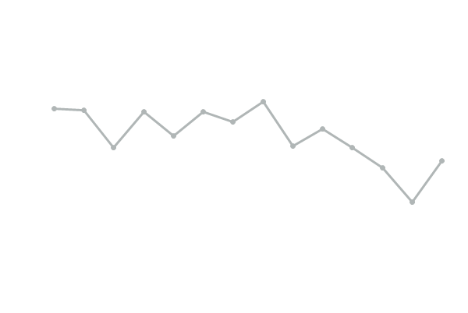
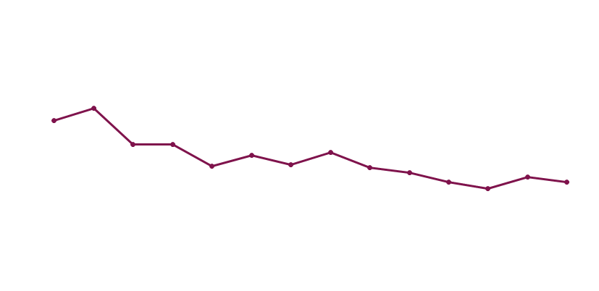
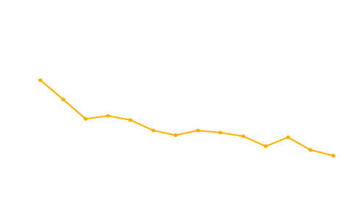
ZONDA: Change in ACQ-6 Score Over Time (Full Analysis Set)
Change From Baseline in ACQ-6¹
•
Benralizumab Q4W (n=72)
Benralizumab Q8W (n=73)
Placebo (n=74)
•
•
LSM Difference Compared With Baseline
Weeks
2
4
6
8
10
12
14
16
18
20
22
24
26
28
 | Results at 28 Weeks
ACQ-6 | Placebo | Q4W | Q8W
Mean change vs. Placebo | — | -0.24 (p=0.139) | -0.55 (p=0.001)
Proportion MCID responders (%)² | 54.7 | 56.9 | 63
Error bars represent 95% CLs. ACQ-6 = Asthma Control Questionnaire 6; LSM = least squares mean; MCID = minimal clinically important difference; Q4W = every 4 weeks; Q8W = every 8 weeks.
1. Nair P et al. Supplemental content. N Engl J Med. 2017;376:2448-2458; 2. In House Data, AstraZeneca Pharmaceuticals LP. CSR D3250C00020.
Notes:
Note:
The least squares mean differences at Week 28 versus placebo were as follows: benralizumab Q4W, -0.24 (95% CI, -0.55 to 0.08; p=0.139) and benralizumab Q8W, -0.55 (95% CI, -0.86 to -0.23; p=0.001)¹
Additional Information:
An ACQ-6 responder was defined as a patient achieving a minimally important clinical difference of ≥0.5 in ACQ-6 score at Week 28²
Reference(s):
Nair P, Wenzel S, Rabe KF, et al. Oral glucocorticoid-sparing effect of benralizumab in severe asthma [supplementary appendix]. N Engl J Med. 2017;376:2448-2458. http://www.nejm.org/doi/suppl/10.1056/NEJMoa1703501/suppl_file/nejmoa1703501_appendix.pdf. Accessed April 3, 2018.
In House Data, AstraZeneca Pharmaceuticals LP. Clinical study report D3250C00020.

Slide 25
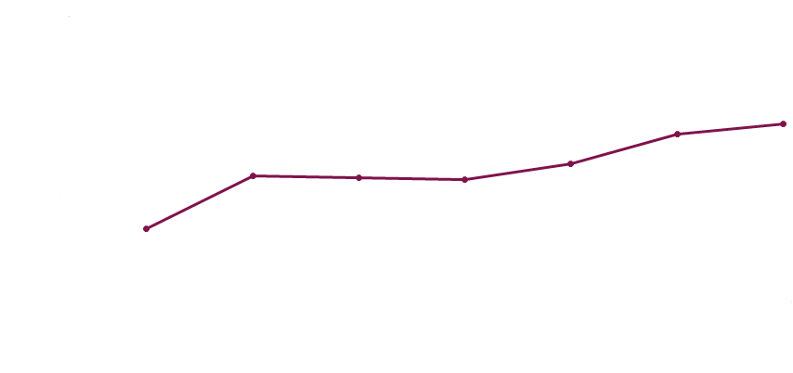
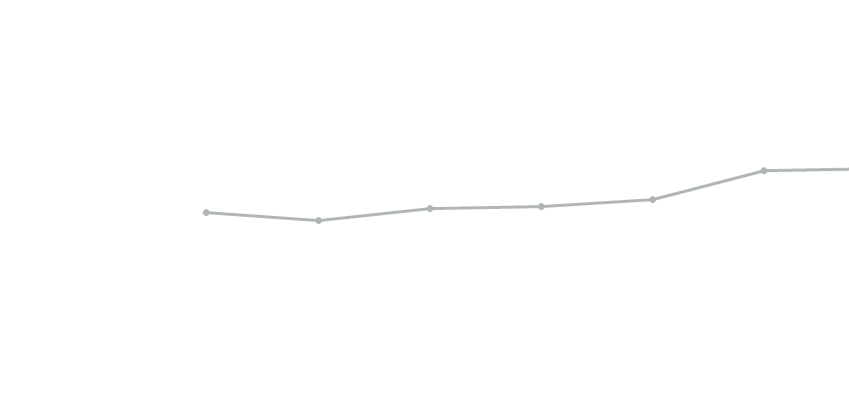
ZONDA: Change in AQLQ(S)+12 Score Over Time (Full Analysis Set)
•
Change From Baseline in AQLQ(S)+12 Score¹
Benralizumab Q4W (n=70)
Benralizumab Q8W (n=72)
Placebo (n=75)
•
•
LSM Difference Compared With Baseline
•
Weeks
 | Results at 28 Weeks¹
AQLQ(S) + 12 score | Placebo | Q4W | Q8W
Mean change vs. Placebo | — | 0.23 (p=0.151) | 0.45 (p=0.004)
Proportion MCID responders (%)² | 52.0 | 59.7 | 60.3
Error bars represent 95% CIs. AQLQ(S) + 12 = Asthma Quality of Life Questionnaire for 12 years and older; CI = confidence interval; LSM = least squares mean; MCID = minimally clinically important difference; Q4W = every 4 weeks; Q8W = every 8 weeks.
1. Nair P et al. Supplemental content. N Engl J Med. 2017;376:2448-2458; 2. In House Data, AstraZeneca Pharmaceuticals LP. CSR D3250C00020.
Notes:
Note:
The least squares mean differences at Week 28 for benralizumab versus placebo Q4W, 0.23 (95% CI, -0.08 to 0.53; p=0.151) and benralizumab Q8W, 0.45 (95% CI, 0.14 to 0.76; p=0.004)¹
Additional Information:
An AQLQ(S)+12 responder was defined as a patient who had an improvement in AQLQ(S)+12 score of ≥0.5from baseline to Week 28²
Reference(s):
Nair P, Wenzel S, Rabe KF, et al. Oral glucocorticoid-sparing effect of benralizumab in severe asthma [supplementary appendix]. N Engl J Med. 2017;376:2448-2458. http://www.nejm.org/doi/suppl/10.1056/NEJMoa1703501/suppl_file/nejmoa1703501_appendix.pdf. Accessed April 3, 2018.
In House Data, AstraZeneca Pharmaceuticals LP. Clinical study report D3250C00020.

Slide 26
ZONDA: Inconsistent Changes in Total Asthma Symptom Score Between Benralizumab Dose Regimens and Placebo at Week 28 (Full Analysis Set)
LSM Difference Compared With Baseline
-0.01 (p =0.947)
-0.18 (p=0.291)
LSM = least squares mean; Q4W = every 4 weeks; Q8W = every 8 weeks
Nair P et al. Supplemental content. N Engl J Med. 2017;376:2448-2458.
Patients were asked to consider and rate (0-6) their asthma symptoms such as night-time awakenings, use of rescue medication, and morning asthma symptoms; evening assessments included activity impairment
Notes:
Note:
The least squares mean differences from baseline to Week 28 in total asthma symptom scores were as follows: placebo, -0.53; benralizumab Q4W, -0.54; and benralizumab Q8W, -0.71
Reference(s):
Nair P, Wenzel S, Rabe KF, et al. Oral glucocorticoid-sparing effect of benralizumab in severe asthma [supplementary appendix]. N Engl J Med. 2017;376:2448-2458. http://www.nejm.org/doi/suppl/10.1056/NEJMoa1703501/suppl_file/nejmoa1703501_appendix.pdf. Accessed April 3, 2018.

Slide 27
ZONDA: Change in Total Daily Asthma Symptom Score Over Time (Full Analysis Set)
LSM Difference Compared With Baseline
LSM = least squares mean; Q4W = every 4 weeks; Q8W = every 8 weeks.
Nair P et al. Supplemental content. N Engl J Med. 2017;376:2448-2458.
2
4
6
8
10
12
14
16
18
20
22
24
26
28
Weeks
Notes:
Note:
The least squares mean differences from baseline at Week 28 in total asthma symptom scores for the benralizumab groups versus placebo were as follows: Q4W, -0.01 (95% CI, -0.35 to 0.32; p=0.947) and Q8W,-0.18 (95% CI, -0.51 to 0.16; p=0.291)
Reference(s):
Nair P, Wenzel S, Rabe KF, et al. Oral glucocorticoid-sparing effect of benralizumab in severe asthma [supplementary appendix]. N Engl J Med. 2017;376:2448-2458. http://www.nejm.org/doi/suppl/10.1056/NEJMoa1703501/suppl_file/nejmoa1703501_appendix.pdf. Accessed April 3, 2018.

Slide 28


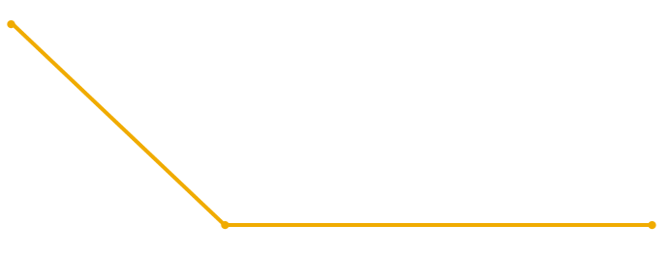
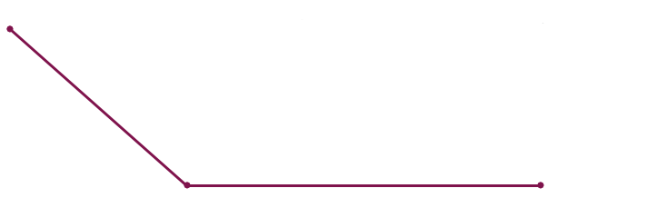
ZONDA: Change in Blood Eosinophils Over 28 Weeks
Blood EOS Count Over Time
Median EOS Count, (cells/µL)
●
●
●
●
●
●
Weeks
Baseline 12 24 28
Median percent changes in blood EOS counts were reduced from baseline by 100% in patients treated with benralizumab Q4W and Q8W compared to 6% in patients receiving placebo
Note: Error bars represent upper and lower quartiles.
EOS = eosinophil; Q4W = every 4 weeks; Q8W = every 8 weeks.
Nair P et al. Supplemental content. N Engl J Med. 2017;376:2448-2458.
Notes:
Note:
Present slide.
Additional Information:
The blood EOS count from the local laboratory that was used to randomize patients in the study (ie, at Visit 1) was used as the baseline value
EOS counts were not obtained again until Week 12 after randomization (ie, the treatment period)
Mean percent reductions for benralizumab Q4W and Q8W at Week 12 were -90.6% and -96.5%; these reductions were maintained through Week 28 (-97.4% and -94.9%)
Note Reference(s):
In House Data, AstraZeneca Pharmaceuticals LP. Clinical study report D3250C00020.
Slide Reference(s):
Nair P, Wenzel S, Rabe KF, et al. Oral glucocorticoid-sparing effect of benralizumab in severe asthma [supplementary appendix]. N Engl J Med. 2017;376:2448-2458. http://www.nejm.org/doi/suppl/10.1056/NEJMoa1703501/suppl_file/nejmoa1703501_appendix.pdf. Accessed April 3, 2018.

Slide 29
ZONDA: Median Sputum Eosinophil Counts Decreased From Baseline to Week 28 (Sputum Subset With Baseline and Follow-up Data: n=26ª)
Sputum EOS Median (%) | Baseline | 12 Weeks | 28 Weeks
Placebo | 4.9 (n=8) | 17.55 (n=4) | 12.15 (n=4)
Benralizumab (Q4W + Q8W) | 4.9 (n=18) | 0 (n=16) | 0.15 (n=8)
Benralizumab (Q4W + Q8W)
Placebo
◦
◦
◦
Sputum Eosinophils, %
◦
◦
◦
◦
◦
◦
◦
◦
◦
◦
ªSputum assessments at each time point are not available for all patients.
Q4W = every 4 weeks; Q8W = every 8 weeks.
Nair P et al. Supplemental content. N Engl J Med. 2017;376:2448-2458.
Baseline
◦
Week 12
Week 28
◦
Notes:
Notes:
Median sputum eosinophils were depleted for patients in the combined benralizumab groups, with values ranging from 4.9% (range, 0-59; n=18) at baseline to 0% (range, 0.0-3.3; n=16) at Week 12 and 0.15% (range, 0-0.8; n=8) at Week 28
Median sputum eosinophil counts increased in the placebo group from 4.9% (range, 0.5-63; n=8) at baseline to 17.55% (range, 0.5-35.0; n=4) at Week 12 and 12.15% (range, 1.3-58.3; n=4) at Week 28
Additional Information:
Sputum EOS counts were obtained at Week 12 and Week 28 after randomization
Reference(s):
Nair P, Wenzel S, Rabe KF, et al. Oral glucocorticoid-sparing effect of benralizumab in severe asthma [supplementary appendix]. N Engl J Med. 2017;376:2448-2458. http://www.nejm.org/doi/suppl/10.1056/NEJMoa1703501/suppl_file/nejmoa1703501_appendix.pdf. Accessed April 3, 2018.

Slide 30
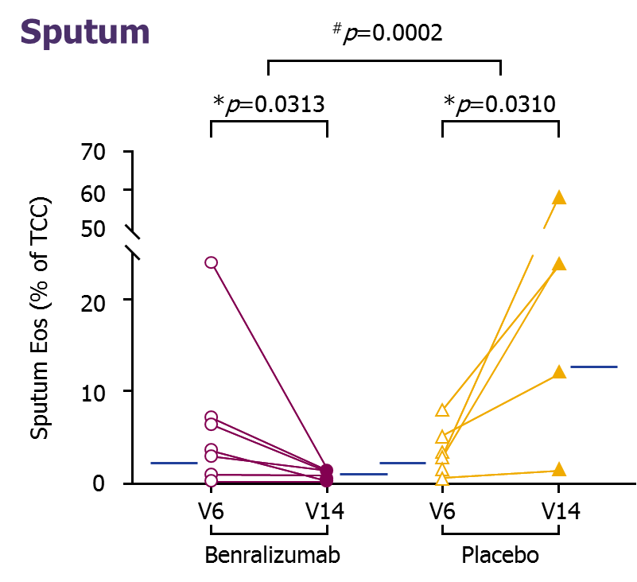
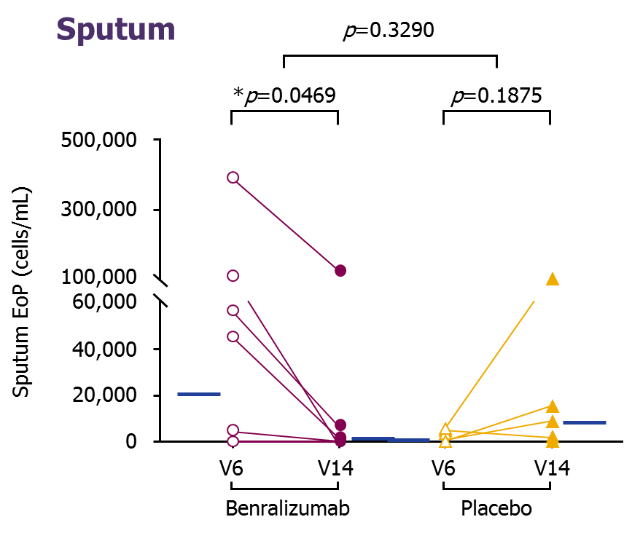
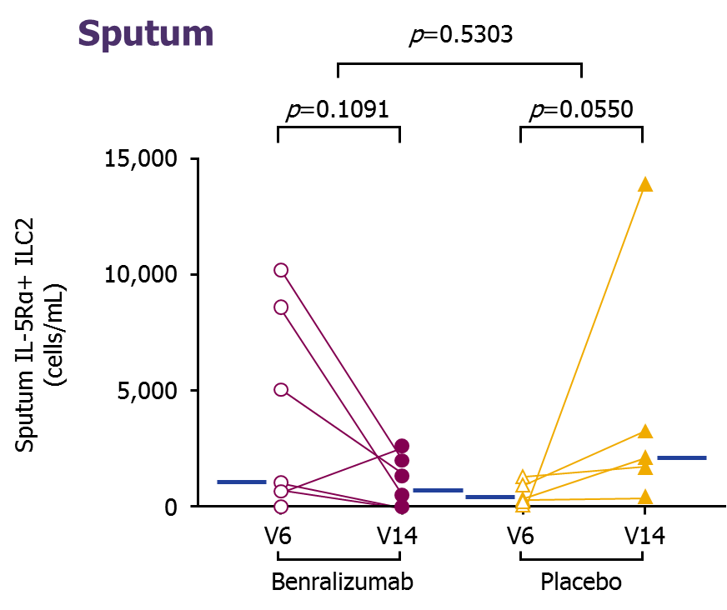
ZONDA: Benralizumab Depleted Mature Sputum EOS and Reduced Sputum EOS Progenitors and ILC2 Cells
Benralizumab MOA
Mature Sputum Eosinophils
Sputum Eosinophil Progenitors
Sputum IL-5Rα+ ILC2 Cells
ª
^{b}
^{b}
^{b}
Week 0
Week 28
Week 0
Week 28
Week 0
Week 28
Week 0
Week 28
Week 0
Week 28
Week 0
Week 28
(n=10)
(n=7)
(n=7)
(n=5)
(n=7)
(n=5)
Randomized, double-blind, 4-center, Canadian substudy of the Phase III ZONDA trial evaluating patients with severe asthma and high blood EOS
(≥150 cells/μL currently) on OCS therapy comparing pooled benralizumab 30 mg SC patients (n=11; Q4W [n=4] or Q8W [ n=7]) with
placebo patients Q4W (n=7)
ªBetween-group significance. ^{b}Within-group significance.
EoP = eosinophil lineage–committed progenitors; EOS = eosinophil; ILC2 = type 2 innate lymphoid cells; IL-5Rα = interleukin-5 receptor alpha; MOA = mechanism of action; Q4W = every 4 weeks; Q8W = every 4 weeks for 3 doses, then every 8 weeks; SC = subcutaneous.
Sehmi R et al. J Allergy Clin Immunol. 2018; 141:1529-1532. https://doi.org/10.1016/j.jaci.2018.01.008. Accessed April 22, 2019.
Notes:
Note:
In a small substudy of ZONDA, benralizumab 30 mg depleted mature sputum eosinophils and reduced sputum eosinophil progenitors and ILC2 cells compared to placebo.
Reference(s): :
Sehmi R, Lim HF, Mukherjee M, et al. Benralizumab attenuates airway eosinophilia in prednisone-dependent asthma. J Allergy Clin Immunol. 2018;141:1529-1532. https://doi.org/10.1016/j.jaci.2018.01.008. Accessed April 22, 2019.

Slide 31
ZONDA: Summary of Adverse Events During the On-Treatment Period (Safety Analysis Set)
Adverse Events, n (%)¹ | Placebo N=75 | Benralizumab Q4W N=72 | Benralizumab Q8W N=73
Any AE | 62 (83) | 49 (68) | 55 (75)
Any serious AE | 14 (19) | 7 (10) | 7 (10)
Any AE leading to discontinuation of benralizumab | 2 (3) | 0 | 3 (4)
Injection site reactions | 2 (3) | 2 (3) | 0
Hypersensitivity AEs | 1 (1) | 1 (1) | 2 (3)
Deaths | 0 | 0 | 2 (3)
Frequency of overall AEs, severe AEs, and serious AEs in benralizumab-treated patients was numerically lower compared to that in placebo patients¹
The two deaths that occurred in the Q8W group were caused by acute cardiac failure: not related to benralizumab treatment (hypertension and CAD present at baseline) and pneumonia: related to benralizumab treatment (recurrent Afib, hypertension, angina pectoris, CHF, and dyslipidemia present at baseline)^{1,2}
Note: AEs leading to discontinuation of benralizumab were: Q8W – cardiac failureª and pneumoniaª; PBO – pericarditis.
ªSerious AEs.
AE = adverse event; Afib = atrial fibrillation; CAD = coronary artery disease; CHF = congestive heart failure; Q4W = every 4 weeks; Q8W = every 8 weeks.
1. Nair P et al. N Engl J Med. 2017;376:2448-2458; 2. Nair P et al. Poster presented at: ATS Meeting; May 19-24, 2017; Washington, DC. Poster 603.
Notes:
Notes:
The number of patients who experienced an AE was similar in the benralizumab groups and lower compared to the placebo group¹
Twenty-eight (13%) patients experienced at least one serious AE (SAE)¹
Additional Information:
SAEs considered to be related to benralizumab were as follows:
One patient in the benralizumab Q4W group had a SAE of hypersensitivity (this event was an allergic reaction that was severe in intensity and resolved after 1 day)^{2,3}
Two patients in the benralizumab Q8W had a SAE of pneumonia and presyncope³
The frequency of drug-related AEs was higher in the benralizumab Q8W group (n=12 [16%]) than in the placebo group (n=10 [13%]) and the benralizumab Q4W group (n=5 [7%])³
The most common treatment-emergent AE of hypersensitivity was urticaria, with a similar frequency across treatment groups:¹
Placebo, n=1 (1%); benralizumab Q4W, n=0; and benralizumab Q8W, n=1 (1%)
No malignancies, helminth infections, or hypersensitivity type III reactions were
reported in any of the treatment groups³
Notes Reference(s):
Nair P, Wenzel S, Rabe KF, et al. Oral glucocorticoid-sparing effect of benralizumab in severe asthma. N Engl J Med. 2017;376:2448-2458.
Nair P, Wenzel S, Rabe KF, et al. Oral glucocorticoid-sparing effect of benralizumab in severe asthma [supplementary appendix]. N Engl J Med. 2017;376:2448-2458. http://www.nejm.org/doi/suppl/10.1056/NEJMoa1703501/suppl_file/nejmoa1703501_appendix.pdf. Accessed April 3, 2018.
In House Data, AstraZeneca Pharmaceuticals LP. Clinical study report D3250C00020.
Slide Reference(s):
Nair P, Wenzel S, Rabe KF, et al. Oral glucocorticoid-sparing effect of benralizumab in severe asthma. N Engl J Med. 2017;376:2448-2458.
Nair P, Wenzel S, Rabe KF, et al. Benralizumab significantly reduced oral corticosteroid dosages and asthma exacerbation rates for patients with severe, uncontrolled asthma: results of the ZONDA phase III trial [poster]. Presented at: American Thoracic Society Meeting; May 19-24, 2017; Washington, DC. Poster 603.

Slide 32
ZONDA: Most Common Adverse Events (Safety Analysis Set)
Summary of Most Common Adverse Events (≥3% in Any Group) During the On-Treatment Period
Adverse Events, n (%) | Placebo N=75 | Benralizumab Q4W N=72 | Benralizumab Q8W N=73
Nasopharyngitis | 15 (20) | 11 (15) | 11 (15)
Asthma | 18 (24) | 8 (11) | 2 (3)
Bronchitis | 12 (16) | 4 (6) | 7 (10)
Sinusitis | 8 (11) | 5 (7) | 4 (5)
Headache | 4 (5) | 5 (7) | 6 (8)
Upper respiratory tract infection | 5 (7) | 4 (6) | 5 (7)
Rhinitis | 2 (3) | 2 (3) | 6 (8)
Influenza | 5 (7) | 3 (4) | 1 (1)
Back pain | 4 (5) | 2 (3) | 2 (3)
Cough | 4 (5) | 2 (3) | 1 (1)
Dyspnea | 4 (5) | 2 (3) | 1 (1)
Oral candidiasis | 4 (5) | 0 | 0
Hypertension | 2 (3) | 2 (3) | 3 (4)
Pneumonia | 3 (4) | 0 | 3 (4)
Q4W = every 4 weeks; Q8W = every 8 weeks.
Nair P et al. Supplemental content. N Engl J Med. 2017;376:2448-2458.
Notes:
Note:
There was a higher incidence of nasopharyngitis (17%), worsening asthma (13%), and bronchitis (10%) than any other AE across all groups¹
Additional Information:
Worsening of asthma was defined as new or increased asthma symptoms or clinical signs that were concerning to the patient or were related to an electronic Asthma Daily Diary alert¹
The following AEs occurred at a frequency of ≥3% in at least 1 treatment group:²
Vertigo: placebo, n=2 (3%); benra Q4W, n=1 (1%); benra Q8W, n=3 (4%)
Nausea: placebo, n=3 (4%); benra Q4W, n=1 (1%); benra Q8W, n=0
Presyncope: placebo, n=0; benra Q4W, n=0; benra Q8W, n=3 (4%)
Status asthmaticus: placebo, n=3 (4%); benra Q4W, n=0; benra Q8W, n=0
Notes Reference(s):
Nair P, Wenzel S, Rabe KF, et al. Oral glucocorticoid-sparing effect of benralizumab in severe asthma. N Engl J Med. 2017;376:2448-2458.
Nair P, Wenzel S, Rabe KF, et al. Oral glucocorticoid-sparing effect of benralizumab in severe asthma [supplementary appendix]. N Engl J Med. 2017;376:2448-2458. http://www.nejm.org/doi/suppl/10.1056/NEJMoa1703501/suppl_file/nejmoa1703501_appendix.pdf. Accessed April 3, 2018.
Slide Reference(s):
Nair P, Wenzel S, Rabe KF, et al. Oral glucocorticoid-sparing effect of benralizumab in severe asthma [supplementary appendix]. N Engl J Med. 2017;376:2448-2458. http://www.nejm.org/doi/suppl/10.1056/NEJMoa1703501/suppl_file/nejmoa1703501_appendix.pdf. Accessed April 3, 2018.

Slide 33
ZONDA: Immunogenicity (Safety Analysis Set)
Anti-drug antibody response was positive in 18 patients at any time point
5 (7%) patients in the benralizumab Q4W group
7 (10%) patients in the benralizumab Q8W group
6 (8%) patients in the placebo group
Neutralizing antibody positive response
4 (6%) patients in the benralizumab Q4W group
6 (8%) patients in the benralizumab Q8W group
3 (4%) patients in the placebo group
There was no apparent influence of positive anti-drug antibody response associated with hypersensitivity or on efficacy and safety outcomes
Note: ADA incidence included only those patients who became newly ADA-positive
ADA = anti-drug antibody; Q4W = every 4 weeks; Q8W = every 8 weeks
Nair P et al. Supplemental content. N Engl J Med. 2017;376:2448-2458.
Notes:
Note:
Present slide.
Additional Information:
In the benralizumab groups:
1 patient was anti-drug antibody (ADA)-positive at baseline only (benralizumab Q8W group)
15 patients were persistently ADA-positive (4 patients in the benralizumab Q4W group and 6 patients in the Q8W group)
Note: Persistent was defined as positive at 2 or more post-baseline assessments (with ≥16 weeks between the first and last positive result) or positive at the last post-baseline assessment.
Reference(s):
Nair P, Wenzel S, Rabe KF, et al. Oral glucocorticoid-sparing effect of benralizumab in severe asthma [supplementary appendix]. N Engl J Med. 2017;376:2448-2458. http://www.nejm.org/doi/suppl/10.1056/NEJMoa1703501/suppl_file/nejmoa1703501_appendix.pdf. Accessed April 3, 2018.

Slide 34
ZONDA: Summary
Largest clinical study of OCS-dependent patients with asthma conducted to date
Benralizumab significantly reduced the OCS requirement in OCS-dependent asthma patients with elevated blood eosinophils requiring high-dose ICS/LABA (75% vs. 25% for placebo)
The likelihood of OCS reduction was more than 4x greater with benralizumab than with placebo
Two-thirds of patients who received benralizumab reduced their OCS dose by ≥50%
Approximately 50% of eligible patients (baseline prednisone ≤12.5 mg) receiving benralizumab stopped OCS completely
Asthma exacerbation rates were significantly lower with benralizumab than with placebo
Up to 70% reduction in overall asthma exacerbations
Up to 93% reduction in exacerbations resulting in an ED visit or hospitalization
Increases in FEV₁ were observed after the first dose with both dosing regimens and were maintained throughout the treatment period
Statistical improvements in mean ACQ and AQLQ(S)+12 for the Q8W dosing regimen approached or exceeded the MCID for the measure
The overall AE profile of benralizumab was similar to that for placebo and was consistent with that observed in SIROCCO and CALIMA
ACQ = Asthma Control Questionnaire; AE = adverse event; AQLQ(S) + 12 = Asthma Quality of Life Questionnaire for patients 12 years and older; ED = emergency department; FEV₁ = forced expiratory volume in 1 second; ICS = inhaled corticosteroid; LABA = long-acting beta-agonists; MCID = minimal clinically important difference; OCS = oral corticosteroid; Q8W = every 8 weeks.
Nair P et al. N Engl J Med. 2017;376:2448-2458.
Notes:
Note:
Present slide.
Additional Information:
Benralizumab was associated with early increases in FEV₁, and exacerbation reductions were greater than those observed in any previous steroid-sparing trial
Reference(s):
Nair P, Wenzel S, Rabe KF, et al. Oral glucocorticoid-sparing effect of benralizumab in severe asthma. N Engl J Med. 2017;376:2448-2458.

Slide 35
BACK-UP

Slide 36
SIRIUS and ZONDA: Baseline Characteristics in Pivotal Studies (Data for Listed Treatment Arms)
 | Mepolizumab 100 mg Q4W (labeled) SIRIUS¹ (N=135; mepo, n=69) | Benralizumab 30 mg Q8W ZONDA^{3,c} (N=220; benra, n=73)
MOA | Humanized anti-α-IL-5 | Humanized α-IL-5R
Route/frequency/ study duration | 100 mg SC Q4W x 24 weeks | 30 mg SC Q8W (+ load) x 28 weeks
Exacerbations in prior 12 months, mean | 3.3 | 3.1
OCS entry inclusion | OCSª (5-35 mg/d) ≥6 months prior to screening | OCSª (7.5-40 mg/d) ≥6 months prior to screening
Median OCS dose after optimization | 10 mg | 10 mg
Background controller requirement | HD-ICS (≥880 µg)^{2,b} + another controller | HD-ICS ICS (>500 µg)^{b} + LABA
FEV₁ predicted, % | 59.6 | 59
Reversibility, % | 27 (mean) | 22.6 (median)
ACQ score | 2.2 (ACQ-5) | 2.42 (ACQ-6)
EOS inclusion, cells/µL | ≥150 or ≥300, previous 12 months | ≥150
Actual screening value | 250 (geometric mean) | 437 (median)
Please note that as head-to-head studies were not conducted between these products it is inappropriate to make direct comparisons as the study design, demographics, and other criteria may be different.
Note: The reslizumab study in patients with OCS-dependent asthma and elevated blood EOS is complete.⁴
ªPrednisone or equivalent for asthma. ^{b}Total daily fluticasone propionate equivalents. ^{c}Data are presented from the full analysis set (EOS ≥150 cells/µL).
ACQ = Asthma Control Questionnaire; benra = benralizumab; EOS = blood eosinophil; FEV₁ = forced expiratory volume in 1 second; HD = high-dose; ICS = inhaled corticosteroid; IL = interleukin; LABA = long-acting beta₂-agonist; MOA = mechanism of action; OCS = oral corticosteroid; Q4W = every 4 weeks; Q8W = every 8 weeks; R = receptor; SC = subcutaneous; SIRIUS = Steroid Reduction with Mepolizumab Study.
1. Bel EH et al. N Engl J Med. 2014;371:1198-1197; 2. Bel EH et al. Protocol content. N Engl J Med. 2014;371:1198-1197; 3. Nair P et al. N Engl J Med. 2017; 376:2448-2458; 4. Study NCT02501629. ClinicalTrials.gov website.
Notes:
Note:
Present slide.
Reference(s):
Bel EH, Wenzel SE, Thompson PJ, et al. Oral glucocorticoid-sparing effect of mepolizumab in eosinophilic asthma. N Engl J Med. 2014; 371:1189-1197.
Bel EH, Wenzel SE, Thompson PJ, et al. Oral glucocorticoid-sparing effect of mepolizumab in eosinophilic asthma [protocol]. N Engl J Med. 2014; 371:1189-1197. http://www.nejm.org/doi/suppl/10.1056/NEJMoa1403291/suppl_file/nejmoa1403291_protocol.pdf. Accessed April 3, 2018.
Nair P, Wenzel S, Rabe KF, et al. Oral glucocorticoid-sparing effect of benralizumab in severe asthma. N Engl J Med. 2017;376:2448-2458.
National Institutes of Health. An efficacy and safety study of reslizumab subcutaneous in patients with oral corticosteroid dependent asthma and elevated blood eosinophils. ClinicalTrials.gov website. http://www.ClinicalTrials.gov/show/NCT02501629. Accessed April 3, 2018.

Slide 37
OCS Titration Schedule For Eligible Patients During Optimization Phase (Visit 2 to Visit 5)
Optimized OCS Dose | Run In/Optimization Phase OCS dose, mg/d
Visit 1 | Visit 2 Week -8 | Visit 3 Week -6 | Visit 4 Week -4 | Visit 5 Week -2
40 | 35 | 30 | 25 | ^{b}
37.5 | 32.5 | 27.5 | 22.5 | ^{b}
35 | 30 | 25 | 20 | ^{b}
32.5 | 27.5 | 22.5 | 17.5 | ^{b}
30 | 25 | 20 | 15 | ^{b}
27.5 | 22.5 | 17.5 | 12.5 | ^{b}
25 | 20 | 15 | 10 | ^{b}
22.5 | 17.5 | 12.5 | 7.5 | ^{b}
20 | 15 | 10 | 7.5 | ^{b}
17.5 | 12.5 | 7.5 | 5 | ª
15 | 10 | 7.5 | 5 | ª
12.5 | 7.5 | 5 | ª
10 | 7.5 | 5 | ª
7.5 | 5 | ª
ªPatients who qualified for 3 consecutive dose reductions at Visits 2 to 4 and continued to meet the OCS reduction criteria at Visit 5, or who reached an OCS dose ≤5.0 mg/d during the optimization phase, were excluded from the study. ^{b}Patients who qualified for 3 consecutive dose reductions at Visits 2 to 4 and continued to meet the OCS dose reduction criteria at Visit 5 were excluded from the study. OCS = oral corticosteroid.
Nair P et al. Supplemental content. N Engl J Med. 2017;376:2448-2458.
Notes:
Note:
Present slide.
Reference(s):
Nair P, Wenzel S, Rabe KF, et al. Oral glucocorticoid-sparing effect of benralizumab in severe asthma [supplementary appendix]. N Engl J Med. 2017;376:2448-2458. http://www.nejm.org/doi/suppl/10.1056/NEJMoa1703501/suppl_file/nejmoa1703501_appendix.pdf. Accessed April 3, 2018.

Slide 38
OCS Titration Schedule For Eligible Patients During Reduction Phase (Visit 8 to Visit 13)
Optimized OCS Dose | Reduction Phase OCS dose, mg/d
Visit 6 Week 0 | Visit 8 Week 4 | Visit 9 Week 8 | Visit 10 Week 12 | Visit 11 Week 16 | Visit 12 Week 20 | Visit 13 Week 24
40 | 35 | 30 | 25 | 20 | 15 | 10
37.5 | 32.5 | 27.5 | 22.5 | 17.5 | 12.5 | 7.5
35 | 30 | 25 | 20 | 15 | 10 | 7.5
32.5 | 27.5 | 22.5 | 17.5 | 12.5 | 7.5 | 5
30 | 25 | 20 | 15 | 10 | 7.5 | 5
27.5 | 22.5 | 17.5 | 12.5 | 7.5 | 5 | 5
25 | 20 | 15 | 10 | 7.5 | 5 | 5
22.5 | 17.5 | 12.5 | 7.5 | 5 | 5 | 5
20 | 15 | 10 | 7.5 | 5 | 5 | 5
17.5 | 12.5 | 7.5 | 5 | 5 | 5 | 2.5
15 | 10 | 7.5 | 5 | 5 | 2.5ª | 1.25ª
12.5 | 7.5 | 5 | 2.5 | 1.25ª | 0 | 0
10 | 7.5 | 5 | 2.5 | 1.25ª | 0 | 0
7.5 | 5 | 2.5 | 1.25ª | 0 | 0 | 0
ªOCS daily dose of 1.25 mg and 2.5 mg every other day was permitted.
OCS = oral corticosteroid.
Nair P et al. Supplemental content. N Engl J Med. 2017;376:2448-2458.
Notes:
Note:
Present slide.
Reference(s):
Nair P, Wenzel S, Rabe KF, et al. Oral glucocorticoid-sparing effect of benralizumab in severe asthma [supplementary appendix]. N Engl J Med. 2017;376:2448-2458. http://www.nejm.org/doi/suppl/10.1056/NEJMoa1703501/suppl_file/nejmoa1703501_appendix.pdf. Accessed April 3, 2018.

Slide 39
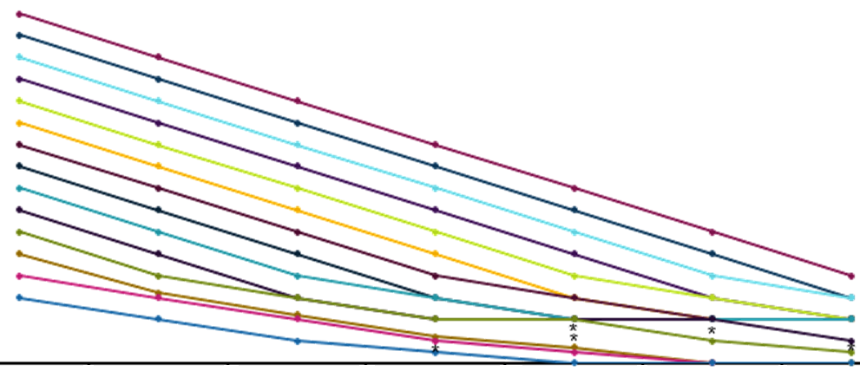
OCS Titration Schedule For Eligible Patients During Reduction Phase (Visit 8 to Visit 13)
OCS Dose, mg/d
Week 0/V6 Week 4/V8 Week 8/V9 Week 12/V10 Week 16/V11 Week 20/V12 Week 24/V13
*OCS daily dose of 1.25 mg and 2.5 mg every other day was permitted.
OCS = oral corticosteroid; V = visit.
Nair P et al. Supplemental content. N Engl J Med. 2017;376:2448-2458.
Optimized OCS dose, mg/d (V6)
Notes:
Note:
Present slide.
Reference(s):
Nair P, Wenzel S, Rabe KF, et al. Oral glucocorticoid-sparing effect of benralizumab in severe asthma [supplementary appendix]. N Engl J Med. 2017;376:2448-2458. http://www.nejm.org/doi/suppl/10.1056/NEJMoa1703501/suppl_file/nejmoa1703501_appendix.pdf. Accessed April 3, 2018.

Slide 40
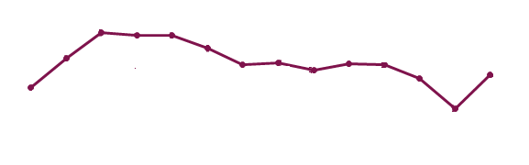
ZONDA: Benralizumab Q4W and Q8W Increased Morning and Evening PEF Over 28 Weeks
•
•
•
Benra Q4W Benra Q8W Placebo
Change from baseline, LSM
2
4
6
8
10
12
14
16
18
20
22
24
26
28
2
4
6
8
10
12
14
16
18
20
22
24
26
28
Weeks
Weeks
28 Weeks | Group LS Meansª LS Mean Differenceª (95% CI)
Q4W – placebo | 29.02 vs. 9.77 19.25 (-6.58, 45.07); p=0.143
Q8W – placebo | 39.78 vs. 9.77 30.01 (4.26, 55.76); p=0.023
28 Weeks | Group LS Meansª LS Mean Differenceª (95% CI)
Q4W – placebo | 16.00 vs. 0.81 15.19 (-10.08, 40.46); p=0.237
Q8W – placebo | 32.33 vs. 0.81 31.52 (6.32, 56.71); p=0.014
Note: Error bars represent 95% CI; p-values are from the repeated measures analysis. ªEstimates for LS means are provided.
Benra = benralizumab; CI = confidence interval; LS = least squares; LSM = least squares means; PEF = peak expiratory flow; Q4W = every 4 weeks; Q8W = every 8 weeks. In House Data, AstraZeneca Pharmaceuticals LP. CSR D3250C00020.
Improvements were observed in both morning and evening PEF as early as Week 2 for both dosing schedule
Notes:
Note:
Improvements were observed in morning and evening PEF by Week 2 for both the benralizumab Q4W and Q8W groups compared to placebo
Reference(s):
In House Data, AstraZeneca Pharmaceuticals LP. Clinical study report D3250C00020.

Slide 41

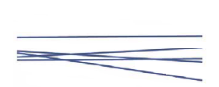
ZONDA: Limited Data Suggest Benralizumab Improves FEV₁ to a Greater Extent in Patients With Increased Baseline Sputum EOS
Sputum EOS <2.5% at Baseline
Benralizumab Patients (n=5)
Sputum EOS ≥2.5% at Baseline
Benralizumab Patients (n=13)
FEV₁, L
4
FEV₁, L
4
3
3
2
2
1
1
0
0
0
28
0
28
Week
Week
EOS = eosinophil; FEV₁ = forced expiratory volume in 1 second.
Nair P et al. Supplemental content. N Engl J Med. 2017;376:2448-2458.
There was no overt improvement in FEV₁ in placebo patients (n=8) in this subset, irrespective of sputum EOS category
Notes:
Note:
Limited data from 26 patients (benralizumab, n=18; placebo, n=8) suggested that compared with placebo benralizumab increased FEV₁ from baseline to Week 28 to a greater extent for patients with baseline sputum eosinophils ≥2.5% (n=13) than for those with counts <2.5% (n=5)
Reference(s):
Nair P, Wenzel S, Rabe KF, et al. Oral glucocorticoid-sparing effect of benralizumab in severe asthma [supplementary appendix]. N Engl J Med. 2017;376:2448-2458. http://www.nejm.org/doi/suppl/10.1056/NEJMoa1703501/suppl_file/nejmoa1703501_appendix.pdf. Accessed April 3, 2018.

Slide 42

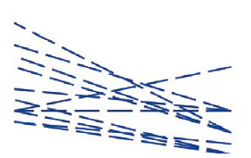
ZONDA: Limited Data Suggest OCS Dosages Decreased to a Greater Extent in Patients With Increased Baseline Sputum EOS
Sputum EOS <2.5% at Baseline
Benralizumab Patients (n=5)
Sputum EOS ≥2.5% at Baseline
Benralizumab Patients (n=13)
OCS Dosage, mg/d
40
OCS Dosage, mg/d
40
30
30
20
20
10
10
0
0
0
28
0
28
Week
Week
EOS = eosinophil; OCS = oral corticosteroid.
Nair P et al. Supplemental content. N Engl J Med. 2017;376:2448-2458.
Notes:
Note:
Limited data from 26 patients (benralizumab, n=18; placebo, n=8) suggested that compared with placebo benralizumab decreased OCS dosages from baseline to Week 28 to a greater extent for patients with baseline sputum eosinophils ≥2.5% (n=13) than for those with counts <2.5% (n=5)
Reference(s):
Nair P, Wenzel S, Rabe KF, et al. Oral glucocorticoid-sparing effect of benralizumab in severe asthma [supplementary appendix]. N Engl J Med. 2017;376:2448-2458. http://www.nejm.org/doi/suppl/10.1056/NEJMoa1703501/suppl_file/nejmoa1703501_appendix.pdf. Accessed April 3, 2018.

Slide 43
Benralizumab Added as Step 5 Treatment in GINA 2019
GINA
Prevalence of severe asthma that is symptomatic despite maximal Step 4 therapy has been estimated at 5-10%¹
Low dose OCS therapy may be beneficial, however chronic OCS use is associated with systemic adverse events²
Step 5
High dose ICS-LABA
Refer for phenotypic assessment±
add-on treatment eg, tiotropium,
Anti-IgE,
Anti-IL5/5R
Anti-IL4R
Step 4
Med dose ICS-LABA
PREFERRED
CONTROLLER
To prevent exacerbations and symptoms
Step 1
Step 2
Step 3
Low-dose ICS/LABA
As-needed low dose ICS-formoterolª
Daily low dose ICS or as-needed low dose ICS-formoterolª
OTHER
CONTROLLER OPTIONS
Low dose ICS taken whenever SABA is taken^{b}
Add
low-dose OCS, but consider side effects
LTRA, or low dose ICS taken whenever SABA taken^{b}
Medium dose/ICS or
low dose ICS + LTRA^{c}
High dose ICS, add on tiotropium or add on LTRA^{c}
PREFERRED RELIEVER
As needed: low dose ICS-formoterolª
As needed low-dose ICS-formoterol^{d}
Other reliever option
As needed SABA
Step 5 add-on treatment option includes:
Anti-interleukin-5 receptor treatment (subcutaneous benralizumab for patients aged ≥12 years) with severe eosinophilic asthma that is uncontrolled on Step 4 treatment
Note: For children 6-11 years, the preferred Step 3 treatment is low dose ICS-LABA or medium dose ICS. ªOff-label; data only with budesonide-formoterol; ^{b}Off-label; separate or combination ICS and SABA inhalers; ^{c}Consider adding HDM SLIT for sensitized patients with allergic rhinitis and FEV₁ >70% predicted; ^{d}Low dose ICS- form is the reliever for patients prescribed budesonide-formoterol or BDP-formoterol maintenance and reliever therapy.
BDP = beclomethasone dipropionate; GINA = Global Initiative for Asthma; ICS = inhaled corticosteroids; HDM = house dust mite; IgE = immunoglobulin E; IL5 = interleukin-5; LABA = long-acting β agonists; LTRA = leukotriene receptor agonist; OCS = oral corticosteroids; SABA = short-acting β agonists; SLIT = sublingual immunotherapy.
1. Chanez P et al. J Allergy Clin Immunol. 2007;119:1337-1348; 2. Global Initiative for Asthma (GINA) 2019. http://www.ginasthma.org.
Notes:
Note:
Benralizumab has been added to GINA 2019 Step 5 treatment.
Background: The GINA report groups together the IL-5 and IL-5R agents in the diagram.
Note Reference(s):
Global Initiative For Asthma (GINA). Global strategy for asthma management and prevention. Updated 2018. http://ginasthma.org/2018-gina-report-global-strategy-for-asthma-management-and-prevention//. Accessed April 3, 2018.
Slide Reference(s):
Chanez P, Wenzel SE, Anderson GP, et al. Severe asthma in adults: what are the important questions? J Allergy Clin Immunol. 2007;119:1337-1348.
Global Initiative For Asthma (GINA). Global strategy for asthma management and prevention. Updated 2019. https://ginasthma.org/wp-content/uploads/2019/04/GINA-2019-main-Pocket-Guide-wms.pdf. Accessed May 7, 2019.

