Slide 1
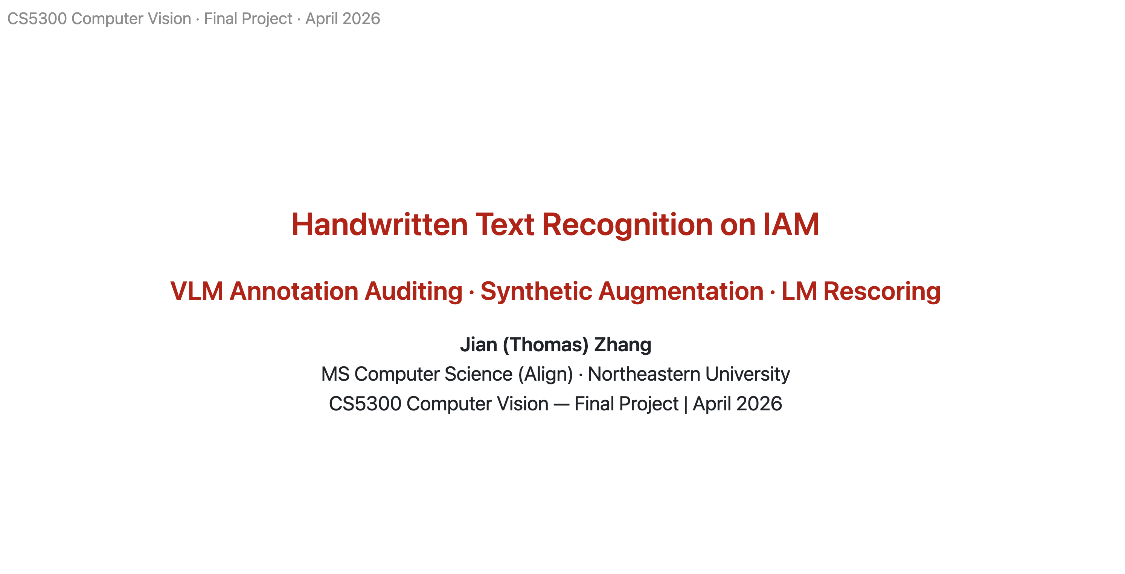

Slide 2
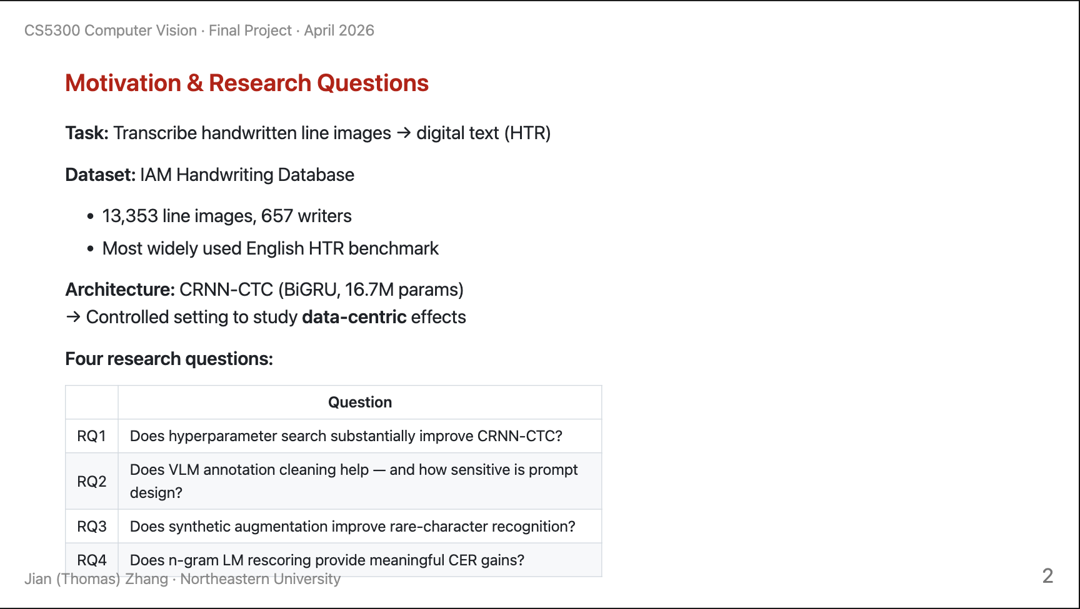

Slide 3



In the IAM dataset, some images contain characters that are written in a highly non-standard way. When looking at a single character in isolation, it appears to be one letter — but once language context is introduced, we recognize it is actually another. For example: k and u, a and o, c and e.

Slide 4



Slide 5
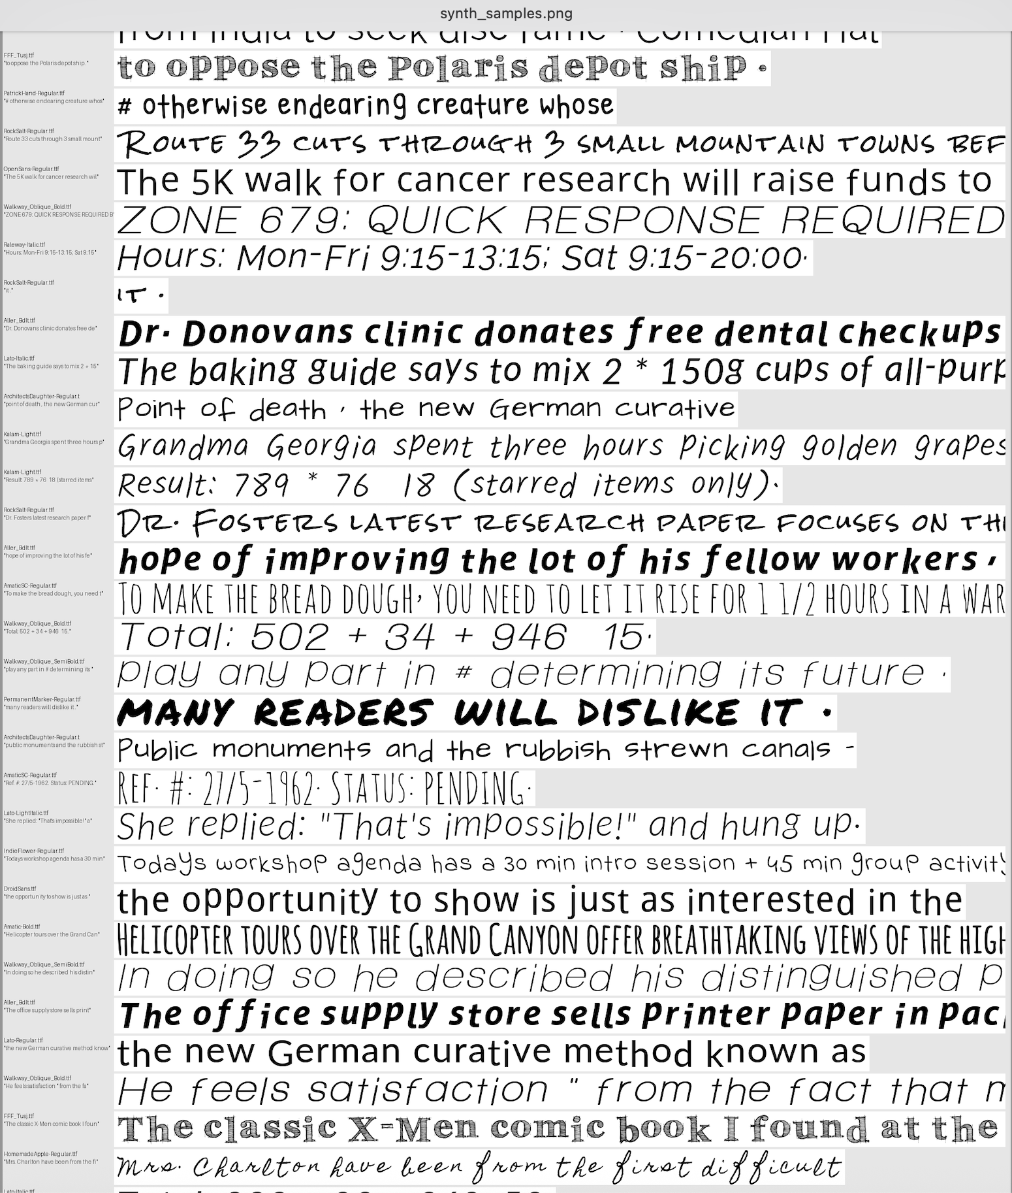

Slide 6
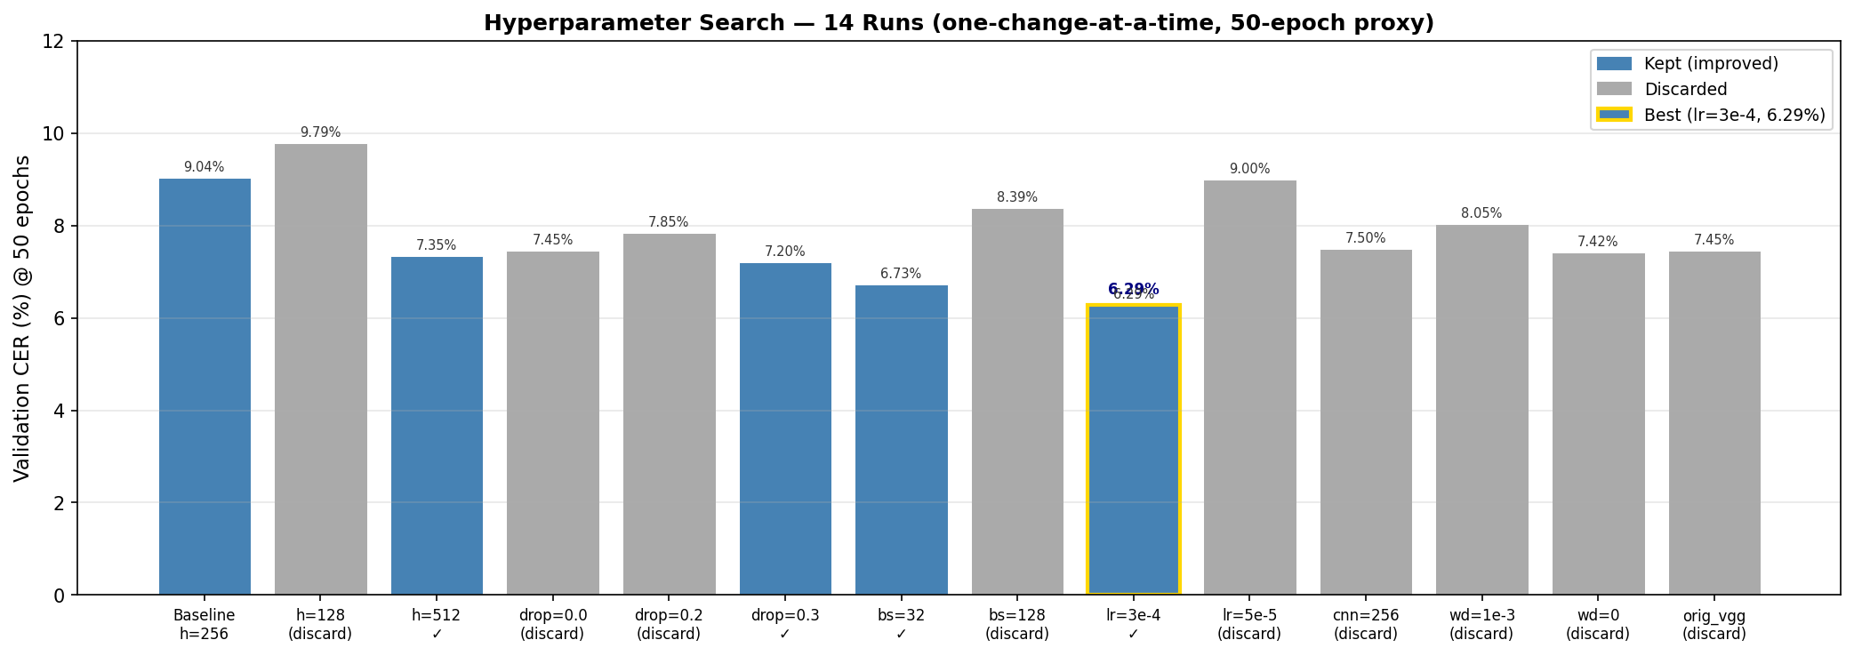

https://github.com/karpathy/autoresearch

Slide 7
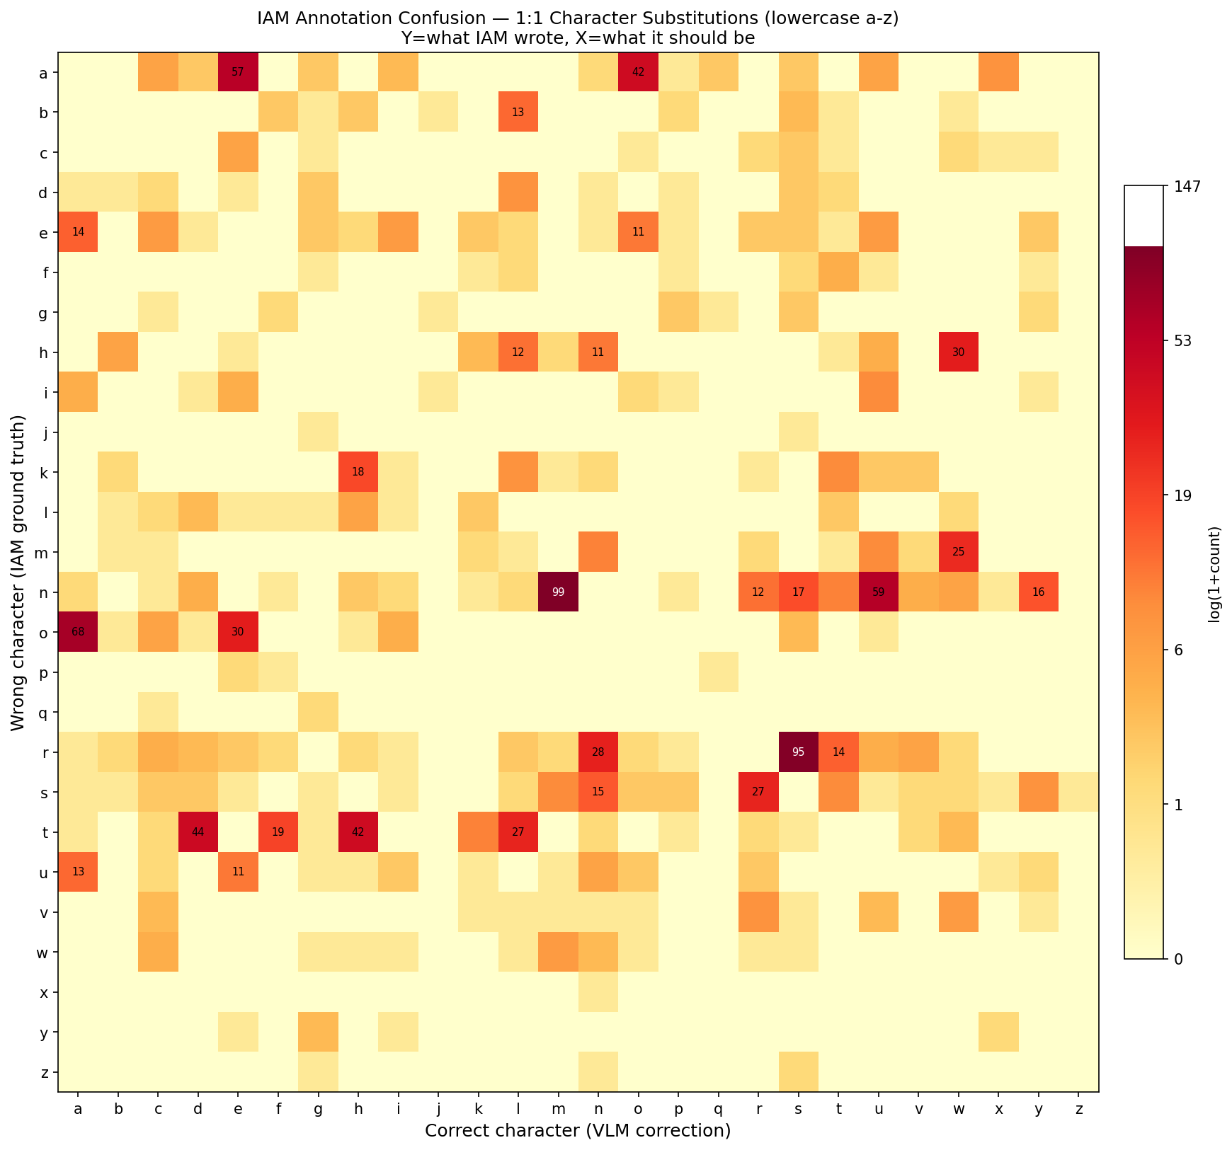

Slide 8
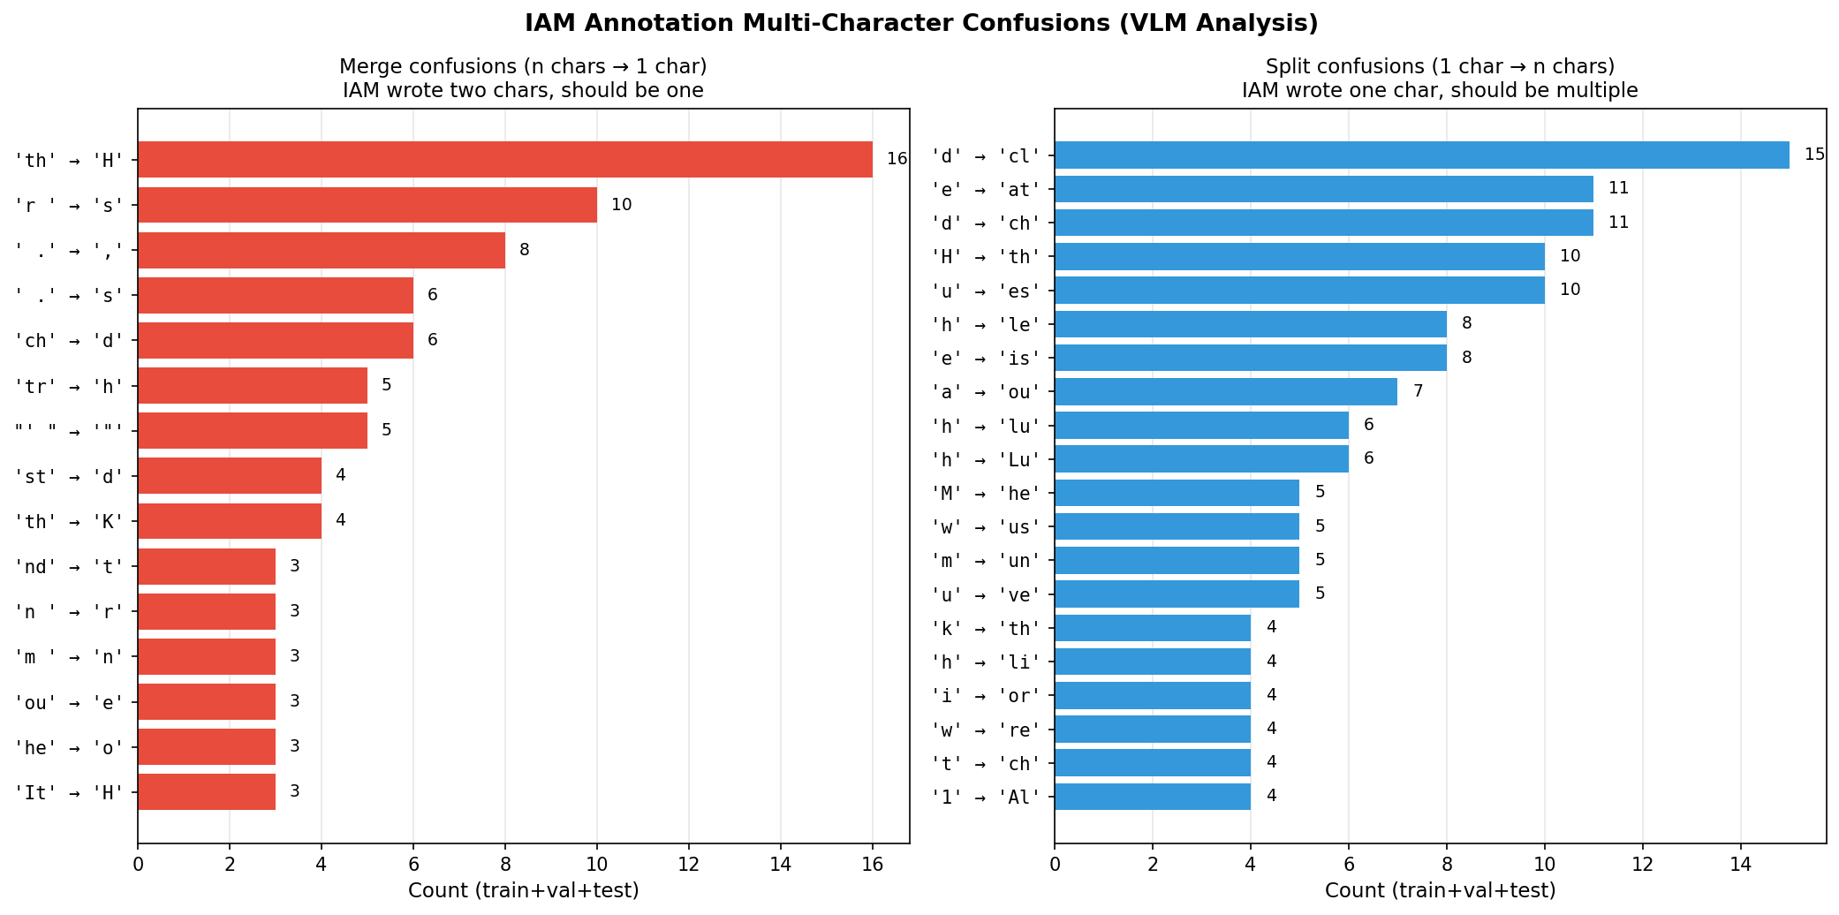

Slide 9
