Slide 1
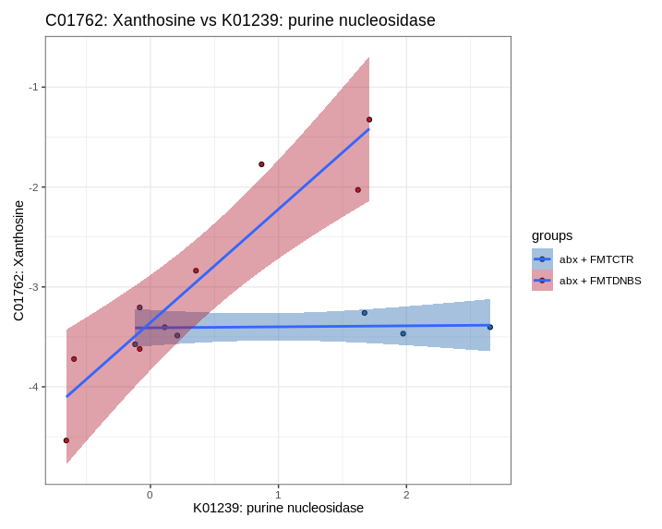
Pathogenic arm

Slide 2
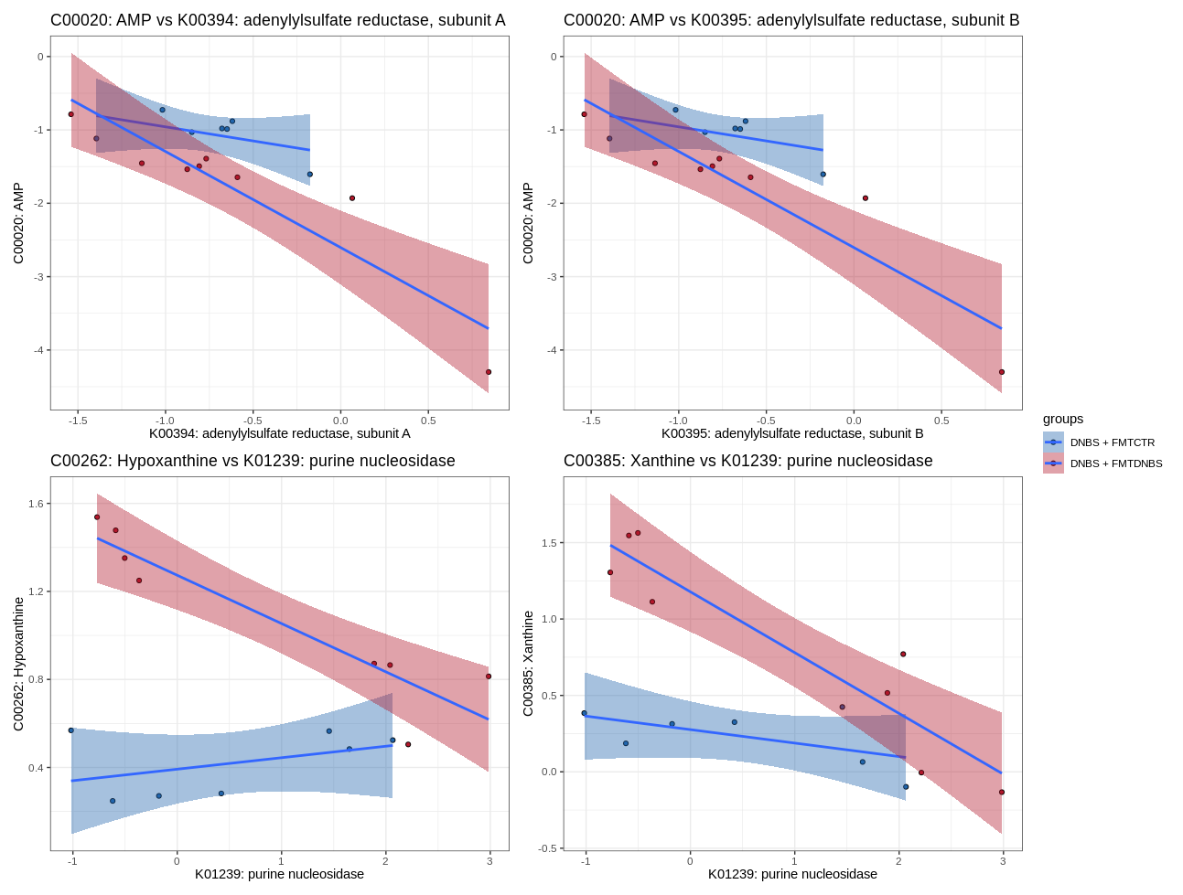
Therapeutic arm

