Slide 1
Containers, Docker, Kubernetes, and DevOps
Aditya Thombre
Roll No. 04
CSE 6th SEM

Slide 2
What are Containers?
- Lightweight, portable, and isolated units that run applications and their dependencies.
- Key Benefits:
• Consistency across environments
• Faster deployment
• Scalability.

Slide 3
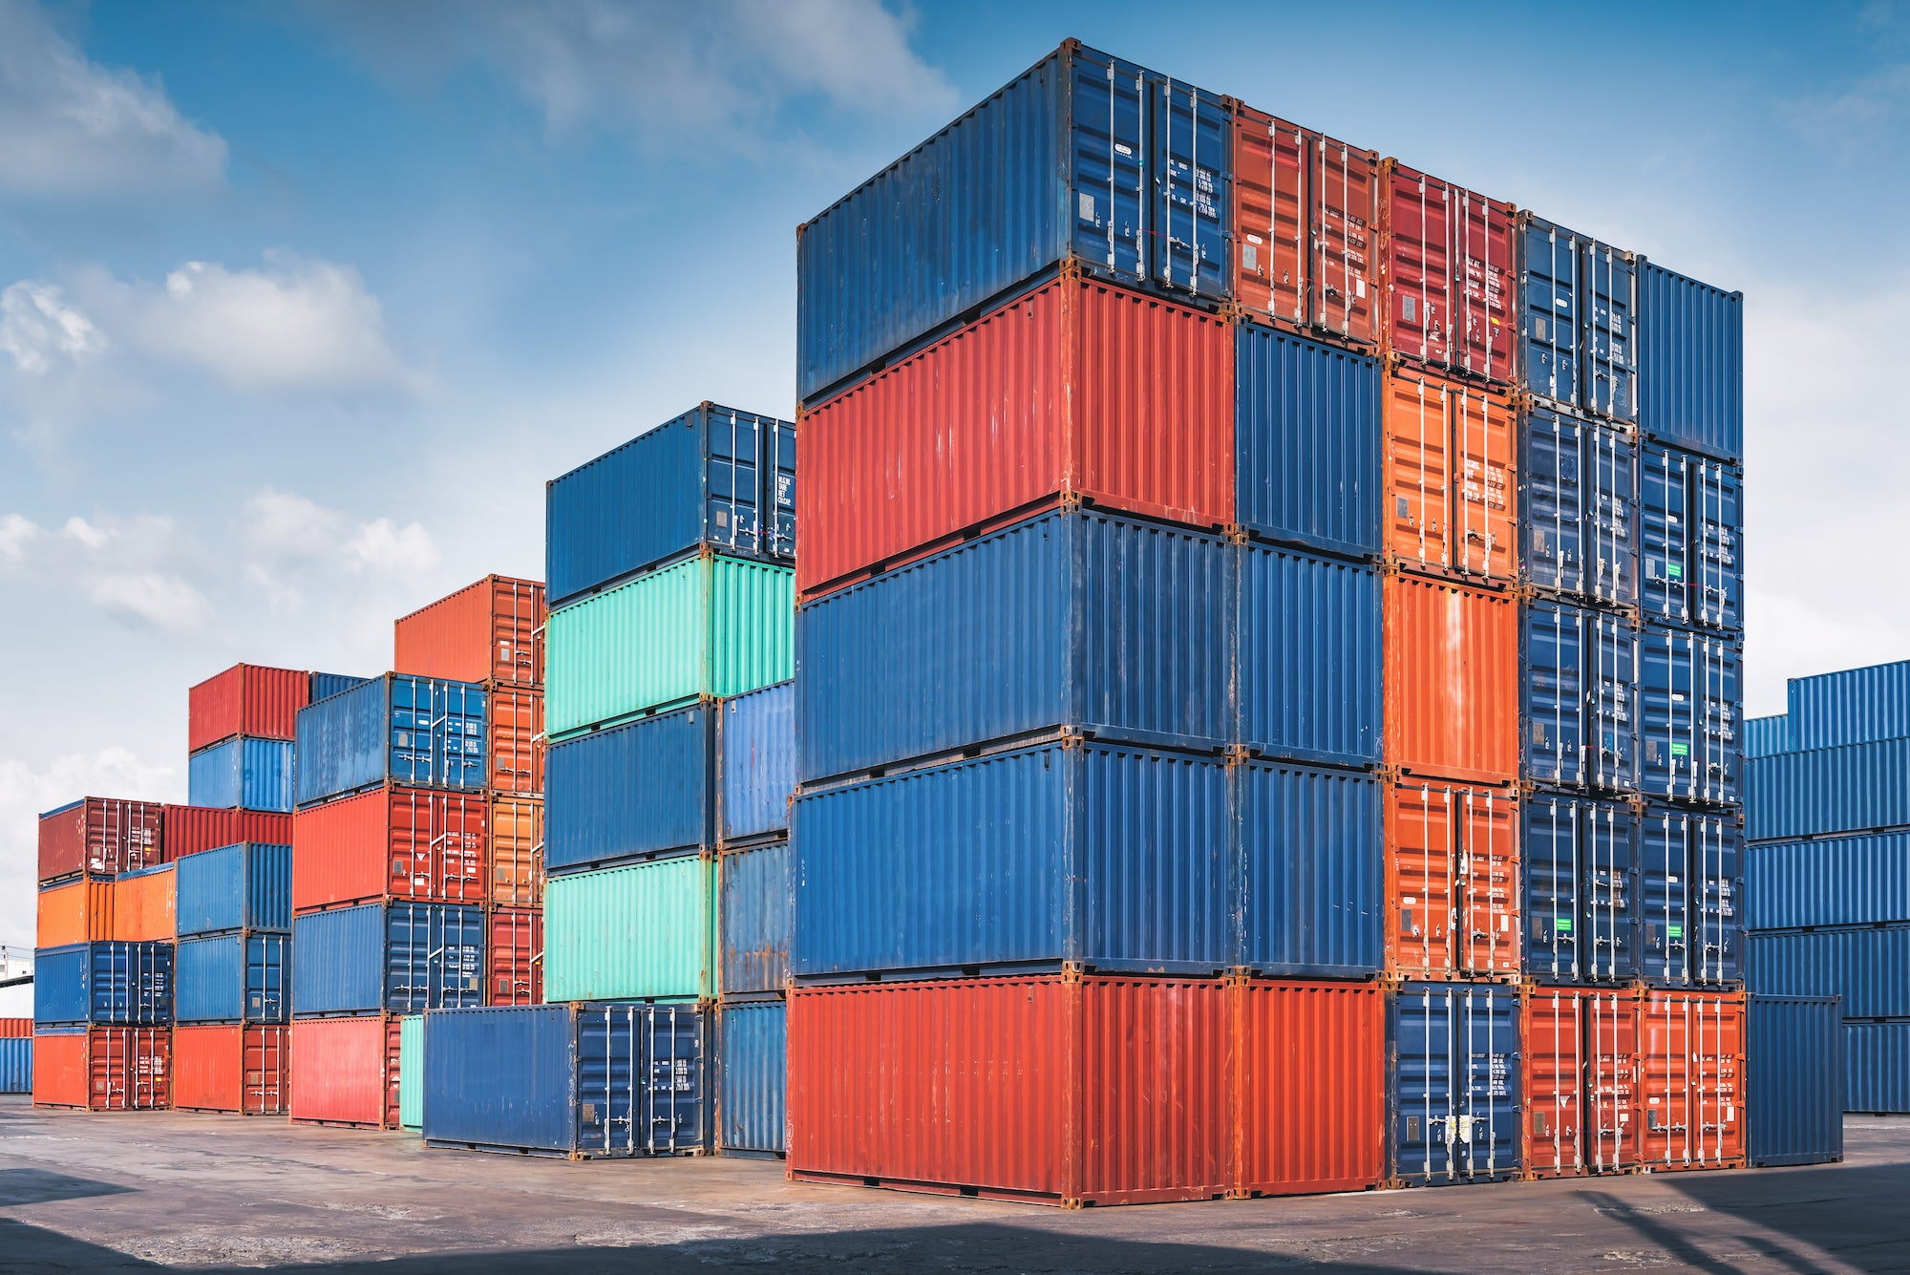
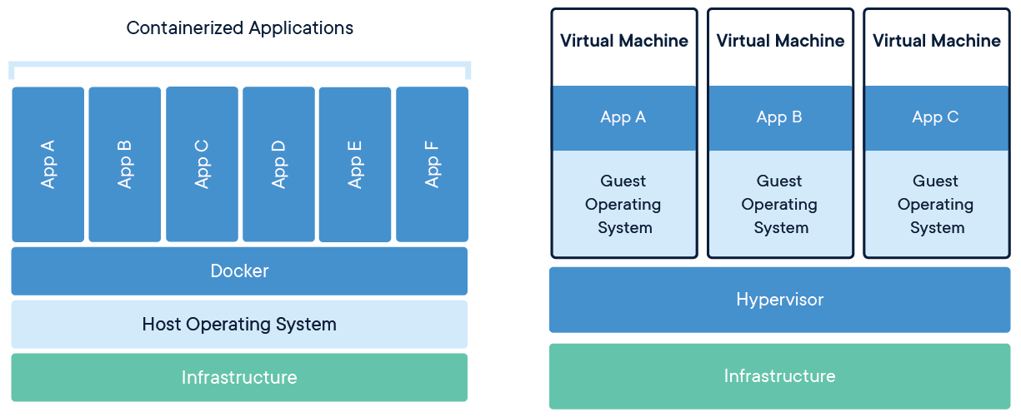
CONTAINERS

Slide 4
Docker Overview
- A platform for creating, deploying, and running applications in containers.
- Why Docker?
• Easy to set up and use
• Environment consistency
• Efficient resource utilization.

Slide 5
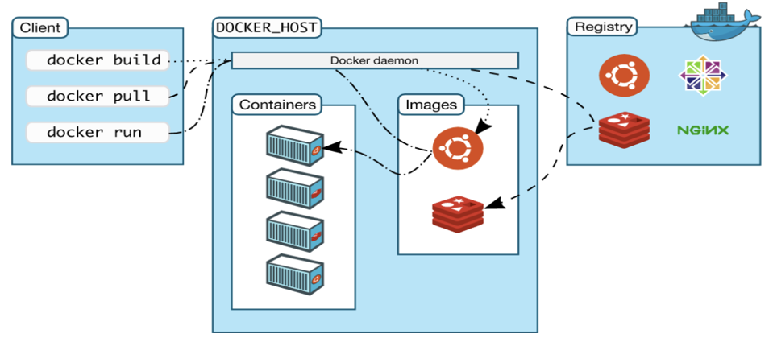
WORKING OF DOCKER

Slide 6
Kubernetes Overview
- Open-source container orchestration platform for managing, scaling, and deploying containers.
- Key Features:
• Automated scaling
• Self-healing capabilities
• Load balancing.

Slide 7

Docker vs Kubernetes
- Docker: Containerization, limited scalability, manual deployment.
- Kubernetes: Orchestration, highly scalable, automated deployment.

Slide 8
What is DevOps?
- A combination of practices and tools integrating software development and IT operations.
- Core Principles:
• Collaboration
• Automation
• Continuous integration and deployment (CI/CD).

Slide 9
DevOps Lifecycle
1. Plan: Define requirements and project scope.
2. Develop: Write and test code collaboratively.
3. Build: Package applications using CI/CD pipelines.
4. Test: Automated and manual testing.
5. Release & Deploy: Controlled application deployment.
6. Operate & Monitor: Continuous monitoring and improvement.

Slide 10
Summary
- Distributed Cloud vs Edge Computing: Centralized vs decentralized.
- Containers & Docker: Lightweight application deployment.
- Kubernetes: Container orchestration.
- DevOps: Streamlined software development and deployment.

Slide 11
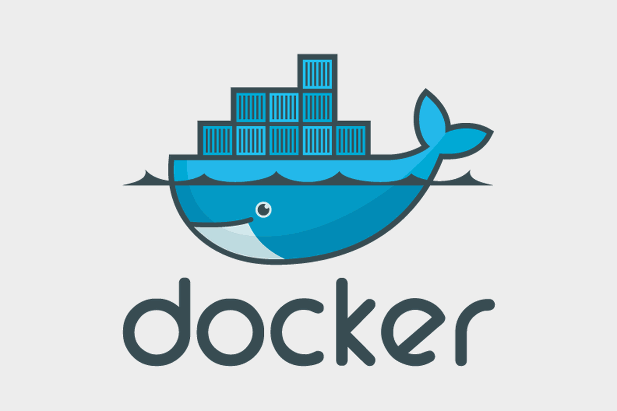
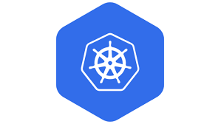
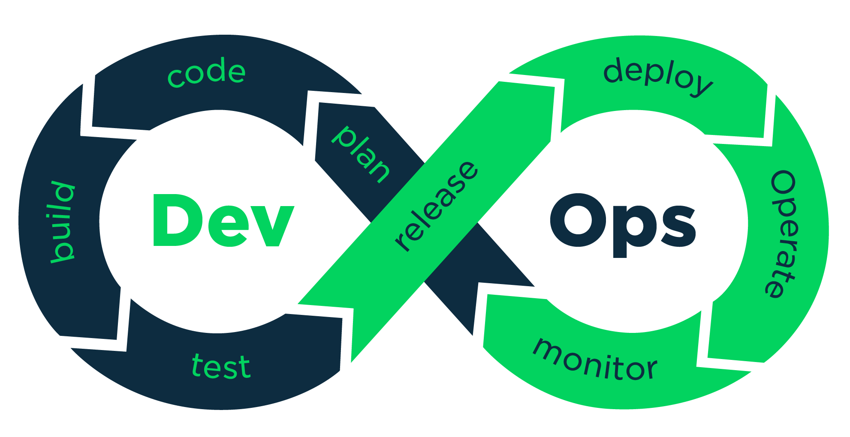
THANK YOU
RN. 04

