Slide 1
0x0000
there's a place in the darkness
that I used to cling to
that presses harsh hope against time
in the absence of martyrs
there's a presence of thieves
who only want to rob you blind
- j knapp

Slide 2
<GHz or bust!
leveraging the power of the
chipcon 1111
(and RFCAT)

Slide 3
0x1000 – intro to <GHz
FCC Rules(title 47) parts 15 and 18 allocate and govern parts of the RF spectrum for unlicensed ISM in the US (US adaptation of the ITU-R 5.138, 5.150, and 5.280 rules)
  Industrial – power grid stuff and more!
  Science -
  Medical – insulin pumps and the like
US ISM bands:
  300 :
  433 : 433.050 – 434.790 MHz
  915 : 902.000 – 928.000 MHz
Popular European ISM band:
  868 : 863.000 – 870.000 MHz
Other ISM includes 2.4 GHz and 5.8 GHz
  cc2531.... hmmm... maybe another toy/talk?

Slide 4
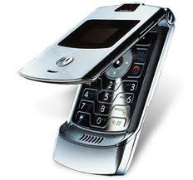
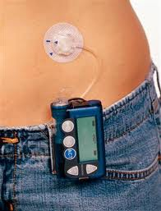
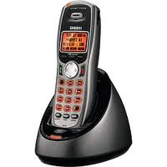
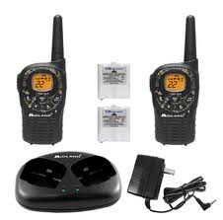
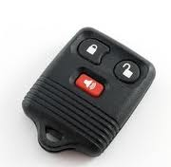
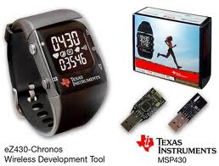
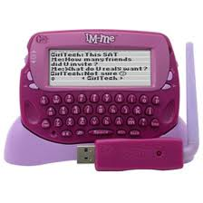
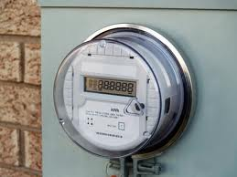
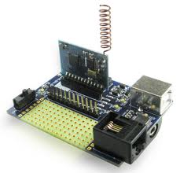
0x1010 – what is <GHz? what plays there?
Industry, Science, Medical bands, US and EU
Cell phones
Cordless Phones
Personal Two-Way Radios
Car Remotes
Pink IM-ME Girl Toys!
TI Chronos Watches
Medical Devices (particularly 401-402MHz, 402-405MHz, 405-406MHz)
Power Meters
custom-made devices
Old TV Broadcast
much, much more...
  <INSERT PICTURES OF STUFF>

Slide 5
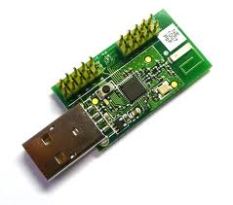

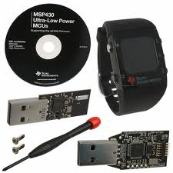
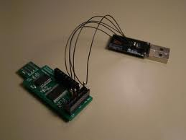
0x1020 – how do we play with it?
cc1110/cc1111 do 300-348MHz, 391-464MHz, 782-928MHz
  and more...
RFCAT uses the CC111x on some common dongles
  Chronos dongle (sold with every TI Chonos watch)
  “Don's Dongles”, aka TI CC1111EMK
  IMME (currently limited to sniffer/detection firmware)
but there are some catches
  rf comms configuration?
  channel hopping sequence?
  bluetooth and DSSS? (not hap'nin)

Slide 6
intro to the cc1111 radio (the cc1100 core)
mcu
radio state engine
radio configuration
usb
timers
dma

Slide 7
cc1111 mcu
modified 8051 core
  8-bit mcu
  single-tick instructions
  256 bytes of iram
  4kb of xram
  XDATA includes all code, iram, xram
  execution happens anywhere :)
register access to radio, dma, crypto, usb, timers, adc

Slide 8
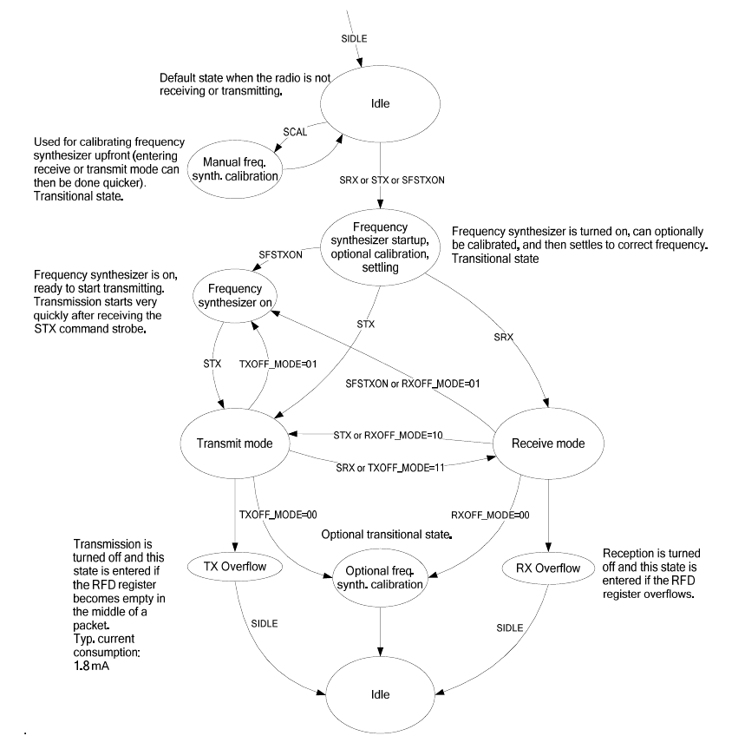
cc1111 radio state engine
IDLE
CAL
FSTXON
RX
TX

Slide 9
cc1111 radio configuration
configuring the radio is done through updating a set of 1-byte registers in varying bit-size fields
  MDMCFG4 – MDMCFG0 – modem control
  PKTCTRL1, PKTCTRL0 – packet control
  FSCTRL1, FSCTRL0 – frequency synth control
  FREND1, FREND0 – front end control
  FREQ2, FREQ1, FREQ0 – base frequency
  MCSM1, MCSM0 – radio state machine
  SYNC1, SYNC0 – SYNC word, or the SFD
  CHANNR, ADDR – channel and address
  AGCCTRL2, AGCCTRL1, AGCCTRL0

Slide 10
cc1111 radio notes
Data Rate, Bandwidth, and Intermediate Frequency and Freq-Deviation depend on each other
put the radio in IDLE state before configuring
put the radio in IDLE state before configuring
put the radio in IDLE state before configuring
STROBE (SIDLE, STX, SRX, SCAL...)
  then wait for the MARCSTATE == MARC_STATE_whatever
CCA impacts entering TX state from RX
  but not from IDLE state

Slide 11
0x3110 – what radio things do we want to know!?
frequencies
modulation (2FSK/GFSK, MSK, ASK/OOK, other)
intermediate frequency (IF)
baud rate
channel width/spacing/hopping?
bandwidth filter
sync words / bit-sync
variable length/fixed length packets
crc
data whitening?
encoding (manchester, fec, enc, etc...)

Slide 12
0x3110 – frequencies
315MHz – car fobs
433MHz – medical devices
868MHz – EU stuff
915MHz – NA stuff of all sorts (power meters, insulin)
2.4GHz – 802.11/wifi, 802.15.4/zigbee/6lowpan, bluetooth
5.8GHz – cordless phones
FREQ2, FREQ1, FREQ0

Slide 13
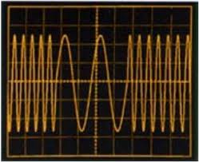
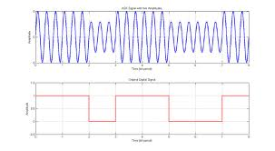
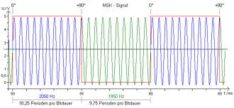
0x3110 – modulations
2FSK/GFSK – Frequency Shift Key (digital FM)
  cordless phones (DECT/CT2)
ASK/OOK – Amplitude Shift Key (digital AM)
  morse-code, car-remotes, etc...
MSK – Minimal Shift Key (a type of quadrature shift modulation like QPSK)
  GSM
MDMCFG2, DEVIATN
`

Slide 14
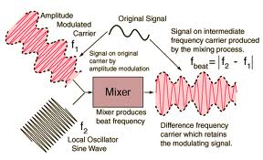
intermediate frequency
mix the RF and LO frequencies to create an IF
  improves signal selectivity
  tune different frequencies to an IF that can be manipulated easily
  cheaper/simpler components
cc1111 supports a wide range of 31 different IF options:
  23437 hz apart, from 0 – 726.5 khz
Smart RF Studio recommends:
  140 khz up to 38.4 kbaud datarate
  187.5 khz at 38.4 kbaud
  281 khz at 250 kbaud
  351.5khz at 500 kbaud
FSCTRL1

Slide 15
0x3110 – data rate (baud)
much like your modems or old
the frequency of bits
  some can overlap and get garbage!
    garbage can be good...
baud has significant impact on IF, Deviation and Channel BW
seeing use of 2400, 19200, 38400, 250000
MDMCFG3 / 4

Slide 16
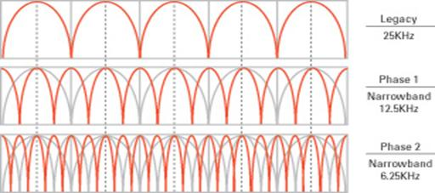
0x3110 – channel width / spacing
simplifying frequency hopping / channelized systems
real freq = base freq + (CHANNR * width)
MDMCFG0 / 1

Slide 17
0x3110 – bandwidth filter
programmable receive filter
provides for flexible channel sizing/spacing
total signal bw = signal bandwidth + (2*variance)
total signal bw wants to be less than 80% bw filter!
MDMCFG4

Slide 18
0x3110 – preamble / sync words
identify when real messages are being received!
starts out with a preamble (1 0 1 0 1 0 1 0...)
then a sync word (programmable bytes)
  marking the end of the preamble
  SFD – start of frame delimiter
configurable to:
  nothing (just send received crap)
  carrier detect (if the RSSI value indicates a message)
  15 or 16 bits of the SYNC WORD identified
  30 out of 32 bits of double-SYNC WORD
SYNC1, SYNC0, MDMCFG2

Slide 19
0x3110 – variable / fixed-length packets
packets can be fixed length or variable length
variable length assumes first bytes is the length byte
both modes use the PKTLEN register:
  Fixed: the length
  Variable: MAX length
PKTCTRL0

Slide 20
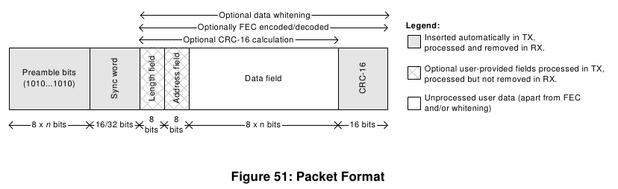
0x3110 – CRC – duh, but not
crc16 check on both TX and RX
uses the internal CRC (part of the RNG) seeded by 0xffff
DATA_ERROR triggers when CRC is enabled and fails
PKTCTRL0

Slide 21
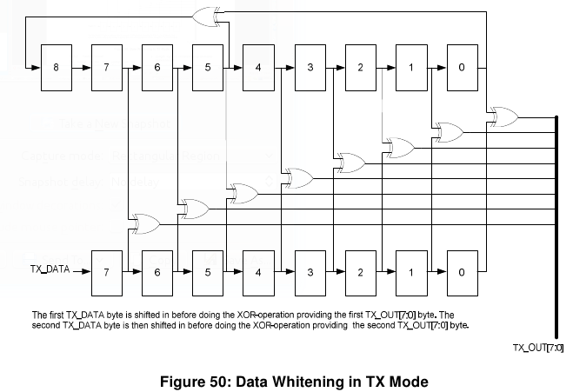
0x3110 – data whitening – 9 bits of pain
ideal radio data looks like random data
real world data can contain long sequences of 0 or 1
data to be transmitted is first XOR'd with a 9-bit sequence
  sequence repeated as many times as necessary to match the data
PKTCTRL0

Slide 22
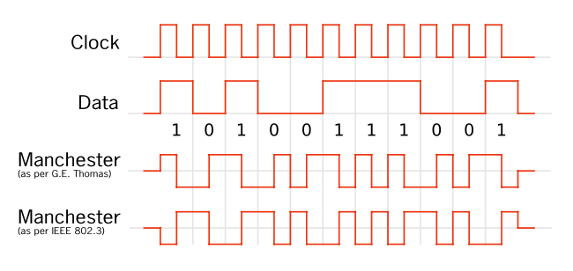
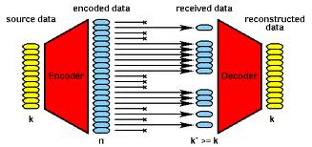
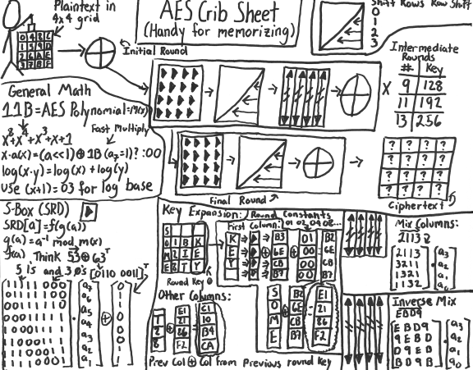
0x3110 – encoding
manchester
  MDMCFG2
forward error correction
  convolutional
    MDMCFG1
  reed-solomon (not supported)
encryption - AES in chip

Slide 23
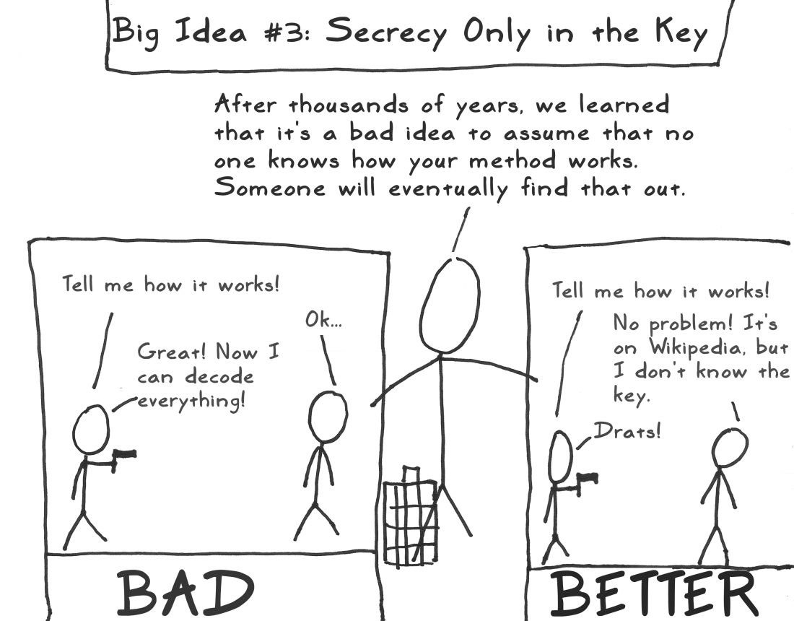
sorry, couldn't resist

Slide 24
0x3120 – how can we figure it out!?
open / public documentation
  insulin pump published frequency
open source implementation / source code
“public” but harder to find (google fail!)
  fcc.gov – search for first part of FCC ID
  patents – amazing what people will patent!
    french patent describing the whole MAC/PHY
reversing hw
  tapping bus lines – logic analyzer
    grab config data
    grab tx/rx data
  pulling and analyzing firmware

Slide 25
0x3121 – how can we figure it out!? - part 2
hopping pattern analysis
  arrays of dongles – space them out and record results
  hedyattack, or something similar
  spectrum analyzer
  USRP2
trial and error – rf parameters
MAC layer? - takes true reversing

Slide 26
0x2000 – intro to FHSS
FHSS is common for devices in the ISM bands
  provides natural protection against unintentional jamming /interferance
  US Title 47 CFR 15.247 affords special power considerations to FHSS devices
    >25khz between channels
    pseudorandom pattern
    each channel used equally (avg) by each transmitter
    if 20db of hopping channel < 250khz:
      must have at least 50 channels
      average <0.4sec per 20 seconds on one channel
    if 20dB of hopping channel >250khz:
      must have at least 25 channels
      average <0.4sec per 10 seconds on one channel

Slide 27
0x2010 – FHSS, the one and only - NOT!
different technologies:
  DSSS – Direct Sequence Spread Spectrum
    hops happen more often than bytes (ugh)
    typically requires special PHY layer
  “FHSS”
    hops occur after a few symbols are transmitted
different topologies:
  point-to-point (only two endpoints)
  allows for different parameters
different customers:
  military has used frequency hopping since Hedy and George submitted the patent in 1941.
  commercial folks (WiFi, Bluetooth, proprietary stuff like power meters)

Slide 28
0x2020 – FHSS intricacies
what's so hard about FHSS?
  must know or be able to come up with the hopping pattern
    can be anywhere from 50 to a million distinct channel hops before the pattern repeats (or more)
  must be able to synchronize with an existing cell or partner
    or become your own master!
  must know channel spacing
  must know channel dwell time (time to sit on each channel)
  likely need to reverse engineer your target and make some guess time.
  DSSS requires that you have special hardware
military application will be very hard to crack, as it typically will have hops based on a synchronized PRNG to select channels

Slide 29
0x2030 – FHSS, the saving graces
any adhoc FHSS multi-node network: (power meters / sensor-nets)
  node sync in a reasonable timeframe
    limited channels in the repeated pattern
  each node knows how to talk to a cell
    let one figure it out, then tap the SPI bus to see what the pattern is...
two keys to determining hopping pattern:
  hop pattern generation algorithm
    typically based on the CELL ID
    one pattern gets you the whole cell :)
  some sync information the cell gives away for free
    gotta tell the n00bs how to sync up, right?
    for single-pass repeating sequences, it's just the channel

Slide 30
0x2040 – FHSS summary
FHSS comes in different forms for different uses and different users
FHSS is naturally tolerant to interference, and allows a device to transmit higher power than nonFHSS comms
getting the FHSS pattern, timing, and appropriate sync method for proprietary comms can be a reversing challenge
getting a NIC to do something with the knowledge gained above has – to date – been very difficult

Slide 31
0x3000 – intro to the RFCAT project
rfcat: RF Chipcon-based Attack Toolset
background...
goals...
plans...
where we're at so far...

Slide 32
0x3010 – RFCAT background
the power grid
  power meters and the folks who love them (yo cutaway, q, travis and josh!)
  no availability of good attack tools for RF
vendor at Distributech 2008:
  “Our Frequency Hopping Spread Spectrum is too fast for hackers to attack.”
    OMFW! really?

Slide 33
0x3020 – RFCAT goals
RE tools - “how does this work?”
security analysis tools - “your FHSS and Crypto is weak!”
satiate my general love of RF
a little of Nevil Maskelyne
“I will not demonstrate to any man who throws doubt upon the system” - Guglielmo Marconi, 1903

Slide 34
0x3030 – this is not HedyAttack
but leveraged the knowledge from HA...
this is the base code which HedyAttack started...
less "researchy" (this project won't find hopping patterns)
more utilitarian - give us comms parameters and a hopping pattern, and we'll be a NIC, sniffer, and interact with RF gadgets

Slide 35
rfcat's interface
rfcat is many things, but I like to think of it as an interactive python access to the <GHz spectrum!
  <insert pic>
rfcat_nic.py
  FHSS-capable NIC (some assembly may be required for FHSS to arbitrary devices)
rfcat_discover.py
  toolset for discovering what is currently using a given band/channel
rfcat_nic_server.py
  access the <GHz band over an IP network or locally and configure on the fly

Slide 36
rfcat_nic.py
customizable NIC-access to the ISM bands
ipython for best enjoyment
<insert pic>
lame spoiler: you get a global object called “d” to talk to the dongle
d.RFsend('blah')
data = d.RFrecv()

Slide 37
0x – configuring by register
all config is done this way anyway
rfcat.py gives direct access to registers through standard PEEK and POKE functionality
<insert pic>
d.peek(MDMCFG1)
d.poke(MDMCFG1, '\xf4')

Slide 38
rfcat_nic_server.py
bringing <GHz over the IP network!
connect on one TCP port to access the wireless network
connect on a second TCP port to access the wireless configuration
created to allow non-python clients to play too
  stdin is not the way you want to interact with embedded wireless protocols

Slide 39
rfsniff (pink version too!)
<insert picture of the IMME>
focused primarily on capturing data from the wireless network
IMME used to provide a nice simple interface

Slide 40
0x3100 – one dongle to rule them all
example RF attack lab setup:
  dongle “Gina” running hedyattack spec-an code
  dongle “Anna” running rfcat_nic.py
  IMME running rfsniff
  (possibly an IMME's running SpecAn)
  saleae logic analyzer for hacking of the wired variety

Slide 41
rf attack form
base freq:
modulation:
baud/bandwidth:
deviation:
channel hopping?
  how many channels: channel spacing:
  pattern and effective sync method?
  dwell period (ms):
fixed-/variable-length packets: len/maxlen:
“address”:
sync word (if applicable):
crc16 (y/n): does chip do correct style?
fec (y/n): type (convolutional/reed-soloman/other):
manchester encoding (y/n):
data whitening? and 9bit pattern:

Slide 42
playing with a medical device
CAUTION: MUCKING WITH THESE CAN KILL PEOPLE.
  THIS FIRMWARE AND CLIENT NOT PROVIDED
<INSERT SPECS HERE>
found frequency in the pdf manual from the Internet
modulation guessed based on spectrum analysis and trial/error
other characteristics guessed and discovered

Slide 43
playing with a power meter
CAUTION: MUCKING WITH POWER SYSTEMS WITHOUT APPROPRIATE AUTHORIZATION IS ILLEGAL, EVEN IF IT IS ON THE SIDE OF YOUR HOUSE!
most power meters use their own proprietary “Neighborhood Area Network” (NAN), typically in the 900MHz range and sometimes 2.4GHz or licensed spectrum.
to get the best reception over distance and gain tolerance to interference, all implement FHSS to take advantage of the Title 47: Part 15 power allowances
many of the existing meters use the same cc1111 or cc1110 chips, or the cc1101 radio core
this is the reason I'm here today

Slide 44
“Abuse is no argument”
- Nevil Maskelyne

Slide 45
References
http://rfcat.googlecode.com
http://en.wikipedia.org/wiki/Part_15_(FCC_rules)
http://en.wikipedia.org/wiki/ISM_band
http://www.ti.com/lit/ds/swrs033g/swrs033g.pdf - “the” manual
http://edge.rit.edu/content/P11207/public/CC1111_USB_HW_User_s_Guide.pdf
http://www.ti.com/litv/pdf/swru082b
http://www.ti.com/product/cc1111f32#technicaldocuments
http://www.ti.com/lit/an/swra077/swra077.pdf
http://www.newscientist.com/article/mg21228440.700-dotdashdiss-the-gentleman-hackers-1903-lulz.html
http://saleae.com/
http://zone.ni.com/devzone/cda/epd/p/id/5150 - FSK details (worthwhile!)
http://www.radagast.org/~dplatt/hamradio/FARS_presentation_on_modulation.pdf
  very good detailed discussion on deviation/modulation
http://en.wikipedia.org/wiki/Frequency_modulation
http://en.wikipedia.org/wiki/Minimum-shift_keying

Slide 46
0xgreetz
power hardware folk who play nice with security researchers
cutaway and q (awesome hedyattackers)
gerard van den bosch
travis and mossman
sk0d0 and the four J's
invisigoth and kenshoto
Jewel, bug, ringwraith, diva
Jesus Christ

Slide 47
0xgreetz
power hardware folk who play nice with security researchers
cutaway and q (awesome hedyattackers)
gerard van den bosch
travis and mossman
sk0d0 and the four J's
invisigoth and kenshoto
Jewel, bug, ringwraith, diva
Jesus Christ

