Slide 1
Automated Trading with MATLAB®
Stuart Kozola
Computational Finance

Slide 2

Challenges when developing and implementing trading strategies and systems
Increasing complexity
  More data
  More complicated models
  Integration and implementation to multiple system
Increasing computational speed
  Push to higher frequency
  Changes in hardware
Long deployment cycle
  (Re)coding is costly and error-prone
  Multiple system interfaces to consider
Notes:
Many of you are here today because you are facing difficulties. After all, algorithmic trading presents more challenges today than ever before:
There is a push towards increasing complexity in our algorithmic models. In our efforts to innovate and to get ahead of the markets, we naturally need to consider more and more data, and the models we use to analyze it are likewise becoming more complex. Black-box solutions are often unable to create the complicated models that we are developing these days. Are you happy with the sophistication of your analytics?
Of course, as data sets grow in size and as mathematical models get more complicated, computational speed begins to enter the picture. This concern is compounded when we consider that the algorithms themselves are tending to operate at higher and higher frequencies. Are you satisfies with the speed of your analytics?
Finally, the markets themselves are changing daily. Models that were accurate last week may be inadequate next week, and it can be difficult to keep pace. We often encounter customers where the research groups are separate from the actual production trading groups, and any models that are developed need to be recoded at large cost in terms of time and errors. Can you evolve your analytics quickly enough to compete?

Slide 3
Agenda
Trading system demonstration
Developing an automated trading decision engine
  Identify a successful trading rule
  Extend trading rule set
  Automate trading rule selection
Implementing an automated trading system
  Testing (paper trading) the system
  Integration and execution through a desktop trading system
  Execution through a server based system (FIX)
Wrap up and Q&A
Notes:
So far we have discussed the general challenges that you face and the impact of these challenges across your organization. We have also started to show how many users turn to MATLAB to overcome these challenges. I have been speaking in generalities, but next I will turn things over to our Application Engineer, who will provide a more concrete example of these challenges and how to solve them…

Slide 4
The problem at hand: Identifying and implementing profitable trading strategies
Commodities analyst
Developing a trading strategy
  Multiple trading rules
  High frequency
Management requirements:
  Tested on historical data
  Uses sophisticated analytics to identify optimal trading rule combination
  Integrates with existing data and execution APIs
Notes:
Today, I’ll be paying the role of a commodities analyst who has been tasked with developing a high-frequency trading strategy that combines multiple trading rules.
I’m going to use a sophisticated optimization algorithm to calibrate the best trading strategies and to determine how best to combine them using a rather large historical data set. I’m furthermore required to not only have this strategy operate in a back-testing environment but also to integrate it with my existing real-time data feed and brokerage APIs.
Before showing you how easy it is to solve this sort of a problem with MATLAB, I’d like to show you the final product so that you can have a clear idea of where we’re going over the next 2 hours…
(show great demo)

Slide 5
Trading decision engine
Development and testing
Historical Data
Strategy Modeling
Back Testing
End of Day / Intraday
Research / Algorithms
Profit / Loss
Files
Model Development
Databases
Calibration
Risk Exposure
Implementation
Live Data
Decision Engine
Execution
Real-Time Feeds
Models
Broker API
Event-Based
Trading Rules
Order Routing
Notes:
(back from great demo)
So, what we have just seen is the final product: a decision engine embedded into an implementation environment, with “live” data streaming in from a data feed and order decisions being router through an execution API.
(click)
Before we get to this point, though, we need also to have a development environment that parallel this workflow. We need to import data, this time from a historical environment like data files or data bases. We need to create a back testing environment that tracks how candidate models perform. We need a modeling environment that allows us to work with this data and to calibrate our models according to what the back testing suggests.
(click)
Finally, we need an easy way to bridge the gap between development and deployment. We need to take vetted prototype models and convert them into something that works in our implementation environment, and we need to further refine these models as they are running.

Slide 6
Requirements for the trading engine
Sophisticated analytics
  Custom rules & indicators
  Non-traditional techniques
Scalable speed
  Higher frequency data
  More trading rules
Quick to develop and deploy
  Try different strategies
  Embed in trading engine
Notes:
As we explore how I created this trading engine, I want you to keep in mind the following requirements. These represent key features of our implementation that may be difficult to accomplish in other environments.
First, we need to have sophisticated analytics. I don’t want to be bound to the models that are proscribed by my analysis environment: instead, I want the flexibility to add and remove rules and techniques from any field that I can imagine.
Next, the solution needs to be scalable. I must be able to accommodate as many trading rules as I wish on as high of frequency data as I wish. As these rules become more complex and my data frequency becomes finer, I want my back testing environment to be able to accommodate them.
Finally, I demand not just computational speed but also development speed: I want to be able to try different strategies on the fly, without having a spend a day coding a new strategy before I even know if it works. Once I’ve found strategies that do work, I really don’t want to have to spent another day re-writing it so that it works in my execution environment.
It’s precisely these requirements -- flexible analytics, fast computational speed, and short deployment times – that can be difficult in many environments. I’m hoping to convince you that MATLAB makes these easy.

Slide 7
Task 1: Develop a back testing environment
Goal: Build a back testing environment around historical data and a preliminary trading rule
Development and testing
Historical Data
Strategy Modeling
Back Testing
End of Day / Intraday
Research / Algorithms
Profit / Loss
Files
Model Development
Databases
Calibration
Risk Exposure
Implementation
Live Data
Decision Engine
Execution
Real-Time Feeds
Models
Broker API
Event-Based
Trading Rules
Order Routing
Notes:
Rather than try to go through this whole, complicated diagram all at once, let’s focus on distinct tasks that we need to perform.
(click)
First, we’ll be focusing on the testing part of our workflow, namely creating a back testing environment.
(click)
Our efforts will focus on the right side here, where we create a re-usable back testing system. In order to create it, though, we’ll need some sort of data (say, daily data from a spreadsheet) and some sort of a preliminary trading model.

Slide 8
Key tasks
Key tasks
Import data from files
Create a preliminary rule
Test the rule’s performance
Solutions
MATLAB data tools
High-level programming and pre-built functions
Powerful graphics environment
Notes:
So, our key tasks will be:
Reading data from files
Prototyping a preliminary trading rule
And Creating a back testing environment to asses this rule’s performance.
Our keys here will be ease of use and re-using anything that we create. Let’s take a look at MATLAB to see how this would work…
(go to demos 1 and 2)
(back from demos 1 and 2)
Just to recap: our key tasks were (recap key tasks)
(click)
And we see that MATLAB provides… (read solutions)

Slide 9
Task 2: Expand the scale of the engine
Task 1: Develop a back testing environment
Goal: Move to a higher frequency (minute-by-minute) and re-calibrate the model
Development and testing
Historical Data
Strategy Modeling
Back Testing
End of Day / Intraday
Research / Algorithms
Profit / Loss
Files
Model Development
Databases
Calibration
Risk Exposure
Implementation
Live Data
Decision Engine
Execution
Real-Time Feeds
Models
Broker API
Event-Based
Trading Rules
Order Routing
Notes:
That takes care of our first task: making a back testing environment. Before we move to the next step, are there any questions?
(click)
Our next task will be ramp up the size of the analysis. Our model predicted that a “moving average” of a single day (which isn’t really a moving average at all) was optimal for our leading indicator. Perhaps we can do better yet, then, if we move to an intra-day strategy.
(click)
This requires us to move from end-of-day data to intra-day data, which is too large to store in anything but a database. As we’ll see, MATLAB will scale naturally with the size of this analysis.

Slide 10

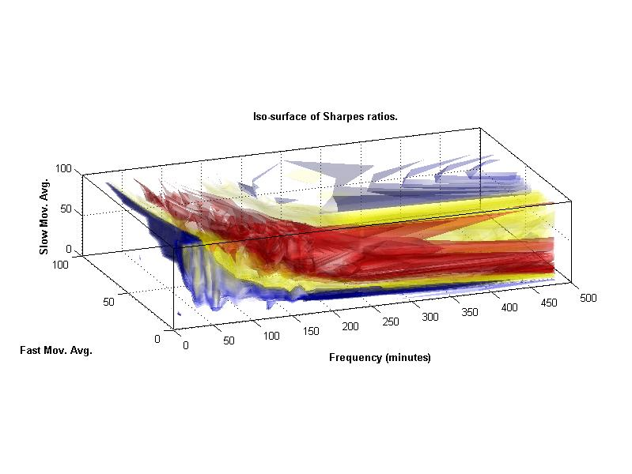
Key tasks
Key tasks
Importing data from databases
Increase computational speed
Solutions
MATLAB data tools: Database Toolbox
High-performance computing: Parallel Computing Toolbox, MATLAB Distributed Computing Server
Notes:
Our key tasks here, then, will be to bring in much larger data sets from data bases and to increase the speed of our calculations to keep pace with the larger data. We would like to re-use most (if not all) of what we’ve already done, so we’ll keep a close eye on how easy it is to adapt our code and analysis to fit this high-frequency domain.
(go to demo 3)
(back from demo 3)
(Recap the key tasks)
(click)
(Go through MATLAB’s solutions)

Slide 11
Task 3: Rule selection engine
Task 2: Expand the scale of the engine
Goal: Develop a rule selection system for instruments using evolutionary learning
Development and testing
Historical Data
Strategy Modeling
Back Testing
End of Day / Intraday
Research / Algorithms
Profit / Loss
Files
Model Development
Databases
Calibration
Risk Exposure
Implementation
Live Data
Decision Engine
Execution
Real-Time Feeds
Models
Broker API
Event-Based
Trading Rules
Order Routing
Notes:
Are there any questions about this task before we move on to the final task of the morning?
(click)
Now, we’ll move on to our last task: we will now focus on the center square here: creating advanced models. Our approach will be to create many different trading rules and to create an evolutionary learning system to identify the optimal combination of rule to use. This approach is meant to give a taste of the kinds of advanced analyses that MATLAB offers compared to other environments.

Slide 12
Key tasks
Key tasks
Increase number of rules
Incorporate advanced analytics to select best combination
Notes:
(Go over key tasks)
(Go to demo 4, up to line 66 where we show the indicator chart for all 3 trading rules)

Slide 13
Working with multiple strategies
Should I trade?
Signal 1
OR
Signal 2
Signal 3
AND
OR
AND
Yes
Yes
No
Dempster et. al., Computational learning techniques for intraday fx trading using popular technical indicators, IEEE Transactions on Neural Networks (2001).
Notes:
So, we need to decide what to do now that we’ve increased our number of trading rules.
(click)
When we poll them to decide if we should engage in a trade or not, they will rarely agree with each other. What do we do?
(click)
We could adopt a conservative strategy where we only trade if all rules agree with each other…
(click)
Or we could adopt a more aggressive strategy and trade is any rule says to. Or we could mix and match these shorts of decisions.
(click)
Finally, we may decide to ignore one or more rules altogether. Even with only three rules, we can easily generate over one thousand different ways to combine these rule with different logical rules and different signals active.

Slide 14
Working with multiple strategies
Represent different combinations as bit strings
Signal 1
AND
Signal 2
OR
Signal 3
1 | 0 | 0 | 1 | 0 | 1 | 1 | 1 | 1 | 1
Signals
Active?
Signal 1
AND
Signal 2
OR
Signal 3
Notes:
Instead of hand-coding every possible combination of these strategies, we will instead let MATLAB do the heavy lifting for us. We can represent any single combination as a bit string, where active and inactive signals are encoded with 1s and 0s (respectively) and where different logical commands are represented by, say, 00 for AND and 01 for OR.
The problem then reduces to identifying the “best” bit string for our data.

Slide 15

Building Custom Evolution Algorithms
Selection
  Retain the best performing bit strings from one generation to the next. Favor these for reproduction
Crossover
  parent1 = [ 1 0 1 0 0 1 1 0 0 0 ]
  parent2 = [ 1 0 0 1 0 0 1 0 1 0 ]
  child = [ 1 0 0 0 0 1 1 0 1 0 ]
Mutation
  parent = [ 1 0 1 0 0 1 1 0 0 0 ]
  child = [ 0 1 0 1 0 1 0 0 0 1 ]
Notes:
Different optimizations algorithms exist for problems like these. Since our problem involves trying different bit strings, one useful approach is a genetic algorithm. This evolutionary technique starts be creating an initial population of several candidate bit strings. It then uses three techniques for creating the next generation of candidates: selection, crossover, and mutation.
(click and explain these three processes, one by one)
Let’s see how easy this is to do in MATLAB (go back to demo 4)

Slide 16
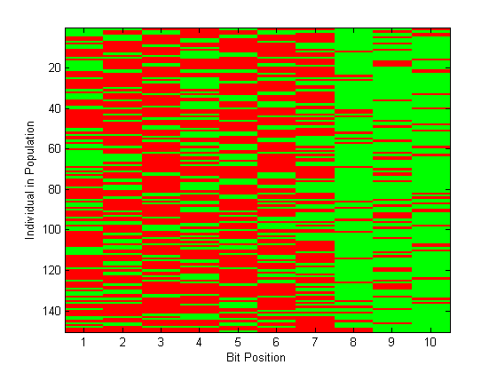
Key tasks
Key tasks
Increase number of rules
Incorporate advanced analytics to select best combination
Solutions
High-level programming
MATLAB Toolboxes: Global Optimization, …
Notes:
(Recap key tasks)
(click)
(Review MATLAB’s solutions)

Slide 17
Task 4: Implement a real-time trading system
Task 3: Rule selection engine
Goal: Integrate the trading decision engine into real-time simulation environment for “paper trading”
Development and testing
Historical Data
Strategy Modeling
Back Testing
End of Day / Intraday
Research / Algorithms
Profit / Loss
Files
Model Development
Databases
Calibration
Risk Exposure
Implementation
Live Data
Decision Engine
Execution
Real-Time Feeds
Models
Broker API
Event-Based
Trading Rules
Order Routing
Notes:
Are there any questions about this task before we move on to the final task of the morning?
(click)
Now, we’ll move on to our last task: we will now focus on the center square here: creating advanced models. Our approach will be to create many different trading rules and to create an evolutionary learning system to identify the optimal combination of rule to use. This approach is meant it give a taste of the kinds of advanced analyses that MATLAB offers compared to other environments.

Slide 18
Review: Requirements for the trading engine
Sophisticated analytics
  Custom rules & indicators
  Non-traditional techniques
Scalable speed
  Higher frequency data
  More trading rules
Quick to develop and deploy
  Try different strategies
  Embed in trading engine
Notes:
So, that’s our back testing and model prototyping environment. Before we take our break, I just want to recap these requirements that were imposed on us.
First, we need to have sophisticated analytics. I don’t want to be bound to the models that are proscribed by my analysis environment: instead, I want the flexibility to add and remove rules and techniques from any field that I can imagine.
Next, the solution needs to be scalable. I must be able to accommodate as many trading rules as I wish on as high of frequency data as I wish. As these rules become more complex and my data frequency becomes finer, I want my back testing environment to be able to accommodate them.
Finally, I demand not just computational speed but also development speed: I want to be able to try different strategies on the fly, without having a spend a day coding a new strategy before I even know if it works. Once I’ve found strategies that do work, I really don’t want to have to spent another day re-writing it so that it works in my execution environment.

Slide 19
MATLAB’s solutions
Sophisticated analytics
  Advanced graphics environment
  Toolboxes give access to hundreds of new techniques
  Flexible and customizable
Scalable speed
  Parallel computing solution
Quick to develop and deploy
  High-level programming
  Automated deployment to desktop or server-based systems
Notes:
It’s precisely these requirements -- flexible analytics, fast computational speed, and short deployment times – that can be difficult in many environments. I hope I just convinced you that MATLAB makes these easy.
Our toolboxes build on top of our flexible, sophisticated environment to give you the proper combination of advanced analytics and ease of use. Out parallel computing tools allow you to quickly perform these analytics even as your data sets grow. Our high-level programming environment allows you to prototype all of this code quickly.
The only part that I haven’t mentioned yet is how easily you can plug all of this into your deployment environment. I will do so… (click) after the break.

Slide 20

Deployment products for targeted environment
MATLAB Compiler
Excel Builder
JAVA Builder
.NET Builder
.exe
.dll/.lib
Excel
Add-in
Java
www
COM
.NET
Notes:
MATLAB Builder for Java lets customers deploy MATLAB applications as Java components on machines without MATLAB, to integrate into Java applications
Builder for Java and Builder for .NET can be used for Web applications
The Compiler now has a Graphical User Interface (GUI), to make it easier for customers to compile and package their applications

Slide 21



Sharing your ideas across the organization
Quant’s
Financial Engineers,
Actuaries
Economists
Desktop Applications
Financial Institution
Development Organization
Model Builders/Integrators
Develop, Test,
Implement, and Install
IT professionals
Software Engineers
Production Databases
Traders
Production Component
Model/ Algorithm/ Analytic
Analytic Engines
Portfolio Managers
Financial Institution
Business Organization
Model/Application Consumers
Web Applications
Business Analysts,
Researchers
Scripting Languages PHP, Perl
Use Models/Applications
in everyday business decisions

Slide 22
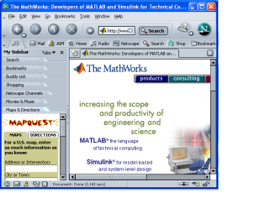
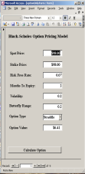
Bringing the algorithm to the data
Business Application
Server
MATLAB Component
MATLAB Component
MATLAB Component
MATLAB Component
Database
Server
MATLAB Component
MATLAB Component
MATLAB Component

Slide 23
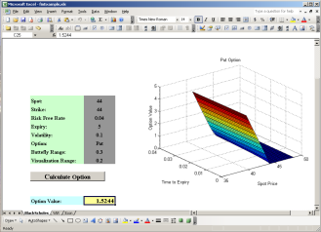
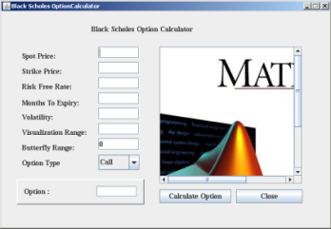
System integration through messaging services
Web
Server
Oracle
Database
SQL Server
Database
Enterprise Service/Messaging Bus …. MSMQ/JMS
MATLAB Java
Analytic
MATLAB .NET Analytic
MATLAB Java
Analytic
MATLAB .NET Analytic
Scheduler

