Slide 1

Team Douglas
Scott Thompson
Tushar Boharapi
Saurav Roy

Slide 2

Agenda
Business Value Proposition
Approach
Text Analytics
Sentiment Analysis
Emotion Analysis
Word associations
Feature Importance
Brand Value Proposition
Next steps

Slide 3
Business Value Proposition
Brand Analytics website
Know what customers are saying about your brand
Understand customer sentiment
Compare brand performance
Competitor analysis
Feature Importance

Slide 4
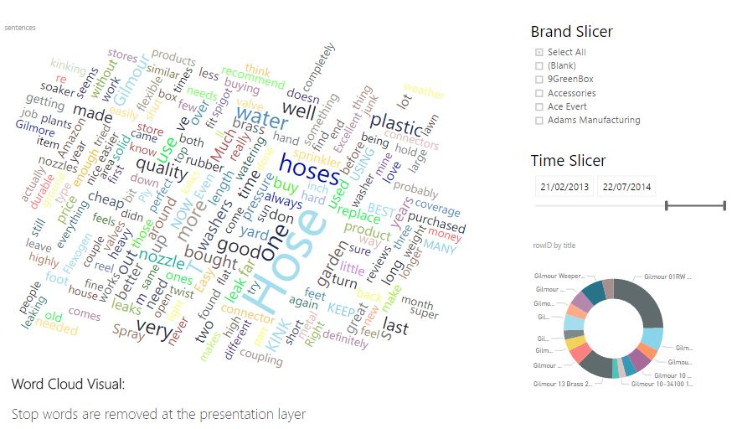
Approach and Text Analytics
Power BI App

Slide 5
Brand Value Proposition
Amazon can provide this type of analysis as a value addition
Understanding what the customers think about a brand can help vendors to better position and price their products
Vendors can find gaps in the competitors products which they can leverage on
At the same time vendors can also look for opportunities to pitch in new products

Slide 6
Next steps
Identify fake reviews – deliberate negative reviews can have a lot of negative impact on product sales
Swift identifying of bots as well as anomalies can be very helpful to both vendors as well as Amazon
Additional feature engineering can further provide us with more insights

Slide 7
Team Douglas
Thank You
Scot Thompson
Tushar Boharapi
Saurav Roy

