Slide 1
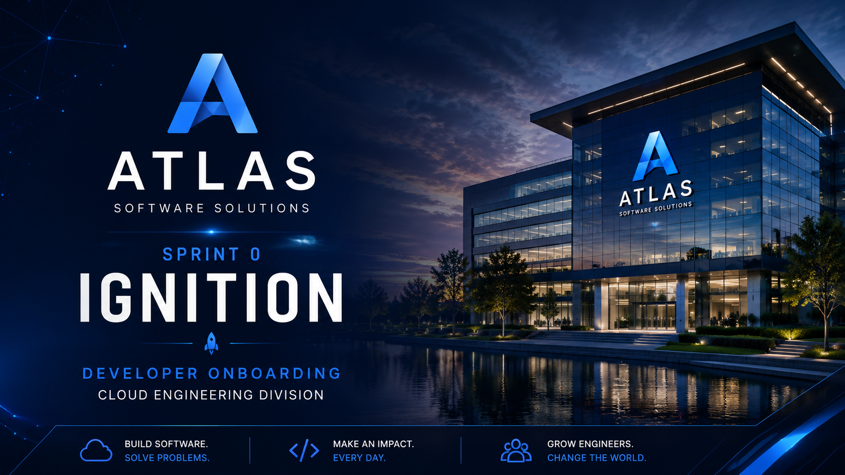
Title Slide

Slide 2
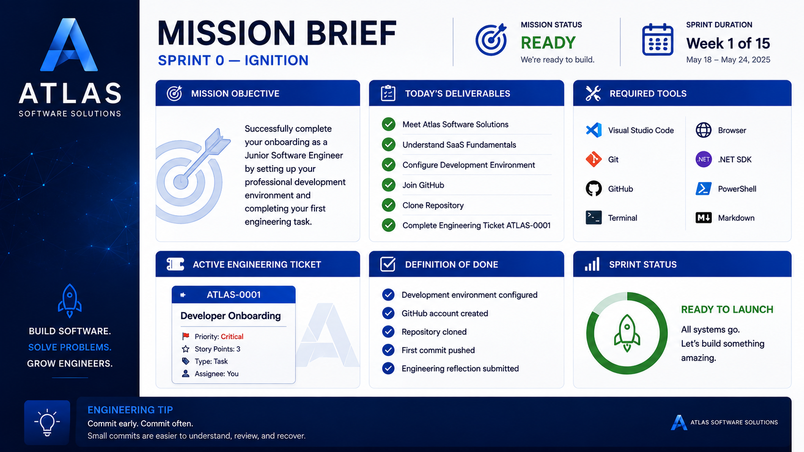
Mission Brief

Slide 3
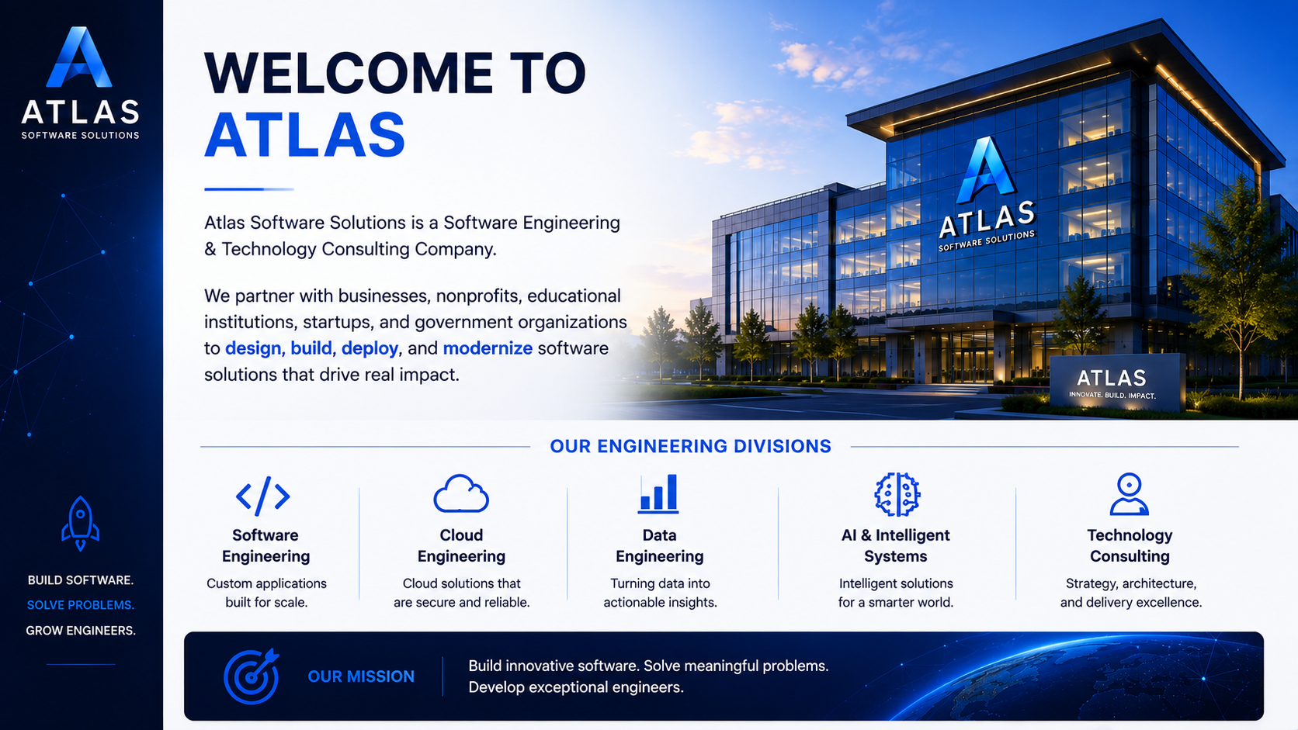
Welcome to Atlas

Slide 4
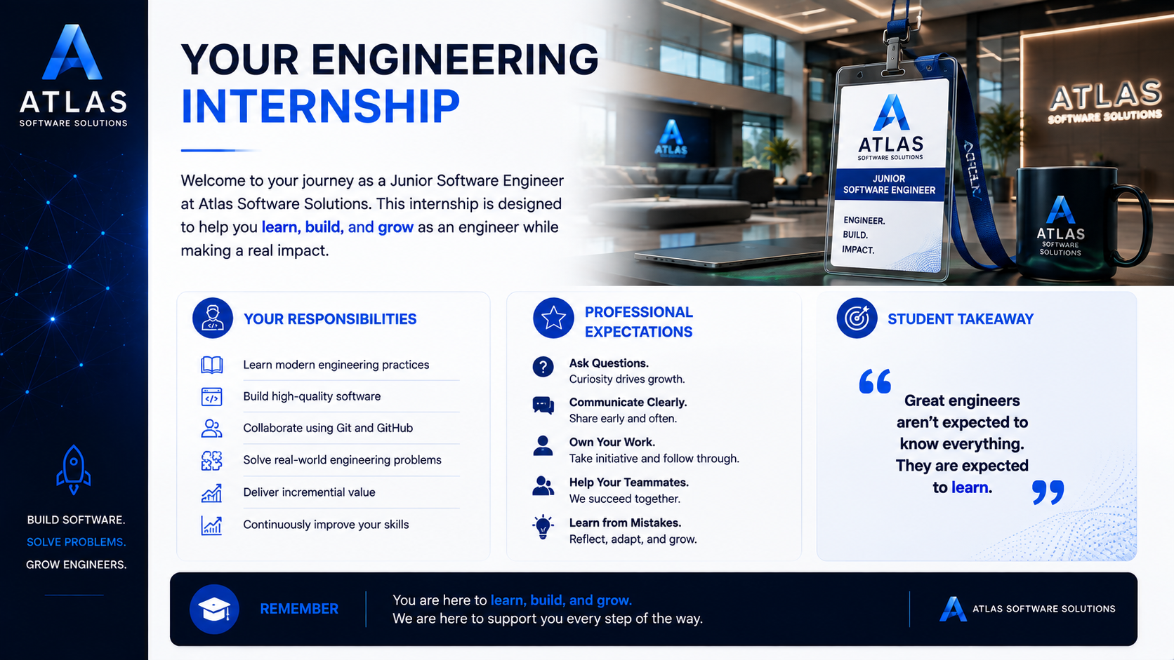
Internship

Slide 5
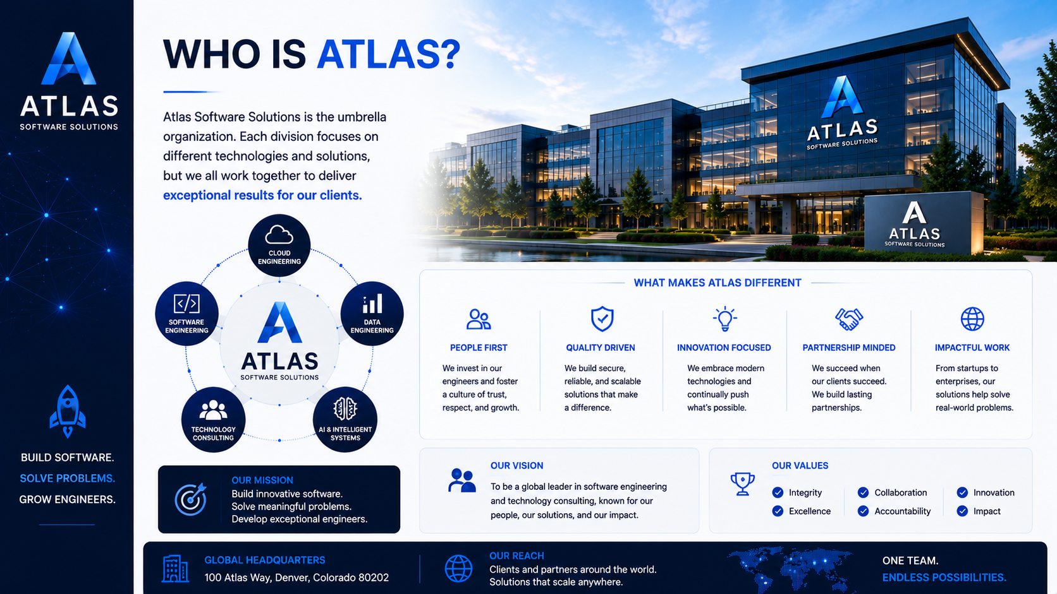
Who is Atlas?

Slide 6
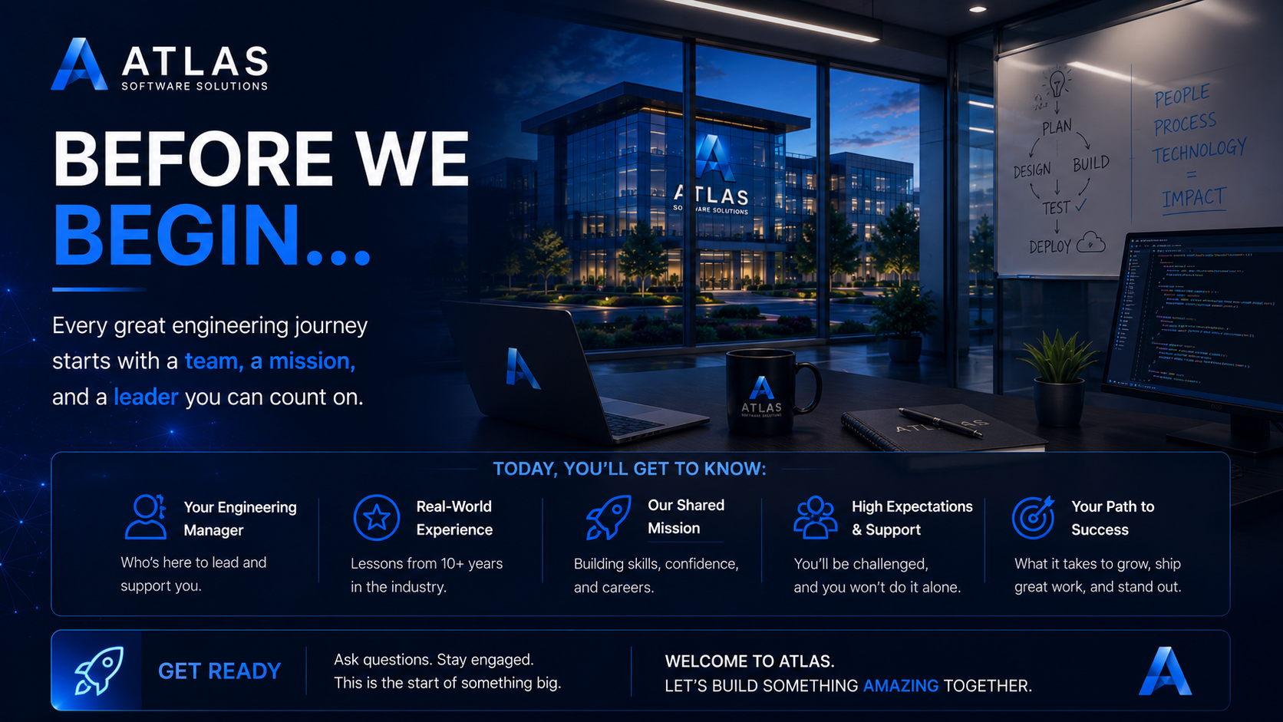
Before we begin

Slide 7
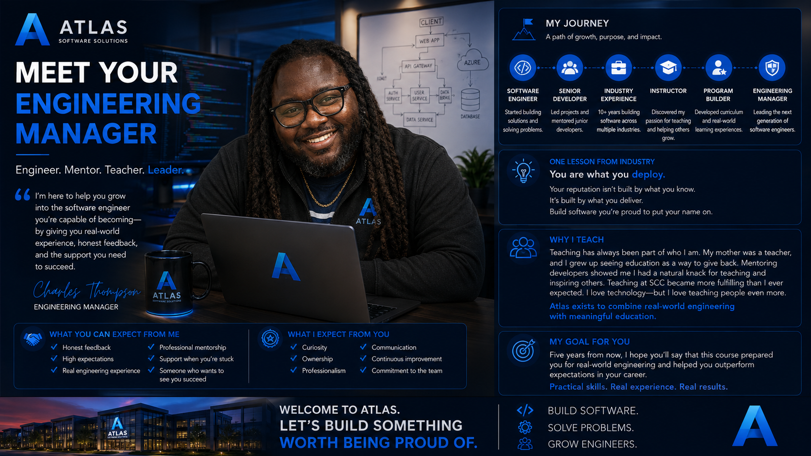
Meet the manager

Slide 8
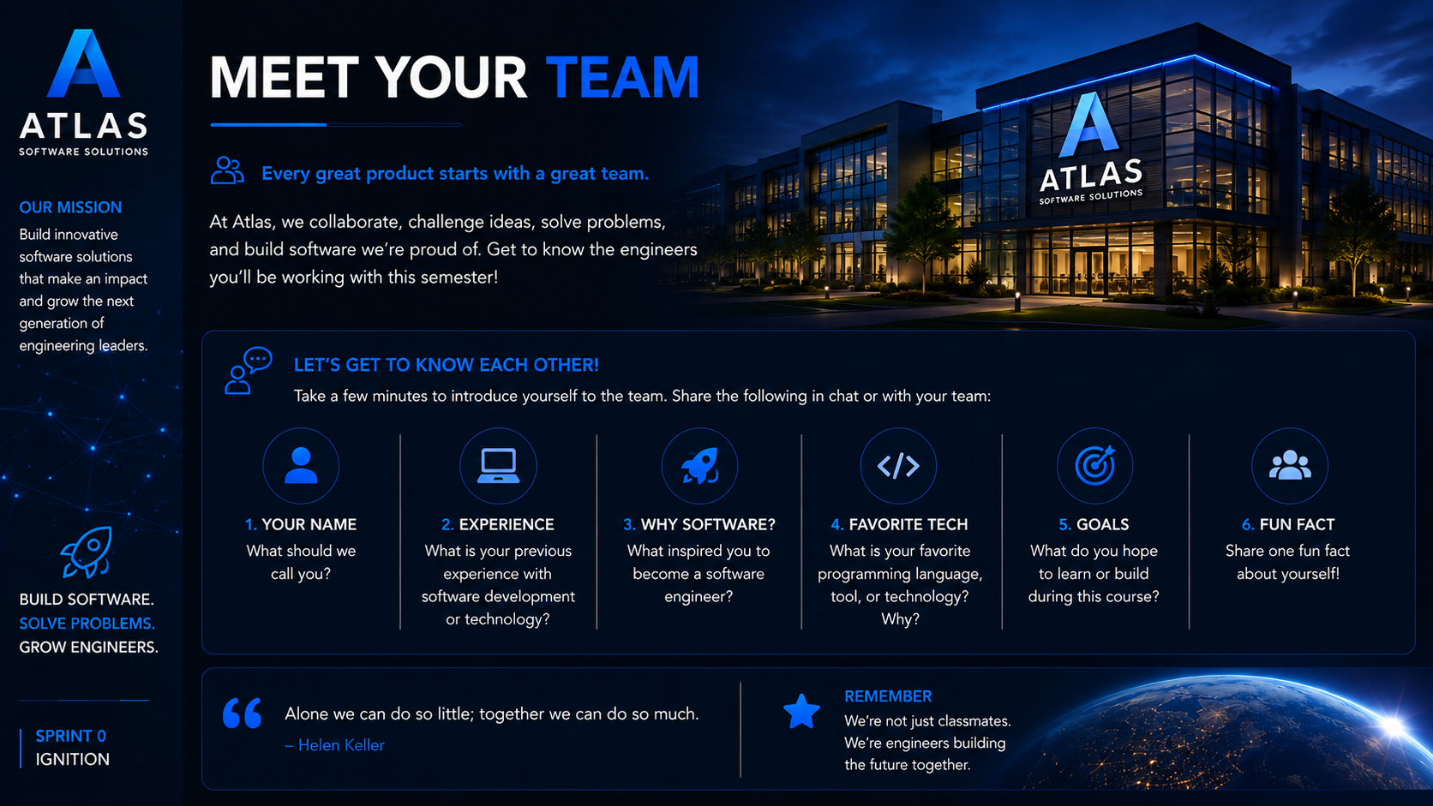
Meet the team

Slide 9
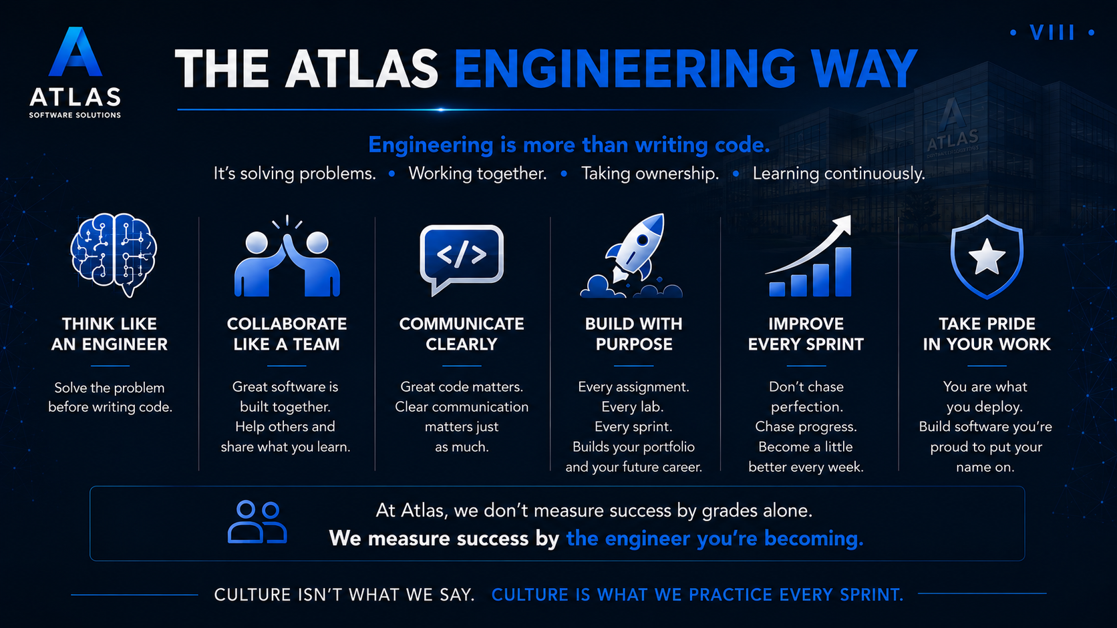
The Engineering Way

Slide 10
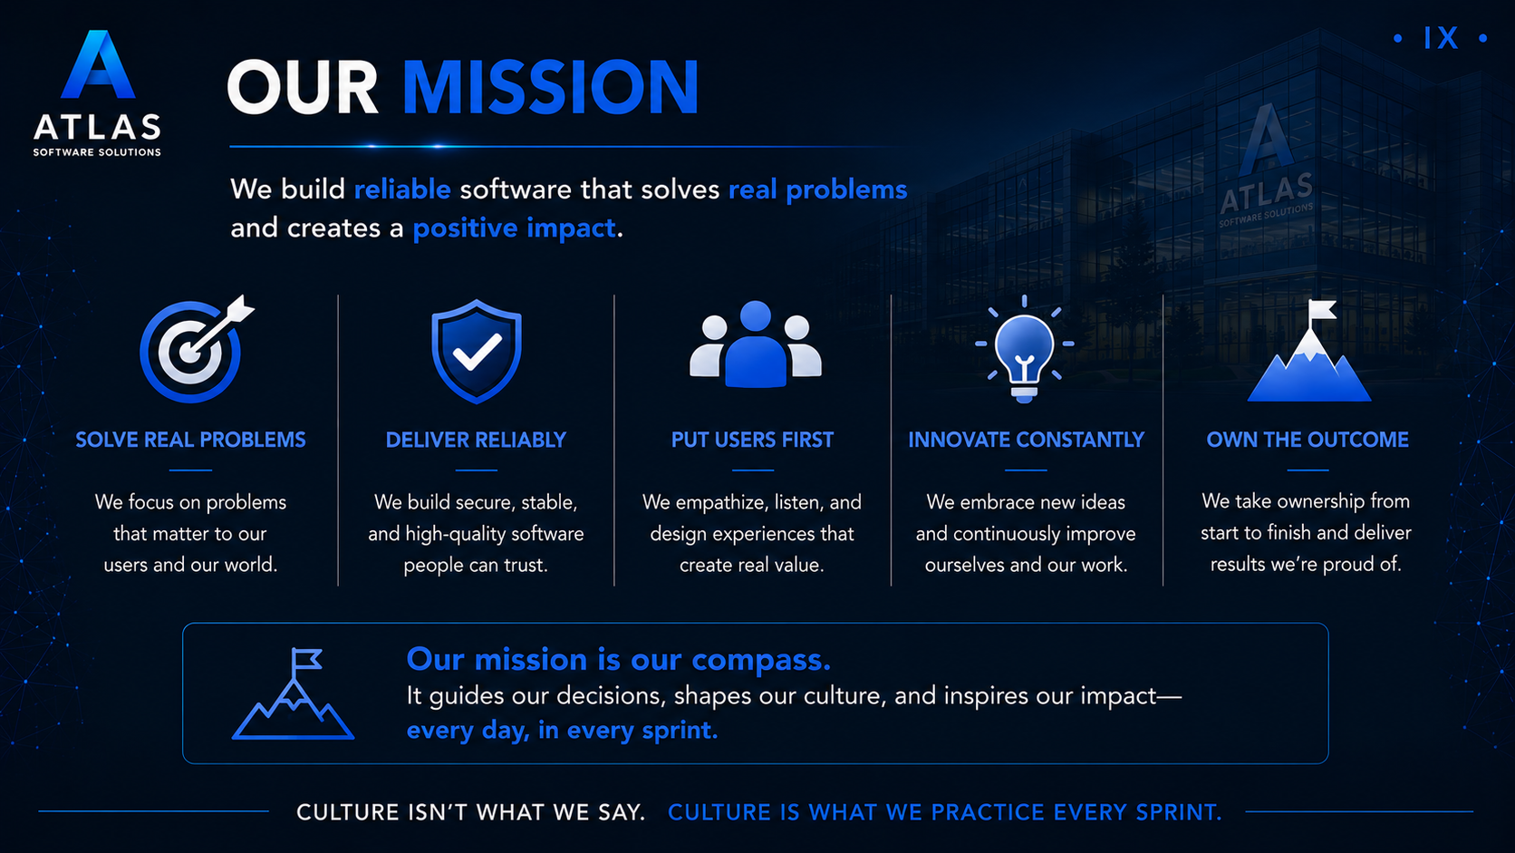
Mission

Slide 11
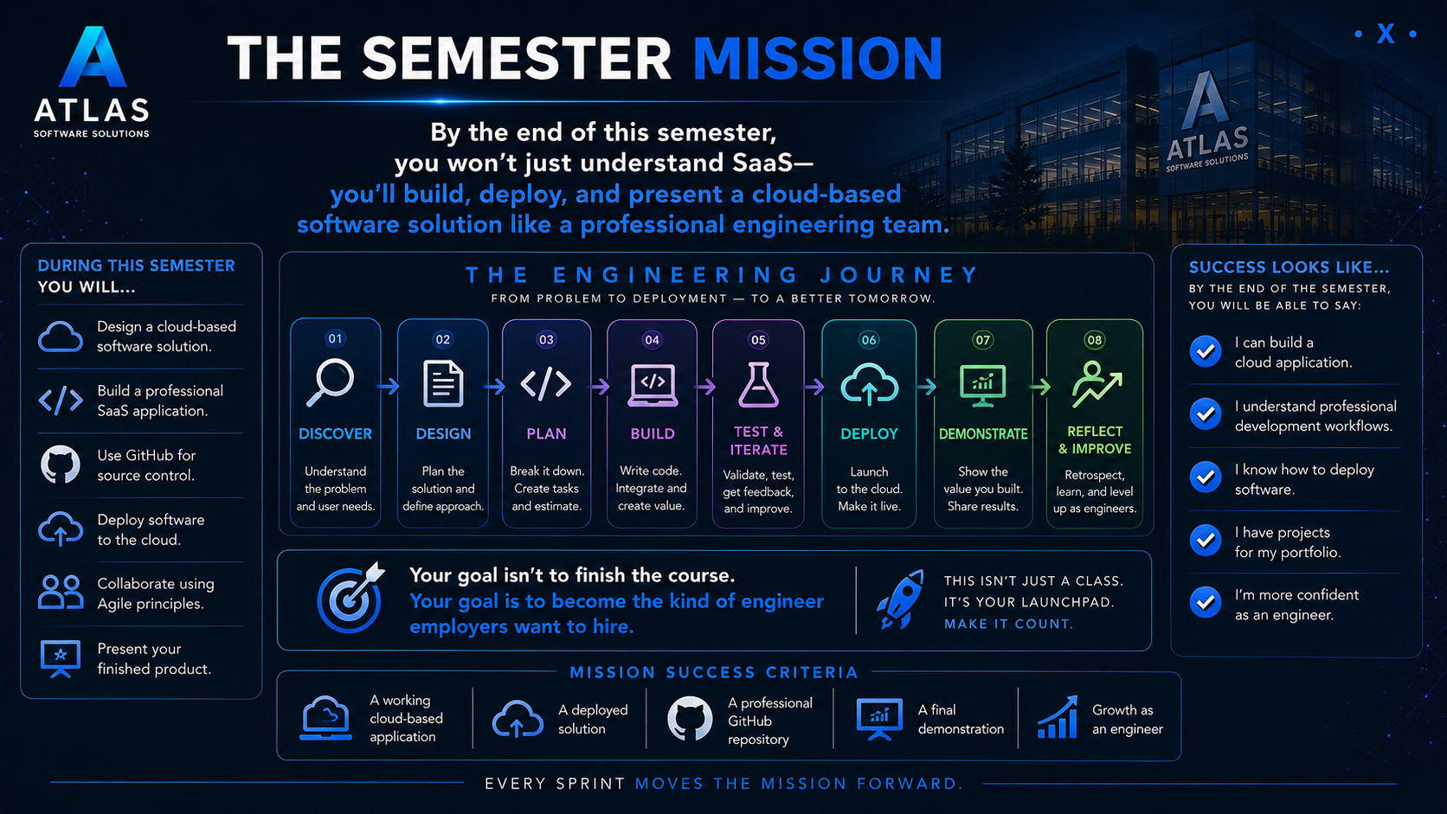
Semester Mission

Slide 12
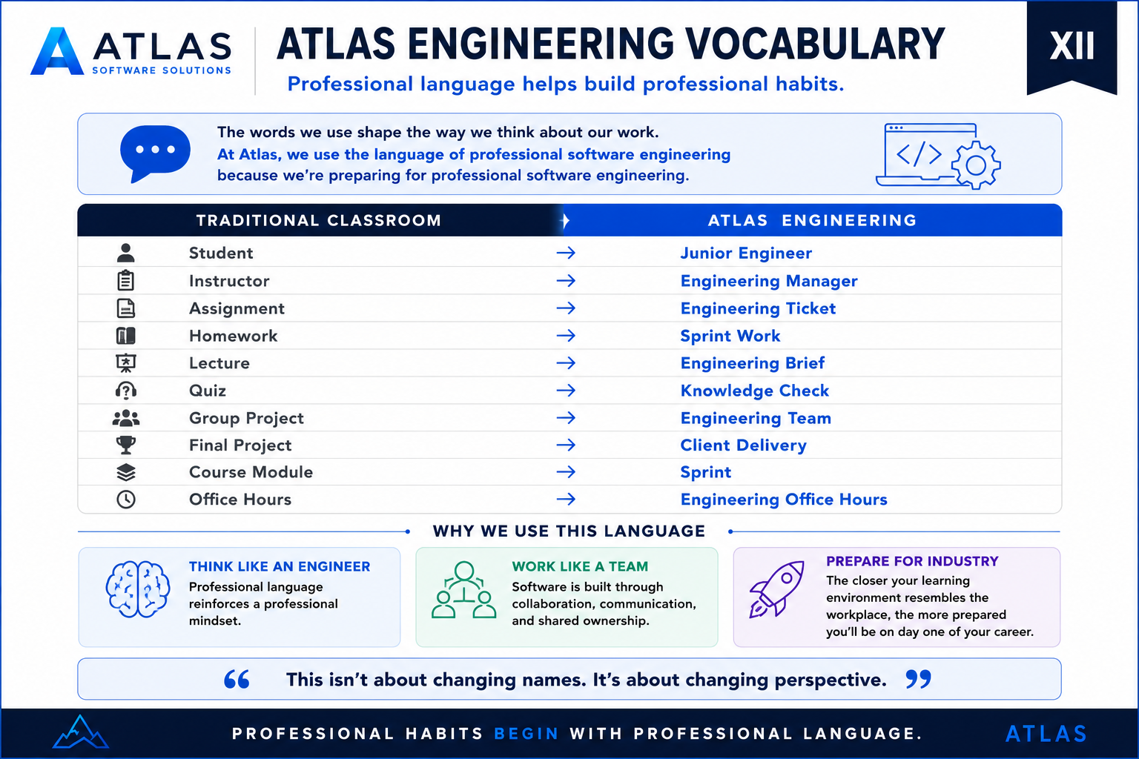
Engineering Vocabulary

Slide 13
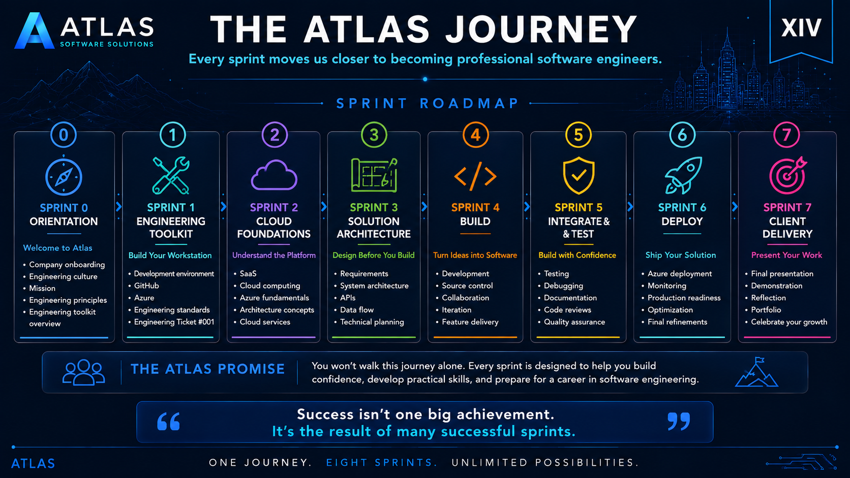
The Atlas Journey
Notes:
"In my career, I've written code that I'm incredibly proud of—and I've written code I'd never want anyone to see again. Both experiences made me a better engineer. Growth doesn't come from avoiding mistakes; it comes from learning from them."

Slide 14
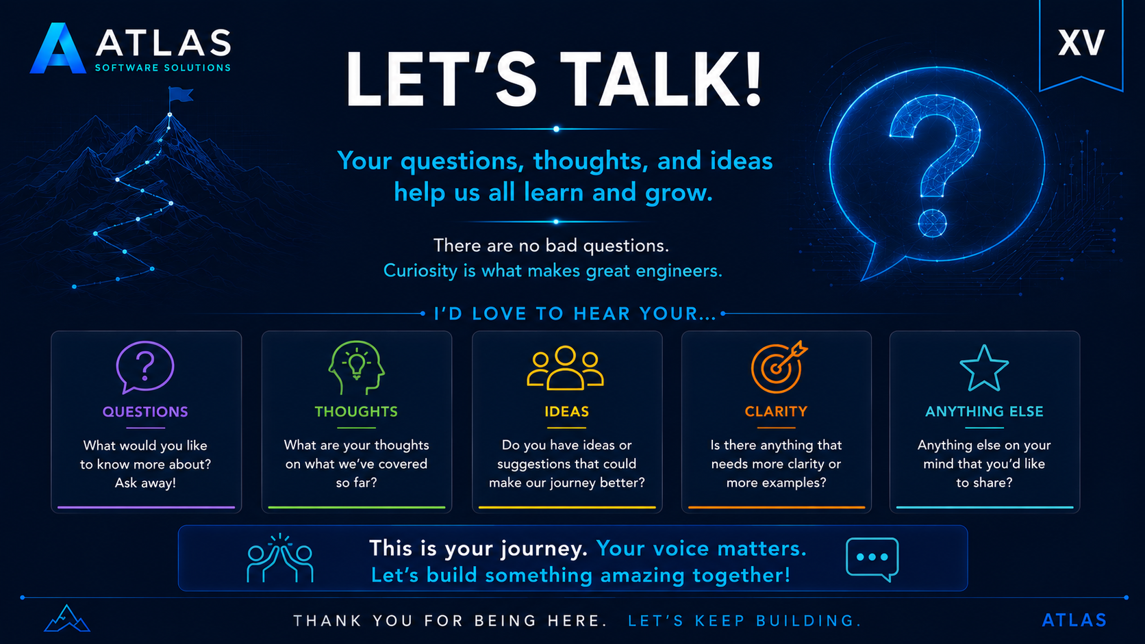
Questions

