Slide 1
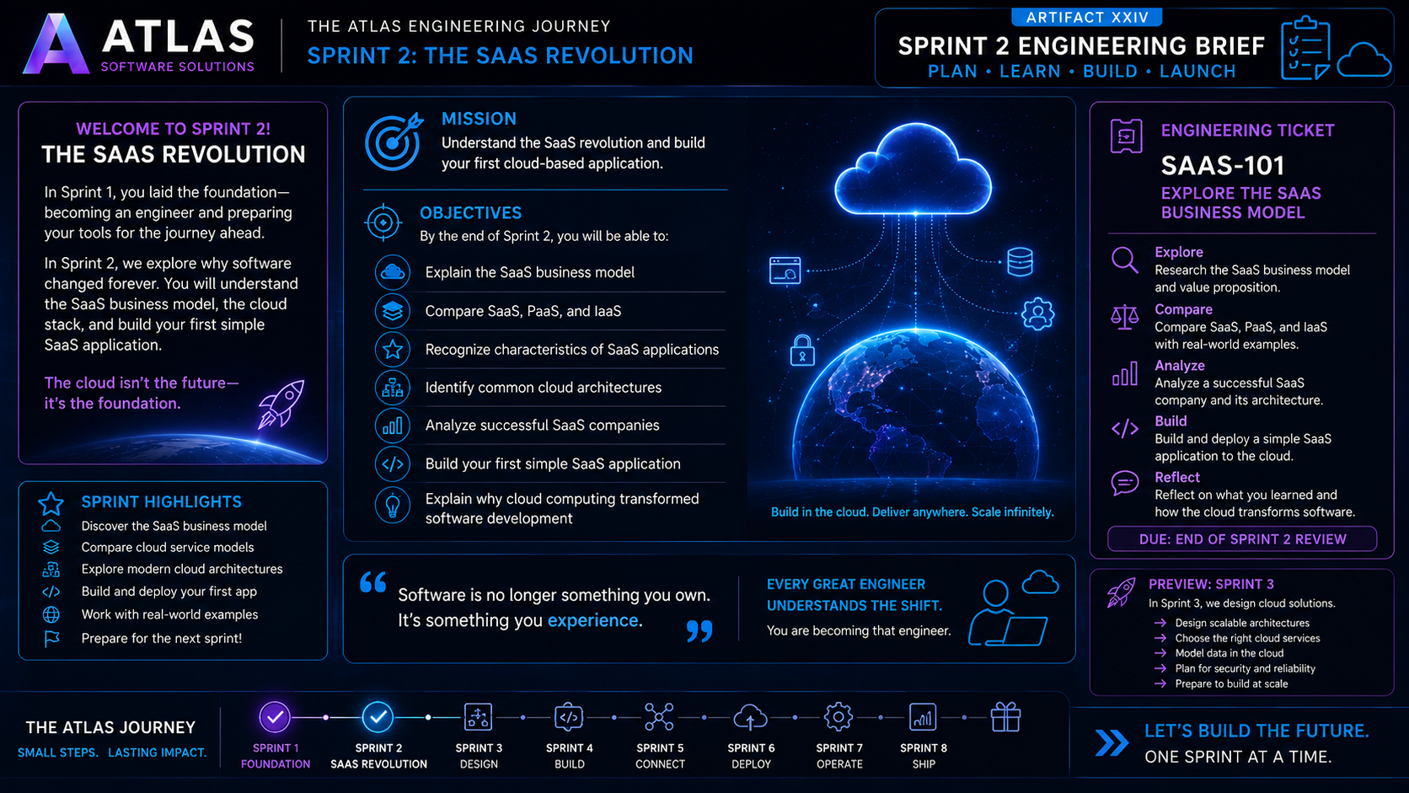
Opening slide
Notes:
============================================================
ARTIFACT XXIV
SPRINT 2 ENGINEERING BRIEF
============================================================
SLIDE PURPOSE
Welcome students to Sprint 2 and establish the theme for the next phase
of their engineering journey.
Students should understand that Sprint 1 focused on becoming engineers.
Sprint 2 shifts their focus toward understanding why Software as a
Service transformed the software industry.
By the end of this sprint, students should see cloud computing not as a
technology trend, but as the foundation of modern software development.
------------------------------------------------------------
OPENING
"Congratulations."
"You've officially completed your first engineering sprint."
"Last week, you built your engineering workstation."
"You created your first GitHub repository."
"You made your first commit."
"You completed your first engineering ticket."
"Today..."
"We begin understanding the technology that powers almost every modern
application you use."
"Welcome to Sprint 2."
------------------------------------------------------------
SPRINT RECAP
Before we move forward, let's remember where we came from.
Sprint 1 was about becoming an engineer.
You learned:
• Professional development tools
• Git
• GitHub
• Azure
• Documentation
• Version control
Those tools prepared you to build software professionally.
Now it's time to understand what you're building.
------------------------------------------------------------
MISSION
Read the mission statement.
"Our mission for Sprint 2 is simple."
"We're going to understand why the software industry changed forever."
"This sprint isn't about memorizing definitions."
"It's about understanding the biggest shift in software development over
the last twenty years."
------------------------------------------------------------
LEARNING OBJECTIVES
Walk through each learning outcome.
Explain the SaaS business model.
Compare SaaS, PaaS, and IaaS.
Recognize SaaS characteristics.
Understand cloud architecture.
Analyze successful SaaS companies.
Build your first simple SaaS application.
Explain how cloud computing transformed software development.
Pause after each objective.
Briefly explain why it matters professionally.
------------------------------------------------------------
THE BIG QUESTION
Ask the class:
"How many software applications did you install this morning?"
(Pause.)
Most students will answer:
"None."
Then ask:
"How many did you use?"
Students will begin listing:
Microsoft Teams
ChatGPT
Spotify
Netflix
Discord
Google Docs
Canvas
Microsoft 365
D2L
Now smile.
"You used software all morning."
"You just didn't install any of it."
"That's the SaaS Revolution."
Pause.
Allow that realization to settle.
------------------------------------------------------------
ENGINEERING TICKET
Introduce SAAS-101.
Explain that this sprint's ticket is different.
Last sprint focused on setup.
This sprint focuses on understanding.
Students will investigate:
How SaaS works.
Why businesses adopted it.
How cloud applications are built.
Why subscriptions replaced software boxes.
------------------------------------------------------------
ENGINEERING STORY
Tell the story of software before the cloud.
Ask:
"How many of you remember buying software in a store?"
Describe:
Buying Microsoft Office on CDs.
Installing software.
Entering license keys.
Waiting for updates.
Explain how frustrating software deployment used to be.
Then compare that to opening a browser today.
No installation.
No updates.
No maintenance.
Only access.
That's why SaaS won.
------------------------------------------------------------
ENGINEERING LESSON
Technology evolves because it solves problems.
SaaS wasn't created because it was exciting.
It succeeded because it removed friction.
It made software easier to deliver.
Easier to update.
Easier to scale.
Easier to maintain.
Professional engineers solve problems.
SaaS solved one of the biggest problems software ever had.
------------------------------------------------------------
CLASS DISCUSSION
Ask the room:
"What SaaS applications do you use every day?"
Create a list on the board.
Then ask:
"What do all of these applications have in common?"
Guide students toward answers like:
Browser
Internet
Subscriptions
Automatic updates
Cloud
Accessibility
------------------------------------------------------------
TRANSITION
"Now that we've established why software changed..."
"Let's discover exactly what Software as a Service really means."
"Welcome to the SaaS Revolution."
------------------------------------------------------------
ESTIMATED TIME
Opening......................3 minutes
Sprint Review................3 minutes
Mission......................2 minutes
Objectives...................5 minutes
Class Discussion.............8 minutes
Engineering Story............5 minutes
Transition...................2 minutes
Total........................28 minutes
------------------------------------------------------------
INSTRUCTOR NOTES
This is not a technical lecture.
Do not begin with definitions.
Begin with experiences.
Students already understand SaaS.
They simply don't know the name yet.
Keep asking questions.
Encourage discussion.
Allow students to discover the concept before you define it.
Close with:
"By the end of this sprint, you'll never look at software the same way
again."
============================================================
This is where I would add your own experience.
Tell students about the first time you realized software had fundamentally changed.
Maybe it was:
The first time you deployed a web application instead of installing one.
The first time you used Azure to publish an application.
The first time you realized you no longer needed installation media.
The first time you collaborated through GitHub instead of emailing ZIP files.
Keep it to 2–3 minutes. The goal is to connect the historical shift to your own career.

Slide 2
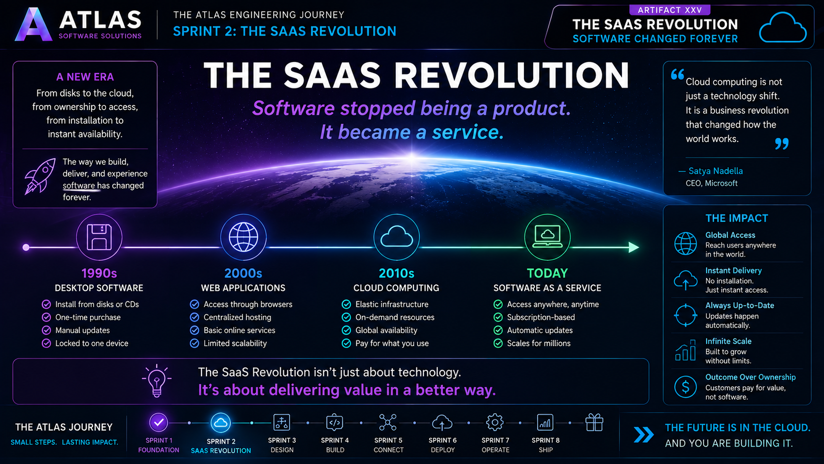
Saas Revolution
Notes:
============================================================
ARTIFACT XXV
THE SAAS REVOLUTION
============================================================
SLIDE PURPOSE
Introduce students to the historical shift from traditional desktop
software to Software as a Service (SaaS).
Students should understand that SaaS was not simply a new technology.
It was a fundamental change in how software is developed, delivered,
maintained, purchased, and experienced.
By the end of this lecture students should understand WHY SaaS became
the dominant software model.
------------------------------------------------------------
OPENING
"I want you to imagine it's 1998."
"You need Microsoft Office."
"What do you do?"
Wait for answers.
Students may say:
• Go to Best Buy
• Buy a CD
• Install it
• Enter a product key
Exactly.
Now ask:
"How many of you installed ChatGPT?"
(Pause.)
"How many of you installed Microsoft 365?"
"Spotify?"
"Google Docs?"
"Canvas?"
Most students will answer...
"I didn't."
Smile.
"Exactly."
"You still used the software."
"You just didn't own it."
"That's the SaaS Revolution."
Pause.
Let that sink in.
------------------------------------------------------------
THE BIG IDEA
Point to the Hero Statement.
Read it slowly.
"Software stopped being a product."
"It became a service."
This single sentence summarizes the biggest change in software
development over the last twenty years.
------------------------------------------------------------
THE TIMELINE
Walk through each era.
1990s
Desktop Software
Software lived on your computer.
You bought it once.
Installed it yourself.
Updates were manual.
If your computer died...
Your software disappeared.
------------------------------------------------------------
2000s
Web Applications
The Internet changed everything.
Software moved into browsers.
Companies no longer needed to distribute CDs.
Updates became easier.
Users could access applications from multiple devices.
------------------------------------------------------------
2010s
Cloud Computing
Infrastructure became virtual.
Servers moved into data centers.
Businesses stopped purchasing hardware.
Cloud providers handled scaling,
storage,
security,
and availability.
Software became easier to build.
------------------------------------------------------------
Today
Software as a Service
Software is always available.
Always updated.
Always improving.
Customers subscribe instead of purchasing.
Applications scale to millions of users.
Software became an ongoing relationship instead of a one-time sale.
------------------------------------------------------------
THE IMPACT PANEL
Walk through each item.
Global Access
Anyone with an internet connection can use software.
Instant Delivery
No installation.
No waiting.
Create an account.
Start working.
Always Updated
Developers deploy improvements continuously.
Users receive new features automatically.
Infinite Scale
Applications can grow from
100 users
to
100 million users.
Outcome Over Ownership
Customers care less about owning software.
They care about solving problems.
------------------------------------------------------------
ENGINEERING STORY
Tell your own story.
Possible examples:
Buying software from Office Depot.
Installing Windows from CDs.
Scratching installation discs.
Searching for serial numbers.
Downloading service packs.
Waiting hours for updates.
Then compare that experience with opening a browser today.
Ask:
"Which experience would you rather have?"
------------------------------------------------------------
ENGINEERING LESSON
Technology evolves when it removes friction.
SaaS removed almost every frustration users experienced with traditional
software.
Professional engineers solve problems.
SaaS solved one of the biggest problems software ever had:
Software distribution.
------------------------------------------------------------
CLASS DISCUSSION
Ask:
"What software do you use every day?"
Write answers on the board.
Then ask:
"Which of these did you install?"
Most students will realize...
Almost none.
Then ask:
"Why do you think companies prefer subscriptions instead of selling
software once?"
Guide discussion toward:
Predictable revenue
Automatic updates
Continuous improvement
Customer retention
Lower support costs
------------------------------------------------------------
REAL-WORLD EXAMPLES
Discuss applications students already know.
Microsoft 365
Netflix
Spotify
Salesforce
Adobe Creative Cloud
Google Workspace
GitHub
ChatGPT
Discord
Zoom
Canvas
D2L
Ask:
"What do all of these have in common?"
------------------------------------------------------------
TRANSITION
"Now that we understand why software changed..."
"Let's discover why businesses embraced this model so quickly."
"Our next topic..."
"Why SaaS Won."
------------------------------------------------------------
ESTIMATED TIME
Opening........................5 minutes
Timeline.......................10 minutes
Impact.........................5 minutes
Engineering Story..............5 minutes
Discussion.....................8 minutes
Transition.....................2 minutes
Total..........................35 minutes
------------------------------------------------------------
INSTRUCTOR NOTES
This lecture is about perspective.
Avoid jumping into technical definitions.
Keep the conversation historical.
Students should discover the advantages naturally.
Use plenty of questions.
Use real products they already use every day.
The goal is for students to realize that SaaS isn't the future.
It's already their everyday reality.
Close with:
"The software industry didn't simply invent a better product.
It invented a better way to deliver value.
That's why the SaaS Revolution changed everything."
============================================================
🎤 Personal Story Opportunity
This is where I would tell students about buying software in the late 1990s or early 2000s—going to a store, bringing home a box, installing from CDs, entering a product key, and hunting for updates. Then contrast that with opening a browser today and immediately using Microsoft 365, GitHub, or ChatGPT.
That comparison is something many students have never experienced, which makes the shift feel real instead of abstract.

Slide 3
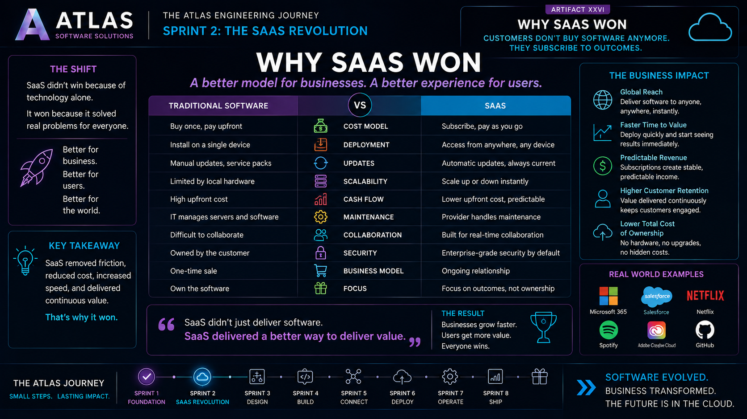
Why Saas Won
Notes:
============================================================
ARTIFACT XXVI
WHY SAAS WON
============================================================
SLIDE PURPOSE
Help students understand why Software as a Service became the dominant
software delivery model.
Students should recognize that SaaS did not win because it was newer.
It won because it solved real problems for customers, businesses,
developers, and IT departments.
By the end of this lecture students should understand that SaaS changed
both technology AND business.
------------------------------------------------------------
OPENING
"I have another question for you."
"If you had to choose between these two options..."
Option A
Pay $900 today.
Install software yourself.
Maintain it yourself.
Upgrade it yourself.
Hope your computer never crashes.
OR...
Option B
Pay $15 a month.
Open your browser.
Start working.
Which would you choose?"
(Pause.)
Almost everyone chooses Option B.
Smile.
"That's exactly why SaaS won."
------------------------------------------------------------
THE BIG IDEA
Read the Hero Statement.
"Customers don't buy software anymore."
"They subscribe to outcomes."
Pause.
Ask:
"What outcome are people buying from Netflix?"
Entertainment.
"What outcome are people buying from Spotify?"
Music.
"What outcome are people buying from Microsoft 365?"
Productivity.
"What outcome are people buying from ChatGPT?"
Intelligence and assistance.
People aren't buying software.
They're buying solutions.
------------------------------------------------------------
THE COMPARISON TABLE
Walk through each row slowly.
Do not rush.
Cost Model
Traditional Software
Buy once.
Large upfront investment.
SaaS
Small recurring payments.
Lower barrier to entry.
Deployment
Traditional
Install software.
Configure computers.
Manage licenses.
SaaS
Open browser.
Log in.
Start working.
Updates
Traditional
Manual patches.
Service packs.
Version upgrades.
SaaS
Continuous deployment.
Automatic updates.
Users always have the latest version.
Scalability
Traditional
Buy larger servers.
Purchase more hardware.
SaaS
Scale instantly.
Add users in minutes.
Maintenance
Traditional
Your IT department owns maintenance.
SaaS
The provider manages infrastructure.
Collaboration
Traditional
Email files.
USB drives.
Shared folders.
SaaS
Real-time collaboration.
Everyone works together.
Business Model
Traditional
One-time transaction.
SaaS
Long-term customer relationship.
Focus
Traditional
Selling software.
SaaS
Delivering value continuously.
------------------------------------------------------------
THE BUSINESS IMPACT
Discuss each business benefit.
Global Reach
Your customers can work from anywhere.
Faster Time to Value
Customers begin benefiting immediately.
Predictable Revenue
Subscriptions provide stable income.
Higher Customer Retention
Satisfied customers continue subscribing.
Lower Total Cost of Ownership
Businesses avoid expensive infrastructure
and maintenance costs.
------------------------------------------------------------
REAL-WORLD EXAMPLES
Point to each logo.
Microsoft 365
Salesforce
Netflix
Spotify
Adobe Creative Cloud
GitHub
Ask:
"What do these companies all have in common?"
Guide students toward:
Subscriptions
Automatic updates
Cloud access
Continuous improvement
Customer accounts
Scalability
------------------------------------------------------------
ENGINEERING STORY
Share your own experience.
Possible ideas:
Installing Microsoft Office from CDs.
Buying Adobe Photoshop once every few years.
Managing software licenses.
Waiting hours for updates.
Then compare that experience to using
Microsoft 365 today.
Ask:
"Which model would you rather support as an engineer?"
------------------------------------------------------------
ENGINEERING LESSON
Technology wins when it removes friction.
Business wins when customers receive value faster.
SaaS accomplished both.
That's why it became the dominant model.
------------------------------------------------------------
CLASS DISCUSSION
Ask the class:
"If you started a software company tomorrow..."
"Would you sell software once..."
"...or would you build a SaaS product?"
Why?
Allow discussion.
Students usually begin thinking like entrepreneurs.
------------------------------------------------------------
REAL-WORLD CHALLENGE
Present this scenario.
Imagine you own a company with 500 employees.
Would you rather:
Install software on 500 computers?
Or...
Give everyone a login?
Which option is easier?
Why?
------------------------------------------------------------
TRANSITION
"Now that we understand WHY SaaS became successful..."
"It's time to understand the cloud services that make it possible."
"Our next topic..."
"SaaS vs. PaaS vs. IaaS."
------------------------------------------------------------
ESTIMATED TIME
Opening......................4 minutes
Comparison Table............12 minutes
Business Impact..............6 minutes
Engineering Story............5 minutes
Discussion...................8 minutes
Transition...................2 minutes
Total........................37 minutes
------------------------------------------------------------
INSTRUCTOR NOTES
This is not a feature comparison.
It is a discussion about value.
Keep asking "Why?"
Why do customers like subscriptions?
Why do businesses like subscriptions?
Why do developers like continuous deployment?
Why do investors like recurring revenue?
Help students discover that SaaS succeeded because everyone
benefited.
Close with:
"SaaS didn't win because it was newer.
It won because it created a better experience for everyone."
============================================================

Slide 4
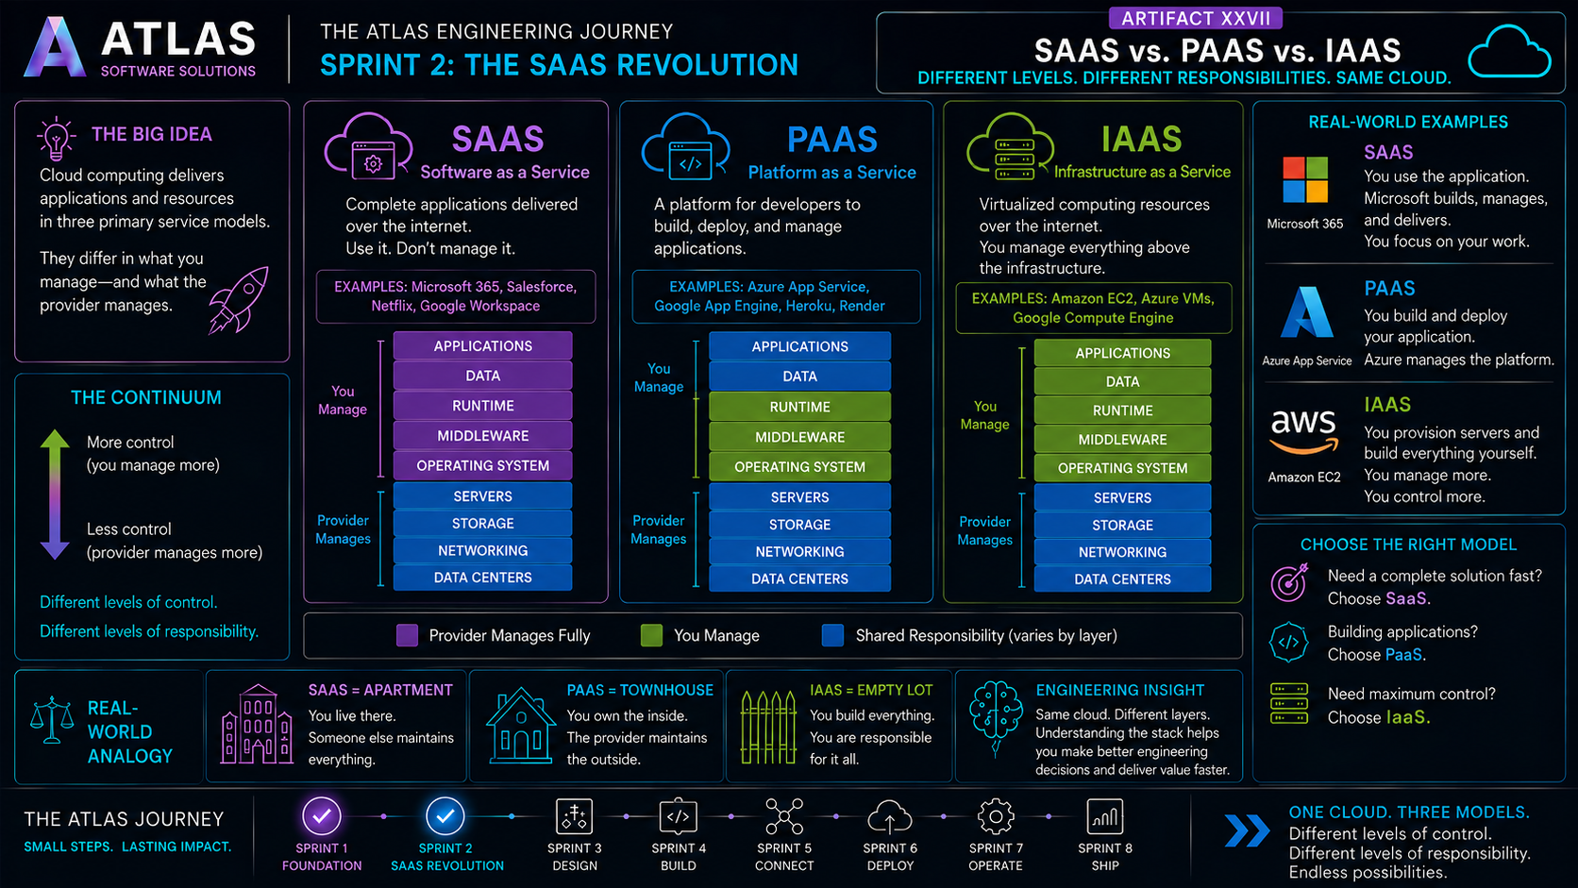
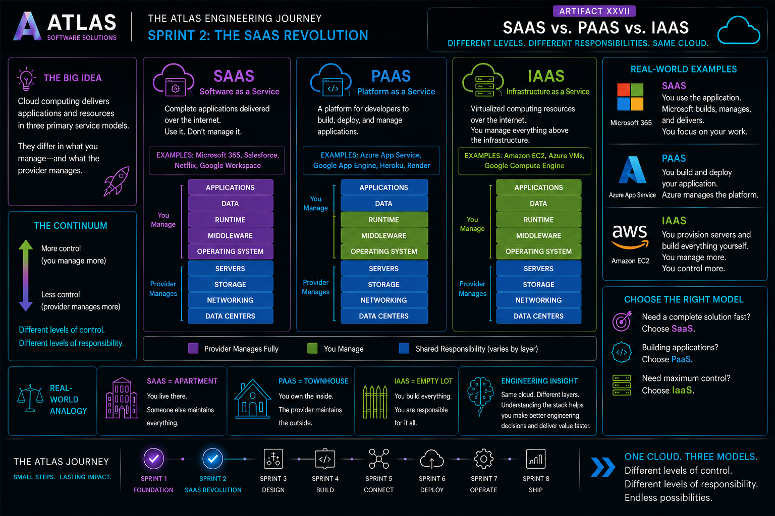
PAAS vs SAAS vs IAAS
Notes:
============================================================
ARTIFACT XXVII
SAAS vs. PAAS vs. IAAS
============================================================
SLIDE PURPOSE
Introduce the three primary cloud service models and help students
understand the differences between Software as a Service (SaaS),
Platform as a Service (PaaS), and Infrastructure as a Service (IaaS).
Students should leave understanding that the models are not competing
technologies—they are different levels of responsibility within the
same cloud ecosystem.
The key lesson:
The more control you want, the more responsibility you have.
------------------------------------------------------------
OPENING
"I have a question."
"Who has ever rented an apartment?"
(Pause.)
"When something breaks..."
"Who fixes it?"
(The landlord.)
"Now imagine you buy a house."
"When the roof leaks..."
"Who fixes it?"
(You.)
"Cloud computing works exactly the same way."
"The more you own..."
"The more you're responsible for."
"Today we're going to learn the three different ways companies use the
cloud."
------------------------------------------------------------
THE BIG IDEA
Point to the title.
"SaaS."
"PaaS."
"IaaS."
"They're all cloud computing."
"They simply divide responsibilities differently."
Professional engineers choose the model that best fits the problem they
are trying to solve.
------------------------------------------------------------
THE RESPONSIBILITY STACK
Point to the stacked diagrams.
Explain that every application is built on layers.
Applications
Data
Runtime
Middleware
Operating System
Servers
Storage
Networking
Data Centers
Every cloud service manages these layers differently.
------------------------------------------------------------
SAAS
Read the definition.
"Software as a Service."
You use the application.
You do not manage the infrastructure.
Examples:
Microsoft 365
Google Workspace
Salesforce
Netflix
Spotify
GitHub
ChatGPT
Explain:
You simply sign in and begin working.
Microsoft manages everything behind the scenes.
Analogy:
Living in an apartment.
You enjoy the space.
Someone else maintains the building.
------------------------------------------------------------
PAAS
Read the definition.
"Platform as a Service."
You build applications.
The cloud provider manages the platform.
Examples:
Azure App Service
Google App Engine
Heroku
Render
Explain:
You write code.
Deploy your application.
The provider manages operating systems,
servers,
storage,
networking,
and much of the runtime environment.
Analogy:
Owning a food truck.
You prepare the food.
Someone else maintains the parking lot,
utilities,
and infrastructure.
------------------------------------------------------------
IAAS
Read the definition.
"Infrastructure as a Service."
You provision virtual machines.
You manage almost everything yourself.
Examples:
Amazon EC2
Azure Virtual Machines
Google Compute Engine
Explain:
You choose the operating system.
Install software.
Configure security.
Maintain updates.
Manage storage.
Scale resources.
Maximum flexibility.
Maximum responsibility.
Analogy:
Buying land and building your own house.
Everything belongs to you.
Everything is your responsibility.
------------------------------------------------------------
REAL-WORLD EXAMPLES
Walk through each example.
Microsoft 365
Use the application.
Azure App Service
Deploy applications without managing servers.
Amazon EC2
Build and configure everything yourself.
Ask:
"Which one sounds easiest?"
Most students answer SaaS.
Then ask:
"Which one gives you the most flexibility?"
Students answer IaaS.
Then explain:
"There is no universally better option."
"There is only the right option for the problem."
------------------------------------------------------------
THE CHOOSE THE RIGHT MODEL PANEL
Review each scenario.
Need software quickly?
Choose SaaS.
Building applications?
Choose PaaS.
Need complete infrastructure control?
Choose IaaS.
Discuss why.
------------------------------------------------------------
ENGINEERING STORY
Share a personal experience.
Example:
"When I first started developing software, I thought I needed complete
control over everything."
"I eventually realized that managing servers wasn't helping me build
better software."
"When I moved to Azure App Service, I spent less time maintaining
infrastructure and more time writing code."
Lesson Learned:
Great engineers don't manage complexity they don't need.
------------------------------------------------------------
ENGINEERING LESSON
The cloud isn't one thing.
It's a collection of services.
Professional engineers understand which layer they should own...
...and which layer they should allow the cloud provider to manage.
Choosing the correct service model saves time,
reduces cost,
improves reliability,
and allows teams to focus on delivering value.
------------------------------------------------------------
CLASS DISCUSSION
Ask the room:
"If you wanted to build the next Spotify..."
"Which cloud model would you choose?"
Why?
Then ask:
"If you wanted to create your own operating system..."
"Would SaaS still work?"
Guide students toward understanding that different problems require
different levels of control.
------------------------------------------------------------
REAL-WORLD CHALLENGE
Scenario:
A startup has five developers.
They need to launch quickly.
Would you recommend:
SaaS
PaaS
or
IaaS?
Why?
Allow discussion.
Most students should conclude that PaaS is the best balance.
------------------------------------------------------------
TRANSITION
"Now that we understand the cloud service models..."
"It's time to see how they work together."
"Our next topic..."
"Modern SaaS Architecture."
"We're finally going to look behind the browser and see what powers the
applications we use every day."
------------------------------------------------------------
ESTIMATED TIME
Opening......................5 minutes
Cloud Stack.................10 minutes
Service Models..............15 minutes
Discussion...................8 minutes
Engineering Story............4 minutes
Transition...................2 minutes
Total........................44 minutes
------------------------------------------------------------
INSTRUCTOR NOTES
Do not teach this as three separate definitions.
Teach it as one continuum.
Keep returning to the central idea:
More control = More responsibility.
Use the apartment, food truck, and house analogies throughout the
lecture.
Ask students questions frequently.
Encourage them to explain their reasoning.
This lecture is successful when students can confidently recommend the
appropriate cloud model for a real-world scenario.
Close with:
"The cloud gives us choices.
Great engineers know which choice is right for the problem they are
solving."
============================================================
⭐ Atlas Teaching Tip
I think this slide should end with one sentence that students will remember:
"SaaS lets you use software. PaaS lets you build software. IaaS lets you build the foundation that software runs on."

Slide 5
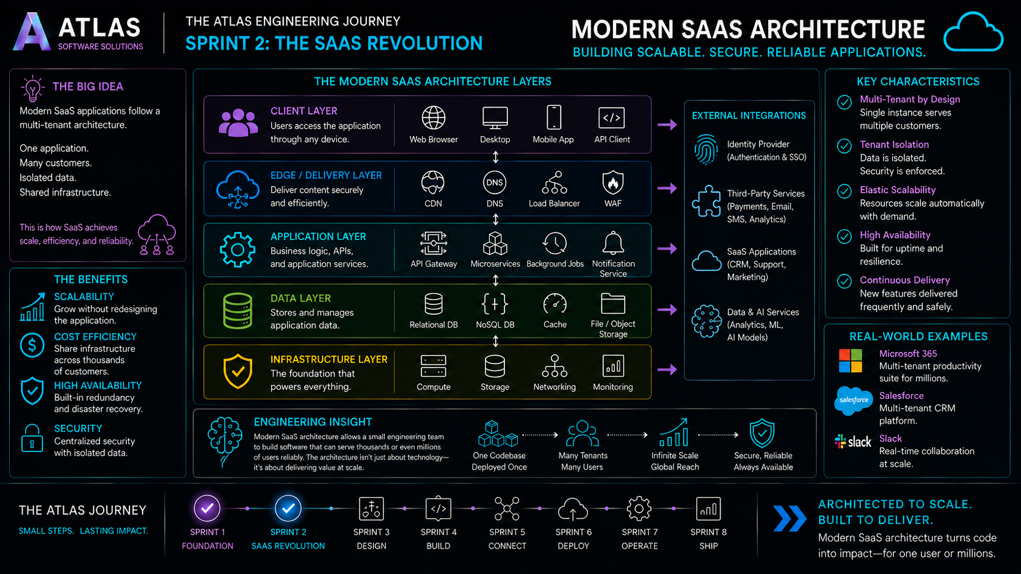
Layers in WEB
Notes:
============================================================
ARTIFACT XXVIII
MODERN SAAS ARCHITECTURE
============================================================
SLIDE PURPOSE
Introduce students to the high-level architecture of a modern Software
as a Service (SaaS) application.
Students should understand that cloud applications are not a single
program running on one computer. Instead, they are composed of multiple
services working together to provide a reliable, secure, and scalable
experience.
By the end of this lesson, students should be able to describe the
journey of a user request from a browser through the cloud and back
again.
------------------------------------------------------------
OPENING
"I'd like everyone to imagine something."
"You open your browser."
"You navigate to GitHub."
"You sign into Microsoft Teams."
"You ask ChatGPT a question."
"Or maybe you watch a movie on Netflix."
Pause.
"Have you ever wondered what actually happens after you press Enter?"
"Today we're going behind the curtain."
"We're going to follow a request through a modern SaaS application."
------------------------------------------------------------
THE BIG IDEA
Read the hero statement.
"Modern SaaS applications are designed to be scalable, secure, and
reliable."
Explain that these applications are built from layers.
Each layer has a specific responsibility.
Together, those layers create the experience users enjoy every day.
------------------------------------------------------------
CLIENT LAYER
Begin at the top.
Everything starts with the user.
Desktop computers.
Laptops.
Phones.
Tablets.
Web browsers.
Native mobile applications.
API clients.
Explain:
No matter what device someone uses...
Every request begins here.
------------------------------------------------------------
EDGE / DELIVERY LAYER
Now move to the next layer.
This is responsible for getting requests into the application.
Discuss:
Content Delivery Networks (CDNs)
DNS
Load Balancers
Web Application Firewalls (WAF)
Explain each briefly.
CDN
Delivers content closer to users.
DNS
Finds the application.
Load Balancer
Distributes traffic across servers.
WAF
Protects the application from malicious traffic.
Analogy:
Think of this as the highway system leading customers to your business.
------------------------------------------------------------
APPLICATION LAYER
This is where software engineers spend much of their time.
Business Logic
APIs
Microservices
Background Jobs
Notifications
Explain:
This is where your code lives.
Every feature users interact with eventually reaches this layer.
Shopping carts.
Student records.
Messaging.
Scheduling.
Inventory.
Authentication.
These are all implemented here.
------------------------------------------------------------
DATA LAYER
Applications need information.
Discuss:
Relational Databases
NoSQL Databases
Caching
Object Storage
Explain:
Different types of information require different storage solutions.
Structured data belongs in databases.
Images and files belong in object storage.
Frequently used data belongs in cache.
The goal is speed and reliability.
------------------------------------------------------------
INFRASTRUCTURE LAYER
Everything ultimately runs on infrastructure.
Compute
Storage
Networking
Monitoring
Explain:
Cloud providers such as Azure, AWS, and Google Cloud provide these
resources.
As engineers, we build applications on top of this foundation.
------------------------------------------------------------
EXTERNAL INTEGRATIONS
Modern applications rarely work alone.
Identity Providers
Payment Gateways
Email Services
Analytics Platforms
Artificial Intelligence Services
Explain:
Professional software connects to many other systems.
We don't reinvent every capability.
We integrate existing services whenever appropriate.
------------------------------------------------------------
KEY CHARACTERISTICS
Review the five principles.
Multi-Tenant by Design
One application.
Many customers.
Tenant Isolation
Each customer's data remains private.
Elastic Scalability
Resources expand and contract automatically.
High Availability
Applications stay online.
Continuous Delivery
Software improves constantly.
Explain:
These characteristics distinguish SaaS from traditional desktop
software.
------------------------------------------------------------
ENGINEERING INSIGHT
Read the Engineering Insight.
"Modern SaaS architecture allows a small engineering team to build
software that can serve thousands—or even millions—of users."
Explain:
Architecture isn't just about technology.
It's about making software dependable, maintainable, and scalable.
------------------------------------------------------------
REAL-WORLD EXAMPLES
Point to the examples.
Microsoft 365
Salesforce
Slack
Ask:
"What architectural components do you think these companies have in
common?"
Guide discussion.
Students should recognize:
Authentication
Databases
APIs
Load balancing
Cloud infrastructure
Monitoring
------------------------------------------------------------
ENGINEERING STORY
Share one of your own deployment experiences.
Example:
"The first time I published a web application..."
"I thought the web server WAS the application."
"I quickly discovered there were databases, authentication services,
logging, monitoring, backups, and cloud infrastructure working together
behind the scenes."
Explain that understanding architecture changes how engineers think
about software.
------------------------------------------------------------
ENGINEERING LESSON
Professional software isn't just code.
It's a system.
Every layer contributes to the user experience.
The better we understand those layers...
The better software we build.
------------------------------------------------------------
CLASS DISCUSSION
Ask:
"If one of these layers failed..."
"What would users experience?"
Examples:
No Database?
No user information.
No Load Balancer?
Slow performance.
No Authentication?
Security risks.
No CDN?
Longer loading times.
Help students recognize that every component has a purpose.
------------------------------------------------------------
TRANSITION
"We've now seen how a modern SaaS application is built."
"But who actually provides all of this infrastructure?"
"Our next topic introduces the companies that make cloud computing
possible."
"The Cloud Providers."
------------------------------------------------------------
ESTIMATED TIME
Opening......................4 minutes
Architecture Overview........15 minutes
Layer Walkthrough............15 minutes
Engineering Story............5 minutes
Discussion...................8 minutes
Transition...................3 minutes
Total........................50 minutes
------------------------------------------------------------
INSTRUCTOR NOTES
Keep the lecture conceptual.
Do not focus on implementation details.
Instead, help students understand how the layers work together.
Use the architecture diagram repeatedly.
Ask students to follow the flow of a request from the client to the
database and back.
Students should leave class thinking:
"Software isn't one program."
"It's an ecosystem of services working together."
Close with:
"The best software architecture is almost invisible.
When everything works together, users simply click a button—and it just
works.
As software engineers, that's exactly what we're building."
============================================================

Slide 6
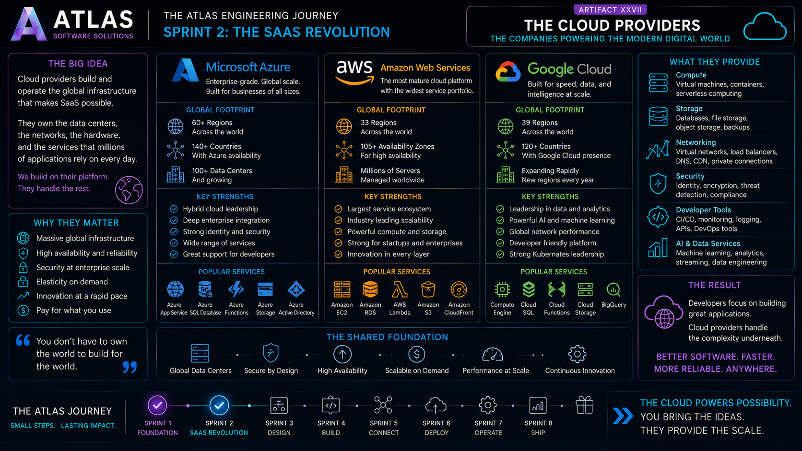
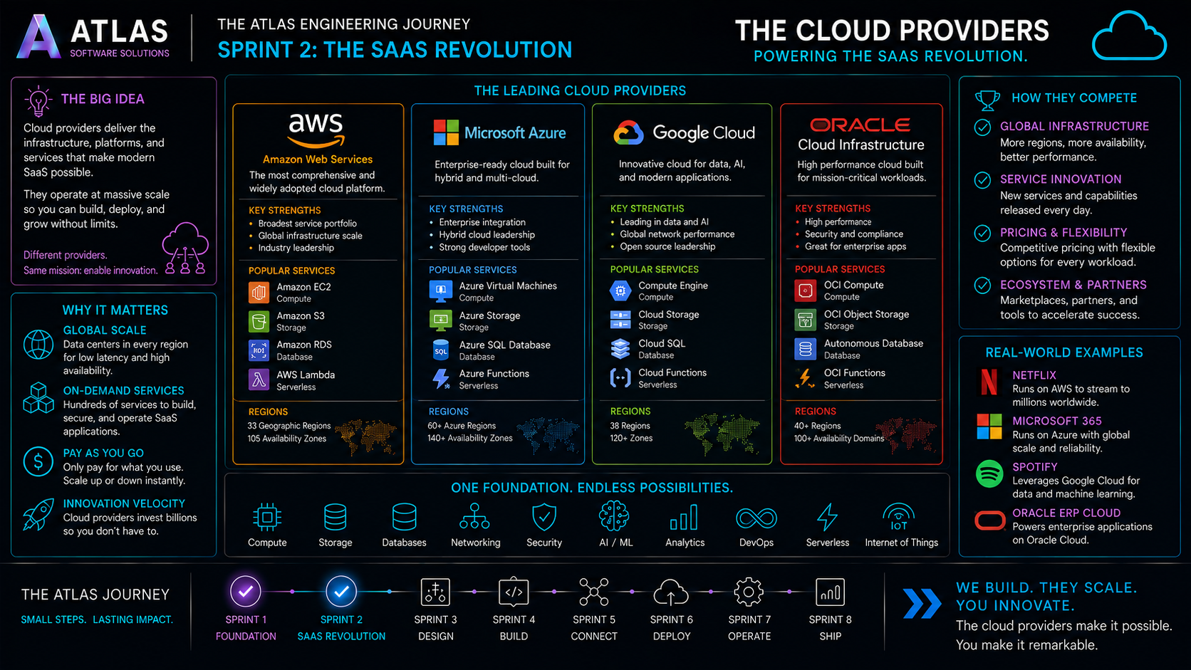
The Cloud Providers
Notes:
============================================================
ARTIFACT XXIX
THE CLOUD PROVIDERS
============================================================
SLIDE PURPOSE
Introduce students to the major cloud providers that power modern SaaS
applications.
Students should understand that Azure, Amazon Web Services (AWS), and
Google Cloud all provide similar foundational cloud services while
differing in strengths, ecosystems, and target markets.
By the end of this lecture students should understand that cloud
providers supply the infrastructure that enables software engineers to
build scalable, secure, globally available applications.
------------------------------------------------------------
OPENING
"I have a question."
"When you watch Netflix..."
"Where does the movie actually come from?"
(Pause.)
"When you open GitHub..."
"Where does GitHub actually live?"
"When you ask ChatGPT a question..."
"Where is it running?"
Students usually answer...
"The cloud."
Smile.
"That's true."
"But today we're going to learn who actually builds that cloud."
------------------------------------------------------------
THE BIG IDEA
Point to the opening statement.
"Cloud providers build and operate the global infrastructure that makes
modern software possible."
"They own the data centers."
"They manage the hardware."
"They maintain the networks."
"They provide the services."
"We build applications on top of everything they provide."
------------------------------------------------------------
MICROSOFT AZURE
Introduce Azure.
Explain that Azure is Microsoft's cloud platform.
Discuss its strengths.
Enterprise integration
Identity management
Hybrid cloud
Strong security
Excellent integration with Windows and Microsoft 365
Explain why Atlas uses Azure.
It integrates well with Visual Studio.
Azure for Students provides free resources.
It aligns with many enterprise environments students may encounter after
graduation.
------------------------------------------------------------
AMAZON WEB SERVICES (AWS)
Explain that AWS was the first major cloud provider.
Discuss strengths.
Largest collection of cloud services
Strong global infrastructure
Excellent scalability
Extensive documentation
Large market share
Mention that many startups and large technology companies rely on AWS.
------------------------------------------------------------
GOOGLE CLOUD
Introduce Google Cloud.
Discuss strengths.
Artificial intelligence
Machine learning
Data analytics
Networking
Kubernetes leadership
Explain that Google applies its experience operating products like
Search, Gmail, and YouTube to its cloud platform.
------------------------------------------------------------
COMMON SERVICES
Walk through the services all providers offer.
Compute
Virtual machines
Containers
Serverless computing
Storage
Databases
Object storage
File storage
Networking
Load balancers
Virtual networks
DNS
Security
Identity
Encryption
Threat protection
Developer Tools
CI/CD
Logging
Monitoring
APIs
Analytics
Artificial intelligence
Explain:
"The names may change."
"The concepts stay the same."
------------------------------------------------------------
THE SHARED FOUNDATION
Point to the bottom panel.
Global Data Centers
High Availability
Scalability
Security
Performance
Continuous Innovation
Explain:
No matter which provider you choose...
These are the capabilities they all strive to deliver.
------------------------------------------------------------
ENGINEERING STORY
Share a personal experience.
Example:
"The first time I deployed an application to Azure..."
"I realized I wasn't buying a server."
"I was renting exactly the resources I needed."
"As my application grew..."
"So did the cloud resources."
"I didn't have to purchase new hardware."
"The cloud grew with me."
------------------------------------------------------------
ENGINEERING LESSON
Software engineers build applications.
Cloud providers build platforms.
Understanding that relationship is one of the most important concepts in
modern software engineering.
The cloud allows us to focus on solving customer problems instead of
building and maintaining data centers.
------------------------------------------------------------
CLASS DISCUSSION
Ask the room:
"If you started a software company tomorrow..."
"Would you build your own data center..."
"...or rent cloud resources?"
Why?
Guide discussion toward:
Cost
Scalability
Maintenance
Security
Global reach
Reliability
------------------------------------------------------------
REAL-WORLD CHALLENGE
Scenario:
A startup launches an application.
It has 50 users today.
Six months later...
It has five million users.
Question:
How does cloud computing make that growth possible?
Allow students to discuss elasticity,
scaling,
global infrastructure,
and managed services.
------------------------------------------------------------
TRANSITION
"Now that we've met the companies powering the cloud..."
"It's time to stop studying cloud applications..."
"...and build one."
"Our next lesson..."
"Your First SaaS Application."
------------------------------------------------------------
ESTIMATED TIME
Opening......................4 minutes
Provider Overview...........15 minutes
Shared Services............10 minutes
Engineering Story...........5 minutes
Discussion...................8 minutes
Transition...................3 minutes
Total........................45 minutes
------------------------------------------------------------
INSTRUCTOR NOTES
Avoid turning this into a feature comparison.
Students do not need to memorize which provider offers which service.
Instead, emphasize the shared concepts.
Cloud providers solve the same fundamental problems:
Compute
Storage
Networking
Security
Scalability
Availability
Innovation
Keep returning to one central message:
The provider manages the infrastructure.
Engineers build the solutions.
Close with:
"The cloud isn't magic.
It's millions of computers working together so your software can reach
millions of people.
As software engineers, we don't build the cloud.
We build what the cloud makes possible."
============================================================

Slide 7
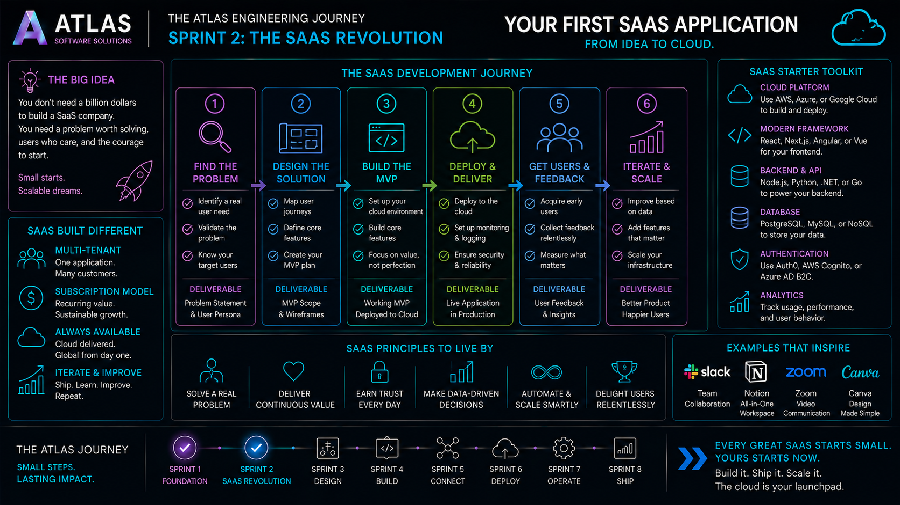
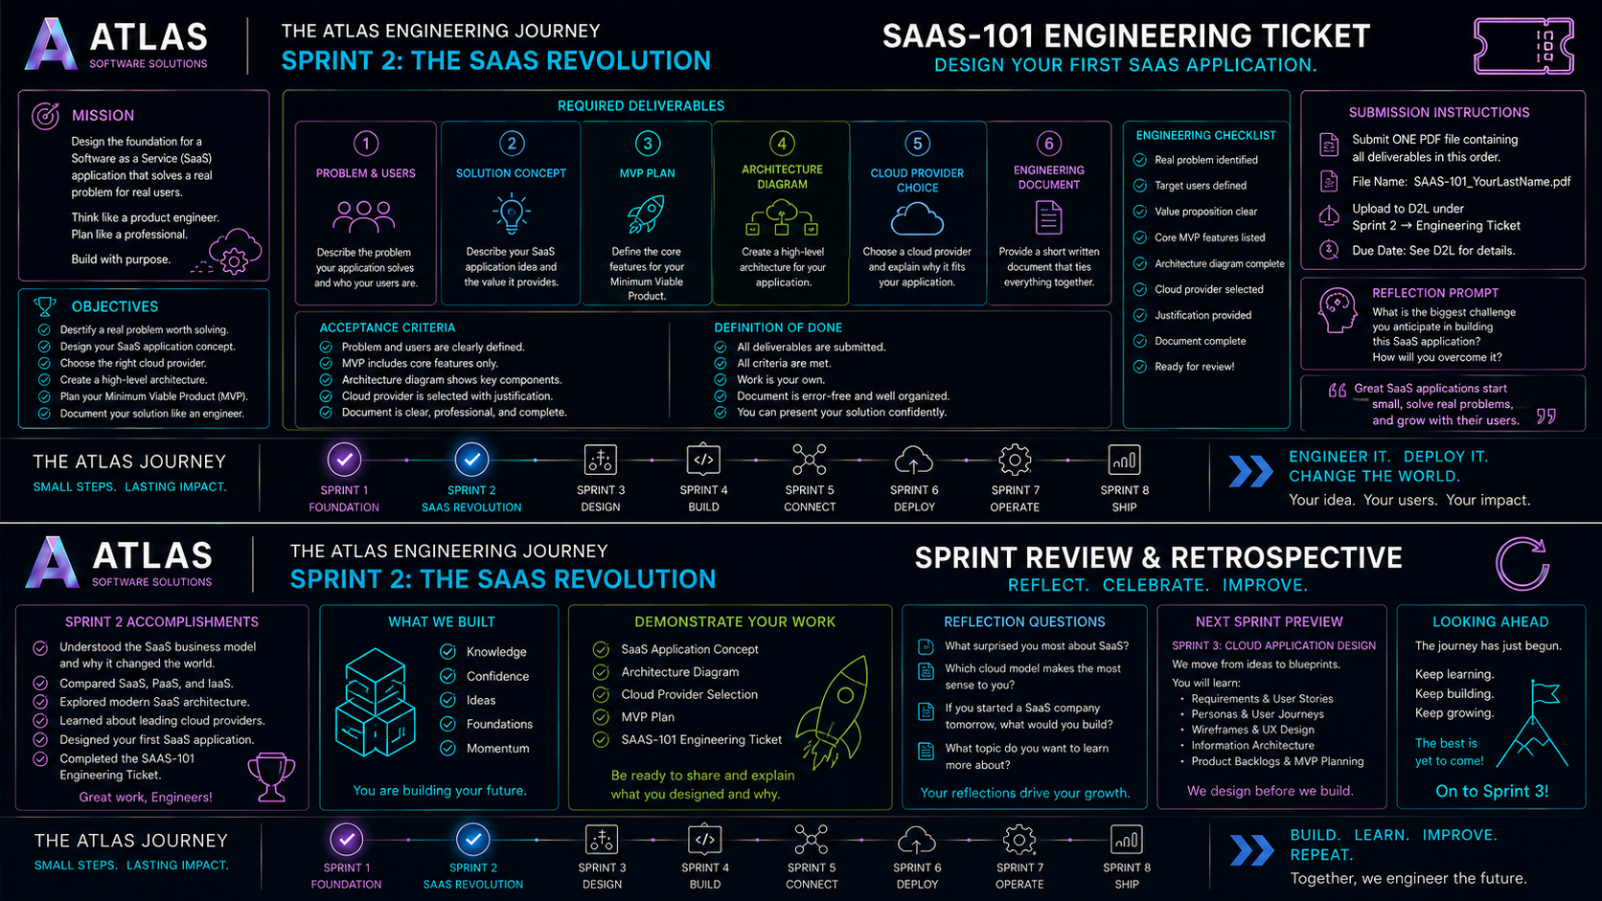
The SaaS Journey
Notes:
============================================================
ARTIFACT XXX
YOUR FIRST SAAS APPLICATION
============================================================
SLIDE PURPOSE
Transition students from understanding Software as a Service to
thinking like SaaS developers.
Students should realize they already possess the foundational knowledge
needed to begin building cloud applications.
The emphasis is not on building a large system.
The emphasis is on taking the first step.
------------------------------------------------------------
OPENING
"I want to ask you a question."
"How many of you think companies like Spotify,
Netflix,
or Slack started with millions of users?"
(Pause.)
"They didn't."
"They started with one idea."
"One small application."
"One team."
"One first version."
"Today, you're beginning that same journey."
------------------------------------------------------------
THE BIG IDEA
Read the Hero Statement.
"You don't need a billion-dollar company to build SaaS."
"You need a real problem worth solving."
Pause.
Continue.
"The greatest software products didn't begin as finished systems."
"They began as simple solutions to real problems."
------------------------------------------------------------
THE SAAS DEVELOPMENT JOURNEY
Walk through each stage.
STEP 1
Find the Problem
Every successful SaaS product begins with understanding people.
Don't build software because it's interesting.
Build software because it solves a problem.
Examples:
Scheduling
Inventory
Homework tracking
Fitness
Budgeting
Communication
------------------------------------------------------------
STEP 2
Design the Solution
Ask:
"What is the smallest version that delivers value?"
Introduce the idea of the MVP.
Minimum Viable Product.
Keep it simple.
Focus on solving one problem well.
------------------------------------------------------------
STEP 3
Build the MVP
Write the code.
Connect the database.
Create the interface.
Remember:
Perfection is not the goal.
Progress is.
------------------------------------------------------------
STEP 4
Deploy and Deliver
Now your application leaves your computer.
Deploy it.
Test it.
Share it.
Collect feedback.
Explain:
"If users can't access your software..."
"It isn't really a SaaS application."
------------------------------------------------------------
STEP 5
Get Users and Feedback
Great software is shaped by users.
Listen.
Observe.
Improve.
Students should understand:
Real engineering continues after deployment.
------------------------------------------------------------
STEP 6
Iterate and Scale
Software is never finished.
Every release makes it better.
Every sprint improves the product.
Connect this back to Agile.
This is why companies release continuously.
------------------------------------------------------------
SAAS BUILT DIFFERENT
Review the four principles.
Multi-Tenant
One application.
Many customers.
Subscription Model
Recurring value.
Long-term relationships.
Always Available
Cloud-first thinking.
Global accessibility.
Iterate and Improve
Ship.
Learn.
Improve.
Repeat.
------------------------------------------------------------
SAAS STARTER TOOLKIT
Point out each tool.
Cloud Platform
Azure
AWS
Google Cloud
Frontend
React
Angular
Vue
Backend
.NET
Python
Node.js
Database
SQL
NoSQL
Authentication
Identity providers
Analytics
Measure everything.
Explain:
"You don't need every tool."
"You need the right tool."
------------------------------------------------------------
EXAMPLES THAT INSPIRE
Point to each company.
Slack
Notion
Zoom
Canva
Ask:
"What problem did this company solve?"
Guide discussion.
Students should begin thinking about problems instead of technology.
------------------------------------------------------------
ENGINEERING STORY
Share one of your own projects.
Talk about a project that started small.
Perhaps a classroom assignment...
A personal project...
Or your food pantry application.
Explain:
"It wasn't perfect."
"But it solved a real problem."
"And that's what mattered."
------------------------------------------------------------
ENGINEERING LESSON
Every successful SaaS application begins the same way.
Someone notices a problem.
Someone builds a solution.
Someone improves it over time.
Professional software engineering is not about writing the most code.
It's about creating the most value.
------------------------------------------------------------
CLASS DISCUSSION
Ask the room:
"If you could build one SaaS application today..."
"What problem would it solve?"
Give students a minute to think.
Invite several to share.
Write their ideas on the board.
This is often where future capstone ideas begin.
------------------------------------------------------------
REAL-WORLD CHALLENGE
Challenge students.
Before next class...
Write down three problems you experience every week.
Don't think about technology.
Think about frustration.
Every frustration is a potential software opportunity.
------------------------------------------------------------
TRANSITION
"We've learned why SaaS changed the world."
"We've learned how it works."
"We've met the companies that power it."
"Now it's your turn."
"Our Engineering Ticket will challenge you to think like a SaaS engineer."
------------------------------------------------------------
ESTIMATED TIME
Opening......................4 minutes
Development Journey.........15 minutes
Toolkit......................7 minutes
Examples.....................6 minutes
Discussion...................8 minutes
Challenge....................3 minutes
Transition...................2 minutes
Total........................45 minutes
------------------------------------------------------------
INSTRUCTOR NOTES
This lecture should inspire students.
Do not overwhelm them with technology.
Keep returning to one message:
Every successful SaaS application started small.
Celebrate progress.
Encourage ideas.
Show excitement.
Students should leave believing:
"I can build something people will use."
Close with:
"The companies we admire today all started with one simple idea.
The next great idea could begin with one of yours."
============================================================

Slide 8
Devliverables
Notes:
============================================================
ARTIFACT XXXI
SAAS-101 ENGINEERING TICKET
============================================================
SLIDE PURPOSE
Introduce the Sprint 2 Engineering Ticket and challenge students to
apply everything they have learned about Software as a Service.
Students are not expected to build a complete application.
They are expected to think like software engineers by identifying a
problem, designing a solution, and planning an MVP.
The emphasis is on engineering thinking—not implementation.
------------------------------------------------------------
OPENING
"Congratulations."
"You've completed Sprint 2."
"You now understand what SaaS is."
"You understand why it changed the software industry."
"You understand cloud providers."
"You understand modern SaaS architecture."
"Now it's your turn."
"Today, you're going to think like the founder of a software company."
------------------------------------------------------------
THE BIG IDEA
Read the Hero Statement.
"Every successful SaaS application begins by solving one real problem."
Pause.
Continue.
"Technology should never be the starting point."
"The problem always comes first."
"Great software engineers don't ask..."
'What can I build?'
"They ask..."
'What problem can I solve?'
------------------------------------------------------------
MISSION
Read the mission statement.
"As an engineer at Atlas Software Solutions..."
"Your mission is to identify a real-world problem and design the first
version of a Software as a Service application."
"This is not a coding assignment."
"This is a product design assignment."
------------------------------------------------------------
ENGINEERING OBJECTIVES
Walk through each objective.
Identify a real-world problem.
Define the target users.
Describe the SaaS solution.
Select a cloud provider.
Choose the appropriate service model.
Design a simple architecture.
Explain the business value.
Explain that professional software engineering always begins with
understanding people before writing code.
------------------------------------------------------------
DELIVERABLES
Review each required deliverable.
Problem Statement
Describe the problem clearly.
Target User
Who experiences this problem?
Cloud Provider
Explain why Azure, AWS, or Google Cloud is the best choice.
Architecture Diagram
Show the major components of your application.
MVP Feature List
Identify only the features needed for Version 1.
One-Page Proposal
Bring everything together into a professional summary.
Emphasize:
"Keep it simple."
"The best MVP solves one problem extremely well."
------------------------------------------------------------
ACCEPTANCE CRITERIA
Explain that engineers don't submit work hoping it is correct.
They build toward clearly defined success criteria.
Review each item.
Can another person understand the problem?
Can they identify the users?
Is the cloud provider justified?
Does the architecture make sense?
Are the MVP features realistic?
Is the proposal professional?
If the answer is yes...
The ticket is complete.
------------------------------------------------------------
DEFINITION OF DONE
Introduce students to an important Agile concept.
Professional teams don't simply finish tasks.
They define what "done" means before they begin.
Review the checklist.
All deliverables submitted.
Architecture included.
Cloud provider justified.
Service model identified.
Proposal complete.
Submitted through D2L.
Explain that defining "done" prevents confusion and improves quality.
------------------------------------------------------------
ENGINEERING REFLECTION
Ask students to answer the reflection questions honestly.
What inspired your idea?
What was the hardest design decision?
Why did you choose your cloud provider?
How might your application evolve over time?
Explain that reflection is part of becoming a better engineer.
Every sprint should end with learning.
------------------------------------------------------------
ENGINEERING STORY
Tell the story of one of your own projects.
For example, discuss the SCC Food Pantry application.
Explain that the project began with a simple question:
"How can we make inventory management easier?"
The first version wasn't perfect.
It wasn't expected to be.
It simply needed to solve a real problem.
Connect that experience to today's assignment.
------------------------------------------------------------
ENGINEERING LESSON
Professional software engineers solve problems.
They don't begin by choosing a programming language.
They don't begin by choosing a database.
They begin by understanding people.
Technology supports the solution.
It is never the solution by itself.
------------------------------------------------------------
CLASS DISCUSSION
Ask the class:
"If you could solve one frustrating problem in your everyday life..."
"What would it be?"
Allow several students to share.
Encourage classmates to ask questions.
This discussion often leads to outstanding SaaS ideas.
------------------------------------------------------------
MOTIVATION
Some students will believe their ideas are too small.
Remind them that many successful companies started with one simple idea.
Facebook began as a campus directory.
Airbnb began by renting an air mattress.
Dropbox began as a simple way to synchronize files.
Every successful SaaS company started with Version 1.
------------------------------------------------------------
CLOSING
Leave students with this message.
"Don't try to build the next billion-dollar company."
"Build something that genuinely helps someone."
"If you solve one real problem well..."
"You're already thinking like a software engineer."
------------------------------------------------------------
ESTIMATED TIME
Introduction..................5 minutes
Mission.......................4 minutes
Deliverables..................8 minutes
Acceptance Criteria...........5 minutes
Discussion....................8 minutes
Engineering Story.............5 minutes
Questions.....................5 minutes
Total.........................40 minutes
------------------------------------------------------------
INSTRUCTOR NOTES
Keep the energy positive.
Students may feel intimidated because they are designing something of
their own.
Reassure them that originality matters less than thoughtful problem
solving.
Celebrate creativity.
Encourage realistic ideas.
The objective is not perfection.
The objective is engineering thinking.
Close with:
"Every great SaaS company once existed only as an idea on a piece of
paper.
Today, you're creating yours."
============================================================

Slide 9
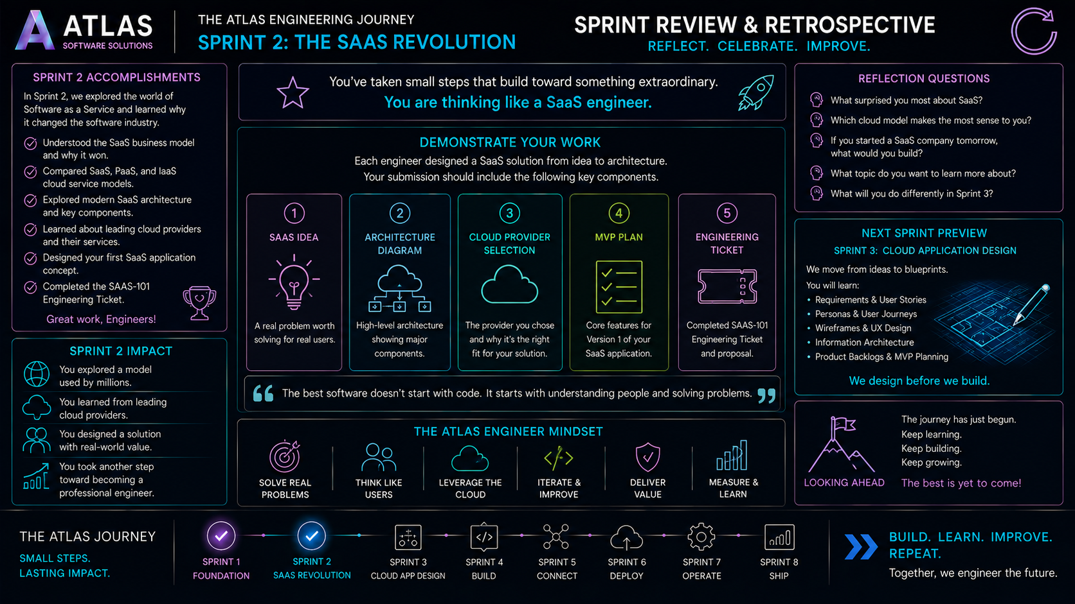
Think!
Notes:
============================================================
ARTIFACT XXXII
SPRINT 2 REVIEW & RETROSPECTIVE
============================================================
SLIDE PURPOSE
Celebrate the completion of Sprint 2 while reinforcing the major
concepts students learned throughout the sprint.
Students should recognize how each lesson connected to the next and
leave with confidence that they now understand the foundations of
Software as a Service.
The retrospective also prepares students for Sprint 3 by transitioning
from understanding SaaS to designing cloud applications.
------------------------------------------------------------
OPENING
"Congratulations."
"You've officially completed Sprint 2."
"Take a moment and think back to the beginning of this sprint."
"Most of us had heard the term SaaS..."
"But now..."
"You understand how SaaS works."
"You understand why it transformed the software industry."
"And more importantly..."
"You now know how engineers think about building SaaS applications."
Pause.
"This is a big milestone."
------------------------------------------------------------
SPRINT REVIEW
Let's remember where we started.
We asked one simple question.
"What is SaaS?"
Along the way we answered several more.
Why did software move to the cloud?
Why did subscriptions replace boxed software?
How do cloud applications actually work?
What is the difference between SaaS, PaaS, and IaaS?
Who provides the cloud?
How do I build my own SaaS application?
Every lesson answered one question and introduced the next.
That is how engineers learn.
------------------------------------------------------------
SPRINT 2 ACCOMPLISHMENTS
Review each accomplishment.
You learned the SaaS business model.
You compared SaaS, PaaS, and IaaS.
You explored modern cloud architecture.
You met the world's largest cloud providers.
You designed your first SaaS application.
You completed Engineering Ticket SAAS-101.
Pause after each item.
Remind students these are real industry concepts used every day.
------------------------------------------------------------
DEMONSTRATE YOUR WORK
Walk through each deliverable.
SaaS Idea
Architecture Diagram
Cloud Provider Selection
MVP Plan
Engineering Ticket
Explain:
"This isn't just coursework."
"This is the beginning of your engineering portfolio."
Encourage students to save their work.
Some of these ideas may grow into future capstone projects or personal
projects.
------------------------------------------------------------
THE ATLAS ENGINEER MINDSET
Review each principle.
Solve Real Problems
Technology exists to improve people's lives.
Think Like Users
Build for people—not for programmers.
Leverage the Cloud
Use technology to amplify your impact.
Iterate and Improve
Great software evolves continuously.
Deliver Value
Features don't matter unless they solve problems.
Measure and Learn
Listen to users.
Improve continuously.
Explain:
"This mindset is more important than any programming language."
------------------------------------------------------------
ENGINEERING STORY
Share one final Sprint 2 story.
Talk about a project where your original idea changed after talking to
users.
Explain that great software rarely succeeds because of the first idea.
It succeeds because engineers continue learning.
Relate this to Agile.
Every sprint is another opportunity to improve.
------------------------------------------------------------
REFLECTION QUESTIONS
Ask students to answer honestly.
What surprised you most about SaaS?
Which cloud model makes the most sense to you?
If you started a SaaS company tomorrow...
What would you build?
What topic do you want to learn more about?
What will you do differently in Sprint 3?
Allow students to discuss their answers.
------------------------------------------------------------
NEXT SPRINT PREVIEW
Read the title.
"Sprint 3."
"Cloud Application Design."
Explain the shift.
"So far..."
"We've learned what SaaS is."
"Next..."
"We begin designing it."
Students will learn:
Requirements gathering
User stories
Personas
Wireframes
UX design
Information architecture
Product backlogs
MVP planning
Explain:
"We're moving from understanding software..."
"...to designing software."
------------------------------------------------------------
LOOKING AHEAD
Point to the mountain graphic.
"The journey has just begun."
"The best software engineers never stop learning."
"Each sprint builds on the one before it."
"You've already come farther than you realize."
------------------------------------------------------------
ENGINEERING LESSON
Programming teaches us how to write code.
Software engineering teaches us how to solve problems.
Cloud computing teaches us how to deliver solutions at scale.
SaaS brings all of those ideas together.
Professional software engineers understand technology.
Great software engineers understand people.
------------------------------------------------------------
CLASS DISCUSSION
Ask the class:
"What was your biggest takeaway from Sprint 2?"
"What concept finally 'clicked' for you?"
"What topic are you most excited to explore next?"
Allow students to celebrate each other's progress.
------------------------------------------------------------
CLOSING
Leave students with this message.
"Two weeks ago..."
"You were learning about cloud computing."
"Today..."
"You're thinking like cloud engineers."
"That's real progress."
"Take pride in what you've accomplished."
------------------------------------------------------------
ESTIMATED TIME
Sprint Review................8 minutes
Accomplishments..............5 minutes
Student Discussion...........10 minutes
Sprint 3 Preview.............8 minutes
Closing Reflection...........5 minutes
Questions....................5 minutes
Total........................41 minutes
------------------------------------------------------------
INSTRUCTOR NOTES
Keep the atmosphere positive.
Celebrate growth.
Encourage students to keep every artifact they create.
Remind them that portfolios are built one project at a time.
Leave students excited—not overwhelmed—about Sprint 3.
Close with:
"Every great engineer was once a beginner who refused to stop
learning."
"And that's exactly what you're doing."
"Take a break."
"You've earned it."
============================================================

Slide 10
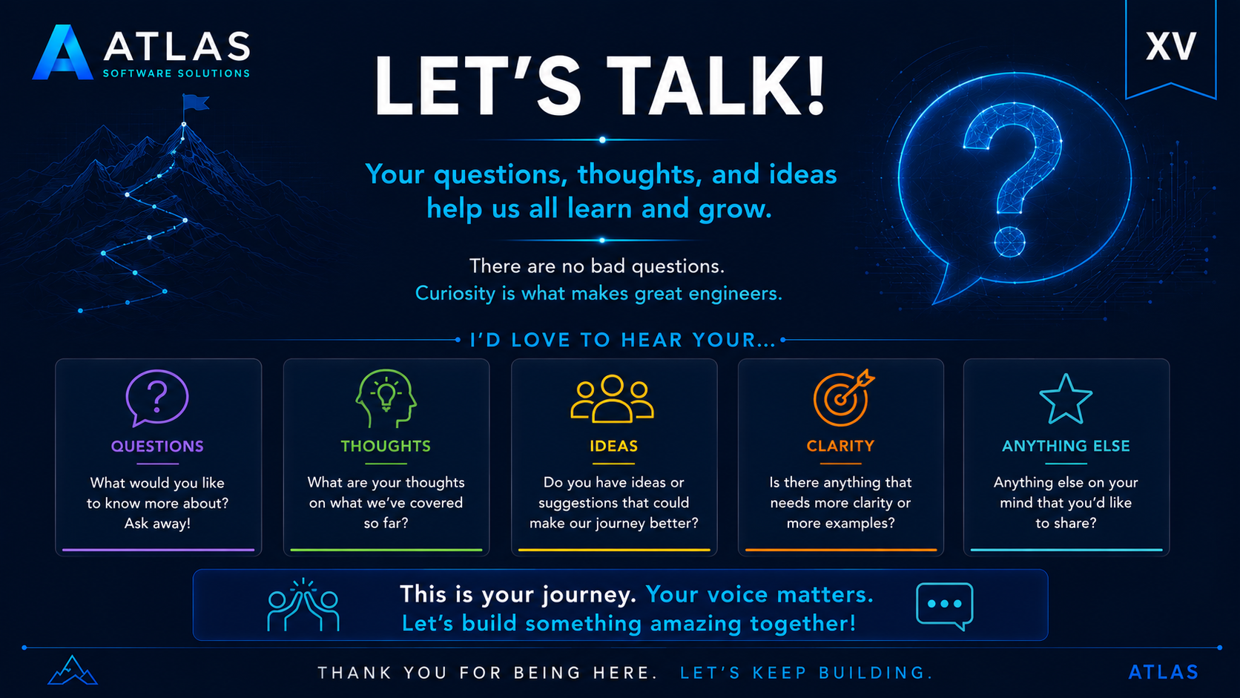
Questions

