Slide 1
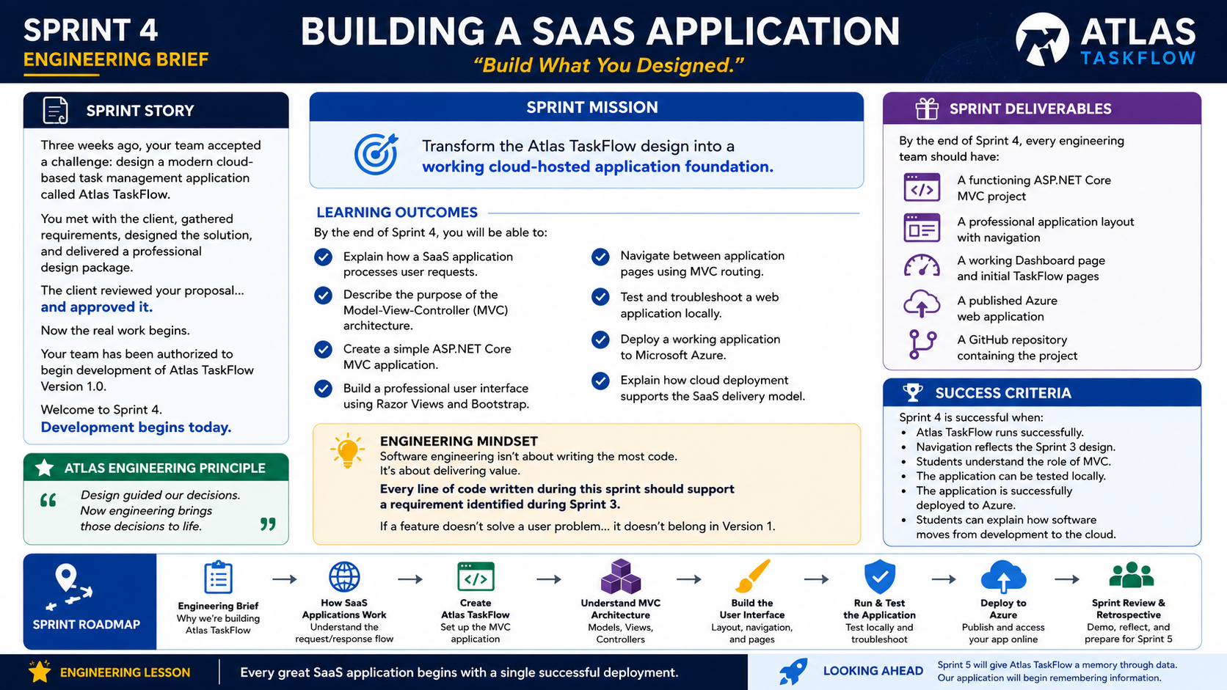
4-01
Notes:
============================================================
SPRINT 4
ENGINEERING BRIEF
BUILDING A SAAS APPLICATION
============================================================
SLIDE PURPOSE
Welcome students into the implementation phase of Atlas TaskFlow.
This brief marks the transition from software design to software
development.
Students should leave this lesson understanding that they are no longer
planning the application—they are now building it.
This sprint introduces the foundations of a cloud-hosted SaaS
application using ASP.NET Core MVC, while keeping the focus on software
engineering rather than framework mastery.
------------------------------------------------------------
OPENING
"Good evening, engineers."
Pause.
"Last sprint..."
"You weren't programmers."
"You were software designers."
"You met with the client."
"You gathered requirements."
"You designed an application."
"You organized its architecture."
"And you delivered a professional design package."
Pause.
"Today..."
"Everything changes."
------------------------------------------------------------
THE CLIENT APPROVAL
Point to the Sprint Story.
Read it naturally.
"Our client has reviewed our proposal."
"They've approved the design."
"They've authorized development."
Explain.
"This is exactly what happens in professional software projects."
"Planning eventually ends."
"And engineering begins."
Smile.
"Welcome to Sprint 4."
------------------------------------------------------------
THE BIG IDEA
Ask the class:
"What is the difference between designing software..."
"...and building software?"
Allow discussion.
Guide them toward these ideas:
Design defines intent.
Development creates reality.
Explain:
"During Sprint 3 we answered..."
"What should we build?"
"This sprint answers..."
"How do we build it?"
------------------------------------------------------------
SPRINT MISSION
Read the mission statement.
"Our goal is not to finish Atlas TaskFlow."
"Our goal is to build its foundation."
Pause.
"Professional software isn't built all at once."
"It's built one working version at a time."
Introduce the term:
Incremental Development.
------------------------------------------------------------
LEARNING OUTCOMES
Walk through each outcome.
Notice that none of them say:
"Become an MVC expert."
Explain why.
"This course isn't about mastering ASP.NET."
"It's about understanding how cloud applications are built and
delivered."
MVC is simply the tool we'll use.
------------------------------------------------------------
ENGINEERING MINDSET
Read the Engineering Mindset panel.
Discuss.
"Software engineering isn't measured by the number of lines of code."
"It's measured by the value those lines create."
Point back to Sprint 3.
"Every line of code we write should trace back to a requirement."
"That's why we spent so much time designing first."
------------------------------------------------------------
SPRINT DELIVERABLES
Walk through each deliverable.
MVC Project
Navigation
Dashboard
TaskFlow Pages
GitHub Repository
Azure Deployment
Explain.
"Notice something."
"Every deliverable is something you can demonstrate."
"By the end of this sprint..."
"You'll have a real cloud application."
------------------------------------------------------------
SUCCESS CRITERIA
Read each item.
Ask students:
"How will we know we've been successful?"
Guide them toward:
The application runs.
The navigation works.
The UI reflects the design.
The application is deployed.
Users can access it.
Explain.
"Success isn't perfection."
"Success is working software."
------------------------------------------------------------
SPRINT ROADMAP
Walk through the roadmap.
How SaaS Applications Work
↓
Create Atlas TaskFlow
↓
Understanding MVC
↓
Build the User Interface
↓
Run & Test
↓
Deploy to Azure
↓
Sprint Review
Explain.
"This roadmap should feel familiar."
"Every lesson moves the application forward."
"There are no random labs."
"There are no disconnected exercises."
"We're building one product together."
------------------------------------------------------------
ENGINEERING LESSON
Read the quote.
"Every great SaaS application begins with a single successful
deployment."
Pause.
Then ask:
"What do you think the first deployment of Google looked like?"
Students usually laugh.
Explain.
"It probably wasn't perfect."
"It simply worked."
"And that's exactly what we're building."
------------------------------------------------------------
LOOKING AHEAD
Point to the final panel.
"Our application still has one limitation."
"It can't remember anything."
"It has no database."
Smile.
"But that's okay."
"One sprint at a time."
------------------------------------------------------------
CLASS DISCUSSION
Ask:
"What part of Sprint 3 do you think will help us the most while
building?"
Possible answers:
Requirements
Wireframes
Navigation
User Stories
Personas
Help students recognize that every design artifact now becomes a
development guide.
------------------------------------------------------------
THE MOMENT
This is where I would slow down.
Walk to the center of the room.
Pause.
Then say...
"Three weeks ago..."
"You started with a blank page."
"You imagined an application."
"You designed it."
"You defended it."
"You improved it."
"And now..."
"You're about to build it."
Pause.
Look around the room.
Then say...
"Open Visual Studio."
Smile.
"Development begins."
------------------------------------------------------------
ESTIMATED TIME
Sprint Welcome.....................5 minutes
Sprint Story.......................8 minutes
Mission & Outcomes.................8 minutes
Engineering Mindset................7 minutes
Deliverables.......................8 minutes
Roadmap............................7 minutes
Discussion.........................8 minutes
Closing............................4 minutes
Total.............................55 minutes
------------------------------------------------------------
INSTRUCTOR NOTES
This lecture should feel like a kickoff meeting rather than a lecture.
Avoid diving into technical details.
The purpose is to build excitement and establish the sprint's mission.
Keep referring back to Sprint 3 and remind students that the work they
completed was not theoretical—it now serves as the blueprint for the
application they are about to build.
End the class with energy.
Stand at the front of the room.
Smile.
Then simply say:
"Engineers..."
"The client approved our design."
"It's time to build."
"Let's open Visual Studio."
============================================================

Slide 2
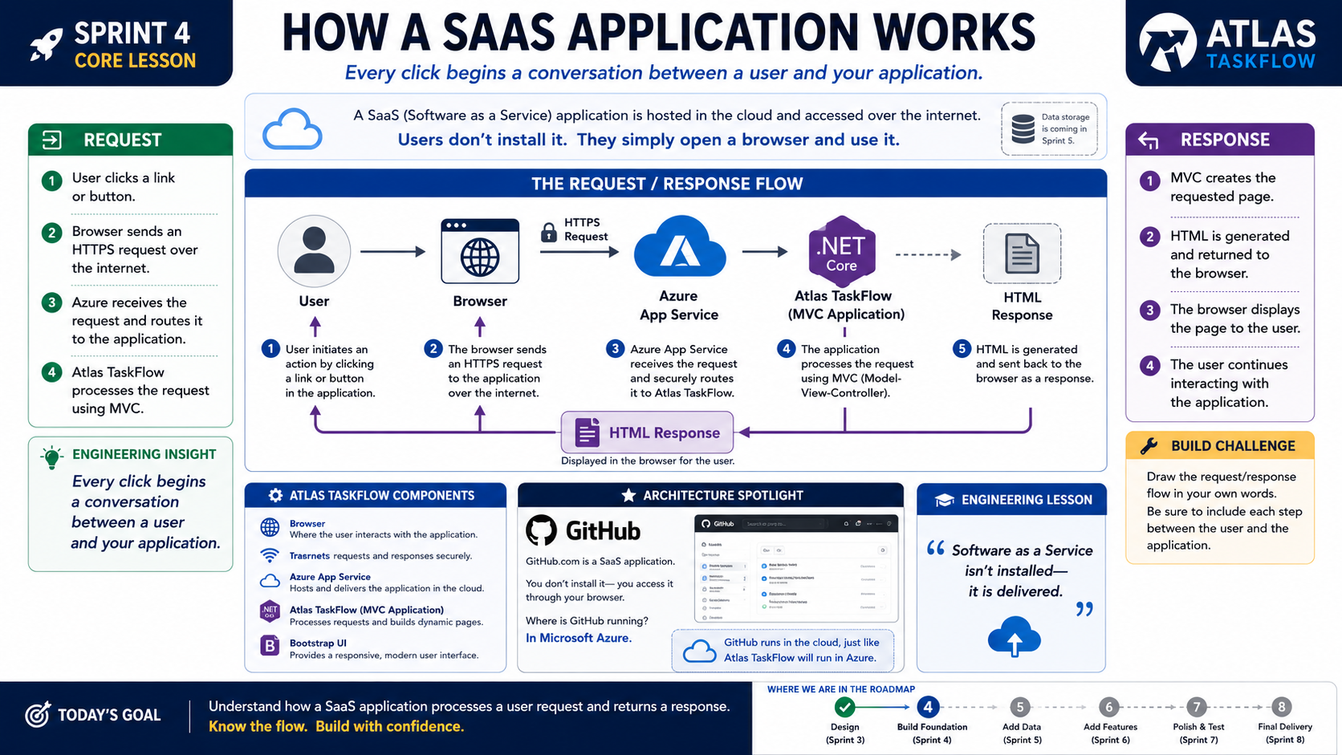
4-02
Notes:
============================================================
SPRINT 4
HOW A SAAS APPLICATION WORKS
============================================================
SLIDE PURPOSE
Introduce students to the request/response lifecycle used by modern
Software as a Service (SaaS) applications.
Students should understand how a browser communicates with a cloud-hosted
application and how a response is returned to the user.
The objective is conceptual understanding—not deep networking or ASP.NET
internals.
------------------------------------------------------------
OPENING
"Before we build Atlas TaskFlow..."
"I want to answer one important question."
"When you click a button on a website..."
"What actually happens?"
Pause.
"To many people..."
"It feels like magic."
"But today..."
"We're going to remove the magic."
------------------------------------------------------------
THE BIG IDEA
Point to the subtitle.
"Every click begins a conversation between a user and your application."
Ask the class:
"What happens after you click the Login button on a website?"
Allow several answers.
Then explain:
"The browser doesn't already know the answer."
"It has to ask."
"And that's exactly what happens every time you interact with a SaaS
application."
------------------------------------------------------------
WHAT IS SAAS?
Point to the definition at the top.
Explain:
"A Software as a Service application is hosted in the cloud."
"You don't install it."
"You simply open a browser."
Ask students:
"How many of you installed Microsoft Teams?"
Most will say no.
Continue:
"You opened a browser."
"Or launched an app that communicates with a cloud service."
"That's SaaS."
Give additional examples:
Canvas
Gmail
Spotify
Netflix
GitHub
Atlas TaskFlow
------------------------------------------------------------
THE REQUEST / RESPONSE FLOW
Move to the center diagram.
Walk through each step slowly.
STEP 1
The User
Explain:
"Everything begins with a person."
"They click."
"They type."
"They search."
"They interact."
Without users...
There is no application.
------------------------------------------------------------
STEP 2
Browser
Explain:
"The browser is simply the messenger."
"It packages your request."
"And sends it securely across the Internet."
Point to HTTPS.
Explain:
"The 'S' stands for Secure."
"This protects communication between the user and the application."
No need to discuss certificates or encryption in detail.
------------------------------------------------------------
STEP 3
Azure App Service
Point to Azure.
Explain:
"This is where our application lives."
Not on our laptop.
Not inside the browser.
In the cloud.
Pause.
Ask:
"If your computer shuts off..."
"Can users still access Atlas TaskFlow?"
Students answer:
"Yes."
Explain why.
------------------------------------------------------------
STEP 4
Atlas TaskFlow
Point to the MVC icon.
Explain:
"This is our application."
"It receives the request."
"It decides what information is needed."
"It builds the page."
Emphasize:
"This is where our code executes."
Pause.
"This..."
"is why we're learning MVC."
------------------------------------------------------------
STEP 5
HTML RESPONSE
Point to the response.
Explain:
"Our application creates HTML."
"It sends that HTML back to the browser."
"The browser displays the page."
Students often think the browser creates the page.
Clarify:
"The browser displays the page."
"Our application builds it."
------------------------------------------------------------
THE RETURN TRIP
Follow the purple arrow.
Explain:
"Notice something."
"The conversation isn't finished."
"As soon as the user clicks again..."
"The entire process repeats."
Millions of times every day.
------------------------------------------------------------
REQUEST PANEL
Walk through the Request panel.
Click
↓
HTTPS Request
↓
Azure
↓
Atlas TaskFlow
Explain:
"This is the journey to the application."
------------------------------------------------------------
RESPONSE PANEL
Walk through the Response panel.
MVC
↓
HTML
↓
Browser
↓
User
Explain:
"This is the journey back."
------------------------------------------------------------
ATLAS TASKFLOW COMPONENTS
Review each component.
Browser
Internet
Azure App Service
Atlas TaskFlow
Bootstrap UI
Explain each in one sentence.
Avoid technical detail.
Students only need to recognize each piece.
------------------------------------------------------------
ARCHITECTURE SPOTLIGHT
GitHub
Ask:
"Where is GitHub running?"
Students usually answer:
"The cloud."
Explain:
"You don't install GitHub."
"You visit GitHub."
"It behaves exactly like Atlas TaskFlow will."
Connect it back to SaaS.
------------------------------------------------------------
ENGINEERING INSIGHT
Read the statement.
"Every click begins a conversation between a user and your application."
Pause.
Explain:
"Software engineering is really about conversations."
"The user asks."
"The application answers."
------------------------------------------------------------
BUILD CHALLENGE
Ask students to close their laptops.
Hand them a sheet of paper.
Challenge:
Draw the request/response flow from memory.
User
↓
Browser
↓
Azure
↓
Atlas TaskFlow
↓
HTML
↓
Browser
↓
User
Walk around the room.
Help students connect the pieces.
------------------------------------------------------------
ENGINEERING LESSON
Read the quote.
"Software as a Service isn't installed..."
"...it is delivered."
Explain.
"That's why this course exists."
"We're learning how software reaches people."
------------------------------------------------------------
ROADMAP
Point to the roadmap.
Explain where we are.
Sprint 3
Design
Sprint 4
Foundation
Sprint 5
Data
Sprint 6
Features
Sprint 7
Deployment & Polish
Sprint 8
Final Release
Students should see progress.
------------------------------------------------------------
LOOKING AHEAD
Ask:
"So..."
"Now that we understand how software reaches users..."
"What should we do next?"
Pause.
Smile.
"We build Atlas TaskFlow."
------------------------------------------------------------
CLASS DISCUSSION
Ask:
"What surprised you most about the request/response process?"
"What part of the diagram seems most important?"
"If Azure disappeared..."
"What would happen?"
Guide students toward understanding that cloud hosting is what enables
Software as a Service.
------------------------------------------------------------
THE MOMENT
Walk to the center of the room.
Point to the diagram.
Then say:
"Every website."
"Every online game."
"Every banking app."
"Every streaming service."
"They all follow this same conversation."
Pause.
"Now..."
"We're going to build one."
------------------------------------------------------------
ESTIMATED TIME
Introduction........................5 minutes
SaaS Overview.......................8 minutes
Request Flow........................15 minutes
Response Flow.......................10 minutes
Architecture Spotlight...............7 minutes
Build Challenge.....................10 minutes
Discussion...........................5 minutes
Closing..............................5 minutes
Total...............................65 minutes
------------------------------------------------------------
INSTRUCTOR NOTES
Keep this lesson visual.
Do not lecture about networking protocols, ports, IIS, middleware, or
advanced web architecture.
The objective is confidence—not complexity.
Students should leave understanding one simple truth:
A browser asks.
The cloud responds.
Our application makes the conversation possible.
Close with:
"Engineers..."
"Now you know how users reach our software."
"Next..."
"Let's build Atlas TaskFlow."
============================================================

Slide 3
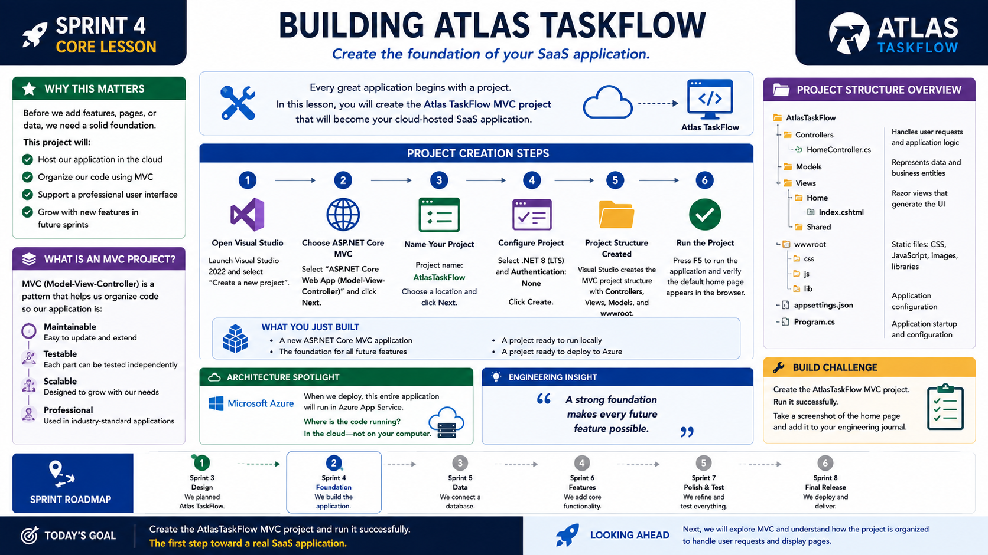
4-03
Notes:
============================================================
SPRINT 4
BUILDING ATLAS TASKFLOW
============================================================
SLIDE PURPOSE
Guide students through creating the Atlas TaskFlow ASP.NET Core MVC
project that will serve as the foundation for the remainder of the
course.
This lesson is intentionally simple.
The objective is not to master ASP.NET Core or MVC.
The objective is to successfully create, run, and understand the
structure of a professional SaaS application.
------------------------------------------------------------
OPENING
"Engineers..."
Pause.
"This is the moment we've been working toward."
"For three sprints..."
"We planned."
"We researched."
"We designed."
"We organized."
"And today..."
"We finally begin building."
Smile.
"Let's create Atlas TaskFlow."
------------------------------------------------------------
THE BIG IDEA
Point to the statement near the top.
"Every great application begins with a project."
Explain.
"We're not building features today."
"We're building the foundation."
"A strong foundation makes everything that comes later easier."
Relate it to construction.
"You don't build the roof first."
"You build the foundation."
------------------------------------------------------------
WHY THIS MATTERS
Walk through each point.
Host our application in the cloud.
Organize our code.
Support future features.
Create a professional structure.
Explain:
"Today's work isn't exciting because of what it does."
"It's exciting because of what it enables."
------------------------------------------------------------
PROJECT CREATION
Move to the six-step process.
Tell students:
"I'm going to build this with you."
"We're not watching."
"We're engineering."
------------------------------------------------------------
STEP 1
Open Visual Studio
Explain.
"This is our engineering workstation."
Point out:
Community Edition is fine.
Professional is fine.
Everyone starts the same way.
------------------------------------------------------------
STEP 2
Choose ASP.NET Core MVC
Pause.
Say:
"Don't worry about memorizing every template."
"Today we only need one."
Explain why MVC.
"MVC helps organize applications."
"We'll understand more about it next lesson."
Today...
Accept the template.
Move forward.
------------------------------------------------------------
STEP 3
Name the Project
Use:
AtlasTaskFlow
Explain why naming matters.
Professional software uses consistent names.
Discuss namespaces briefly.
Keep it simple.
------------------------------------------------------------
STEP 4
Configure the Project
Explain:
".NET LTS simply means Long-Term Support."
"We're choosing the stable version."
Authentication:
None.
Explain why.
"We'll add security later."
One sprint at a time.
------------------------------------------------------------
STEP 5
Project Created
Visual Studio generates the solution.
Pause.
Then say:
"Look around."
"This..."
"is what a professional project looks like."
Don't explain every folder yet.
Simply allow students to become comfortable.
------------------------------------------------------------
STEP 6
Run the Project
Press F5.
Wait.
When the browser opens...
Pause.
Smile.
Then say:
"Congratulations."
"You just built your first SaaS application foundation."
Students usually smile here.
Celebrate it.
------------------------------------------------------------
WHAT YOU JUST BUILT
Review the summary.
A professional MVC project.
Ready for development.
Ready for Azure.
Ready for Sprint 5.
Explain.
"It doesn't do much yet."
"But that's okay."
"It runs."
"And working software is progress."
------------------------------------------------------------
PROJECT STRUCTURE
Point to the folder tree.
Controllers
Models
Views
wwwroot
Program.cs
appsettings.json
Keep explanations extremely short.
Controllers
Handle requests.
Models
Represent information.
Views
Display pages.
wwwroot
Stores static files.
Program.cs
Starts the application.
appsettings.json
Stores configuration.
Do not dive deeper.
Students only need recognition today.
------------------------------------------------------------
ARCHITECTURE SPOTLIGHT
Microsoft Azure
Ask:
"When we deploy..."
"Where will this project run?"
Students answer:
"In Azure."
Explain.
"Exactly."
"Not on our laptop."
"Our users connect to Azure."
------------------------------------------------------------
ENGINEERING INSIGHT
Read the quote.
"A strong foundation makes every future feature possible."
Pause.
Explain.
"The best software isn't built by rushing."
"It's built carefully."
------------------------------------------------------------
BUILD CHALLENGE
Challenge students.
Create the project.
Run it successfully.
Take a screenshot of the default home page.
Save it in your engineering journal.
Explain:
"This is the first milestone of Atlas TaskFlow."
------------------------------------------------------------
ROADMAP
Point to Sprint 4.
Explain.
"Today we built the foundation."
Next:
Understand MVC.
Build the interface.
Deploy.
Every lesson moves the application forward.
------------------------------------------------------------
LOOKING AHEAD
Ask:
"What happens after we create a project?"
Students answer:
"We start building."
Exactly.
"Our project exists."
"Now let's understand how it's organized."
------------------------------------------------------------
CLASS DISCUSSION
Ask:
"What surprised you most about creating the project?"
"Did the structure look different than a desktop application?"
"What folders looked familiar?"
Keep discussion informal.
------------------------------------------------------------
THE MOMENT
Walk around the classroom.
Look at students' screens.
Then say...
"Every application you've ever used..."
"Started exactly like this."
Pause.
"Google."
"Amazon."
"Canvas."
"GitHub."
"They all began..."
"With someone's first project."
Look around.
Then smile.
"And today..."
"So did yours."
------------------------------------------------------------
ESTIMATED TIME
Introduction.......................5 minutes
Why This Matters...................8 minutes
Project Creation..................20 minutes
Project Structure.................10 minutes
Architecture Spotlight............5 minutes
Build Challenge..................10 minutes
Discussion........................5 minutes
Closing...........................2 minutes
Total............................65 minutes
------------------------------------------------------------
INSTRUCTOR NOTES
This lesson should feel like a workshop rather than a lecture.
Walk around the classroom.
Help students individually.
Celebrate every successful build.
Avoid teaching advanced MVC concepts.
Avoid discussing dependency injection, middleware, routing,
configuration, or services.
Those belong in future lessons.
Today's goal is simple:
Students create a professional project.
Students run the application.
Students gain confidence.
Close with:
"Engineers..."
"Atlas TaskFlow officially exists."
"And we're just getting started."
============================================================

Slide 4
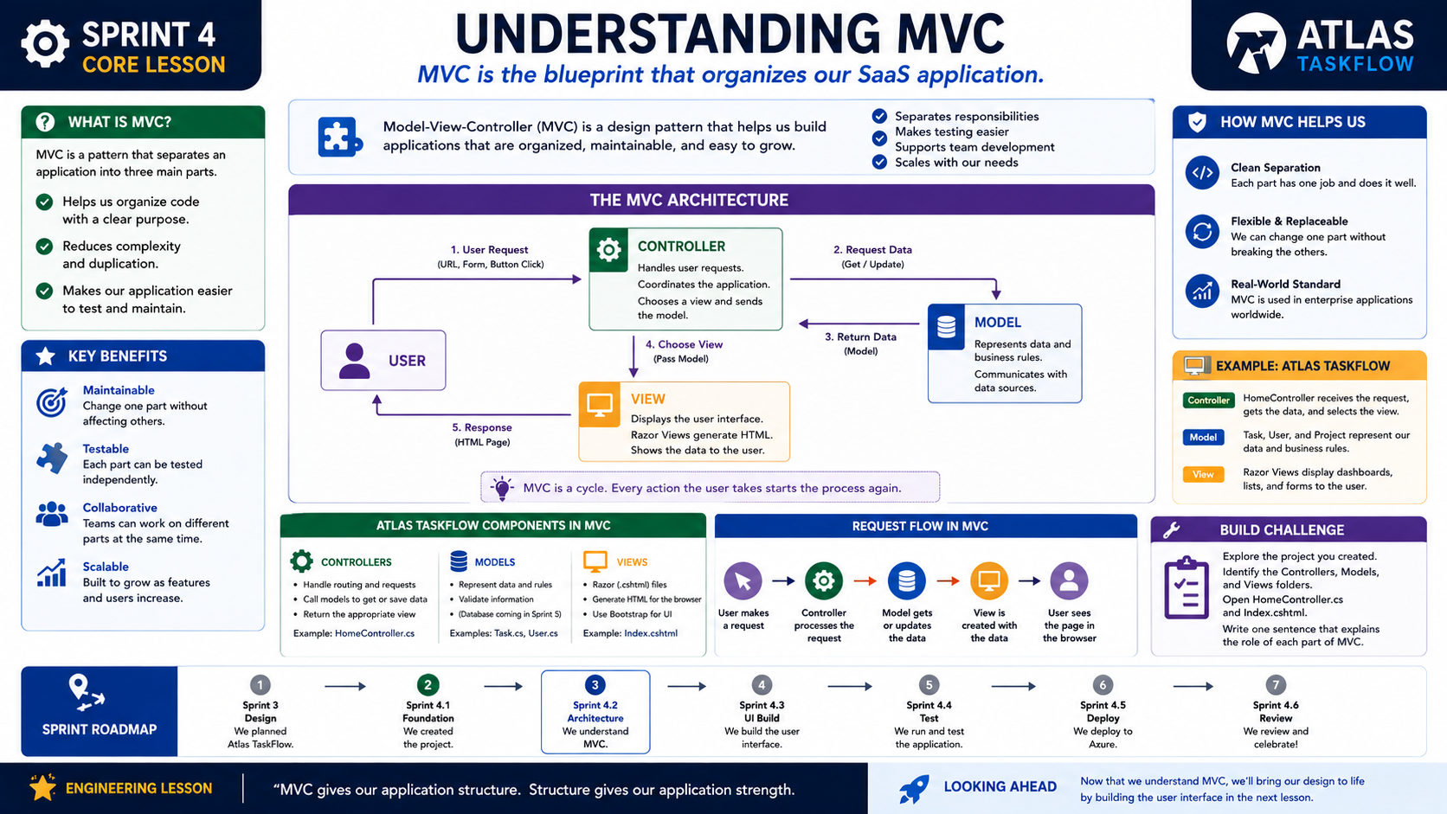
4-04
Notes:
============================================================
SPRINT 4
UNDERSTANDING MVC
============================================================
SLIDE PURPOSE
Introduce the Model-View-Controller (MVC) architectural pattern used by
Atlas TaskFlow.
Students should understand that MVC is simply a way to organize an
application by giving each part a specific responsibility.
The goal is understanding—not mastery.
Avoid advanced MVC topics and keep the lesson focused on how MVC supports
the SaaS application they are building.
------------------------------------------------------------
OPENING
"Last class..."
"We created Atlas TaskFlow."
"It runs."
"It has folders."
"It has files."
"But today we're going to answer a simple question."
Pause.
"Why is it organized this way?"
Smile.
"That's where MVC comes in."
------------------------------------------------------------
THE BIG IDEA
Point to the subtitle.
"MVC is the blueprint that organizes our SaaS application."
Explain.
"When engineers build large applications..."
"They don't put everything into one file."
"They organize it."
"That's exactly what MVC helps us do."
------------------------------------------------------------
WHAT IS MVC?
Read the definition.
"MVC stands for Model-View-Controller."
Explain each word simply.
Model
Stores and represents information.
View
Displays information.
Controller
Coordinates what happens.
Pause.
Then say:
"Think of MVC as teamwork."
"Each part has one job."
------------------------------------------------------------
WHY MVC?
Point to the left panel.
Discuss each reason.
Organized.
Maintainable.
Testable.
Scalable.
Explain.
"If every part has one responsibility..."
"The application becomes easier to understand."
Ask:
"What happens when one person tries to do every job?"
Students answer:
"It becomes messy."
"Exactly."
"So does software."
------------------------------------------------------------
THE MVC DIAGRAM
Move to the center illustration.
Walk through the process slowly.
STEP 1
The user clicks a button.
Explain.
"The conversation begins."
------------------------------------------------------------
STEP 2
The Controller receives the request.
Explain.
"The Controller acts like a traffic director."
"It decides what needs to happen."
It doesn't store data.
It doesn't display the page.
It coordinates.
------------------------------------------------------------
STEP 3
The Model provides information.
Explain.
"The Model knows about the application's data."
"It represents information and business rules."
Do not discuss databases yet.
Simply say:
"We'll connect Models to a database in Sprint 5."
------------------------------------------------------------
STEP 4
The Controller selects a View.
Explain.
"The Controller chooses which page the user should see."
------------------------------------------------------------
STEP 5
The View displays the information.
Explain.
"The View generates the page."
"The browser displays it."
Pause.
Then point back to the User.
"The cycle begins again."
------------------------------------------------------------
MVC IS A CONVERSATION
Point to the statement beneath the diagram.
"MVC is a cycle."
Explain.
"Every button."
"Every menu."
"Every page."
Follows this same pattern.
------------------------------------------------------------
ATLAS TASKFLOW COMPONENTS
Walk through the three sections.
Controllers
Receive requests.
Examples:
HomeController
TaskController
DashboardController
Models
Represent application information.
Examples:
Task
User
Project
Views
Display HTML pages.
Examples:
Dashboard
Tasks
Projects
Keep explanations under one minute each.
------------------------------------------------------------
REQUEST FLOW
Point to the lower diagram.
Ask students to describe it.
User
↓
Controller
↓
Model
↓
View
↓
User
Have students explain each step aloud.
------------------------------------------------------------
HOW MVC HELPS US
Review the benefits.
Separation
Maintainability
Professional Standard
Explain.
"Notice these aren't programming features."
"They're engineering advantages."
------------------------------------------------------------
ATLAS TASKFLOW EXAMPLE
Walk through the example.
User clicks Dashboard.
HomeController receives the request.
Task information is prepared.
Dashboard View is displayed.
Students should recognize the flow from the previous lesson.
------------------------------------------------------------
BUILD CHALLENGE
Challenge students.
Open the project they created.
Find:
Controllers
Models
Views
Open:
HomeController.cs
Open:
Index.cshtml
Ask them to identify:
Which file is the Controller?
Which file is the View?
No coding yet.
Only exploration.
------------------------------------------------------------
ENGINEERING LESSON
Read the quote.
"MVC gives our application structure."
"Structure gives our application strength."
Explain.
"Professional engineers don't organize applications this way because
it's fashionable."
"They organize them this way because it works."
------------------------------------------------------------
SPRINT ROADMAP
Point to Sprint 4.
Explain where today's lesson fits.
Last lesson:
We created the project.
Today:
We understand the structure.
Next:
We begin building the interface.
------------------------------------------------------------
LOOKING AHEAD
Ask:
"If we understand the project..."
"What should we build next?"
Pause.
"The user interface."
Smile.
"And that's exactly where we're going."
------------------------------------------------------------
CLASS DISCUSSION
Ask:
"If MVC disappeared..."
"What problems might developers face?"
Guide discussion toward:
Large files.
Confusing code.
Difficult maintenance.
Harder teamwork.
Explain that MVC helps solve those problems.
------------------------------------------------------------
THE MOMENT
Walk to the center of the room.
Point to the MVC diagram.
Then say...
"This diagram..."
"Will appear in nearly every professional ASP.NET application you'll
ever see."
Pause.
"You don't need to memorize it."
"You only need to understand why it exists."
Smile.
"And now you do."
------------------------------------------------------------
ESTIMATED TIME
Introduction........................5 minutes
What is MVC?.......................10 minutes
MVC Diagram........................15 minutes
Atlas Example......................10 minutes
Project Exploration................15 minutes
Discussion..........................5 minutes
Closing.............................5 minutes
Total..............................65 minutes
------------------------------------------------------------
INSTRUCTOR NOTES
Keep this lesson conversational.
Do not teach advanced MVC topics such as dependency injection,
middleware, routing tables, filters, model binding, services, or
repositories.
Those belong in Advanced C#.
The objective today is simply to help students recognize how an MVC
application is organized and why that organization makes software easier
to build.
Students should leave class with one clear understanding:
The Controller coordinates.
The Model represents information.
The View displays information.
Together...
They create a well-organized SaaS application.
Close with:
"Engineers..."
"Now we know how Atlas TaskFlow is organized."
"Next..."
"We're going to make it look like the application we designed."
============================================================

Slide 5
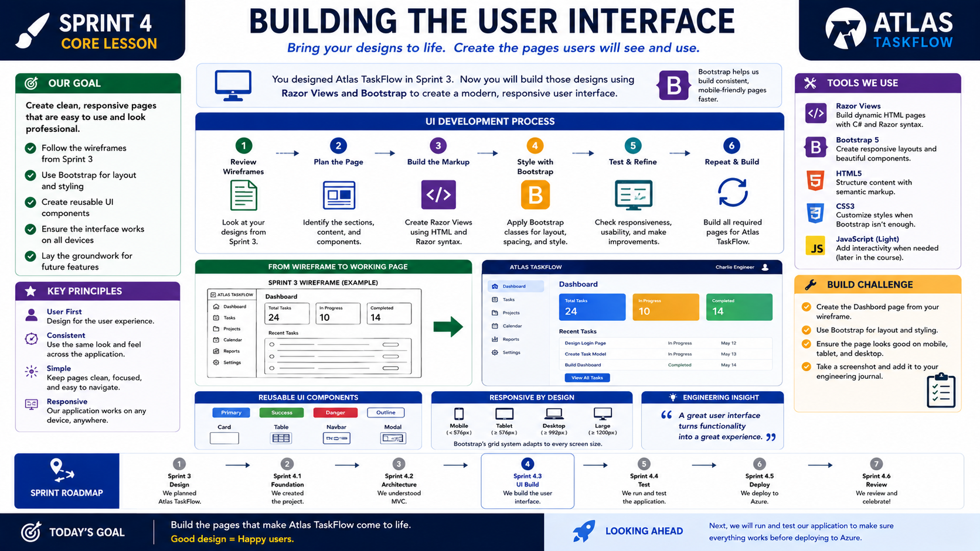
4-05
Notes:
============================================================
SPRINT 4
BUILDING THE USER INTERFACE
============================================================
SLIDE PURPOSE
Guide students through transforming the Atlas TaskFlow wireframes from
Sprint 3 into a working user interface using Razor Views and Bootstrap.
Students should recognize that they are not inventing a new design.
They are implementing the design they already created.
The objective is to build a clean, responsive interface that reflects
their original engineering decisions.
------------------------------------------------------------
OPENING
"Engineers..."
"Today is one of my favorite days."
Pause.
"Three weeks ago..."
"You sketched an application."
"You imagined what users would see."
"You organized the navigation."
"You designed the dashboard."
Pause.
"Today..."
"We bring those designs to life."
------------------------------------------------------------
THE BIG IDEA
Point to the subtitle.
"Bring your designs to life."
Explain.
"Professional software doesn't start with code."
"It starts with ideas."
"Our ideas became wireframes."
"Our wireframes become pages."
"Our pages become software."
------------------------------------------------------------
OUR GOAL
Walk through the goals.
Create clean pages.
Follow the Sprint 3 wireframes.
Use Bootstrap for layout.
Build reusable components.
Support multiple devices.
Explain.
"Notice our goal."
"We're not trying to impress people."
"We're trying to make software easy to use."
------------------------------------------------------------
FROM DESIGN TO DEVELOPMENT
Point to the wireframe comparison.
Ask students:
"Does this dashboard look familiar?"
Smile.
"It should."
"You designed it."
Explain.
"This is why Sprint 3 mattered."
"We aren't guessing."
"We're implementing."
------------------------------------------------------------
UI DEVELOPMENT PROCESS
Walk through each step.
STEP 1
Review the wireframes.
Explain.
"Don't start coding."
"Start thinking."
"What did we design?"
------------------------------------------------------------
STEP 2
Plan the page.
Identify:
Navigation
Cards
Tables
Buttons
Content
Explain.
"Break large problems into small pieces."
------------------------------------------------------------
STEP 3
Build the markup.
Explain.
"We create the Razor View."
"We write the HTML."
"We build the structure."
Nothing fancy.
Just structure.
------------------------------------------------------------
STEP 4
Style with Bootstrap.
Explain.
"Bootstrap saves us time."
"It provides professional layouts."
"It helps our application work on many screen sizes."
Show examples.
Cards.
Buttons.
Navigation.
Tables.
------------------------------------------------------------
STEP 5
Test and refine.
Ask students:
"Does the page match your design?"
"If not..."
"Fix it."
Explain.
"Professional developers constantly improve the user experience."
------------------------------------------------------------
STEP 6
Repeat.
Explain.
"One page becomes two."
"Two become five."
"Five become an application."
Software grows one feature at a time.
------------------------------------------------------------
KEY PRINCIPLES
Walk through each principle.
User First
Consistency
Simplicity
Responsiveness
Ask:
"Which one is most important?"
Guide discussion.
There isn't one correct answer.
All four work together.
------------------------------------------------------------
TOOLS WE USE
Review each technology.
Razor Views
HTML
Bootstrap
CSS
Light JavaScript
Explain.
"We're only using enough technology to build our interface."
"This isn't a web development course."
"It's a SaaS engineering course."
Keep the focus on the product.
------------------------------------------------------------
RESPONSIVE DESIGN
Point to the device icons.
Ask:
"Should Atlas TaskFlow only work on laptops?"
Students answer:
"No."
Explain.
"A SaaS application should work wherever the user is."
Briefly discuss:
Desktop
Tablet
Mobile
No deep dive into responsive CSS.
------------------------------------------------------------
REUSABLE COMPONENTS
Show the examples.
Cards.
Buttons.
Tables.
Navigation.
Explain.
"Good developers don't rebuild everything."
"They reuse consistent components."
------------------------------------------------------------
BUILD CHALLENGE
Challenge students.
Build the Dashboard page.
Use the Sprint 3 wireframe.
Use Bootstrap.
Run the application.
Compare your result to the original design.
Take a screenshot.
Save it in your engineering journal.
------------------------------------------------------------
ENGINEERING INSIGHT
Read the quote.
"A great user interface turns functionality into a great experience."
Pause.
Explain.
"Users don't see our Controllers."
"They don't see our Models."
"They see the interface."
"That's why design matters."
------------------------------------------------------------
SPRINT ROADMAP
Point to Sprint 4.
Review where we are.
Engineering Brief
↓
How SaaS Works
↓
Build Atlas TaskFlow
↓
Understand MVC
↓
Build the Interface
↓
Run & Test
↓
Deploy to Azure
Explain.
"Our application is beginning to look real."
------------------------------------------------------------
LOOKING AHEAD
Ask:
"What happens after we finish building?"
Students answer:
"We test."
Exactly.
"Every engineer tests before deployment."
------------------------------------------------------------
CLASS DISCUSSION
Ask:
"What part of your wireframe was easiest to build?"
"What was more difficult than expected?"
"Did building the interface change any of your design ideas?"
Explain that iteration is part of engineering.
------------------------------------------------------------
THE MOMENT
Walk to the front of the room.
Point at the completed dashboard.
Then say...
"Three weeks ago..."
"This existed only on paper."
Pause.
"Today..."
"It exists in your browser."
Smile.
"That's engineering."
------------------------------------------------------------
ESTIMATED TIME
Sprint Review.......................5 minutes
Wireframe Review...................10 minutes
UI Development Process.............15 minutes
Responsive Design..................8 minutes
Hands-on Build....................18 minutes
Discussion.........................6 minutes
Closing............................3 minutes
Total.............................65 minutes
------------------------------------------------------------
INSTRUCTOR NOTES
This should be a workshop-first lesson.
Spend most of the class walking around helping students implement
their Dashboard page.
Keep reminding students that they are following their own design
documents from Sprint 3.
Avoid spending significant time teaching HTML, CSS, or Bootstrap
features in depth.
Introduce only the components necessary to build the interface.
The learning objective is not Bootstrap mastery.
The learning objective is understanding how thoughtful design becomes
working software.
Close with:
"Engineers..."
"You've taken an idea..."
"You turned it into a design."
"And today..."
"You turned that design into a real user interface."
============================================================

Slide 6
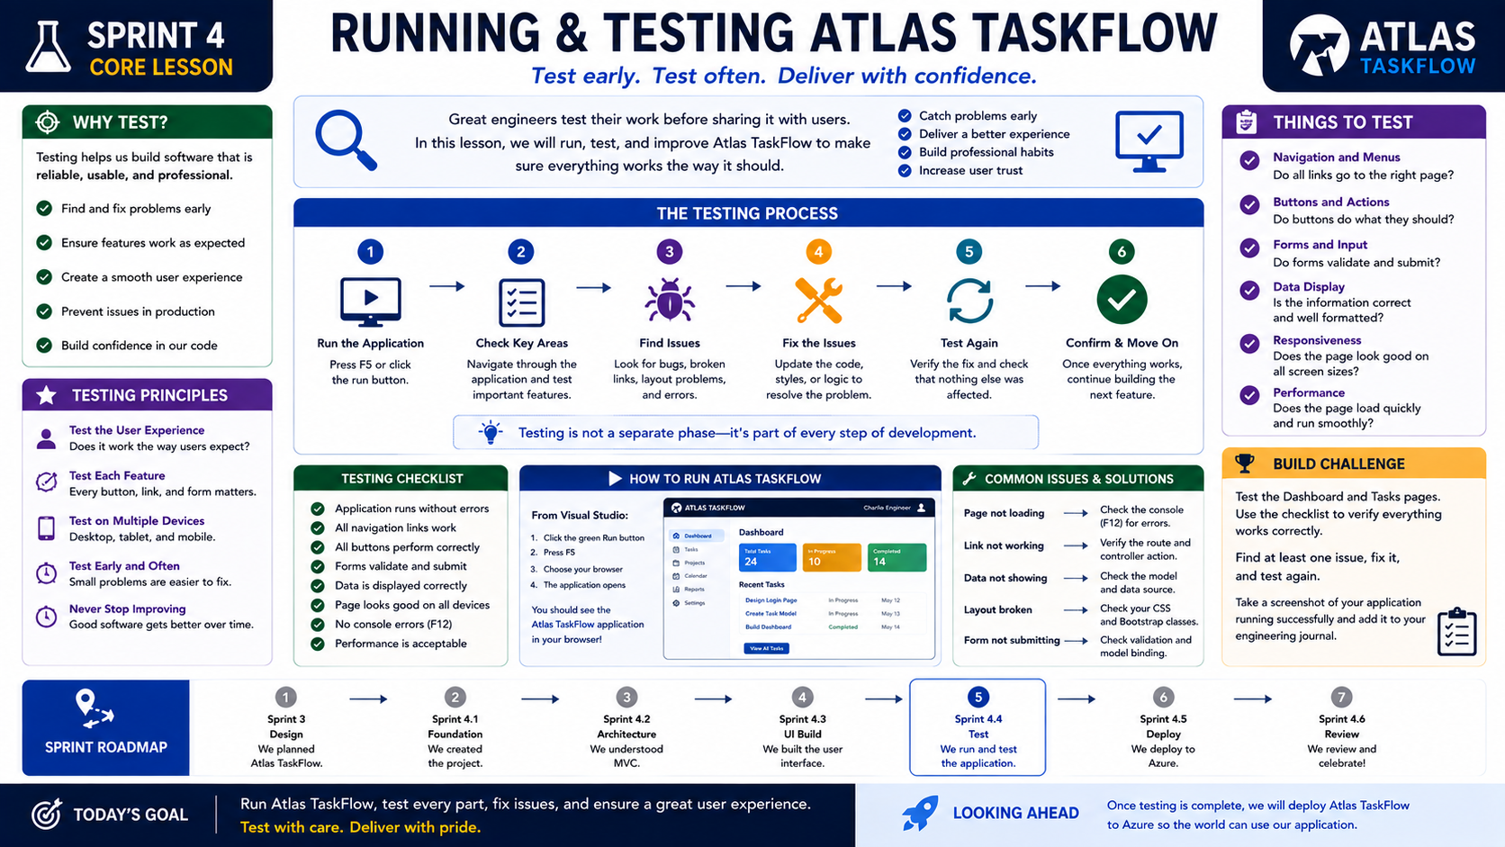
4-06
Notes:
============================================================
SPRINT 4
RUNNING & TESTING ATLAS TASKFLOW
============================================================
SLIDE PURPOSE
Introduce students to the importance of testing throughout software
development.
Students should understand that testing is not something performed only
at the end of a project.
Professional engineers test continuously while they build.
The objective of this lesson is to develop good engineering habits by
running, validating, troubleshooting, and improving Atlas TaskFlow
before deployment.
------------------------------------------------------------
OPENING
"Engineers..."
"I have a question."
"How many of you have written code..."
"...without running it?"
(Laughter usually follows.)
Continue.
"We've all done it."
"We get excited."
"We write code."
"We keep writing."
"And eventually..."
"We press Run."
Pause.
"Professional engineers don't work that way."
"They test constantly."
------------------------------------------------------------
THE BIG IDEA
Point to the subtitle.
"Test early."
"Test often."
"Deliver with confidence."
Explain.
"Testing isn't about proving you're right."
"It's about discovering what needs improvement."
"The earlier we find problems..."
"The easier they are to fix."
------------------------------------------------------------
WHY TEST?
Walk through the panel.
Testing helps us:
Find problems early.
Ensure features work correctly.
Create a better user experience.
Prevent production issues.
Build confidence.
Explain.
"Every test you perform today..."
"Saves someone frustration tomorrow."
------------------------------------------------------------
THE TESTING PROCESS
Move through each step.
STEP 1
Run the Application.
Press F5.
Open the browser.
Confirm the application starts.
Pause.
"Success begins here."
------------------------------------------------------------
STEP 2
Check Key Areas.
Navigate through:
Dashboard
Tasks
Projects
Navigation
Menus
Buttons
Explain.
"Don't assume."
"Verify."
------------------------------------------------------------
STEP 3
Find Issues.
Tell students:
"I expect you to find problems."
Smile.
"If you don't..."
"You probably aren't looking carefully enough."
Explain.
"Finding bugs is success."
Ignoring bugs is failure.
------------------------------------------------------------
STEP 4
Fix the Problem.
Update the code.
Save.
Rebuild.
Explain.
"Software engineering is iterative."
"Fix."
"Improve."
"Repeat."
------------------------------------------------------------
STEP 5
Test Again.
Ask:
"After fixing something..."
"Should we trust it?"
Students answer:
"No."
Exactly.
"We verify."
------------------------------------------------------------
STEP 6
Move Forward.
Explain.
"Only after a feature works..."
"Do we begin building the next one."
------------------------------------------------------------
TESTING PRINCIPLES
Walk through each.
Test the user experience.
Test every feature.
Test on multiple devices.
Test early.
Never stop improving.
Explain.
"Testing isn't only about code."
"It's about people."
------------------------------------------------------------
THINGS TO TEST
Review the checklist.
Navigation.
Buttons.
Forms.
Displayed data.
Responsive layout.
Performance.
Ask students:
"If a button doesn't work..."
"Does the application work?"
Guide discussion.
------------------------------------------------------------
TESTING CHECKLIST
Walk through the checklist.
Application launches.
Navigation works.
Buttons work.
Forms respond.
Pages display correctly.
No obvious errors.
Performance feels smooth.
Explain.
"This is the beginning of quality assurance."
------------------------------------------------------------
HOW TO RUN ATLAS TASKFLOW
Show students.
Press F5.
Visual Studio builds.
Browser opens.
Application launches.
Pause.
Celebrate.
"It works."
------------------------------------------------------------
COMMON ISSUES
Review examples.
Broken link.
Missing page.
Incorrect route.
Layout issue.
Console errors.
Explain.
"Every engineer encounters these."
"The difference..."
"Is learning how to solve them."
------------------------------------------------------------
BUILD CHALLENGE
Challenge students.
Open Atlas TaskFlow.
Navigate every page.
Find one issue.
Fix it.
Run again.
Take a screenshot.
Add it to your engineering journal.
Explain.
"I don't want perfection."
"I want improvement."
------------------------------------------------------------
ENGINEERING INSIGHT
Read the quote.
"Testing isn't a separate phase."
"It's part of every step of development."
Pause.
Repeat it.
"This is how professional teams build software."
------------------------------------------------------------
SPRINT ROADMAP
Point to Sprint 4.
Explain.
We've built.
Now we verify.
Next...
We deploy.
------------------------------------------------------------
LOOKING AHEAD
Ask:
"When should users find bugs?"
Students answer:
"Never."
Smile.
"So who should find them?"
"We should."
"That's why we test."
------------------------------------------------------------
CLASS DISCUSSION
Ask students:
"What problem did you discover today?"
"What surprised you?"
"What bug took the longest to solve?"
Encourage students to share solutions.
Software engineering is collaborative.
------------------------------------------------------------
THE MOMENT
Walk around the classroom.
Watch students clicking through their applications.
Then say...
"Today..."
"You stopped being someone who writes code."
Pause.
"You became someone who validates software."
"And that's one of the biggest differences between a programmer..."
"...and a software engineer."
------------------------------------------------------------
ESTIMATED TIME
Introduction.......................5 minutes
Why Testing Matters...............10 minutes
Testing Process...................15 minutes
Hands-on Testing..................20 minutes
Discussion........................10 minutes
Closing............................5 minutes
Total.............................65 minutes
------------------------------------------------------------
INSTRUCTOR NOTES
Keep students actively testing throughout the lesson.
Resist the temptation to fix every issue for them.
Instead, ask guiding questions.
"What changed?"
"What were you expecting?"
"What does the browser tell you?"
"What does Visual Studio tell you?"
Encourage students to debug logically.
The goal is not simply finding bugs.
The goal is developing confidence in their engineering process.
Close with:
"Engineers..."
"Software isn't finished when it compiles."
"It's finished when it works."
"And tomorrow..."
"We're going to share it with the world."
============================================================

Slide 7
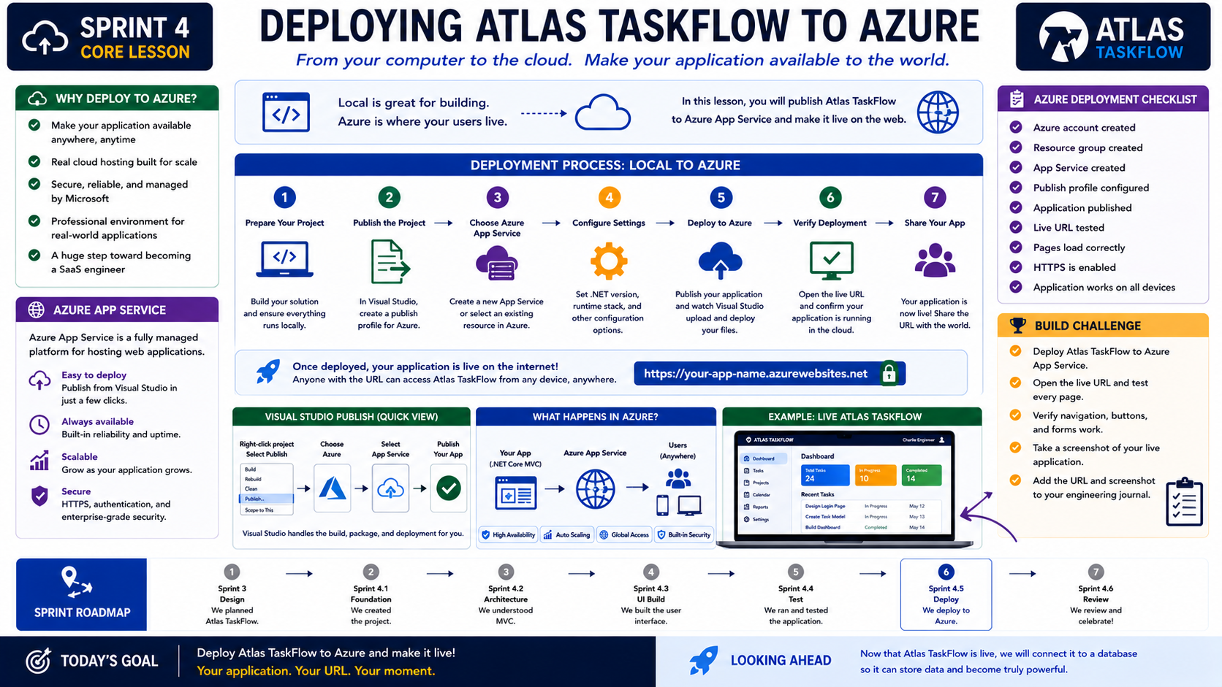
4-07
Notes:
============================================================
SPRINT 4
DEPLOYING ATLAS TASKFLOW TO AZURE
============================================================
SLIDE PURPOSE
Guide students through publishing Atlas TaskFlow from their local
development environment to Microsoft Azure App Service.
Students should understand that deployment is what transforms a local
application into a Software as a Service (SaaS) application that users
can access through the internet.
The objective is not simply learning how to click the Publish button.
The objective is understanding the complete journey from developer to
user.
------------------------------------------------------------
OPENING
"Engineers..."
Pause.
"Today is a milestone."
"Everything we've built..."
"Everything we've designed..."
"Everything we've tested..."
"Leaves our computer."
Pause.
"And becomes available to the world."
Smile.
"Welcome to deployment."
------------------------------------------------------------
THE BIG IDEA
Point to the subtitle.
"From your computer..."
"...to the cloud."
Explain.
"Until now..."
"Atlas TaskFlow has only existed on your machine."
"If someone wanted to use your application..."
"They couldn't."
"But today..."
"That changes."
------------------------------------------------------------
WHY DEPLOY TO AZURE?
Walk through each point.
Available anywhere.
Reliable.
Scalable.
Secure.
Professional.
Explain.
"Users don't care what's on your laptop."
"They care about what's available when they need it."
That's why cloud hosting exists.
------------------------------------------------------------
LOCAL VS CLOUD
Point to the banner.
Read it.
"Local is great for building."
"Azure is where your users live."
Pause.
Ask:
"If your laptop is turned off..."
"Can your users access localhost?"
Students answer:
"No."
Exactly.
"So where should our application live?"
"The cloud."
------------------------------------------------------------
THE DEPLOYMENT PROCESS
Walk through each step.
STEP 1
Prepare the Project.
Explain.
"Before deployment..."
"The application should build successfully."
"No errors."
"No broken pages."
------------------------------------------------------------
STEP 2
Publish
Explain.
"In Visual Studio..."
"We choose Publish."
Visual Studio packages the application.
------------------------------------------------------------
STEP 3
Choose Azure App Service
Explain.
"This is Microsoft's cloud hosting platform."
"Our application now has a home."
------------------------------------------------------------
STEP 4
Configure
Explain.
"We verify our settings."
Resource Group.
App Service.
Runtime.
Region.
No deep dive.
Simply explain that these settings tell Azure how to host the application.
------------------------------------------------------------
STEP 5
Deploy
Pause.
Smile.
"This is the exciting part."
Visual Studio uploads the application.
Files are copied.
Azure starts the application.
------------------------------------------------------------
STEP 6
Verify
Open the URL.
Refresh.
Click through the pages.
Explain.
"Never assume deployment worked."
"Always verify."
------------------------------------------------------------
STEP 7
Share
Explain.
"Your application now has an address."
"It's no longer just your project."
"It has become a service."
------------------------------------------------------------
AZURE APP SERVICE
Review the panel.
Easy deployment.
Reliable hosting.
Automatic scaling.
HTTPS support.
Professional infrastructure.
Explain.
"Microsoft manages the servers."
"We focus on building software."
------------------------------------------------------------
VISUAL STUDIO PUBLISH
Walk students through the publishing process.
Right-click project.
Publish.
Azure.
App Service.
Select resource.
Publish.
Keep the demonstration slow.
------------------------------------------------------------
WHAT HAPPENS IN AZURE?
Point to the diagram.
Explain.
"Our code leaves Visual Studio."
↓
Azure receives it.
↓
Azure hosts it.
↓
Users connect through a browser.
Pause.
"This..."
"is Software as a Service."
------------------------------------------------------------
LIVE APPLICATION
Point to the example.
Ask:
"Where is Atlas TaskFlow running now?"
Students answer:
"In Azure."
Smile.
"Exactly."
"Not on my computer."
------------------------------------------------------------
BUILD CHALLENGE
Challenge students.
Deploy Atlas TaskFlow.
Open the live URL.
Navigate every page.
Verify everything works.
Take a screenshot.
Record the URL in your engineering journal.
Explain.
"Today your application earns its web address."
------------------------------------------------------------
AZURE CHECKLIST
Walk through each item.
Azure account.
App Service.
Publish profile.
Deployment.
Live URL.
HTTPS.
Working pages.
Explain.
"Professional engineers verify deployments before announcing them."
------------------------------------------------------------
ENGINEERING LESSON
Read today's statement.
"Your application."
"Your URL."
"Your moment."
Pause.
Explain.
"This isn't just another assignment."
"You've built something people can actually visit."
------------------------------------------------------------
SPRINT ROADMAP
Point to Sprint 4.
Review the journey.
Engineering Brief.
↓
How SaaS Works.
↓
Create Project.
↓
Understand MVC.
↓
Build Interface.
↓
Run & Test.
↓
Deploy.
Explain.
"Every lesson led here."
------------------------------------------------------------
LOOKING AHEAD
Ask:
"Our application looks great."
"But what happens if we close it?"
Students answer:
"It forgets everything."
Smile.
"Exactly."
"Sprint 5 gives Atlas TaskFlow a memory."
------------------------------------------------------------
CLASS DISCUSSION
Ask students:
"How did it feel opening your application through a real URL?"
"What surprised you during deployment?"
"What problems did you solve?"
Encourage students to celebrate one another's success.
------------------------------------------------------------
THE MOMENT
This is the moment.
Walk around the room.
Wait until everyone has deployed.
Then ask:
"Everyone..."
"Open your application."
Pause.
"Now..."
"Look at the address bar."
Pause again.
Then say...
"That..."
"isn't localhost."
"That isn't your computer."
"That's your application..."
"Running in the cloud."
Smile.
"Congratulations."
"You've built a Software as a Service application."
Allow that moment to sink in.
------------------------------------------------------------
ESTIMATED TIME
Introduction........................5 minutes
Why Azure?.........................10 minutes
Deployment Process.................15 minutes
Hands-on Deployment................20 minutes
Verification.......................10 minutes
Discussion..........................5 minutes
Closing.............................5 minutes
Total..............................70 minutes
------------------------------------------------------------
INSTRUCTOR NOTES
This lesson is more than a deployment walkthrough.
It is the emotional payoff for everything students have accomplished
throughout Sprint 4.
Move slowly during the live demonstration.
Celebrate every successful deployment.
Have students share their live URLs with one another and visit each
other's applications.
This reinforces one of the core ideas of SaaS:
Software exists to be used by others.
Avoid discussing advanced Azure topics such as App Service Plans,
virtual networks, deployment slots, CI/CD pipelines, containers, or
resource optimization.
Those belong in later courses.
Today's objective is simple:
Students experience the transition from
Developer
↓
Application
↓
Cloud
↓
User.
Close with:
"Engineers..."
"You started this sprint with an empty project."
"You leave this sprint with a live cloud application."
"Welcome to Software as a Service."
============================================================

Slide 8
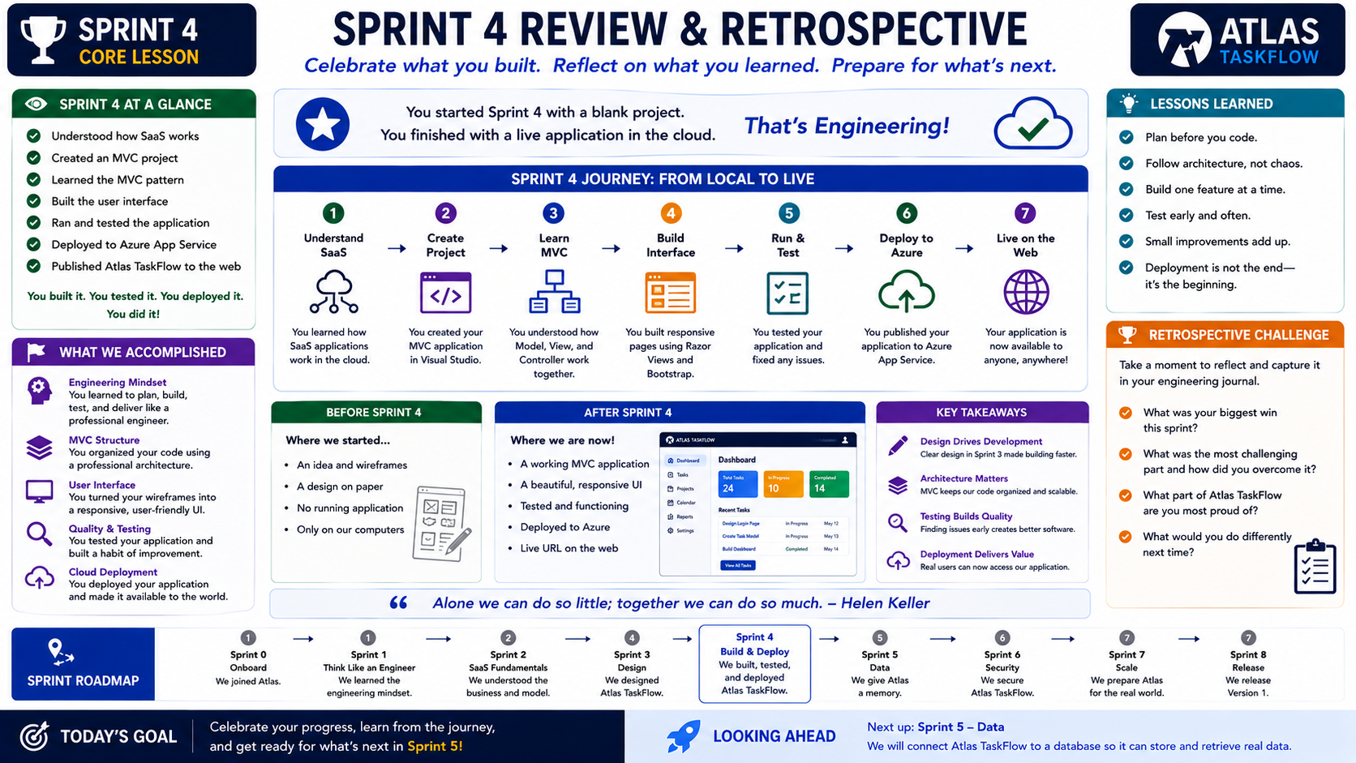
4-08
Notes:
============================================================
SPRINT 4
REVIEW & RETROSPECTIVE
============================================================
SLIDE PURPOSE
Celebrate the completion of Sprint 4 and reflect on the engineering
journey from design to deployment.
Students should recognize the progress they have made, connect the
lessons learned throughout the sprint, and prepare for Sprint 5 where
Atlas TaskFlow will begin storing data.
This lesson reinforces the engineering mindset of continuous
improvement.
------------------------------------------------------------
OPENING
"Engineers..."
Pause.
"I don't want to start class with a lecture today."
"I want to start with a question."
"How many of you now have a live web application?"
Pause.
Smile.
"Take a second..."
"And appreciate that."
------------------------------------------------------------
THE BIG IDEA
Point to the statement at the top.
"You started Sprint 4 with a blank project."
"You finished Sprint 4 with a live application."
Pause.
"That's engineering."
Explain.
"Professional software isn't created overnight."
"It grows through planning..."
"Building..."
"Testing..."
"And continuous improvement."
------------------------------------------------------------
SPRINT 4 AT A GLANCE
Walk through each accomplishment.
You understood SaaS.
You created an MVC project.
You learned MVC.
You built the interface.
You tested your application.
You deployed to Azure.
You published Atlas TaskFlow.
Pause.
"Think about everything you accomplished."
"None of this existed just a few weeks ago."
------------------------------------------------------------
THE JOURNEY
Point to the timeline.
Walk through each milestone.
Understand SaaS.
↓
Create Project.
↓
Learn MVC.
↓
Build Interface.
↓
Run & Test.
↓
Deploy.
↓
Live on the Web.
Explain.
"Every lesson built upon the one before it."
"There were no random activities."
"We built one application together."
------------------------------------------------------------
BEFORE & AFTER
Point to the comparison.
BEFORE
Wireframes.
Ideas.
Sketches.
No application.
AFTER
Running MVC application.
Professional interface.
Cloud deployment.
Live URL.
Ask:
"Which side would you rather demonstrate to an employer?"
Students usually smile.
------------------------------------------------------------
WHAT WE ACCOMPLISHED
Discuss each area.
Engineering Mindset
Planning before coding.
MVC Structure
Organizing software.
User Interface
Building for users.
Quality & Testing
Finding problems before users do.
Cloud Deployment
Making software available anywhere.
Explain.
"These aren't isolated skills."
"They're habits."
------------------------------------------------------------
KEY TAKEAWAYS
Walk through each lesson.
Design drives development.
Architecture matters.
Testing builds quality.
Deployment delivers value.
Explain.
"Technology changes."
"These ideas don't."
"They're engineering principles."
------------------------------------------------------------
LESSONS LEARNED
Read each item.
Plan before you code.
Follow architecture.
Build one feature at a time.
Test often.
Improve continuously.
Deployment isn't the end.
Pause.
"It's the beginning."
Explain why.
"Deployment simply means..."
"Now people can start using your software."
------------------------------------------------------------
RETROSPECTIVE CHALLENGE
Have students open their engineering journal.
Ask them to answer:
What was your biggest success?
What challenged you the most?
What are you most proud of?
If you built Atlas TaskFlow again...
What would you improve?
Allow time for writing.
Then invite volunteers to share.
------------------------------------------------------------
THE QUOTE
Read the quote.
"Alone we can do so little..."
"Together we can do so much."
Explain.
"No engineer builds software entirely alone."
"Software is a team sport."
Relate it to:
Code reviews.
Testing.
Design.
Deployment.
Professional collaboration.
------------------------------------------------------------
SPRINT ROADMAP
Review the complete journey.
Sprint 0
Joined Atlas.
Sprint 1
Think like an engineer.
Sprint 2
Understand SaaS.
Sprint 3
Design.
Sprint 4
Build and Deploy.
Pause.
Then point to Sprint 5.
"Our journey isn't over."
------------------------------------------------------------
LOOKING AHEAD
Ask:
"Our application looks great."
"It runs."
"It's online."
"But what's missing?"
Students answer:
"It doesn't remember anything."
Exactly.
"Sprint 5 changes that."
"We're giving Atlas TaskFlow a memory."
------------------------------------------------------------
CLASS DISCUSSION
Ask students:
"What lesson changed the way you think about software?"
"What accomplishment are you most proud of?"
"What surprised you about building a web application?"
"What advice would you give next semester's students?"
Allow students to celebrate one another.
------------------------------------------------------------
THE MOMENT
This is the close of Sprint 4.
Walk to the center of the room.
Pause.
Then say...
"When we began this sprint..."
"Atlas TaskFlow was an idea."
"You designed it."
"You organized it."
"You built it."
"You tested it."
"You deployed it."
Pause.
"And now..."
"It's real."
Long pause.
"Take a moment."
"That's something you created."
------------------------------------------------------------
TRANSITION TO SPRINT 5
Smile.
Then ask:
"What happens if I close Atlas TaskFlow right now?"
Students answer:
"We lose everything."
Exactly.
"Our application has no memory."
"So next sprint..."
"We're going to teach it how to remember."
------------------------------------------------------------
ESTIMATED TIME
Sprint Reflection...................10 minutes
Journey Review......................10 minutes
Engineering Lessons.................10 minutes
Retrospective Activity..............20 minutes
Class Discussion....................10 minutes
Sprint Close.........................5 minutes
Total...............................65 minutes
------------------------------------------------------------
INSTRUCTOR NOTES
Keep this lesson conversational.
Celebrate student accomplishments.
Allow students to demonstrate their live applications to one another.
Encourage discussion rather than lecture.
Students should leave feeling proud of what they have accomplished and
motivated for Sprint 5.
This is an opportunity to reinforce confidence.
Remind them that just a few weeks ago, many had never created or
deployed a web application.
Today they have a cloud-hosted SaaS application they can share with
others.
Close with:
"Engineers..."
"You didn't just complete Sprint 4."
"You crossed one of the biggest milestones in this course."
"You turned an idea into a live application."
"Take pride in that."
"Next sprint..."
"We make Atlas TaskFlow smarter."
============================================================

Slide 9
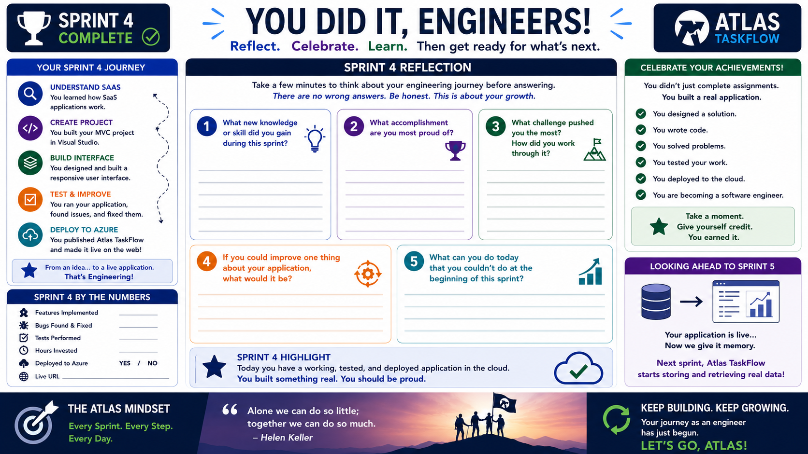
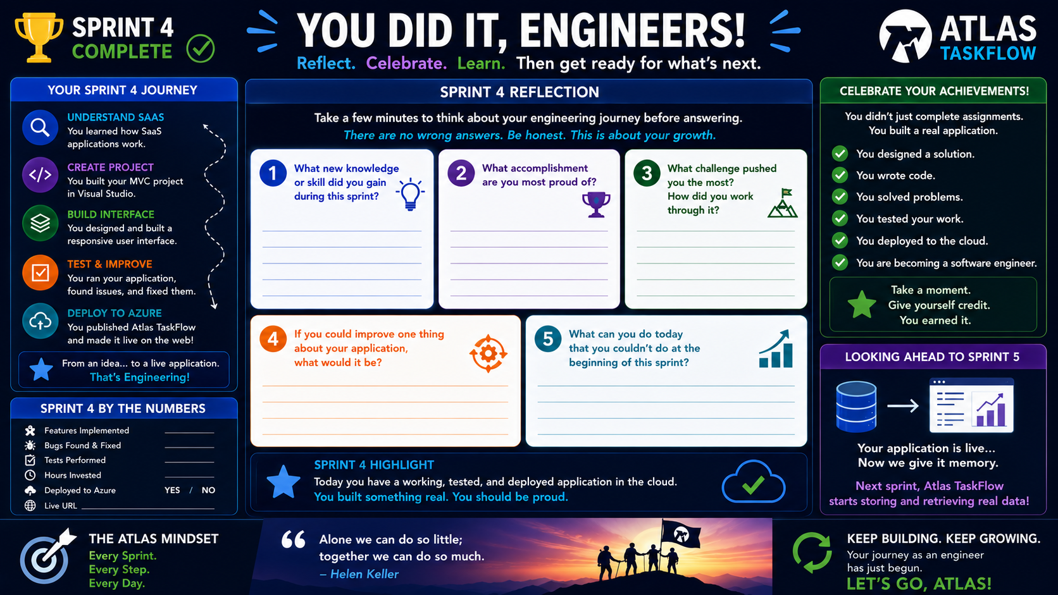
4-09

