Slide 1
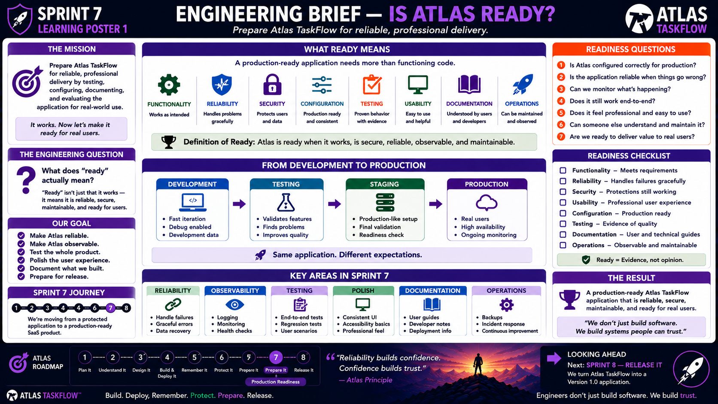
7-01
Notes:
============================================================
SPRINT 7
ENGINEERING BRIEF — IS ATLAS READY?
"Prepare Atlas TaskFlow for reliable, professional delivery."
============================================================
SLIDE PURPOSE
Introduce Sprint 7 as the transition from a working application to a
production-ready application.
Students should understand that:
WORKING ≠ READY
A production-ready application must be:
• Functional
• Reliable
• Secure
• Properly configured
• Tested
• Usable
• Documented
• Observable
• Maintainable
The purpose of this sprint is not to make Atlas perfect.
The purpose is to prepare Atlas for responsible real-world use.
------------------------------------------------------------
OPENING
"Engineers..."
"Look at where Atlas TaskFlow is today."
"It runs."
"It has a database."
"It remembers information."
"It knows who users are."
"It controls access."
"We've tested its security."
Pause.
"So..."
"Are we ready to give it to real users?"
Students will likely say:
"Maybe."
Exactly.
Say:
"That's the question Sprint 7 is going to answer."
------------------------------------------------------------
THE ENGINEERING QUESTION
Point to:
WHAT DOES "READY" ACTUALLY MEAN?
Say:
"Think about the applications you use every day."
"Do they simply need to work?"
Or do you expect them to:
Work reliably.
Protect your information.
Handle errors.
Be available.
Be understandable.
Look professional.
Recover from problems.
Be maintained.
Exactly.
"That's what ready means."
------------------------------------------------------------
WORKING VS READY
Write on the board:
WORKING
≠
READY
Explain:
"An application can work perfectly during a classroom demonstration
and still not be ready for real users."
Examples:
Debug mode is enabled.
Secrets are hard-coded.
Errors expose technical details.
There are no backups.
Nobody knows when the application fails.
The interface is confusing.
No documentation exists.
Testing is incomplete.
Say:
"Working is the starting point."
"Readiness is the next level."
------------------------------------------------------------
THE MISSION
Point to:
THE MISSION.
Read:
"Prepare Atlas TaskFlow for reliable, professional delivery by
testing, configuring, documenting, and evaluating the application
for real-world use."
Explain:
"This sprint is about preparation."
"We're taking what we built..."
"...and making it something we could responsibly hand to users."
------------------------------------------------------------
WHAT READY MEANS
Point to the eight areas.
FUNCTIONALITY
RELIABILITY
SECURITY
CONFIGURATION
TESTING
USABILITY
DOCUMENTATION
OPERATIONS
Say:
"These are our readiness categories."
"We're going to examine each one."
------------------------------------------------------------
FUNCTIONALITY
Point to:
FUNCTIONALITY.
Ask:
"Does Atlas do what it's supposed to do?"
Review:
Requirements.
Features.
User stories.
Workflows.
Expected behavior.
Explain:
"Functionality is still our foundation."
"If the application doesn't perform its core purpose..."
"Nothing else matters."
------------------------------------------------------------
RELIABILITY
Point to:
RELIABILITY.
Ask:
"What happens when something goes wrong?"
Examples:
Database unavailable.
Invalid input.
Missing information.
Unexpected error.
Network problem.
Explain:
"A reliable application doesn't necessarily prevent every problem."
"It handles problems gracefully."
------------------------------------------------------------
GRACEFUL FAILURE
Give an example.
Bad:
Application crashes.
User sees a stack trace.
Data is lost.
Better:
Application detects the problem.
User receives a useful message.
The failure is logged.
The application remains stable.
Explain:
"That's graceful failure."
------------------------------------------------------------
SECURITY
Point to:
SECURITY.
Say:
"We just spent an entire sprint on this."
Review:
Authentication.
Authorization.
Data protection.
Secrets.
HTTPS.
Security testing.
Explain:
"Security doesn't disappear because we're entering Sprint 7."
"It becomes part of our readiness evaluation."
------------------------------------------------------------
CONFIGURATION
Point to:
CONFIGURATION.
Ask:
"Would you deploy your development environment exactly as it is?"
Students may say:
"No."
Exactly.
Explain:
"Development and production have different requirements."
Examples:
Debugging.
Connection strings.
Secrets.
Environment variables.
Error handling.
Application settings.
Explain:
"We need to make sure Atlas is configured appropriately for where it
is running."
------------------------------------------------------------
TESTING
Point to:
TESTING.
Say:
"How do we know Atlas is ready?"
"Evidence."
Testing gives us evidence.
Review:
Functional tests.
End-to-end tests.
Regression tests.
User scenarios.
Security tests.
Deployment tests.
Explain:
"Testing isn't just something we do before the deadline."
"Testing is how we build confidence."
------------------------------------------------------------
USABILITY
Point to:
USABILITY.
Ask:
"Can someone actually use Atlas without us standing beside them?"
Look at:
Navigation.
Forms.
Buttons.
Messages.
Layout.
Responsive behavior.
Accessibility.
Consistency.
Explain:
"Users don't care how elegant our controller code is."
"They care whether they can accomplish their task."
------------------------------------------------------------
DOCUMENTATION
Point to:
DOCUMENTATION.
Ask:
"If you disappeared tomorrow..."
"Could another developer understand Atlas?"
Could they:
Run it?
Configure it?
Deploy it?
Troubleshoot it?
Understand the database?
Understand the major features?
Explain:
"Documentation transfers knowledge."
------------------------------------------------------------
OPERATIONS
Point to:
OPERATIONS.
Ask:
"After we deploy Atlas..."
"Who knows when something breaks?"
This introduces observability.
We need:
Logs.
Monitoring.
Health checks.
Backups.
Recovery plans.
Incident thinking.
Explain:
"Deployment isn't the end."
"It's the beginning of operating the application."
------------------------------------------------------------
DEFINITION OF READY
Point to the green box.
Read:
"Atlas is ready when it works, is secure, reliable, observable, and
maintainable."
Pause.
"This is our definition of ready."
Then emphasize:
"Ready does not mean perfect."
"It means we have enough evidence and preparation to responsibly move
forward."
------------------------------------------------------------
FROM DEVELOPMENT TO PRODUCTION
Move to the development-to-production diagram.
Say:
"Atlas doesn't jump directly from our laptop to real users."
We move through environments.
DEVELOPMENT
↓
TESTING
↓
STAGING
↓
PRODUCTION
Explain:
"Each stage gives us another opportunity to discover problems."
------------------------------------------------------------
DEVELOPMENT
Point to Development.
Explain:
"This is where we build."
Characteristics:
Fast iteration.
Debugging.
Development data.
Frequent changes.
Experimental work.
Say:
"Development is allowed to be messy."
"But production isn't."
------------------------------------------------------------
TESTING
Point to Testing.
Explain:
"Testing asks whether the application behaves correctly."
We:
Validate features.
Find problems.
Run test scenarios.
Improve quality.
Say:
"Testing is where we gain evidence."
------------------------------------------------------------
STAGING
Point to Staging.
Explain:
"Staging is a production-like environment used for final validation."
This can include:
Production-like configuration.
Deployment testing.
Final validation.
Readiness checks.
Explain:
"We're not just testing the code."
"We're testing the environment and deployment process."
------------------------------------------------------------
PRODUCTION
Point to Production.
Explain:
"This is where real users interact with the application."
Production requires:
Reliable configuration.
Secure settings.
Monitoring.
Availability.
Support.
Maintenance.
Say:
"The expectations change when real people depend on the system."
------------------------------------------------------------
SAME APPLICATION — DIFFERENT EXPECTATIONS
Point to the purple statement.
Read:
"Same application. Different expectations."
Explain:
"The code may be similar."
"But the environment changes the level of responsibility."
A development error:
Annoying.
A production error:
Potentially impacts users.
------------------------------------------------------------
OUR SPRINT 7 GOALS
Point to:
OUR GOAL.
Read each:
Make Atlas reliable.
Make Atlas observable.
Test the whole product.
Polish the user experience.
Document what we built.
Prepare for release.
Explain:
"Everything we do in this sprint supports one of those goals."
------------------------------------------------------------
RELIABILITY
Introduce the first major workstream.
Students will investigate:
Failure handling.
Graceful errors.
Data recovery.
Backups.
Ask:
"If Atlas crashes tomorrow..."
"How do we recover?"
------------------------------------------------------------
OBSERVABILITY
Introduce the second major workstream.
Ask:
"If Atlas breaks at 2 AM..."
"How would we know?"
Students may say:
"Someone tells us."
Explain:
"That's not enough."
We need:
Logs.
Monitoring.
Health checks.
Alerts where appropriate.
Explain:
"Observability helps us understand what the system is doing."
------------------------------------------------------------
TESTING
Third workstream.
Say:
"We're going beyond testing individual features."
"We're testing the whole product."
Examples:
Create account.
Login.
Create project.
Create task.
Edit task.
Complete task.
Logout.
Login again.
Verify data.
Test unauthorized access.
This is end-to-end thinking.
------------------------------------------------------------
POLISH
Point to:
POLISH.
Explain:
"Atlas should feel intentional."
Look for:
Inconsistent buttons.
Broken layouts.
Confusing messages.
Missing confirmation.
Poor navigation.
Unclear forms.
Accessibility issues.
Say:
"Small details influence whether users trust the product."
------------------------------------------------------------
DOCUMENTATION
Point to:
DOCUMENTATION.
Explain:
"We need to document both the user experience and the technical
system."
User:
"How do I use Atlas?"
Developer:
"How does Atlas work?"
Administrator:
"How do I operate Atlas?"
Those are different questions.
------------------------------------------------------------
OPERATIONS
Point to:
OPERATIONS.
Explain:
"Operations is what happens after deployment."
Examples:
Backups.
Incident response.
Monitoring.
Continuous improvement.
Updates.
Maintenance.
Say:
"A SaaS application isn't finished when we deploy it."
------------------------------------------------------------
READINESS QUESTIONS
Move to the right side of the poster.
Read each question.
1.
"Is Atlas configured correctly for production?"
2.
"Is the application reliable when things go wrong?"
3.
"Can we monitor what's happening?"
4.
"Does it still work end-to-end?"
5.
"Does it feel professional and easy to use?"
6.
"Can someone else understand and maintain it?"
7.
"Are we ready to deliver value to real users?"
8.
"What remains before full release?"
Explain:
"These questions will guide Sprint 7."
------------------------------------------------------------
READINESS CHECKLIST
Point to the checklist.
Walk through:
Functionality.
Reliability.
Security.
Usability.
Configuration.
Testing.
Documentation.
Operations.
Explain:
"Every category needs evidence."
------------------------------------------------------------
EVIDENCE, NOT OPINION
Point to the green statement.
Read:
"Ready = Evidence, not opinion."
Say:
"Don't tell me Atlas is ready because you feel like it's ready."
"Show me."
Examples:
Test results.
Screenshots.
Logs.
Successful deployment.
Backup test.
Security test.
Documentation.
User testing.
Explain:
"Engineering decisions should be supported by evidence."
------------------------------------------------------------
THE READINESS SCORECARD
Tell students:
"Throughout Sprint 7, we're going to build evidence for each category."
For example:
FUNCTIONALITY
✓ Requirements tested.
RELIABILITY
✓ Failure scenarios tested.
SECURITY
✓ Security controls verified.
CONFIGURATION
✓ Production settings reviewed.
TESTING
✓ End-to-end scenarios completed.
USABILITY
✓ User experience reviewed.
DOCUMENTATION
✓ Guides completed.
OPERATIONS
✓ Monitoring and recovery considered.
------------------------------------------------------------
THE RESULT
Point to:
THE RESULT.
Read:
"A production-ready Atlas TaskFlow application that is reliable,
secure, maintainable, and ready for real users."
Explain:
"That's our destination."
------------------------------------------------------------
IMPORTANT DISTINCTION
Say:
"Sprint 6 asked..."
"Can we trust Atlas?"
"Sprint 7 asks..."
"Can we operate and deliver Atlas responsibly?"
"Sprint 8 will ask..."
"Can we release Atlas?"
Pause.
"These are three different engineering questions."
------------------------------------------------------------
SPRINT 7 JOURNEY
Point to the roadmap.
Say:
"We're moving from a protected application..."
"...to a production-ready SaaS product."
This sprint is about:
Preparation.
Validation.
Polish.
Documentation.
Operational readiness.
------------------------------------------------------------
ATLAS ENGINEERING PRINCIPLE
Point to the quote:
"Reliability builds confidence.
Confidence builds trust."
Explain:
"Security helps us earn trust."
"Reliability helps us keep it."
------------------------------------------------------------
DISCUSSION QUESTION
Ask the class:
"What is one thing that would make you hesitate to give Atlas to a
real customer today?"
Let students discuss.
Write their answers on the board.
Potential answers:
Bugs.
Performance.
Backups.
Security.
Documentation.
User experience.
Monitoring.
Missing features.
Explain:
"Those concerns become our Sprint 7 work."
------------------------------------------------------------
ANOTHER QUESTION
Ask:
"What is the difference between..."
"A developer saying 'It works.'"
and:
"An engineer saying 'It's ready.'"
Expected discussion:
Evidence.
Testing.
Reliability.
Documentation.
Configuration.
Operational planning.
------------------------------------------------------------
LOOKING AHEAD
Point to:
SPRINT 8 — RELEASE IT.
Say:
"Everything we're doing now prepares us for the final step."
Sprint 8 will be about:
Final delivery.
Final demonstration.
Final evaluation.
Version 1.0.
But:
"We aren't ready to release yet."
"First..."
"We prepare."
------------------------------------------------------------
CLOSING
Say:
"Engineers don't stop at 'It works.'"
Pause.
"We ask..."
"Can we trust it?"
"We already did that."
Then:
"Can we operate it?"
"Can we maintain it?"
"Can we support it?"
"Can we deliver it?"
Pause.
"That's Sprint 7."
============================================================
ESTIMATED TIME
Opening / Working vs Ready.............8 minutes
Eight Readiness Areas..................15 minutes
Development → Production...............10 minutes
Sprint 7 Workstreams....................10 minutes
Readiness Questions.....................8 minutes
Discussion..............................9 minutes
Sprint 8 Preview........................5 minutes
TOTAL...................................65 minutes
============================================================
INSTRUCTOR NOTES
This is the framing lesson for the entire sprint.
Students should leave understanding that Sprint 7 is not simply
"more features."
It is about making the existing product ready for responsible use.
------------------------------------------------------------
IMPORTANT TEACHING MOVE
Keep returning to:
WORKING ≠ READY
When a student says:
"But it works."
Ask:
"Is it reliable?"
"Is it documented?"
"Can someone else maintain it?"
"Can we monitor it?"
"Can we recover it?"
"Is production configured correctly?"
This reinforces the difference between programming and engineering.
------------------------------------------------------------
DO NOT OVER-ENGINEER
Keep the concepts practical.
Students do not need to build:
• Enterprise CI/CD infrastructure
• Complex Kubernetes environments
• Advanced distributed systems
• Enterprise monitoring platforms
• Full disaster recovery architecture
They need to understand the principles and apply reasonable practices
to Atlas.
------------------------------------------------------------
PRODUCTION BOUNDARY
Explain that "production ready" in this course means:
Ready for the scope and requirements of Atlas TaskFlow Version 1.0.
It does NOT mean:
"Ready to compete with Microsoft, Google, or Salesforce."
The goal is professional student-level SaaS engineering.
------------------------------------------------------------
KEY TAKEAWAY
Write this on the board:
WORKING
≠
READY
Then:
READY =
FUNCTIONAL
+
RELIABLE
+
SECURE
+
TESTED
+
USABLE
+
DOCUMENTED
+
OBSERVABLE
+
MAINTAINABLE
------------------------------------------------------------
FINAL STATEMENT
"Engineers..."
"Anyone can say, 'It works.'"
"Our job is to be able to say..."
"'It's ready.'"
"And then..."
"Show the evidence."
============================================================

Slide 2
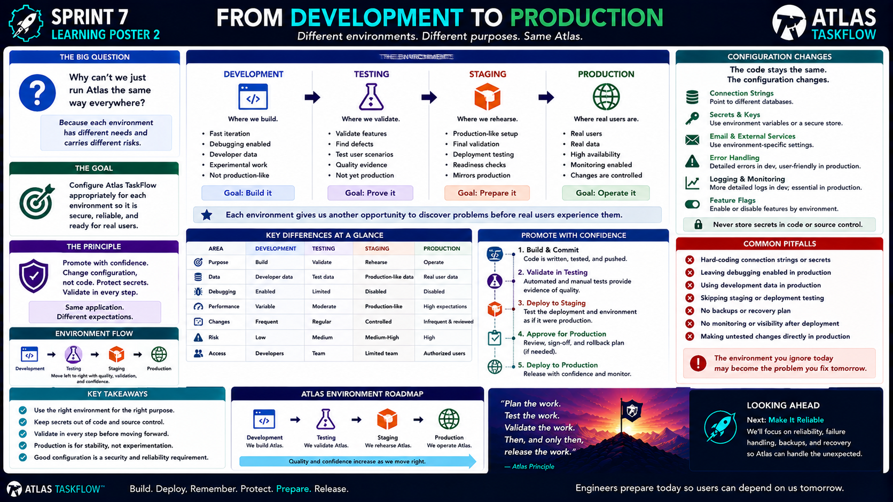
7-02
Notes:
============================================================
SPRINT 7
FROM DEVELOPMENT TO PRODUCTION
"Different environments. Different purposes. Same Atlas."
============================================================
SLIDE PURPOSE
Help students understand why software moves through different
environments before reaching real users.
Students should understand:
• Development
• Testing
• Staging
• Production
• Environment-specific configuration
• Secrets management
• Deployment validation
• Monitoring
• Why production requires higher standards
• Why we should promote software with confidence
The goal is not to teach enterprise DevOps.
The goal is to teach students how professional software moves from
"it works on my machine" toward reliable real-world operation.
------------------------------------------------------------
OPENING
"Engineers..."
"How many of you have ever had something work perfectly on your
computer..."
"...and then not work somewhere else?"
Pause.
"Welcome to software development."
Students will likely laugh.
Say:
"That problem is one reason environments exist."
------------------------------------------------------------
THE BIG QUESTION
Point to:
"Why isn't production just another copy of our development
environment?"
Answer:
"Because the expectations are different."
Development is optimized for:
Speed.
Experimentation.
Debugging.
Production is optimized for:
Reliability.
Security.
Availability.
Real users.
------------------------------------------------------------
THE BIG IDEA
Point to:
"Production is different."
Say:
"Production isn't just where we put the application."
"Production is where people depend on the application."
That's the distinction.
------------------------------------------------------------
THE SOFTWARE LIFECYCLE PIPELINE
Point to:
DEVELOPMENT
↓
TESTING
↓
STAGING
↓
PRODUCTION
Say:
"Atlas moves through these stages."
"Each stage gives us another opportunity to find problems before
real users experience them."
------------------------------------------------------------
DEVELOPMENT
Point to Development.
Ask:
"What happens here?"
Students:
Build.
Code.
Debug.
Experiment.
Exactly.
Development is where we move quickly.
Characteristics:
Fast iteration.
Debugging.
Development data.
Frequent changes.
Experimental work.
------------------------------------------------------------
WHY DEVELOPMENT CAN BE MESSY
Say:
"Development is allowed to be messy."
You may have:
Debugging enabled.
Temporary data.
Test accounts.
Developer tools.
Frequent code changes.
Explain:
"That's okay."
"But we don't want those same settings automatically going into
production."
------------------------------------------------------------
DEVELOPMENT GOAL
Point to:
BUILD IT.
Say:
"The goal of development is to build."
Not:
Operate.
Monitor.
Support.
Serve thousands of users.
Build.
------------------------------------------------------------
TESTING
Point to Testing.
Ask:
"What happens here?"
Students:
Test features.
Find bugs.
Validate behavior.
Exactly.
Explain:
"Testing gives us evidence."
We ask:
Does it work?
Does it work when users make mistakes?
Does it work after changes?
Does it still work with existing features?
------------------------------------------------------------
TESTING GOAL
Point to:
PROVE IT.
Say:
"Testing is about proving behavior."
Not proving that the application is perfect.
Proving that expected behavior occurs.
------------------------------------------------------------
STAGING
Point to Staging.
Ask:
"What makes staging different?"
Answer:
"It should resemble production."
Explain:
"Staging is our rehearsal."
We can test:
Deployment.
Configuration.
Database connection.
Application behavior.
Production-like settings.
Final validation.
------------------------------------------------------------
STAGING GOAL
Point to:
PREPARE IT.
Say:
"Staging asks..."
"If we put this into production..."
"Will it behave the way we expect?"
------------------------------------------------------------
PRODUCTION
Point to Production.
Say:
"This is where real users are."
That changes everything.
Production has:
Real data.
Real users.
Real expectations.
High availability requirements.
Monitoring.
Controlled changes.
Explain:
"Production isn't the place to experiment."
------------------------------------------------------------
PRODUCTION GOAL
Point to:
OPERATE IT.
Say:
"Production is where we operate the service."
That means:
Monitor.
Maintain.
Support.
Recover.
Improve.
------------------------------------------------------------
SAME APPLICATION — DIFFERENT EXPECTATIONS
Point to the purple banner.
Read:
"Same application. Different expectations."
Explain:
"Atlas is still Atlas."
"But our responsibilities change."
Development:
Speed.
Testing:
Quality.
Staging:
Readiness.
Production:
Reliability.
------------------------------------------------------------
ENVIRONMENT COMPARISON
Walk through the table.
PURPOSE:
Development → Build.
Testing → Validate.
Staging → Final check.
Production → Real users.
DATA:
Development → Development data.
Testing → Test data.
Staging → Production-like data.
Production → Real data.
Explain:
"We should be especially careful when moving toward real data."
------------------------------------------------------------
DEBUGGING
Point to Debugging.
Development:
Debugging enabled.
Production:
Appropriate production configuration.
Explain:
"Detailed debugging information is useful for developers."
"But it can expose information we don't want users to see."
Connect this back to Sprint 6.
------------------------------------------------------------
LOGGING
Development:
Minimal or detailed logs may be useful.
Production:
Useful operational logging.
Explain:
"We want enough information to diagnose problems..."
"...without logging sensitive information."
------------------------------------------------------------
RISK INCREASES
Point to the Risk row.
Say:
"As we move toward production..."
"The consequences of mistakes increase."
Development mistake:
Developer fixes it.
Testing mistake:
Tester finds it.
Staging mistake:
Team corrects it before release.
Production mistake:
Real users may be affected.
------------------------------------------------------------
CONFIGURATION CHANGES
Point to:
CONFIGURATION CHANGES.
Say:
"One of the most important ideas today..."
"The code may stay the same."
"The configuration changes."
Examples:
Connection strings.
Secrets.
Email services.
External services.
Logging.
Feature flags.
Error handling.
------------------------------------------------------------
CONNECTION STRINGS
Explain:
"Development may point to a local database."
"Production may point to a cloud database."
The application code shouldn't need to be rewritten simply because
the environment changes.
------------------------------------------------------------
SECRETS & KEYS
Point to:
SECRETS & KEYS.
Say:
"Production credentials are secrets."
Examples:
Database passwords.
API keys.
Service credentials.
Tokens.
Explain:
"These should not be committed to source control."
Repeat:
> "Never store secrets in code or source control."
------------------------------------------------------------
ENVIRONMENT VARIABLES
Explain:
"One common way to provide environment-specific configuration is
through environment variables or secure configuration stores."
Conceptually:
DEVELOPMENT
→ Development configuration.
PRODUCTION
→ Production configuration.
Same application.
Different settings.
------------------------------------------------------------
EMAIL & EXTERNAL SERVICES
Explain:
"Applications often connect to external services."
Examples:
Email.
Payment services.
APIs.
Storage.
Analytics.
Explain:
"Development might use a test service."
"Production should use the appropriate production service."
------------------------------------------------------------
ERROR HANDLING
Point to Error Handling.
Development:
Detailed information can help developers.
Production:
User-friendly errors.
Appropriate logging.
Explain:
"Users don't need a stack trace."
"They need to know what happened and what they should do next."
------------------------------------------------------------
LOGGING & MONITORING
Point to:
LOGGING & MONITORING.
Ask:
"How do we know something went wrong?"
Logs.
Metrics.
Health checks.
Monitoring.
Alerts.
Explain:
"This becomes much more important in production."
------------------------------------------------------------
FEATURE FLAGS
Briefly introduce:
"Sometimes we want code deployed without making a feature available
to every user."
A feature flag can allow us to:
Enable a feature.
Disable a feature.
Test a feature.
Gradually release a feature.
Keep this conceptual.
------------------------------------------------------------
PROMOTE WITH CONFIDENCE
Point to the deployment flow.
1. BUILD & COMMIT
Code is written, tested, and pushed.
2. VALIDATE IN TESTING
Automated and manual tests provide evidence.
3. DEPLOY TO STAGING
Test the deployment and environment.
4. APPROVE FOR PRODUCTION
Review.
Sign off.
Rollback plan if needed.
5. DEPLOY TO PRODUCTION
Release with confidence.
6. MONITOR
Watch the application after release.
Explain:
"This is the professional mindset."
------------------------------------------------------------
BUILD & COMMIT
Ask:
"What should happen before we push code?"
Students:
Test.
Review.
Commit.
Explain:
"We don't want known broken code moving forward."
------------------------------------------------------------
VALIDATE IN TESTING
Ask:
"What's the purpose of testing?"
Evidence.
Review:
Functional testing.
Regression testing.
Security testing.
End-to-end testing.
------------------------------------------------------------
DEPLOY TO STAGING
Say:
"Now we're testing more than the code."
"We're testing the deployment."
Ask:
"Did configuration work?"
"Did the database connect?"
"Did the application start?"
"Does the deployed application behave correctly?"
------------------------------------------------------------
APPROVE FOR PRODUCTION
Explain:
"Before production, we need a decision."
Is it ready?
Are known issues acceptable?
Do we have a rollback plan?
Do we have monitoring?
Are the required tests complete?
This is a readiness gate.
------------------------------------------------------------
DEPLOY TO PRODUCTION
Say:
"Now we're releasing to real users."
But:
"Deployment isn't the end."
------------------------------------------------------------
MONITOR
Point to Monitor.
Ask:
"What happens immediately after deployment?"
We watch.
Look for:
Errors.
Performance problems.
Availability issues.
Unexpected behavior.
Explain:
"A successful deployment can still reveal problems."
------------------------------------------------------------
COMMON PITFALLS
Walk through the red section.
HARD-CODED CONNECTION STRINGS OR SECRETS.
Ask:
"Why is this dangerous?"
Because secrets can be exposed.
------------------------------------------------------------
LEAVING DEBUGGING ENABLED
Ask:
"Why is this dangerous?"
Potential information exposure.
Unexpected behavior.
Poor performance.
------------------------------------------------------------
USING DEVELOPMENT DATA IN PRODUCTION
Ask:
"Would we want real users interacting with fake development data?"
No.
Explain:
"Production data should be intentionally managed."
------------------------------------------------------------
SKIPPING STAGING OR DEPLOYMENT TESTING
Ask:
"What happens if the deployment itself is broken?"
We discover it in production.
That's exactly what we're trying to avoid.
------------------------------------------------------------
NO BACKUPS OR RECOVERY PLAN
Ask:
"What happens if the database disappears?"
Silence.
Then:
"Exactly."
We need a plan.
------------------------------------------------------------
NO MONITORING
Ask:
"What if Atlas fails and nobody knows?"
We can't respond effectively.
------------------------------------------------------------
MAKING UNTESTED CHANGES DIRECTLY IN PRODUCTION
Say:
"This is one of the habits we're trying to eliminate."
Production should not become our development environment.
------------------------------------------------------------
THE DEPLOYMENT READINESS FLOW
Point to:
BUILD
↓
VALIDATE
↓
CONFIGURE
↓
DEPLOY
↓
MONITOR
Explain:
"This is our basic deployment cycle."
Every step exists for a reason.
------------------------------------------------------------
MONITORING & OPERATIONS
Walk across the five elements.
LOGS
Track errors and events.
HEALTH CHECKS
Know whether the service is functioning.
ALERTS
Respond quickly.
METRICS
Watch performance and trends.
RECOVERY
Restore service when needed.
Say:
"These are the beginnings of operating a real service."
------------------------------------------------------------
BACKUPS
Ask:
"What's the difference between having a backup and having a recovery
plan?"
A backup is the data.
Recovery is knowing how to restore and verify it.
Connect this to Sprint 6.
------------------------------------------------------------
THE MINDSET
Point to:
"Think ahead to failure."
Say:
"We don't plan for failure because we expect Atlas to fail."
"We plan because responsible engineers understand that systems can
fail."
------------------------------------------------------------
PRODUCTION ISN'T A PLACE
Point to the statement:
"Production isn't a place — it's a promise."
Explain:
"Production means we're promising users something."
We're promising:
The application will work.
Their information will be protected.
We'll know when problems occur.
We'll respond to problems.
We'll maintain the service.
------------------------------------------------------------
READY FOR REAL USERS?
Point to the green section.
Ask:
"When is Atlas ready?"
Answer:
"When Atlas is configured, tested, monitored, and ready to operate."
Not:
"When the code compiles."
Not:
"When the demo works."
Not:
"When the deadline arrives."
------------------------------------------------------------
CLASS DISCUSSION
Ask:
"Which environment should be the most carefully controlled?"
Production.
Ask:
"Which environment should change most frequently?"
Development.
Ask:
"Which environment should most closely resemble production?"
Staging.
Ask:
"Which environment gives us evidence?"
Testing.
------------------------------------------------------------
ATLAS EXAMPLE
Walk through a hypothetical Atlas change.
Feature:
"Task Due Date Notifications"
Development:
Build feature.
Testing:
Verify behavior.
Staging:
Verify deployment and configuration.
Production:
Release.
Monitor.
Explain:
"We don't want the first time we discover a deployment problem to
be when a customer is waiting for the feature."
------------------------------------------------------------
ENGINEERING PRINCIPLE
Point to:
"Plan the work.
Test the work.
Validate the work.
Then, and only then, release the work."
Explain:
"This is the discipline that separates a controlled deployment from
a hopeful deployment."
------------------------------------------------------------
SPRINT CONNECTION
Point to Sprint 7.
Say:
"We're preparing Atlas."
We've now discussed:
Readiness.
Environments.
Configuration.
Deployment.
Monitoring.
Next:
Reliability.
------------------------------------------------------------
LOOKING AHEAD
Point to:
MAKE IT RELIABLE.
Say:
"Now that we understand where Atlas is going..."
"We need to ask another question."
"What happens when things don't go according to plan?"
That's reliability.
------------------------------------------------------------
CLOSING
Say:
"Engineers don't just ask..."
"Can we deploy it?"
"We ask..."
"Can we deploy it responsibly?"
Pause.
"Build."
"Validate."
"Configure."
"Deploy."
"Monitor."
"Then improve."
============================================================
ESTIMATED TIME
Opening & Environment Concept...........8 minutes
Development / Testing / Staging / Prod..15 minutes
Configuration............................10 minutes
Deployment Flow..........................10 minutes
Monitoring & Operations...................8 minutes
Pitfalls Discussion......................7 minutes
Class Discussion & Closing...............7 minutes
TOTAL....................................65 minutes
============================================================
INSTRUCTOR NOTES
Keep this practical.
Students should understand the environment lifecycle without
becoming overwhelmed by enterprise DevOps terminology.
------------------------------------------------------------
IMPORTANT TEACHING MOVE
Keep returning to:
"Same application. Different expectations."
This is the core concept.
------------------------------------------------------------
DEVELOPMENT
Optimize for:
Speed.
Experimentation.
Debugging.
------------------------------------------------------------
TESTING
Optimize for:
Evidence.
Validation.
Quality.
------------------------------------------------------------
STAGING
Optimize for:
Readiness.
Production-like validation.
Deployment confidence.
------------------------------------------------------------
PRODUCTION
Optimize for:
Reliability.
Security.
Availability.
Real users.
------------------------------------------------------------
IMPORTANT BOUNDARY
Students do not need to build a full enterprise CI/CD pipeline for
this lesson.
The concept is:
Build → Validate → Configure → Deploy → Monitor.
They should understand the process before automating it.
------------------------------------------------------------
SECURITY REMINDER
Repeat:
"Never store production secrets in code or source control."
Connect directly to Sprint 6.
Security doesn't stop when Sprint 6 ends.
------------------------------------------------------------
PRODUCTION BOUNDARY
Make clear:
"Production-ready" in this course means appropriate for Atlas
TaskFlow Version 1.0 and its intended scope.
It does not mean enterprise-scale infrastructure.
------------------------------------------------------------
KEY TAKEAWAY
Write this on the board:
DEVELOPMENT
BUILD IT
↓
TESTING
PROVE IT
↓
STAGING
PREPARE IT
↓
PRODUCTION
OPERATE IT
------------------------------------------------------------
FINAL STATEMENT
"Engineers..."
"Production isn't where testing stops."
"Production is where responsibility begins."
============================================================

Slide 3
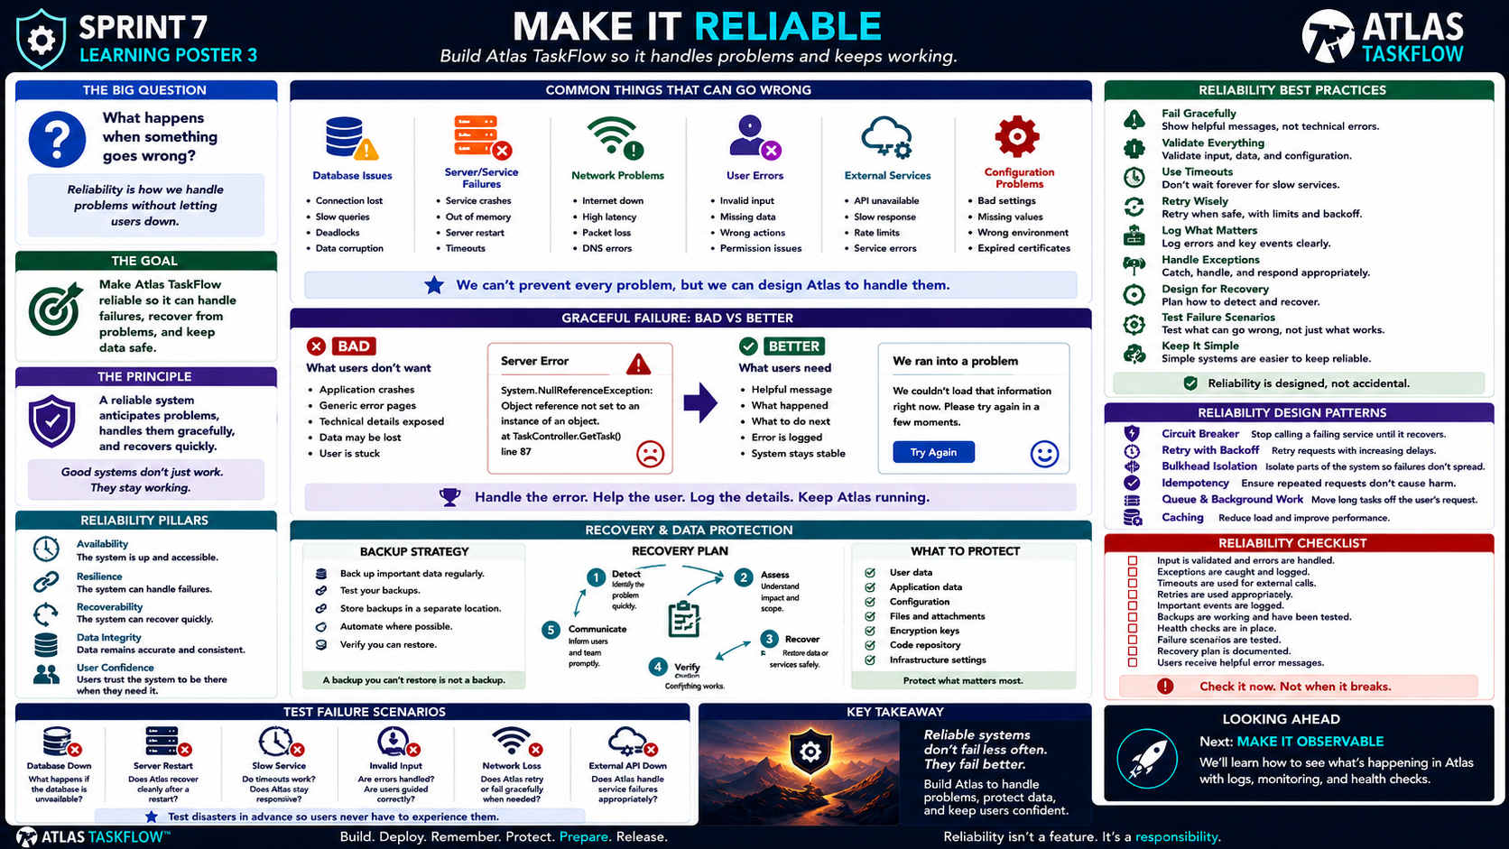
7-03
Notes:
============================================================
SPRINT 7
MAKE IT RELIABLE
"Build Atlas TaskFlow so it handles problems and keeps working."
============================================================
SLIDE PURPOSE
Teach students that reliability is not the absence of failure.
Reliable systems:
• Anticipate problems.
• Handle failures gracefully.
• Protect important data.
• Recover when failures occur.
• Give users useful feedback.
• Record enough information to diagnose problems.
• Continue operating when possible.
The goal is to shift students from:
"It works when everything goes right."
to:
"It behaves appropriately when something goes wrong."
------------------------------------------------------------
OPENING
"Engineers..."
"Let's assume something is going to go wrong."
Pause.
"Not because we're bad developers."
"Because systems fail."
Ask:
"What can go wrong?"
Let students respond.
Database.
Internet.
Server.
User input.
External API.
Configuration.
Authentication.
Storage.
Human error.
Exactly.
Say:
"Our job isn't to pretend those things won't happen."
"Our job is to prepare Atlas for them."
------------------------------------------------------------
THE BIG QUESTION
Point to:
"WHAT HAPPENS WHEN SOMETHING GOES WRONG?"
Say:
"This is the reliability question."
Not:
"Does Atlas work?"
But:
"What does Atlas do when it doesn't?"
------------------------------------------------------------
WHAT IS RELIABILITY?
Point to:
"Reliability is how we handle problems without letting users down."
Explain:
"Reliability doesn't mean nothing ever fails."
"It means failures are handled appropriately."
Examples:
A service becomes unavailable.
Atlas detects it.
The user receives a useful message.
The error is logged.
The application remains stable.
The system recovers.
That's reliability.
------------------------------------------------------------
THE PRINCIPLE
Point to:
"A reliable system anticipates problems, handles them gracefully,
and recovers quickly."
Read it.
Then:
"Good systems don't just work."
"They stay working."
------------------------------------------------------------
COMMON THINGS THAT CAN GO WRONG
Move across the top row.
We're going to look at six major categories.
DATABASE ISSUES.
SERVER / SERVICE FAILURES.
NETWORK PROBLEMS.
USER ERRORS.
EXTERNAL SERVICES.
CONFIGURATION PROBLEMS.
------------------------------------------------------------
DATABASE ISSUES
Ask:
"What happens if Atlas can't connect to the database?"
Possible causes:
Connection lost.
Database unavailable.
Slow query.
Deadlock.
Data problem.
Explain:
"The database is one of the most important dependencies Atlas has."
Ask:
"Should Atlas simply crash?"
No.
------------------------------------------------------------
DATABASE FAILURE
Imagine:
Atlas requests:
"Get my tasks."
Database:
"Unavailable."
Bad behavior:
Application crashes.
Stack trace appears.
User receives nothing.
Better behavior:
Application detects the failure.
Logs the problem.
Shows a useful message.
Maintains a stable state.
Allows retry when appropriate.
Explain:
"The goal is graceful failure."
------------------------------------------------------------
SERVER / SERVICE FAILURES
Ask:
"What happens if the server restarts?"
Or:
"What happens if the application runs out of memory?"
Or:
"What happens if a service times out?"
Explain:
"Servers are not immortal."
"Applications need to handle service interruptions."
------------------------------------------------------------
NETWORK PROBLEMS
Ask:
"What happens if the network is slow?"
Possibilities:
Internet unavailable.
High latency.
Packet loss.
DNS problem.
Explain:
"An application that depends on the network needs to expect network
failures."
------------------------------------------------------------
USER ERRORS
Point to:
USER ERRORS.
Say:
"Users are unpredictable."
Students laugh.
Then:
"Not because users are bad."
"Because users don't think like developers."
Examples:
Missing information.
Invalid dates.
Unexpected input.
Wrong actions.
Permission problems.
Explain:
"Good software guides users instead of punishing them."
------------------------------------------------------------
EXTERNAL SERVICES
Point to:
EXTERNAL SERVICES.
Ask:
"What happens if Atlas depends on another service and that service
goes down?"
Examples:
Email API.
Payment service.
Cloud storage.
External API.
Authentication provider.
Explain:
"Atlas can't control every dependency."
"But Atlas can control how it responds when those dependencies fail."
------------------------------------------------------------
CONFIGURATION PROBLEMS
Point to:
CONFIGURATION.
Ask:
"What happens if the application has the wrong configuration?"
Examples:
Missing values.
Wrong environment.
Invalid connection string.
Expired certificate.
Incorrect service URL.
Explain:
"Configuration problems can break perfectly good code."
------------------------------------------------------------
THE BIG PRINCIPLE
Point to the center statement:
"We can't prevent every problem, but we can design Atlas to handle
them."
Say:
"This is the heart of reliability."
We can't control:
The internet.
Cloud providers.
Users.
External APIs.
Hardware.
Every possible failure.
But we can control:
How Atlas responds.
------------------------------------------------------------
GRACEFUL FAILURE
Move to:
GRACEFUL FAILURE: BAD VS BETTER.
Explain:
"Let's compare two applications."
------------------------------------------------------------
BAD
Point to the red example.
Read the error conceptually:
"System.NullReferenceException..."
"Object reference not set..."
Ask:
"Does the user understand that?"
No.
Ask:
"Does the user know what to do?"
No.
Ask:
"Does the user know whether their data was saved?"
Probably not.
Explain:
"This is a developer error message."
"It may be useful to a developer."
"It is not a useful user experience."
------------------------------------------------------------
BETTER
Point to the green example.
Read:
"We couldn't load that information right now.
Please try again in a few moments."
Explain:
"Now the user understands..."
Something went wrong.
The application is still responding.
They can try again.
The technical details don't need to be exposed.
------------------------------------------------------------
ERROR HANDLING PRINCIPLE
Point to:
"HANDLE THE ERROR.
HELP THE USER.
LOG THE DETAILS.
KEEP ATLAS RUNNING."
Read each phrase.
This is an excellent reliability pattern.
------------------------------------------------------------
HANDLE THE ERROR
Explain:
"Don't let unexpected failures crash the entire application if you
can safely handle them."
Examples:
Catch appropriate exceptions.
Return safe responses.
Provide fallback behavior.
------------------------------------------------------------
HELP THE USER
Ask:
"What does the user actually need?"
Usually:
What happened?
What can I do?
Should I try again?
Was my information saved?
Don't overwhelm users with technical details.
------------------------------------------------------------
LOG THE DETAILS
Explain:
"Developers need more information than users."
Logs can capture:
Error.
Time.
Request.
Context.
Exception details.
But:
"Don't log secrets or sensitive information."
Connect back to Sprint 6.
------------------------------------------------------------
KEEP ATLAS RUNNING
Explain:
"One failed operation shouldn't necessarily bring down the entire
application."
This is the goal of isolation and graceful handling.
------------------------------------------------------------
RELIABILITY PILLARS
Move to the left lower panel.
Introduce five pillars.
AVAILABILITY
The system is up and accessible.
RESILIENCE
The system can handle failures.
RECOVERABILITY
The system can recover quickly.
DATA INTEGRITY
Data remains accurate and consistent.
USER CONFIDENCE
Users trust the system to be there when they need it.
------------------------------------------------------------
AVAILABILITY
Ask:
"Can users reach Atlas?"
Availability includes:
Application uptime.
Database availability.
Network availability.
Cloud service availability.
Explain:
"Availability is about being there."
------------------------------------------------------------
RESILIENCE
Ask:
"What happens when something fails?"
Resilience means:
The system continues operating where possible.
Failures don't spread unnecessarily.
The application degrades gracefully.
Explain:
"Resilience is how we absorb problems."
------------------------------------------------------------
RECOVERABILITY
Ask:
"If Atlas goes down..."
"Can we get it back?"
Recovery involves:
Backups.
Restore procedures.
Recovery planning.
Testing.
Explain:
"Recovery isn't theoretical."
"We should know what we would do."
------------------------------------------------------------
DATA INTEGRITY
Ask:
"What happens if something fails halfway through an operation?"
Example:
A task is partially updated.
Explain:
"We don't want corrupted or inconsistent data."
Data integrity means:
Correct.
Consistent.
Authorized.
Reliable.
------------------------------------------------------------
USER CONFIDENCE
Ask:
"Would users trust Atlas after something goes wrong?"
Explain:
A good error message.
Reliable recovery.
Clear communication.
Consistent behavior.
All build confidence.
------------------------------------------------------------
RELIABILITY BEST PRACTICES
Move to the right panel.
We'll walk through each.
------------------------------------------------------------
FAIL GRACEFULLY
"Show helpful messages, not technical errors."
Connect to the earlier example.
------------------------------------------------------------
VALIDATE EVERYTHING
Explain:
Validate:
Input.
Data.
Configuration.
External responses.
"Don't assume data is always correct."
------------------------------------------------------------
USE TIMEOUTS
Explain:
"Don't wait forever for a service that isn't responding."
If an external service hangs:
Set a reasonable timeout.
Handle the timeout.
Tell the user what happened.
------------------------------------------------------------
RETRY WISELY
Explain:
"Sometimes a temporary failure can succeed if we try again."
But:
"Don't retry forever."
Use:
Limits.
Backoff.
Appropriate conditions.
This prevents making the problem worse.
------------------------------------------------------------
LOG WHAT MATTERS
Explain:
"Logs should help us understand what happened."
Log:
Errors.
Important events.
Relevant context.
Don't log:
Passwords.
Secrets.
Sensitive information unnecessarily.
------------------------------------------------------------
HANDLE EXCEPTIONS
Explain:
"Unexpected problems need controlled handling."
Avoid:
Empty catch blocks.
Swallowing errors.
Showing technical details to users.
Instead:
Handle.
Log.
Respond appropriately.
------------------------------------------------------------
DESIGN FOR RECOVERY
Ask:
"If this fails..."
"How do we get back?"
Examples:
Backup.
Restore.
Retry.
Fallback.
Restart.
Manual intervention.
------------------------------------------------------------
TEST FAILURE SCENARIOS
Point to:
"Test what can go wrong, not just what works."
This is one of the most important ideas in the poster.
Ask:
"Have you ever tested what happens when the database is unavailable?"
"How about a slow API?"
"How about invalid input?"
Explain:
"Those are reliability tests."
------------------------------------------------------------
KEEP IT SIMPLE
Explain:
"Complex systems have more ways to fail."
Don't introduce unnecessary complexity.
For Atlas:
Simple.
Understandable.
Maintainable.
Testable.
------------------------------------------------------------
RELIABILITY DESIGN PATTERNS
Point to the right-middle panel.
Say:
"These are common patterns engineers use to improve reliability."
We aren't implementing every one of these in Atlas.
We're learning what they mean and when they matter.
------------------------------------------------------------
CIRCUIT BREAKER
Explain:
"Stop repeatedly calling a service that is already failing."
Example:
External API is down.
Instead of sending hundreds of requests:
Stop.
Wait.
Try again later.
The goal:
Prevent cascading failure.
------------------------------------------------------------
RETRY WITH BACKOFF
Explain:
"Don't retry immediately over and over."
Instead:
Try.
Wait.
Try again.
Wait longer.
Then stop.
Explain:
"Retries need limits."
------------------------------------------------------------
BULKHEAD ISOLATION
Explain conceptually:
"Keep one failing part from taking everything else down."
Like compartments in a ship.
If one compartment floods:
The entire ship doesn't necessarily sink.
------------------------------------------------------------
IDEMPOTENCY
This is an important professional concept.
Explain:
"If a request happens twice..."
"It shouldn't accidentally perform a dangerous action twice."
Example:
Create payment.
Submit order.
Update record.
For Atlas:
Repeated requests shouldn't create duplicate or inconsistent data
when the operation is supposed to be safely repeatable.
------------------------------------------------------------
QUEUE & BACKGROUND WORK
Explain:
"Some work doesn't need to happen while the user waits."
Examples:
Sending email.
Generating reports.
Processing large jobs.
Move long-running work into background processing when appropriate.
For Atlas:
"Keep the user experience responsive."
------------------------------------------------------------
CACHING
Explain:
"If we repeatedly request the same information..."
"We may be able to cache it."
Benefits:
Less database load.
Faster response.
Better performance.
But:
"Don't cache sensitive information carelessly."
------------------------------------------------------------
BACKUP STRATEGY
Move to the recovery section.
Ask:
"What happens if our database is lost?"
Answer:
Restore from backup.
Then:
"How often do we back up?"
"Where are backups stored?"
"How do we know they work?"
------------------------------------------------------------
BACKUP BEST PRACTICES
Review:
Back up important data regularly.
Test backups.
Store backups separately.
Automate where possible.
Verify restoration.
Then point to:
"A backup you can't restore is not a backup."
Explain:
"This is one of the most important lines on the poster."
------------------------------------------------------------
RECOVERY PLAN
Point to the recovery cycle.
Walk through:
1. DETECT
Identify the problem.
2. ASSESS
Understand impact and scope.
3. RECOVER
Restore data or service.
4. VERIFY
Confirm everything works.
5. COMMUNICATE
Inform users/team appropriately.
Explain:
"Recovery is a process."
------------------------------------------------------------
WHAT TO PROTECT
Point to the right recovery panel.
Review:
User data.
Application data.
Configuration.
Files and attachments.
Encryption keys.
Code repository.
Infrastructure settings.
Explain:
"Recovery isn't only about the database."
"We need to know what Atlas depends on."
------------------------------------------------------------
FAILURE SCENARIO TESTING
Move to the bottom-left panel.
Say:
"We are going to test what happens when things fail."
Review each scenario.
------------------------------------------------------------
DATABASE DOWN
Ask:
"What happens if the database is unavailable?"
Expected:
Useful error.
No crash.
Error logged.
Application remains stable where possible.
------------------------------------------------------------
SERVER RESTART
Ask:
"What happens if the server restarts?"
Questions:
Does Atlas come back?
Does the database reconnect?
Is data intact?
Does the application remain usable?
------------------------------------------------------------
SLOW SERVICE
Ask:
"What happens if something takes too long?"
Does Atlas:
Wait forever?
Timeout?
Show a useful message?
Retry?
Explain:
"Timeouts are part of reliability."
------------------------------------------------------------
INVALID INPUT
Ask:
"What happens if a user provides bad data?"
Expected:
Validation.
Helpful feedback.
No crash.
No corrupted data.
------------------------------------------------------------
NETWORK LOSS
Ask:
"What happens if the network disappears?"
Does the application:
Fail gracefully?
Retry appropriately?
Show useful feedback?
Remain stable?
------------------------------------------------------------
EXTERNAL API DOWN
Ask:
"What happens if a service Atlas depends on stops responding?"
Expected:
Timeout.
Fallback if available.
Helpful message.
Logging.
No cascading failure.
------------------------------------------------------------
RELIABILITY CHECKLIST
Move to the checklist.
Tell students:
"These are the things we're going to verify."
Read:
Input is validated.
Exceptions are caught and logged.
Timeouts are used where appropriate.
Retries are used appropriately.
Important events are logged.
Backups are working.
Health checks are in place.
Failure scenarios are tested.
Recovery plan is documented.
Users receive helpful error messages.
------------------------------------------------------------
THE CHECKLIST PRINCIPLE
Point to:
"Check it now. Not when it breaks."
Explain:
"The worst time to discover your backup doesn't work..."
"...is after you lose the database."
"The worst time to discover your error handling is broken..."
"...is during a production outage."
------------------------------------------------------------
BUILD CHALLENGE
Tell students:
"You're going to perform a reliability review of Atlas."
Students should select several failure scenarios.
At minimum:
Database failure.
Server restart.
Invalid input.
Slow/unavailable service.
Network failure.
Application error.
Then document:
Expected behavior.
Actual behavior.
Problem found.
Fix.
Retest result.
------------------------------------------------------------
THE RELIABILITY LOOP
Write on the board:
EXPECT
↓
TEST
↓
FAIL
↓
FIX
↓
RECOVER
↓
VERIFY
Explain:
"Reliability improves when we deliberately test failure."
------------------------------------------------------------
IMPORTANT DISTINCTION
Say:
"Reliability isn't about preventing every failure."
"Some failures are unavoidable."
"The goal is to control the impact."
That's a key engineering idea.
------------------------------------------------------------
SPRINT CONNECTION
Point to Sprint 7.
Say:
"Last lesson we learned how environments help us prepare Atlas."
"Now we're asking..."
"What happens when Atlas encounters problems?"
That's reliability.
------------------------------------------------------------
LOOKING AHEAD
Point to:
MAKE IT OBSERVABLE.
Say:
"There's one problem with all of this."
"How do we know something is wrong?"
Pause.
"If Atlas fails at 2 AM..."
"...how do we find out?"
That's our next lesson.
"Observability."
------------------------------------------------------------
CLOSING
Say:
"Engineers..."
"We can't prevent every problem."
"But we can prepare for problems."
"We can handle them."
"We can recover."
"And we can learn from them."
Pause.
"Reliable systems don't fail less often."
"They fail better."
============================================================
ESTIMATED TIME
Opening & Reliability Concept..........8 minutes
Failure Categories.....................12 minutes
Graceful Failure........................10 minutes
Reliability Practices..................10 minutes
Recovery & Backups......................8 minutes
Failure Testing........................10 minutes
Discussion & Closing....................7 minutes
TOTAL...................................65 minutes
============================================================
INSTRUCTOR NOTES
This should be a mixture of explanation and hands-on experimentation.
The strongest teaching moment will come from students deliberately
causing controlled failures in their own Atlas environment.
------------------------------------------------------------
IMPORTANT TEACHING MOVE
Keep asking:
"What happens if...?"
Examples:
"What happens if the database disappears?"
"What happens if the API doesn't respond?"
"What happens if the user submits invalid data?"
"What happens if the server restarts?"
"What happens if the network fails?"
This develops reliability thinking.
------------------------------------------------------------
DO NOT OVER-IMPLEMENT
Students do not need to implement every reliability design pattern
shown on the poster.
The poster introduces patterns such as:
Circuit breaker.
Retry with backoff.
Bulkhead isolation.
Idempotency.
Queue/background work.
Caching.
The course goal is recognition and appropriate application.
------------------------------------------------------------
ATLAS SCOPE
For Atlas, prioritize:
✓ Graceful error handling.
✓ Input validation.
✓ Appropriate timeouts.
✓ Safe retries where needed.
✓ Logging.
✓ Backups.
✓ Recovery planning.
✓ Failure testing.
✓ User-friendly errors.
Don't require enterprise-scale resilience architecture.
------------------------------------------------------------
BACKUP EMPHASIS
Ask students:
"Can you restore your backup?"
If they haven't tested it:
"You don't know yet."
This is a great opportunity to reinforce:
BACKUP
≠
RECOVERY
------------------------------------------------------------
RELIABILITY VS SECURITY
Connect to Sprint 6.
Security asks:
"Who should have access?"
Reliability asks:
"What happens when something goes wrong?"
Both protect user trust.
------------------------------------------------------------
KEY TAKEAWAY
Write this on the board:
EXPECT
→
HANDLE
→
RECOVER
→
VERIFY
Then:
"Reliable systems don't just work."
"They keep working when things go wrong."
------------------------------------------------------------
FINAL STATEMENT
"Engineers..."
"We don't design Atlas assuming everything will go right."
"We design Atlas knowing something eventually won't."
"And when that happens..."
"Atlas needs to know what to do."
============================================================

Slide 4
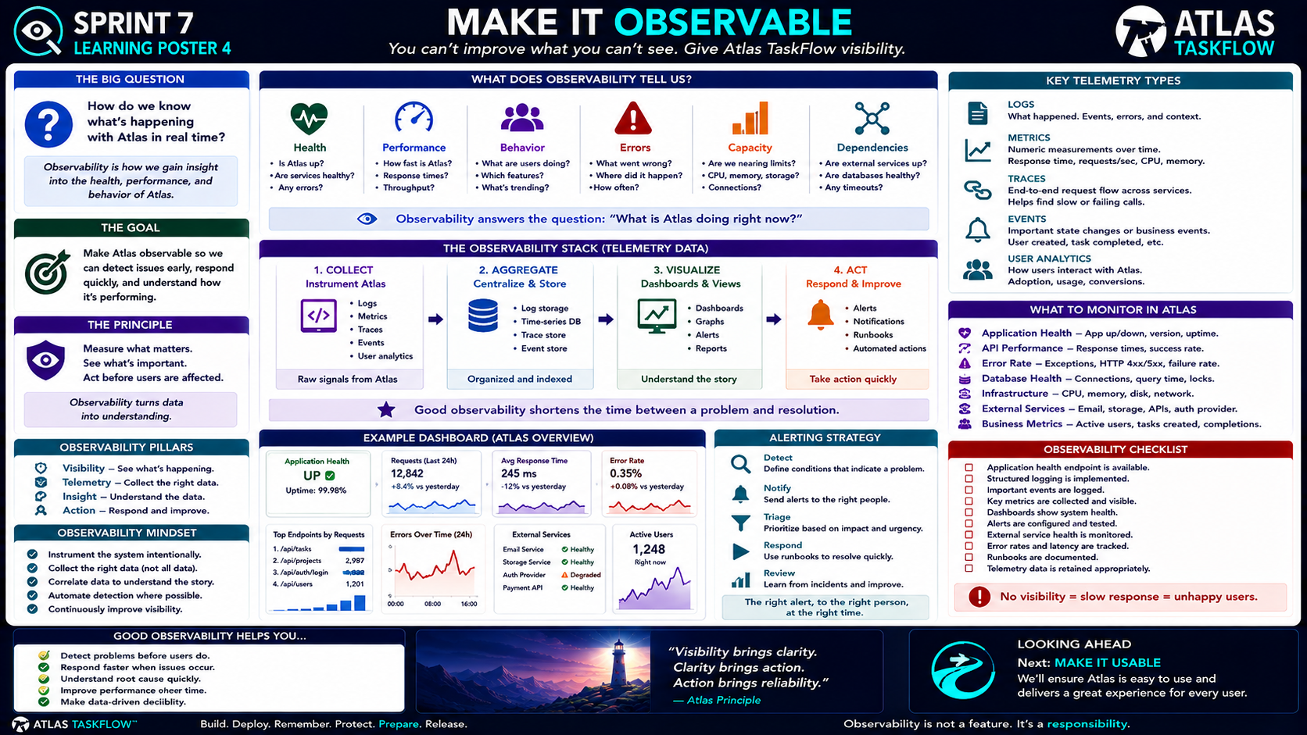
7-04
Notes:
============================================================
SPRINT 7
MAKE IT OBSERVABLE
"You can't improve what you can't see."
============================================================
SLIDE PURPOSE
Teach students that deployed software needs visibility.
Students should understand:
• What observability means
• Why logging matters
• Metrics
• Health checks
• Application health
• Performance
• Errors
• Dependencies
• User behavior
• Alerts
• Dashboards
• Operational awareness
The goal is not to turn students into DevOps engineers.
The goal is to teach them that once software is deployed:
WE NEED TO KNOW WHAT IT IS DOING.
------------------------------------------------------------
OPENING
"Engineers..."
"Imagine Atlas is deployed."
"Everything looks great."
"Users are working."
"Then something breaks."
Pause.
"How do we know?"
Students may say:
A user tells us.
We check the application.
We look at logs.
We get an alert.
Exactly.
Say:
"If our only monitoring system is a user calling us..."
"We have a problem."
------------------------------------------------------------
THE BIG QUESTION
Point to:
"HOW DO WE KNOW WHAT'S HAPPENING WITH ATLAS IN REAL TIME?"
Say:
"That's the observability question."
Reliability asks:
"What happens when something goes wrong?"
Observability asks:
"How do we know?"
------------------------------------------------------------
WHAT IS OBSERVABILITY?
Point to:
"Observability is how we gain insight into the health, performance,
and behavior of Atlas."
Explain:
"Observability gives us visibility into the system."
It helps answer:
Is Atlas healthy?
Is Atlas slow?
Are users experiencing errors?
Are dependencies working?
Is usage increasing?
Is something unusual happening?
------------------------------------------------------------
THE GOAL
Point to:
"MAKE ATLAS OBSERVABLE."
Read:
"Make Atlas observable so we can detect issues early, respond quickly,
and understand how it's performing."
Explain:
"We don't collect information just because we can."
"We collect information that helps us make decisions."
------------------------------------------------------------
THE PRINCIPLE
Point to:
"Measure what matters."
Say:
"Observability is not about collecting every piece of data."
"It's about collecting the right information."
Then:
"See what's important."
"Act before users are affected."
------------------------------------------------------------
OBSERVABILITY VS MONITORING
Explain:
"These terms are related, but they're not exactly the same."
Monitoring often asks:
"Is something working?"
Observability helps us ask:
"Why is it behaving this way?"
Example:
Monitoring:
"Error rate is high."
Observability:
"Error rate increased after deployment,
and the failures are coming from the task API."
Explain:
"Observability gives us context."
------------------------------------------------------------
THE OBSERVABILITY QUESTION
Point to the center statement:
"What is Atlas doing right now?"
Say:
"That's the question our telemetry should help answer."
------------------------------------------------------------
WHAT DOES OBSERVABILITY TELL US?
Walk across the top panel.
HEALTH
"Is Atlas up?"
"Are dependencies healthy?"
"Are there errors?"
------------------------------------------------------------
PERFORMANCE
"How fast is Atlas?"
"What are response times?"
"How much traffic are we handling?"
------------------------------------------------------------
BEHAVIOR
"What are users doing?"
"What features are being used?"
"What patterns are changing?"
------------------------------------------------------------
ERRORS
"What went wrong?"
"Where did it happen?"
"How often?"
------------------------------------------------------------
CAPACITY
"Are we approaching limits?"
CPU.
Memory.
Storage.
Connections.
Explain:
"Capacity helps us identify problems before resources are exhausted."
------------------------------------------------------------
DEPENDENCIES
Ask:
"What does Atlas depend on?"
Database.
Email.
Storage.
Authentication.
External APIs.
Explain:
"If something Atlas depends on fails..."
"Atlas may fail too."
We need visibility into those dependencies.
------------------------------------------------------------
THE OBSERVABILITY STACK
Move to the center flow.
COLLECT
↓
AGGREGATE
↓
VISUALIZE
↓
ACT
Explain:
"This is the basic observability cycle."
------------------------------------------------------------
1. COLLECT
Point to Collect.
"First, we collect signals."
Examples:
Logs.
Metrics.
Traces.
Events.
User analytics.
Explain:
"These are our raw signals."
------------------------------------------------------------
2. AGGREGATE
Point to Aggregate.
"Then we organize the information."
We may:
Centralize logs.
Store metrics.
Store traces.
Index events.
Explain:
"If the information is scattered everywhere..."
"It's difficult to understand."
------------------------------------------------------------
3. VISUALIZE
Point to Visualize.
"Now we turn the data into something humans can understand."
Examples:
Dashboards.
Graphs.
Reports.
Views.
Explain:
"A thousand log entries aren't useful if nobody can interpret them."
------------------------------------------------------------
4. ACT
Point to Act.
"Finally, we respond."
Examples:
Alerts.
Notifications.
Runbooks.
Automated actions.
Human response.
Say:
"Observability only becomes valuable when it leads to action."
------------------------------------------------------------
THE FOUR STEPS
Write on the board:
COLLECT
→
UNDERSTAND
→
DECIDE
→
ACT
Explain:
"Don't collect telemetry just to have a giant pile of data."
"The goal is better decisions."
------------------------------------------------------------
KEY TELEMETRY TYPES
Move to the right panel.
Introduce:
LOGS.
METRICS.
TRACES.
EVENTS.
USER ANALYTICS.
------------------------------------------------------------
LOGS
Point to Logs.
Explain:
"Logs tell us what happened."
Examples:
Application started.
User logged in.
Task created.
Database error.
API failure.
Exception.
Important state change.
Say:
"Logs provide a narrative."
------------------------------------------------------------
GOOD LOGGING
Ask:
"What makes a log useful?"
Context.
Timestamp.
Event.
Severity.
Relevant identifier.
Explain:
A useful log helps answer:
What happened?
When?
Where?
Why?
------------------------------------------------------------
BAD LOGGING
Examples:
"Error."
"Something broke."
"Failed."
Ask:
"Are those useful?"
Not very.
Explain:
"We need enough context to investigate."
------------------------------------------------------------
SECURITY REMINDER
Say:
"Remember Sprint 6."
"Logs can contain sensitive information."
Don't log:
Passwords.
Tokens.
Secrets.
Sensitive data unnecessarily.
Explain:
"Observability must not become a data leak."
------------------------------------------------------------
METRICS
Point to Metrics.
Explain:
"Metrics are numbers measured over time."
Examples:
Response time.
Requests per second.
CPU.
Memory.
Error rate.
Active users.
Database connections.
Ask:
"Why are numbers useful?"
Because they reveal trends.
------------------------------------------------------------
METRIC EXAMPLE
Imagine:
Average response time:
Monday:
200 ms.
Tuesday:
210 ms.
Wednesday:
450 ms.
Thursday:
900 ms.
Ask:
"What might we investigate?"
Exactly.
"Something changed."
Metrics help us see that trend.
------------------------------------------------------------
TRACES
Point to Traces.
Explain:
"A trace follows a request through the system."
For example:
Browser.
↓
Atlas.
↓
Controller.
↓
Database.
↓
External API.
↓
Response.
Explain:
"Tracing helps us find where time or failures occur."
Keep this conceptual.
Students do not need to build distributed tracing infrastructure.
------------------------------------------------------------
EVENTS
Point to Events.
Explain:
"Events represent important occurrences."
Examples:
User created.
Task completed.
Project created.
Deployment completed.
Database migration executed.
Security event occurred.
Explain:
"Events tell us that something important happened."
------------------------------------------------------------
USER ANALYTICS
Point to User Analytics.
Explain:
"This tells us how users interact with the application."
Examples:
Active users.
Feature usage.
Task creation.
Project creation.
Completion rates.
Explain:
"User analytics can help product decisions."
But:
"Don't collect information just because we can."
Privacy still matters.
------------------------------------------------------------
WHAT TO MONITOR IN ATLAS
Move to the right-middle panel.
Walk through each.
------------------------------------------------------------
APPLICATION HEALTH
Ask:
"Is Atlas up?"
Monitor:
Uptime.
Version.
Health status.
Health endpoint.
------------------------------------------------------------
API PERFORMANCE
Ask:
"How quickly is Atlas responding?"
Monitor:
Response time.
Requests.
Failure rate.
Throughput.
------------------------------------------------------------
ERROR RATE
Ask:
"How often are requests failing?"
Monitor:
Exceptions.
HTTP 4xx.
HTTP 5xx.
Application errors.
Explain:
"An increasing error rate can be an early warning."
------------------------------------------------------------
DATABASE HEALTH
Ask:
"Is the database healthy?"
Monitor:
Connections.
Query time.
Locks.
Failures.
Explain:
"The database is one of Atlas's most important dependencies."
------------------------------------------------------------
INFRASTRUCTURE
Monitor:
CPU.
Memory.
Disk.
Network.
Explain:
"Resources can become bottlenecks."
------------------------------------------------------------
EXTERNAL SERVICES
Monitor:
Email.
Storage.
APIs.
Authentication provider.
Other dependencies.
Ask:
"What happens if one of these becomes unavailable?"
"We need to know."
------------------------------------------------------------
BUSINESS METRICS
Explain:
"Technical health isn't the whole story."
We may also monitor:
Active users.
Projects created.
Tasks completed.
Successful workflows.
Explain:
"The system can be technically healthy while users are struggling."
------------------------------------------------------------
EXAMPLE DASHBOARD
Point to the example dashboard.
Explain:
"This is the kind of information a team might want to see."
Application health.
Requests.
Response time.
Error rate.
Endpoint usage.
External service health.
Active users.
Ask:
"If you had only five minutes to check Atlas..."
"What would you want to know?"
Let students answer.
------------------------------------------------------------
THE DASHBOARD PRINCIPLE
Say:
"A dashboard should answer questions."
Not:
"Look how many charts we have."
A good dashboard answers:
Is Atlas healthy?
Is it slow?
Are errors increasing?
Is something unusual?
What needs attention?
------------------------------------------------------------
ALERTING
Move to Alerting Strategy.
Ask:
"What happens if nobody is looking at the dashboard?"
Exactly.
"We need alerts for important conditions."
------------------------------------------------------------
DETECT
Define conditions that indicate a problem.
Examples:
Error rate too high.
Application unavailable.
Database unhealthy.
Response time excessive.
Storage nearly full.
------------------------------------------------------------
NOTIFY
Send the alert to the right people.
Explain:
"Not every alert needs to wake everyone up."
The right alert goes to:
The right person.
At the right urgency.
------------------------------------------------------------
TRIAGE
Explain:
"Not every problem has the same priority."
Ask:
"Which matters more?"
One user has a minor UI issue.
or:
Nobody can log into Atlas.
Exactly.
Triage based on:
Impact.
Urgency.
Scope.
------------------------------------------------------------
RESPOND
Point to Respond.
Explain:
"An alert should lead to action."
Examples:
Restart service.
Investigate logs.
Rollback deployment.
Contact dependency provider.
Fix configuration.
------------------------------------------------------------
REVIEW
Point to Review.
Explain:
"After an incident..."
"We learn."
Ask:
What happened?
Why?
Could we have detected it earlier?
How do we prevent it?
------------------------------------------------------------
THE ALERTING LOOP
Write:
DETECT
↓
NOTIFY
↓
TRIAGE
↓
RESPOND
↓
REVIEW
Explain:
"This turns observability into operational improvement."
------------------------------------------------------------
OBSERVABILITY MINDSET
Point to the lower-left panel.
Review:
Instrument intentionally.
Collect the right data.
Correlate data.
Automate detection where possible.
Continuously improve visibility.
Explain:
"Observability is a discipline."
Not:
"Turn on every logging option."
------------------------------------------------------------
INSTRUMENT INTENTIONALLY
Ask:
"What information helps us answer an important question?"
If we don't know what question we're trying to answer...
"We probably don't need the telemetry."
------------------------------------------------------------
COLLECT THE RIGHT DATA
Explain:
"More data isn't automatically better."
Too much data can create:
Noise.
Storage costs.
Difficulty finding useful information.
Privacy problems.
------------------------------------------------------------
CORRELATE DATA
Explain:
"One signal can tell part of the story."
Example:
Error rate increases.
Response time increases.
Database query time increases.
Together:
"We may have a database performance problem."
That's correlation.
------------------------------------------------------------
AUTOMATE WHERE POSSIBLE
Explain:
"People shouldn't have to stare at dashboards all day."
Automate:
Health checks.
Alerts.
Threshold detection.
Routine notifications.
------------------------------------------------------------
CONTINUOUSLY IMPROVE
Say:
"Every incident teaches us something."
Maybe we need:
A better log.
A new metric.
A better alert.
A health check.
A dashboard.
Explain:
"Observability improves over time."
------------------------------------------------------------
OBSERVABILITY CHECKLIST
Move to the checklist.
Review:
Application health endpoint.
Structured logging.
Important events logged.
Key metrics collected.
Dashboards available.
Alerts configured and tested.
External service health monitored.
Error rates tracked.
Latency tracked.
Telemetry retained appropriately.
Ask:
"Which of these does Atlas already have?"
"Which are missing?"
------------------------------------------------------------
NO VISIBILITY = SLOW RESPONSE
Point to the red statement.
Read:
"No visibility = slow response = unhappy users."
Explain:
"If we don't know there's a problem..."
"We can't respond quickly."
And:
"The longer users experience a problem..."
"The more trust we lose."
Connect back to Sprint 6.
------------------------------------------------------------
BUILD CHALLENGE
Tell students:
"You're going to make Atlas observable."
Minimum requirements:
1. Add or review application logging.
2. Identify important application events.
3. Identify useful metrics.
4. Create or configure a health check.
5. Identify critical dependencies.
6. Define at least a few meaningful alerts or monitoring conditions.
7. Create a simple dashboard or monitoring view if the environment
supports it.
8. Document what each signal tells you.
------------------------------------------------------------
OBSERVABILITY DESIGN QUESTION
For every metric or log ask:
"What question does this answer?"
Example:
Metric:
Error rate.
Question:
"Are failures increasing?"
Health check:
"Is the application available?"
Response time:
"Is Atlas getting slower?"
Database connections:
"Is the database becoming constrained?"
------------------------------------------------------------
TESTING OBSERVABILITY
Important:
"Don't just configure monitoring."
"Test it."
Example:
Cause a controlled application error.
Ask:
"Did the error appear in the logs?"
Cause a health-check failure if practical.
Ask:
"Did the monitoring system detect it?"
Generate activity.
Ask:
"Did the metric change?"
Explain:
"Observability needs testing just like our application does."
------------------------------------------------------------
FALSE POSITIVES
Briefly introduce.
Ask:
"What happens if we get an alert every five minutes..."
"...and nothing is actually wrong?"
People start ignoring alerts.
Explain:
"Too many meaningless alerts create alert fatigue."
Good alerts should matter.
------------------------------------------------------------
FALSE NEGATIVES
The opposite problem.
"Something is wrong..."
"But nobody gets alerted."
That's also bad.
The goal:
Useful.
Actionable.
Meaningful.
------------------------------------------------------------
OBSERVABILITY VS SURVEILLANCE
Briefly clarify.
"Observability is about understanding system behavior."
"It doesn't mean collecting every detail about every user."
Connect to privacy.
Collect only what is necessary and appropriate.
------------------------------------------------------------
ATLAS CONNECTION
Ask:
"If Atlas were a real SaaS company..."
"What would the operations team want to know every morning?"
Possible answers:
Is Atlas online?
Are errors increasing?
Are users active?
Is the database healthy?
Are external services working?
Is performance degrading?
Are resources approaching limits?
Excellent.
------------------------------------------------------------
ENGINEERING PRINCIPLE
Point to the quote:
"Visibility brings clarity.
Clarity brings action.
Action brings reliability."
Explain:
"Observability helps us move from guessing..."
"...to knowing."
------------------------------------------------------------
SPRINT CONNECTION
Review Sprint 7 so far.
We asked:
Is Atlas ready?
Then:
How do we move from development to production?
Then:
What happens when things go wrong?
Now:
How do we know what's happening?
The progression is:
PREPARE
↓
DEPLOY
↓
HANDLE
↓
OBSERVE
------------------------------------------------------------
LOOKING AHEAD
Point to:
MAKE IT USABLE.
Say:
"We've talked about what happens behind the scenes."
"But users don't interact with logs."
"They interact with the application."
"Next..."
"We're going to focus on the experience they actually see."
------------------------------------------------------------
CLOSING
Say:
"Engineers..."
"You can't improve what you can't see."
"Logs help us understand."
"Metrics help us measure."
"Health checks help us detect."
"Alerts help us respond."
"Dashboards help us see the bigger picture."
Pause.
"Observability gives Atlas visibility."
============================================================
ESTIMATED TIME
Opening & Concept.......................8 minutes
Telemetry Types........................12 minutes
What to Monitor........................10 minutes
Observability Stack.....................8 minutes
Alerting Strategy.......................8 minutes
Dashboard & Checklist...................8 minutes
Build Challenge........................10 minutes
Closing..................................5 minutes
TOTAL...................................69 minutes
============================================================
INSTRUCTOR NOTES
Keep this practical.
Students should not leave thinking:
"Observability means installing a giant monitoring platform."
The lesson is about the principles.
------------------------------------------------------------
IMPORTANT TEACHING MOVE
Ask repeatedly:
"What question does this telemetry answer?"
This prevents students from collecting meaningless data.
------------------------------------------------------------
DO NOT OVER-ENGINEER
Students do not need to build:
• Full distributed tracing infrastructure
• Enterprise SIEM
• Complex observability pipelines
• Machine-learning anomaly detection
• Large-scale telemetry architecture
The goal is:
Logs.
Health checks.
Useful metrics.
Basic monitoring.
Meaningful alerts.
------------------------------------------------------------
ATLAS MINIMUM OBSERVABILITY
For Version 1.0, prioritize:
✓ Application health.
✓ Error logging.
✓ Important application events.
✓ Response time awareness.
✓ Database health.
✓ External dependency awareness.
✓ Basic monitoring.
✓ Meaningful alerts.
------------------------------------------------------------
LOGGING REMINDER
Connect directly to Sprint 6:
"Never log passwords, secrets, tokens, or unnecessary sensitive
information."
Observability must not create a security problem.
------------------------------------------------------------
HEALTH CHECK EMPHASIS
A simple health check can answer:
"Is Atlas alive?"
A deeper health check can answer:
"Is Atlas alive AND can it reach the resources it needs?"
Explain the difference conceptually.
------------------------------------------------------------
DASHBOARD BOUNDARY
The dashboard does not need to be beautiful.
It needs to be useful.
Ask:
"If something is wrong, can this dashboard help us notice it?"
------------------------------------------------------------
ALERTING BOUNDARY
Students don't need dozens of alerts.
A few meaningful conditions are better than dozens of noisy ones.
Teach:
"Alert on things that require action."
------------------------------------------------------------
KEY TAKEAWAY
Write this on the board:
COLLECT
↓
UNDERSTAND
↓
ACT
Then:
"Visibility creates confidence."
------------------------------------------------------------
FINAL STATEMENT
"Engineers..."
"Reliability tells us how Atlas handles failure."
"Observability tells us when failure is happening."
"And when we can see the problem..."
"We can do something about it."
============================================================

Slide 5
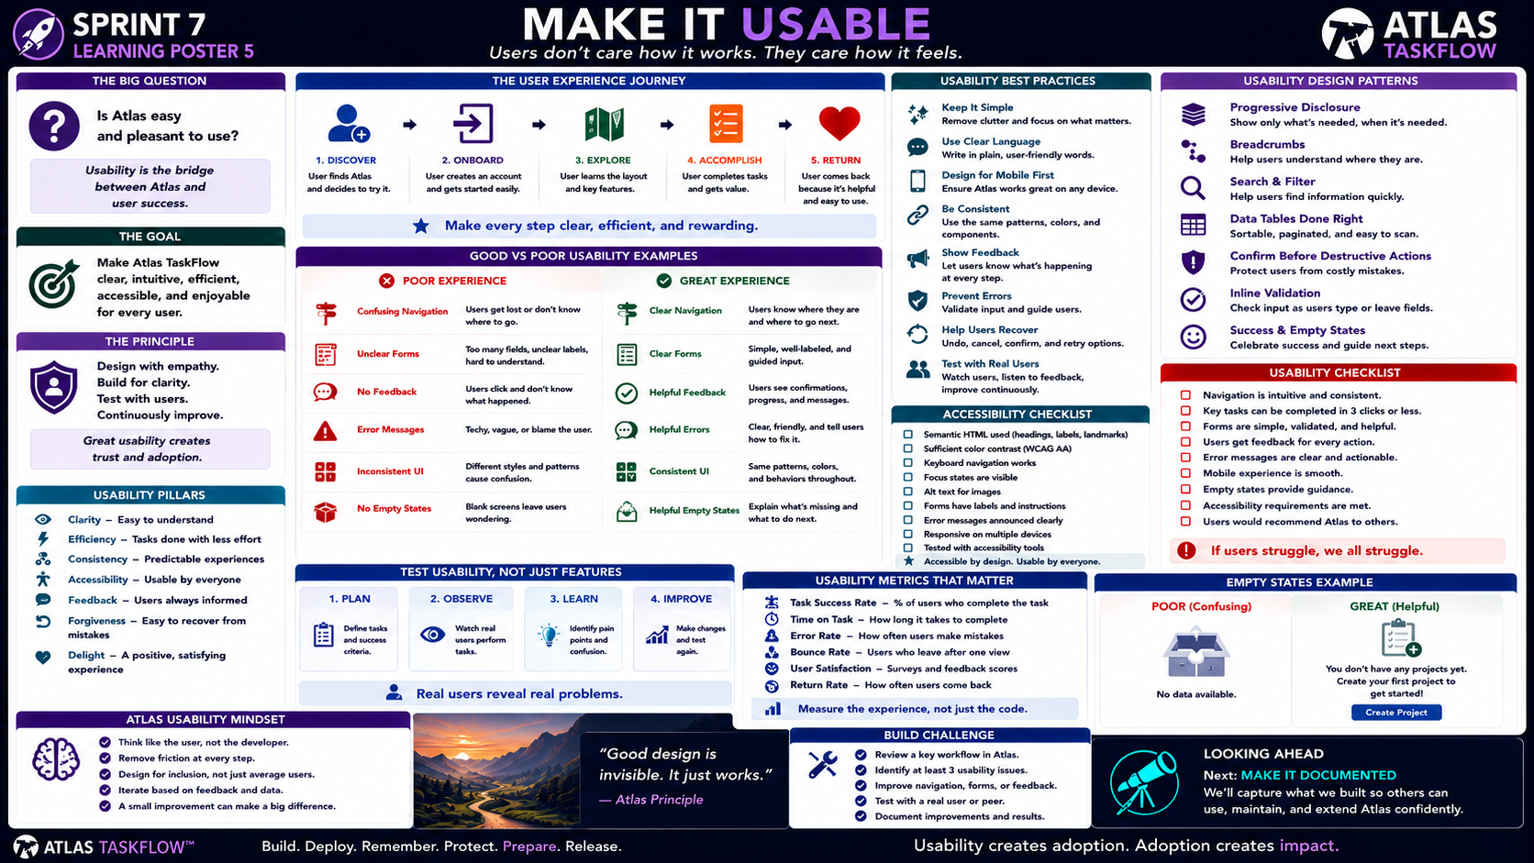
7-05
Notes:
============================================================
SPRINT 7
MAKE IT USABLE
"Users don't care how it works.
They care how it feels."
============================================================
SLIDE PURPOSE
Shift students from developer-centered thinking to user-centered
thinking.
Students should evaluate Atlas TaskFlow based on:
• Clarity
• Efficiency
• Consistency
• Accessibility
• Feedback
• Error recovery
• Responsiveness
• User confidence
• Overall experience
The goal is not simply to make Atlas "look good."
The goal is to make Atlas:
CLEAR.
EFFICIENT.
ACCESSIBLE.
PREDICTABLE.
ENJOYABLE.
------------------------------------------------------------
OPENING
"Engineers..."
"Let's pretend Atlas is finished."
"The database works."
"The security works."
"The deployment works."
"The monitoring works."
Pause.
"Now I give Atlas to someone who's never seen it before."
Ask:
"Do they know what to do?"
Pause.
"That's usability."
------------------------------------------------------------
THE BIG QUESTION
Point to:
"IS ATLAS EASY AND PLEASANT TO USE?"
Say:
"Notice that I didn't ask..."
"Does the code work?"
"I asked..."
"Can a person use it?"
------------------------------------------------------------
WHAT IS USABILITY?
Explain:
"Usability is how easily a person can accomplish what they came to
the application to accomplish."
Good usability means:
Users understand what to do.
Users can accomplish tasks efficiently.
Users know what happened.
Users can recover from mistakes.
Users don't need a developer standing beside them.
------------------------------------------------------------
THE GOAL
Point to:
"Make Atlas TaskFlow clear, intuitive, efficient, accessible, and
enjoyable for every user."
Read each word.
Then ask:
"Which one is the easiest to overlook?"
Possible answers:
Accessibility.
Clarity.
Feedback.
Error recovery.
Explain:
"Developers often know how the application works so well that we
forget what it's like to see it for the first time."
------------------------------------------------------------
THE DEVELOPER PROBLEM
Say:
"You built Atlas."
"So you already know how it works."
"You know where the buttons are."
"You know what the icons mean."
"You know what the database is doing."
"But the user doesn't."
That's the challenge.
------------------------------------------------------------
THE PRINCIPLE
Point to:
"Design with empathy.
Build for clarity.
Test with users.
Continuously improve."
Say:
"This is our usability cycle."
------------------------------------------------------------
THE USER EXPERIENCE JOURNEY
Walk across the journey:
DISCOVER
↓
ONBOARD
↓
EXPLORE
↓
ACCOMPLISH
↓
RETURN
Explain:
"Usability isn't one screen."
"It's the entire experience."
------------------------------------------------------------
1. DISCOVER
Ask:
"If I first encounter Atlas..."
"Do I understand what it does?"
Can the user determine:
What Atlas is.
Who it is for.
What problem it solves.
What they should do next.
Explain:
"First impressions matter."
------------------------------------------------------------
2. ONBOARD
Ask:
"Can a new user get started?"
Look at:
Registration.
Login.
Initial instructions.
First project.
First task.
Explain:
"Don't make users figure everything out themselves."
------------------------------------------------------------
3. EXPLORE
Explain:
"Once users are inside Atlas..."
"Can they understand the layout?"
Look at:
Navigation.
Menus.
Labels.
Icons.
Page structure.
Explain:
"Users should build a mental model of the application."
------------------------------------------------------------
4. ACCOMPLISH
This is the most important stage.
Ask:
"Can users actually accomplish their goal?"
Examples:
Create a project.
Create a task.
Assign a task.
Complete a task.
Edit information.
Find information.
Explain:
"Every unnecessary step adds friction."
------------------------------------------------------------
5. RETURN
Ask:
"Would the user come back?"
Why?
Because Atlas:
Saved them time.
Was easy to understand.
Was reliable.
Made their work easier.
Explain:
"Good usability creates repeat use."
------------------------------------------------------------
THE USER JOURNEY PRINCIPLE
Point to:
"Make every step clear, efficient, and rewarding."
Say:
"If users have to stop and ask..."
"What do I do now?"
"...we have a usability problem."
------------------------------------------------------------
GOOD VS POOR EXPERIENCE
Move to the comparison section.
Explain:
"We're going to compare two experiences."
------------------------------------------------------------
CONFUSING NAVIGATION
Poor:
Users don't know where they are.
Users don't know where to go.
Great:
Navigation is predictable.
Users know where they are.
Users know what to do next.
------------------------------------------------------------
UNCLEAR FORMS
Poor:
Too many fields.
Unclear labels.
No guidance.
Great:
Clear labels.
Reasonable fields.
Helpful instructions.
Validation.
------------------------------------------------------------
NO FEEDBACK
Poor:
User clicks a button.
Nothing appears to happen.
Great:
User receives confirmation.
Loading indicator.
Success message.
Clear next step.
------------------------------------------------------------
BAD ERROR MESSAGES
Poor:
Technical.
Vague.
Blaming.
Example concept:
"Invalid operation."
Great:
Clear.
Specific.
Actionable.
Example:
"Enter a valid project name."
Explain:
"An error should help the user recover."
------------------------------------------------------------
INCONSISTENT UI
Poor:
Different buttons.
Different colors.
Different terminology.
Different layouts.
Great:
Consistent patterns.
Same terminology.
Predictable interactions.
Explain:
"Consistency reduces cognitive load."
------------------------------------------------------------
EMPTY STATES
This is important.
Poor:
Blank page.
"No data."
Great:
Explain what's missing.
Tell the user what to do next.
Provide an action.
Example:
"You don't have any projects yet."
"Create your first project to get started."
Then:
[Create Project]
Explain:
"Empty doesn't have to mean confusing."
------------------------------------------------------------
USABILITY PILLARS
Point to the left panel.
Walk through:
CLARITY
Easy to understand.
EFFICIENCY
Tasks require less effort.
CONSISTENCY
Similar things behave similarly.
ACCESSIBILITY
Usable by everyone.
FEEDBACK
Users always know what's happening.
FORGIVENESS
Users can recover from mistakes.
DELIGHT
The experience feels positive.
------------------------------------------------------------
CLARITY
Ask:
"Can the user understand what this button does?"
Compare:
"Submit"
vs.
"Create Project"
Explain:
"Specific language reduces uncertainty."
------------------------------------------------------------
EFFICIENCY
Ask:
"How many clicks does it take to complete a common task?"
Don't obsess over a specific number.
Instead:
"Remove unnecessary steps."
------------------------------------------------------------
CONSISTENCY
Ask:
"If the blue button means Save on one page..."
"What should it mean on another?"
Exactly.
"Save."
Consistency builds confidence.
------------------------------------------------------------
ACCESSIBILITY
Say:
"Usability isn't just for the average user."
"Accessibility means people with different abilities can use Atlas."
Review:
Keyboard navigation.
Labels.
Contrast.
Focus states.
Alternative text.
Semantic HTML.
Responsive design.
Explain:
"Accessibility is part of quality."
------------------------------------------------------------
ACCESSIBILITY — KEYBOARD
Ask:
"Can someone navigate Atlas without a mouse?"
Test:
Tab.
Shift + Tab.
Enter.
Escape where appropriate.
Can users:
Reach controls.
Understand focus.
Submit forms.
Navigate.
------------------------------------------------------------
ACCESSIBILITY — CONTRAST
Explain:
"Text needs sufficient contrast with its background."
Students should check:
Text.
Buttons.
Links.
Forms.
Error messages.
Don't make accessibility purely about color.
------------------------------------------------------------
ACCESSIBILITY — FORM LABELS
Ask:
"Does every form field clearly tell users what information belongs
there?"
Bad:
[____________]
Good:
Project Name
[____________]
Explain:
"Labels should be clear and persistent."
------------------------------------------------------------
ACCESSIBILITY — FOCUS
Explain:
"Keyboard users need to know where they are."
A visible focus state matters.
------------------------------------------------------------
MOBILE EXPERIENCE
Point to:
"Design for mobile first."
Ask:
"What happens if someone opens Atlas on their phone?"
Check:
Navigation.
Forms.
Buttons.
Tables.
Text.
Spacing.
Touch targets.
Explain:
"Responsive design is part of usability."
------------------------------------------------------------
USABILITY DESIGN PATTERNS
Move to the right panel.
Explain:
"These are patterns that help users understand and navigate software."
------------------------------------------------------------
PROGRESSIVE DISCLOSURE
"Don't show everything at once."
Show:
What's needed now.
Reveal:
Advanced options when necessary.
This reduces clutter.
------------------------------------------------------------
BREADCRUMBS
Explain:
"Breadcrumbs help users understand where they are."
Example:
Projects > Atlas > Sprint 7 > Tasks
Useful when navigation becomes deeper.
------------------------------------------------------------
SEARCH & FILTER
Ask:
"If Atlas has 500 tasks..."
"Should users scroll through all 500?"
No.
Search.
Filter.
Sort.
Explain:
"Good interfaces help users find information."
------------------------------------------------------------
DATA TABLES
Explain:
Tables should be:
Readable.
Sortable when appropriate.
Responsive.
Easy to scan.
Don't overload users with unnecessary columns.
------------------------------------------------------------
CONFIRM BEFORE DESTRUCTIVE ACTIONS
Ask:
"What happens when the user clicks Delete?"
Should Atlas immediately delete something important?
Maybe not.
Use:
Confirmation.
Clear warning.
Cancel option.
Explain:
"Good interfaces protect users from expensive mistakes."
------------------------------------------------------------
INLINE VALIDATION
Explain:
"Don't wait until the user submits an entire form to tell them every
field is wrong."
Where appropriate:
Validate close to the field.
Explain the problem.
Give the user a path forward.
------------------------------------------------------------
SUCCESS STATES
Ask:
"What happens after something works?"
Don't just return to the previous page.
Give confirmation:
"Project created."
"Task updated."
"Changes saved."
Explain:
"Feedback builds confidence."
------------------------------------------------------------
TEST USABILITY — NOT JUST FEATURES
Point to:
PLAN
↓
OBSERVE
↓
LEARN
↓
IMPROVE
Say:
"This is different from traditional functional testing."
We're not asking:
"Does the button work?"
We're asking:
"Can a person accomplish the task?"
------------------------------------------------------------
1. PLAN
Define:
User.
Task.
Success criteria.
Example:
"New user creates their first project."
Success:
Project created without assistance.
------------------------------------------------------------
2. OBSERVE
Watch a real person attempt the task.
Important:
Don't immediately help.
Let them struggle a little.
Why?
Because their struggle is evidence.
------------------------------------------------------------
3. LEARN
Identify:
Confusion.
Errors.
Unnecessary steps.
Questions.
Hesitation.
Unexpected behavior.
Ask:
"Where did they get stuck?"
------------------------------------------------------------
4. IMPROVE
Make changes.
Then:
Test again.
Explain:
"Usability testing is iterative."
------------------------------------------------------------
REAL USERS REVEAL REAL PROBLEMS
Point to the bottom statement.
Say:
"You built Atlas."
"But you are not the target user."
"That's why we test with other people."
------------------------------------------------------------
USABILITY METRICS
Move to the metrics panel.
Introduce:
TASK SUCCESS RATE
Percentage of users who successfully complete a task.
TIME ON TASK
How long it takes.
ERROR RATE
How often users make mistakes.
BOUNCE RATE
Users who leave after one view or interaction.
USER SATISFACTION
What users report about the experience.
RETURN RATE
Whether users come back.
Explain:
"We don't need sophisticated analytics for every student project."
"The important idea is that usability can be measured."
------------------------------------------------------------
MEASURE THE EXPERIENCE
Point to:
"Measure the experience, not just the code."
Say:
"Code quality matters."
"But users experience the interface."
------------------------------------------------------------
EMPTY STATES
Return to the empty-state example.
Ask:
"Which screen would you rather see?"
Poor:
"No data available."
Great:
"You don't have any projects yet."
"Create your first project to get started."
[Create Project]
Explain:
"The second version answers three questions."
What happened?
Why?
What do I do next?
------------------------------------------------------------
THE ERROR RECOVERY PRINCIPLE
Say:
"Good usability isn't about preventing every mistake."
"It's about helping users recover."
Example:
User enters an invalid date.
Bad:
"Error."
Better:
"Due date must be after today's date."
Best:
Highlight field.
Explain problem.
Tell them how to fix it.
------------------------------------------------------------
ATLAS USABILITY MINDSET
Move to the bottom-left panel.
Read:
"Think like the user, not the developer."
Explain:
"This is probably the hardest mindset shift."
------------------------------------------------------------
REMOVE FRICTION
Ask:
"What steps don't need to exist?"
Remove:
Unnecessary forms.
Repeated information.
Unnecessary clicks.
Confusing navigation.
------------------------------------------------------------
DESIGN FOR INCLUSION
Say:
"Don't design only for someone exactly like you."
Consider:
Different devices.
Different abilities.
Different experience levels.
Different workflows.
------------------------------------------------------------
ITERATE BASED ON FEEDBACK
Explain:
"If users consistently struggle with something..."
"That's evidence."
Don't say:
"They're using it wrong."
Ask:
"How could we make it clearer?"
------------------------------------------------------------
A SMALL IMPROVEMENT CAN MAKE A BIG DIFFERENCE
Example:
Changing:
"Submit"
to:
"Create Project"
may eliminate uncertainty.
Small design decisions matter.
------------------------------------------------------------
USABILITY CHECKLIST
Move to the checklist.
Walk through:
Navigation is intuitive.
Common tasks are efficient.
Forms are clear.
Validation works.
Feedback exists.
Error messages are actionable.
Mobile experience works.
Empty states guide users.
Accessibility requirements are considered.
Users can understand Atlas without developer assistance.
------------------------------------------------------------
BUILD CHALLENGE
Tell students:
"Choose one important Atlas workflow."
Examples:
Create project.
Create task.
Complete task.
Edit task.
Find a project.
Then:
1. Perform the task yourself.
2. Ask another person to perform it.
3. Observe without helping.
4. Record confusion points.
5. Improve the workflow.
6. Test again.
7. Document the changes.
------------------------------------------------------------
IMPORTANT RULE
Tell students:
"Don't explain Atlas while they're testing."
If the user asks:
"What do I click?"
Don't immediately answer.
Ask:
"What would you expect to click?"
This reveals the usability problem.
------------------------------------------------------------
USABILITY TESTING EXAMPLE
Scenario:
"Create your first project."
Observe:
Where do they look?
What do they click?
Do they understand the terminology?
Do they hesitate?
Do they make an error?
Can they recover?
Do they finish?
Then:
"That's your usability evidence."
------------------------------------------------------------
THE DEVELOPER TEST
Ask:
"Can I complete the task?"
That's not enough.
------------------------------------------------------------
THE USER TEST
Ask:
"Can someone unfamiliar with Atlas complete the task?"
That's much stronger evidence.
------------------------------------------------------------
USABILITY PRINCIPLE
Point to the quote:
"Good design is invisible.
It just works."
Explain:
"When usability is good..."
Users don't think about the interface.
They think about their task.
------------------------------------------------------------
THE ATLAS STANDARD
Say:
"Our goal isn't to impress users with our code."
"Our goal is to help users accomplish something."
That's the standard.
------------------------------------------------------------
SPRINT CONNECTION
Review:
Sprint 6:
Protect the user.
Sprint 7:
Prepare the experience.
Explain:
"Security protects users from harm."
"Usability helps users succeed."
We need both.
------------------------------------------------------------
LOOKING AHEAD
Point to:
MAKE IT DOCUMENTED.
Say:
"We've improved what users see."
"But there's another question."
"What happens when someone needs to understand Atlas without us?"
Pause.
"That's documentation."
------------------------------------------------------------
CLOSING
Say:
"Engineers..."
"Don't design for yourself."
"Design for the person trying to accomplish something."
Pause.
"Make it clear."
"Make it efficient."
"Make it accessible."
"Make it forgiving."
"Then watch someone use it."
"And listen."
============================================================
ESTIMATED TIME
Opening & Usability Concept............8 minutes
User Journey...........................10 minutes
Good vs Poor Examples..................10 minutes
Usability Principles...................10 minutes
Accessibility...........................8 minutes
Usability Testing.......................10 minutes
Build Challenge........................10 minutes
Closing..................................5 minutes
TOTAL...................................71 minutes
============================================================
INSTRUCTOR NOTES
This should be interactive.
Students should actually have someone else use Atlas whenever
possible.
------------------------------------------------------------
IMPORTANT TEACHING MOVE
Do not let students explain the application during usability testing.
The moment a student says:
"No, you click THIS button..."
stop them.
Say:
"Don't help them."
"The fact that they didn't know what to click is the data."
------------------------------------------------------------
USER TESTING BOUNDARY
A usability test can be extremely simple.
The tester does not need to be a professional UX researcher.
A classmate, friend, family member, or instructor can provide useful
feedback.
------------------------------------------------------------
GOOD TESTING QUESTION
Ask:
"What would you expect to happen next?"
This reveals the user's mental model.
------------------------------------------------------------
ANOTHER GOOD QUESTION
Ask:
"What were you expecting when you clicked that?"
This reveals whether the interface communicated its intent.
------------------------------------------------------------
AVOID LEADING QUESTIONS
Don't ask:
"Was this button easy to understand?"
Ask:
"What do you think this button does?"
The second question gives more honest information.
------------------------------------------------------------
ACCESSIBILITY BOUNDARY
Students should implement practical accessibility improvements.
Prioritize:
✓ Semantic structure.
✓ Labels.
✓ Keyboard access.
✓ Visible focus.
✓ Contrast.
✓ Alt text where appropriate.
✓ Responsive design.
✓ Clear error messages.
They do not need to become accessibility specialists in one sprint.
------------------------------------------------------------
USABILITY VS AESTHETICS
Emphasize:
"Pretty doesn't automatically mean usable."
A beautiful interface can still be:
Confusing.
Slow.
Inaccessible.
Inconsistent.
Difficult to navigate.
------------------------------------------------------------
KEY TAKEAWAY
Write on the board:
DESIGN
↓
OBSERVE
↓
LEARN
↓
IMPROVE
Then:
"Users reveal what developers miss."
------------------------------------------------------------
FINAL STATEMENT
"Engineers..."
"Good software doesn't make users think about the software."
"It helps them think about what they're trying to accomplish."
"Make Atlas easy to use."
"Because usability creates adoption..."
"...and adoption creates impact."
============================================================

Slide 6
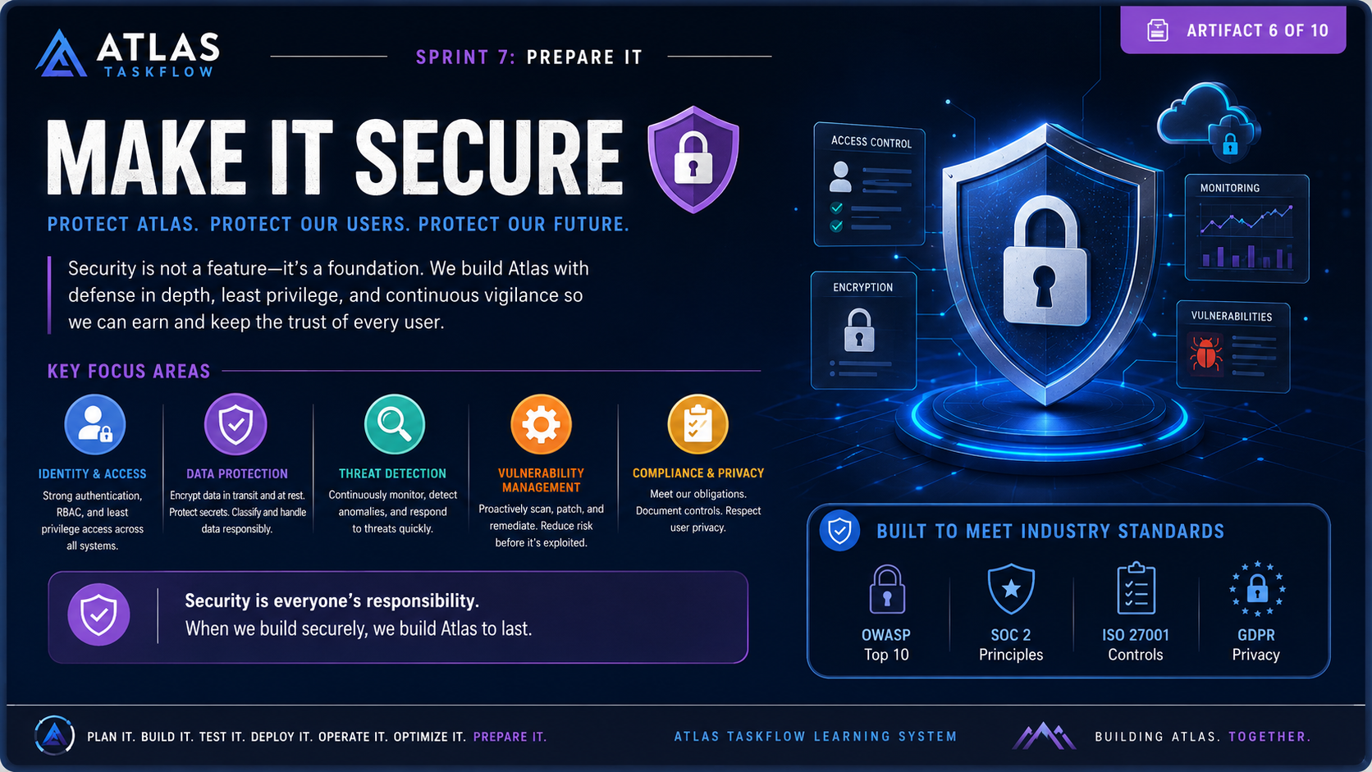
7-06
Notes:
Speaker Notes — Make It Secure
Opening
“Now that Atlas is becoming production-ready, we have to address one of the most important questions: Can we trust it?
Security isn't something we add at the end of development. It has to be part of how we design, build, test, deploy, and operate Atlas.”
Security as a Foundation
“When we talk about security, we're talking about protecting three things: our users, our data, and our system.
A secure system assumes that threats will exist. Our job is to reduce the opportunity for those threats to succeed and to limit the damage if something does go wrong.
That's why Atlas uses principles like defense in depth, least privilege, and continuous vigilance.”
Key Focus Areas
Identity & Access
“First, we need to know who is accessing Atlas and what they're allowed to do.
Authentication answers, ‘Who are you?’ Authorization answers, ‘What are you allowed to do?’
We should use strong authentication, role-based access control, and the principle of least privilege. Users and services should receive only the permissions they actually need.”
Data Protection
“Next is protecting our data.
Sensitive information needs to be protected both at rest and in transit. That means using appropriate encryption, protecting credentials and secrets, and making sure sensitive information isn't accidentally exposed through logs, configuration files, or source code.”
Threat Detection
“Security isn't just about preventing attacks. We also need to recognize when something unusual is happening.
Monitoring and alerting allow us to detect suspicious activity, investigate it, and respond before a small problem becomes a major incident.”
Vulnerability Management
“Software dependencies, operating systems, libraries, and infrastructure can all contain vulnerabilities.
That means security requires continuous maintenance: scanning for vulnerabilities, keeping dependencies updated, patching systems, and addressing known weaknesses before they're exploited.”
Compliance & Privacy
“Finally, we have to understand the obligations that apply to our system.
Frameworks and regulations such as OWASP guidance, SOC 2, ISO 27001, and privacy requirements give us useful ways to think about controls, accountability, and protecting user information.
The goal isn't simply to check compliance boxes. The goal is to build security practices that actually protect people.”
Security Is Everyone's Responsibility
“One important lesson here is that security isn't just the security team's responsibility.
A developer can introduce a vulnerability through code. A DevOps engineer can expose a service through an incorrect configuration. A system administrator can leave an outdated component unpatched.
Every person involved in Atlas contributes to its security.”
Closing
“So when we say Make It Secure, we're saying that security must be built into Atlas from the inside out.
We authenticate users. We control access. We protect data. We monitor threats. We manage vulnerabilities. And we continuously improve our defenses.
Because when we build Atlas securely, we're not just protecting the application.
We're protecting the trust that allows people to use it.”

Slide 7
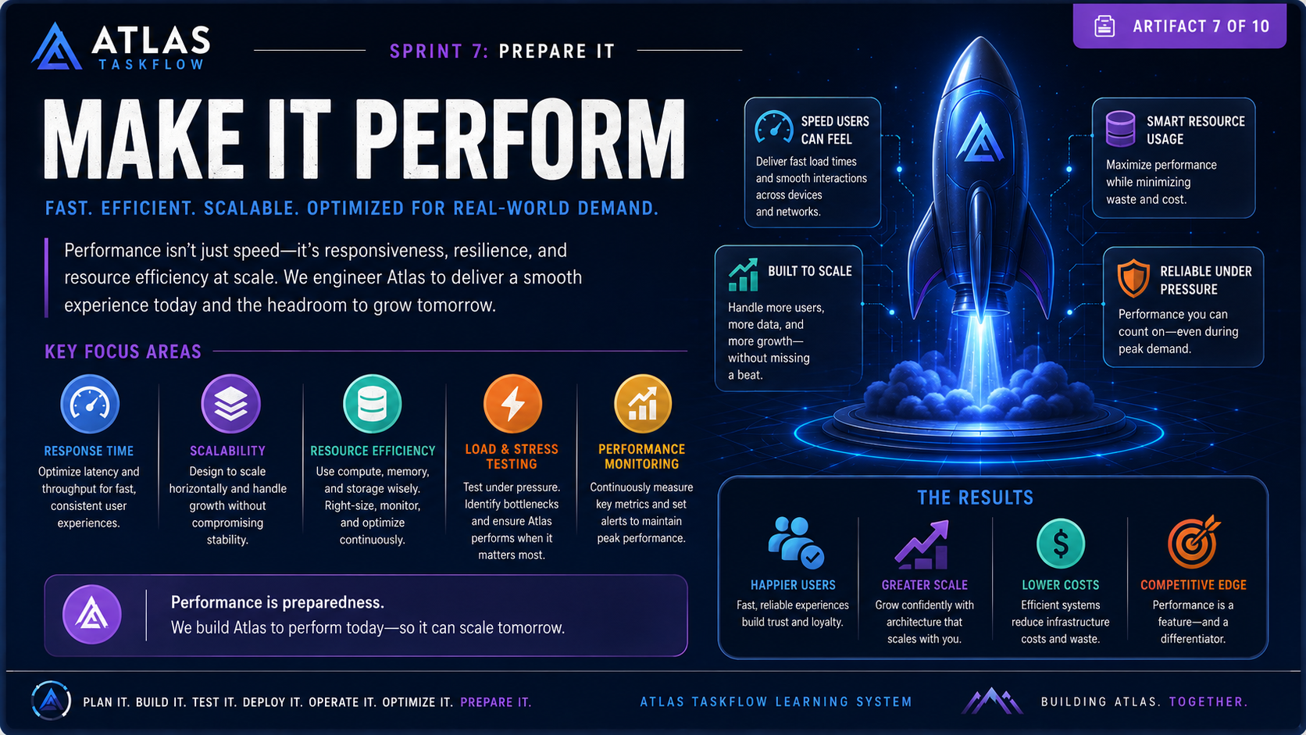
7-07
Notes:
Speaker Notes — Make It Perform
Opening
“Getting Atlas into production is only part of the job. We also need to make sure Atlas performs well once real users start using it.
A system that technically works but is slow, unreliable under load, or expensive to operate isn't really production-ready.
That's why performance has to be designed into Atlas—not treated as something we fix after users complain.”
Performance Is More Than Speed
“When we hear the word performance, we usually think about speed.
But performance is bigger than that.
We're concerned with responsiveness, scalability, reliability, and resource efficiency.
Our goal is to give users a smooth experience today while making sure the system has enough capacity to support tomorrow's growth.”
Key Focus Areas
Response Time
“First is response time.
How quickly does Atlas respond when a user clicks a button, loads a page, submits a request, or retrieves information?
We want to minimize unnecessary delays and make response times consistent—not just fast when there are only a few users.”
Scalability
“Next is scalability.
What happens when Atlas goes from 10 users to 100? What about 1,000?
We need an architecture that can grow without requiring us to completely redesign the system.
Scalability means Atlas can handle increasing users, transactions, and workloads while maintaining an acceptable level of performance.”
Resource Efficiency
“Performance also means using our resources wisely.
CPU, memory, storage, database connections, network bandwidth, and cloud infrastructure all cost money.
We want to avoid wasting resources while still providing the performance users expect.
That means measuring usage, identifying bottlenecks, right-sizing infrastructure, and continuously optimizing where necessary.”
Load & Stress Testing
“We can't assume Atlas will perform well under pressure—we have to test it.
Load testing helps us understand what happens when many users access the system at the same time.
Stress testing pushes the system beyond normal expectations so we can discover its breaking points.
The goal isn't necessarily to prevent the system from ever failing. The goal is to understand how it fails and how gracefully it recovers.”
Performance Monitoring
“Once Atlas is deployed, performance testing doesn't stop.
We need ongoing monitoring.
We should track things like response times, throughput, CPU and memory utilization, database performance, error rates, and other important metrics.
When performance starts to degrade, monitoring should help us identify the problem before users experience a major outage or slowdown.”
The Results
“If we do this well, there are several benefits.
First, we get happier users because the application feels fast and responsive.
Second, we gain greater scalability, allowing Atlas to grow without constantly rebuilding the architecture.
Third, we can achieve lower costs because we're using infrastructure efficiently.
And finally, performance becomes a competitive advantage. When two products provide similar functionality, users tend to prefer the one that is faster, smoother, and more reliable.”
Performance Is Preparedness
“The key message of this artifact is simple:
Performance is preparedness.
We're not optimizing Atlas simply because we want impressive benchmark numbers.
We're preparing Atlas for the real world.
We want it to perform when demand increases, when workloads become unpredictable, and when users depend on it.
So as we prepare Atlas for production, we're asking a critical question:
Can Atlas perform when it matters most?
If the answer is yes, we're one step closer to being truly production-ready.”

Slide 8
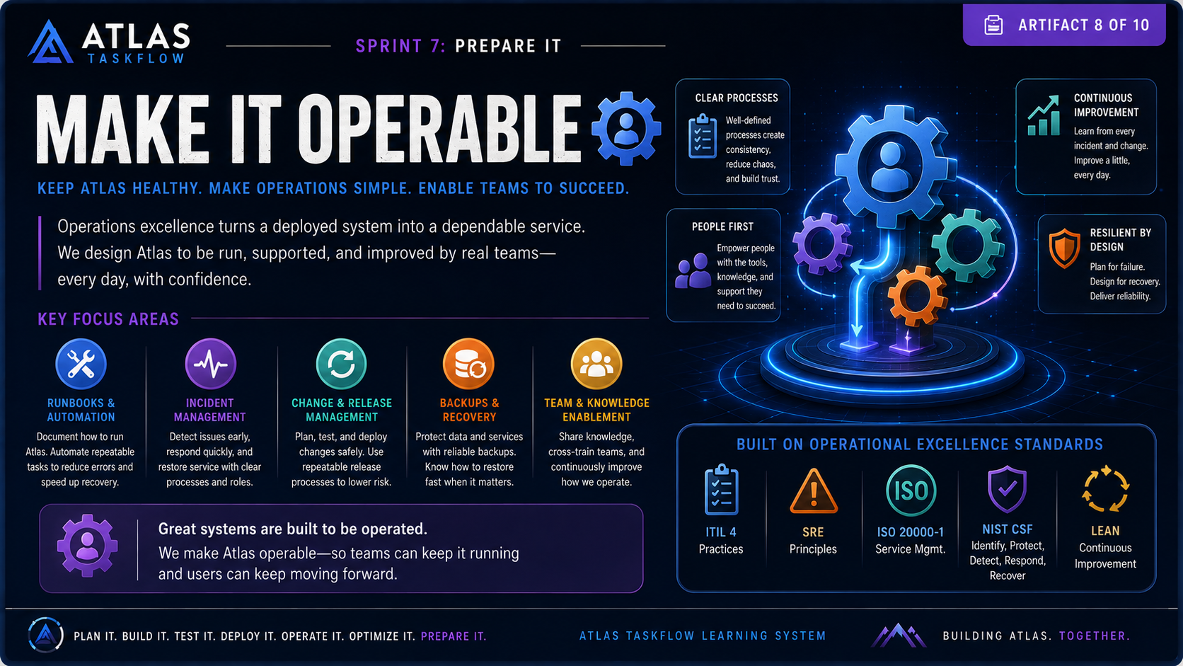
7-08
Notes:
# Speaker Notes — Make It Operable
### Opening
“Getting Atlas deployed is not the finish line.
Once a system is in production, someone has to **run it, support it, maintain it, recover it, and improve it**.
That's what we mean when we say **Make It Operable**.
A system can be technically excellent and still fail as a product if the team doesn't know how to operate it effectively.”
### What Does Operable Mean?
“Operability is about turning a deployed application into a **dependable service**.
We want Atlas to be something that a team can operate confidently day after day.
That means we need clear processes, the right tools, documented knowledge, and the ability to respond when something goes wrong.
The goal isn't to eliminate every possible problem. The goal is to make sure that when problems happen, the team knows what to do.”
### Key Focus Areas
**Runbooks & Automation**
“First, we need to document how Atlas is operated.
A **runbook** is essentially a playbook for handling a specific operational task or situation.
For example: How do we restart a service? How do we deploy a release? How do we restore a database? What do we do when an API stops responding?
Whenever possible, we should automate repetitive operational tasks.
Automation reduces human error, makes processes repeatable, and can dramatically speed up recovery.”
**Incident Management**
“Eventually, something will go wrong.
An incident could be an outage, a performance problem, a security event, or a major system failure.
We need a defined process for detecting the problem, determining its impact, communicating with the appropriate people, resolving the issue, and documenting what happened.
The objective isn't to find someone to blame.
The objective is to **restore service and learn from the incident**.”
**Change & Release Management**
“Every change introduces some level of risk.
That means we need a controlled process for planning, testing, approving, and deploying changes.
We want releases to be predictable and repeatable.
Good release management also gives us the ability to roll back when something doesn't go according to plan.”
**Backups & Recovery**
“Another important operational responsibility is protecting our ability to recover.
Backups are important, but simply having a backup isn't enough.
We need to know:
Where are the backups stored?
How frequently are they created?
How long are they retained?
And most importantly—**can we actually restore from them?**
A backup that has never been tested isn't something we should blindly depend on.
Recovery procedures should be tested so the team knows they work before a real emergency occurs.”
**Team & Knowledge Enablement**
“Finally, operability depends on people.
If only one person knows how Atlas works, we have created a major operational risk.
Knowledge needs to be shared across the team.
Documentation, cross-training, onboarding materials, and clear ownership help ensure that Atlas doesn't depend on a single individual.
We want the team to be able to support the system together.”
### Built on Operational Excellence
“The practices shown here connect Atlas to established approaches such as **ITIL 4, Site Reliability Engineering, ISO 20000-1, NIST's Cybersecurity Framework, and Lean principles**.
We don't necessarily need to implement every framework in its entirety.
Instead, we can learn from the practices they promote: structured operations, reliability, continuous improvement, risk management, and efficient processes.”
### Resilient by Design
“One of the most important ideas here is **designing for failure**.
We should assume that servers can fail, deployments can go wrong, databases can become unavailable, and people can make mistakes.
The question isn't, ‘How do we make sure nothing ever fails?’
The better question is:
**‘When something fails, how quickly and safely can we recover?’**
That's the mindset behind resilient systems.”
### Closing
“So when we say **Make It Operable**, we're making a commitment that Atlas won't simply be something we deploy and walk away from.
We're building a system that teams can understand, operate, support, recover, and improve.
The key message is:
**Great systems are built to be operated.**
If we want Atlas to provide value for years—not just launch successfully—we have to prepare the people and processes that keep it running.”
### Transition
“We've now addressed security, performance, and operations.
The next question becomes: **How do we know Atlas is actually ready to go into the hands of real users?**
That's where our final preparation step comes in.”

Slide 9
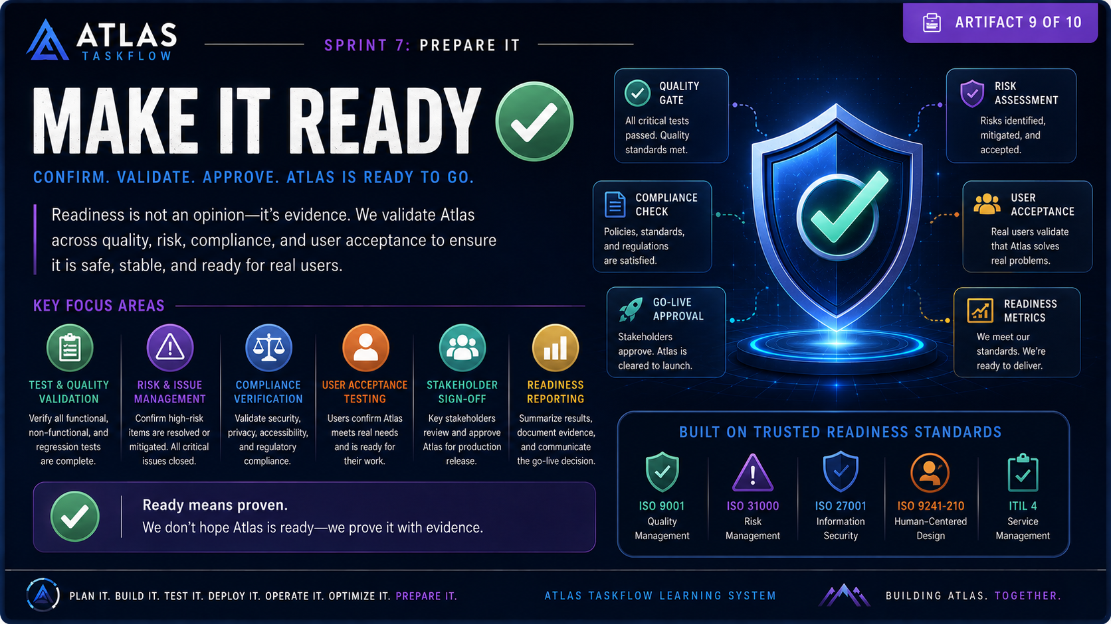
7-09
Notes:
Speaker Notes — Make It Ready
Opening
“We've built Atlas. We've tested it. We've secured it. We've prepared the infrastructure and the people who will operate it.
But before we put Atlas into the hands of real users, we have to answer one final question:
Is Atlas actually ready?
And that's an important distinction.
Being finished is not the same thing as being ready.”
Readiness Is Evidence
“Readiness should never be based on someone's feeling that the project is probably good enough.
Readiness is evidence.
We need to be able to demonstrate that Atlas works, that the major risks have been addressed, that our requirements have been satisfied, and that the people who will use and support the system are prepared.
We're moving from belief to proof.”
Key Focus Areas
Test & Quality Validation
“First, we need to confirm that the system actually works as expected.
That includes functional testing, non-functional testing, regression testing, integration testing, and any other testing required by the project.
Critical defects shouldn't simply be documented—they need to be resolved or formally accepted before we move forward.”
Risk & Issue Management
“Next, we need to look at the remaining risks.
What could still go wrong?
Which issues are still open?
Which risks have been reduced, and which ones have been accepted?
A mature project doesn't pretend that risk doesn't exist. It understands the remaining risk and makes an informed decision about whether that risk is acceptable.”
Compliance Verification
“We also need to verify that Atlas meets the standards, policies, regulations, and organizational requirements that apply to it.
That can include security, privacy, accessibility, data handling, documentation, and other compliance requirements.
The question is:
Have we met the obligations necessary to responsibly release this system?”
User Acceptance Testing
“This is where we bring the user's perspective into the final decision.
Technical teams can tell us that the software works according to the specification.
But users can tell us whether the software actually works for them.
User acceptance testing asks whether Atlas solves the real problem, supports real workflows, and is usable enough for the people who depend on it.”
Stakeholder Sign-Off
“Once the evidence has been collected, the appropriate stakeholders need to review it.
They need to understand what we're launching, what risks remain, what has been tested, and what the expected outcomes are.
Then someone has to make the decision:
Are we approving Atlas for production?
That approval represents accountability. We're not simply pushing a button—we're making a deliberate organizational decision.”
Readiness Reporting
“Finally, we need to bring everything together.
Our readiness report should summarize the testing results, outstanding issues, risk status, compliance verification, user acceptance results, and stakeholder approvals.
This creates a record of why we believe Atlas was ready to launch.”
The Readiness Gate
“Think of this artifact as a gate.
Atlas doesn't simply move from development to production because the calendar says it's time.
It moves forward because we've satisfied the criteria necessary to release it responsibly.
The gate asks:
Does Atlas work?
Is Atlas secure?
Are the risks understood?
Are users prepared?
Are the teams prepared?
Have the right people approved the release?”
Ready Means Proven
“The key statement on this slide is:
Ready means proven.
We don't hope Atlas is ready.
We don't assume Atlas is ready.
We prove it through evidence.
This mindset is important because production systems affect real people. Once Atlas goes live, defects and failures aren't just development problems anymore—they can become operational, financial, or customer problems.”
The Go-Live Decision
“At this point, we should have enough evidence to make one of three decisions.
Go: Atlas meets the readiness criteria and can move forward.
No-Go: Significant problems remain and the release needs to stop.
Or, in some situations, conditional approval: Atlas can proceed with clearly documented limitations, mitigations, and ownership.
The important thing is that the decision is intentional and supported by evidence.”
Closing
“So we've reached the final gate of PREPARE IT.
We've moved through reliability, observability, usability, security, performance, and operations.
Now we've validated the complete system and confirmed whether it is ready for real-world use.
And if the evidence says yes, there's only one thing left to do:
Launch Atlas.
That's our next artifact—and that's where preparation turns into impact.”

Slide 10
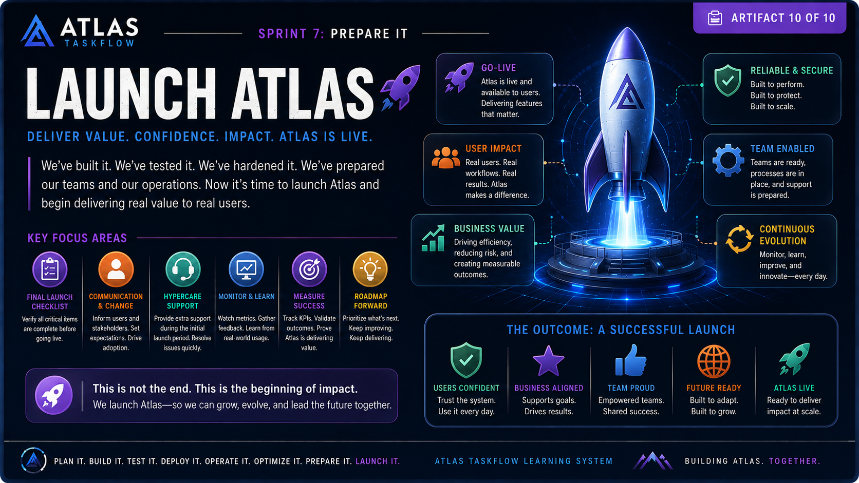
7-10
Notes:
Speaker Notes — Launch Atlas
Opening
“We've reached the moment we've been preparing for.
We've built Atlas. We've tested it. We've secured it. We've optimized it. We've prepared our operations and our teams. And we've validated that Atlas is ready.
Now it's time to Launch Atlas.
But launch isn't simply the moment we move a deployment into production.
Launch is the moment when the work we've done begins creating value for real users.”
From Project to Product
“Up until this point, we've primarily been thinking about Atlas as a project.
We've had requirements, designs, tasks, milestones, tests, and deliverables.
But once Atlas launches, our mindset has to change.
Atlas is no longer just something we're building.
Atlas is now something we're responsible for.
Users will depend on it. Teams will support it. Stakeholders will measure it. And the organization will expect it to deliver results.
Launch is where the project becomes a living product.”
Key Focus Areas
Final Launch Checklist
“Before we actually go live, we perform one final check.
Are all critical tests complete?
Are known critical issues resolved?
Are backups working?
Are monitoring and alerts active?
Are deployment and rollback procedures documented?
Are users and support teams prepared?
The launch checklist gives us confidence that we're not forgetting something important at the last moment.”
Communication & Change
“A successful launch is also a communication exercise.
Users need to know that Atlas is coming, what is changing, why it matters, and where they can get help.
Stakeholders need to understand what to expect.
And support teams need to know how to respond when questions or problems arise.
Technology adoption doesn't happen automatically.
We have to bring people along with us.”
Hypercare Support
“The first few days or weeks after launch are particularly important.
This period is often called hypercare.
During hypercare, we provide additional support and closely monitor Atlas.
We're looking for unexpected problems, usability issues, performance concerns, and questions from real users.
The goal isn't to panic when something happens.
The goal is to respond quickly, learn from what we're seeing, and stabilize the system.”
Monitor & Learn
“Once Atlas is live, we start collecting real-world evidence.
We're watching system metrics.
We're looking at errors.
We're listening to users.
We're examining how people actually use the system compared with how we expected them to use it.
This is important because our assumptions during development aren't always correct.
Production gives us information that development simply cannot.”
Measure Success
“We also need to determine whether Atlas is actually delivering the value we promised.
Remember the original problem we were trying to solve.
Did Atlas improve the process?
Did it save time?
Did it reduce errors?
Did it improve the user experience?
Did it reduce costs or increase efficiency?
These are the questions that determine whether our project was successful.
A system can be technically excellent and still fail if it doesn't create meaningful value.”
Roadmap Forward
“Finally, launch isn't the end of development.
It's the beginning of the next phase.
Once Atlas is being used, we'll discover new requirements, new opportunities, and new challenges.
We'll prioritize what comes next based on evidence.
That means continuing to improve Atlas rather than treating version one as the final version.
The product evolves because the users, technology, and business environment evolve.”
The Six Outcomes of a Successful Launch
“The slide identifies six important outcomes we want from our launch.
Go-Live means Atlas is actually available and delivering the functionality we promised.
User Impact means real people are benefiting from the system.
Business Value means the organization is seeing measurable results.
Reliable & Secure means the system continues to perform while protecting its users and data.
Team Enabled means the people responsible for Atlas know how to support and improve it.
And Continuous Evolution means we're prepared to learn, adapt, and keep improving.”
Launch Is Not the Finish Line
“One of the most important messages in this entire sprint is at the bottom of the slide:
This is not the end. This is the beginning of impact.
That's the mindset I want you to take away.
A software project isn't successful simply because we finished the code.
It's successful when people actually use what we built and it makes their lives, their work, or their organization better.”
Connecting Back to Atlas
“Think about everything we've done throughout the Atlas TaskFlow.
We started with an idea.
We planned it.
We designed it.
We built it.
We tested it.
We deployed it.
We made it observable.
We made it usable.
We secured it.
We made it perform.
We made it operable.
We proved that it was ready.
And now we're launching it.”
The Real Definition of Done
“This gives us a much better definition of done.
Done isn't:
‘The developer finished the feature.’
Done isn't:
‘The code compiled.’
Done isn't even:
‘The application was deployed.’
Done means the system is delivering value safely, reliably, and sustainably to real users.
That's the standard we should strive for.”
Closing Sprint 7
“And that brings us to the end of Sprint 7: PREPARE IT.
We've prepared Atlas not simply to exist, but to succeed in the real world.
The next challenge isn't about getting Atlas ready anymore.
It's about what happens after readiness.
How do we operate it?
How do we learn from it?
How do we measure it?
How do we improve it?
And how do we keep creating value over time?
Because building Atlas isn't about reaching a finish line.
We're building something that can continue to evolve.”
Final Statement
“So let's launch Atlas.
Deliver value. Build confidence. Create impact.
And remember:
This is not the end.
This is the beginning of impact.”

