Slide 1
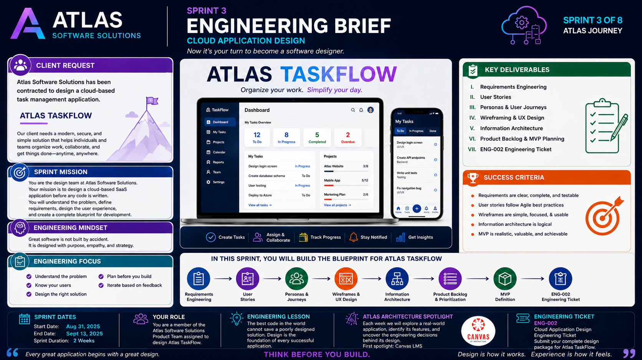
3-01
Notes:
============================================================
SPRINT 3 ENGINEERING BRIEF
CLOUD APPLICATION DESIGN
CLIENT PROJECT:
ATLAS TASKFLOW
============================================================
SLIDE PURPOSE
Welcome students to Sprint 3 and introduce their first complete software
design project.
Students are no longer learning isolated concepts.
Throughout Sprint 3 they will serve as the Product Team at Atlas
Software Solutions and design Atlas TaskFlow, a cloud-based Software as
a Service application.
Every lesson this sprint contributes directly to this product.
By the end of Sprint 3 students will have a complete design blueprint
ready for development in Sprint 4.
------------------------------------------------------------
OPENING
"Welcome back, engineers."
"We've reached an exciting point in the semester."
"In Sprint 1, you learned how software engineers work."
"In Sprint 2, you learned how modern SaaS applications are built."
"This sprint..."
"You're becoming the engineering team."
Pause.
"Today you receive your first client project."
------------------------------------------------------------
CLIENT BRIEF
Read the Client Request.
"Atlas Software Solutions has been contracted to design a new cloud-based
task management platform."
"The product is called Atlas TaskFlow."
"Our responsibility is to understand the client's needs and produce a
complete software design before development begins."
Explain:
"Professional software teams never begin with code."
"They begin by understanding the problem."
------------------------------------------------------------
INTRODUCING ATLAS TASKFLOW
Point to the dashboard.
"This is Atlas TaskFlow."
"A modern SaaS application for organizing work."
"It allows users to create tasks..."
"Track progress..."
"Collaborate with teams..."
"And stay organized."
Explain:
"Everything we design this sprint will belong to this application."
------------------------------------------------------------
SPRINT MISSION
Review the mission.
Understand the problem.
Gather requirements.
Understand users.
Design the experience.
Create a blueprint.
Explain:
"This sprint isn't about programming."
"It's about thinking."
------------------------------------------------------------
ENGINEERING MINDSET
Read the statement.
"Great software isn't built by accident."
"It is designed with purpose..."
"Empathy..."
"And strategy."
Discuss each.
Purpose
Know why the application exists.
Empathy
Understand the people who will use it.
Strategy
Plan before writing code.
------------------------------------------------------------
ENGINEERING FOCUS
Walk through each focus area.
Understand the problem.
Know your users.
Design the right solution.
Plan before you build.
Iterate based on feedback.
Ask students:
"Notice what isn't listed."
Programming languages.
Databases.
Frameworks.
Explain:
"Those come later."
------------------------------------------------------------
SPRINT ROADMAP
Point to the engineering journey.
Requirements Engineering
↓
User Stories
↓
Personas
↓
Wireframes
↓
Information Architecture
↓
Product Backlog
↓
MVP Definition
↓
ENG-002
Explain:
"Each lesson builds another piece of Atlas TaskFlow."
"By the end of the sprint..."
"We'll have a complete design package."
------------------------------------------------------------
KEY DELIVERABLES
Review each item.
Requirements
User Stories
Personas
User Journeys
Wireframes
Architecture
Backlog
Engineering Ticket
Explain:
"These are exactly the artifacts professional software teams create
before development begins."
------------------------------------------------------------
SUCCESS CRITERIA
Read each item.
Requirements are clear.
User stories are complete.
Wireframes are usable.
Architecture is logical.
MVP is realistic.
Explain:
"A successful sprint isn't measured by lines of code."
"It's measured by clarity."
------------------------------------------------------------
YOUR ROLE
"You are not acting as students."
"You are Product Team members at Atlas Software Solutions."
"Your responsibility is to deliver a professional design package to your
client."
Explain that every engineering decision should support the client and
future users.
------------------------------------------------------------
ATLAS ARCHITECTURE SPOTLIGHT
Introduce the new recurring activity.
"This sprint we're starting something new."
"Every week we'll analyze a real software application."
"Our first spotlight is Canvas."
Ask:
"What makes Canvas easy to use?"
"What features does it provide?"
"What requirements had to exist before developers wrote code?"
Allow students to begin thinking like software architects.
------------------------------------------------------------
ENGINEERING LESSON
Read the Engineering Lesson.
"The best code in the world cannot save a poorly designed solution."
Pause.
Continue.
"Design decisions influence everything that follows."
"Good software begins long before anyone opens Visual Studio."
------------------------------------------------------------
ENGINEERING STORY
Share the story of the SCC Food Pantry project.
Focus on discovery.
Discuss meeting stakeholders.
Changing requirements.
Learning from conversations.
Explain:
"We thought we knew the problem."
"But every meeting taught us something new."
"That's software engineering."
------------------------------------------------------------
ATLAS DESIGN CHALLENGE
Explain the new challenge format.
"At the end of every lesson this sprint..."
"You'll complete a five-minute engineering challenge."
"The goal isn't a grade."
"The goal is practice."
Tell students:
"Great engineers improve through repetition."
------------------------------------------------------------
CLASS DISCUSSION
Ask:
"What features should Atlas TaskFlow include?"
Write student ideas on the board.
Examples:
Task Management
Projects
Teams
Calendar
Notifications
Search
Reports
Dark Mode
Attachments
Explain:
"Congratulations."
"You've already started gathering requirements."
------------------------------------------------------------
TRANSITION
"Every successful software project begins with one question."
"What problem are we solving?"
"Our next lesson teaches the first skill every software engineer needs."
"Requirements Engineering."
------------------------------------------------------------
ESTIMATED TIME
Welcome.......................5 minutes
Client Brief..................8 minutes
Project Overview..............8 minutes
Sprint Roadmap................8 minutes
Architecture Spotlight........7 minutes
Discussion...................10 minutes
Transition....................4 minutes
Total........................50 minutes
------------------------------------------------------------
INSTRUCTOR NOTES
Keep the excitement high.
Students should leave class believing they have joined a real software
engineering team.
Refer to Atlas TaskFlow throughout the sprint.
Never call it "the example."
Call it "our product."
Every lesson should add another piece to the design.
Close with:
"By the end of Sprint 3..."
"You won't just understand software design."
"You'll have designed an application that we're going to build together."
Pause.
Smile.
"And that's exactly how professional software engineering begins."
============================================================

Slide 2
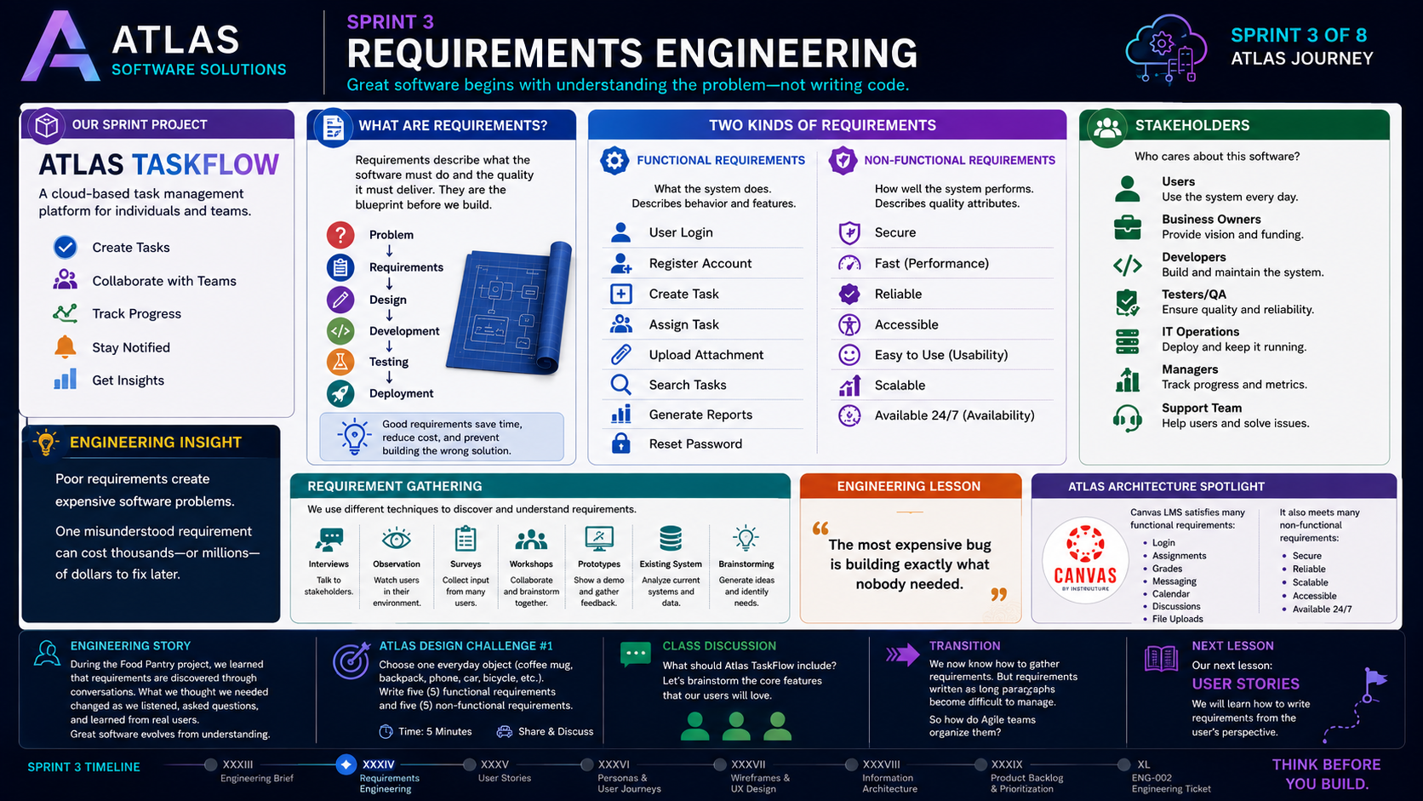
3-02
Notes:
============================================================
SPRINT 3
ARTIFACT XXXIV
REQUIREMENTS ENGINEERING
============================================================
SLIDE PURPOSE
Introduce students to one of the most important concepts in software
engineering: understanding the problem before designing the solution.
Students should realize that successful software projects begin with
clear requirements—not programming.
Everything they create for Atlas TaskFlow this sprint will begin with
requirements engineering.
------------------------------------------------------------
OPENING
"Today we're beginning the first real engineering activity of our
client project."
"Before software engineers write code..."
"They ask questions."
"They listen."
"They observe."
"They learn."
"Today we're going to discover what our client actually needs."
Pause.
"Welcome to Requirements Engineering."
------------------------------------------------------------
CONNECT TO TASKFLOW
Point to Atlas TaskFlow.
"Remember..."
"We've been hired to design Atlas TaskFlow."
"Our client didn't ask us to write code."
"They asked us to solve a problem."
Explain:
"If we misunderstand the problem..."
"It doesn't matter how good our code is."
"We'll build the wrong product."
------------------------------------------------------------
WHAT ARE REQUIREMENTS?
Read the definition.
"Requirements describe what software must do and how well it must do
it."
Walk through the engineering process.
Problem
↓
Requirements
↓
Design
↓
Development
↓
Testing
↓
Deployment
Explain:
"Notice where requirements occur."
"They happen before design."
"Everything depends on getting this step right."
------------------------------------------------------------
FUNCTIONAL REQUIREMENTS
Read several examples.
Login
Register
Create Task
Assign Task
Upload Attachment
Search Tasks
Generate Reports
Reset Password
Explain:
"Functional requirements describe behavior."
"They answer one question..."
"What should the software do?"
Point back to Atlas TaskFlow.
Ask students:
"What other features should our application include?"
Write answers on the board.
------------------------------------------------------------
NON-FUNCTIONAL REQUIREMENTS
Now shift to quality.
Secure
Fast
Reliable
Accessible
Easy to Use
Scalable
Available 24/7
Explain:
"These don't describe features."
"They describe quality."
Ask:
"Would you rather use a feature-rich application that crashes every
hour..."
"Or a simple application that always works?"
Students immediately understand the importance.
------------------------------------------------------------
STAKEHOLDERS
Review each stakeholder.
Users
Business Owners
Developers
QA
Operations
Managers
Support
Explain:
"Every stakeholder sees the project differently."
"Our job is to balance those perspectives."
------------------------------------------------------------
REQUIREMENT GATHERING
Review each technique.
Interviews
Observation
Surveys
Workshops
Prototypes
Existing Systems
Brainstorming
Explain:
"There is no single correct way."
"Professional engineers combine multiple techniques."
------------------------------------------------------------
ENGINEERING INSIGHT
Read the statement.
"Poor requirements create expensive software problems."
Pause.
Explain.
"Changing one requirement after deployment can cost hundreds—or even
thousands—of times more than changing it during planning."
That's why Requirements Engineering exists.
------------------------------------------------------------
ATLAS ARCHITECTURE SPOTLIGHT
Canvas LMS
Ask students:
"What functional requirements does Canvas satisfy?"
Collect answers.
Then ask:
"What non-functional requirements must Canvas satisfy?"
Guide discussion toward:
Security
Availability
Accessibility
Performance
Scalability
Explain:
"We're beginning to think like software architects."
------------------------------------------------------------
ENGINEERING STORY
Tell the SCC Food Pantry story.
Focus on the meetings.
The questions.
The changing requirements.
Explain:
"We discovered the real problem by listening."
"Every meeting improved the design."
That's exactly what Requirements Engineering is.
------------------------------------------------------------
ATLAS DESIGN CHALLENGE
Introduce Challenge #1.
Choose an everyday object.
Examples:
Coffee Mug
Backpack
Laptop
Phone
Bicycle
Headphones
Write:
Five Functional Requirements
Five Non-Functional Requirements
Give students five minutes.
Then discuss.
------------------------------------------------------------
CLASS DISCUSSION
Now return to Atlas TaskFlow.
Ask:
"If you were the client..."
"What would you absolutely expect our application to do?"
Record responses.
Tell students:
"Congratulations."
"You've just begun writing software requirements."
------------------------------------------------------------
ENGINEERING LESSON
Read the quote.
"The most expensive bug is building exactly what nobody needed."
Pause.
Explain.
"Software engineering isn't just about writing software."
"It's about solving the correct problem."
------------------------------------------------------------
TRANSITION
"Now we know how to discover requirements."
"But software teams don't keep these ideas in long documents."
"They organize them into something much simpler."
"Our next lesson..."
"User Stories."
------------------------------------------------------------
ESTIMATED TIME
Introduction...................5 minutes
Requirements...................10 minutes
Functional vs Non-functional...12 minutes
Stakeholders...................5 minutes
Architecture Spotlight.........8 minutes
Design Challenge...............7 minutes
Discussion.....................8 minutes
Transition.....................3 minutes
Total..........................58 minutes
------------------------------------------------------------
INSTRUCTOR NOTES
Keep the lecture conversational.
Frequently connect every concept back to Atlas TaskFlow.
When students suggest features...
Treat them as if they are participating in a real requirements meeting.
Write ideas on the board.
Challenge assumptions.
Ask follow-up questions.
This should feel like the first client workshop.
Close with:
"Every successful software application begins with understanding
people."
"Today..."
"We took the first step toward building Atlas TaskFlow."
============================================================

Slide 3
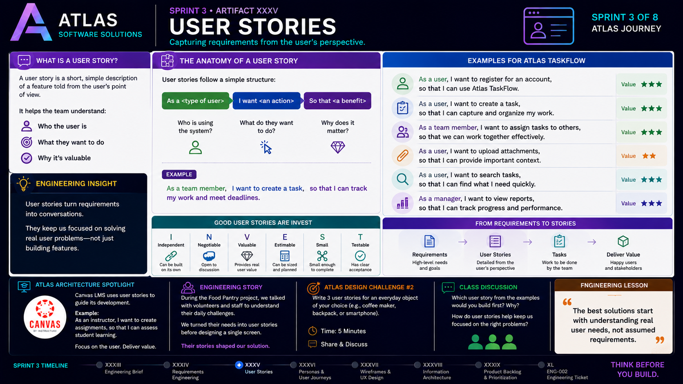
3-03
Notes:
============================================================
SPRINT 3
ARTIFACT XXXV
USER STORIES
============================================================
SLIDE PURPOSE
Introduce students to Agile User Stories and demonstrate how software
requirements are transformed into user-centered development tasks.
Students should understand that software is not built around features;
it is built around solving problems for real people.
Every User Story they create today will become part of the Atlas
TaskFlow Product Backlog later in Sprint 3.
------------------------------------------------------------
OPENING
"Last class we gathered requirements."
"We asked what the software should do."
"But professional Agile teams rarely work from long requirement
documents."
"They organize work into something much simpler."
"They use User Stories."
Pause.
"Today we'll learn how to think from the user's perspective."
------------------------------------------------------------
CONNECT TO TASKFLOW
Point to Atlas TaskFlow.
"Remember our client?"
"They don't want a list of technical features."
"They want software that helps people manage their work."
"Every feature we build must provide value to someone."
Ask students:
"Who will use Atlas TaskFlow?"
Record answers:
Students
Project Managers
Team Members
Administrators
Business Owners
Explain:
"Each of these users has different needs."
------------------------------------------------------------
WHAT IS A USER STORY?
Read the definition.
"A User Story is a short description of a feature from the user's
perspective."
Explain:
"It isn't a technical specification."
"It starts a conversation."
"It reminds us who we're building for."
------------------------------------------------------------
THE USER STORY TEMPLATE
Walk through each section.
As a...
Who is the user?
I want...
What do they want to accomplish?
So that...
Why does it matter?
Write the template on the board.
As a __________
I want __________
So that __________
Tell students:
"If you remember one thing from today's lecture..."
"Remember this format."
------------------------------------------------------------
TASKFLOW EXAMPLES
Review each example.
"As a user..."
"I want to register for an account..."
"So that I can use Atlas TaskFlow."
Ask students:
"What value does this provide?"
Continue through several examples.
Creating Tasks
Assigning Tasks
Uploading Attachments
Searching Tasks
Viewing Reports
Explain:
"Notice that every story focuses on solving a user problem."
------------------------------------------------------------
ENGINEERING INSIGHT
Read the Engineering Insight.
"User Stories turn requirements into conversations."
Explain:
"Requirements often tell us WHAT to build."
"User Stories remind us WHY we're building it."
------------------------------------------------------------
THE INVEST MODEL
Introduce the acronym.
Independent
Negotiable
Valuable
Estimable
Small
Testable
Discuss each briefly.
Independent
Can be developed separately.
Negotiable
Encourages discussion.
Valuable
Provides value to the user.
Estimable
Can be planned.
Small
Fits within a sprint.
Testable
Has clear acceptance criteria.
Explain:
"This checklist helps Product Owners determine whether a User Story is
ready for development."
------------------------------------------------------------
FROM REQUIREMENTS TO STORIES
Walk through the process.
Requirements
↓
User Stories
↓
Tasks
↓
Deliver Value
Explain:
"This is how Agile teams organize work."
"We're taking big ideas..."
"And breaking them into manageable pieces."
------------------------------------------------------------
ATLAS ARCHITECTURE SPOTLIGHT
Today's Spotlight:
Canvas LMS
Ask students:
"What User Stories exist in Canvas?"
Examples:
As a student...
I want to submit assignments...
So that my instructor can grade my work.
As an instructor...
I want to post announcements...
So that students stay informed.
As a student...
I want to view my grades...
So that I know how I'm performing.
Explain:
"Applications are collections of User Stories."
------------------------------------------------------------
ENGINEERING STORY
Share the Food Pantry project.
Explain that stakeholders rarely described technical features.
Instead they said things like:
"We need volunteers to know what's running low."
"We need to track donations."
"We need reports."
Those conversations naturally became User Stories.
------------------------------------------------------------
ATLAS DESIGN CHALLENGE #2
Challenge students:
Choose an application you use every day.
Examples:
Spotify
Netflix
Discord
Amazon
Canvas
Microsoft Teams
Write three User Stories.
Time:
5 minutes.
Have students share one story with the class.
------------------------------------------------------------
CLASS DISCUSSION
Now return to Atlas TaskFlow.
Ask:
"What User Story should we build first?"
Collect responses.
Discuss:
Which stories deliver the most value?
Which are required before anything else works?
Introduce the concept of prioritization.
Explain:
"This is exactly what Product Owners do."
------------------------------------------------------------
ENGINEERING LESSON
Read the quote.
"The best solutions start with understanding real user needs—not assumed
requirements."
Pause.
Explain:
"Technology changes."
"Programming languages change."
"But understanding people will always be one of the most valuable skills
a software engineer can have."
------------------------------------------------------------
TRANSITION
"We now know how to describe features from the user's perspective."
"But how do we better understand the people we're designing for?"
"Our next lesson introduces Personas and User Journeys."
"We're going to step into the user's shoes."
------------------------------------------------------------
ESTIMATED TIME
Review Previous Lesson...........5 minutes
User Story Concept..............10 minutes
TaskFlow Examples...............10 minutes
INVEST Model.....................8 minutes
Architecture Spotlight...........7 minutes
Design Challenge.................8 minutes
Class Discussion.................7 minutes
Transition.......................3 minutes
Total...........................58 minutes
------------------------------------------------------------
INSTRUCTOR NOTES
Keep Atlas TaskFlow at the center of the lesson.
When students create User Stories, encourage them to think about
different types of users rather than just themselves.
Challenge them to ask:
Who benefits?
Why is this feature valuable?
Could we build this independently?
Throughout the discussion, reinforce that User Stories are not simply a
writing exercise.
They are communication tools that connect users, developers, designers,
and stakeholders around a shared understanding of value.
Close with:
"Requirements tell us what to build."
"User Stories remind us who we're building it for."
"And great software never loses sight of the user."
============================================================

Slide 4
3-04
Notes:
============================================================
SPRINT 3
ARTIFACT XXXVI
PERSONAS & USER JOURNEYS
============================================================
SLIDE PURPOSE
Introduce students to Personas and User Journeys as essential tools for
understanding users before designing software.
Students should understand that successful software isn't designed for
"everyone."
It is designed for specific people with specific goals, frustrations,
and needs.
Today we begin designing Atlas TaskFlow through the eyes of our users.
------------------------------------------------------------
OPENING
"Today we're taking another step in our client project."
"So far we've discovered requirements."
"We've written User Stories."
"But today we're going to ask a different question."
"Who are we actually building this application for?"
Pause.
"Because if we don't understand our users..."
"We'll never design the right experience."
------------------------------------------------------------
CONNECT TO TASKFLOW
Point to the Atlas TaskFlow section.
"Our client wants a task management platform."
"But who uses it?"
Students.
Project Managers.
Team Members.
Administrators.
Business Owners.
Explain:
"Although they're using the same application..."
"They're using it for completely different reasons."
"That's why we create Personas."
------------------------------------------------------------
WHAT IS A PERSONA?
Explain:
"A Persona is a fictional representation of a real type of user."
"It helps us understand goals..."
"Frustrations..."
"Motivations..."
"And expectations."
Emphasize:
"We're not inventing imaginary people."
"We're summarizing patterns we've learned from real users."
------------------------------------------------------------
ATLAS TASKFLOW PERSONAS
Walk through each persona.
------------------------------------------------------------
OLIVIA
Student
Goals
Stay organized
Track assignments
Meet deadlines
Frustrations
Too many due dates
Disorganized information
Stress
Ask students:
"How could TaskFlow help Olivia?"
------------------------------------------------------------
ETHAN
Team Member
Goals
Know assigned work
Collaborate
Share updates
Frustrations
Unclear priorities
Finding files
Communication
Discuss.
------------------------------------------------------------
MAYA
Project Manager
Goals
Monitor progress
Assign work
Keep projects on schedule
Frustrations
Lack of visibility
Missed deadlines
Status uncertainty
------------------------------------------------------------
DANIEL
Administrator
Goals
Manage users
Maintain security
Configure settings
Frustrations
Permissions
Security risks
Complex administration
Explain:
"Notice something."
"Every user wants something different."
"One interface must satisfy them all."
------------------------------------------------------------
ENGINEERING INSIGHT
Read the statement.
"Great software is built from empathy."
Pause.
Explain.
"Empathy isn't just a personal skill."
"It's an engineering skill."
"When we understand people..."
"We design better software."
------------------------------------------------------------
USER JOURNEYS
Point to the journey map.
"A User Journey describes the experience someone has while completing a
goal."
Walk through Olivia's journey.
Login
↓
View Tasks
↓
Open Assignment
↓
Upload Work
↓
Submit
↓
Track Progress
Explain:
"This isn't about screens."
"It's about experiences."
------------------------------------------------------------
ACTIONS
Explain.
"What is the user doing?"
------------------------------------------------------------
THOUGHTS
"What is the user thinking?"
------------------------------------------------------------
FEELINGS
"How do they feel?"
Confident?
Confused?
Frustrated?
Relieved?
------------------------------------------------------------
OPPORTUNITIES
"How can we improve their experience?"
This is where great UX happens.
------------------------------------------------------------
ATLAS ARCHITECTURE SPOTLIGHT
Today's Spotlight:
Microsoft Planner
Ask students:
"What different users exist?"
Managers
Employees
Executives
Administrators
Then ask:
"How does Planner change depending on who's using it?"
Guide students toward role-based design.
------------------------------------------------------------
ENGINEERING STORY
Share the Food Pantry project.
Discuss how different users had different needs.
Volunteers
Pantry Staff
Administrators
Students
Explain:
"We couldn't design one screen for everyone."
"We had to understand each person's workflow."
------------------------------------------------------------
ATLAS DESIGN CHALLENGE #3
Challenge:
Choose one Atlas TaskFlow persona.
Map their journey for:
"Create a New Task."
Include:
Actions
Thoughts
Feelings
Opportunities
Time:
10 minutes
Have students compare journeys.
------------------------------------------------------------
CLASS DISCUSSION
Ask:
"Which persona do you relate to most?"
"What frustrations would you solve first?"
"What feature would make the biggest difference?"
Explain:
"These answers influence design decisions."
------------------------------------------------------------
ENGINEERING LESSON
Read the quote.
"Design is not just what it looks like and feels like."
"Design is how it works."
Pause.
Explain.
"Beautiful software isn't enough."
"It must also help people accomplish their goals."
------------------------------------------------------------
TRANSITION
"We now understand who we're designing for."
"And we understand the journey they'll take."
"So how do software designers begin creating the interface?"
"Our next lesson..."
"Wireframes & UX Design."
------------------------------------------------------------
ESTIMATED TIME
Review Previous Lesson............5 minutes
Personas........................10 minutes
Journey Mapping.................12 minutes
Architecture Spotlight...........7 minutes
Design Challenge................10 minutes
Discussion.......................8 minutes
Transition.......................3 minutes
Total...........................55 minutes
------------------------------------------------------------
INSTRUCTOR NOTES
Keep the discussion centered on empathy.
Ask students to think beyond themselves.
Remind them that good engineers don't design software for "users."
They design software for real people with real goals and real
frustrations.
When discussing Atlas TaskFlow, continually ask:
"What would Olivia expect?"
"What would Maya need?"
"What would Daniel worry about?"
This reinforces user-centered design.
Close with:
"Requirements tell us what to build."
"User Stories tell us why it matters."
"Personas tell us who we're building for."
"And User Journeys show us how they experience our software."
"Tomorrow..."
"We'll begin turning those ideas into actual interface designs."
============================================================

Slide 5
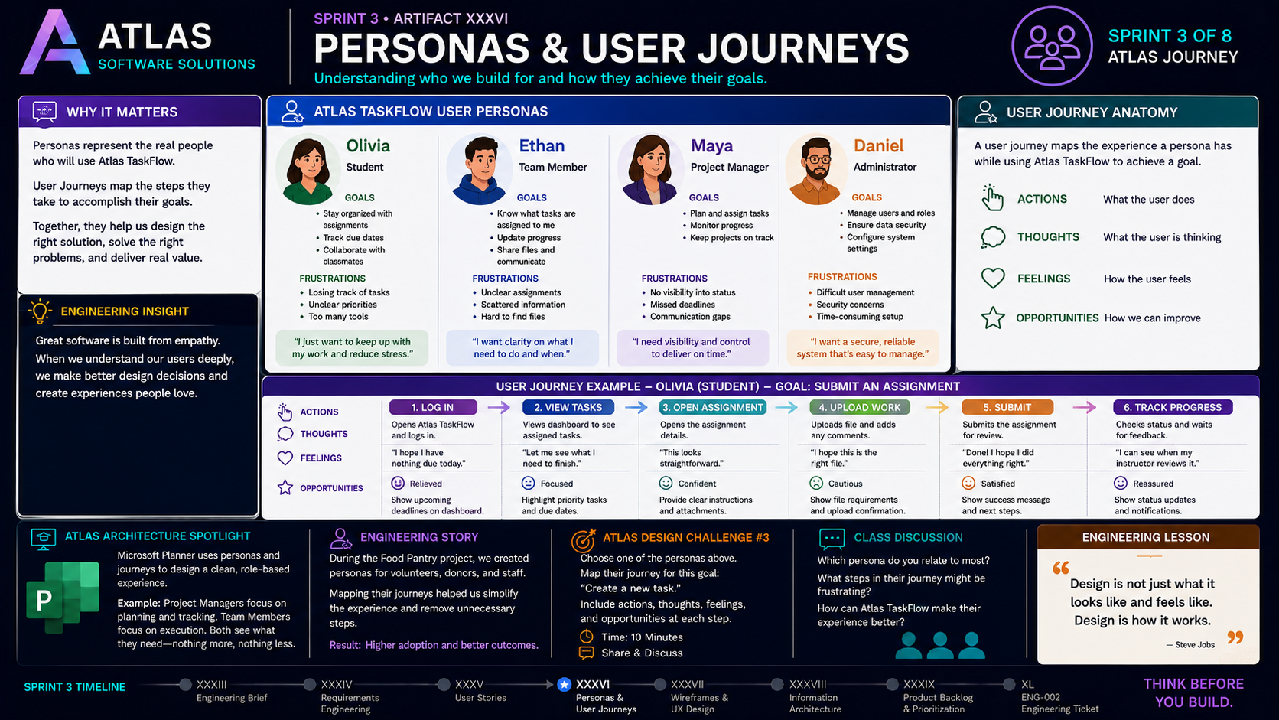
3-05
Notes:
============================================================
SPRINT 3
ARTIFACT XXXVII
WIREFRAMES & UX DESIGN
============================================================
SLIDE PURPOSE
Introduce students to wireframing and User Experience (UX) Design.
Students should understand that wireframes are not artwork.
They are engineering blueprints that communicate layout,
functionality, workflow, and user interactions before development
begins.
Today Atlas TaskFlow begins taking visual form.
------------------------------------------------------------
OPENING
"Welcome back, engineers."
"Over the past several classes we've answered three important
questions."
"What are we building?"
"Who are we building it for?"
"And why does it matter?"
Pause.
"Today we answer a new question."
"What will it actually look like?"
------------------------------------------------------------
CONNECT TO TASKFLOW
Point to the Atlas TaskFlow wireframes.
"Everything we've created so far has been preparation."
Requirements.
User Stories.
Personas.
User Journeys.
"Today..."
"We transform those ideas into interface designs."
Explain:
"Professional software teams almost never jump directly into coding."
"They sketch."
"They prototype."
"They test."
------------------------------------------------------------
WHY WIREFRAMES?
Read the panel.
Explain:
"Wireframes are blueprints."
"They focus on layout."
"Navigation."
"Content."
"Workflow."
"They intentionally ignore colors and graphics."
Explain why.
"If users can't understand the application as a wireframe..."
"Adding colors won't fix it."
------------------------------------------------------------
WIREFRAME PRINCIPLES
Review each principle.
Clarity
Can users understand the screen quickly?
Simplicity
Remove unnecessary elements.
Hierarchy
Guide attention to what matters most.
Consistency
Similar screens should behave similarly.
Functionality
Every element should serve a purpose.
Ask:
"Which principle do you think is most important?"
------------------------------------------------------------
LOW-FIDELITY VS HIGH-FIDELITY
Point to the comparison.
Low-Fidelity
Fast.
Simple.
Great for brainstorming.
Easy to change.
High-Fidelity
Detailed.
Interactive.
Closer to the final application.
Used for usability testing.
Explain:
"Professional teams usually create many low-fidelity wireframes before
building polished prototypes."
------------------------------------------------------------
ATLAS TASKFLOW WIREFRAMES
Walk through each screen.
Dashboard
"What information should users see immediately?"
Task List
"How can users quickly find their work?"
Create Task
"What information is required?"
Task Detail
"What additional context belongs here?"
Team View
"How should collaboration be presented?"
Explain:
"Every screen supports one or more User Stories from our previous
lesson."
------------------------------------------------------------
DESIGN FOR ALL PERSONAS
Point to the personas.
Olivia
Student
Ethan
Team Member
Maya
Project Manager
Daniel
Administrator
Explain:
"The interface isn't identical for everyone."
"Each role needs different information."
Ask students:
"Should Olivia see administrator settings?"
Discuss role-based design.
------------------------------------------------------------
ENGINEERING INSIGHT
Read the statement.
"Good wireframes make design decisions visible before code decisions
become expensive."
Explain.
"It's much cheaper to move a button on paper..."
"Than after deployment."
------------------------------------------------------------
ATLAS ARCHITECTURE SPOTLIGHT
Today's Spotlight:
Figma
Explain:
"Figma is one of the most widely used design tools in the software
industry."
Show examples if available.
Discuss collaboration.
Version history.
Comments.
Real-time teamwork.
Explain:
"This is where many professional applications begin."
------------------------------------------------------------
ENGINEERING STORY
Share the Food Pantry project.
Describe sketching interfaces before development.
Discuss how conversations around wireframes uncovered missing
requirements.
Explain:
"One simple sketch saved hours of coding."
------------------------------------------------------------
ATLAS DESIGN CHALLENGE #4
Challenge:
Choose one Atlas TaskFlow screen.
Examples:
Dashboard
Task List
Create Task
Team View
Draw a low-fidelity wireframe.
Do not use colors.
Focus on:
Layout
Navigation
Functionality
Time:
15 minutes.
Have students present their sketches.
------------------------------------------------------------
CLASS DISCUSSION
Ask:
"Which screen is the most important?"
"What information should appear first?"
"What could be removed?"
"How can we reduce user confusion?"
Guide students toward minimalist design.
------------------------------------------------------------
ENGINEERING LESSON
Read the quote.
"Simplicity is the ultimate sophistication."
Pause.
Explain.
"Great software often removes features instead of adding them."
"The best interface is the one users don't have to think about."
------------------------------------------------------------
TRANSITION
"We now know what Atlas TaskFlow looks like."
"But how do all these screens fit together?"
"How should information be organized?"
"Our next lesson..."
"Information Architecture."
------------------------------------------------------------
ESTIMATED TIME
Review.............................5 minutes
Wireframe Concepts.................10 minutes
Principles.........................8 minutes
TaskFlow Walkthrough...............12 minutes
Architecture Spotlight............7 minutes
Design Challenge..................12 minutes
Discussion.........................6 minutes
Transition.........................3 minutes
Total.............................63 minutes
------------------------------------------------------------
INSTRUCTOR NOTES
Keep reminding students that wireframes are communication tools.
Encourage them to draw quickly and iterate often.
Do not allow students to become focused on artistic ability.
Instead ask:
Can users complete their task?
Can they find important information?
Does the workflow make sense?
Throughout the lesson, continually connect every screen back to:
Requirements
User Stories
Personas
User Journeys
Show students that none of today's work exists in isolation.
Every design decision should be supported by previous engineering
artifacts.
Close with:
"Today we gave Atlas TaskFlow a face."
"Next class..."
"We'll organize its brain."
"Welcome to Information Architecture."
============================================================

Slide 6
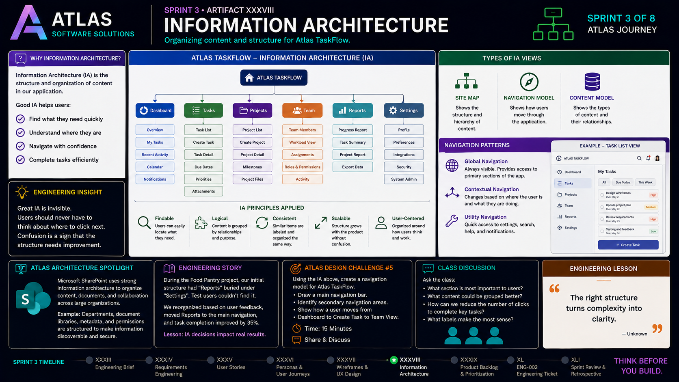
3-06
Notes:
============================================================
SPRINT 3
ARTIFACT XXXVIII
INFORMATION ARCHITECTURE
============================================================
SLIDE PURPOSE
Introduce students to Information Architecture (IA) and explain how
software engineers organize content, navigation, and application
structure before development begins.
Students should understand that Information Architecture is not about
how software looks.
It is about how information is organized so users can accomplish their
goals efficiently.
Today we organize Atlas TaskFlow into a complete application structure.
------------------------------------------------------------
OPENING
"Today we move beyond individual screens."
"So far we've designed interfaces."
"But now we have a new challenge."
"How do all of these screens connect?"
Pause.
"A great application isn't just made of good screens."
"It's made of a logical structure."
"Today we become software architects."
------------------------------------------------------------
CONNECT TO TASKFLOW
Point to the Atlas TaskFlow sitemap.
"Over the past several lessons we've created a collection of
wireframes."
"Now we need to organize them."
Ask students:
"What should users see first?"
"What belongs together?"
"What should always be accessible?"
Explain:
"This is Information Architecture."
------------------------------------------------------------
WHAT IS INFORMATION ARCHITECTURE?
Read the definition.
"Information Architecture is the organization and structure of content
within an application."
Explain:
"It answers questions like..."
Where should users begin?
How many clicks should it take?
Which information belongs together?
What navigation makes the most sense?
------------------------------------------------------------
THE TASKFLOW SITE MAP
Walk through the sitemap.
Dashboard
Tasks
Projects
Team
Reports
Settings
Explain:
"Think of this as the blueprint for our application's navigation."
Each section should feel natural to users.
Discuss why each category exists.
------------------------------------------------------------
BREAK DOWN THE SECTIONS
Dashboard
Overview
Recent Activity
Calendar
Notifications
Explain:
"The dashboard answers one question..."
"What should users know immediately?"
------------------------------------------------------------
Tasks
Task List
Create Task
Task Details
Due Dates
Attachments
Explain:
"Everything related to completing work lives together."
------------------------------------------------------------
Projects
Project List
Milestones
Project Files
Discuss organization by project.
------------------------------------------------------------
Team
Members
Assignments
Roles
Activity
Explain role-based collaboration.
------------------------------------------------------------
Reports
Progress
Summary
Export
Explain:
"Reports answer management questions."
------------------------------------------------------------
Settings
Profile
Preferences
Security
Integrations
Administration
Discuss why settings belong together rather than being scattered
throughout the application.
------------------------------------------------------------
INFORMATION ARCHITECTURE PRINCIPLES
Review each principle.
Findable
Users should locate information quickly.
Logical
Related content belongs together.
Consistent
Navigation should remain predictable.
Scalable
The structure should support future growth.
User-Centered
Organization should match how users think.
Ask:
"Which principle is most important?"
Guide discussion.
------------------------------------------------------------
NAVIGATION PATTERNS
Explain each.
Global Navigation
Always available.
Contextual Navigation
Changes depending on where the user is.
Utility Navigation
Settings
Search
Help
Notifications
Explain:
"Professional applications often combine all three."
------------------------------------------------------------
ENGINEERING INSIGHT
Read the statement.
"Great Information Architecture is invisible."
Pause.
Explain.
"If users stop to ask..."
'Where do I click next?'
"Our architecture has failed."
------------------------------------------------------------
ATLAS ARCHITECTURE SPOTLIGHT
Today's Spotlight:
Microsoft SharePoint
Explain:
"SharePoint manages enormous amounts of information."
Discuss:
Document libraries
Permissions
Departments
Search
Metadata
Explain:
"Without Information Architecture..."
"SharePoint would become impossible to navigate."
------------------------------------------------------------
ENGINEERING STORY
Share the Food Pantry project.
Explain how early navigation ideas changed after stakeholder feedback.
Perhaps reports belonged in the dashboard instead of hidden in
settings.
Discuss how reorganizing information made the application easier to
use.
------------------------------------------------------------
ATLAS DESIGN CHALLENGE #5
Challenge:
Using Atlas TaskFlow...
Design a navigation model.
Include:
Main Navigation
Secondary Navigation
Settings
Search
Notifications
Draw a sitemap.
Time:
15 minutes.
Share with another group.
Discuss differences.
------------------------------------------------------------
CLASS DISCUSSION
Ask:
"What information should users access every day?"
"What features should always be visible?"
"What belongs inside Settings?"
"How many clicks should it take to create a task?"
Encourage students to justify every design decision.
------------------------------------------------------------
ENGINEERING LESSON
Read the quote.
"The right structure turns complexity into clarity."
Pause.
Explain.
"Good architecture reduces confusion."
"It helps users focus on their work instead of learning the
application."
------------------------------------------------------------
TRANSITION
"We now know how Atlas TaskFlow is organized."
"But software teams still have more ideas than time."
"So how do we decide what to build first?"
"Our next lesson..."
"Product Backlogs and MVP Planning."
------------------------------------------------------------
ESTIMATED TIME
Review Previous Lesson.............5 minutes
Information Architecture..........12 minutes
TaskFlow Sitemap..................12 minutes
Navigation Models..................8 minutes
Architecture Spotlight.............7 minutes
Design Challenge..................10 minutes
Discussion.........................8 minutes
Transition.........................3 minutes
Total.............................65 minutes
------------------------------------------------------------
INSTRUCTOR NOTES
Keep bringing the conversation back to the user.
Whenever students suggest moving features, ask:
"Would Olivia expect to find it there?"
"Would Maya look there first?"
"Would Daniel need this every day?"
Help students understand that Information Architecture is based on
mental models—not developer convenience.
Use Atlas TaskFlow as a living product.
Every decision should connect back to:
Requirements
User Stories
Personas
User Journeys
Wireframes
Show students that architecture is the layer that connects all of those
artifacts into one coherent application.
Close with:
"We've designed the experience."
"We've organized the application."
"Next class..."
"We'll become Product Owners."
"We'll decide what gets built first."
============================================================

Slide 7
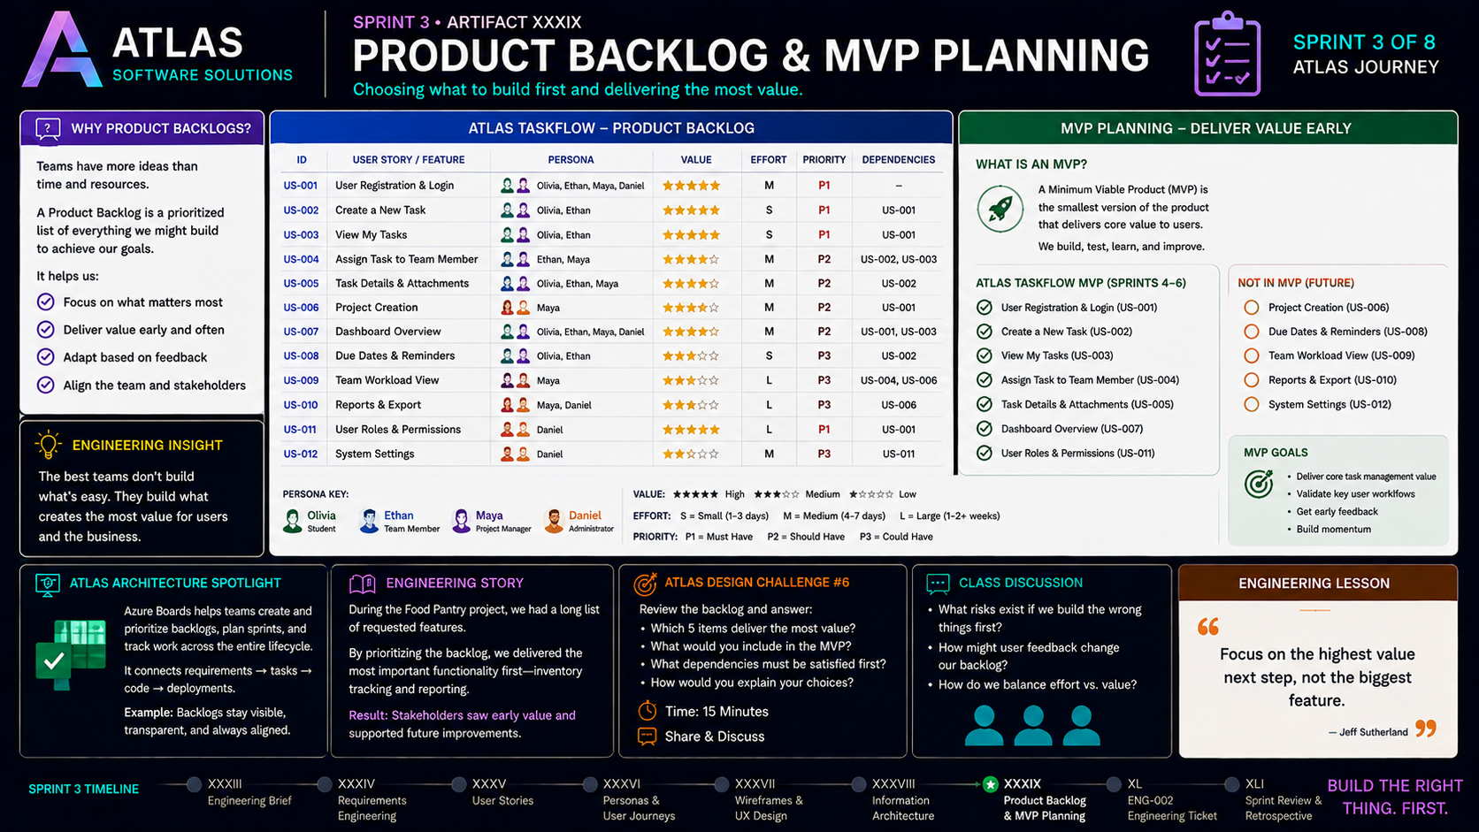
3-07
Notes:
============================================================
SPRINT 3
ARTIFACT XXXIX
PRODUCT BACKLOG & MVP PLANNING
============================================================
SLIDE PURPOSE
Introduce students to Product Backlogs and Minimum Viable Product (MVP)
planning.
Students should understand that software teams almost always have more
ideas than time and resources.
The Product Backlog helps teams organize, prioritize, and deliver the
highest-value work first.
Today we transform the Atlas TaskFlow design package into a development
plan.
------------------------------------------------------------
OPENING
"Today is an exciting milestone."
"Over the past several weeks we've designed Atlas TaskFlow."
"We gathered requirements."
"We wrote User Stories."
"We identified Personas."
"We mapped User Journeys."
"We designed Wireframes."
"We organized our Information Architecture."
Pause.
"But here's the reality."
"We can't build everything at once."
"So today we answer one final question."
"What should we build first?"
------------------------------------------------------------
CONNECT TO TASKFLOW
Point to the Atlas TaskFlow Product Backlog.
"This isn't just a list."
"This is our roadmap."
"Every User Story we've written now becomes a potential development
task."
Explain:
"A Product Backlog is a living document."
"It changes as we learn."
"It changes as users give feedback."
"It changes as priorities change."
------------------------------------------------------------
WHAT IS A PRODUCT BACKLOG?
Read the definition.
"A Product Backlog is a prioritized list of work that delivers value to
users."
Explain:
"Notice the word prioritized."
"Everything is important."
"But not everything is equally important."
------------------------------------------------------------
REVIEW THE BACKLOG
Walk through several User Stories.
US-001
User Registration & Login
Ask:
"Can users access the application without this?"
Students answer:
"No."
Explain why it's a Priority 1 feature.
------------------------------------------------------------
US-002
Create a New Task
Ask:
"Would Atlas TaskFlow still be useful without creating tasks?"
Discuss.
------------------------------------------------------------
US-003
View My Tasks
Explain why viewing tasks belongs in the first release.
------------------------------------------------------------
US-004
Assign Tasks
Discuss collaboration.
------------------------------------------------------------
Continue highlighting several additional stories.
Discuss:
Business Value
Estimated Effort
Dependencies
Priority
Explain how Product Owners balance these factors.
------------------------------------------------------------
ENGINEERING INSIGHT
Read the statement.
"The best teams don't build what's easiest."
"They build what creates the most value."
Pause.
Explain:
"Engineers don't measure success by the number of features."
"They measure success by solving the right problems."
------------------------------------------------------------
WHAT IS AN MVP?
Introduce the concept.
"MVP stands for Minimum Viable Product."
Explain:
"It is NOT the smallest application."
"It is the smallest application that still delivers meaningful value."
Emphasize:
"Minimum."
"Viable."
"Product."
All three words matter.
------------------------------------------------------------
THE TASKFLOW MVP
Walk through the selected features.
User Registration
Login
Create Task
View Tasks
Assign Tasks
Task Details
Dashboard
User Roles
Explain:
"If we stopped after building these features..."
"Would users still receive value?"
Discuss.
------------------------------------------------------------
NOT INCLUDED IN VERSION 1
Point to the future features.
Reports
Exports
Advanced Team Views
Reminders
Advanced Settings
Explain:
"These aren't bad ideas."
"They're simply not the first priorities."
Relate this to the backlog mindset:
"Not now" is different from "Never."
------------------------------------------------------------
MVP GOALS
Review each objective.
Deliver core functionality.
Validate assumptions.
Gather user feedback.
Build momentum.
Explain:
"The MVP isn't the end."
"It's the beginning."
------------------------------------------------------------
ATLAS ARCHITECTURE SPOTLIGHT
Today's Spotlight:
Azure Boards
Explain:
"Azure Boards is used by software teams to manage Product Backlogs,
Sprints, and work items."
Discuss:
Backlogs
Epics
Features
User Stories
Tasks
Sprint Boards
Explain how today's lesson connects directly to Agile development tools.
------------------------------------------------------------
ENGINEERING STORY
Share the Food Pantry project.
Explain that the original vision included dozens of ideas.
But time and resources required prioritization.
Discuss how focusing on inventory management first delivered value
quickly and allowed additional ideas to be considered later.
------------------------------------------------------------
ATLAS DESIGN CHALLENGE #6
Challenge:
Review the Atlas TaskFlow backlog.
Choose:
Five features for Version 1.
Defend your choices.
Explain:
Business Value
User Impact
Dependencies
Development Effort
Time:
15 minutes.
Groups present their MVP.
Discuss differences.
------------------------------------------------------------
CLASS DISCUSSION
Ask:
"What feature would you remove from Version 1?"
"What feature would absolutely stay?"
"Would your priorities change if our client changed?"
Guide students toward understanding that prioritization is based on
value—not personal preference.
------------------------------------------------------------
ENGINEERING LESSON
Read the quote.
"Focus on the highest-value next step—not the biggest feature."
Pause.
Explain.
"Successful software grows through iterations."
"It doesn't begin as a finished product."
------------------------------------------------------------
LOOKING AHEAD
Remind students:
"We've now completed a professional software design package."
Requirements.
User Stories.
Personas.
User Journeys.
Wireframes.
Information Architecture.
Product Backlog.
MVP.
Ask:
"What comes next?"
Smile.
"Development."
------------------------------------------------------------
TRANSITION
"Our next artifact is ENG-002."
"You'll package everything you've created into a professional design
specification."
"This is the same type of documentation a software team would deliver
before writing production code."
------------------------------------------------------------
ESTIMATED TIME
Sprint Review.....................5 minutes
Product Backlog.................12 minutes
Prioritization..................10 minutes
MVP Planning....................10 minutes
Architecture Spotlight...........7 minutes
Design Challenge................12 minutes
Discussion.......................7 minutes
Transition.......................2 minutes
Total...........................65 minutes
------------------------------------------------------------
INSTRUCTOR NOTES
Keep the conversation focused on value.
When students argue that every feature belongs in Version 1, challenge
them with realistic constraints.
Ask:
"What if you only had four weeks?"
"What if your budget was cut in half?"
"What if your client needed a working version next month?"
Help students understand that prioritization is one of the most
important responsibilities in software engineering.
Reinforce that saying "not yet" is often a better engineering decision
than trying to build everything at once.
Close with:
"Today we became Product Owners."
"We made difficult decisions."
"We focused on value."
"And because of those decisions..."
"Atlas TaskFlow is finally ready for development."
============================================================

Slide 8
3-08
Notes:
============================================================
SPRINT 3
ARTIFACT XL
ENG-002 DESIGN PACKAGE
============================================================
SLIDE PURPOSE
Introduce ENG-002 as the formal software design package for Atlas
TaskFlow.
Students should recognize that every artifact created throughout Sprint
3 contributes to a single professional engineering deliverable.
ENG-002 is the blueprint that the development team will use to begin
building Atlas TaskFlow in Sprint 4.
------------------------------------------------------------
OPENING
"Today is a major milestone."
"Over the last several weeks..."
"We've been acting as the Product Team at Atlas Software Solutions."
"We met with our client."
"We gathered requirements."
"We understood our users."
"We designed their experience."
"And now..."
"We're ready to deliver our design."
Pause.
"Welcome to ENG-002."
------------------------------------------------------------
WHAT IS ENG-002?
Read the definition.
"ENG-002 is the complete software design package for Atlas TaskFlow."
Explain:
"This is more than an assignment."
"It's a professional engineering document."
"If another development team received this package..."
"They should understand exactly what they're expected to build."
------------------------------------------------------------
THE DESIGN PACKAGE
Walk through each section.
------------------------------------------------------------
1. REQUIREMENTS
Review the purpose.
Functional Requirements
Non-Functional Requirements
Business Rules
Stakeholder Needs
Explain:
"This tells developers WHAT the software must do."
------------------------------------------------------------
2. USER STORIES
Discuss.
Every requirement becomes User Stories.
Each story describes:
Who
What
Why
Explain:
"This section keeps development focused on delivering user value."
------------------------------------------------------------
3. PERSONAS & USER JOURNEYS
Explain:
"This reminds developers who they're building for."
Discuss Olivia.
Ethan.
Maya.
Daniel.
Walk through how Personas influence design decisions.
------------------------------------------------------------
4. WIREFRAMES & UX
Review.
Dashboard
Task List
Create Task
Task Detail
Team View
Explain:
"These sketches communicate workflow before a single line of code is
written."
------------------------------------------------------------
5. INFORMATION ARCHITECTURE
Review the sitemap.
Navigation
Organization
Relationships
Discuss why structure matters.
------------------------------------------------------------
6. PRODUCT BACKLOG & MVP
Explain.
"This section defines what gets built first."
Discuss prioritization.
Business Value.
Dependencies.
MVP.
------------------------------------------------------------
7. ASSUMPTIONS & CONSTRAINTS
Explain:
"No project is perfect."
"Every engineering team makes assumptions."
Discuss examples.
Budget.
Timeline.
Technology.
Resources.
Known risks.
------------------------------------------------------------
8. GLOSSARY & DEFINITIONS
Explain why documentation matters.
Developers should interpret terminology consistently.
Examples:
Task
Project
Sprint
Backlog
Priority
Persona
MVP
------------------------------------------------------------
9. REVISION HISTORY
Explain:
"Professional documentation evolves."
Every major change should be recorded.
Date.
Version.
Author.
Description.
Discuss why version control matters.
------------------------------------------------------------
DESIGN PACKAGE SUMMARY
Review the three goals.
Aligned on Goals
Everyone understands the problem.
Focused on Users
Every decision supports user needs.
Ready for Development
The engineering team has everything required to begin building.
------------------------------------------------------------
CLIENT APPROVAL
Point to the approval section.
Explain:
"This represents the client accepting our proposed design."
Discuss what client approval means.
Not perfection.
Agreement.
Shared expectations.
A clear path forward.
------------------------------------------------------------
ARTIFACTS AT A GLANCE
Review the collection.
Requirements
User Stories
Personas
Wireframes
Information Architecture
Product Backlog
Explain:
"Notice how every artifact supports the next."
"This is one engineering package."
------------------------------------------------------------
PACKAGE CONTENTS CHECKLIST
Walk through the checklist.
Ask students:
"Could another engineer understand our project using only this
document?"
If the answer is yes...
The package is complete.
------------------------------------------------------------
QUALITY CHECK
Review each item.
Artifacts complete.
Requirements traceable.
Dependencies identified.
Risks documented.
MVP defined.
Explain:
"Professional software teams review documentation before coding begins."
------------------------------------------------------------
ATLAS TEAM RESPONSIBILITIES
Discuss how different roles contributed.
Product Owner
Prioritized value.
UX Designer
Designed the experience.
Architect
Organized the system.
Developers
Prepared for implementation.
QA
Ensured completeness.
Explain:
"Software engineering is a team sport."
------------------------------------------------------------
ENGINEERING STORY
Share the Food Pantry project.
Describe how planning, documentation, and stakeholder communication
reduced confusion during development.
Explain:
"The stronger the design package..."
"The smoother development becomes."
------------------------------------------------------------
ENGINEERING LESSON
Read the statement.
"Think. Design. Deliver Value."
Pause.
Explain:
"Great software isn't created by rushing into code."
"It's created through thoughtful engineering."
------------------------------------------------------------
LOOKING AHEAD
Point to Sprint 4.
"We've completed the design."
"Our client approved the plan."
"Our engineering package is finished."
Pause.
"What happens next?"
Smile.
"We build it."
------------------------------------------------------------
CLASS DISCUSSION
Ask:
"If you joined a software company tomorrow..."
"Would this package help you understand the project?"
"What additional information would you want?"
Discuss how documentation supports collaboration across teams.
------------------------------------------------------------
TRANSITION
"Our next artifact is Sprint 3 Review & Retrospective."
"We'll reflect on what we've accomplished..."
"And prepare for Sprint 4."
------------------------------------------------------------
ESTIMATED TIME
Sprint Recap......................5 minutes
ENG-002 Walkthrough..............15 minutes
Design Package Review............15 minutes
Quality Checklist................10 minutes
Engineering Story.................5 minutes
Discussion........................8 minutes
Sprint 4 Preview..................5 minutes
Total............................63 minutes
------------------------------------------------------------
INSTRUCTOR NOTES
This is a celebration as much as it is a lecture.
Students should leave class realizing that they have completed a
professional software design package.
Keep referring back to the sequence of artifacts created during Sprint
3 and emphasize that none of them were isolated assignments.
Each artifact became another section of the final deliverable.
End the lesson by holding up the completed ENG-002 package and saying:
"Three weeks ago..."
"This was just an idea."
"Today..."
"It is a complete engineering blueprint."
"And next sprint..."
"We're going to bring Atlas TaskFlow to life."
============================================================

Slide 9
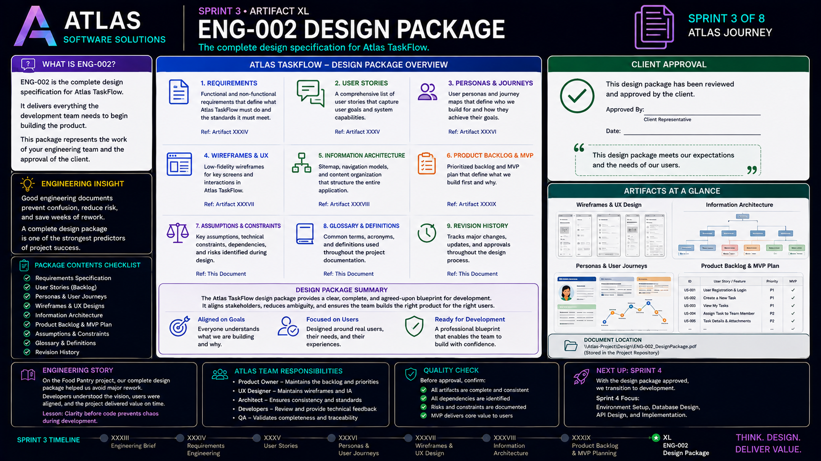
3-09
Notes:
============================================================
SPRINT 3
ARTIFACT XL
ENG-002 DESIGN PACKAGE
============================================================
SLIDE PURPOSE
Introduce ENG-002 as the formal software design package for Atlas
TaskFlow.
Students should recognize that every artifact created throughout Sprint
3 contributes to a single professional engineering deliverable.
ENG-002 is the blueprint that the development team will use to begin
building Atlas TaskFlow in Sprint 4.
------------------------------------------------------------
OPENING
"Today is a major milestone."
"Over the last several weeks..."
"We've been acting as the Product Team at Atlas Software Solutions."
"We met with our client."
"We gathered requirements."
"We understood our users."
"We designed their experience."
"And now..."
"We're ready to deliver our design."
Pause.
"Welcome to ENG-002."
------------------------------------------------------------
WHAT IS ENG-002?
Read the definition.
"ENG-002 is the complete software design package for Atlas TaskFlow."
Explain:
"This is more than an assignment."
"It's a professional engineering document."
"If another development team received this package..."
"They should understand exactly what they're expected to build."
------------------------------------------------------------
THE DESIGN PACKAGE
Walk through each section.
------------------------------------------------------------
1. REQUIREMENTS
Review the purpose.
Functional Requirements
Non-Functional Requirements
Business Rules
Stakeholder Needs
Explain:
"This tells developers WHAT the software must do."
------------------------------------------------------------
2. USER STORIES
Discuss.
Every requirement becomes User Stories.
Each story describes:
Who
What
Why
Explain:
"This section keeps development focused on delivering user value."
------------------------------------------------------------
3. PERSONAS & USER JOURNEYS
Explain:
"This reminds developers who they're building for."
Discuss Olivia.
Ethan.
Maya.
Daniel.
Walk through how Personas influence design decisions.
------------------------------------------------------------
4. WIREFRAMES & UX
Review.
Dashboard
Task List
Create Task
Task Detail
Team View
Explain:
"These sketches communicate workflow before a single line of code is
written."
------------------------------------------------------------
5. INFORMATION ARCHITECTURE
Review the sitemap.
Navigation
Organization
Relationships
Discuss why structure matters.
------------------------------------------------------------
6. PRODUCT BACKLOG & MVP
Explain.
"This section defines what gets built first."
Discuss prioritization.
Business Value.
Dependencies.
MVP.
------------------------------------------------------------
7. ASSUMPTIONS & CONSTRAINTS
Explain:
"No project is perfect."
"Every engineering team makes assumptions."
Discuss examples.
Budget.
Timeline.
Technology.
Resources.
Known risks.
------------------------------------------------------------
8. GLOSSARY & DEFINITIONS
Explain why documentation matters.
Developers should interpret terminology consistently.
Examples:
Task
Project
Sprint
Backlog
Priority
Persona
MVP
------------------------------------------------------------
9. REVISION HISTORY
Explain:
"Professional documentation evolves."
Every major change should be recorded.
Date.
Version.
Author.
Description.
Discuss why version control matters.
------------------------------------------------------------
DESIGN PACKAGE SUMMARY
Review the three goals.
Aligned on Goals
Everyone understands the problem.
Focused on Users
Every decision supports user needs.
Ready for Development
The engineering team has everything required to begin building.
------------------------------------------------------------
CLIENT APPROVAL
Point to the approval section.
Explain:
"This represents the client accepting our proposed design."
Discuss what client approval means.
Not perfection.
Agreement.
Shared expectations.
A clear path forward.
------------------------------------------------------------
ARTIFACTS AT A GLANCE
Review the collection.
Requirements
User Stories
Personas
Wireframes
Information Architecture
Product Backlog
Explain:
"Notice how every artifact supports the next."
"This is one engineering package."
------------------------------------------------------------
PACKAGE CONTENTS CHECKLIST
Walk through the checklist.
Ask students:
"Could another engineer understand our project using only this
document?"
If the answer is yes...
The package is complete.
------------------------------------------------------------
QUALITY CHECK
Review each item.
Artifacts complete.
Requirements traceable.
Dependencies identified.
Risks documented.
MVP defined.
Explain:
"Professional software teams review documentation before coding begins."
------------------------------------------------------------
ATLAS TEAM RESPONSIBILITIES
Discuss how different roles contributed.
Product Owner
Prioritized value.
UX Designer
Designed the experience.
Architect
Organized the system.
Developers
Prepared for implementation.
QA
Ensured completeness.
Explain:
"Software engineering is a team sport."
------------------------------------------------------------
ENGINEERING STORY
Share the Food Pantry project.
Describe how planning, documentation, and stakeholder communication
reduced confusion during development.
Explain:
"The stronger the design package..."
"The smoother development becomes."
------------------------------------------------------------
ENGINEERING LESSON
Read the statement.
"Think. Design. Deliver Value."
Pause.
Explain:
"Great software isn't created by rushing into code."
"It's created through thoughtful engineering."
------------------------------------------------------------
LOOKING AHEAD
Point to Sprint 4.
"We've completed the design."
"Our client approved the plan."
"Our engineering package is finished."
Pause.
"What happens next?"
Smile.
"We build it."
------------------------------------------------------------
CLASS DISCUSSION
Ask:
"If you joined a software company tomorrow..."
"Would this package help you understand the project?"
"What additional information would you want?"
Discuss how documentation supports collaboration across teams.
------------------------------------------------------------
TRANSITION
"Our next artifact is Sprint 3 Review & Retrospective."
"We'll reflect on what we've accomplished..."
"And prepare for Sprint 4."
------------------------------------------------------------
ESTIMATED TIME
Sprint Recap......................5 minutes
ENG-002 Walkthrough..............15 minutes
Design Package Review............15 minutes
Quality Checklist................10 minutes
Engineering Story.................5 minutes
Discussion........................8 minutes
Sprint 4 Preview..................5 minutes
Total............................63 minutes
------------------------------------------------------------
INSTRUCTOR NOTES
This is a celebration as much as it is a lecture.
Students should leave class realizing that they have completed a
professional software design package.
Keep referring back to the sequence of artifacts created during Sprint
3 and emphasize that none of them were isolated assignments.
Each artifact became another section of the final deliverable.
End the lesson by holding up the completed ENG-002 package and saying:
"Three weeks ago..."
"This was just an idea."
"Today..."
"It is a complete engineering blueprint."
"And next sprint..."
"We're going to bring Atlas TaskFlow to life."
============================================================

Slide 10
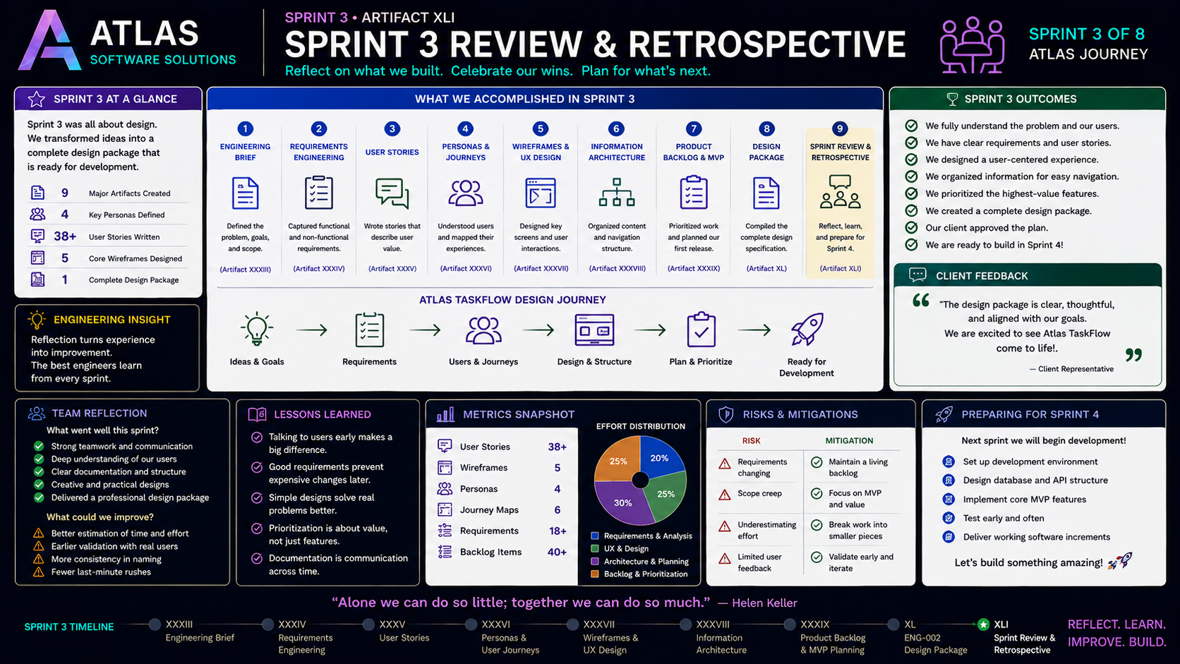
3-10
Notes:
============================================================
SPRINT 3
ARTIFACT XLI
SPRINT REVIEW & RETROSPECTIVE
============================================================
SLIDE PURPOSE
Celebrate the successful completion of Sprint 3 while encouraging
students to reflect on their engineering journey.
Students should recognize that they have completed a professional
software design process and are now prepared to begin development.
This is both a celebration and a transition into Sprint 4.
------------------------------------------------------------
OPENING
"Engineers..."
"Today isn't about learning something new."
"It's about recognizing what we've accomplished."
Pause.
"Three weeks ago..."
"Atlas TaskFlow existed only as an idea."
"Today..."
"It exists as a complete software design package."
Smile.
"That's something worth celebrating."
------------------------------------------------------------
SPRINT REVIEW
Walk through the sprint timeline.
Engineering Brief
Requirements Engineering
User Stories
Personas & User Journeys
Wireframes & UX Design
Information Architecture
Product Backlog & MVP Planning
ENG-002 Design Package
Sprint Review
Explain:
"Notice something."
"Each lesson depended on the one before it."
"This wasn't a collection of assignments."
"It was one engineering project."
------------------------------------------------------------
SPRINT AT A GLANCE
Review the accomplishments.
Nine major artifacts.
Four personas.
Thirty-plus User Stories.
Five wireframes.
One professional design package.
Explain:
"Professional software teams produce these exact kinds of artifacts."
"You've now done the same."
------------------------------------------------------------
WHAT WE ACCOMPLISHED
Walk through each artifact.
Engineering Brief
"We accepted the client project."
Requirements Engineering
"We learned the problem."
User Stories
"We translated needs into value."
Personas & Journeys
"We understood our users."
Wireframes
"We designed the interface."
Information Architecture
"We organized the experience."
Product Backlog
"We prioritized value."
ENG-002
"We delivered a professional design package."
Pause.
"This is an entire software design lifecycle."
------------------------------------------------------------
ATLAS TASKFLOW DESIGN JOURNEY
Follow the visual journey.
Ideas
↓
Requirements
↓
Users
↓
Design
↓
Architecture
↓
Planning
↓
Development Ready
Explain:
"This is exactly how modern software begins."
------------------------------------------------------------
SPRINT OUTCOMES
Review each outcome.
We understand the problem.
We understand our users.
We created clear requirements.
We designed meaningful experiences.
We organized information.
We prioritized value.
We earned client approval.
We are ready for Sprint 4.
Pause.
"These aren't classroom objectives."
"These are engineering milestones."
------------------------------------------------------------
CLIENT FEEDBACK
Read the client response.
Discuss what client approval represents.
Not perfection.
Shared understanding.
Confidence.
Alignment.
Explain:
"The client trusts us enough to begin development."
------------------------------------------------------------
ENGINEERING INSIGHT
Read the statement.
"Reflection turns experience into improvement."
Explain.
"The best engineers don't simply finish projects."
"They ask..."
"What worked?"
"What didn't?"
"What can we improve?"
------------------------------------------------------------
TEAM REFLECTION
Review successes.
Communication
Documentation
Problem Solving
Design
Planning
Then discuss improvements.
Time estimation
Validation
Naming consistency
Iteration
Explain:
"Every sprint teaches us something."
------------------------------------------------------------
LESSONS LEARNED
Walk through each lesson.
Talk to users early.
Good requirements save time.
Simple designs solve complex problems.
Prioritize value.
Documentation is communication.
Ask students:
"Which lesson surprised you the most?"
------------------------------------------------------------
METRICS SNAPSHOT
Review the numbers.
User Stories
Wireframes
Personas
Requirements
Backlog Items
Explain.
"Engineering isn't measured only by code."
"It's measured by progress."
------------------------------------------------------------
RISKS & MITIGATIONS
Discuss.
Changing Requirements
Scope Creep
Time Estimation
Limited Feedback
Explain how each risk was managed.
Connect back to Agile thinking.
------------------------------------------------------------
PREPARING FOR SPRINT 4
Read the roadmap.
Development Environment
Database Design
API Planning
Implementation
Testing
Working Software
Pause.
Then smile.
"This..."
"This is where coding finally begins."
------------------------------------------------------------
CLASS DISCUSSION
Ask:
"What artifact helped you understand software engineering the most?"
"If you could redesign one part of Atlas TaskFlow..."
"What would you change?"
"What was your biggest engineering lesson?"
Give students time to reflect.
------------------------------------------------------------
ENGINEERING LESSON
Read the quote.
"Alone we can do so little..."
"Together we can do so much."
Explain.
"Software engineering has never been an individual sport."
"The best products come from teams."
------------------------------------------------------------
THE MOMENT
This is where I would slow down.
Walk to the center of the room.
Pause.
Then say...
"Three weeks ago..."
"You were given a blank problem."
"You asked questions."
"You gathered requirements."
"You understood users."
"You designed experiences."
"You organized an application."
"You prioritized value."
"And today..."
"You delivered a professional software design package."
Pause.
Look around the room.
Then say...
"That's what software engineers do."
------------------------------------------------------------
TRANSITION TO SPRINT 4
"Our client approved the design."
"Our backlog is prioritized."
"Our engineering package is complete."
"Our architecture is ready."
Smile.
"Next sprint..."
"We stop imagining Atlas TaskFlow."
"We build it."
------------------------------------------------------------
ESTIMATED TIME
Sprint Review......................10 minutes
Artifact Walkthrough...............15 minutes
Reflection........................10 minutes
Discussion........................10 minutes
Sprint 4 Preview..................10 minutes
Closing............................5 minutes
Total.............................60 minutes
------------------------------------------------------------
INSTRUCTOR NOTES
Celebrate.
This lecture should feel different from every other lecture.
Do not rush.
Students should leave feeling proud of what they accomplished.
Keep reminding them that every artifact they created contributed to one
professional engineering package.
Before dismissing class...
Hold up the completed ENG-002 Design Package.
Then say...
"This document started with one idea."
"Now it contains everything needed to build Atlas TaskFlow."
Pause.
"Next sprint..."
"We become software developers."
Smile.
"And I can't wait."
============================================================

