Slide 1
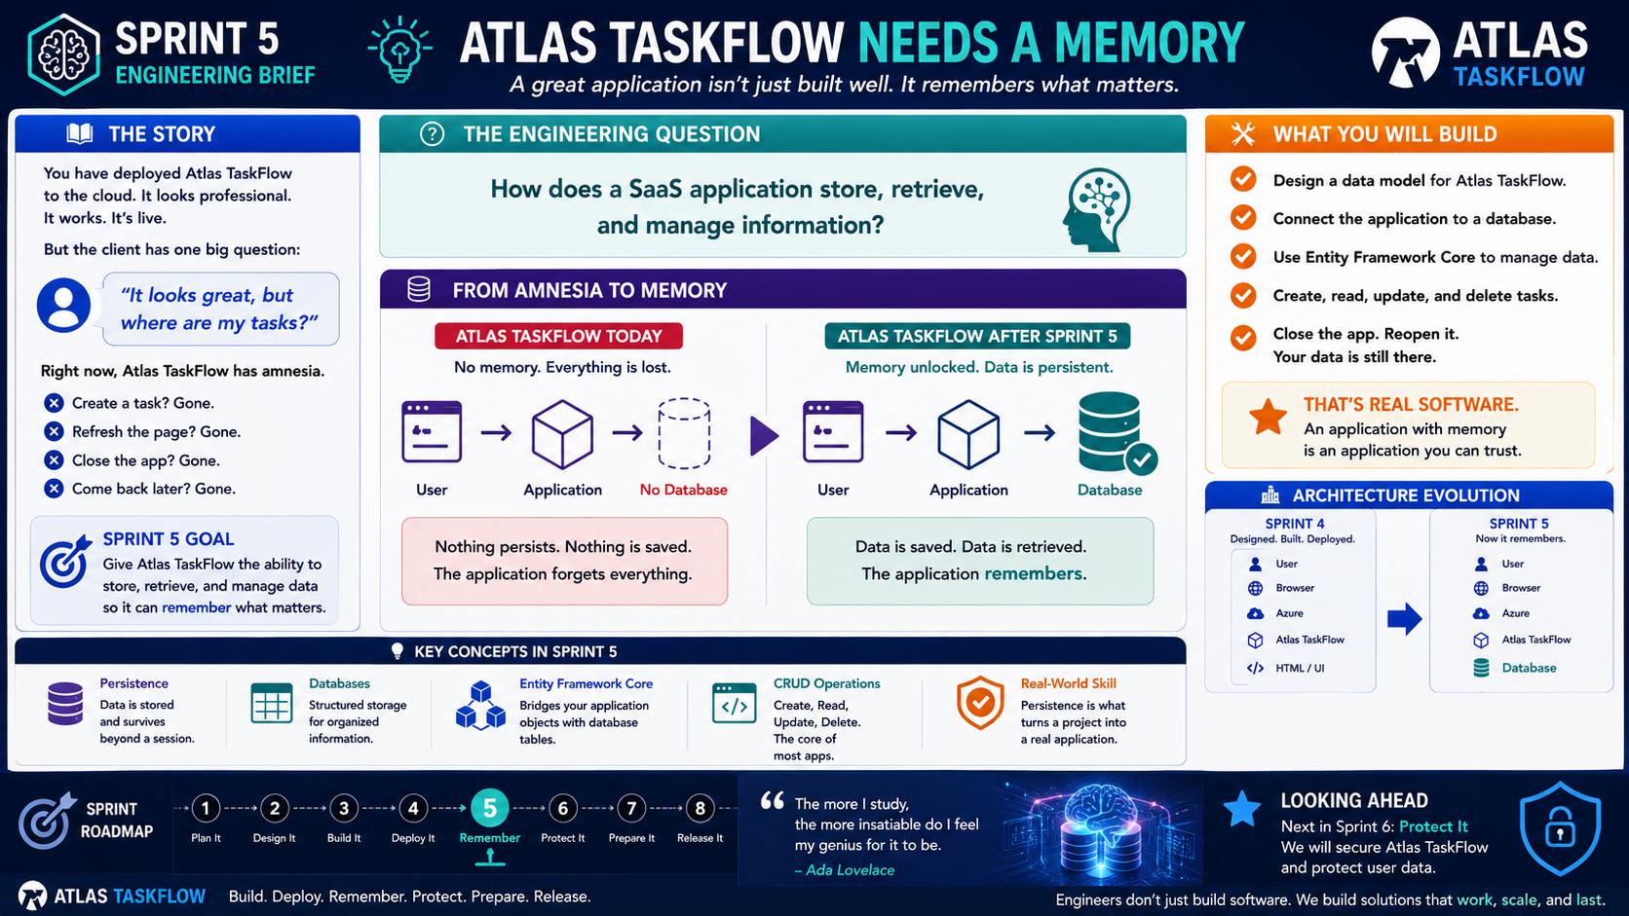
5-01
Notes:
============================================================
SPRINT 5
ATLAS TASKFLOW NEEDS A MEMORY
============================================================
SLIDE PURPOSE
Introduce the central engineering problem for Sprint 5:
Atlas TaskFlow is live, but it cannot permanently store information.
Students will understand why persistence is essential to SaaS applications
and preview how a database will extend the architecture they created in
Sprint 4.
The objective is conceptual understanding.
Do NOT begin teaching database syntax yet.
------------------------------------------------------------
OPENING
"Engineers..."
"Last sprint, we accomplished something pretty incredible."
"We took Atlas TaskFlow..."
"...and put it in the cloud."
Pause.
"Users can access it."
"It works."
"It looks professional."
Pause.
"But..."
"There is a problem."
------------------------------------------------------------
THE CLIENT'S QUESTION
Point to the client statement:
"It looks great, but where are my tasks?"
Pause.
Ask the class:
"What do you think the client means?"
Allow responses.
Guide them toward:
"The application doesn't save anything."
Then say:
"Exactly."
"Atlas TaskFlow has a memory problem."
------------------------------------------------------------
THE PROBLEM
Point to the list.
Create a task.
It's gone.
Refresh the page.
It's gone.
Close the application.
It's gone.
Come back tomorrow.
It's gone.
Explain:
"Right now, Atlas TaskFlow only remembers information while we're
working with it."
"Once that information disappears..."
"The application can't get it back."
------------------------------------------------------------
THE ENGINEERING QUESTION
Point to the center question:
"How does a SaaS application store, retrieve, and manage information?"
Explain:
"This is the question we're going to answer during Sprint 5."
Not:
"How do I write SQL?"
Not:
"How do I configure Entity Framework?"
The bigger question is:
"How does our software remember?"
------------------------------------------------------------
SPRINT 5 GOAL
Read the goal:
"Give Atlas TaskFlow the ability to store, retrieve, and manage data
so it can remember what matters."
Explain:
"That's our mission."
"By the end of this sprint..."
"Atlas TaskFlow should remember."
------------------------------------------------------------
FROM AMNESIA TO MEMORY
Point to the left side.
ATLAS TASKFLOW TODAY
User
↓
Application
↓
No Database
Explain:
"The user interacts with the application..."
"But there is nowhere permanent for the information to go."
"So when the session ends..."
"The information disappears."
------------------------------------------------------------
NOW POINT TO THE RIGHT SIDE
ATLAS TASKFLOW AFTER SPRINT 5
User
↓
Application
↓
Database
Explain:
"This is the change we're making."
"The application now has somewhere to store information."
"When the user comes back..."
"The information is still there."
------------------------------------------------------------
THE KEY WORD
Point to:
PERSISTENCE
Say:
"This is an important word."
"Persistence means information survives beyond the current session."
Give an example:
"If I create a task today..."
"And come back tomorrow..."
"The task is still there."
"That's persistence."
------------------------------------------------------------
ASK THE CLASS
"If I close my browser..."
"Should my tasks disappear?"
Students:
"No."
Ask:
"Why?"
Guide them toward:
"Because the data is stored somewhere outside the browser."
------------------------------------------------------------
KEY CONCEPT: DATABASE
Point to the database icon.
Explain:
"A database gives our application a structured place to store
information."
Don't go into SQL yet.
Don't discuss database administration.
Simply say:
"Think of the database as the application's long-term memory."
------------------------------------------------------------
KEY CONCEPT: ENTITY FRAMEWORK CORE
Point to Entity Framework Core.
Say:
"We're going to use a technology called Entity Framework Core."
Pause.
"But don't worry about memorizing that name today."
Explain its role simply:
"Entity Framework Core gives our C# application a way to work with
database information."
"Our C# objects can represent information stored in database tables."
That's enough for today.
------------------------------------------------------------
KEY CONCEPT: CRUD
Point to CRUD.
Explain:
"Most applications perform four basic operations with data."
Create.
Read.
Update.
Delete.
Give the Atlas example:
Create a task.
Read a task.
Update a task.
Delete a task.
Then say:
"You're going to hear these four words a lot."
------------------------------------------------------------
THE ARCHITECTURE EVOLUTION
Point to the Sprint 4 architecture.
Review:
User
Browser
Azure
Atlas TaskFlow
HTML / UI
Then point to Sprint 5.
Now:
User
Browser
Azure
Atlas TaskFlow
Database
Explain:
"We aren't replacing anything we built."
"We're extending it."
"This is an important engineering principle."
"Good software grows."
------------------------------------------------------------
CONNECT TO SPRINT 4
Ask:
"What did we accomplish in Sprint 4?"
Students should respond:
"Built and deployed the application."
Then ask:
"What is missing?"
Answer:
"Data."
Explain:
"Sprint 4 gave Atlas a home."
"Sprint 5 gives Atlas a memory."
------------------------------------------------------------
WHAT STUDENTS WILL BUILD
Point to the checklist.
During Sprint 5, students will:
Design the data model.
Connect the application to a database.
Use Entity Framework Core.
Create, read, update, and delete tasks.
Test persistence.
Explain:
"We're going to take this one step at a time."
------------------------------------------------------------
IMPORTANT BOUNDARY
Tell students:
"This is not a database administration course."
"We're not becoming database administrators."
"We're learning how software uses data."
Pause.
"And we're going to learn it by building something."
------------------------------------------------------------
REAL-WORLD CONNECTION
Ask:
"What would happen if Amazon forgot your shopping cart?"
"What if Canvas forgot your grades?"
"What if Gmail forgot your messages?"
"What if your banking application forgot your transactions?"
Allow responses.
Then say:
"Those applications need persistent data."
"That's what makes them useful."
------------------------------------------------------------
BUILD CHALLENGE
Give students a short design activity.
Ask:
"Without writing any code..."
"Write down five things Atlas TaskFlow needs to remember."
Possible answers:
Tasks.
Users.
Projects.
Due dates.
Task status.
Categories.
Do not correct every answer.
The purpose is to get students thinking about data.
------------------------------------------------------------
ENGINEERING INSIGHT
Point to the statement:
"Persistence is what turns a project into a real application."
Explain:
"A webpage can display information."
"An application needs to work with information."
"And a SaaS application needs to remember information."
------------------------------------------------------------
SPRINT ROADMAP
Point to Sprint 5.
Review the progression:
Plan It
Design It
Build It
Deploy It
Remember It
Protect It
Prepare It
Release It
Explain:
"We are here."
"Remember It."
------------------------------------------------------------
LOOKING AHEAD
Point to Sprint 6.
Say:
"Once Atlas can remember information..."
"We have another responsibility."
"Protecting it."
Next sprint:
Security.
User data.
Application protection.
Do not teach security yet.
Just create anticipation.
------------------------------------------------------------
THE MOMENT
Ask students to think about the Atlas application they deployed.
Then say:
"Right now..."
"Atlas TaskFlow can be accessed from anywhere."
"But it doesn't remember what happened yesterday."
Pause.
"By the end of this sprint..."
"It will."
------------------------------------------------------------
CLOSING
Say:
"Last sprint..."
"We taught Atlas how to reach users."
"This sprint..."
"We're teaching Atlas how to remember them."
Pause.
Then:
"Let's give Atlas a memory."
============================================================
ESTIMATED TIME
Opening & Client Problem.............8 minutes
Engineering Question.................7 minutes
Persistence Concept..................10 minutes
Architecture Evolution...............10 minutes
Key Concepts..........................10 minutes
Build Challenge.......................10 minutes
Discussion & Closing..................10 minutes
TOTAL.................................65 minutes
============================================================
INSTRUCTOR NOTES
Keep this lesson conceptual.
Do not open Visual Studio immediately.
Do not begin writing database code.
Do not begin writing SQL.
Students should first understand WHY persistence exists.
Use examples students recognize:
Canvas
Gmail
Amazon
Banking applications
Social media
Then connect everything back to Atlas TaskFlow.
The goal is for students to understand:
Application + Data = Useful Software
Application + Persistent Data = SaaS capability
Close with:
"Engineers..."
"Atlas TaskFlow is alive."
"Now..."
"We're going to teach it how to remember."
============================================================
Instructor emphasis
There are three words I'd really emphasize during this lesson:
Persistence
Data survives beyond the current session.
Database
The application's structured long-term storage.
CRUD
Create, Read, Update, Delete.
Those three concepts give students the vocabulary they need before we start building.
And importantly, we don't rush into Entity Framework Core. We introduce it as the tool that will help us solve the problem students already understand.
That's the Atlas approach working exactly as intended:
Problem → Engineering Question → Concept → Technology → Build.

Slide 2
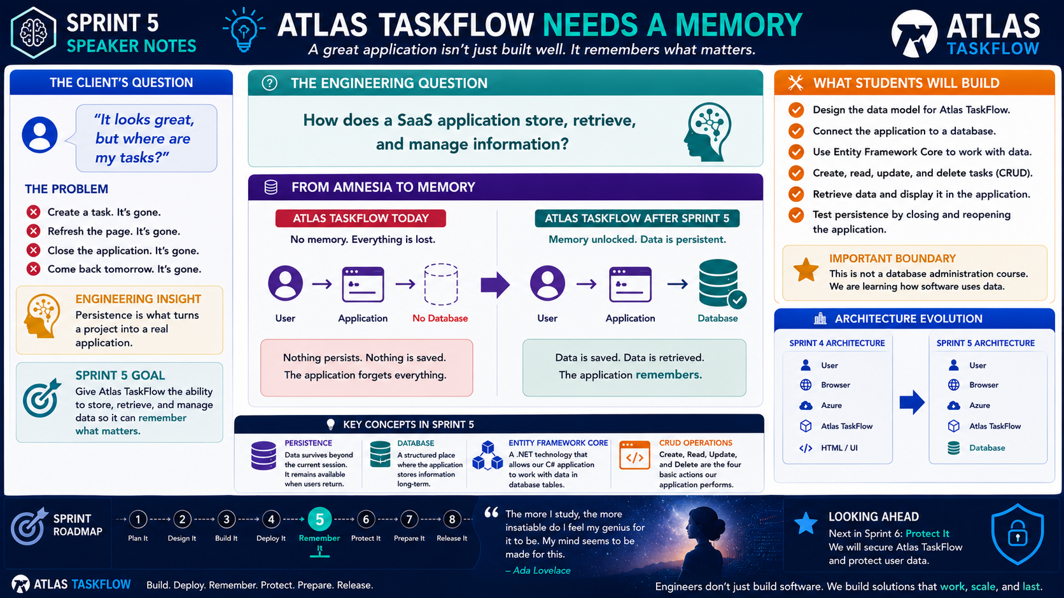
5-02
Notes:
============================================================
SPRINT 5
WHERE DOES SaaS DATA LIVE?
============================================================
SLIDE PURPOSE
Help students understand where information is stored in a SaaS
application and how data moves between the user, application, and
database.
Students should understand the difference between:
• The user interface
• The application
• Persistent storage
The objective is conceptual understanding.
Do NOT begin teaching SQL syntax or database administration.
------------------------------------------------------------
OPENING
"Last lesson, we discovered that Atlas TaskFlow has a problem."
"It can't remember."
Pause.
"Today we're going to answer the obvious next question."
"Where does the memory live?"
------------------------------------------------------------
ASK THE CLASS
"If I create a task in Atlas TaskFlow..."
"Where is that task stored?"
Let students answer.
Possible answers:
"The website."
"The browser."
"Azure."
"The computer."
"The database."
Don't immediately correct them.
Say:
"Good."
"Those are all interesting answers."
"Let's figure out which one is actually responsible for remembering
our data."
------------------------------------------------------------
THE BIG IDEA
Point to the architecture diagram.
USER
↓
BROWSER
↓
APPLICATION
↓
DATABASE
Explain:
"These are four different pieces."
"They work together..."
"But they have different jobs."
------------------------------------------------------------
THE USER
Point to the User.
Explain:
"The user creates the information."
"For example..."
"I create a task."
"The user is responsible for providing the information."
"But the user doesn't permanently store it."
------------------------------------------------------------
THE BROWSER
Point to the Browser.
Explain:
"The browser gives the user a way to interact with the application."
"It displays pages."
"It sends requests."
"It receives responses."
Then emphasize:
"But the browser is NOT our application's long-term memory."
Ask:
"If I close Chrome..."
"Should my task disappear?"
Students:
"No."
Exactly.
------------------------------------------------------------
THE APPLICATION
Point to Atlas TaskFlow.
Explain:
"The application receives the user's request."
"It decides what needs to happen."
"It communicates with the database."
"This is where our C# and MVC code lives."
Then say:
"The application is the middleman."
------------------------------------------------------------
THE DATABASE
Point to the database.
Pause.
"This is the important part."
"The database is where persistent information lives."
Explain:
"It stores information."
"It organizes information."
"It allows the application to retrieve information later."
Use the phrase:
"Long-term memory."
------------------------------------------------------------
THE COMPLETE CONVERSATION
Walk through the flow.
User:
"Create a new task."
↓
Browser:
"Sends the request."
↓
Atlas TaskFlow:
"Processes the request."
↓
Database:
"Stores the task."
Then reverse it.
User:
"Show me my tasks."
↓
Browser:
"Sends the request."
↓
Atlas TaskFlow:
"Asks the database."
↓
Database:
"Returns the tasks."
↓
Atlas TaskFlow:
"Builds the response."
↓
Browser:
"Displays the tasks."
------------------------------------------------------------
THE IMPORTANT DISTINCTION
Say this slowly:
"The browser displays the information."
"The application processes the information."
"The database remembers the information."
Pause.
Repeat it.
"The browser displays."
"The application processes."
"The database remembers."
This is the key takeaway of the lesson.
------------------------------------------------------------
WHAT HAPPENS WITHOUT A DATABASE?
Point to the Sprint 4 architecture.
User
↓
Browser
↓
Azure
↓
Atlas TaskFlow
↓
HTML
Explain:
"This worked."
"We had a working application."
"But it couldn't permanently store our information."
"This is why Sprint 4 and Sprint 5 are different."
------------------------------------------------------------
WHAT CHANGES IN SPRINT 5?
Point to the updated architecture.
User
↓
Browser
↓
Azure
↓
Atlas TaskFlow
↓
Database
Explain:
"We aren't replacing our application."
"We're adding another capability."
"Atlas now has somewhere to store information."
------------------------------------------------------------
CLOUD CONNECTION
Point to Azure.
Ask:
"Where is our application running?"
Students:
"Azure."
Then ask:
"Where does our database run?"
Explain:
"Eventually, our database will also need to live somewhere accessible
to the application."
"This is part of building a cloud application."
Keep this conceptual.
Don't dive into Azure SQL configuration yet.
------------------------------------------------------------
DATABASE ANALOGY
Use a familiar analogy.
Say:
"Think about a library."
The browser is like the person looking for information.
The application is like the librarian.
The database is like the collection of books.
The librarian doesn't become the book.
The librarian retrieves the book.
Likewise:
"The application doesn't become the database."
"It communicates with the database."
------------------------------------------------------------
DATA VS APPLICATION
Ask:
"What happens if I redeploy my application?"
Guide students toward:
"The application code changes."
Then ask:
"Should all of our users' tasks disappear?"
Students:
"No."
Exactly.
Explain:
"That's one reason we separate application code from stored data."
"The application can change..."
"While the information remains."
This is an important professional concept.
------------------------------------------------------------
WHAT DOES A DATABASE STORE?
Point to examples.
Users.
Tasks.
Projects.
Categories.
Statuses.
Dates.
Explain:
"A database doesn't just store random pieces of information."
"It stores structured information."
This leads naturally into our next lessons.
------------------------------------------------------------
THE TASK EXAMPLE
Ask:
"What information might we need to remember about a task?"
Let students brainstorm.
Possible answers:
Task ID.
Title.
Description.
Due date.
Status.
Priority.
Assigned user.
Explain:
"Now we're beginning to think like database designers."
"But we're not designing the database yet."
"We're identifying what the application needs to remember."
------------------------------------------------------------
ENGINEERING INSIGHT
Read the statement:
"Where data lives determines how long it lives."
Explain:
"If information only exists in memory..."
"It can disappear."
"If information is persisted..."
"It can survive."
That is the difference between temporary information and persistent
information.
------------------------------------------------------------
BUILD CHALLENGE
Give students a quick activity.
Draw this on paper:
USER
↓
BROWSER
↓
ATLAS TASKFLOW
↓
DATABASE
Then ask them to label the responsibility of each component.
User:
Provides information.
Browser:
Displays and sends requests.
Application:
Processes requests.
Database:
Stores persistent information.
------------------------------------------------------------
CLASS DISCUSSION
Ask:
"Why shouldn't the browser be responsible for permanently storing all
our application data?"
Then:
"What would happen if the database disappeared?"
Guide students toward:
The application could still exist.
But it would lose access to its persistent information.
------------------------------------------------------------
REAL-WORLD CONNECTION
Ask students to think about:
Canvas.
Amazon.
Gmail.
Banking applications.
GitHub.
Then ask:
"If those applications didn't have persistent storage..."
"What would happen?"
Let them answer.
Then say:
"Exactly."
"That's why databases are everywhere."
------------------------------------------------------------
SPRINT CONNECTION
Point back to Sprint 4.
Sprint 4:
Build and Deploy.
Sprint 5:
Store and Retrieve.
Explain:
"We are extending the architecture."
"Every sprint adds another engineering capability."
------------------------------------------------------------
LOOKING AHEAD
Ask:
"Now that we know where the data lives..."
"What do we need to figure out next?"
Students should arrive at:
"What data do we need?"
Exactly.
"Next..."
"We design the data model for Atlas TaskFlow."
------------------------------------------------------------
CLOSING
Say:
"Remember these three sentences."
"The browser displays."
"The application processes."
"The database remembers."
Pause.
"Once you understand that..."
"You understand the foundation of data-driven SaaS applications."
------------------------------------------------------------
ESTIMATED TIME
Opening Discussion..................8 minutes
Architecture Explanation............15 minutes
Browser/Application/Database.........15 minutes
Real-World Examples..................7 minutes
Build Challenge......................10 minutes
Discussion & Closing.................10 minutes
TOTAL................................65 minutes
------------------------------------------------------------
INSTRUCTOR NOTES
This lesson should remain highly visual.
Keep returning to the architecture diagram.
Avoid:
• SQL syntax
• Database administration
• Connection strings
• Advanced Azure database configuration
• Entity Framework implementation
• Normalization
Those concepts come later.
The goal is to establish the mental model.
Students should leave knowing:
USER
Creates information.
BROWSER
Displays and requests information.
APPLICATION
Processes information.
DATABASE
Persists information.
Close with:
"Engineers..."
"Now we know where Atlas remembers."
"Next..."
"We need to decide exactly what it should remember."
============================================================ Three emphasis points for you
I'd really hammer these three because they're going to become the foundation for everything that follows:
1. The browser is not the database.
Students coming from basic programming often assume that because they can see data on the screen, the browser must somehow be holding it.
That's an important misconception to eliminate early.
2. The application is the middleman.
This gives them a simple mental model for MVC + EF Core:
User → Application → Data
They don't need to understand every framework component yet.
3. Persistence is the difference between temporary and lasting information.
This is the concept I want them to remember most.
If the application can remember it tomorrow, we've persisted it.
And that sets us up perfectly for the next artifact:
Designing the Atlas TaskFlow Data Model

Slide 3
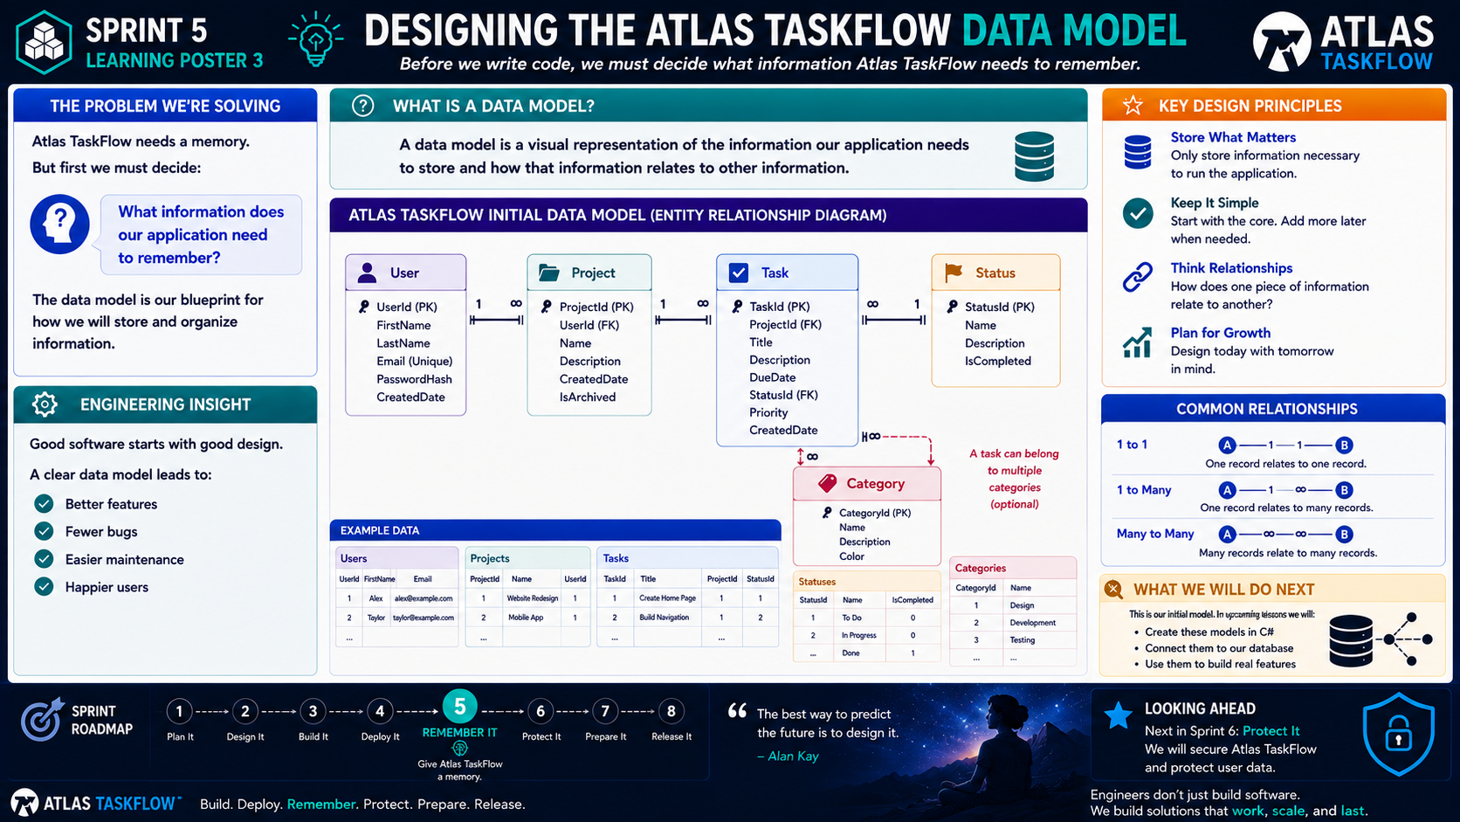
5-03
Notes:
============================================================
SPRINT 5
DESIGNING THE ATLAS TASKFLOW DATA MODEL
============================================================
SLIDE PURPOSE
Help students determine what information Atlas TaskFlow needs to
remember and how that information relates to other information.
Students will translate the requirements and user experience they
already created into a simple data model.
The objective is NOT to teach advanced database design.
The objective is to answer one engineering question:
"What information does Atlas TaskFlow need to remember?"
------------------------------------------------------------
OPENING
"Engineers..."
"Last lesson, we figured out where Atlas TaskFlow's memory lives."
"Today, we have a different problem."
Pause.
"Before we build the memory..."
"We have to decide what goes into it."
------------------------------------------------------------
THE ENGINEERING QUESTION
Point to the question:
"What information does our application need to remember?"
Ask students:
"If Atlas TaskFlow were a real company..."
"What information would the application need tomorrow that it knows
today?"
Let students think.
Then explain:
"That's what we're designing today."
------------------------------------------------------------
CONNECT TO SPRINT 3
Remind students:
"Remember Sprint 3?"
"You created requirements."
"You created personas."
"You mapped user journeys."
"You designed TaskFlow."
Now say:
"All of that work gives us clues about our data."
This is important:
"We aren't inventing data."
"We're discovering data from the requirements."
------------------------------------------------------------
WHAT IS A DATA MODEL?
Point to the definition.
"A data model is a visual representation of the information our
application needs to store and how that information relates to other
information."
Explain:
"Think of it as a blueprint."
"Before we build the database..."
"We decide what the database needs to contain."
------------------------------------------------------------
START WITH THE USER
Point to User.
Ask:
"Who uses Atlas TaskFlow?"
Students:
"Users."
Then ask:
"What do we need to know about a user?"
Possible answers:
Name.
Email.
Account information.
Explain:
"We only store information the application actually needs."
This introduces the principle:
Store What Matters.
------------------------------------------------------------
MOVE TO PROJECTS
Point to Project.
Ask:
"What does a user actually manage in TaskFlow?"
Students:
"Projects."
Explain:
"A user can have multiple projects."
Draw the relationship:
User
↓
Many Projects
Explain:
"One user can own multiple projects."
This is a:
**One-to-Many relationship.**
------------------------------------------------------------
MOVE TO TASKS
Ask:
"What is the main thing our users are trying to manage?"
Students:
"Tasks."
Exactly.
Explain:
"Projects contain tasks."
Draw:
Project
↓
Many Tasks
Then ask:
"What information does a task need?"
Students might identify:
Title.
Description.
Due date.
Priority.
Status.
Explain:
"This is where our requirements become data."
------------------------------------------------------------
STATUS
Point to Status.
Ask:
"How does a user know where a task stands?"
Possible answers:
To Do.
In Progress.
Complete.
Explain:
"Status is information too."
Instead of storing arbitrary text everywhere, we can represent
statuses in a structured way.
For example:
To Do
In Progress
Done
This gives us consistency.
------------------------------------------------------------
CATEGORY
Point to Category.
Ask:
"Would users benefit from grouping or labeling tasks?"
Possible answers:
Development.
Design.
Testing.
Documentation.
Explain:
"That's another piece of information the application may need."
Then explain:
"Not every application needs every possible table."
"Remember our principle."
Point to:
KEEP IT SIMPLE.
------------------------------------------------------------
THE DATA MODEL
Now walk through the complete model.
User
↓
Project
↓
Task
↓
Status
And optionally:
Task
↕
Category
Explain:
"This is our initial model."
"It doesn't have to be perfect."
"It has to be useful."
------------------------------------------------------------
IMPORTANT EMPHASIS
Say:
"We are designing Version 1."
Not Version 10.
Not every possible future feature.
Just what Atlas needs right now.
This is an important engineering lesson:
**Design for today's requirements while leaving room for tomorrow.**
------------------------------------------------------------
PRIMARY KEYS
Point to the IDs.
UserId.
ProjectId.
TaskId.
StatusId.
CategoryId.
Explain:
"Each record needs a way to be uniquely identified."
"For example..."
"If we have two users named Alex..."
"Their names aren't enough to tell them apart."
"The UserId gives each record a unique identity."
Keep the explanation simple.
------------------------------------------------------------
FOREIGN KEYS
Point to:
Project.UserId
Task.ProjectId
Task.StatusId
Explain:
"These fields connect records together."
"For example..."
"ProjectId tells us which project a task belongs to."
"UserId tells us which user owns a project."
This is the key idea:
**Primary keys identify.**
**Foreign keys connect.**
Repeat it.
------------------------------------------------------------
RELATIONSHIPS
Point to the relationship examples.
1 to 1
1 to Many
Many to Many
Explain:
"We don't need to master every database relationship today."
"We need to recognize how information relates."
Use Atlas examples.
One User → Many Projects.
One Project → Many Tasks.
One Status → Many Tasks.
Then discuss Category as an optional future relationship.
------------------------------------------------------------
WHY RELATIONSHIPS MATTER
Ask:
"What happens if we don't connect our data?"
Guide students.
"We wouldn't know which task belongs to which project."
"We wouldn't know which project belongs to which user."
Explain:
"Relationships give our data meaning."
The database isn't just a collection of unrelated tables.
------------------------------------------------------------
EXAMPLE DATA
Point to the example tables.
Show:
Users.
Projects.
Tasks.
Statuses.
Categories.
Explain:
"This is what our data might actually look like."
We can have:
Alex → Website Redesign → Create Homepage
Taylor → Mobile App → Build Navigation
The exact data isn't important.
The relationships are.
------------------------------------------------------------
ENGINEERING INSIGHT
Point to the Engineering Insight panel.
"Good software starts with good design."
Explain:
"If we don't understand our data..."
"We're going to have problems later."
A clear data model helps with:
Better features.
Fewer bugs.
Easier maintenance.
A better user experience.
------------------------------------------------------------
THE "STORE WHAT MATTERS" PRINCIPLE
Point to the design principle.
Say:
"Here's something I want you to remember."
"We don't store information just because we can."
"We store information because the application needs it."
Ask:
"Do we need a user's favorite color to manage tasks?"
Probably not.
"Then why store it?"
Exactly.
Don't collect unnecessary information.
------------------------------------------------------------
KEEP IT SIMPLE
Point to the second principle.
Explain:
"Our first data model should be small."
"We can always add functionality later."
This is especially important for Atlas.
"We're building Version 1."
Not the final version of the company.
------------------------------------------------------------
PLAN FOR GROWTH
Point to the final principle.
Explain:
"Keeping it simple doesn't mean ignoring the future."
"It means we build today's solution in a way that doesn't prevent
tomorrow's improvements."
For example:
Today:
Task → Project
Later:
Task → Project → Team → Organization
But we don't need to build all of that today.
------------------------------------------------------------
BUILD CHALLENGE
Give students the following task:
"Take one feature from your Sprint 3 design."
Ask:
1. What information does this feature need?
2. What entity should store it?
3. What other entity does it relate to?
4. What uniquely identifies the record?
Give them an example.
Feature:
Create a Task.
Data:
TaskId.
Title.
Description.
DueDate.
StatusId.
ProjectId.
Then ask:
"What does ProjectId tell us?"
Students:
"Which project the task belongs to."
------------------------------------------------------------
ENGINEERING CHECK
Before moving on, ask students:
"Can you explain why we have a Task table?"
"Can you explain why Task has a ProjectId?"
"Can you explain why User has a UserId?"
"Can you explain what Status represents?"
If they can answer those questions...
They're ready to move forward.
------------------------------------------------------------
IMPORTANT BOUNDARY
Tell students:
"This is our initial data model."
"We are not trying to design the entire database for Microsoft."
"We are designing enough data structure to make Atlas TaskFlow work."
Avoid diving into:
• Advanced normalization
• Database optimization
• Stored procedures
• Complex indexing
• Advanced relationship patterns
• Database administration
Those aren't today's objectives.
------------------------------------------------------------
SPRINT CONNECTION
Point to the roadmap.
Sprint 3:
Design It.
Sprint 4:
Build It.
Deploy It.
Sprint 5:
Remember It.
Explain:
"Everything we've designed is now becoming data."
"Our user stories created requirements."
"Our requirements created features."
"Our features tell us what data we need."
This is the engineering chain.
------------------------------------------------------------
LOOKING AHEAD
Point to:
"Introducing Entity Framework Core."
Say:
"We now know what Atlas needs to remember."
"We know how the information relates."
"But our C# application still needs a way to communicate with the
database."
Pause.
"That's where Entity Framework Core comes in."
------------------------------------------------------------
CLOSING
Say:
"Engineers don't start by creating tables."
"We start by understanding the problem."
"Then we identify the information."
"Then we design the relationships."
"Then..."
"We build it."
Pause.
"Today, we created the blueprint for Atlas TaskFlow's memory."
------------------------------------------------------------
ESTIMATED TIME
Sprint 3 Connection..................5 minutes
Data Model Introduction.............10 minutes
Atlas Entities.......................15 minutes
Relationships.........................10 minutes
Design Principles....................8 minutes
Build Challenge......................12 minutes
Discussion & Closing.................5 minutes
TOTAL................................65 minutes
------------------------------------------------------------
INSTRUCTOR NOTES
This lesson should connect directly to the students' Sprint 3 work.
Whenever possible, ask students to reference their own:
• Requirements
• User stories
• Personas
• User journeys
• Task flows
The important teaching move is:
"Show me where this data came from."
If a student proposes a field or entity, ask:
"What requirement does that support?"
This reinforces traceability between requirements, design, and
implementation.
Do not let the data model become unnecessarily complicated.
Atlas TaskFlow Version 1 needs enough data to support the core
application.
The data model can evolve later.
------------------------------------------------------------
KEY TAKEAWAY
Write this on the board:
PRIMARY KEY
= Identifies
FOREIGN KEY
= Connects
DATA MODEL
= Blueprint
PERSISTENCE
= Remembers
Then say:
"These four ideas will carry us through the rest of Sprint 5."
------------------------------------------------------------
CLOSING STATEMENT
"Engineers..."
"Atlas TaskFlow needed a memory."
"Today..."
"We designed what that memory needs to contain."
"Next..."
"We're going to connect our C# application to it."
============================================================

Slide 4
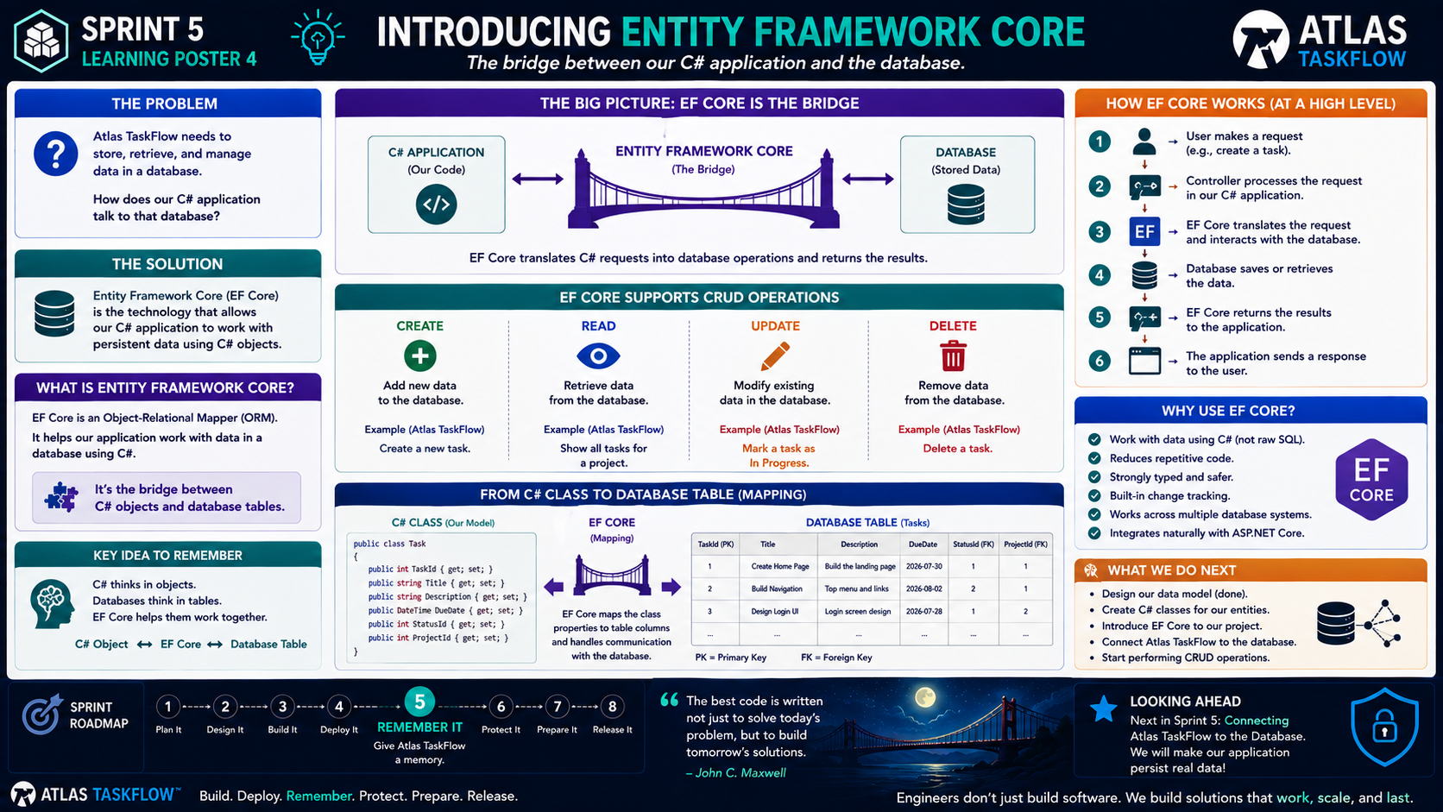
5-04
Notes:
============================================================
SPRINT 5
INTRODUCING ENTITY FRAMEWORK CORE
============================================================
SLIDE PURPOSE
Introduce Entity Framework Core (EF Core) as the bridge between the
Atlas TaskFlow C# application and its database.
Students should understand:
C# Objects
↓
Entity Framework Core
↓
Database Tables
The objective is to understand WHY EF Core exists and what role it
plays in a data-driven SaaS application.
This is not an advanced EF Core lesson.
------------------------------------------------------------
OPENING
"Engineers..."
"Atlas TaskFlow needs a memory."
"We figured out where that memory lives."
"We designed what that memory needs to contain."
Pause.
"But there's one problem."
"Our C# application still needs to communicate with the database."
Point to the center of the slide.
"That's where Entity Framework Core comes in."
------------------------------------------------------------
THE ENGINEERING QUESTION
Ask:
"How does our C# application talk to a database?"
Let students answer.
Possible answers:
"SQL."
"Connection."
"Database."
"EF Core."
Acknowledge the answers.
Then say:
"All of those are related."
"But today we're focusing on the tool we're going to use."
"Entity Framework Core."
------------------------------------------------------------
THE BIG IDEA
Point to the bridge.
"C# Application."
"Entity Framework Core."
"Database."
Say:
"Think of EF Core as the bridge between our application and our
database."
Pause.
"The application works with C#."
"The database stores information in tables."
"EF Core helps those two worlds communicate."
------------------------------------------------------------
THE KEY SENTENCE
Say this slowly:
"C# thinks in objects."
"Databases think in tables."
"EF Core helps them work together."
Pause.
Repeat:
"C# objects."
"Database tables."
"EF Core connects them."
This is the primary takeaway from today's lesson.
------------------------------------------------------------
WHAT IS EF CORE?
Point to the definition.
"Entity Framework Core is an Object-Relational Mapper."
Then immediately translate the terminology.
"That's a fancy way of saying..."
"It helps our application work with database data using C# objects."
Explain:
"We don't have to think about every database operation as raw SQL."
"EF Core gives us a programming model for working with our data."
------------------------------------------------------------
THE WORD ENTITY
Point to the word "Entity."
Ask:
"What is an entity?"
Explain:
"An entity is something our application needs to keep track of."
For Atlas TaskFlow:
User.
Project.
Task.
Status.
Category.
These entities came directly from the data model we just designed.
------------------------------------------------------------
CONNECT TO THE PREVIOUS LESSON
Point back to the data model.
Say:
"Notice something."
"We're not creating these entities out of nowhere."
"We already designed them."
The process is:
Requirements
↓
Features
↓
Data Model
↓
C# Models
↓
Database
Explain:
"This is traceability."
"The work we did earlier is now guiding our implementation."
------------------------------------------------------------
FROM DATA MODEL TO C#
Use Task as the example.
Our data model says a Task needs:
TaskId
Title
Description
DueDate
StatusId
ProjectId
Explain:
"Now our application needs a C# representation of that information."
Show the simple class from the poster.
Say:
"This is our Task model."
"These properties represent the information our application works
with."
------------------------------------------------------------
FROM C# CLASS TO DATABASE TABLE
Point to the mapping diagram.
Task class
↓
EF Core
↓
Tasks table
Explain:
"EF Core helps map the properties of our C# class to columns in the
database."
For example:
TaskId → TaskId
Title → Title
Description → Description
DueDate → DueDate
StatusId → StatusId
ProjectId → ProjectId
Explain:
"The names and configuration can vary."
"The important idea is the mapping."
------------------------------------------------------------
THE WORD "MAPPING"
Emphasize:
"Mapping."
Say:
"When we talk about EF Core..."
"You're going to hear the word mapping."
"Mapping means connecting something in our application to something in
our database."
For Atlas:
C# Task object
maps to
Task database record.
------------------------------------------------------------
CRUD
Point to the four operations.
CREATE
READ
UPDATE
DELETE
Ask:
"Does anyone remember these from earlier?"
Review:
Create a task.
Read tasks.
Update a task.
Delete a task.
Say:
"These are the basic operations our application needs to perform with
persistent data."
------------------------------------------------------------
CREATE
Walk through the Atlas example.
User creates:
"Build homepage."
The application creates a Task object.
EF Core sends the appropriate operation to the database.
The database stores the information.
Say:
"The task now exists beyond the current browser session."
That's persistence.
------------------------------------------------------------
READ
User opens the Tasks page.
The application asks for the user's tasks.
EF Core communicates with the database.
The database returns the records.
The application displays them.
Say:
"This is how Atlas remembers."
------------------------------------------------------------
UPDATE
User changes:
"Build homepage"
to:
"Build landing page."
The application updates the task.
EF Core communicates the change.
The database stores the updated information.
Explain:
"The database now contains the current version."
------------------------------------------------------------
DELETE
User removes a task.
The application requests the deletion.
EF Core communicates the operation.
The database removes the record.
Explain:
"That's the complete CRUD cycle."
------------------------------------------------------------
THE REQUEST FLOW
Point to the right-side workflow.
Walk through it:
1. User makes a request.
2. Controller receives the request.
3. Our C# application processes it.
4. EF Core communicates with the database.
5. Database saves or retrieves information.
6. The result comes back to the application.
7. The application responds to the user.
Say:
"This is the conversation happening behind the screen."
------------------------------------------------------------
CONNECT THIS TO MVC
Point to the MVC architecture students already know.
Say:
"MVC is still doing its job."
"The Controller handles the request."
"The Model represents our data."
"The View displays the result."
"EF Core handles the communication with persistent data."
Simple architecture:
USER
↓
BROWSER
↓
CONTROLLER
↓
MODEL / EF CORE
↓
DATABASE
Don't overcomplicate this.
------------------------------------------------------------
WHY USE EF CORE?
Point to the benefits.
Ask:
"Why wouldn't we just write SQL for everything?"
Explain:
"We absolutely can use SQL when appropriate."
"But EF Core lets our C# application work with data through C# models
and objects."
Benefits include:
Less repetitive database code.
Strongly typed models.
Integration with ASP.NET Core.
A consistent programming model.
Support for common CRUD operations.
Say:
"The goal is to reduce unnecessary complexity."
------------------------------------------------------------
IMPORTANT BOUNDARY
Tell students:
"Let me be very clear."
"We are NOT becoming EF Core experts in this class."
"We are learning enough to make Atlas TaskFlow work."
No:
Advanced query optimization.
Repository patterns.
Unit of Work.
Complex tracking behavior.
Advanced relationship loading.
Performance tuning.
Those are future topics.
------------------------------------------------------------
THE CONTEXT
Briefly introduce DbContext.
Say:
"You'll also hear the term DbContext."
"Think of it as the main working connection between our application and
the database."
"It gives our application access to the entities and database
operations we need."
Don't go into configuration yet.
Students only need the concept.
------------------------------------------------------------
WHY THIS MATTERS
Ask:
"What would Atlas TaskFlow be without this connection?"
Students should recognize:
The application could still exist.
The interface could still exist.
But persistent data would not work.
Say:
"EF Core helps turn our application from something that displays data..."
"...into something that can work with data."
------------------------------------------------------------
ENGINEERING INSIGHT
Point to the engineering insight.
"Good tools reduce complexity."
Explain:
"Professional engineers don't write everything from scratch."
"We choose tools that solve problems effectively."
"EF Core is one of those tools."
But emphasize:
"Knowing the tool is useful."
"Understanding the problem is more important."
------------------------------------------------------------
BUILD CHALLENGE
Give students a small challenge.
Ask:
"Look at the Atlas TaskFlow data model."
"Pick one entity."
For example:
Task.
Then identify:
What is the entity?
What properties does it contain?
What database table should represent it?
What operations will users perform?
Example:
Task
↓
TaskId
Title
Description
DueDate
StatusId
ProjectId
Then ask:
"What CRUD operations will Atlas need?"
Students:
Create.
Read.
Update.
Delete.
------------------------------------------------------------
ENGINEERING CHECK
Ask students:
"What is EF Core?"
Expected answer:
"A tool that helps our C# application work with database data."
Ask:
"What does the database do?"
"Stores persistent data."
Ask:
"What does a C# model do?"
"Represents the data in our application."
Ask:
"What does EF Core do?"
"Connects the application to the database."
If they can answer those three questions, the lesson succeeded.
------------------------------------------------------------
COMMON MISCONCEPTIONS
Address these explicitly.
EF Core is NOT the database.
EF Core is NOT SQL.
EF Core is NOT MVC.
EF Core is NOT the user interface.
EF Core is a data-access technology that helps our application work
with persistent data.
------------------------------------------------------------
SPRINT 5 CONNECTION
Point to the roadmap.
Sprint 3:
Design It.
Sprint 4:
Build It.
Deploy It.
Sprint 5:
REMEMBER IT.
Say:
"We now know what Atlas needs to remember."
"We know where that information will live."
"We have introduced the bridge that connects our application to it."
"Now we're ready to actually connect everything."
------------------------------------------------------------
LOOKING AHEAD
Point to the next lesson.
"Next..."
"We stop talking about the database."
"We connect Atlas TaskFlow to it."
Students will:
Create their models.
Configure EF Core.
Connect the application.
Create the database.
Test the connection.
Say:
"That's when Atlas gets its memory."
------------------------------------------------------------
CLOSING
Say:
"Remember the bridge."
C# Application
↓
EF Core
↓
Database
Then:
"C# thinks in objects."
"Databases think in tables."
"EF Core helps them work together."
Pause.
"Next..."
"We make that connection real."
============================================================
ESTIMATED TIME
Opening.............................5 minutes
EF Core Concept.....................10 minutes
C# Objects & Database Tables.........10 minutes
CRUD Operations......................15 minutes
Request/Response Flow................10 minutes
Build Challenge......................10 minutes
Discussion & Closing.................5 minutes
TOTAL...............................65 minutes
============================================================
INSTRUCTOR NOTES
This lesson should build directly on the previous two lessons.
Students already understand:
1. Atlas needs persistent data.
2. A database stores persistent data.
3. Atlas needs a defined data model.
Now they need to understand:
4. EF Core connects the C# application to that data.
Keep returning to the central bridge diagram.
If students begin asking advanced EF Core questions, acknowledge the
question but defer it.
For example:
"That's a great Advanced C# question."
"We'll go much deeper into that later."
This protects the scope of the SaaS course.
The purpose here is confidence, not mastery.
------------------------------------------------------------
KEY TAKEAWAY
Write this on the board:
C# OBJECTS
↕
EF CORE
↕
DATABASE TABLES
Then underneath:
"EF Core is the bridge."
------------------------------------------------------------
CLOSING STATEMENT
"Engineers..."
"We know what Atlas needs to remember."
"We know where that information lives."
"We now know how our C# application can communicate with it."
"Next..."
"We connect Atlas TaskFlow to its memory."
============================================================

Slide 5
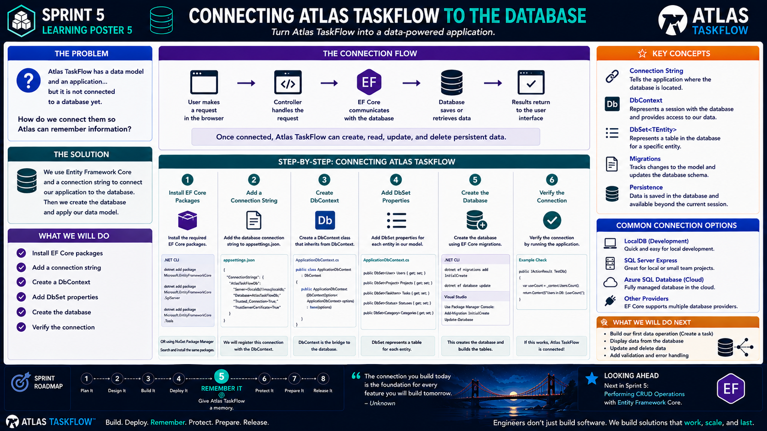
5-05
Notes:
============================================================
SPRINT 5
CONNECTING ATLAS TASKFLOW TO THE DATABASE
============================================================
SLIDE PURPOSE
Guide students through establishing the connection between the Atlas
TaskFlow ASP.NET Core MVC application and a relational database using
Entity Framework Core.
Students should understand the major pieces required to establish
database connectivity:
• EF Core packages
• Connection string
• DbContext
• DbSet<TEntity>
• Database creation/migrations
• Verification
The goal is a working connection, not mastery of database configuration.
------------------------------------------------------------
OPENING
"Engineers..."
"We've designed the memory."
"We've learned about the bridge."
"Today..."
"We're going to connect them."
Pause.
"This is the moment Atlas TaskFlow gets access to its memory."
------------------------------------------------------------
THE ENGINEERING QUESTION
Point to the question:
"How do we connect Atlas TaskFlow to a database?"
Explain:
"We already have..."
A C# application.
A data model.
Entity Framework Core.
A database technology.
"But they're not connected yet."
"Today we're going to connect those pieces."
------------------------------------------------------------
THE CONNECTION FLOW
Walk through the diagram:
USER
↓
BROWSER
↓
CONTROLLER
↓
EF CORE
↓
DATABASE
↓
RESULT
Explain:
"This is the conversation that will happen every time our application
works with persistent data."
For example:
"Create a task."
The request travels through the application.
EF Core communicates with the database.
The database stores the information.
The result comes back.
------------------------------------------------------------
STEP 1 — INSTALL EF CORE PACKAGES
Point to Step 1.
Explain:
"Before our application can use EF Core..."
"We need the appropriate EF Core packages."
Explain that packages provide the functionality our project needs.
Depending on the database provider, we may need:
Microsoft.EntityFrameworkCore
Microsoft.EntityFrameworkCore.SqlServer
Microsoft.EntityFrameworkCore.Tools
Do not spend significant time on package management.
The important idea:
"Our project needs the tools necessary to communicate with the database."
------------------------------------------------------------
STEP 2 — ADD A CONNECTION STRING
Point to Step 2.
Ask:
"How does the application know where the database is?"
Answer:
"The connection string."
Explain:
"A connection string tells the application how to locate and connect to
the database."
It may contain information such as:
Server.
Database name.
Authentication information.
Security settings.
------------------------------------------------------------
IMPORTANT SECURITY NOTE
Pause here.
"One important rule."
"Never put sensitive credentials directly into your source code."
Explain:
"Connection information needs to be handled carefully."
For our classroom project, students may see connection strings in
appsettings.json.
But explain:
"Real applications use appropriate secret management."
Don't turn this into a security lesson yet.
That belongs in Sprint 6.
------------------------------------------------------------
STEP 3 — CREATE THE DBCONTEXT
Point to Step 3.
Explain:
"Now we need something that represents our application's working
connection to the database."
Introduce:
DbContext.
Say:
"Think of DbContext as the main gateway EF Core uses to work with our
database."
Simple mental model:
Application
↓
DbContext
↓
Database
------------------------------------------------------------
THE DBCONTEXT
Show the conceptual example.
ApplicationDbContext
inherits from:
DbContext
Explain:
"Our context will contain the information EF Core needs to work with
our application's entities."
Don't get lost in inheritance details.
The important concept is:
"DbContext is our application's database gateway."
------------------------------------------------------------
STEP 4 — ADD DBSET PROPERTIES
Point to Step 4.
Explain:
"Now we tell EF Core what entities our application works with."
Examples:
DbSet<User>
DbSet<Project>
DbSet<Task>
DbSet<Status>
DbSet<Category>
Explain:
"Each DbSet represents a collection of records for an entity."
Simple analogy:
DbSet<Task>
↓
Tasks table
------------------------------------------------------------
IMPORTANT DISTINCTION
Say:
"A DbSet is not literally the database table."
"Think of it as EF Core's way of representing that set of data in the
application."
This distinction prevents students from treating EF Core abstractions
as the database itself.
------------------------------------------------------------
STEP 5 — CREATE THE DATABASE
Point to Step 5.
Explain:
"We've now told the application what our data looks like."
"But the database still needs to be created."
Introduce migrations at a high level.
"Migrations allow EF Core to track changes to our model and apply those
changes to the database structure."
Keep this simple.
Today we're using migrations to create the initial database structure.
------------------------------------------------------------
THE MIGRATION CONCEPT
Draw:
C# Models
↓
Migration
↓
Database Schema
Explain:
"If we change our model later..."
"We can create another migration."
"The database can then be updated."
This is why migrations are useful.
------------------------------------------------------------
STEP 6 — VERIFY THE CONNECTION
Point to Step 6.
Say:
"Never assume the connection works."
"We test it."
Run the application.
Perform a simple database operation.
Check for errors.
Verify that the database exists.
Explain:
"Successful deployment taught us to verify."
"Database connectivity requires the same discipline."
------------------------------------------------------------
THE FIRST TEST
Give students a very simple test:
Run Atlas TaskFlow.
Open the application.
Navigate to the database-connected feature.
Perform a basic operation.
Verify that the database responds.
If the application reaches the database successfully:
"We have a connection."
------------------------------------------------------------
WHAT COULD GO WRONG?
Ask students:
"What could prevent this from working?"
Possible answers:
Incorrect connection string.
Missing package.
Wrong database provider.
Incorrect server name.
Database doesn't exist.
Migration wasn't applied.
Configuration problem.
Explain:
"This is normal."
"Database configuration problems are part of development."
------------------------------------------------------------
DEBUGGING MINDSET
If something fails, don't immediately change everything.
Ask:
1. Did the application start?
2. Did the request reach the controller?
3. Did EF Core initialize?
4. Did the connection string load?
5. Can the database be reached?
6. Did the migration run?
Explain:
"Debugging is a process of narrowing down the problem."
------------------------------------------------------------
THE ARCHITECTURE
Point to the full architecture:
USER
↓
BROWSER
↓
MVC APPLICATION
↓
CONTROLLER
↓
EF CORE / DBCONTEXT
↓
DATABASE
Say:
"This is the architecture we're building."
"We've now connected the bottom half."
------------------------------------------------------------
WHY THIS MATTERS
Ask:
"What changes once the database is connected?"
Before:
Atlas can display information.
After:
Atlas can store information.
Explain:
"This is the difference between a static interface..."
"...and a data-driven application."
------------------------------------------------------------
BUILD CHALLENGE
Students should complete the following:
1. Install required EF Core packages.
2. Configure the database provider.
3. Add the connection string.
4. Create ApplicationDbContext.
5. Add DbSet properties.
6. Create the initial migration.
7. Update/create the database.
8. Run the application.
9. Verify the connection.
------------------------------------------------------------
ENGINEERING CHECKPOINT
Have students stop before moving forward.
Ask:
"Show me your DbContext."
"Show me your connection string."
"Show me your migration."
"Show me your database."
This creates a natural checkpoint before CRUD begins.
------------------------------------------------------------
IMPORTANT BOUNDARY
Tell students:
"We are not building features yet."
"Today we're building the foundation that allows those features to
store information."
This is important.
The next lesson is where CRUD begins.
------------------------------------------------------------
SPRINT CONNECTION
Point to the roadmap.
Sprint 5:
REMEMBER IT.
Say:
"We've now given Atlas access to its memory."
"But having a memory isn't enough."
"Now we need to teach Atlas how to use it."
------------------------------------------------------------
LOOKING AHEAD
Point to the next lesson:
"Performing CRUD Operations."
Explain:
"Now that the connection exists..."
"We can finally create a task."
"Save it."
"Retrieve it."
"Change it."
"Delete it."
Pause.
"That's when Atlas really starts remembering."
------------------------------------------------------------
CLOSING
Say:
"Today we connected..."
C# Application
↓
EF Core
↓
Database
Then:
"Next..."
"We start putting information into it."
============================================================
ESTIMATED TIME
Connection Concept...................8 minutes
EF Core Package Setup................8 minutes
Connection String....................8 minutes
DbContext............................10 minutes
DbSet.................................8 minutes
Migrations...........................8 minutes
Verification.........................10 minutes
Debugging Discussion.................5 minutes
TOTAL................................65 minutes
============================================================
INSTRUCTOR NOTES
This should be a guided hands-on lesson.
Demonstrate each step once.
Then allow students to perform it.
Do not allow students to race through the steps without understanding
what each component does.
At every major step ask:
"What does this accomplish?"
For example:
Packages:
"What capability did we add?"
Connection string:
"How does the application know where the database is?"
DbContext:
"What is our database gateway?"
DbSet:
"Which entities are we working with?"
Migration:
"How does our model become database structure?"
Verification:
"How do we know it works?"
------------------------------------------------------------
TROUBLESHOOTING APPROACH
When a student encounters an error, resist immediately giving them
the solution.
Ask:
"What step are you on?"
"What did you expect to happen?"
"What actually happened?"
"What does the error message say?"
"What changed most recently?"
This reinforces the engineering debugging process.
------------------------------------------------------------
SECURITY REMINDER
When discussing connection strings, briefly reinforce:
"Never commit production credentials to GitHub."
Students should understand that configuration and secrets must be
handled responsibly.
Save the deeper security discussion for Sprint 6.
------------------------------------------------------------
KEY TAKEAWAY
Write this on the board:
CONNECTION STRING
= Where is the database?
DBCONTEXT
= How does EF Core work with it?
DBSET
= What data are we working with?
MIGRATION
= How does our model become database structure?
PERSISTENCE
= Does the data survive?
------------------------------------------------------------
CLOSING STATEMENT
"Engineers..."
"Atlas TaskFlow now has a connection to its memory."
"Next..."
"We're going to give it something to remember."
============================================================

Slide 6
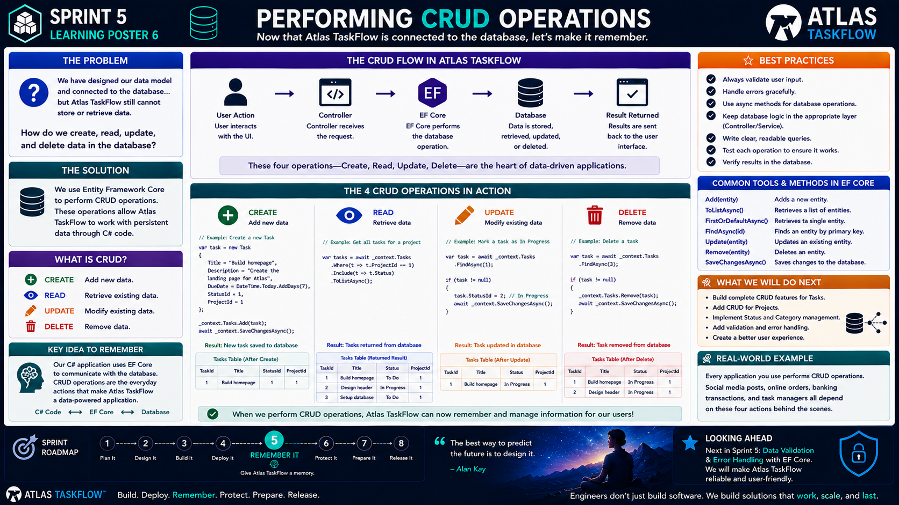
5-06
Notes:
============================================================
SPRINT 5
PERFORMING CRUD OPERATIONS
============================================================
SLIDE PURPOSE
Introduce and implement the four fundamental data operations used by
Atlas TaskFlow:
CREATE
READ
UPDATE
DELETE
Students will use Entity Framework Core to perform these operations
against persistent application data.
The goal is not to memorize EF Core methods.
The goal is to understand the relationship between a user action,
application logic, EF Core, and the database.
------------------------------------------------------------
OPENING
"Engineers..."
"Atlas TaskFlow has a memory now."
"We connected the application to the database."
Pause.
"But having a database isn't enough."
"An application has to know how to use that database."
Ask:
"What should users be able to do with their tasks?"
Students will likely say:
"Create."
"View."
"Edit."
"Delete."
Exactly.
"That's CRUD."
------------------------------------------------------------
THE ENGINEERING QUESTION
Point to the question:
"How do we create, read, update, and delete data in the database?"
Explain:
"These four operations are at the heart of most data-driven
applications."
"Atlas TaskFlow will use all four."
------------------------------------------------------------
WHAT DOES CRUD MEAN?
Point to each operation.
CREATE
Add new information.
READ
Retrieve existing information.
UPDATE
Modify existing information.
DELETE
Remove information.
Say:
"CRUD isn't a special Atlas concept."
"It's a general software engineering concept."
------------------------------------------------------------
REAL-WORLD CONNECTION
Ask students to think about a social media application.
CREATE:
Create a post.
READ:
View a post.
UPDATE:
Edit a post.
DELETE:
Delete a post.
Then ask:
"What about an online store?"
CREATE:
Place an order.
READ:
View an order.
UPDATE:
Update an order.
DELETE:
Cancel an order.
Explain:
"These operations are happening everywhere."
------------------------------------------------------------
THE ATLAS CRUD FLOW
Point to the center diagram.
USER ACTION
↓
CONTROLLER
↓
EF CORE
↓
DATABASE
↓
RESULT
Explain:
"This is what happens when a user performs a data operation."
The user doesn't talk directly to the database.
"The application handles the request."
"EF Core handles communication with the database."
------------------------------------------------------------
CREATE
Point to CREATE.
Say:
"Let's start with the most exciting one."
"We're going to create something."
Example:
User enters:
Title:
Build Homepage
Description:
Create the landing page for Atlas TaskFlow.
Due Date:
Friday
Status:
To Do
Project:
Atlas TaskFlow
The user clicks:
SAVE
------------------------------------------------------------
WHAT HAPPENS?
Walk through the flow.
User clicks Save.
↓
Controller receives the request.
↓
Application creates a Task object.
↓
EF Core adds the entity.
↓
SaveChangesAsync() sends the change.
↓
Database stores the task.
Explain:
"The information now exists beyond the current browser session."
Pause.
"That's persistence."
------------------------------------------------------------
THE MOMENT
Tell students:
"After creating the task..."
"Close the browser."
"Open Atlas TaskFlow again."
"Find the task."
Pause.
"If it's still there..."
"Atlas remembers."
This is the key emotional moment of Sprint 5.
------------------------------------------------------------
READ
Point to READ.
Say:
"Now we need to get the information back."
Example:
User opens:
"My Tasks"
The application requests the tasks.
EF Core queries the database.
The database returns the records.
The application sends them to the View.
The user sees their tasks.
------------------------------------------------------------
READING DATA
Explain the conceptual flow:
Database
↓
EF Core
↓
Controller
↓
View
↓
Browser
Say:
"The application asks..."
"The database answers."
------------------------------------------------------------
UPDATE
Point to UPDATE.
Say:
"Now suppose the user changes something."
Example:
Task:
Build Homepage
Status:
To Do
becomes:
In Progress
The application retrieves the task.
Changes the property.
EF Core saves the change.
The database now contains the updated information.
------------------------------------------------------------
WHY UPDATE MATTERS
Ask:
"What happens if our application could create tasks but couldn't
change them?"
Students will recognize the problem.
Explain:
"Real applications are constantly changing data."
Tasks move through statuses.
Dates change.
Descriptions change.
Assignments change.
"Persistence isn't just about saving."
"It's about managing information."
------------------------------------------------------------
DELETE
Point to DELETE.
Say:
"Finally..."
"Sometimes information needs to be removed."
Example:
A user creates a duplicate task.
They click:
DELETE
The application identifies the task.
EF Core removes it.
The database no longer contains that record.
------------------------------------------------------------
IMPORTANT QUESTION
Ask:
"Should every user be allowed to delete every task?"
Students may say:
"No."
Good.
Tell them:
"That's a security and authorization question."
"We'll deal with that later."
For now:
"We're learning the mechanics of CRUD."
This gives us a natural bridge to Sprint 6.
------------------------------------------------------------
EF CORE METHODS
Point to the methods.
Explain them at a high level:
Add()
Adds a new entity.
ToListAsync()
Retrieves multiple records.
FirstOrDefaultAsync()
Retrieves a specific record.
FindAsync()
Finds an entity by its key.
Update()
Marks an entity as changed.
Remove()
Marks an entity for deletion.
SaveChangesAsync()
Persists the changes.
Emphasize:
"Don't memorize these as vocabulary words."
"Understand what operation you're trying to perform."
------------------------------------------------------------
THE MOST IMPORTANT METHOD
Point to:
SaveChangesAsync()
Say:
"Pay attention to this one."
"Changing an object in C# isn't automatically the same thing as changing
the database."
"SaveChangesAsync() is what tells EF Core to persist the changes."
This is an important distinction.
------------------------------------------------------------
CRUD IS A CYCLE
Draw:
CREATE
↓
READ
↓
UPDATE
↓
DELETE
Then:
READ
↓
UPDATE
↓
READ
Explain:
"Applications are constantly moving through this cycle."
A user creates information.
Reads it.
Changes it.
Reads it again.
Eventually deletes it.
------------------------------------------------------------
BUILD CHALLENGE
Students will implement CRUD for Tasks.
### CREATE
Build a form that creates a task.
### READ
Display the user's tasks.
### UPDATE
Allow a task to be edited.
### DELETE
Allow a task to be removed.
Tell students:
"Don't try to build everything at once."
Build one operation.
Test it.
Then move to the next.
------------------------------------------------------------
RECOMMENDED BUILD ORDER
Point to the sequence.
1. CREATE
2. READ
3. UPDATE
4. DELETE
Explain:
"Start with Create and Read."
"Once those work..."
"Add Update."
"Then Delete."
This keeps debugging manageable.
------------------------------------------------------------
TEST AFTER EACH OPERATION
Ask:
"What should we do after implementing Create?"
Students:
"Test it."
Exactly.
Test:
Create a task.
Refresh.
Close the application.
Reopen it.
Verify the task exists.
Then move forward.
------------------------------------------------------------
TESTING CHECKLIST
For CREATE:
Can I save a task?
For READ:
Can I see saved tasks?
For UPDATE:
Can I change a task?
For DELETE:
Can I remove a task?
Then ask:
"Does the database reflect what the interface shows?"
This is critical.
------------------------------------------------------------
BEST PRACTICES
Point to the right-side panel.
Validate user input.
Handle errors gracefully.
Use asynchronous database operations.
Keep database logic organized.
Test every operation.
Verify results in the database.
Explain:
"CRUD is easy to demonstrate."
"Doing it reliably is engineering."
------------------------------------------------------------
VALIDATION
Briefly introduce the next problem.
Ask:
"What happens if someone submits an empty task title?"
"What if the due date is invalid?"
"What if the database isn't available?"
Explain:
"Those are problems we're going to address next."
Don't solve them yet.
Just establish the need.
------------------------------------------------------------
ENGINEERING INSIGHT
Point to the statement:
"CRUD operations are the heartbeat of data-driven applications."
Explain:
"Without CRUD..."
"Our database is basically storage nobody can use."
"CRUD gives the application the ability to work with that information."
------------------------------------------------------------
ARCHITECTURE CONNECTION
Return to the architecture.
USER
↓
BROWSER
↓
CONTROLLER
↓
EF CORE
↓
DATABASE
Then say:
"Every CRUD operation follows this basic pattern."
This reinforces the architecture from earlier lessons.
------------------------------------------------------------
SPRINT CONNECTION
Point to:
⑤ REMEMBER IT
Say:
"This is what Remember It actually means."
Atlas can:
Create information.
Store information.
Retrieve information.
Change information.
Remove information.
"Atlas isn't just displaying data anymore."
"It is managing data."
------------------------------------------------------------
LOOKING AHEAD
Point to:
"Data Validation & Error Handling."
Ask:
"Is our application finished?"
Students:
"No."
"Why?"
Possible answers:
"Users can enter bad information."
"Errors can happen."
"The database could be unavailable."
Exactly.
"Next..."
"We make Atlas more reliable."
------------------------------------------------------------
CLOSING
Say:
"Today..."
"You taught Atlas how to remember."
"You taught it how to retrieve."
"You taught it how to change."
"And you taught it how to forget."
Pause.
"That's CRUD."
Then:
"But professional software isn't just about what happens when
everything goes right."
"Next..."
"We learn what happens when things go wrong."
============================================================
ESTIMATED TIME
CRUD Introduction...................10 minutes
Create..............................10 minutes
Read.................................10 minutes
Update...............................10 minutes
Delete................................8 minutes
Hands-on Implementation.............15 minutes
Testing & Discussion..................7 minutes
TOTAL...............................70 minutes
============================================================
INSTRUCTOR NOTES
This should be a highly hands-on lesson.
Demonstrate CREATE first.
Have students implement it.
Stop.
Test it.
Then demonstrate READ.
Repeat.
Do not give students all four operations at once and expect them to
copy everything.
The goal is to develop an iterative engineering process:
BUILD
↓
TEST
↓
VERIFY
↓
CONTINUE
------------------------------------------------------------
IMPORTANT TEACHING POINT
Students may become frustrated when EF Core code doesn't immediately
work.
That's useful.
Ask:
"What did you expect?"
"What actually happened?"
"Did the controller receive the request?"
"Did EF Core execute?"
"Did SaveChangesAsync() run?"
"Does the record exist in the database?"
Teach debugging through the actual application.
------------------------------------------------------------
COMMON MISCONCEPTIONS
Changing a C# object does not automatically save the database.
Displaying a task does not mean it was persisted.
Deleting an item from a View does not automatically delete the database
record.
EF Core communicates with the database; it does not replace the
database.
------------------------------------------------------------
KEY TAKEAWAY
Write this on the board:
CREATE
= Add
READ
= Retrieve
UPDATE
= Change
DELETE
= Remove
Then:
SAVE
= Persist
------------------------------------------------------------
FINAL STATEMENT
"Engineers..."
"Atlas TaskFlow can now work with real data."
"That's a major milestone."
"But reliable software isn't just about successful operations."
"Next..."
"We teach Atlas what to do when things go wrong."
============================================================
1. Don't teach CRUD as four methods
This is important.
Students shouldn't leave thinking:
Add() = Create ToList() = Read Update() = Update Remove() = Delete
That's syntax memorization.
Instead:
User action → application logic → EF Core → database → result
The methods are simply the tools that implement that process.
2. SaveChangesAsync() deserves special attention
This is a fantastic teaching moment.
Students will eventually change a property in a C# object and wonder:
"Why didn't the database change?"
That's because changing an object and persisting the change are two different things.
That's an actual engineering concept—not just an EF Core trick.
3. Make the "It remembered!" moment happen
I would actually make this a mini-classroom celebration.
Have everyone:
Create a task.
Save it.
Close the browser.
Reopen Atlas.
Find the task.

Slide 7
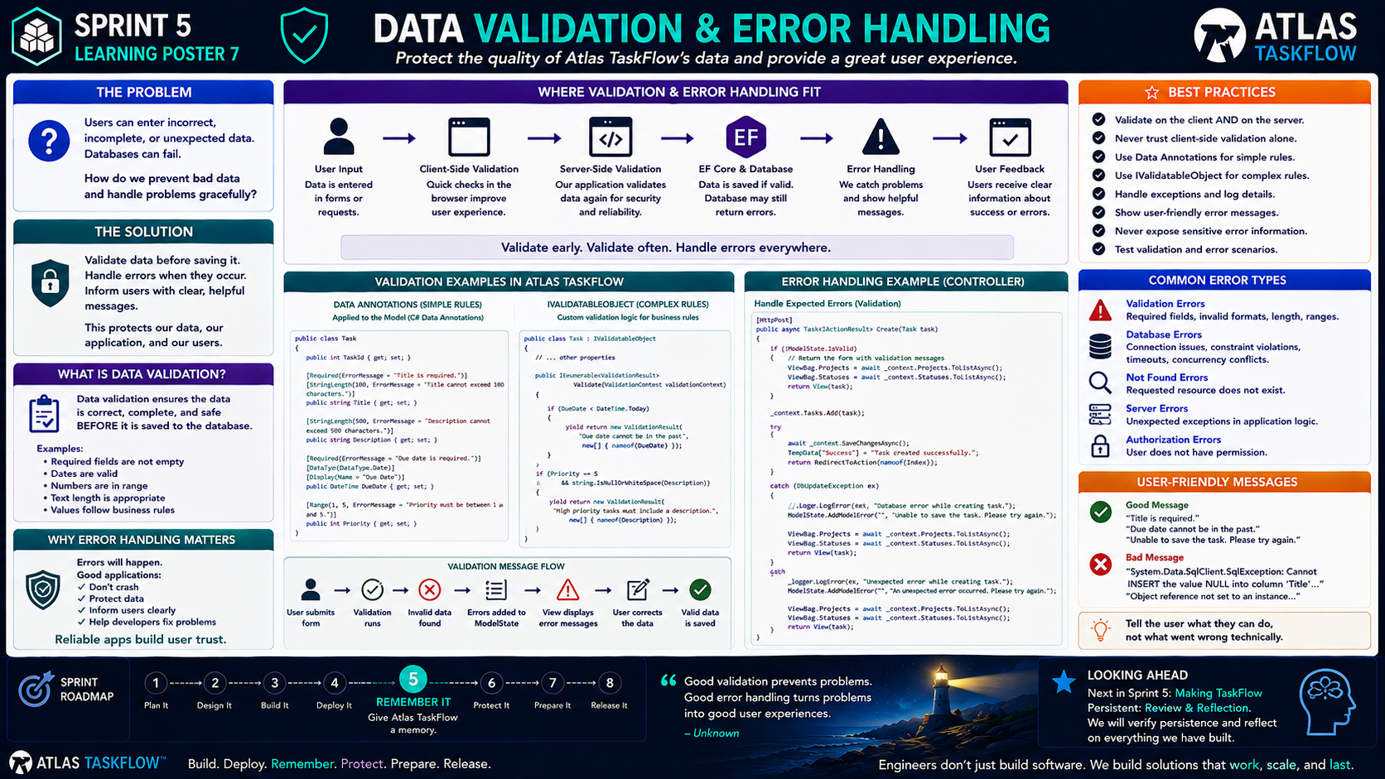
5-07
Notes:
============================================================
SPRINT 5
DATA VALIDATION & ERROR HANDLING
============================================================
SLIDE PURPOSE
Teach students how to protect the quality of application data and
respond appropriately when something goes wrong.
Students should understand:
• Why validation is necessary
• The difference between client-side and server-side validation
• How ASP.NET Core model validation supports the application
• How to handle expected database/application errors
• Why users should receive helpful messages
• Why technical error details should not be exposed to users
The goal is reliable application behavior.
This is NOT an advanced security or exception-handling course.
------------------------------------------------------------
OPENING
"Engineers..."
"We have reached an important point."
"Atlas TaskFlow can now remember."
"We can create tasks."
"We can retrieve them."
"We can update them."
"We can delete them."
Pause.
"But..."
"What happens when the user does something wrong?"
------------------------------------------------------------
THE ENGINEERING QUESTION
Point to the question:
"How do we prevent bad data and handle problems gracefully?"
Ask:
"What could a user do that might cause a problem?"
Let students brainstorm.
Possible answers:
Leave a required field blank.
Enter an invalid date.
Enter too much text.
Submit incomplete information.
Try to access something that doesn't exist.
Lose the database connection.
Then say:
"Exactly."
"Real users don't always do what we expect."
------------------------------------------------------------
THE REAL WORLD
Give an example.
Suppose the Task form asks for:
Title
Description
Due Date
Status
Ask:
"What happens if the user doesn't enter a title?"
Possible answers:
"Save it anyway."
"Show an error."
"Application crashes."
Then say:
"We don't want a crash."
"We want the application to help the user fix the problem."
------------------------------------------------------------
WHAT IS VALIDATION?
Point to the definition.
"Validation checks whether data meets the rules our application
requires BEFORE we accept it."
Explain:
"If Title is required..."
"An empty Title is invalid."
"If DueDate cannot be in the past..."
"A past DueDate is invalid."
"If Priority must be between 1 and 5..."
"6 is invalid."
Validation protects the quality of our data.
------------------------------------------------------------
THE VALIDATION FLOW
Walk through the diagram.
USER SUBMITS FORM
↓
VALIDATION RUNS
↓
INVALID?
↓
ERROR MESSAGE
↓
USER CORRECTS DATA
↓
VALID
↓
DATA IS SAVED
Explain:
"The application doesn't simply accept everything."
"It checks first."
------------------------------------------------------------
VALIDATION IS A BUSINESS RULE
Point to the examples.
Ask:
"Who decides whether a task title is required?"
Students may say:
"The programmer."
Clarify:
"The programmer implements the rule."
"But the rule comes from the application's requirements."
This connects validation back to Sprint 3.
------------------------------------------------------------
REQUIREMENTS → VALIDATION
Explain:
"Remember requirements?"
If the requirement says:
"Every task must have a title."
Then the application needs validation:
"Title is required."
If the requirement says:
"Tasks must have a due date."
Then:
"Due date is required."
If the requirement says:
"Priority must be between 1 and 5."
Then:
"Priority must be between 1 and 5."
Say:
"Validation turns requirements into enforceable rules."
------------------------------------------------------------
DATA ANNOTATIONS
Point to the Data Annotations section.
Explain:
"ASP.NET Core gives us simple tools for defining common validation
rules."
Examples:
[Required]
[StringLength]
[Range]
[DataType]
Explain:
"We can place these rules on our model."
The model now communicates:
"This information is required."
"This value has limits."
"This value must follow certain rules."
------------------------------------------------------------
EXAMPLE
Point to the Task model.
Show:
[Required]
Title
Explain:
"If Title is empty..."
"The application can identify the problem."
Then:
[StringLength]
Explain:
"We can also prevent excessively long values."
Then:
[Range]
Explain:
"We can limit numeric values."
------------------------------------------------------------
WHY VALIDATE ON THE SERVER?
Point to Server-Side Validation.
Ask:
"Can we trust the browser to validate everything?"
Students may say:
"No."
Exactly.
Explain:
"Client-side validation improves the user experience."
"But server-side validation protects the application."
This is an important distinction.
------------------------------------------------------------
CLIENT-SIDE VALIDATION
Explain:
"Client-side validation happens in the browser."
Benefits:
Fast feedback.
Better user experience.
No unnecessary request to the server.
Example:
User leaves Title blank.
The browser can immediately say:
"Title is required."
------------------------------------------------------------
SERVER-SIDE VALIDATION
Explain:
"Server-side validation happens inside our application."
"The server must validate the data again."
Why?
"Because users can bypass browser behavior."
"Requests can be manipulated."
"The server is ultimately responsible for protecting the application."
Do not turn this into a security deep dive.
Simply establish the principle:
"Never trust client-side validation alone."
------------------------------------------------------------
VALIDATION VS ERROR HANDLING
This distinction is important.
Ask:
"Is an empty title the same thing as a database failure?"
Students should recognize:
"No."
Explain:
"Validation handles invalid input."
"Error handling handles unexpected problems."
------------------------------------------------------------
VALIDATION ERROR
Example:
User submits:
Title = blank
Application says:
"Title is required."
The user can fix it.
No system failure occurred.
------------------------------------------------------------
DATABASE ERROR
Example:
The database connection fails.
The application tries to save the task.
The operation fails.
Now we need error handling.
The user shouldn't see a giant technical exception.
Instead:
"Unable to save the task. Please try again."
------------------------------------------------------------
GOOD ERROR MESSAGES
Point to the examples.
GOOD:
"Title is required."
"Due date cannot be in the past."
"Unable to save the task. Please try again."
BAD:
"System.Data.SqlClient.SqlException..."
"Object reference not set to an instance of an object."
"NullReferenceException at line 47."
Explain:
"Those messages may help developers."
"They don't help users."
------------------------------------------------------------
THE RULE
Point to:
"TELL THE USER WHAT THEY CAN DO — NOT WHAT WENT WRONG TECHNICALLY."
Explain:
Users need actionable information.
Developers need technical information.
Those are not always the same thing.
------------------------------------------------------------
LOGGING
Briefly introduce logging.
Say:
"If something unexpected happens..."
"We still need to know what happened."
"The application should log useful technical information."
The user might see:
"Unable to save the task. Please try again."
The developer's log might contain:
Database operation failed.
Connection problem.
Exception details.
Explain:
"The user gets a safe message."
"The developer gets the technical details."
------------------------------------------------------------
EXPECTED VS UNEXPECTED ERRORS
Explain:
"Some problems are expected."
Examples:
Missing required field.
Invalid date.
Invalid range.
These can be handled directly.
Other problems are unexpected:
Database unavailable.
Network failure.
Unexpected application exception.
Those require error handling.
------------------------------------------------------------
THE ERROR HANDLING FLOW
Walk through:
USER
↓
APPLICATION
↓
ERROR OCCURS
↓
APPLICATION HANDLES ERROR
↓
LOG TECHNICAL DETAILS
↓
SHOW USER-FRIENDLY MESSAGE
Explain:
"An error shouldn't automatically mean the application crashes."
"Good applications respond."
------------------------------------------------------------
WHY THIS MATTERS
Point to:
"Reliable apps build user trust."
Ask:
"Which application would you rather use?"
Application A:
Crashes when you enter bad information.
Application B:
Explains what went wrong and tells you how to fix it.
Students will choose B.
Say:
"That's reliability."
------------------------------------------------------------
BUILD CHALLENGE
Have students intentionally break their Task form.
Test:
1. Empty title.
2. Excessively long title.
3. Invalid date.
4. Invalid status.
5. Missing required information.
Then ask:
"What happens?"
Students should document:
What they entered.
What happened.
What message appeared.
What they expected.
------------------------------------------------------------
ERROR TESTING
Next, simulate an application failure if practical.
For example:
Temporarily make the database unavailable.
Then attempt to save a task.
Ask:
"What happened?"
"Did the application crash?"
"What did the user see?"
"What would a better message look like?"
------------------------------------------------------------
ENGINEERING MINDSET
Say:
"Engineers don't only test the happy path."
Explain:
"The happy path is when everything goes right."
Professional testing also asks:
"What if the user makes a mistake?"
"What if the network fails?"
"What if the database is unavailable?"
"What if something unexpected happens?"
------------------------------------------------------------
CONNECT TO SPRINT 5
Point to:
REMEMBER IT.
Say:
"We've taught Atlas how to remember."
"But now we're teaching Atlas how to protect the quality of what it
remembers."
Bad data becomes bad application behavior.
Good validation protects the data.
Good error handling protects the user experience.
------------------------------------------------------------
SPRINT 6 PREVIEW
Briefly point toward:
PROTECT IT.
Say:
"Notice something."
"Validation is part of building trustworthy software."
"Next sprint, we're going to take that idea further."
"We'll start talking about protecting users and their information."
Don't teach security yet.
Just create the connection.
------------------------------------------------------------
LOOKING AHEAD
Point to the final Sprint 5 artifact.
"Making TaskFlow Persistent."
Explain:
"Now we're going to prove everything works."
Students will demonstrate:
Create.
Save.
Close.
Reopen.
Retrieve.
Update.
Delete.
Handle invalid input.
Then reflect on the sprint.
------------------------------------------------------------
CLOSING
Say:
"Engineers..."
"Good software doesn't assume users will always do the right thing."
"Good software anticipates problems."
"Good software protects its data."
"Good software helps its users recover."
Pause.
"That's what reliability looks like."
============================================================
ESTIMATED TIME
Opening & Discussion..................8 minutes
Validation Concept....................10 minutes
Client vs Server Validation...........10 minutes
Error Handling........................10 minutes
Logging & User Messages.................7 minutes
Build Challenge........................12 minutes
Testing & Discussion...................8 minutes
TOTAL..................................65 minutes
============================================================
INSTRUCTOR NOTES
Keep this lesson practical.
Use the actual Atlas TaskFlow forms whenever possible.
Students should see validation happen inside the application they have
been building.
Avoid turning this into an exception-handling lecture.
The goal is:
INPUT
↓
VALIDATE
↓
PROCESS
↓
HANDLE FAILURE
↓
RESPOND
------------------------------------------------------------
IMPORTANT DISTINCTION
Make sure students understand:
VALIDATION
"Is this data acceptable?"
ERROR HANDLING
"What do we do when something goes wrong?"
They are related, but they are not the same thing.
------------------------------------------------------------
SECURITY BOUNDARY
Do not go deeply into:
• Authentication
• Authorization
• Encryption
• CSRF
• Identity
• Secrets management
Those belong primarily in Sprint 6.
However, briefly mention:
"Server-side validation is one layer of application protection."
------------------------------------------------------------
KEY TAKEAWAY
Write this on the board:
VALIDATE EARLY.
VALIDATE OFTEN.
HANDLE ERRORS.
HELP THE USER.
LOG THE DETAILS.
Then:
"Reliable software expects problems."
------------------------------------------------------------
FINAL STATEMENT
"Engineers..."
"Atlas can remember."
"Now Atlas knows how to reject bad information and respond when things
go wrong."
"One final step remains."
"We need to prove that everything we've built actually works."
============================================================

Slide 8
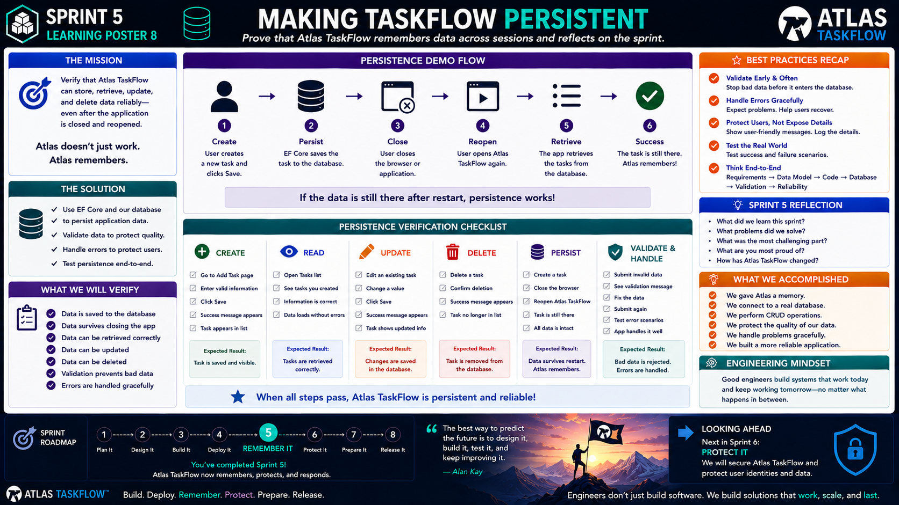
5-08
Notes:
============================================================
SPRINT 5
MAKING TASKFLOW PERSISTENT
"Prove that Atlas TaskFlow remembers."
============================================================
SLIDE PURPOSE
Bring Sprint 5 together by having students demonstrate that Atlas
TaskFlow can reliably store, retrieve, update, and delete persistent
data.
Students should demonstrate that data survives beyond the current
browser session and that validation and error handling work as
expected.
The second purpose of this lesson is reflection.
Students should be able to explain:
• What they built
• Why they built it
• What problems they solved
• What they learned
• How Atlas TaskFlow changed during Sprint 5
This is both a technical verification and an engineering retrospective.
------------------------------------------------------------
OPENING
"Engineers..."
"We've spent this entire sprint teaching Atlas TaskFlow one thing."
Pause.
"How to remember."
Point to the title.
"Today..."
"We're going to prove that it does."
------------------------------------------------------------
THE SPRINT 5 MISSION
Point to the mission.
"Verify that Atlas TaskFlow can store, retrieve, update, and delete
data reliably—even after the application is closed and reopened."
Read it.
Then ask:
"What would prove that our application actually remembers?"
Allow responses.
Possible answers:
"The data is still there."
"We can retrieve it."
"It survives closing the application."
"CRUD works."
"Validation works."
Exactly.
------------------------------------------------------------
THE DIFFERENCE BETWEEN WORKING AND PROVEN
Say:
"There's an important engineering distinction here."
"Something working once doesn't prove that it's reliable."
Pause.
"We need to test it."
"We need to repeat it."
"We need to verify the result."
This is an important connection to Sprint 4.
------------------------------------------------------------
THE PERSISTENCE DEMO
Point to the six-step flow.
1. CREATE
2. PERSIST
3. CLOSE
4. REOPEN
5. RETRIEVE
6. SUCCESS
Say:
"This is our primary Sprint 5 demonstration."
------------------------------------------------------------
STEP 1 — CREATE
Open Atlas TaskFlow.
Navigate to the task creation page.
Create a new task.
Use realistic data.
For example:
Title:
Build Sprint 5 Dashboard
Description:
Complete the TaskFlow dashboard implementation.
Status:
To Do
Due Date:
Future date
Click:
SAVE
Explain:
"The user has created information."
------------------------------------------------------------
STEP 2 — PERSIST
Explain what should happen behind the scenes.
The application creates the Task object.
EF Core tracks the change.
SaveChangesAsync() persists the information.
The database stores the record.
Say:
"This is the moment the information becomes persistent."
Pause.
"It no longer exists only in our application."
"It now exists in our database."
------------------------------------------------------------
STEP 3 — CLOSE
Now close the browser.
You can also stop and restart the application if appropriate.
Say:
"Here's the test."
"If the application only remembered the task temporarily..."
"It should be gone."
Pause.
"We're about to find out."
------------------------------------------------------------
STEP 4 — REOPEN
Open Atlas TaskFlow again.
Navigate back to the Tasks page.
Say:
"Atlas doesn't know we're testing it."
"This is just another user session."
------------------------------------------------------------
STEP 5 — RETRIEVE
The application loads the tasks.
EF Core queries the database.
The database returns the record.
The application displays it.
Ask:
"Is our task still there?"
Students:
"Yes."
Pause.
"That's persistence."
------------------------------------------------------------
STEP 6 — SUCCESS
Point to the green check.
Say:
"Atlas remembered."
This is the Sprint 5 milestone.
------------------------------------------------------------
THE BIGGER ARCHITECTURE
Point to the flow.
USER
↓
BROWSER
↓
MVC APPLICATION
↓
EF CORE
↓
DATABASE
Then say:
"Every piece we've built this sprint contributed to this moment."
The user creates the information.
The MVC application processes the request.
EF Core communicates with the database.
The database stores the information.
The application retrieves it later.
------------------------------------------------------------
CRUD VERIFICATION
Move to the CRUD checklist.
Now demonstrate:
CREATE
Create a task.
READ
Retrieve the task.
UPDATE
Change the task.
DELETE
Remove the task.
Explain:
"We aren't just proving that the database exists."
"We're proving that the application can manage its data."
------------------------------------------------------------
CREATE CHECK
Ask:
"Can we create a task?"
Verify:
✓ Form works.
✓ Valid information is accepted.
✓ Task appears in the list.
✓ Record exists in the database.
------------------------------------------------------------
READ CHECK
Ask:
"Can we retrieve the task?"
Verify:
✓ Task appears.
✓ Information is correct.
✓ Data loads without errors.
------------------------------------------------------------
UPDATE CHECK
Ask:
"Can we change the task?"
Change something obvious.
For example:
Status:
To Do
↓
In Progress
Save.
Refresh.
Verify:
"The updated value should remain."
------------------------------------------------------------
DELETE CHECK
Ask:
"Can we remove the task?"
Delete it.
Refresh.
Verify:
"The task should no longer appear."
Explain:
"The database should reflect what the user sees."
------------------------------------------------------------
PERSISTENCE CHECK
Now perform the important test again.
Create a task.
Close the application.
Reopen it.
Retrieve the task.
Explain:
"This is the test that separates temporary information from persistent
information."
------------------------------------------------------------
VALIDATION CHECK
Move to Validate & Handle.
Intentionally enter invalid data.
Examples:
Blank title.
Invalid date.
Invalid value.
Submit.
Ask:
"What should happen?"
Students:
"The application should reject the data."
"An appropriate message should appear."
Exactly.
------------------------------------------------------------
ERROR HANDLING CHECK
If practical, simulate an application/database problem.
Ask:
"What happens when something unexpected occurs?"
The application should:
Handle the problem.
Avoid exposing raw technical details.
Provide a useful message.
Log technical information when appropriate.
Explain:
"Reliable software doesn't pretend errors don't exist."
"It knows how to respond to them."
------------------------------------------------------------
END-TO-END THINKING
Point to:
Requirements
↓
Data Model
↓
Code
↓
Database
↓
Validation
↓
Reliability
Explain:
"This is the entire engineering chain."
"Nothing we built this sprint exists in isolation."
------------------------------------------------------------
WHAT WE ACCOMPLISHED
Read through the accomplishment list.
"We gave Atlas a memory."
"We connected it to a real database."
"We implemented CRUD."
"We protected the quality of our data."
"We handled problems."
"We built a more reliable application."
Pause.
"That's a lot of engineering in one sprint."
------------------------------------------------------------
SPRINT 5 REFLECTION
Point to the reflection questions.
Ask students to answer these individually.
1. What did you learn during this sprint?
2. What problem did you solve?
3. What was the most challenging part?
4. What are you most proud of?
5. How has Atlas TaskFlow changed?
Give students time to write.
------------------------------------------------------------
REFLECTION QUESTION #1
"What did you learn?"
Encourage students to move beyond:
"I learned EF Core."
Ask:
"What can your application do now that it couldn't do before?"
That's a stronger engineering reflection.
------------------------------------------------------------
REFLECTION QUESTION #2
"What problem did you solve?"
Possible answer:
"Atlas couldn't save information."
But push further:
"How did you solve it?"
Students should identify:
Database.
Data model.
EF Core.
CRUD.
Persistence.
------------------------------------------------------------
REFLECTION QUESTION #3
"What was the most challenging part?"
Normalize the answer.
Debugging database connections.
Understanding EF Core.
Model relationships.
Validation.
CRUD.
Configuration.
Explain:
"Challenges are part of engineering."
"The goal isn't to avoid every problem."
"The goal is to learn how to solve problems."
------------------------------------------------------------
REFLECTION QUESTION #4
"What are you most proud of?"
This one is intentionally personal.
Students might say:
"My first database."
"My first working MVC application."
"Getting CRUD working."
"Deploying to Azure."
"Making the app remember."
Allow students to recognize their progress.
------------------------------------------------------------
REFLECTION QUESTION #5
"How has Atlas TaskFlow changed?"
Have students compare:
SPRINT 4
Atlas was:
Cloud-hosted.
Navigable.
Functional.
But had no persistent application data.
SPRINT 5
Atlas is now:
Cloud-hosted.
Data-driven.
Persistent.
CRUD-enabled.
Validated.
More reliable.
------------------------------------------------------------
ENGINEERING MINDSET
Point to the Engineering Mindset.
"Good engineers build systems that work today and keep working
tomorrow."
Explain:
"That's what persistence and reliability are about."
"We aren't just making something that works during a demonstration."
"We're making something that behaves consistently."
------------------------------------------------------------
THE SPRINT 5 TRANSFORMATION
Say:
"Let's look at where we started."
Sprint 4:
"Atlas was live."
Then:
"What was missing?"
Students:
"Memory."
Now:
"Atlas is live..."
"...and it remembers."
------------------------------------------------------------
THE ROADMAP
Point to the Sprint Roadmap.
1. Plan It
2. Design It
3. Build It
4. Deploy It
5. REMEMBER IT
Point specifically to #5.
Say:
"This is where we are."
"Remember It is complete."
Pause.
"We're ready for the next engineering problem."
------------------------------------------------------------
SPRINT 6 PREVIEW
Point to:
PROTECT IT
Say:
"But now that Atlas remembers information..."
"We have a responsibility."
"We need to protect it."
Ask:
"What kinds of information might need protection?"
Students may identify:
User information.
Passwords.
Tasks.
Projects.
Private data.
Explain:
"Next sprint, we're going to start thinking about security."
------------------------------------------------------------
FINAL SPRINT 5 STATEMENT
Say this slowly:
"Atlas TaskFlow doesn't just work."
"Atlas TaskFlow remembers."
Pause.
"And now..."
"We have to protect what it remembers."
============================================================
ESTIMATED TIME
Persistence Demonstration.............15 minutes
CRUD Verification.....................15 minutes
Validation & Error Testing............10 minutes
Sprint Accomplishments.................5 minutes
Reflection............................15 minutes
Sprint 6 Preview.......................5 minutes
TOTAL................................65 minutes
============================================================
INSTRUCTOR NOTES
This should feel different from the previous Learning Posters.
This is a demonstration and retrospective.
Do not spend the entire class lecturing.
Let students demonstrate their own applications.
------------------------------------------------------------
STUDENT DEMONSTRATION FORMAT
Each student/team should demonstrate:
1. Create a task.
2. Save it.
3. Show that it appears.
4. Close/restart the application.
5. Reopen it.
6. Retrieve the task.
7. Update the task.
8. Verify the update.
9. Delete the task.
10. Verify the deletion.
11. Demonstrate validation.
12. Explain one error-handling scenario.
------------------------------------------------------------
RECOMMENDED DEMONSTRATION QUESTION
Ask:
"Show me the moment your application proves that the data persisted."
This forces students to demonstrate the actual requirement rather than
simply showing a working interface.
------------------------------------------------------------
REFLECTION SUBMISSION
Students should submit their responses to the five reflection
questions.
Encourage complete answers.
Avoid accepting:
"It worked."
"It was hard."
"I learned databases."
Ask students to explain:
WHAT
WHY
HOW
WHAT CHANGED
------------------------------------------------------------
ASSESSMENT EMPHASIS
Students should be evaluated primarily on:
✓ Functional persistence
✓ Correct CRUD behavior
✓ Data validation
✓ Error handling
✓ Understanding of the architecture
✓ Ability to explain what they built
Not simply:
"Did the code compile?"
------------------------------------------------------------
IMPORTANT ENGINEERING LESSON
Remind students:
"A successful build is not the same thing as a successful application."
The application must:
Work.
Persist.
Handle invalid input.
Recover from problems.
Produce expected results.
------------------------------------------------------------
KEY TAKEAWAY
Write this on the board:
SPRINT 4
BUILD + DEPLOY
↓
SPRINT 5
REMEMBER + VERIFY
Then:
SPRINT 6
PROTECT
------------------------------------------------------------
FINAL CLOSING
"Three weeks ago..."
"You were given a problem."
"You gathered requirements."
"You designed a solution."
"You built it."
"You deployed it."
"And now..."
"Atlas TaskFlow remembers."
Pause.
"That's software engineering."
============================================================

