Slide 1
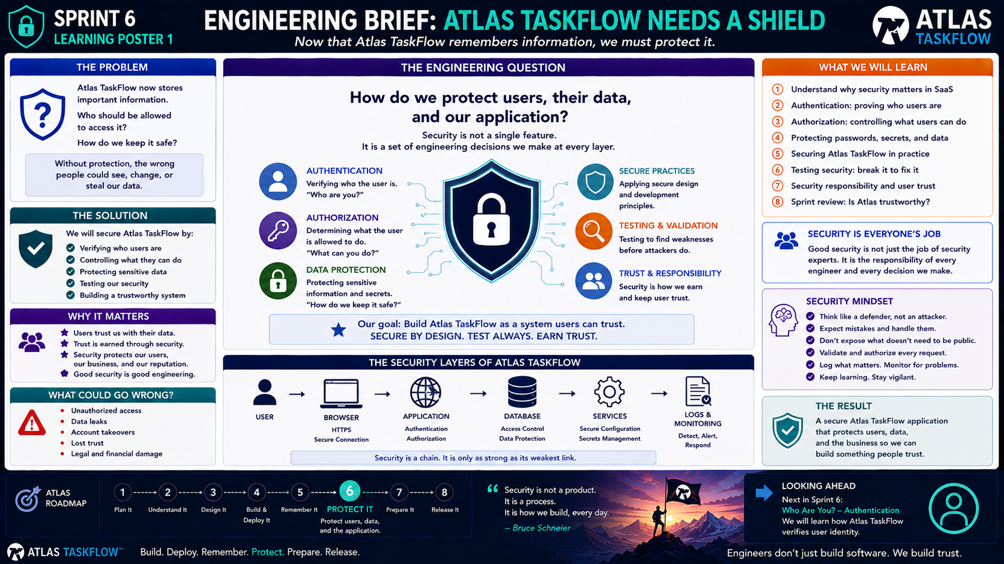
6-01
Notes:
============================================================
SPRINT 6
WHO ARE YOU?
AUTHENTICATION
============================================================
SLIDE PURPOSE
Introduce authentication as the process of verifying a user's identity.
Students should understand:
• Why applications need user identity
• What authentication means
• The difference between authentication and authorization
• The basic login process
• Sessions/cookies at a conceptual level
• Why passwords must be protected
• How authentication fits into Atlas TaskFlow
The goal is conceptual understanding followed by practical application.
This is NOT a deep dive into ASP.NET Core Identity.
------------------------------------------------------------
OPENING
"Engineers..."
"Last sprint, we gave Atlas TaskFlow a memory."
"Atlas can now remember tasks."
"Projects."
"Users."
"Other application data."
Pause.
"But that creates a new problem."
Point toward the shield.
"If Atlas remembers information..."
"How does it know WHO is asking for it?"
------------------------------------------------------------
THE ENGINEERING QUESTION
Point to:
"WHO ARE YOU?"
Say:
"That's the question authentication answers."
Pause.
"Before Atlas gives someone access to protected information..."
"It needs to know who that person is."
------------------------------------------------------------
REAL-WORLD CONNECTION
Ask:
"When you open your banking application..."
"How does the application know it's you?"
Students may say:
"Username."
"Password."
"Face ID."
"Fingerprint."
"Authentication."
Exactly.
Explain:
"Those are methods of proving identity."
------------------------------------------------------------
WHAT IS AUTHENTICATION?
Point to the definition.
"Authentication is the process of verifying the identity of a user."
Simplify:
"Authentication answers one question."
Point to:
WHO ARE YOU?
------------------------------------------------------------
AUTHENTICATION VS AUTHORIZATION
This is one of the most important distinctions in Sprint 6.
Write on the board:
AUTHENTICATION
= Who are you?
AUTHORIZATION
= What are you allowed to do?
Say:
"Do not confuse these."
Example:
"I know you are Charles."
That's authentication.
"But are you allowed to delete this project?"
That's authorization.
------------------------------------------------------------
THE ATLAS EXAMPLE
Imagine two users:
Alex
Taylor
Both have Atlas accounts.
Alex signs in.
Atlas verifies:
"Yes, this is Alex."
Authentication complete.
But then Alex tries to access Taylor's private project.
Now we have an authorization question.
"Is Alex allowed to see it?"
That's next.
------------------------------------------------------------
THE LOGIN PROCESS
Point to the flow:
USER
↓
LOGIN FORM
↓
CREDENTIALS
↓
APPLICATION
↓
VERIFY IDENTITY
↓
AUTHENTICATED USER
Walk through it.
The user provides credentials.
The application verifies them.
If they are valid:
The user becomes authenticated.
If they are invalid:
Access is denied.
------------------------------------------------------------
WHAT IS A CREDENTIAL?
Explain:
"A credential is information used to prove identity."
Examples:
Username.
Password.
Passkey.
Security token.
Biometric authentication.
Explain:
"We're going to focus primarily on username/password authentication
because it's easy to understand."
But:
"Modern applications have many authentication methods."
------------------------------------------------------------
PASSWORDS
Ask:
"Where should the application store a user's password?"
Students may say:
"In the database."
Then correct the misconception.
"Not as plain text."
Pause.
"The application should never need to know a user's original password
after it has been securely processed."
Introduce:
HASHING.
------------------------------------------------------------
PASSWORD HASHING
Explain:
"A password hash is a one-way representation of a password."
Conceptual flow:
PASSWORD
↓
HASH
↓
STORED REPRESENTATION
When the user logs in:
PASSWORD
↓
HASH
↓
COMPARE
Explain:
"The application verifies the password without storing the original
password in plain text."
Keep this conceptual.
Do not dive into cryptographic algorithms.
------------------------------------------------------------
IMPORTANT SECURITY RULE
Say this clearly:
"Never store passwords as plain text."
Then:
"Never put passwords or secrets into GitHub."
Pause.
"These are basic professional security practices."
------------------------------------------------------------
THE LOGIN FLOW
Walk through a simplified login.
User enters:
Email:
alex@example.com
Password:
••••••••
Application receives the request.
Application verifies the credentials.
If valid:
User is authenticated.
If invalid:
Login fails.
------------------------------------------------------------
WHAT HAPPENS AFTER LOGIN?
Ask:
"Does Atlas ask the user for their password on every page?"
Students:
"No."
Exactly.
Explain:
"Once the user has authenticated..."
"The application needs a way to remember that authentication."
Introduce:
SESSION / AUTHENTICATION COOKIE
Keep it conceptual.
------------------------------------------------------------
AUTHENTICATION COOKIE
Explain:
"After successful authentication, the application can provide the
browser with an authentication cookie."
"The browser sends that information with later requests."
"That allows the application to recognize the user."
Simple model:
LOGIN
↓
AUTHENTICATE
↓
AUTHENTICATION COOKIE
↓
SUBSEQUENT REQUESTS
↓
APPLICATION KNOWS USER
------------------------------------------------------------
IMPORTANT DISTINCTION
Say:
"The cookie does not mean the user is automatically authorized to do
everything."
"It simply helps the application know who the user is."
Again:
Authentication.
Who are you?
Authorization.
What can you do?
------------------------------------------------------------
SIGN OUT
Ask:
"What happens when the user clicks Logout?"
Explain:
"The application ends the authenticated session."
"The browser no longer presents the authentication state."
"The user must authenticate again."
------------------------------------------------------------
WHY LOGOUT MATTERS
Imagine:
A student uses a library computer.
They log into Atlas.
They walk away without logging out.
Another person sits down.
Ask:
"What could happen?"
Students:
"Someone could access their account."
Exactly.
Explain:
"Security includes how users end sessions, not just how they begin them."
------------------------------------------------------------
ATLAS TASKFLOW
Now connect authentication directly to the product.
Atlas users should eventually be able to:
Create an account.
Sign in.
Sign out.
Access their tasks.
Access their projects.
Have Atlas identify them.
This creates the foundation for authorization.
------------------------------------------------------------
USER IDENTITY
Point to the data model.
We previously created:
User
UserId
Explain:
"Now that User becomes much more important."
"The application needs to associate activity with a specific user."
For example:
User:
Alex
UserId:
42
Project:
Atlas Website
Task:
Build Dashboard
Now Atlas can understand:
"This task belongs to Alex."
------------------------------------------------------------
WHY IDENTITY MATTERS
Ask:
"What would happen if Atlas didn't know who created a task?"
Students may recognize:
We wouldn't know ownership.
We couldn't restrict access.
We couldn't personalize the dashboard.
We couldn't reliably protect data.
Exactly.
"Identity is the foundation for authorization."
------------------------------------------------------------
AUTHENTICATION ARCHITECTURE
Show the conceptual flow:
USER
↓
LOGIN
↓
AUTHENTICATION
↓
USER IDENTITY
↓
AUTHENTICATED REQUEST
↓
ATLAS TASKFLOW
Explain:
"Now every request can potentially be associated with an authenticated
user."
------------------------------------------------------------
BUILD CHALLENGE
Have students identify the authentication requirements for Atlas.
Ask them to define:
1. How does a user sign in?
2. What information identifies the user?
3. What happens when authentication succeeds?
4. What happens when authentication fails?
5. What happens when the user logs out?
6. How will Atlas know which user is making a request?
------------------------------------------------------------
IF USING ASP.NET CORE IDENTITY
Introduce it carefully.
Say:
"ASP.NET Core provides a framework called ASP.NET Core Identity that
handles many of these common identity requirements."
Explain:
"It gives us infrastructure for things like:
User accounts.
Passwords.
Login.
Logout.
Authentication state.
User management."
Then:
"We're going to use the framework rather than reinventing
authentication ourselves."
------------------------------------------------------------
IMPORTANT BOUNDARY
Say:
"This is NOT the time to write our own password system."
"Professional developers use established identity frameworks."
Explain:
"Authentication is one area where reinventing the wheel can create
serious security problems."
------------------------------------------------------------
COMMON MISCONCEPTIONS
Address these directly.
Authentication is NOT authorization.
A login form is NOT the entire authentication system.
A username is NOT proof of identity.
A password should NOT be stored as plain text.
Being authenticated does NOT mean a user can access everything.
Logging in does NOT eliminate the need for authorization.
------------------------------------------------------------
SECURITY MINDSET
Ask:
"What is the worst thing we could do when building authentication?"
Possible answer:
"Assume it works."
Exactly.
Explain:
"Authentication must be tested."
We need to test:
Correct credentials.
Incorrect credentials.
Missing credentials.
Logout.
Expired/invalid authentication state.
Unauthorized access.
------------------------------------------------------------
TESTING SCENARIOS
Have students think through:
TEST 1
Correct username + correct password.
Expected:
Login succeeds.
TEST 2
Correct username + incorrect password.
Expected:
Login fails.
TEST 3
Unknown user.
Expected:
Login fails.
TEST 4
User logs out.
Expected:
Protected access requires authentication again.
------------------------------------------------------------
ENGINEERING INSIGHT
Point to the statement:
"Identity is the foundation of trust."
Explain:
"If Atlas doesn't know who someone is..."
"It can't reliably determine what they're allowed to access."
"Authentication comes first."
------------------------------------------------------------
SPRINT CONNECTION
Point to:
⑥ PROTECT IT
Say:
"Sprint 5 gave Atlas memory."
"Sprint 6 gives Atlas identity."
Then:
"Once Atlas knows who you are..."
"We can decide what you're allowed to do."
------------------------------------------------------------
LOOKING AHEAD
Point toward:
"Who Can Do What?"
Say:
"Next, we move from authentication to authorization."
Ask:
"If Atlas knows that you're Charles..."
"Does that mean you're allowed to delete every task?"
Students:
"No."
Exactly.
"Next..."
"We decide what users are allowed to do."
------------------------------------------------------------
CLOSING
Say:
"Authentication answers one question."
Pause.
"Who are you?"
Then:
"Once Atlas knows who you are..."
"We can ask the next question."
"What are you allowed to do?"
============================================================
ESTIMATED TIME
Opening & Identity Problem...........8 minutes
Authentication Concept...............10 minutes
Authentication vs Authorization......10 minutes
Login & Session Flow..................12 minutes
Passwords & Identity Security.........8 minutes
Atlas Identity Design.................8 minutes
Testing & Discussion.................9 minutes
TOTAL................................65 minutes
============================================================
INSTRUCTOR NOTES
Keep authentication conceptual before showing implementation.
Students should understand the process before interacting with the
framework.
The mental model should be:
USER
↓
AUTHENTICATE
↓
IDENTITY
↓
AUTHENTICATED REQUEST
Do not spend significant time on cryptographic implementation.
Do not teach students to build their own password hashing system.
Use established frameworks and practices.
------------------------------------------------------------
IMPORTANT TEACHING MOVE
Keep asking:
"Who are you?"
Then:
"What are you allowed to do?"
Students should eventually automatically associate:
WHO = Authentication
WHAT = Authorization
------------------------------------------------------------
SECURITY BOUNDARY
Briefly introduce:
• Password hashing
• Authentication cookies
• Session state
• Secure credentials
But save deeper security concepts for later artifacts.
------------------------------------------------------------
KEY TAKEAWAY
Write this on the board:
AUTHENTICATION
"WHO ARE YOU?"
↓
IDENTITY
↓
AUTHENTICATED REQUEST
Then:
AUTHORIZATION
"WHAT CAN YOU DO?"
------------------------------------------------------------
FINAL STATEMENT
"Engineers..."
"Before Atlas can protect information..."
"It needs to know who is asking for it."
"Today, we taught Atlas how to recognize identity."
"Next..."
"We decide what that identity is allowed to do."
============================================================

Slide 2
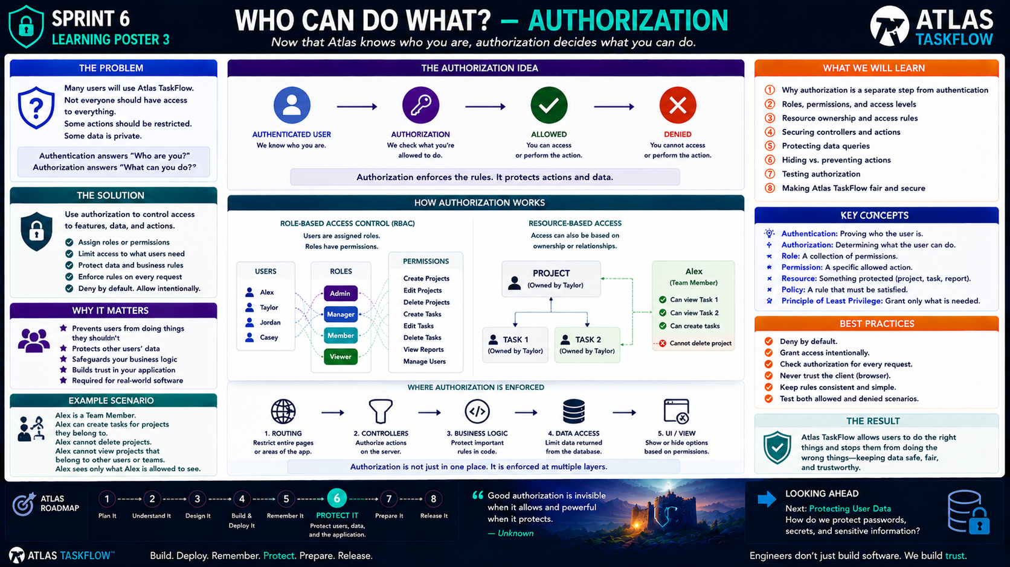
6-02
Notes:
============================================================
SPRINT 6
WHO CAN DO WHAT?
AUTHORIZATION
============================================================
SLIDE PURPOSE
Teach students that authentication and authorization are separate
security responsibilities.
Students should understand:
• Authentication identifies the user.
• Authorization determines what the user can access or do.
• Roles can be used to group permissions.
• Ownership can determine access to resources.
• Authorization must be enforced on the server.
• Access decisions should be intentional and tested.
The goal is practical security thinking.
This is NOT an enterprise identity-management course.
------------------------------------------------------------
OPENING
"Engineers..."
"Last lesson, we taught Atlas how to answer one question."
Point to:
WHO ARE YOU?
"Authentication."
Pause.
"But knowing who someone is isn't enough."
Ask:
"If Atlas knows you're Charles..."
"Should Atlas automatically let you delete every task?"
Students:
"No."
Exactly.
"That's today's question."
------------------------------------------------------------
THE ENGINEERING QUESTION
Point to:
"WHO CAN DO WHAT?"
Say:
"That's authorization."
Authentication asks:
"Who are you?"
Authorization asks:
"What are you allowed to do?"
------------------------------------------------------------
THE SIMPLEST EXAMPLE
Use a school building.
Ask:
"If I know you're a student..."
"Does that mean you can walk into the faculty office?"
Students:
"No."
Explain:
"The system knows who you are."
"But it still has to decide what you're allowed to access."
That's authorization.
------------------------------------------------------------
AUTHENTICATION VS AUTHORIZATION
Write on the board:
AUTHENTICATION
= WHO?
AUTHORIZATION
= WHAT?
Then:
WHO ARE YOU?
↓
WHAT CAN YOU DO?
Say:
"Keep those two questions separate."
This distinction should become automatic.
------------------------------------------------------------
THE ATLAS EXAMPLE
Imagine three users:
Alex
Taylor
Jordan
They can all successfully log into Atlas.
Authentication:
✓ Alex is Alex.
✓ Taylor is Taylor.
✓ Jordan is Jordan.
But their permissions may be different.
For example:
Admin
Manager
Team Member
Viewer
Explain:
"Authentication tells us who they are."
"Authorization tells us what their account allows."
------------------------------------------------------------
WHAT IS A ROLE?
Point to:
ROLE
Explain:
"A role is a collection of permissions."
Examples:
Admin.
Manager.
Team Member.
Viewer.
Then explain:
"We can assign users roles."
"The role helps determine what they are allowed to do."
------------------------------------------------------------
ROLE EXAMPLE
Use Atlas.
ADMIN:
Manage users.
Create projects.
Edit projects.
Delete projects.
MANAGER:
Create projects.
Edit projects.
Manage team tasks.
TEAM MEMBER:
Create tasks.
Edit assigned tasks.
VIEWER:
View information.
Explain:
"The exact roles are determined by the requirements of the application."
"We're using these as examples."
------------------------------------------------------------
WHAT IS A PERMISSION?
Point to:
PERMISSION
Explain:
"A permission is a specific action a user is allowed to perform."
Examples:
Create Task.
Edit Task.
Delete Task.
Create Project.
View Project.
Manage Users.
Say:
"Roles group permissions together."
------------------------------------------------------------
ROLE → PERMISSIONS
Draw:
USER
↓
ROLE
↓
PERMISSIONS
For example:
Alex
↓
Team Member
↓
Create Tasks
Edit Tasks
View Projects
Explain:
"Alex doesn't need to be individually configured for every action."
"The role gives us a manageable way to organize permissions."
------------------------------------------------------------
BUT ROLES AREN'T EVERYTHING
Point to:
RESOURCE-BASED ACCESS
Explain:
"Sometimes the question isn't simply what role you have."
"It's about what resource you're trying to access."
Example:
Taylor owns Project A.
Alex owns Project B.
Both are Team Members.
Should Alex automatically be able to edit Taylor's project?
No.
Why?
"Because ownership matters."
------------------------------------------------------------
OWNERSHIP
Use the Atlas example:
PROJECT
Owner:
Taylor
Tasks:
Task 1
Task 2
Task 3
Explain:
"Taylor may be allowed to manage this project because Taylor owns it."
"Alex may not."
This is called:
RESOURCE-BASED AUTHORIZATION.
Keep the terminology secondary.
The important idea is:
"Who owns the thing?"
------------------------------------------------------------
THE TWO QUESTIONS
For every protected resource, we can ask:
1. Who is the user?
2. Are they allowed to access this resource?
Example:
User:
Alex
Resource:
Taylor's Project
Authentication:
✓ Alex is authenticated.
Authorization:
✗ Alex is not allowed to access Taylor's private project.
Therefore:
ACCESS DENIED.
------------------------------------------------------------
THE ALLOWED / DENIED FLOW
Point to the central flow.
AUTHENTICATED USER
↓
AUTHORIZATION CHECK
↓
ALLOWED?
↙ ↘
YES NO
↓ ↓
ACCESS DENIED
Explain:
"Every protected action needs a decision."
------------------------------------------------------------
AUTHORIZATION IS A RULE
Explain:
"Authorization is really a collection of rules."
Examples:
Only authenticated users can access Tasks.
Only project members can view a project.
Only project owners can delete a project.
Only administrators can manage users.
These rules become part of the application's behavior.
------------------------------------------------------------
WHERE SHOULD AUTHORIZATION HAPPEN?
Point to the architecture.
USER
↓
BROWSER
↓
APPLICATION
↓
DATABASE
Say:
"Where should we enforce authorization?"
Students may say:
"The browser."
Correct them.
"The browser can hide things."
"But the server must enforce the rule."
------------------------------------------------------------
IMPORTANT SECURITY PRINCIPLE
Say:
"Hiding a button is not security."
Pause.
"If I hide the Delete button..."
"That doesn't mean the user can't try to call the Delete action directly."
Therefore:
"Authorization must be enforced on the server."
This is one of the most important points of the lesson.
------------------------------------------------------------
THE WRONG APPROACH
Imagine the page contains:
[ Delete Project ]
The developer hides the button for unauthorized users.
Ask:
"Are we secure?"
No.
Explain:
"The user could potentially manipulate the request or navigate
directly to the endpoint."
The server still needs to check:
"Is this user authorized?"
------------------------------------------------------------
THE RIGHT APPROACH
User requests:
DELETE /Projects/42
Server checks:
Who is the user?
What role do they have?
Do they own the project?
Are they allowed to delete it?
Then:
ALLOW
or
DENY.
------------------------------------------------------------
AUTHORIZATION AT MULTIPLE LAYERS
Point to the architecture.
1. ROUTING
Can the user reach the page?
2. CONTROLLER
Can the user perform the action?
3. BUSINESS LOGIC
Does the action follow application rules?
4. DATA ACCESS
Should this data be returned?
5. UI
Should the option be displayed?
Explain:
"Good authorization isn't just hiding buttons."
"It is enforced throughout the application."
------------------------------------------------------------
PRINCIPLE OF LEAST PRIVILEGE
Introduce the term.
"Least privilege means giving users only the access they actually
need."
Example:
A Viewer doesn't need Delete permissions.
A Team Member doesn't need Manage Users permissions.
An Administrator may need broader access.
Explain:
"More access isn't automatically better."
------------------------------------------------------------
DENY BY DEFAULT
Point to:
DENY BY DEFAULT.
Explain:
"When we're not sure whether someone should have access..."
"The safer assumption is to deny access until the rule says otherwise."
This is a security mindset.
------------------------------------------------------------
ATLAS EXAMPLE
Ask:
"Should a logged-in user be able to see every project in Atlas?"
Answer:
"Not necessarily."
Then:
"What determines access?"
Possible answers:
Role.
Ownership.
Membership.
Business rules.
Exactly.
------------------------------------------------------------
BUILD CHALLENGE
Have students create an authorization matrix.
Example:
| Role | View | Create | Edit | Delete |
|------|------|--------|------|--------|
| Admin | ✓ | ✓ | ✓ | ✓ |
| Manager | ✓ | ✓ | ✓ | Limited |
| Team Member | ✓ | ✓ | Own | No |
| Viewer | ✓ | No | No | No |
Explain:
"The exact rules are up to the application's requirements."
Students should create their own rules based on Atlas TaskFlow.
------------------------------------------------------------
OWNERSHIP CHALLENGE
Give students this scenario:
Taylor owns:
"Website Redesign"
Alex is a member of another project.
Ask:
"Should Alex be able to delete Taylor's project?"
No.
Ask:
"Should Alex be able to see Taylor's project?"
"It depends."
This is important.
"Authorization rules come from requirements and business decisions."
------------------------------------------------------------
AUTHORIZATION TESTING
Ask students to think like attackers.
Test:
Authenticated user accessing an allowed resource.
Authenticated user accessing a restricted resource.
Unauthenticated user accessing a protected page.
User attempting another user's resource.
User attempting a restricted action.
Explain:
"We need to test both sides."
Allowed.
Denied.
------------------------------------------------------------
THE NEGATIVE TEST
Emphasize:
"Security testing isn't just proving that the right user can get in."
"We also need to prove that the wrong user cannot."
This is a major engineering mindset.
------------------------------------------------------------
COMMON MISCONCEPTIONS
Address these directly.
Authentication is NOT authorization.
A logged-in user is NOT automatically an administrator.
Hiding a button is NOT authorization.
Knowing a URL is NOT permission.
Being authenticated does NOT mean access to every resource.
Roles are NOT the only way to make authorization decisions.
Ownership can matter.
------------------------------------------------------------
IF USING ASP.NET CORE
Briefly connect to implementation.
Explain:
"ASP.NET Core gives us built-in authorization tools."
Examples include:
[Authorize]
Roles.
Policies.
Claims.
Keep these at the conceptual level.
Say:
"We're going to use the framework rather than inventing our own
authorization system."
------------------------------------------------------------
DO NOT OVERENGINEER
Say:
"For Atlas TaskFlow, we're going to keep this manageable."
"We don't need 50 roles."
"We don't need enterprise identity architecture."
"We need enough authorization to demonstrate that users can access
what they should and cannot access what they shouldn't."
This reinforces the scope of the SaaS class.
------------------------------------------------------------
ENGINEERING INSIGHT
Point to the statement:
"Good authorization is invisible when it works and powerful when it
protects."
Explain:
"A normal user shouldn't have to think about authorization."
"The application should simply enforce the rules."
------------------------------------------------------------
SPRINT CONNECTION
Point to:
⑥ PROTECT IT
Say:
"Authentication gave Atlas identity."
"Authorization gives Atlas boundaries."
Now Atlas can answer:
"Who are you?"
and:
"What are you allowed to do?"
------------------------------------------------------------
LOOKING AHEAD
Point to:
PROTECTING USER DATA.
Say:
"There's one more important question."
"If Atlas knows who you are and what you're allowed to do..."
"How do we protect the information itself?"
Next:
Passwords.
Secrets.
Sensitive data.
Secure configuration.
------------------------------------------------------------
CLOSING
Say:
"Authentication answers..."
'Who are you?'
Pause.
"Authorization answers..."
'What are you allowed to do?'
Then:
"Security isn't about giving everyone access."
"It's about giving the right people the right access."
============================================================
ESTIMATED TIME
Authentication Review................5 minutes
Authorization Concept................10 minutes
Roles & Permissions...................12 minutes
Ownership.............................10 minutes
Server-Side Enforcement................10 minutes
Authorization Matrix Challenge.........10 minutes
Testing & Discussion...................8 minutes
TOTAL..................................65 minutes
============================================================
INSTRUCTOR NOTES
This lesson should be highly scenario-driven.
Avoid turning authorization into a lecture about framework attributes.
Use Atlas examples.
Ask:
"Should Alex be able to do this?"
"Why?"
"What rule would allow or deny it?"
Then translate the answer into an authorization concept.
------------------------------------------------------------
IMPORTANT TEACHING MOVE
Keep returning to:
WHO?
WHAT?
Authentication:
WHO ARE YOU?
Authorization:
WHAT CAN YOU DO?
This distinction should become automatic.
------------------------------------------------------------
SECURITY BOUNDARY
Don't go deeply into:
• Claims-based identity architecture
• OAuth/OIDC internals
• JWT implementation
• Complex policy engines
• Multi-tenant authorization architecture
Those are outside the scope of this course.
Introduce the concepts only enough for students to understand the
security model.
------------------------------------------------------------
KEY TAKEAWAY
Write this on the board:
AUTHENTICATION
= WHO?
AUTHORIZATION
= WHAT?
ROLE
= COLLECTION OF PERMISSIONS
OWNERSHIP
= WHO CONTROLS THE RESOURCE?
LEAST PRIVILEGE
= ONLY WHAT IS NEEDED
------------------------------------------------------------
FINAL STATEMENT
"Engineers..."
"Atlas now knows who you are."
"Today, we taught Atlas what you're allowed to do."
"Next..."
"We protect the information Atlas is responsible for."
============================================================

Slide 3
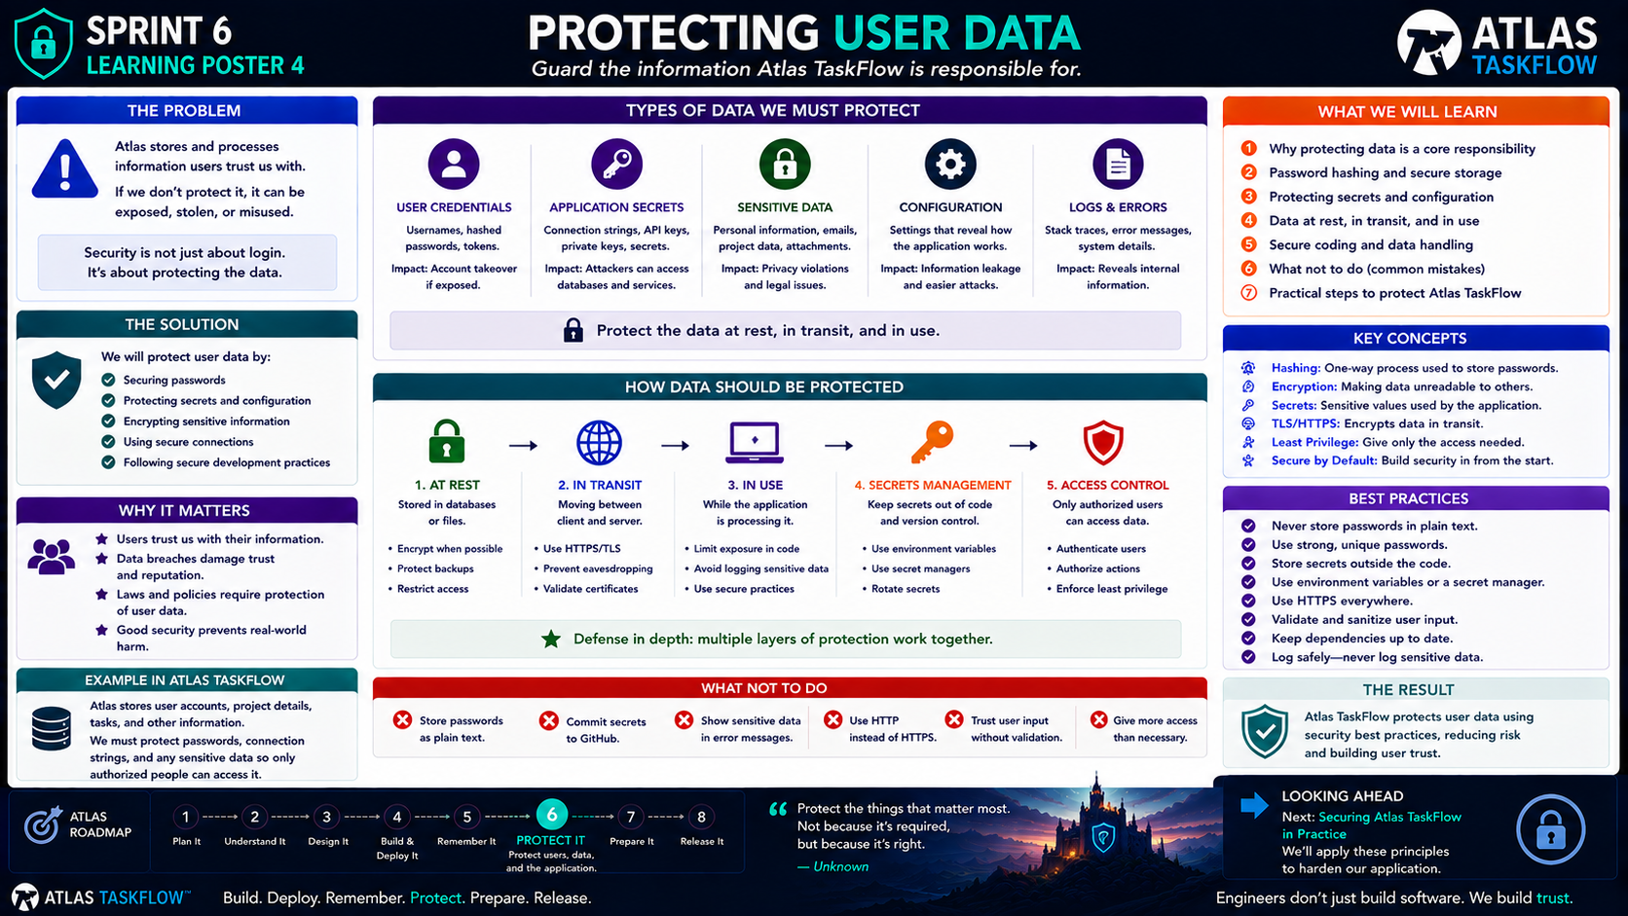
6-03
Notes:
============================================================
SPRINT 6
PROTECTING USER DATA
"Guard the information Atlas TaskFlow is responsible for."
============================================================
SLIDE PURPOSE
Help students understand that application security extends beyond
authentication and authorization.
Students should identify the types of information Atlas TaskFlow
needs to protect and understand basic methods for protecting that
information.
Students should understand:
• Credentials
• Passwords
• Application secrets
• Connection strings
• Sensitive user/application data
• Data at rest
• Data in transit
• Secure configuration
• Logging considerations
• Defense in depth
The objective is security awareness and practical application.
This is NOT a cybersecurity certification course.
------------------------------------------------------------
OPENING
"Engineers..."
"Last lesson, Atlas learned who you are."
"Then Atlas learned what you're allowed to do."
Pause.
"But there's another question."
Point to the center of the poster.
"What exactly are we protecting?"
------------------------------------------------------------
THE ENGINEERING QUESTION
Ask:
"If users trust Atlas TaskFlow with their information..."
"What responsibility do we have?"
Let students answer.
Possible answers:
"Keep it private."
"Don't lose it."
"Don't let unauthorized users access it."
"Protect passwords."
"Keep hackers out."
Exactly.
Say:
"Security is about protecting the information users trust us with."
------------------------------------------------------------
THE BIG IDEA
Point to:
"Security is not just about login."
"It's about protecting the data."
Explain:
"A login screen can be perfectly designed..."
"...and we can still have an insecure application."
Why?
Because the application might:
Expose sensitive information.
Store passwords incorrectly.
Leak secrets.
Use insecure connections.
Return data to the wrong user.
Log sensitive information.
Security is broader than authentication.
------------------------------------------------------------
WHAT DATA DOES ATLAS HAVE?
Point to the data categories.
Ask students:
"What information does Atlas TaskFlow contain?"
Students may identify:
User accounts.
Projects.
Tasks.
Due dates.
Descriptions.
Team information.
Credentials.
Configuration.
Explain:
"Not all information has the same level of sensitivity."
This is important.
------------------------------------------------------------
USER CREDENTIALS
Point to:
USER CREDENTIALS.
Explain:
"Credentials are among the most important things we protect."
Examples:
Usernames.
Passwords.
Authentication tokens.
Security information.
Then emphasize:
"Passwords should never be stored in plain text."
------------------------------------------------------------
PASSWORDS
Ask:
"Why shouldn't we store this?"
Password:
P@ssword123
Explain:
"If someone gets access to the database..."
"...they shouldn't immediately have everyone's password."
Introduce the concept:
PASSWORD HASHING.
Say:
"Passwords are normally stored as secure hashes rather than readable
passwords."
Keep it conceptual.
------------------------------------------------------------
HASHING VS ENCRYPTION
This is a good distinction.
Say:
"Hashing and encryption are not the same thing."
Hashing:
One-way transformation.
Used for passwords.
Encryption:
Information is transformed so it can later be decrypted by someone
with the appropriate key.
Used to protect information that may need to be recovered.
Don't go into cryptographic algorithms.
Students just need the distinction.
------------------------------------------------------------
APPLICATION SECRETS
Point to:
APPLICATION SECRETS.
Ask:
"What does our application need to know that users shouldn't?"
Examples:
Database credentials.
API keys.
Service credentials.
Encryption keys.
Connection information.
Explain:
"These are secrets."
------------------------------------------------------------
THE GITHUB TEST
Ask:
"If I push my project to GitHub..."
"Should my production database password be sitting in the source code?"
Students:
"No."
Exactly.
Say:
"If a secret is committed to source control..."
"Assume it has been exposed."
------------------------------------------------------------
THE WRONG APPROACH
Show the conceptual example:
connectionString =
"Server=...;Password=MySecretPassword"
Explain:
"This might work."
"But it's a terrible practice for production."
Why?
Because source code gets:
Shared.
Copied.
Backed up.
Reviewed.
Published.
Stored in repositories.
Secrets should not live directly in application source code.
------------------------------------------------------------
BETTER APPROACH
Explain:
"Use configuration and secret-management mechanisms."
Examples:
Environment variables.
Secret managers.
Cloud configuration.
Development secrets.
Explain:
"The exact tool can vary."
"The principle stays the same."
Keep secrets outside the code whenever possible.
------------------------------------------------------------
DATA AT REST
Point to:
AT REST.
Ask:
"What does that mean?"
Explain:
"Data that is stored."
Examples:
Database.
Backup.
File.
Storage service.
Explain:
"Stored data needs protection."
Methods can include:
Encryption.
Access controls.
Secure backups.
Database permissions.
Good credential management.
------------------------------------------------------------
DATA IN TRANSIT
Point to:
IN TRANSIT.
Explain:
"Data moving between systems."
Examples:
Browser → Application.
Application → Database.
Application → External API.
Say:
"This is why HTTPS matters."
------------------------------------------------------------
HTTPS
Ask:
"When you log into a website..."
"Should your password travel across the internet as plain text?"
No.
Explain:
"HTTPS uses TLS to protect data moving between the client and server."
Simple model:
BROWSER
↓
HTTPS / TLS
↓
APPLICATION
This protects the communication channel.
------------------------------------------------------------
DATA IN USE
Point to:
IN USE.
Explain:
"Data also exists while the application is processing it."
For example:
A Task object exists in application memory.
A user profile is being processed.
A request is being handled.
Explain:
"Security doesn't end once data leaves the database."
This is why we think in layers.
------------------------------------------------------------
DEFENSE IN DEPTH
Point to:
DEFENSE IN DEPTH.
Explain:
"Good security doesn't depend on one protection."
Instead:
Authentication.
Authorization.
Secure connections.
Data protection.
Secret management.
Validation.
Logging.
Monitoring.
Explain:
"If one layer fails..."
"Other layers may still provide protection."
------------------------------------------------------------
THE SECURITY CHAIN
Use the flow:
USER
↓
AUTHENTICATION
↓
AUTHORIZATION
↓
APPLICATION
↓
DATA ACCESS
↓
DATABASE
Each layer has responsibilities.
Say:
"Security is a chain."
"Every link matters."
------------------------------------------------------------
LOGS AND ERRORS
Point to:
LOGS & ERRORS.
Ask:
"Should we log everything?"
Students may say:
"No."
Correct.
"Logging is useful."
"But sensitive information should not be exposed unnecessarily."
Examples we should avoid logging:
Passwords.
Authentication tokens.
Sensitive personal information.
Secrets.
Explain:
"Logs can become sensitive data too."
------------------------------------------------------------
ERROR MESSAGES
Connect this back to Sprint 5.
Ask:
"Should a user see a database connection string in an error message?"
Obviously no.
Explain:
"Technical errors should be logged appropriately."
"The user should receive a safe, useful message."
This connects Sprint 5 reliability to Sprint 6 security.
------------------------------------------------------------
LEAST PRIVILEGE
Review the concept from authorization.
Say:
"Another way to protect data is to limit who can access it."
"Users should receive only the access they need."
Applications should also use only the permissions they need.
For example:
"An application doesn't need administrator-level database access just
because it can connect to a database."
Keep this conceptual.
------------------------------------------------------------
SECURE BY DEFAULT
Introduce:
"Secure by default."
Explain:
"When we're not sure whether something should be exposed..."
"The safer starting point is to keep it protected."
Examples:
Private data should not automatically become public.
New accounts shouldn't automatically become administrators.
Secrets shouldn't automatically appear in logs.
Database access shouldn't automatically be unrestricted.
------------------------------------------------------------
WHAT NOT TO DO
Point to the red section.
Review each mistake.
Store passwords as plain text.
Commit secrets to GitHub.
Expose sensitive information in errors.
Use HTTP instead of HTTPS.
Trust user input.
Give users more access than necessary.
Ask students:
"Why is each one dangerous?"
Let them answer.
------------------------------------------------------------
ATLAS TASKFLOW EXAMPLE
Use a realistic scenario.
Atlas stores:
User account.
Project information.
Task information.
Authentication information.
Database connection information.
Ask:
"Which of these should be protected?"
Answer:
"All of them, but in different ways."
Explain:
"Security decisions depend on the type of information."
------------------------------------------------------------
BUILD CHALLENGE
Have students perform a security inventory of Atlas TaskFlow.
Create three columns:
WHAT WE STORE
HOW WE PROTECT IT
WHO SHOULD ACCESS IT
Example:
User Password
→ Hash securely
→ User / identity system
Database Credentials
→ Secret management
→ Application only
Project Data
→ Authorization
→ Authorized users
Application Logs
→ Avoid sensitive information
→ Developers/administrators
------------------------------------------------------------
SECURITY INVENTORY
Ask students to identify at least five pieces of information in Atlas.
For each one:
1. What is it?
2. Is it sensitive?
3. Where is it stored?
4. Who should access it?
5. How should it be protected?
This moves the lesson from theory into engineering thinking.
------------------------------------------------------------
THREAT THINKING
Ask:
"What happens if this information is exposed?"
Examples:
Password exposed:
Potential account takeover.
Database credentials exposed:
Potential database compromise.
Private project exposed:
Privacy problem.
Sensitive log exposed:
Information leakage.
Explain:
"Security decisions become easier when we understand the consequences."
------------------------------------------------------------
IMPORTANT BOUNDARY
Tell students:
"We are not trying to build perfect security."
"No application is completely risk-free."
"Our job is to identify important risks and apply reasonable
protections."
This is a much healthier engineering mindset than:
"My application is secure."
------------------------------------------------------------
SECURITY IS A PROCESS
Say:
"Security isn't a checkbox."
It involves:
Design.
Development.
Testing.
Deployment.
Monitoring.
Maintenance.
Explain:
"A secure application today can become insecure tomorrow if we stop
maintaining it."
This sets up Sprint 7 later.
------------------------------------------------------------
ENGINEERING INSIGHT
Point to:
"Protect the things that matter most."
Explain:
"Good security starts with understanding what we're protecting."
"You can't protect something you haven't identified."
------------------------------------------------------------
SPRINT CONNECTION
Point to:
⑥ PROTECT IT.
Review:
Authentication:
Who are you?
Authorization:
What can you do?
Data Protection:
How do we protect what matters?
Say:
"Now we have all three pieces."
------------------------------------------------------------
LOOKING AHEAD
Point to:
"Securing Atlas TaskFlow in Practice."
Say:
"So far, we've discussed security."
"Next..."
"We're going to apply these principles to our actual application."
Students will begin reviewing Atlas for:
Authentication.
Authorization.
Data protection.
Secrets.
Secure configuration.
HTTPS.
------------------------------------------------------------
CLOSING
Say:
"Engineers..."
"Security isn't about building a wall around everything."
"It's about understanding what matters..."
"...who needs access..."
"...and how to protect it."
Pause.
"Atlas remembers."
"Atlas knows who you are."
"Atlas knows what you're allowed to do."
"Now..."
"We need to protect the information itself."
============================================================
ESTIMATED TIME
Opening & Security Responsibility.......8 minutes
Data Categories.........................10 minutes
Passwords & Secrets.....................12 minutes
Data at Rest / Transit / Use.............10 minutes
Defense in Depth.........................8 minutes
Security Inventory Challenge.............12 minutes
Discussion & Closing.....................5 minutes
TOTAL....................................65 minutes
============================================================
INSTRUCTOR NOTES
This lesson should connect heavily to things students have already
built.
Ask them to inspect their actual Atlas TaskFlow project.
Look for:
Connection strings.
Configuration files.
User information.
Database access.
Error messages.
Logging.
HTTPS.
Do not simply tell students what is secure.
Have them identify potential weaknesses themselves.
------------------------------------------------------------
IMPORTANT TEACHING MOVE
Keep asking:
"What are we protecting?"
"Who needs access?"
"Where is it stored?"
"What happens if it is exposed?"
These four questions develop a security mindset.
------------------------------------------------------------
PASSWORD BOUNDARY
Do not teach students to create their own password hashing system.
Use established identity/security frameworks.
The important principle is:
"Never store passwords as plain text."
------------------------------------------------------------
SECRETS BOUNDARY
Emphasize:
Never commit production secrets to GitHub.
If a secret is accidentally committed:
Treat it as exposed.
Rotate it.
Remove it from active use.
Use appropriate secret/configuration management.
------------------------------------------------------------
SECURITY BOUNDARY
Don't turn this into a deep cybersecurity lesson.
Avoid:
• Cryptographic algorithm implementation
• Advanced key management
• Penetration testing
• Network security architecture
• Compliance frameworks
• Enterprise SIEM systems
Those are outside the scope of this class.
------------------------------------------------------------
KEY TAKEAWAY
Write this on the board:
AT REST
= Stored
IN TRANSIT
= Moving
IN USE
= Processing
Then:
AUTHENTICATE
↓
AUTHORIZE
↓
PROTECT
↓
MONITOR
------------------------------------------------------------
FINAL STATEMENT
"Engineers..."
"Users trust software with information."
"That trust is our responsibility."
"Next..."
"We're going to put these security principles into practice."
============================================================

Slide 4
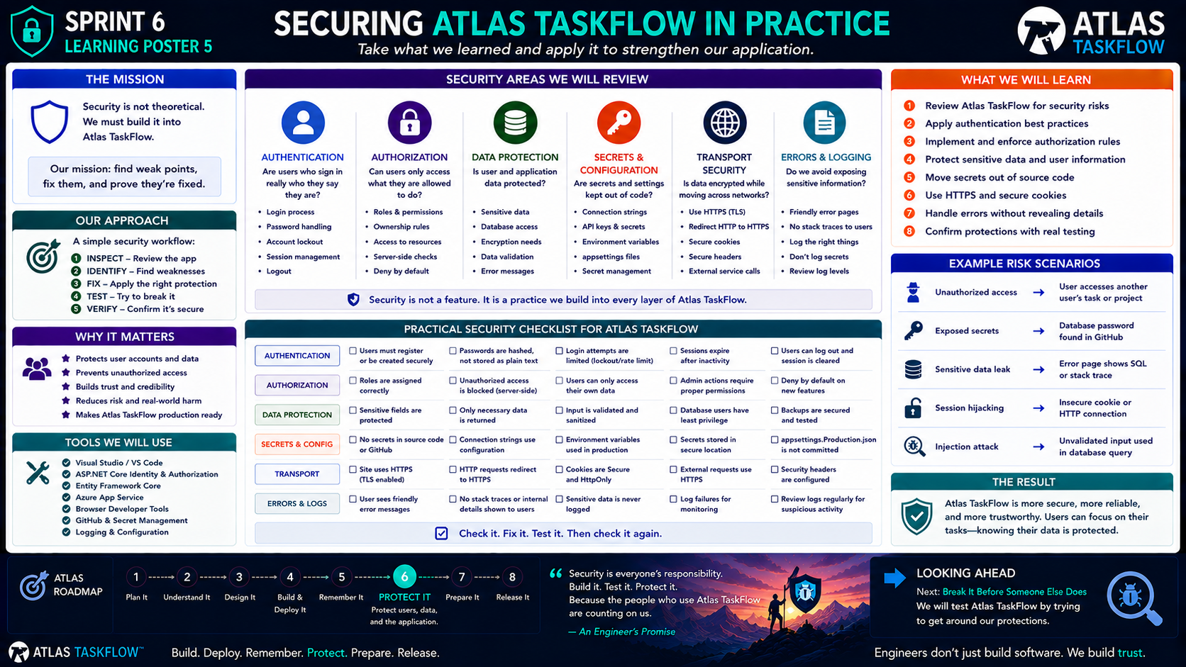
6-04
Notes:
============================================================
SPRINT 6
SECURING ATLAS TASKFLOW IN PRACTICE
"Build it. Test it. Protect it."
============================================================
SLIDE PURPOSE
Move students from learning security concepts to applying those
concepts directly to their Atlas TaskFlow application.
Students will inspect their application, identify weaknesses, apply
appropriate protections, test those protections, and verify the
results.
The core engineering workflow is:
INSPECT
↓
IDENTIFY
↓
FIX
↓
TEST
↓
VERIFY
This should be a hands-on working session.
------------------------------------------------------------
OPENING
"Engineers..."
"We've talked about authentication."
"We've talked about authorization."
"We've talked about protecting data."
"We've talked about secrets."
Pause.
"But here's the problem."
"Talking about security doesn't make an application secure."
Point to:
INSPECT → IDENTIFY → FIX → TEST → VERIFY
"Today, we're going to apply what we've learned."
------------------------------------------------------------
THE MISSION
Point to:
"Find weak points. Fix them. Prove they're fixed."
Say:
"This is a security review."
"We're going to look at Atlas TaskFlow the way an engineer should."
"Not just asking..."
'Does it work?'
"But also..."
'Can someone misuse it?'
------------------------------------------------------------
SECURITY IS NOT THEORETICAL
Point to the shield.
Say:
"Security isn't something that lives in a textbook."
"It has to exist inside our application."
Ask:
"Where does security live?"
Possible answers:
Login.
Permissions.
Database.
Code.
Configuration.
Network.
Exactly.
"Security exists across the application."
------------------------------------------------------------
OUR APPROACH
Walk through the five steps.
INSPECT
Look at what we've built.
IDENTIFY
Find potential weaknesses.
FIX
Apply the appropriate protection.
TEST
Try to break the protection.
VERIFY
Confirm the protection actually works.
Say:
"This is an engineering process."
"Don't skip straight to FIX."
------------------------------------------------------------
STEP 1 — INSPECT
Tell students:
"Open your Atlas TaskFlow project."
Have them inspect:
Authentication.
Authorization.
Models.
Controllers.
Configuration.
Database access.
GitHub repository.
Azure deployment.
Ask:
"What are we looking for?"
Answer:
"Places where information or access could be exposed."
------------------------------------------------------------
AUTHENTICATION REVIEW
Point to Authentication.
Ask:
"Can an unauthenticated user access protected pages?"
Test:
Open Atlas without signing in.
Try to navigate to a protected page.
Expected:
Access denied or redirect to login.
Then:
"Can a valid user sign in?"
"Can they log out?"
"Does the application recognize them afterward?"
------------------------------------------------------------
AUTHENTICATION CHECKLIST
Review:
Users can register.
Users can sign in.
Passwords are handled securely.
Invalid login attempts are rejected.
Users can log out.
Protected pages require authentication.
Session behavior is appropriate.
Say:
"We're not just checking whether the login form looks good."
"We're checking whether authentication actually protects the application."
------------------------------------------------------------
AUTHORIZATION REVIEW
Move to Authorization.
Ask:
"Now that we're authenticated..."
"What can we do?"
Test:
User A.
User B.
Have User A attempt to access User B's information.
Ask:
"Should this work?"
Expected:
"No."
Explain:
"This is where authorization becomes real."
------------------------------------------------------------
OWNERSHIP TEST
Create two users if necessary.
User A owns:
Project A.
User B owns:
Project B.
Try to access Project B as User A.
Then try to modify it.
Then try to delete it.
Ask:
"What happened?"
Expected:
Access should be denied.
Explain:
"This is resource ownership."
------------------------------------------------------------
SERVER-SIDE AUTHORIZATION
Point to:
"Server-side checks."
Say:
"Remember our earlier lesson."
"Hiding a button isn't security."
If User A doesn't see the Delete button for User B's project...
Ask:
"What happens if User A manually requests the delete action?"
The server must still reject it.
Say:
"The server is the final authority."
------------------------------------------------------------
DATA PROTECTION REVIEW
Move to Data Protection.
Ask:
"What information does Atlas store?"
Review:
User information.
Projects.
Tasks.
Credentials.
Configuration.
Potentially other sensitive data.
Now ask:
"Who should be able to access each type?"
Students should connect this to authorization.
------------------------------------------------------------
DATA MINIMIZATION
Ask:
"Does Atlas need to store everything?"
No.
Explain:
"One way to protect information is not to collect information we don't
need."
Store what the application requires.
Avoid unnecessary sensitive information.
------------------------------------------------------------
SECRETS & CONFIGURATION
Point to:
Secrets & Configuration.
Ask:
"Open your GitHub repository."
Search for:
Passwords.
Connection strings.
API keys.
Tokens.
Secrets.
Explain:
"We're looking for accidental exposure."
------------------------------------------------------------
THE GITHUB TEST
Ask:
"If someone downloaded our repository..."
"Could they find a production password?"
If yes:
"That's a problem."
Explain:
"Source control is not a secret vault."
Secrets should be managed through appropriate configuration and secret
management mechanisms.
------------------------------------------------------------
CONNECTION STRINGS
Point to:
Connection strings.
Say:
"Development environments may use local configuration."
"But production credentials should be handled securely."
Explain:
"We don't want a database password sitting in committed source code."
------------------------------------------------------------
TRANSPORT SECURITY
Move to:
Transport.
Ask:
"How does the browser communicate with our application?"
HTTPS.
Explain:
"HTTPS protects data while it moves between the browser and server."
Test:
Open the deployed Atlas application.
Look for:
HTTPS.
Secure connection.
Valid certificate.
Then explain:
"Users should not be sending passwords over an unprotected connection."
------------------------------------------------------------
SECURE COOKIES
Briefly discuss cookies.
Say:
"Authentication information may be stored in cookies."
"Those cookies need appropriate security settings."
The goal is to reduce the chance that authentication information can
be improperly accessed.
Keep this conceptual.
------------------------------------------------------------
ERRORS & LOGGING
Point to:
Errors & Logging.
Ask:
"What happens when something breaks?"
Have students intentionally trigger an error if practical.
Look at the resulting user experience.
Ask:
"Does the user see a helpful message?"
"Does the user see a stack trace?"
"Does the user see a database connection?"
"Does the user see sensitive information?"
Expected:
"No."
------------------------------------------------------------
THE ERROR MESSAGE TEST
Bad:
"SqlException: Login failed for user..."
Better:
"Unable to complete your request. Please try again."
Explain:
"Users need useful information."
"Developers need technical information."
Those should be handled differently.
------------------------------------------------------------
LOGGING
Ask:
"Where does the technical information go?"
Logging.
Explain:
"Logs help developers understand failures."
But:
"Logs should not become another place where secrets leak."
Ask:
"Should we log passwords?"
No.
"Authentication tokens?"
No.
"Database passwords?"
Absolutely not.
------------------------------------------------------------
EXAMPLE RISK SCENARIOS
Walk through each scenario.
------------------------------------------------------------
RISK 1 — UNAUTHORIZED ACCESS
Scenario:
User accesses another user's task.
Question:
"What should happen?"
Access denied.
------------------------------------------------------------
RISK 2 — EXPOSED SECRET
Scenario:
Database password is committed to GitHub.
Question:
"What should happen?"
The secret should be removed and rotated.
Then:
"How do we prevent it?"
Use proper secret management.
------------------------------------------------------------
RISK 3 — SENSITIVE DATA LEAK
Scenario:
An error page displays SQL information.
Question:
"Should the user see that?"
No.
------------------------------------------------------------
RISK 4 — SESSION PROBLEM
Scenario:
Authentication information is handled insecurely.
Question:
"What could happen?"
Potential unauthorized access.
Explain:
"This is why secure session and cookie configuration matters."
------------------------------------------------------------
RISK 5 — UNVALIDATED INPUT
Scenario:
User-controlled input is passed directly into database operations.
Question:
"What could happen?"
Potential injection or data manipulation.
Connect back to Sprint 5:
"Validation still matters."
------------------------------------------------------------
SECURITY CHECKLIST
Now move into the large checklist.
Tell students:
"This is your security inspection."
Have them work through each category.
Authentication.
Authorization.
Data Protection.
Secrets & Configuration.
Transport.
Errors & Logs.
------------------------------------------------------------
STUDENT WORKFLOW
For every checklist item, students should mark:
PASS
FAIL
NEEDS REVIEW
Then explain:
"A failed check isn't a failure as a student."
"It's a discovery."
"Finding a problem is the first step toward fixing it."
------------------------------------------------------------
THE SECURITY REPORT
Have students document:
1. What did we inspect?
2. What did we find?
3. What risk does it create?
4. What did we change?
5. How did we test it?
6. What was the result?
This is a miniature professional security review.
------------------------------------------------------------
THE FIX
Now students make changes.
Examples:
Add authorization checks.
Protect a controller action.
Remove a secret from source code.
Improve error handling.
Enable HTTPS.
Correct access rules.
Protect sensitive information.
Explain:
"Don't change something just because it sounds more secure."
"Change it because you can identify the risk it addresses."
------------------------------------------------------------
TEST AGAIN
This is critical.
Say:
"After fixing something..."
"Break it again."
Pause.
"Did the protection actually work?"
Example:
Before:
User A could access User B's project.
Fix:
Add authorization check.
After:
User A attempts access again.
Expected:
Denied.
------------------------------------------------------------
VERIFY
Point to:
VERIFY.
Ask:
"What evidence proves the fix worked?"
Possible evidence:
Access denied.
Correct redirect.
Secret removed.
HTTPS enabled.
Error information hidden.
User can only access their own data.
Explain:
"Don't say it's fixed because you changed the code."
"Say it's fixed because you tested the behavior."
------------------------------------------------------------
ENGINEERING INSIGHT
Point to:
"Security is not a feature."
Say:
"Security is a practice we build into every layer of the application."
Authentication.
Authorization.
Data.
Configuration.
Transport.
Errors.
Testing.
Explain:
"Security isn't one checkbox."
------------------------------------------------------------
TOOLS
Review the tools students are using.
Visual Studio / VS Code.
ASP.NET Core Identity & Authorization.
Entity Framework Core.
Azure App Service.
Browser developer tools.
GitHub.
Logging and configuration.
Explain:
"Professional engineers use tools to inspect and verify systems."
------------------------------------------------------------
SECURITY IS ITERATIVE
Say:
"We aren't going to make Atlas perfectly secure today."
"No one can honestly promise that."
Instead:
"We identify important risks."
"We address them."
"We test them."
"We continue improving."
That's engineering.
------------------------------------------------------------
BUILD CHALLENGE
Students perform a security review of their own Atlas TaskFlow.
Minimum requirements:
✓ Test authentication.
✓ Test authorization.
✓ Test ownership.
✓ Inspect repository for secrets.
✓ Verify HTTPS.
✓ Test error handling.
✓ Review sensitive data exposure.
✓ Document findings.
✓ Fix identified problems.
✓ Retest.
------------------------------------------------------------
THE ENGINEER'S PROMISE
Point to the quote:
"Build it.
Test it.
Protect it."
Say:
"When users trust us with their information..."
"We have a responsibility to protect it."
------------------------------------------------------------
SPRINT CONNECTION
Point to:
⑥ PROTECT IT.
Review the progression:
Authentication
↓
Authorization
↓
Data Protection
↓
Secure Configuration
↓
Testing
Say:
"We have moved from understanding security..."
"...to applying security."
------------------------------------------------------------
LOOKING AHEAD
Point to:
"Break It Before Someone Else Does."
Say:
"We've reviewed the application."
"We've identified weaknesses."
"We've fixed them."
"But there's one thing left."
"We need to try to break our own protections."
Pause.
"Next..."
"We think like an attacker."
------------------------------------------------------------
CLOSING
Say:
"Engineers don't assume security works."
"We test it."
"We challenge it."
"We verify it."
Pause.
"Because the goal isn't to say..."
'Atlas is secure.'
"The goal is to be able to say..."
'We tested the protections we built.'
============================================================
ESTIMATED TIME
Security Review Introduction...........8 minutes
Application Inspection................15 minutes
Security Checklist....................15 minutes
Fixes................................10 minutes
Security Testing......................12 minutes
Documentation & Reflection.............5 minutes
TOTAL................................65 minutes
============================================================
INSTRUCTOR NOTES
This should be primarily hands-on.
Students should have their Atlas TaskFlow project open throughout
the lesson.
Do not let this become a hypothetical security lecture.
Whenever possible ask:
"Show me."
Instead of:
"Tell me."
------------------------------------------------------------
RECOMMENDED STUDENT WORKFLOW
INSPECT
Look at the application.
IDENTIFY
Find a weakness.
DOCUMENT
Record the risk.
FIX
Apply a solution.
TEST
Try the original scenario again.
VERIFY
Record the result.
------------------------------------------------------------
IMPORTANT TEACHING POINT
Finding a vulnerability is not failure.
Finding a vulnerability and ignoring it is the problem.
Tell students:
"Security testing is valuable because it helps us discover problems
before someone else does."
------------------------------------------------------------
SECURITY BOUNDARY
Do not turn this into offensive cybersecurity training.
Students should test their own Atlas TaskFlow application and controlled
classroom environments.
Focus on:
Authentication.
Authorization.
Access control.
Secrets.
Configuration.
Data exposure.
Error handling.
Secure transport.
------------------------------------------------------------
KEY TAKEAWAY
Write this on the board:
INSPECT
↓
IDENTIFY
↓
FIX
↓
TEST
↓
VERIFY
Then:
"Security requires evidence."
------------------------------------------------------------
FINAL STATEMENT
"Engineers..."
"We don't build security into Atlas by saying it's secure."
"We build it by identifying risks..."
"...fixing them..."
"...and proving the protections work."
"Next..."
"We're going to try to break Atlas."
============================================================

Slide 5
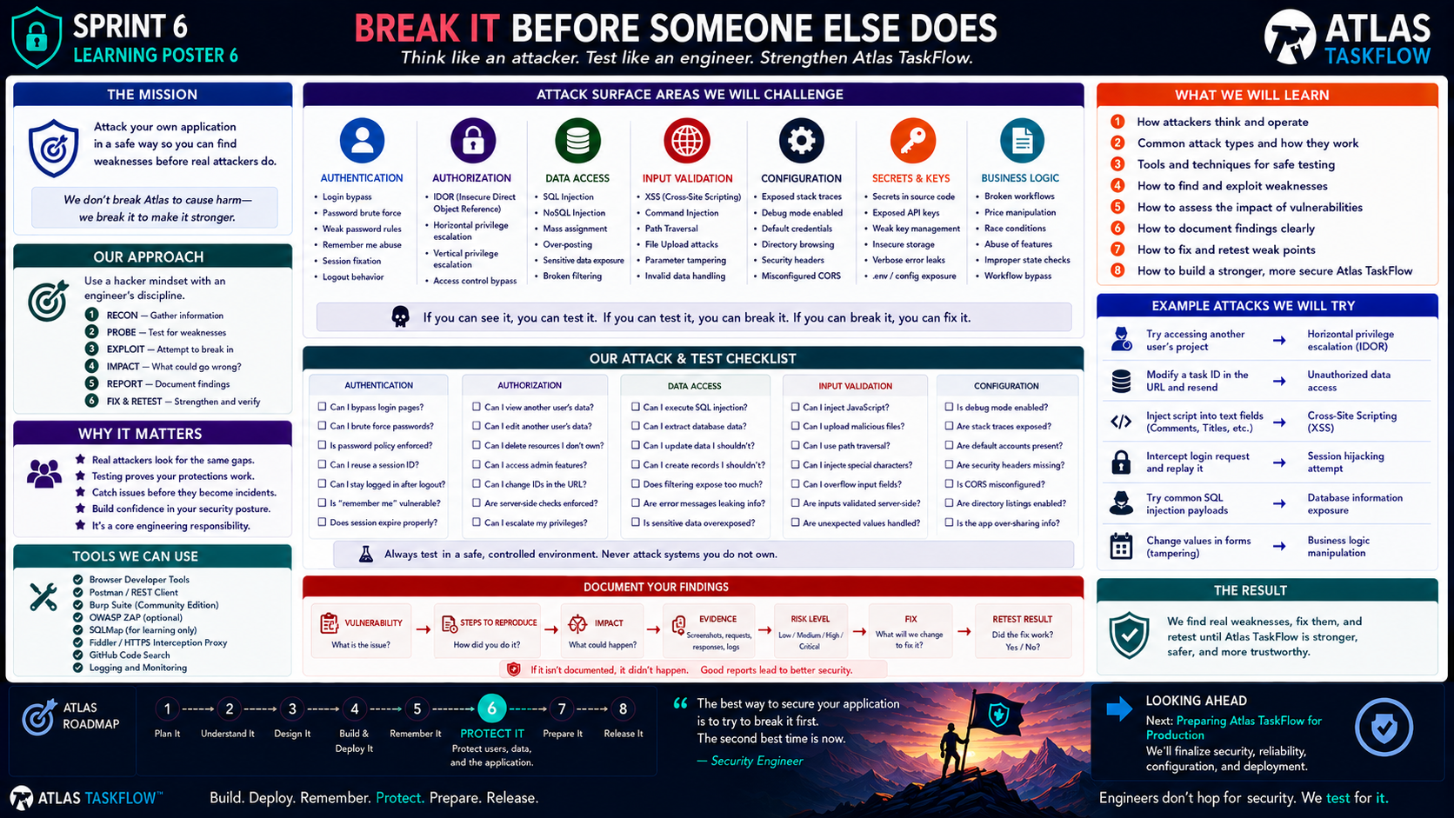
6-05
Notes:
============================================================
SPRINT 6
BREAK IT BEFORE SOMEONE ELSE DOES
"Think like an attacker. Test like an engineer."
============================================================
SLIDE PURPOSE
Teach students to test the security protections they have added to
Atlas TaskFlow by deliberately attempting controlled, authorized
misuse of their own application.
Students should learn to:
• Think about attack surfaces
• Test security assumptions
• Identify weaknesses
• Document findings
• Assess impact
• Fix vulnerabilities
• Retest the application
• Understand that security requires evidence
The emphasis is on defensive security testing of their own Atlas
TaskFlow application.
This is NOT an offensive cybersecurity course.
------------------------------------------------------------
OPENING
"Engineers..."
"We just spent time protecting Atlas."
"We added authentication."
"We added authorization."
"We protected data."
"We secured configuration."
Pause.
"But here's the problem."
"How do we know those protections actually work?"
Point to the title.
"We try to break them."
------------------------------------------------------------
THE ENGINEERING QUESTION
Point to:
"CAN WE BREAK OUR OWN APPLICATION?"
Say:
"If we can find the weakness..."
"We can fix it."
"And if we can fix it before someone else finds it..."
"That's good engineering."
------------------------------------------------------------
IMPORTANT RULE
Before doing anything else, say:
"We are testing systems we own or have explicit permission to test."
"Our target today is Atlas TaskFlow."
"Not someone else's website."
"Not a public system."
"Not a random application."
Explain:
"Security testing without authorization can become harmful or illegal."
"For this class, we stay inside our controlled environment."
------------------------------------------------------------
THE SECURITY TESTING MINDSET
Point to:
"Think like an attacker."
Explain:
"An attacker doesn't care how beautiful our code is."
"They care about what they can access."
"They ask questions like:"
"Can I get somewhere I shouldn't?"
"Can I access someone else's data?"
"Can I perform an action I shouldn't?"
"Can I bypass a rule?"
"Can I make the application behave differently than intended?"
------------------------------------------------------------
OUR APPROACH
Walk through:
RECON
↓
PROBE
↓
EXPLORE
↓
IMPACT
↓
REPORT
↓
FIX & RETEST
Explain each.
------------------------------------------------------------
RECON
"Recon means understanding the system we're testing."
For Atlas, identify:
Pages.
Forms.
Controllers.
User roles.
Resources.
URLs.
Application features.
Explain:
"We're learning the attack surface."
We're not attacking yet.
We're understanding what exists.
------------------------------------------------------------
PROBE
"Now we start asking questions."
Examples:
Can an unauthenticated user reach a protected page?
Can User A access User B's resource?
Can a restricted action be requested directly?
Does changing an identifier expose another record?
Can invalid input get past validation?
Explain:
"We're testing assumptions."
------------------------------------------------------------
EXPLORE
"Once we find something interesting..."
"We investigate."
Example:
Suppose User A shouldn't access Project B.
We test:
Can User A view it?
Can User A edit it?
Can User A delete it?
Can User A access it through another page?
Can User A access it through a direct request?
Explain:
"We want to understand the scope of the weakness."
------------------------------------------------------------
IMPACT
Ask:
"If this weakness were real..."
"What could happen?"
Examples:
Unauthorized data access.
Unauthorized changes.
Data exposure.
Account compromise.
Loss of trust.
Business impact.
Explain:
"Not every vulnerability has the same severity."
------------------------------------------------------------
REPORT
Say:
"If we find something..."
"We document it."
A good finding should answer:
What is wrong?
Where did we find it?
How can we reproduce it?
Who could be affected?
What could happen?
How serious is it?
------------------------------------------------------------
FIX
Then:
"We fix it."
Examples:
Add authorization.
Correct ownership checks.
Improve validation.
Remove exposed secrets.
Improve configuration.
Protect sensitive information.
------------------------------------------------------------
RETEST
Point to:
FIX → RETEST
Say:
"This step is critical."
"After fixing a vulnerability..."
"We perform the same test again."
Ask:
"Why?"
Because:
"We need evidence that the fix actually worked."
------------------------------------------------------------
ATTACK SURFACE — AUTHENTICATION
Point to Authentication.
Ask:
"What can we test?"
Students may identify:
Login.
Logout.
Password behavior.
Protected pages.
Authentication state.
Then ask:
"What could go wrong?"
Examples:
Protected page accessible without login.
Login state not cleared properly.
Authentication rules not enforced.
Explain:
"We are testing behavior, not trying to steal credentials."
------------------------------------------------------------
AUTHENTICATION TEST
Scenario:
User is not logged in.
Attempt to access a protected Atlas page.
Expected:
Access denied or redirected to login.
Then:
Log in correctly.
Access the page.
Expected:
Access allowed.
This gives us both sides:
DENY
and
ALLOW.
------------------------------------------------------------
AUTHORIZATION — USER A VS USER B
Point to Authorization.
Set up:
User A
User B
Project A
Project B
Ask:
"Can User A access User B's project?"
Expected:
No.
Then test:
View.
Edit.
Delete.
Explain:
"We're testing whether authorization applies to every relevant
operation."
------------------------------------------------------------
IDOR / DIRECT OBJECT ACCESS
Introduce the term carefully.
"Sometimes applications identify resources with an ID."
For example:
Project 42.
Task 108.
Explain:
"A dangerous assumption is that knowing an ID means you're allowed to
access that resource."
The test is:
"Does the server verify ownership or authorization?"
If not:
"That's a vulnerability."
Do not teach students to scan or attack unrelated systems.
Keep the test inside their own Atlas application.
------------------------------------------------------------
DATA ACCESS
Point to Data Access.
Ask:
"Can a user retrieve information they shouldn't?"
Test:
User A attempts to access User B's data.
Ask:
"Does the server return the data?"
Expected:
No.
Explain:
"Data filtering and authorization need to happen before sensitive
information is returned."
------------------------------------------------------------
INPUT VALIDATION
Point to Input Validation.
Ask:
"What happens when we give Atlas unexpected input?"
Examples:
Very long values.
Unexpected characters.
Missing values.
Unexpected data types.
Invalid dates.
Explain:
"We're checking whether the application validates input at the
appropriate boundary."
------------------------------------------------------------
INJECTION — CONCEPT ONLY
Introduce the idea carefully.
"Applications sometimes use user input when communicating with other
systems."
"If input isn't handled properly, an attacker may be able to influence
how that system interprets the input."
Examples include:
Database injection.
Script injection.
Command injection.
Explain:
"For Atlas, we're not learning attack payloads."
"We're learning to recognize the risk and verify that our framework
and code handle user input safely."
------------------------------------------------------------
CROSS-SITE SCRIPTING
Explain conceptually:
"An application may display information entered by a user."
Ask:
"What if that information contains something the application should
not execute?"
The risk:
Malicious script could potentially execute in another user's browser.
For Atlas:
Test whether user-entered text is safely displayed.
Expected:
User input is treated as data, not executable code.
------------------------------------------------------------
CONFIGURATION TESTING
Point to Configuration.
Ask:
"What configuration could accidentally expose information?"
Examples:
Debug mode.
Detailed error pages.
Default accounts.
Development settings.
Exposed directories.
Unnecessary services.
Explain:
"Configuration can create vulnerabilities even when the application
code is correct."
------------------------------------------------------------
DEBUG MODE
Ask:
"Should a production application show developers a full stack trace?"
No.
Explain:
"Development information can reveal useful details about the
application."
Therefore:
Production should use appropriate error handling and configuration.
------------------------------------------------------------
SECRETS & KEYS
Point to:
Secrets & Keys.
Ask:
"Can we find a database password in our repository?"
"Can we find an API key?"
"Can we find a token?"
Expected:
No.
Explain:
"Secrets are one of the easiest things to accidentally expose."
------------------------------------------------------------
BUSINESS LOGIC
Point to Business Logic.
Explain:
"Not every security problem is a technical exploit."
"Sometimes the application simply allows something it shouldn't."
Examples:
A user changes a task they don't own.
A user deletes something they shouldn't.
A user changes their own role.
A user performs an action out of sequence.
These are business-logic problems.
------------------------------------------------------------
RACE CONDITIONS
Briefly introduce the concept.
"Sometimes the result depends on timing."
For example:
Two requests attempt to change the same resource.
Explain:
"We don't need to build advanced concurrency testing today."
"We just need to understand that business rules must hold even when
requests happen in unexpected ways."
------------------------------------------------------------
THE ATTACK & TEST CHECKLIST
Move to the large checklist.
Tell students:
"You're going to work through these categories."
Authentication.
Authorization.
Data Access.
Input Validation.
Configuration.
Secrets.
Business Logic.
For each category:
ASK A QUESTION.
TEST THE APPLICATION.
RECORD THE RESULT.
------------------------------------------------------------
THE GOLDEN RULE
Say:
"Don't test randomly."
Every test should have:
A question.
An expected result.
An actual result.
Evidence.
Example:
QUESTION:
Can User A access User B's project?
EXPECTED:
Access denied.
ACTUAL:
Access denied.
RESULT:
PASS.
------------------------------------------------------------
WHEN YOU FIND A FAILURE
Say:
"Don't panic."
"Don't immediately change five things."
Document it first.
Record:
What happened.
Where it happened.
Why it matters.
Then fix it.
Then retest.
------------------------------------------------------------
DOCUMENT YOUR FINDINGS
Point to:
VULNERABILITY
↓
REPRODUCTION STEPS
↓
IMPACT
↓
EVIDENCE
↓
RISK LEVEL
↓
FIX
↓
RETEST RESULT
Explain:
"This is what professional security reporting looks like at a basic
level."
------------------------------------------------------------
RISK LEVELS
Introduce:
LOW
MEDIUM
HIGH
CRITICAL
Keep it simple.
LOW:
Limited impact.
MEDIUM:
Meaningful impact but limited scope.
HIGH:
Significant access or data exposure.
CRITICAL:
Potentially severe compromise of the application or its most
important resources.
Explain:
"The exact rating depends on context."
------------------------------------------------------------
EVIDENCE
Ask:
"What evidence can we collect?"
Examples:
Screenshot.
Application response.
Error message.
Log entry.
Test result.
Configuration evidence.
Explain:
"Evidence makes the finding reproducible."
------------------------------------------------------------
SAFETY BOUNDARY
Repeat:
"We test only Atlas TaskFlow and approved classroom environments."
Do not test:
Random websites.
School systems.
Public applications.
Other students' systems without permission.
Production systems unless explicitly authorized.
Explain:
"Ethical security testing requires permission."
------------------------------------------------------------
BUILD CHALLENGE
Students perform controlled security tests against Atlas.
Minimum tests:
1. Unauthenticated access.
2. User A → User B resource access.
3. Unauthorized edit.
4. Unauthorized delete.
5. Invalid input.
6. Configuration review.
7. Repository secret review.
8. Error disclosure review.
9. Business-rule bypass attempt.
10. Retest at least one fixed issue.
------------------------------------------------------------
THE BREAK / FIX / RETEST LOOP
Point to:
BREAK
↓
FIX
↓
RETEST
Say:
"This is the most important loop in today's lesson."
A vulnerability isn't the end.
It's the beginning of improvement.
------------------------------------------------------------
ENGINEERING INSIGHT
Point to:
"Security gets stronger through testing."
Say:
"We don't prove software is secure by looking at it."
"We gain confidence by testing it."
"Then testing it again."
------------------------------------------------------------
SPRINT CONNECTION
Point to:
⑥ PROTECT IT
Review:
Authentication.
Authorization.
Data protection.
Secure configuration.
Security testing.
Say:
"This is the culmination of Sprint 6."
"We didn't just learn security concepts."
"We applied them."
------------------------------------------------------------
LOOKING AHEAD
Point to:
SPRINT 7 — PREPARE IT.
Say:
"We've built."
"We've deployed."
"We've given Atlas memory."
"We've protected it."
"Now we have another question."
"Is Atlas ready for real-world use?"
That will lead us into:
Configuration.
Reliability.
Monitoring.
Documentation.
Production readiness.
------------------------------------------------------------
CLOSING
Say:
"The best time to find a security problem..."
Pause.
"...is before your users do."
Then:
"Think like an attacker."
"Test like an engineer."
"Fix what you find."
"And test it again."
============================================================
ESTIMATED TIME
Security Testing Introduction...........8 minutes
Recon & Attack Surface..................10 minutes
Authentication Testing..................8 minutes
Authorization Testing..................10 minutes
Data/Input Testing......................8 minutes
Configuration & Secrets..................7 minutes
Findings & Documentation................8 minutes
TOTAL....................................65 minutes
============================================================
INSTRUCTOR NOTES
This should be a controlled lab activity.
Students should work only against their own Atlas TaskFlow application
or another environment explicitly provided for the exercise.
The emphasis is defensive:
Find.
Understand.
Fix.
Verify.
------------------------------------------------------------
IMPORTANT TEACHING MOVE
Don't give students a list of attacks and tell them to blindly try
them.
Give them questions.
For example:
"Can User A access User B's project?"
Then let them determine how to test that question.
This develops problem-solving skills rather than tool memorization.
------------------------------------------------------------
TOOL BOUNDARY
Students may use normal development/testing tools such as:
Browser Developer Tools.
Postman or similar API/testing tools if appropriate.
Application logs.
GitHub repository inspection.
Browser behavior.
Their development environment.
Keep testing controlled and authorized.
------------------------------------------------------------
KEY TAKEAWAY
Write this on the board:
QUESTION
↓
TEST
↓
EVIDENCE
↓
FIX
↓
RETEST
Then:
"Security requires evidence."
------------------------------------------------------------
FINAL STATEMENT
"Engineers..."
"We don't assume our protections work."
"We challenge them."
"We test them."
"We fix what fails."
"And then..."
"We test again."
"That's how Atlas TaskFlow gets stronger."
============================================================

Slide 6
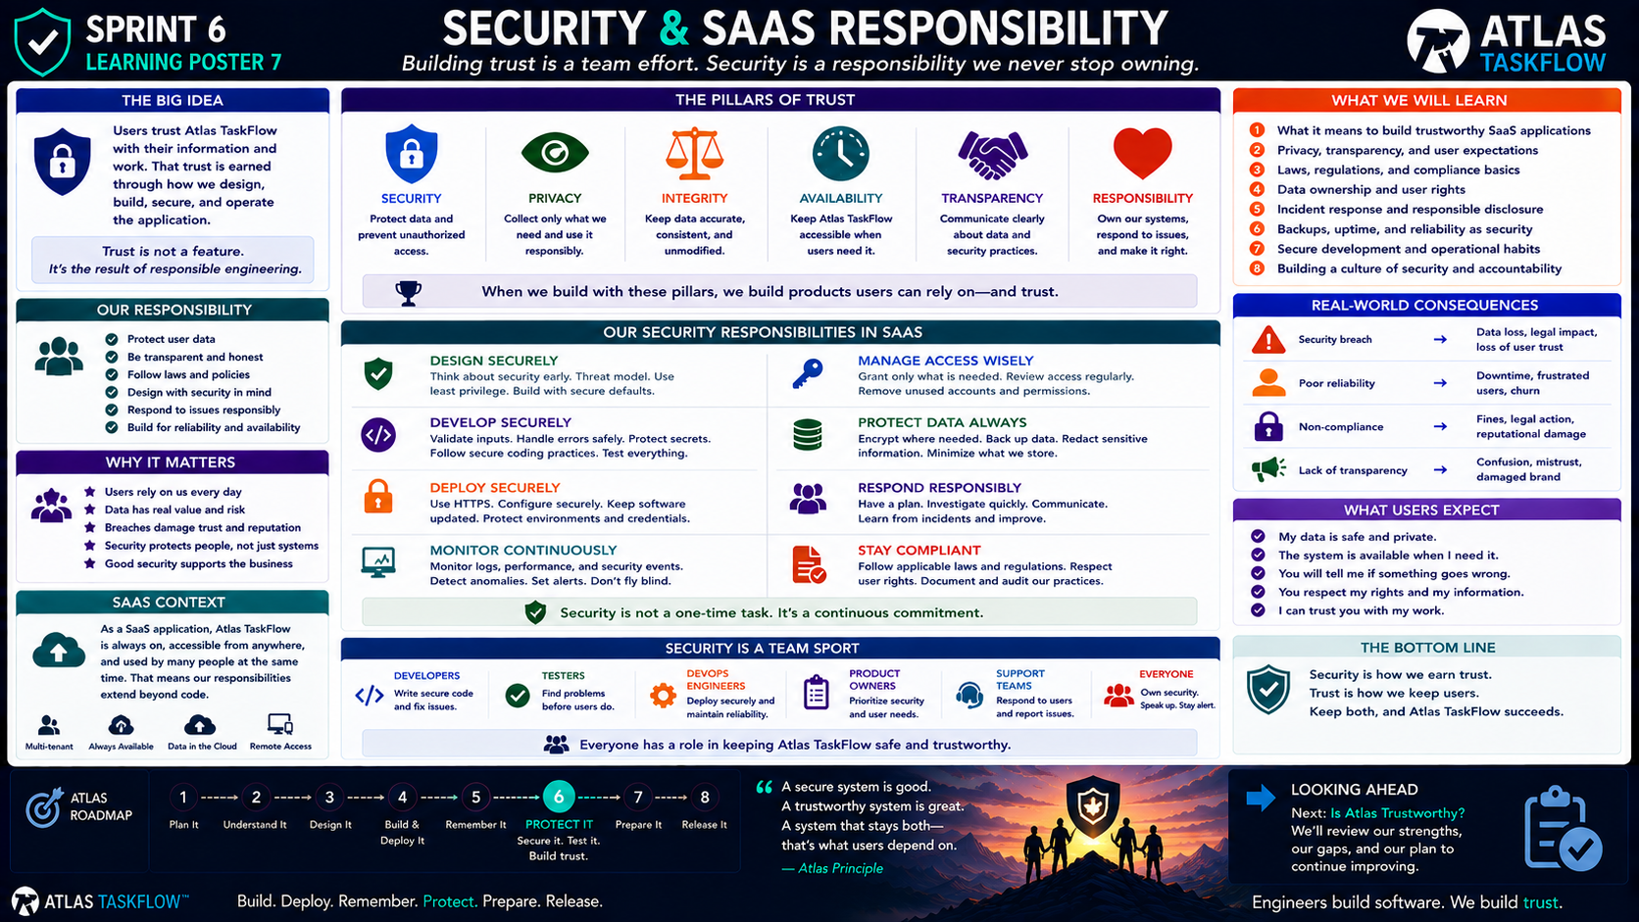
6-06
Notes:
============================================================
SPRINT 6
SECURITY & SAAS RESPONSIBILITY
"Building trust is a team effort."
============================================================
SLIDE PURPOSE
Help students understand that SaaS security extends beyond code.
A SaaS provider is responsible for protecting the trust users place
in the application.
Students should understand:
• Security
• Privacy
• Integrity
• Availability
• Transparency
• Responsibility
• Data ownership
• User expectations
• Incident response
• Reliability
• Security as a continuous process
The goal is to help students think like software engineers who are
responsible for a product—not simply programmers who write code.
------------------------------------------------------------
OPENING
"Engineers..."
"We've spent this sprint talking about security."
"We've authenticated users."
"We've authorized actions."
"We've protected data."
"We've tested our application."
Pause.
"But security isn't just about the code."
Point to:
TRUST.
Say:
"People are trusting us."
------------------------------------------------------------
THE BIG IDEA
Point to:
"Users trust Atlas TaskFlow with their information and their work."
Ask:
"What does that trust mean?"
Allow students to respond.
Possible answers:
The application should work.
Their information should be protected.
Other users shouldn't see private information.
Their data shouldn't disappear.
The application shouldn't lie to them.
Exactly.
Say:
"Trust is earned through responsible engineering."
------------------------------------------------------------
TRUST IS NOT A FEATURE
Point to:
"Trust is not a feature."
Say:
"You can't add a button called 'Trust.'"
Pause.
"Trust comes from everything the application does."
How we:
Design.
Build.
Secure.
Deploy.
Monitor.
Respond.
Communicate.
------------------------------------------------------------
THE PILLARS OF TRUST
Introduce the six pillars.
SECURITY
PRIVACY
INTEGRITY
AVAILABILITY
TRANSPARENCY
RESPONSIBILITY
Say:
"These are different ideas, but together they create trust."
------------------------------------------------------------
PILLAR 1 — SECURITY
Point to:
SECURITY.
Explain:
"Security means protecting systems and information from unauthorized
access, misuse, or damage."
Examples:
Authentication.
Authorization.
Secure configuration.
Protected data.
Secure development.
Ask:
"What happens if we don't take security seriously?"
Data exposure.
Account compromise.
Loss of trust.
------------------------------------------------------------
PILLAR 2 — PRIVACY
Point to:
PRIVACY.
Explain:
"Privacy is about how we collect, use, store, and share information."
Ask:
"Should Atlas collect information just because it can?"
No.
Say:
"We should collect what we need and use it responsibly."
Introduce:
DATA MINIMIZATION.
"Don't collect unnecessary information."
------------------------------------------------------------
PILLAR 3 — INTEGRITY
Point to:
INTEGRITY.
Explain:
"Integrity means information remains accurate and trustworthy."
Example:
If Taylor creates:
Task:
Submit Project
And someone else changes it to:
Task:
Delete Project
without authorization...
"We have an integrity problem."
Integrity means:
The right data.
Correct data.
Authorized changes.
------------------------------------------------------------
PILLAR 4 — AVAILABILITY
Point to:
AVAILABILITY.
Explain:
"Users expect SaaS applications to be available when they need them."
Ask:
"What good is a secure application if nobody can use it?"
Exactly.
Security and availability are connected.
Atlas needs to be:
Accessible.
Reliable.
Resilient.
------------------------------------------------------------
PILLAR 5 — TRANSPARENCY
Point to:
TRANSPARENCY.
Explain:
"Users deserve to understand important things about how their
information is handled."
Examples:
What information is collected?
Why is it collected?
Who can access it?
What happens if something goes wrong?
Say:
"Transparency builds trust."
------------------------------------------------------------
PILLAR 6 — RESPONSIBILITY
Point to:
RESPONSIBILITY.
Explain:
"If something goes wrong..."
"We don't ignore it."
"We investigate."
"We communicate."
"We fix the problem."
"We learn from it."
That's responsibility.
------------------------------------------------------------
WHY THIS MATTERS
Ask:
"Why should a software company care?"
Students may say:
Because of users.
Because of reputation.
Because of money.
Because of laws.
Because of ethics.
All are correct.
Say:
"Software can affect real people."
------------------------------------------------------------
REAL-WORLD CONSEQUENCES
Walk through the examples.
SECURITY BREACH
↓
Data exposure.
Loss of trust.
Potential legal consequences.
------------------------------------------------------------
POOR RELIABILITY
↓
Downtime.
Frustrated users.
Lost productivity.
Users leave.
------------------------------------------------------------
NON-COMPLIANCE
↓
Potential legal consequences.
Financial penalties.
Operational problems.
Reputation damage.
------------------------------------------------------------
LACK OF TRANSPARENCY
↓
Confusion.
Mistrust.
Damaged relationships.
Explain:
"Engineering decisions have consequences outside the code."
------------------------------------------------------------
WHAT USERS EXPECT
Point to the user expectations.
Read each one:
"My data is safe and private."
"The system is available when I need it."
"You will tell me if something goes wrong."
"You respect my rights and information."
"I can trust you with my work."
Pause.
Say:
"These aren't unreasonable expectations."
"They are the foundation of a SaaS relationship."
------------------------------------------------------------
THE SAAS DIFFERENCE
Point to the SaaS context.
Explain:
"When we give someone software they run on their own computer..."
"Their organization may manage much of the environment."
"But with SaaS..."
"We operate the service."
That means our responsibility extends beyond writing the application.
------------------------------------------------------------
SAAS RESPONSIBILITY
A SaaS provider may be responsible for:
Application security.
Infrastructure configuration.
Data protection.
Availability.
Backups.
Monitoring.
Incident response.
Updates.
User communication.
Explain:
"The application doesn't stop being our responsibility after we
deploy it."
------------------------------------------------------------
DESIGN SECURELY
Point to:
DESIGN SECURELY.
Explain:
"Security should begin before code."
Ask:
"Where could a user access something they shouldn't?"
"What information needs protection?"
"What happens if this feature fails?"
This connects security back to Sprint 3.
Say:
"Good security starts with good design."
------------------------------------------------------------
DEVELOP SECURELY
Point to:
DEVELOP SECURELY.
Review:
Validate input.
Handle errors safely.
Protect secrets.
Use established frameworks.
Test assumptions.
Say:
"Security practices have to exist in the code."
------------------------------------------------------------
DEPLOY SECURELY
Point to:
DEPLOY SECURELY.
Review:
HTTPS.
Secure configuration.
Protected credentials.
Appropriate environment settings.
Updated software.
Explain:
"A secure application can become insecure through an unsafe
deployment."
------------------------------------------------------------
MONITOR CONTINUOUSLY
Point to:
MONITOR CONTINUOUSLY.
Explain:
"Once Atlas is deployed..."
"We need to know what's happening."
Examples:
Logs.
Errors.
Performance.
Security events.
Availability.
Explain:
"You can't respond to a problem you don't know about."
------------------------------------------------------------
MANAGE ACCESS WISELY
Point to:
MANAGE ACCESS WISELY.
Review:
Least privilege.
Remove unused accounts.
Review permissions.
Protect administrative access.
Explain:
"Access should change as people and responsibilities change."
------------------------------------------------------------
PROTECT DATA ALWAYS
Point to:
PROTECT DATA ALWAYS.
Review:
Secure storage.
Encryption where appropriate.
Backups.
Access controls.
Data minimization.
Explain:
"Data protection is not something we do once."
------------------------------------------------------------
RESPOND RESPONSIBLY
Point to:
RESPOND RESPONSIBLY.
Ask:
"What happens if Atlas has a security problem?"
Students may say:
"Fix it."
Say:
"Yes—but that's only part of it."
We may need to:
Investigate.
Contain.
Fix.
Communicate.
Document.
Learn.
Improve.
------------------------------------------------------------
INCIDENT RESPONSE
Introduce the basic cycle:
DETECT
↓
INVESTIGATE
↓
CONTAIN
↓
FIX
↓
RECOVER
↓
LEARN
Explain:
"We aren't going to build a complete incident-response program."
"We just need to understand that responsible organizations have a
plan for when things go wrong."
------------------------------------------------------------
BACKUPS
Ask:
"What happens if our database disappears?"
Students:
"We restore it."
Ask:
"From where?"
Backups.
Explain:
"A backup is only useful if it can actually be restored."
Important principle:
"Backup success should be tested."
------------------------------------------------------------
AVAILABILITY IS SECURITY
Explain:
"People sometimes think security means keeping people out."
"But availability matters too."
If the application is:
Secure but always down...
Users still can't rely on it.
The goal is:
Secure.
Available.
Reliable.
------------------------------------------------------------
COMPLIANCE — CONCEPT ONLY
Briefly introduce:
"Organizations may also have legal and regulatory responsibilities
depending on the information and industry involved."
Examples may include:
Privacy laws.
Data protection requirements.
Industry regulations.
Institutional policies.
Explain:
"We don't need to memorize regulations for this class."
"The important lesson is that software operates within a larger
legal and organizational environment."
------------------------------------------------------------
DATA OWNERSHIP
Ask:
"If a user creates a project in Atlas..."
"Who does the information belong to?"
This can become complicated depending on the organization and
agreement.
Explain:
"Data ownership and data rights are business and legal questions."
"Software engineers need to understand that these questions exist."
------------------------------------------------------------
USER RIGHTS
Explain:
"Users may have expectations or legal rights concerning their
information."
Examples:
Access.
Correction.
Deletion.
Privacy.
Transparency.
Don't turn this into a law lecture.
The goal is awareness.
------------------------------------------------------------
SECURITY IS A TEAM SPORT
Point to the team section.
Explain:
"Security isn't just the developer's responsibility."
DEVELOPERS:
Write secure code.
TESTERS:
Find problems.
DEVOPS / ENGINEERS:
Secure deployments and infrastructure.
PRODUCT OWNERS:
Prioritize security requirements.
SUPPORT:
Respond to user issues.
EVERYONE:
Own security.
------------------------------------------------------------
THE REAL ENGINEERING LESSON
Say:
"If everyone assumes someone else is responsible for security..."
"Nobody is."
Security needs shared ownership.
------------------------------------------------------------
ATLAS TASKFLOW
Bring it back to the project.
Ask:
"What does Atlas need to do to earn user trust?"
Have students identify:
Protect accounts.
Protect data.
Limit access.
Remain available.
Handle failures.
Communicate honestly.
Maintain the application.
Respond to problems.
------------------------------------------------------------
THE TRUST TEST
Ask students:
"If you were a customer..."
"Would you trust Atlas TaskFlow with your work?"
Then:
"Why?"
Then:
"What would make you hesitate?"
This is a powerful discussion.
Let students identify weaknesses.
------------------------------------------------------------
ENGINEERING REFLECTION
Ask:
"What is the difference between..."
"An application that works?"
and:
"An application users can trust?"
Possible answers:
Security.
Reliability.
Availability.
Transparency.
Responsibility.
Support.
Maintenance.
Explain:
"That's the difference between software that functions and a service
people depend on."
------------------------------------------------------------
THE BOTTOM LINE
Point to:
"Security is how we earn trust."
"Trust is how we keep users."
Explain:
"Both matter."
A technically impressive application that users don't trust will fail.
------------------------------------------------------------
SPRINT 6 REVIEW
Review the entire sprint.
1. Authentication
Who are you?
2. Authorization
What can you do?
3. Data Protection
What are we protecting?
4. Security Review
Where are the weak points?
5. Security Testing
Can we break our protections?
6. SaaS Responsibility
What responsibility do we have to users?
------------------------------------------------------------
SPRINT 6 TRANSFORMATION
Say:
"We started Sprint 6 with a simple problem."
"Atlas remembers."
"Therefore..."
"We need to protect what it remembers."
Now:
Atlas knows who users are.
Atlas controls access.
Atlas protects information.
Atlas has been tested.
Atlas has a security mindset.
------------------------------------------------------------
LOOKING AHEAD
Point to:
IS ATLAS TRUSTWORTHY?
Say:
"Now we're going to stop and evaluate."
"Did we actually accomplish what we set out to do?"
"We're going to review the sprint."
"We're going to demonstrate the application."
"And we're going to identify what still needs work."
------------------------------------------------------------
CLOSING
Say:
"Engineers build software."
"But software engineers build more than software."
"We build systems that people trust."
Pause.
"That trust has to be earned."
"Every day."
"Every deployment."
"Every feature."
"Every line of code."
Then:
"That's our responsibility."
============================================================
ESTIMATED TIME
Opening & Trust........................8 minutes
Six Pillars of Trust...................15 minutes
SaaS Responsibility....................10 minutes
Incident Response & Reliability.........8 minutes
Security as a Team......................8 minutes
Atlas Trust Discussion..................10 minutes
Sprint Review / Closing..................6 minutes
TOTAL...................................65 minutes
============================================================
INSTRUCTOR NOTES
This is intentionally broader than the previous technical artifacts.
Do not turn this into a legal or compliance lecture.
The goal is professional awareness.
------------------------------------------------------------
IMPORTANT TEACHING MOVE
Keep bringing the conversation back to:
"Would you trust this application?"
Then:
"Why?"
Then:
"What would make you stop trusting it?"
Those questions make abstract security principles concrete.
------------------------------------------------------------
USE STUDENT EXAMPLES
When students identify something that would reduce trust, ask:
"What engineering decision would prevent that?"
Example:
"Users could see another user's tasks."
→ Authorization.
"The application loses data."
→ Backups / reliability.
"Passwords are exposed."
→ Secure credential handling.
"Nobody knows what happened during an outage."
→ Communication / incident response.
------------------------------------------------------------
IMPORTANT BOUNDARY
Do not teach detailed legal requirements.
Avoid deep dives into:
• GDPR
• HIPAA
• PCI-DSS
• SOC 2
• Legal contracts
• Regulatory compliance frameworks
Introduce the idea that regulations and policies exist.
Save detailed compliance work for courses or contexts where it is
appropriate.
------------------------------------------------------------
KEY TAKEAWAY
Write this on the board:
SECURITY
+
PRIVACY
+
INTEGRITY
+
AVAILABILITY
+
TRANSPARENCY
+
RESPONSIBILITY
=
TRUST
------------------------------------------------------------
FINAL STATEMENT
"Engineers build software."
"We build trust."
"And when users trust us with their information..."
"That trust becomes our responsibility."
============================================================

Slide 7
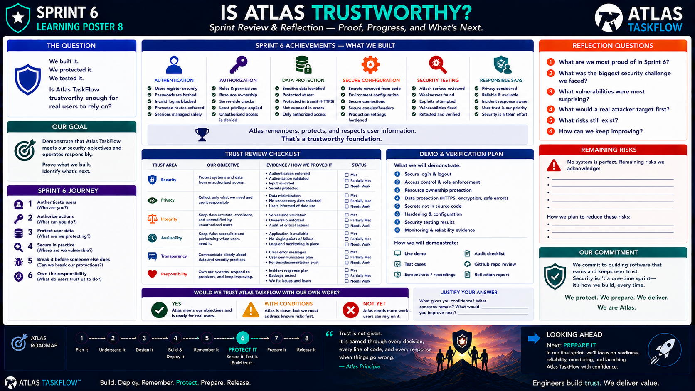
6-07
Notes:
============================================================
SPRINT 6
IS ATLAS TRUSTWORTHY?
Sprint Review & Reflection
"Proof. Progress. What's Next."
============================================================
SLIDE PURPOSE
Bring Sprint 6 together by evaluating whether Atlas TaskFlow has
become a trustworthy application.
Students will:
• Demonstrate authentication
• Demonstrate authorization
• Demonstrate resource ownership
• Demonstrate data protection
• Review secure configuration
• Demonstrate security testing
• Evaluate privacy and responsibility
• Identify remaining risks
• Reflect on their engineering decisions
• Decide whether Atlas is ready to move forward
This is NOT a claim that Atlas is "perfectly secure."
The goal is to determine whether the team has identified important
risks, implemented reasonable protections, tested those protections,
and understands what remains.
------------------------------------------------------------
OPENING
"Engineers..."
"We've reached the end of Sprint 6."
Pause.
"Let's think about where Atlas started."
"Sprint 4..."
"Atlas could run in the cloud."
"Sprint 5..."
"Atlas could remember."
"Sprint 6..."
"Atlas learned how to protect what it remembers."
Pause.
"Now we have one question."
Point to the title:
"Is Atlas trustworthy?"
------------------------------------------------------------
THE QUESTION
Read the left panel.
"We built it."
"We protected it."
"We tested it."
Then:
"Is Atlas TaskFlow trustworthy enough for real users to rely on?"
Explain:
"Notice the wording."
"We're not asking whether Atlas is perfect."
"We're asking whether we've done the engineering work necessary to
earn reasonable trust."
------------------------------------------------------------
OUR GOAL
Point to:
DEMONSTRATE.
PROVE.
IDENTIFY.
Explain:
"Today isn't about telling me that your application works."
"You're going to show me."
And:
"You're going to identify what still needs work."
------------------------------------------------------------
THE SPRINT 6 JOURNEY
Walk through the six steps.
1. AUTHENTICATE
Who are you?
2. AUTHORIZE
What can you do?
3. PROTECT USER DATA
What are we protecting?
4. SECURE IN PRACTICE
Where are we vulnerable?
5. BREAK IT
Can we break our protections?
6. OWN THE RESPONSIBILITY
What do users trust us to do?
Say:
"That is the journey we've taken."
------------------------------------------------------------
ACHIEVEMENT 1 — AUTHENTICATION
Point to Authentication.
Ask:
"Can a user prove who they are?"
Demonstrate:
Register or existing account.
Login.
Logout.
Invalid login.
Protected page without authentication.
Expected:
Authenticated users can access appropriate areas.
Unauthenticated users cannot access protected resources.
------------------------------------------------------------
ACHIEVEMENT 2 — AUTHORIZATION
Point to Authorization.
Ask:
"Once Atlas knows who you are..."
"What are you allowed to do?"
Demonstrate:
Role-based permissions.
Restricted actions.
Protected routes.
Access denial.
Explain:
"Authentication got us to the door."
"Authorization decides which doors open."
------------------------------------------------------------
ACHIEVEMENT 3 — RESOURCE OWNERSHIP
Point to:
RESOURCE OWNERSHIP.
Set up:
User A.
User B.
Project A.
Project B.
Demonstrate:
User A accessing User B's resource.
Expected:
Denied.
Then:
User A accessing their own resource.
Expected:
Allowed.
Say:
"This is where security becomes very real."
------------------------------------------------------------
ACHIEVEMENT 4 — DATA PROTECTION
Point to:
DATA PROTECTION.
Review:
Sensitive data.
Passwords.
HTTPS.
Secure errors.
Access controls.
Explain:
"We're protecting information both from unauthorized users and
unnecessary exposure."
------------------------------------------------------------
ACHIEVEMENT 5 — SECURE CONFIGURATION
Point to:
SECURE CONFIGURATION.
Ask:
"Are secrets sitting in the repository?"
Check:
GitHub.
Configuration.
Environment settings.
Connection strings.
API keys.
Tokens.
Expected:
No production secrets committed to source control.
------------------------------------------------------------
ACHIEVEMENT 6 — SECURITY TESTING
Point to:
SECURITY TESTING.
Ask:
"Did we actually try to break our protections?"
Review:
Unauthorized access.
Ownership bypass.
Invalid input.
Direct access attempts.
Configuration issues.
Error disclosure.
Explain:
"We don't get credit for saying something is secure."
"We get confidence from testing it."
------------------------------------------------------------
ACHIEVEMENT 7 — RESPONSIBLE SaaS
Point to:
RESPONSIBLE SaaS.
Review:
Privacy.
Availability.
Integrity.
Transparency.
Responsibility.
Say:
"Security isn't only about preventing attackers."
"It's also about being responsible for the service we operate."
------------------------------------------------------------
THE TRUST REVIEW
Move to the Trust Review Checklist.
Explain:
"We're going to evaluate Atlas across six trust areas."
------------------------------------------------------------
SECURITY
Objective:
Protect systems and data from unauthorized access.
Evidence:
Authentication enforced.
Authorization validated.
Input validated.
Secrets protected.
Ask:
"Can we prove each of these?"
------------------------------------------------------------
PRIVACY
Objective:
Collect only what we need and use it responsibly.
Evidence:
Data minimization.
No unnecessary information.
Users understand how information is used.
Ask:
"Are we collecting information just because we can?"
"No."
"We should collect what the application actually needs."
------------------------------------------------------------
INTEGRITY
Objective:
Keep data accurate, consistent, and protected from unauthorized
changes.
Evidence:
Server-side validation.
Ownership enforcement.
Authorized actions.
Ask:
"Can another user change information they don't own?"
Expected:
"No."
------------------------------------------------------------
AVAILABILITY
Objective:
Keep Atlas accessible when users need it.
Evidence:
Application is available.
No obvious single point of failure discovered.
Monitoring/logging exists where appropriate.
Explain:
"A secure application that is constantly unavailable isn't a good SaaS
service."
------------------------------------------------------------
TRANSPARENCY
Objective:
Communicate clearly about data and security practices.
Evidence:
Clear error messages.
Appropriate user communication.
Documentation or policies where appropriate.
Explain:
"Users should not have to guess what the application is doing."
------------------------------------------------------------
RESPONSIBILITY
Objective:
Own the system, respond to problems, and keep improving.
Evidence:
Incident response thinking.
Backups.
Testing.
Documented findings.
Fixes.
Lessons learned.
Say:
"Responsibility means we don't stop caring after deployment."
------------------------------------------------------------
STATUS
Point to:
MET
PARTIALLY MET
NEEDS WORK
Explain:
"Not everything has to be marked MET."
Pause.
"In fact..."
"If you discover something that needs work, that's useful information."
"The goal is an honest engineering assessment."
------------------------------------------------------------
DEMO & VERIFICATION PLAN
Move to the demonstration section.
Tell students:
"Here's what you're going to demonstrate."
1. Secure login and logout.
2. Access control and role enforcement.
3. Resource ownership protection.
4. Data protection.
5. Secrets and configuration.
6. Security testing results.
7. Monitoring/reliability evidence.
8. Security review evidence.
------------------------------------------------------------
DEMONSTRATION RULE
Say:
"Show me the behavior."
Not:
"Tell me the behavior."
Example:
Don't say:
"Users can't access other people's projects."
Show:
User A.
User B.
Attempt access.
Access denied.
That's evidence.
------------------------------------------------------------
EVIDENCE TYPES
Point to:
TEST CASES.
AUDIT CHECKLIST.
GITHUB REVIEW.
SCREENSHOTS.
REFLECTION REPORT.
Explain:
"Professional engineering decisions should be supported by evidence."
------------------------------------------------------------
REMAINING RISKS
Move to the right panel.
Read:
"No system is perfect."
Say:
"This is important."
"We are not going to pretend Atlas has zero risk."
Ask:
"What risks still exist?"
Possible answers:
Incomplete testing.
Limited monitoring.
Scaling concerns.
Backup limitations.
Advanced security concerns.
Missing features.
Potential edge cases.
Explain:
"Identifying remaining risks demonstrates maturity."
------------------------------------------------------------
THE RISK QUESTION
For every remaining risk, ask:
"What could happen?"
"Who could be affected?"
"How likely is it?"
"How would we reduce the risk?"
This turns a vague concern into an engineering problem.
------------------------------------------------------------
WOULD WE TRUST ATLAS?
Move to the bottom decision panel.
There are three possible outcomes:
YES.
WITH CONDITIONS.
NOT YET.
Explain each.
------------------------------------------------------------
YES
"Atlas meets our objectives and is ready for real users."
This means:
Major security requirements are met.
Testing provides reasonable confidence.
Remaining risks are acceptable for the current scope.
------------------------------------------------------------
WITH CONDITIONS
"Atlas is close, but we must address known risks first."
Explain:
"This is probably the most realistic result for a Version 1 product."
Some things may still need improvement.
------------------------------------------------------------
NOT YET
"Atlas needs more work before real users should rely on it."
Explain:
"If serious risks remain..."
"We don't pretend they're gone."
"We fix them."
------------------------------------------------------------
THE DECISION
Ask students:
"Which one would you choose for Atlas?"
Then:
"Why?"
Require evidence.
Don't accept:
"Because I think it's ready."
Ask:
"What evidence supports that decision?"
------------------------------------------------------------
JUSTIFY YOUR ANSWER
Point to:
"What gives you confidence?"
"What concerns remain?"
"What would you improve next?"
Give students time to answer.
This is the most important reflection portion.
------------------------------------------------------------
SPRINT 6 REFLECTION
Move to the reflection questions.
1.
"What are we most proud of in Sprint 6?"
Encourage students to identify a real accomplishment.
------------------------------------------------------------
QUESTION 2
"What was the biggest security challenge we faced?"
Possible answers:
Authentication.
Authorization.
Ownership.
Configuration.
Debugging.
Understanding security concepts.
------------------------------------------------------------
QUESTION 3
"What vulnerabilities were most surprising?"
This is an important question.
Students may realize:
"Hiding the button wasn't enough."
"Users could access URLs directly."
"Ownership wasn't enforced."
"Secrets were exposed."
------------------------------------------------------------
QUESTION 4
"What would a real attacker target first?"
Ask:
"Why?"
Students should begin thinking about:
Accounts.
Passwords.
Administrative access.
Sensitive data.
Weak authorization.
Exposed secrets.
------------------------------------------------------------
QUESTION 5
"What risks still exist?"
Tell students:
"Be honest."
"Every system has risk."
------------------------------------------------------------
QUESTION 6
"How can we keep improving?"
Possible answers:
More testing.
Better monitoring.
Stronger authentication.
Improved authorization.
Better documentation.
More backups.
More security reviews.
Regular updates.
------------------------------------------------------------
THE COMMITMENT
Point to:
"We commit to building software that earns and keeps user trust."
Read it.
Then:
"Security isn't one sprint."
"It's how we build."
------------------------------------------------------------
SECURITY IS CONTINUOUS
Say:
"Today's secure application can become tomorrow's vulnerable
application."
Why?
New vulnerabilities.
New dependencies.
New users.
New features.
New threats.
Changing requirements.
Therefore:
"Security continues after Sprint 6."
------------------------------------------------------------
THE BIGGER ENGINEERING LESSON
Point to the quote:
"Trust is not given."
"Trust is earned."
Explain:
"Every design decision contributes."
"Every feature contributes."
"Every deployment contributes."
"Every response to a problem contributes."
------------------------------------------------------------
SPRINT 6 TRANSFORMATION
Show:
START:
Atlas remembers.
QUESTION:
How do we protect it?
PROCESS:
Authenticate.
Authorize.
Protect.
Test.
Review.
RESULT:
Atlas is more trustworthy.
------------------------------------------------------------
THE ATLAS PRINCIPLE
Say:
"Atlas isn't trustworthy because we say it is."
"It's trustworthy because we can demonstrate the protections we built."
This is the key lesson.
------------------------------------------------------------
SPRINT 6 COMPLETE
Point to the roadmap.
Sprint 6:
PROTECT IT
Check it off.
Say:
"We are done with Protect It."
Pause.
"But the product isn't finished."
------------------------------------------------------------
LOOKING AHEAD
Point to:
SPRINT 7 — PREPARE IT.
Say:
"Now we ask a different question."
"Is Atlas ready?"
Ready for:
Real users.
Real traffic.
Real failures.
Real maintenance.
Real deployment conditions.
Explain:
"Sprint 7 is about readiness."
------------------------------------------------------------
FINAL CLOSING
Say:
"Engineers..."
"We built Atlas."
"We deployed Atlas."
"We gave Atlas memory."
"We protected Atlas."
"We tested Atlas."
Pause.
"Now..."
"We have to decide whether Atlas is ready for the world."
Then:
"That's what comes next."
============================================================
ESTIMATED TIME
Sprint 6 Review........................10 minutes
Security Demonstration................20 minutes
Trust Checklist........................10 minutes
Risk Review.............................8 minutes
Trust Decision..........................7 minutes
Reflection.............................15 minutes
Sprint 7 Preview........................5 minutes
TOTAL...................................75 minutes
============================================================
INSTRUCTOR NOTES
This should function as the Sprint 6 assessment and retrospective.
Students should demonstrate their actual Atlas TaskFlow application.
Avoid turning this into another lecture.
The majority of the session should be:
DEMONSTRATE
DISCUSS
REFLECT
------------------------------------------------------------
RECOMMENDED DEMONSTRATION
Each student/team should demonstrate:
1. Login.
2. Logout.
3. Protected page.
4. Authorized action.
5. Unauthorized action.
6. Ownership protection.
7. Data protection.
8. Security testing result.
9. Repository/configuration review.
10. One remaining risk.
------------------------------------------------------------
ASSESSMENT EMPHASIS
Evaluate:
✓ Understanding of authentication.
✓ Understanding of authorization.
✓ Ability to demonstrate access controls.
✓ Understanding of data protection.
✓ Security testing.
✓ Ability to identify risk.
✓ Ability to explain engineering decisions.
✓ Honest reflection.
Do not grade students solely on whether their application is
"perfect."
------------------------------------------------------------
IMPORTANT TEACHING POINT
A student who says:
"I found a vulnerability, fixed it, and here's how I verified the fix."
has demonstrated strong engineering thinking.
A student who says:
"My application has no vulnerabilities."
without evidence has not.
------------------------------------------------------------
KEY TAKEAWAY
Write this on the board:
BUILD
↓
PROTECT
↓
TEST
↓
PROVE
↓
IMPROVE
Then:
"Trust requires evidence."
------------------------------------------------------------
FINAL STATEMENT
"Engineers..."
"Trust isn't something we claim."
"It's something we earn."
"And we earn it by building responsibly..."
"...testing honestly..."
"...and improving continuously."
============================================================

