Slide 1

Notes:
Static student copy of the current web slide. Slide artwork is flattened; add personal notes here. Interactive explanations, playback and accessible HTML are available at:
https://davidchivers.co.uk/teaching/macro-applications/lecture_3.html#/title-slide
The Economics of Brexit
Lecture 3: The Single Market
Dr David Chivers
Macroeconomic Applications and Policy

Slide 2
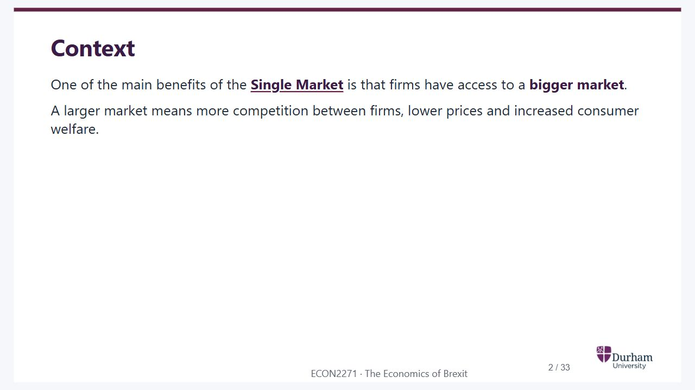
Notes:
Static student copy of the current web slide. Slide artwork is flattened; add personal notes here. Interactive explanations, playback and accessible HTML are available at:
https://davidchivers.co.uk/teaching/macro-applications/lecture_3.html#/l3-s02
Context
One of the main benefits of the Single Market is that firms have access to a bigger market.
A larger market means more competition between firms, lower prices and increased consumer welfare.
http://ec.europa.eu/growth/single-market/index_en.htm

Slide 3

Notes:
Static student copy of the current web slide. Slide artwork is flattened; add personal notes here. Interactive explanations, playback and accessible HTML are available at:
https://davidchivers.co.uk/teaching/macro-applications/lecture_3.html#/l3-s03
Learning objectives
At the end of this topic, you will be able to:
Analyse how increased market size affects:
Competitiveness: the pro-competitive effect.
The scale of firms: industrial restructuring.
Welfare.
Discuss the empirical evidence on the effects of the Single Market Act on European price-cost margins.

Slide 4
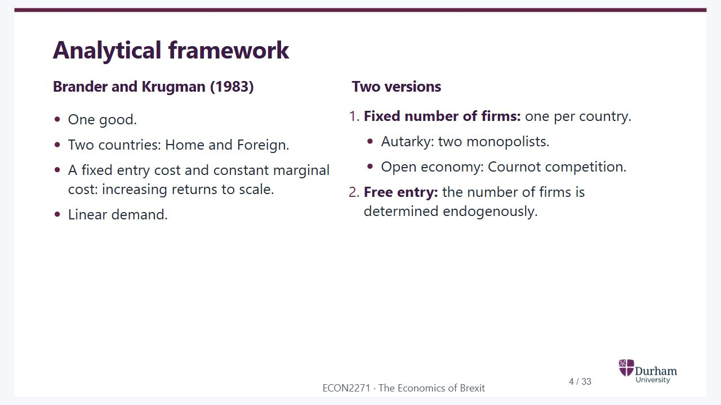
Notes:
Static student copy of the current web slide. Slide artwork is flattened; add personal notes here. Interactive explanations, playback and accessible HTML are available at:
https://davidchivers.co.uk/teaching/macro-applications/lecture_3.html#/l3-s04
Analytical framework
Brander and Krugman (1983)
One good.
Two countries: Home and Foreign.
A fixed entry cost and constant marginal cost: increasing returns to scale.
Linear demand.
Two versions
Fixed number of firms: one per country.
Autarky: two monopolists.
Open economy: Cournot competition.
Free entry: the number of firms is determined endogenously.

Slide 5
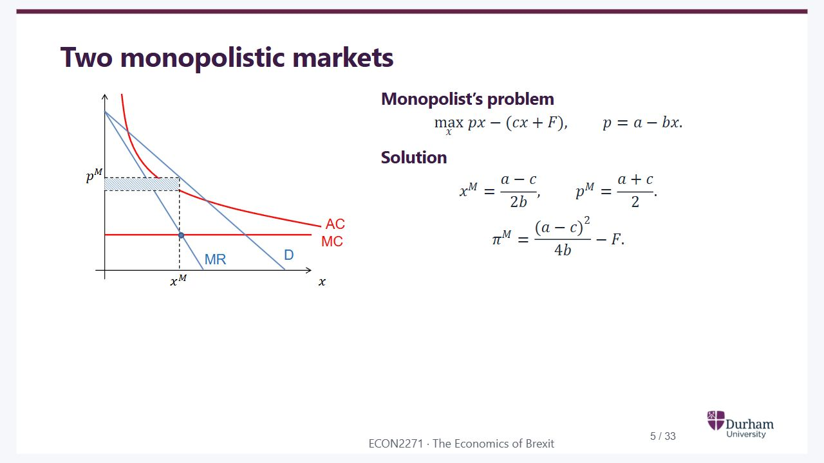
Notes:
Static student copy of the current web slide. Slide artwork is flattened; add personal notes here. Interactive explanations, playback and accessible HTML are available at:
https://davidchivers.co.uk/teaching/macro-applications/lecture_3.html#/l3-s05
Two monopolistic markets
Monopolist’s problem
max
𝑥
𝑝
𝑥
−
(
𝑐
𝑥
+
𝐹
)
,
𝑝
=
𝑎
−
𝑏
𝑥
.
Solution
𝑥
𝑀
=
𝑎
−
𝑐
2
𝑏
,
𝑝
𝑀
=
𝑎
+
𝑐
2
.
𝜋
𝑀
=
(
𝑎
−
𝑐
)
2
4
𝑏
−
𝐹
.
Monopoly diagram: marginal revenue crosses marginal cost at monopoly output. Demand determines monopoly price. Average cost lies below price at that output.

Slide 6
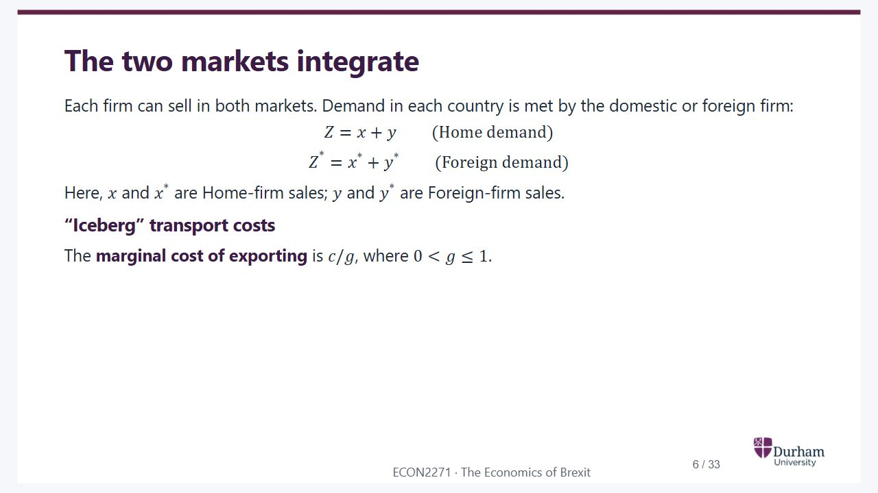
Notes:
Static student copy of the current web slide. Slide artwork is flattened; add personal notes here. Interactive explanations, playback and accessible HTML are available at:
https://davidchivers.co.uk/teaching/macro-applications/lecture_3.html#/l3-s06
The two markets integrate
Each firm can sell in both markets. Demand in each country is met by the domestic or foreign firm:
𝑍
=
𝑥
+
𝑦
(Home demand)
𝑍
*
=
𝑥
*
+
𝑦
*
(Foreign demand)
Here,
𝑥
and
𝑥
*
are Home-firm sales;
𝑦
and
𝑦
*
are Foreign-firm sales.
“Iceberg” transport costs
The marginal cost of exporting is
𝑐
/
𝑔
, where
0
<
𝑔
≤
1
.

Slide 7
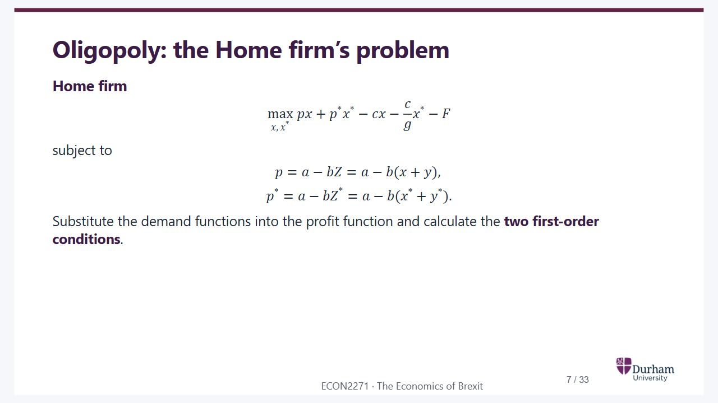
Notes:
Static student copy of the current web slide. Slide artwork is flattened; add personal notes here. Interactive explanations, playback and accessible HTML are available at:
https://davidchivers.co.uk/teaching/macro-applications/lecture_3.html#/l3-s07
Oligopoly: the Home firm’s problem
Home firm
max
𝑥
,
𝑥
*
𝑝
𝑥
+
𝑝
*
𝑥
*
−
𝑐
𝑥
−
𝑐
𝑔
𝑥
*
−
𝐹
subject to
𝑝
=
𝑎
−
𝑏
𝑍
=
𝑎
−
𝑏
(
𝑥
+
𝑦
)
,
𝑝
*
=
𝑎
−
𝑏
𝑍
*
=
𝑎
−
𝑏
(
𝑥
*
+
𝑦
*
)
.
Substitute the demand functions into the profit function and calculate the two first-order conditions.

Slide 8
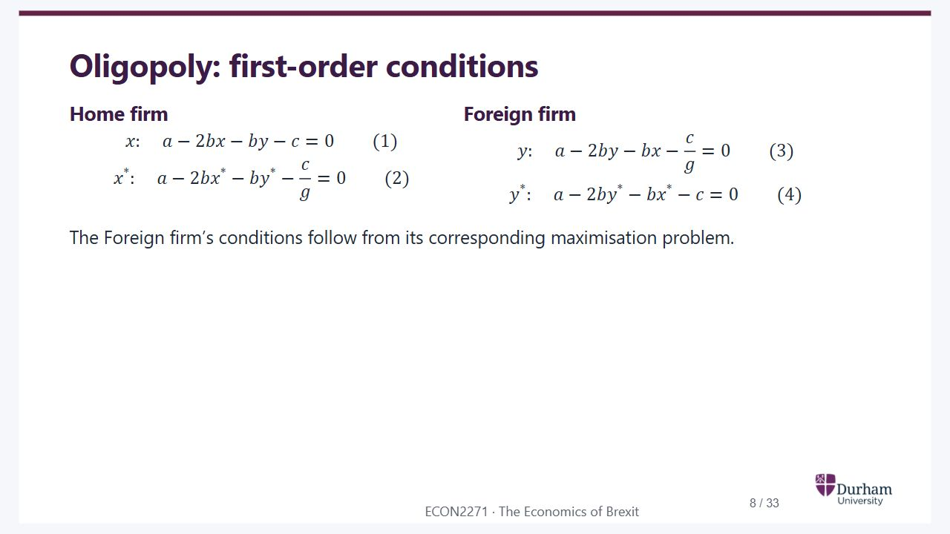
Notes:
Static student copy of the current web slide. Slide artwork is flattened; add personal notes here. Interactive explanations, playback and accessible HTML are available at:
https://davidchivers.co.uk/teaching/macro-applications/lecture_3.html#/l3-s08
Oligopoly: first-order conditions
Home firm
𝑥
:
𝑎
−
2
𝑏
𝑥
−
𝑏
𝑦
−
𝑐
=
0
(
1
)
𝑥
*
:
𝑎
−
2
𝑏
𝑥
*
−
𝑏
𝑦
*
−
𝑐
𝑔
=
0
(
2
)
Foreign firm
𝑦
:
𝑎
−
2
𝑏
𝑦
−
𝑏
𝑥
−
𝑐
𝑔
=
0
(
3
)
𝑦
*
:
𝑎
−
2
𝑏
𝑦
*
−
𝑏
𝑥
*
−
𝑐
=
0
(
4
)
The Foreign firm’s conditions follow from its corresponding maximisation problem.

Slide 9
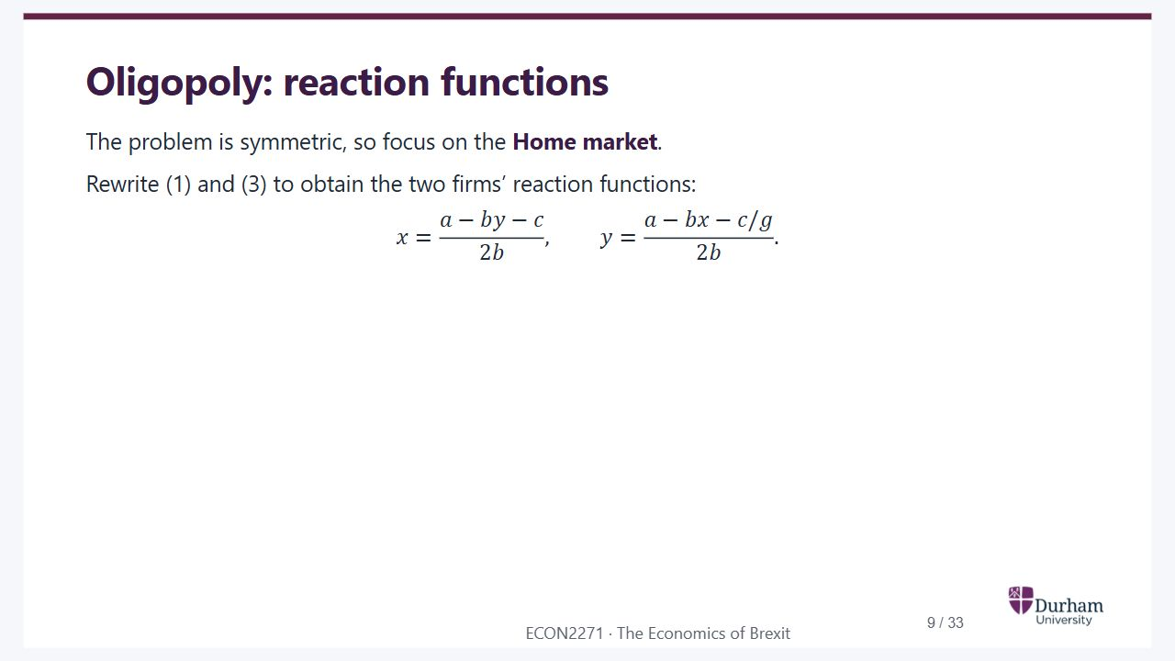
Notes:
Static student copy of the current web slide. Slide artwork is flattened; add personal notes here. Interactive explanations, playback and accessible HTML are available at:
https://davidchivers.co.uk/teaching/macro-applications/lecture_3.html#/l3-s09
Oligopoly: reaction functions
The problem is symmetric, so focus on the Home market.
Rewrite (1) and (3) to obtain the two firms’ reaction functions:
𝑥
=
𝑎
−
𝑏
𝑦
−
𝑐
2
𝑏
,
𝑦
=
𝑎
−
𝑏
𝑥
−
𝑐
/
𝑔
2
𝑏
.

Slide 10
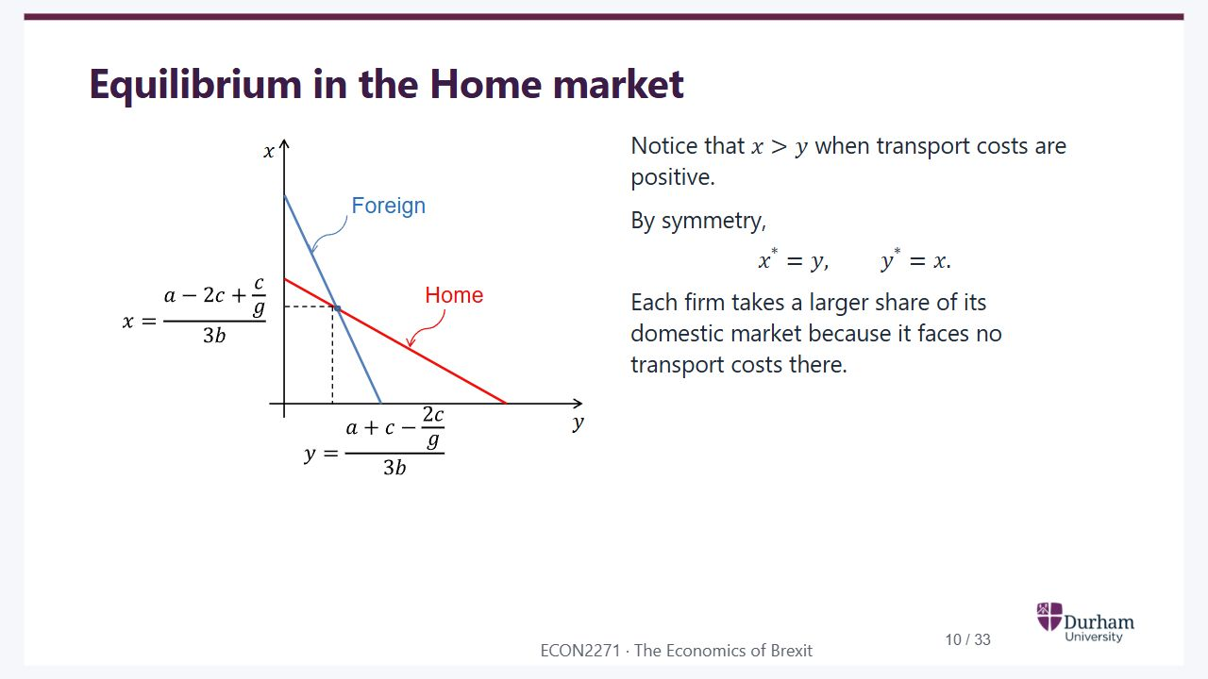
Notes:
Static student copy of the current web slide. Slide artwork is flattened; add personal notes here. Interactive explanations, playback and accessible HTML are available at:
https://davidchivers.co.uk/teaching/macro-applications/lecture_3.html#/l3-s10
Equilibrium in the Home market
Notice that
𝑥
>
𝑦
when transport costs are positive.
By symmetry,
𝑥
*
=
𝑦
,
𝑦
*
=
𝑥
.
Each firm takes a larger share of its domestic market because it faces no transport costs there.
Home-market reaction functions for the two firms. The downward-sloping reactions intersect at equilibrium, with the domestic firm selling more than the foreign firm when transport costs are positive.

Slide 11
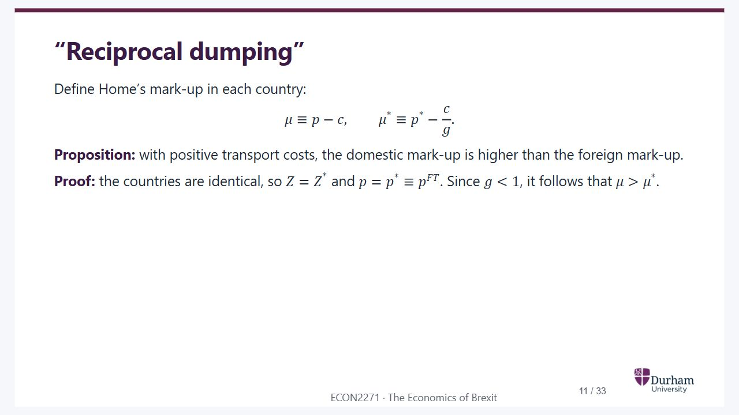
Notes:
Static student copy of the current web slide. Slide artwork is flattened; add personal notes here. Interactive explanations, playback and accessible HTML are available at:
https://davidchivers.co.uk/teaching/macro-applications/lecture_3.html#/l3-s11
“Reciprocal dumping”
Define Home’s mark-up in each country:
𝜇
≡
𝑝
−
𝑐
,
𝜇
*
≡
𝑝
*
−
𝑐
𝑔
.
Proposition: with positive transport costs, the domestic mark-up is higher than the foreign mark-up.
Proof: the countries are identical, so
𝑍
=
𝑍
*
and
𝑝
=
𝑝
*
≡
𝑝
𝐹
𝑇
. Since
𝑔
<
1
, it follows that
𝜇
>
𝜇
*
.

Slide 12
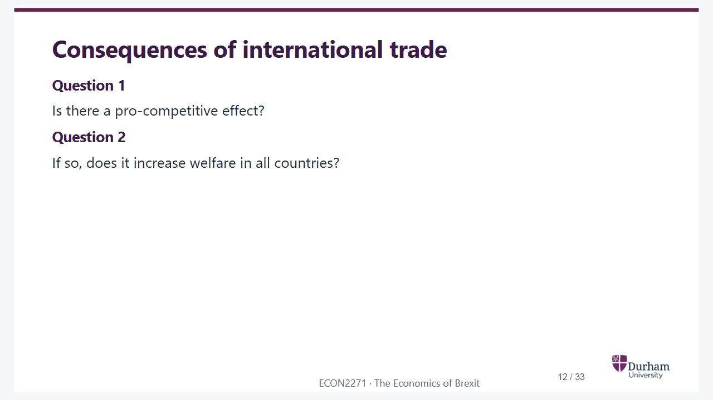
Notes:
Static student copy of the current web slide. Slide artwork is flattened; add personal notes here. Interactive explanations, playback and accessible HTML are available at:
https://davidchivers.co.uk/teaching/macro-applications/lecture_3.html#/l3-s12
Consequences of international trade
Question 1
Is there a pro-competitive effect?
Question 2
If so, does it increase welfare in all countries?

Slide 13
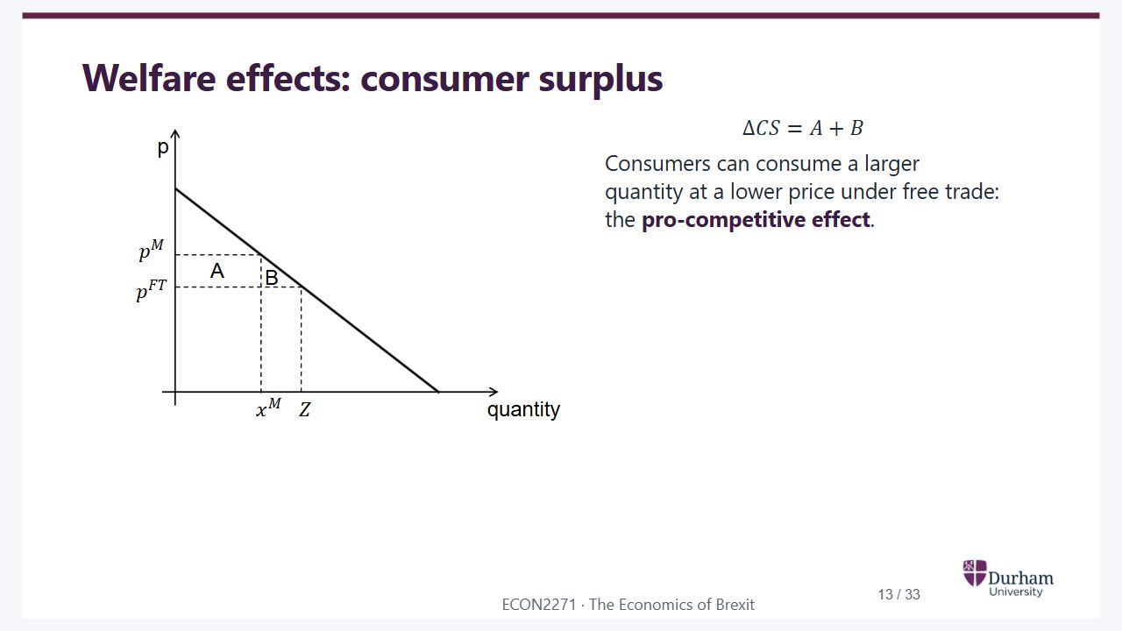
Notes:
Static student copy of the current web slide. Slide artwork is flattened; add personal notes here. Interactive explanations, playback and accessible HTML are available at:
https://davidchivers.co.uk/teaching/macro-applications/lecture_3.html#/l3-s13
Welfare effects: consumer surplus
Δ
𝐶
𝑆
=
𝐴
+
𝐵
Consumers can consume a larger quantity at a lower price under free trade: the pro-competitive effect.
Consumer-surplus gain from integration. Price falls from the monopoly price to the free-trade price and consumption rises. The gain comprises areas A and B.

Slide 14
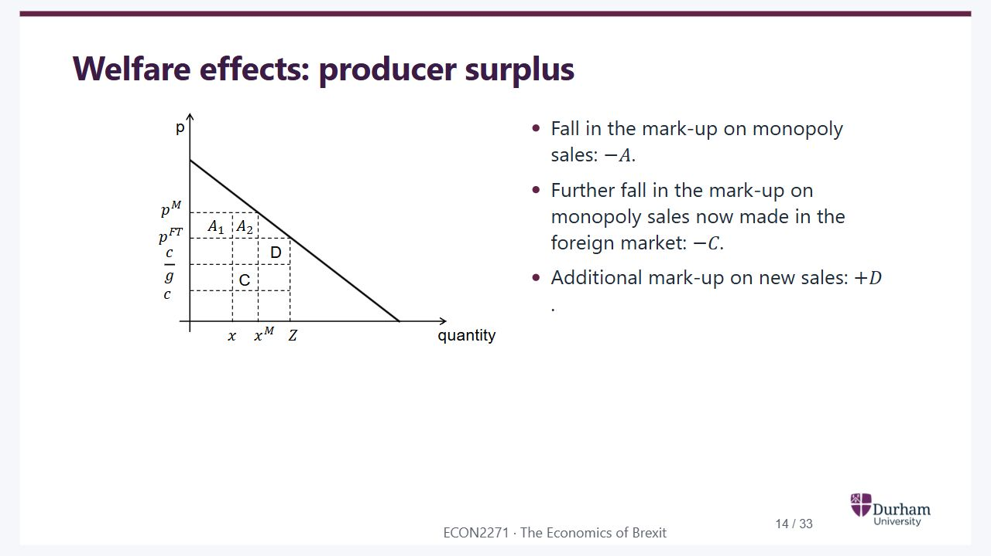
Notes:
Static student copy of the current web slide. Slide artwork is flattened; add personal notes here. Interactive explanations, playback and accessible HTML are available at:
https://davidchivers.co.uk/teaching/macro-applications/lecture_3.html#/l3-s14
Welfare effects: producer surplus
Fall in the mark-up on monopoly sales:
−
𝐴
.
Further fall in the mark-up on monopoly sales now made in the foreign market:
−
𝐶
.
Additional mark-up on new sales:
+
𝐷
.
Producer-surplus decomposition under integration. Domestic mark-ups fall, exports incur transport costs, and new sales generate additional margin. The diagram labels the losses A and C and gain D.

Slide 15
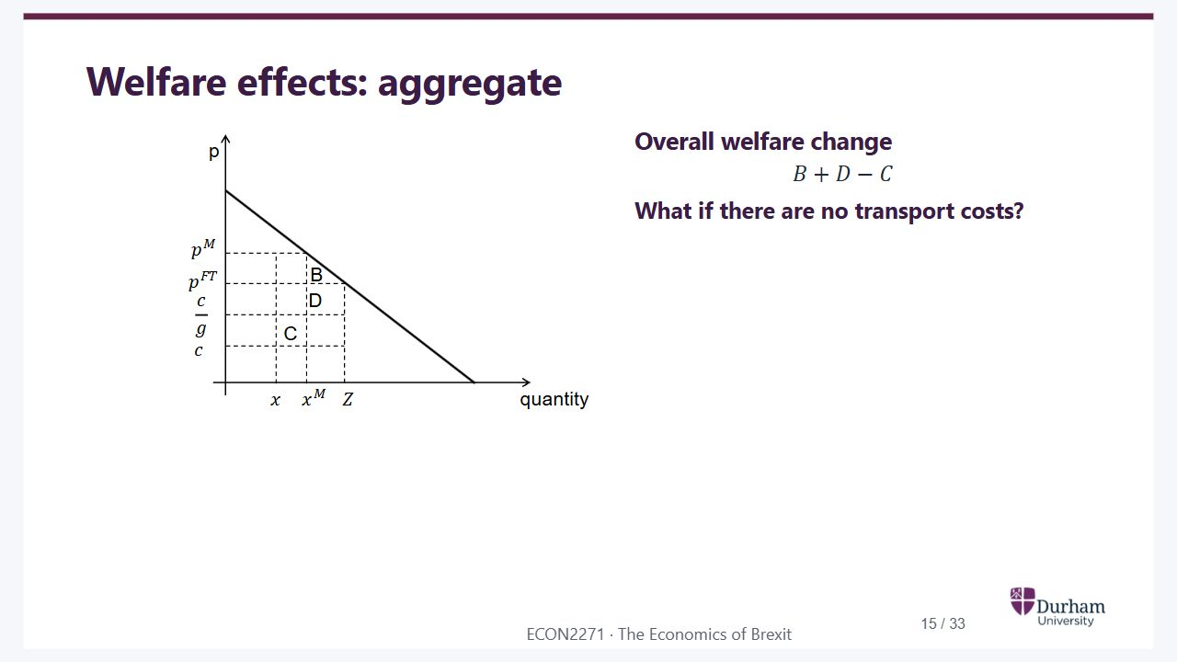
Notes:
Static student copy of the current web slide. Slide artwork is flattened; add personal notes here. Interactive explanations, playback and accessible HTML are available at:
https://davidchivers.co.uk/teaching/macro-applications/lecture_3.html#/l3-s15
Welfare effects: aggregate
Overall welfare change
𝐵
+
𝐷
−
𝐶
What if there are no transport costs?
Aggregate welfare diagram. Consumer and producer effects combine to B plus D minus C, with C representing a cost associated with transporting exports.

Slide 16
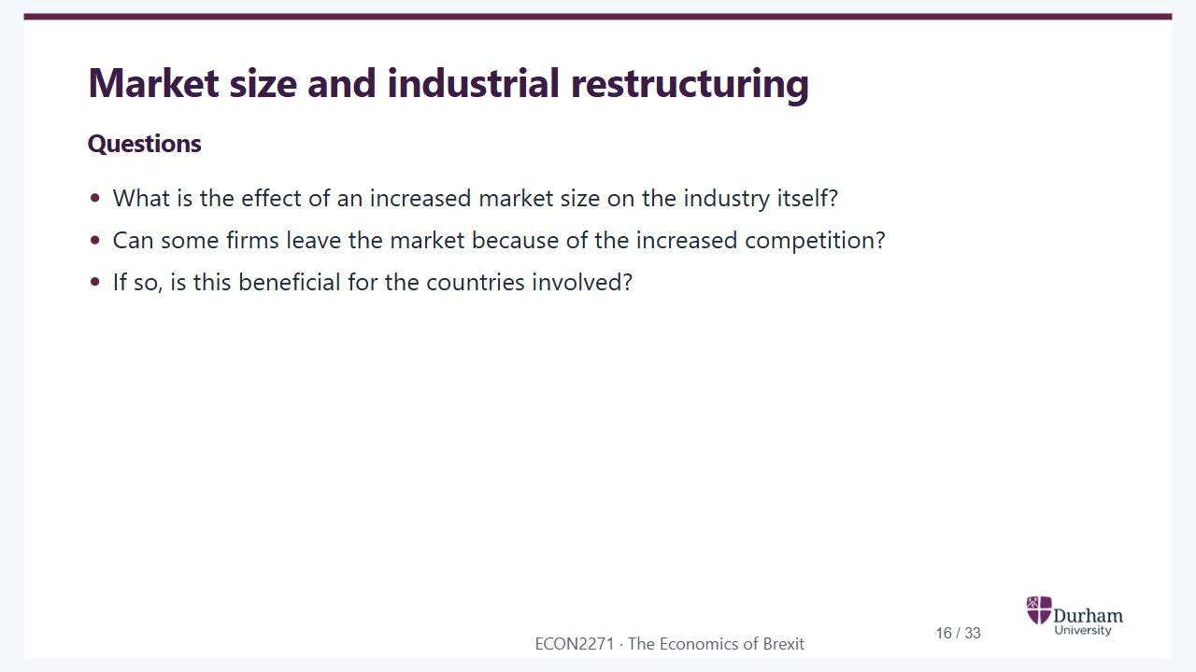
Notes:
Static student copy of the current web slide. Slide artwork is flattened; add personal notes here. Interactive explanations, playback and accessible HTML are available at:
https://davidchivers.co.uk/teaching/macro-applications/lecture_3.html#/l3-s16
Market size and industrial restructuring
Questions
What is the effect of an increased market size on the industry itself?
Can some firms leave the market because of the increased competition?
If so, is this beneficial for the countries involved?

Slide 17
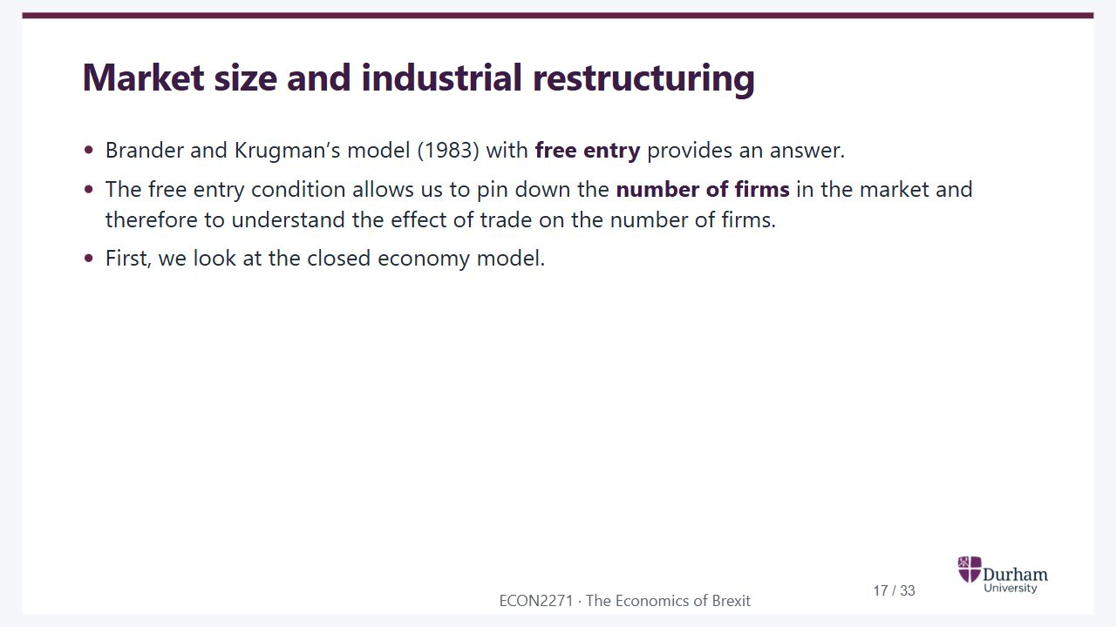
Notes:
Static student copy of the current web slide. Slide artwork is flattened; add personal notes here. Interactive explanations, playback and accessible HTML are available at:
https://davidchivers.co.uk/teaching/macro-applications/lecture_3.html#/l3-s17
Market size and industrial restructuring
Brander and Krugman’s model (1983) with free entry provides an answer.
The free entry condition allows us to pin down the number of firms in the market and therefore to understand the effect of trade on the number of firms.
First, we look at the closed economy model.

Slide 18
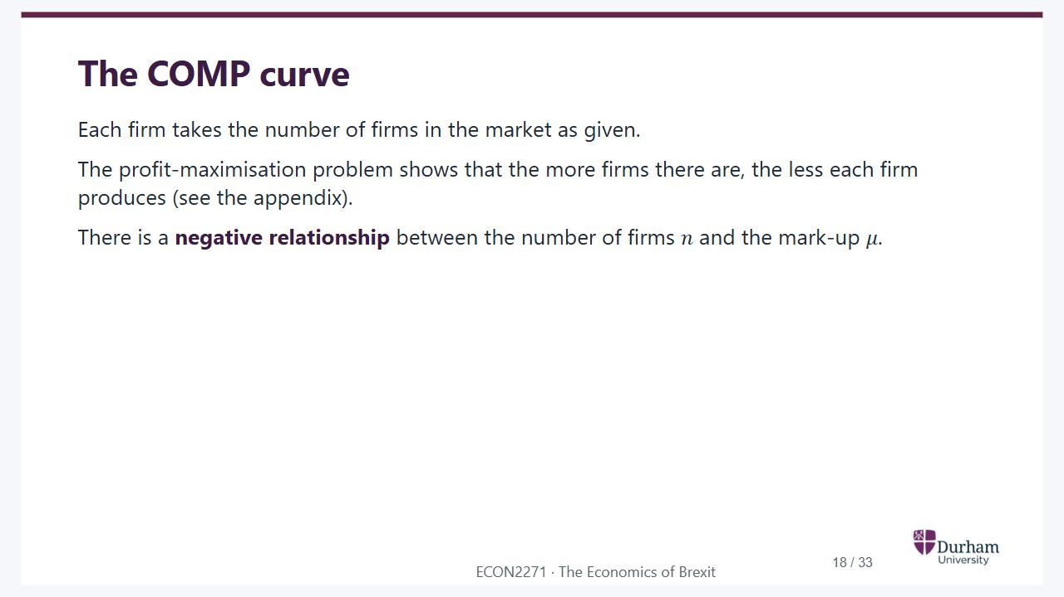
Notes:
Static student copy of the current web slide. Slide artwork is flattened; add personal notes here. Interactive explanations, playback and accessible HTML are available at:
https://davidchivers.co.uk/teaching/macro-applications/lecture_3.html#/l3-s18
The COMP curve
Each firm takes the number of firms in the market as given.
The profit-maximisation problem shows that the more firms there are, the less each firm produces (see the appendix).
There is a negative relationship between the number of firms
𝑛
and the mark-up
𝜇
.

Slide 19
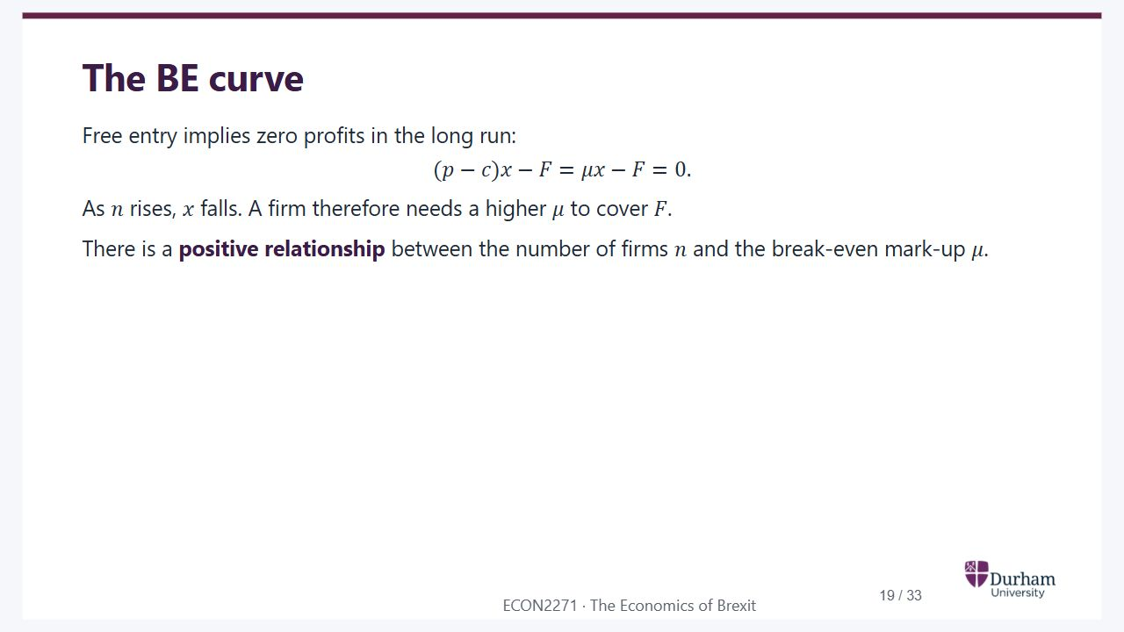
Notes:
Static student copy of the current web slide. Slide artwork is flattened; add personal notes here. Interactive explanations, playback and accessible HTML are available at:
https://davidchivers.co.uk/teaching/macro-applications/lecture_3.html#/l3-s19
The BE curve
Free entry implies zero profits in the long run:
(
𝑝
−
𝑐
)
𝑥
−
𝐹
=
𝜇
𝑥
−
𝐹
=
0
.
As
𝑛
rises,
𝑥
falls. A firm therefore needs a higher
𝜇
to cover
𝐹
.
There is a positive relationship between the number of firms
𝑛
and the break-even mark-up
𝜇
.

Slide 20
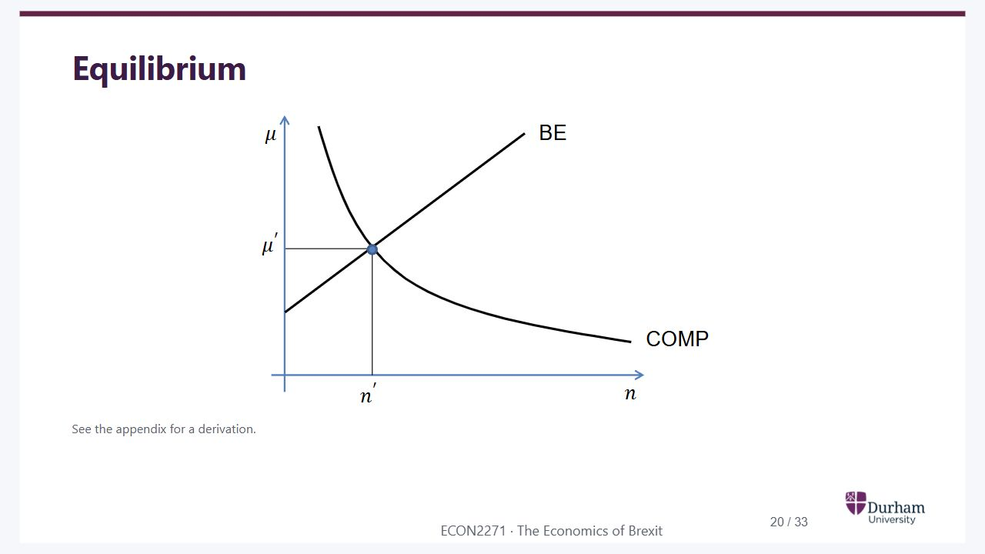
Notes:
Static student copy of the current web slide. Slide artwork is flattened; add personal notes here. Interactive explanations, playback and accessible HTML are available at:
https://davidchivers.co.uk/teaching/macro-applications/lecture_3.html#/l3-s20
Equilibrium
See the appendix for a derivation.
The downward-sloping COMP curve and upward-sloping BE curve intersect at equilibrium firm count n prime and mark-up mu prime.

Slide 21
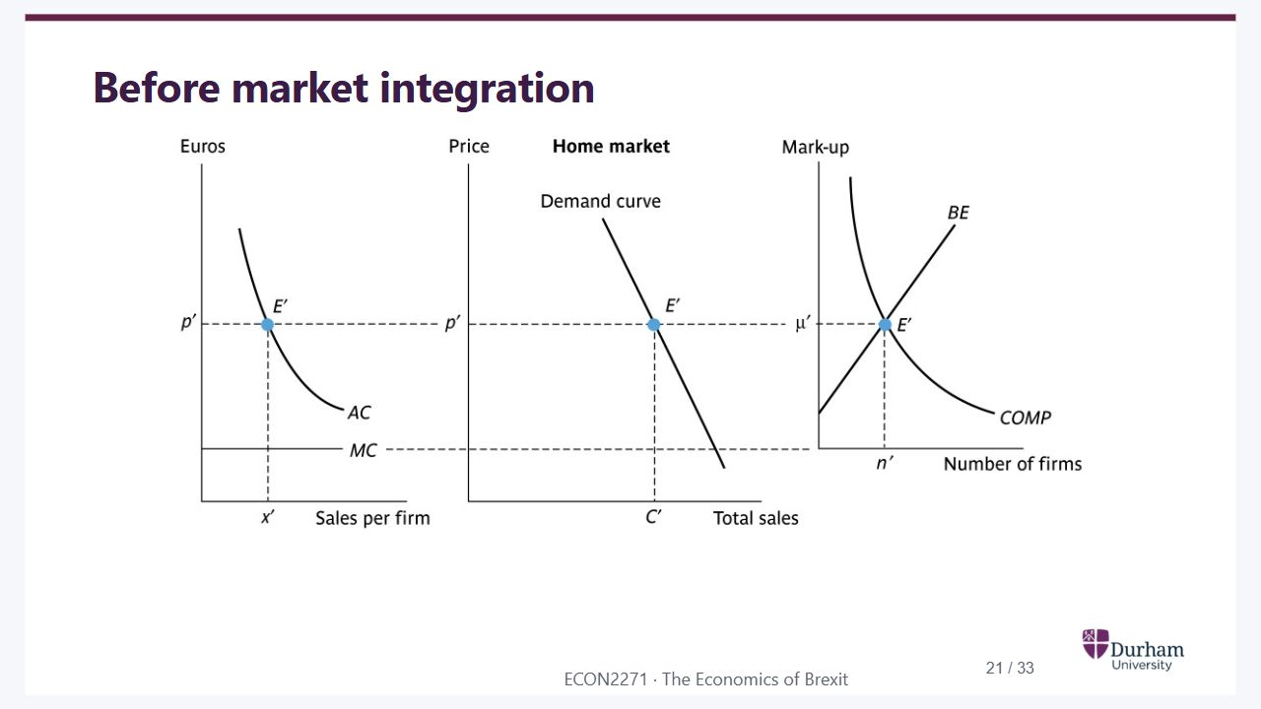
Notes:
Static student copy of the current web slide. Slide artwork is flattened; add personal notes here. Interactive explanations, playback and accessible HTML are available at:
https://davidchivers.co.uk/teaching/macro-applications/lecture_3.html#/l3-s21
Before market integration
Three linked panels before integration: firm average and marginal cost, market demand, and the BE-COMP equilibrium. Dashed guides connect equilibrium firm output, price, sales and mark-up.

Slide 22
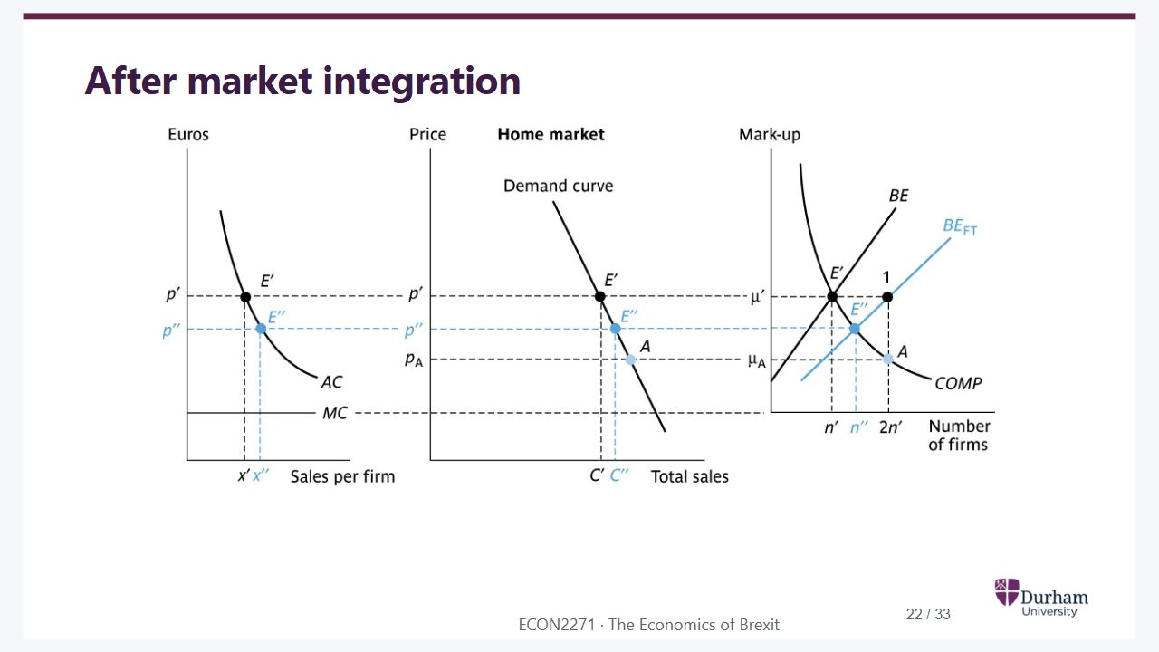
Notes:
Static student copy of the current web slide. Slide artwork is flattened; add personal notes here. Interactive explanations, playback and accessible HTML are available at:
https://davidchivers.co.uk/teaching/macro-applications/lecture_3.html#/l3-s22
After market integration
The same three panels after integration. The initial increase in competing firms lowers the mark-up; exit and restructuring then raise output per surviving firm. The new equilibrium differs from the short-run point A.

Slide 23

Notes:
Static student copy of the current web slide. Slide artwork is flattened; add personal notes here. Interactive explanations, playback and accessible HTML are available at:
https://davidchivers.co.uk/teaching/macro-applications/lecture_3.html#/l3-s23
EU: a bigger market
Pro-competitive effect
The mark-up falls and output rises because twice as many firms compete in the market.
Industrial restructuring
Some firms exit because point A is not feasible:
𝑃
<
𝐴
𝐶
.
The remaining firms are larger and exploit increasing returns to scale more effectively.
Trade liberalisation is always welfare-improving with free entry in this model. Why?

Slide 24
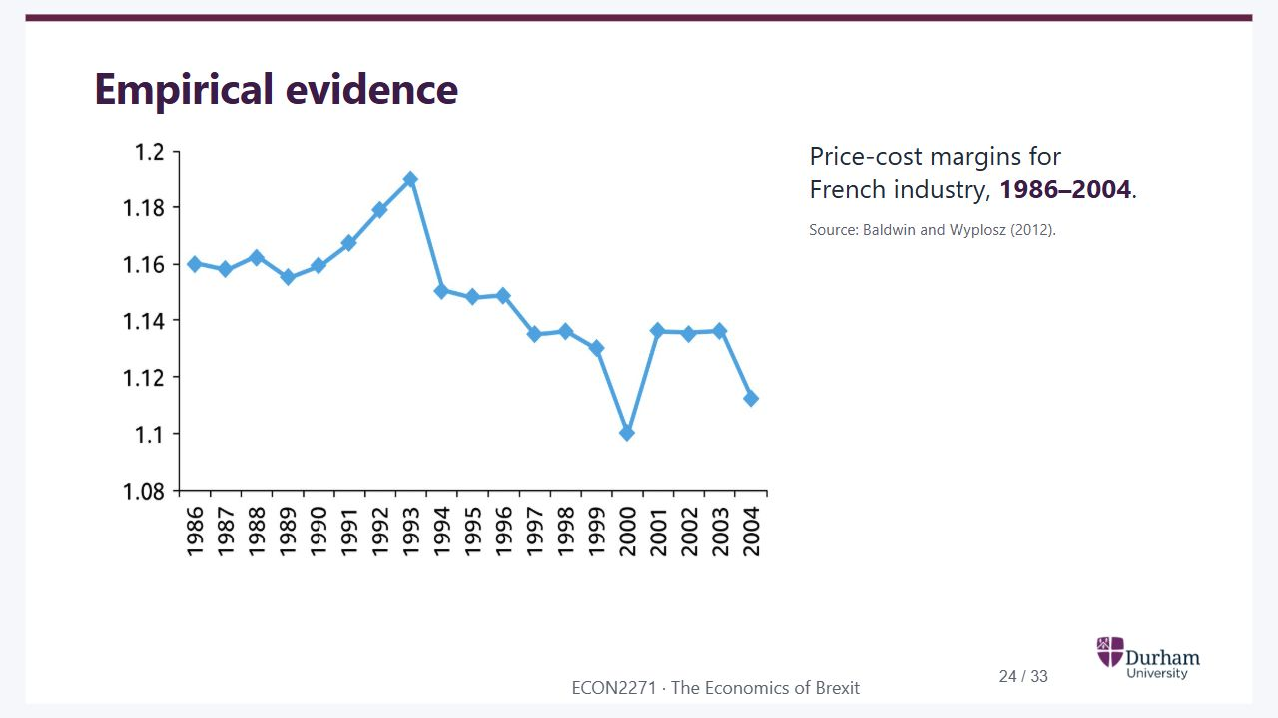
Notes:
Static student copy of the current web slide. Slide artwork is flattened; add personal notes here. Interactive explanations, playback and accessible HTML are available at:
https://davidchivers.co.uk/teaching/macro-applications/lecture_3.html#/l3-s24
Empirical evidence
Price-cost margins for French industry, 1986–2004.
Source: Baldwin and Wyplosz (2012).
Line chart of French industrial price-cost margins, 1986 to 2004. Margins fluctuate but are lower at the end of the period than at the beginning. Source: Baldwin and Wyplosz, 2012.

Slide 25
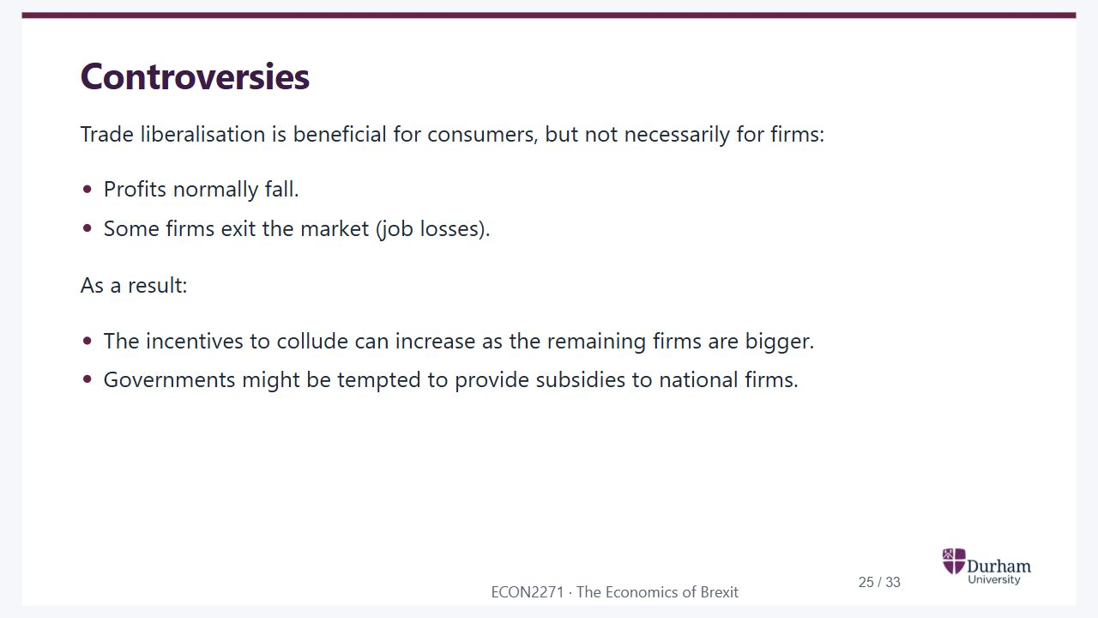
Notes:
Static student copy of the current web slide. Slide artwork is flattened; add personal notes here. Interactive explanations, playback and accessible HTML are available at:
https://davidchivers.co.uk/teaching/macro-applications/lecture_3.html#/l3-s25
Controversies
Trade liberalisation is beneficial for consumers, but not necessarily for firms:
Profits normally fall.
Some firms exit the market (job losses).
As a result:
The incentives to collude can increase as the remaining firms are bigger.
Governments might be tempted to provide subsidies to national firms.

Slide 26

Notes:
Static student copy of the current web slide. Slide artwork is flattened; add personal notes here. Interactive explanations, playback and accessible HTML are available at:
https://davidchivers.co.uk/teaching/macro-applications/lecture_3.html#/l3-s26
Summing up
Free mobility of goods is beneficial as consumers benefit from the higher competition triggered by the increased market size.
Market integration also leads to a process of industrial restructuring (job losses if labour mobility across sectors and countries is not perfect).

Slide 27

Notes:
Static student copy of the current web slide. Slide artwork is flattened; add personal notes here. Interactive explanations, playback and accessible HTML are available at:
https://davidchivers.co.uk/teaching/macro-applications/lecture_3.html#/l3-s27
Next lecture
We will talk about migration.

Slide 28
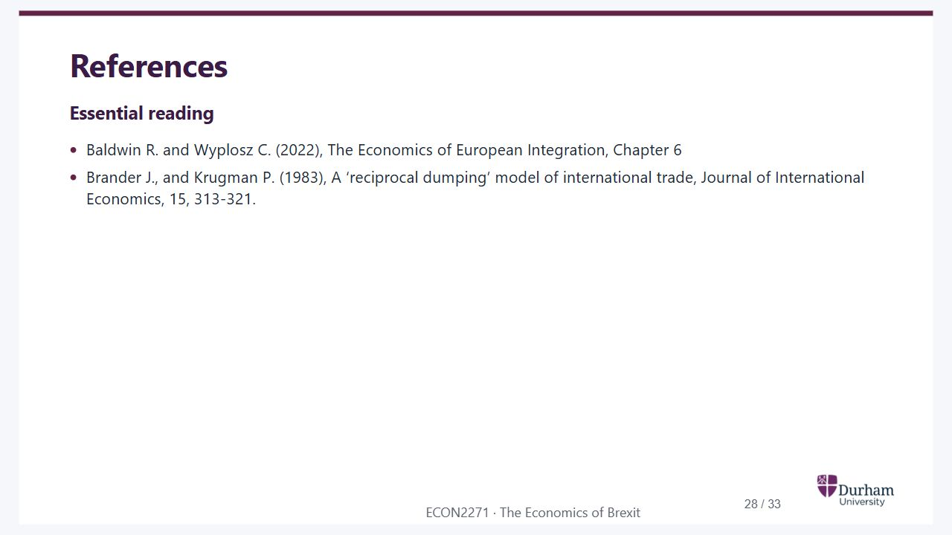
Notes:
Static student copy of the current web slide. Slide artwork is flattened; add personal notes here. Interactive explanations, playback and accessible HTML are available at:
https://davidchivers.co.uk/teaching/macro-applications/lecture_3.html#/l3-s28
References
Essential reading
Baldwin R. and Wyplosz C. (2022), The Economics of European Integration, Chapter 6
Brander J., and Krugman P. (1983), A ‘reciprocal dumping’ model of international trade, Journal of International Economics, 15, 313-321.

Slide 29
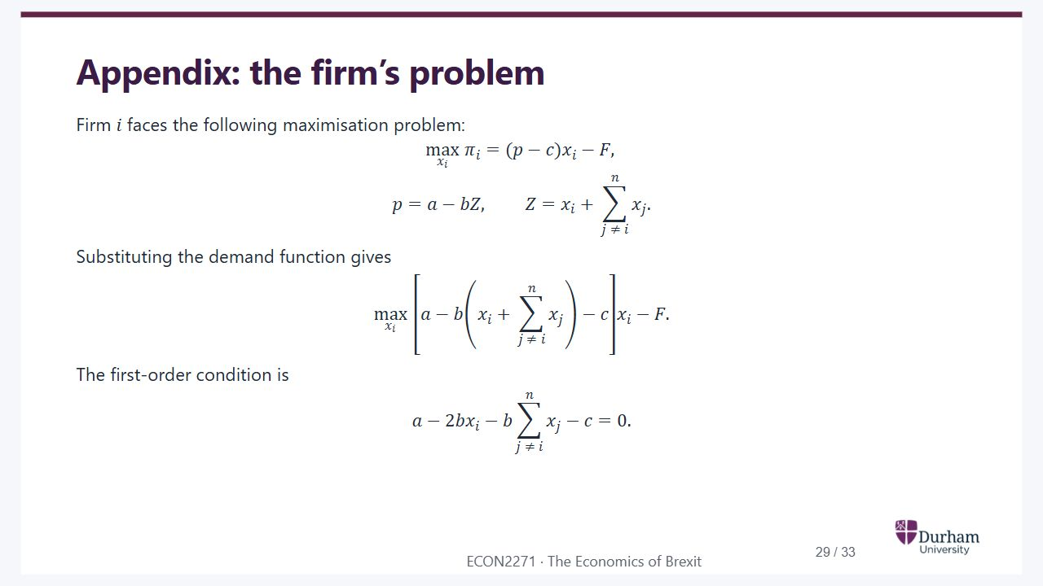
Notes:
Static student copy of the current web slide. Slide artwork is flattened; add personal notes here. Interactive explanations, playback and accessible HTML are available at:
https://davidchivers.co.uk/teaching/macro-applications/lecture_3.html#/l3-s29
Appendix: the firm’s problem
Firm
𝑖
faces the following maximisation problem:
max
𝑥
𝑖
𝜋
𝑖
=
(
𝑝
−
𝑐
)
𝑥
𝑖
−
𝐹
,
𝑝
=
𝑎
−
𝑏
𝑍
,
𝑍
=
𝑥
𝑖
+
∑
𝑗
≠
𝑖
𝑛
𝑥
𝑗
.
Substituting the demand function gives
max
𝑥
𝑖
[
𝑎
−
𝑏
(
𝑥
𝑖
+
∑
𝑗
≠
𝑖
𝑛
𝑥
𝑗
)
−
𝑐
]
𝑥
𝑖
−
𝐹
.
The first-order condition is
𝑎
−
2
𝑏
𝑥
𝑖
−
𝑏
∑
𝑗
≠
𝑖
𝑛
𝑥
𝑗
−
𝑐
=
0
.

Slide 30
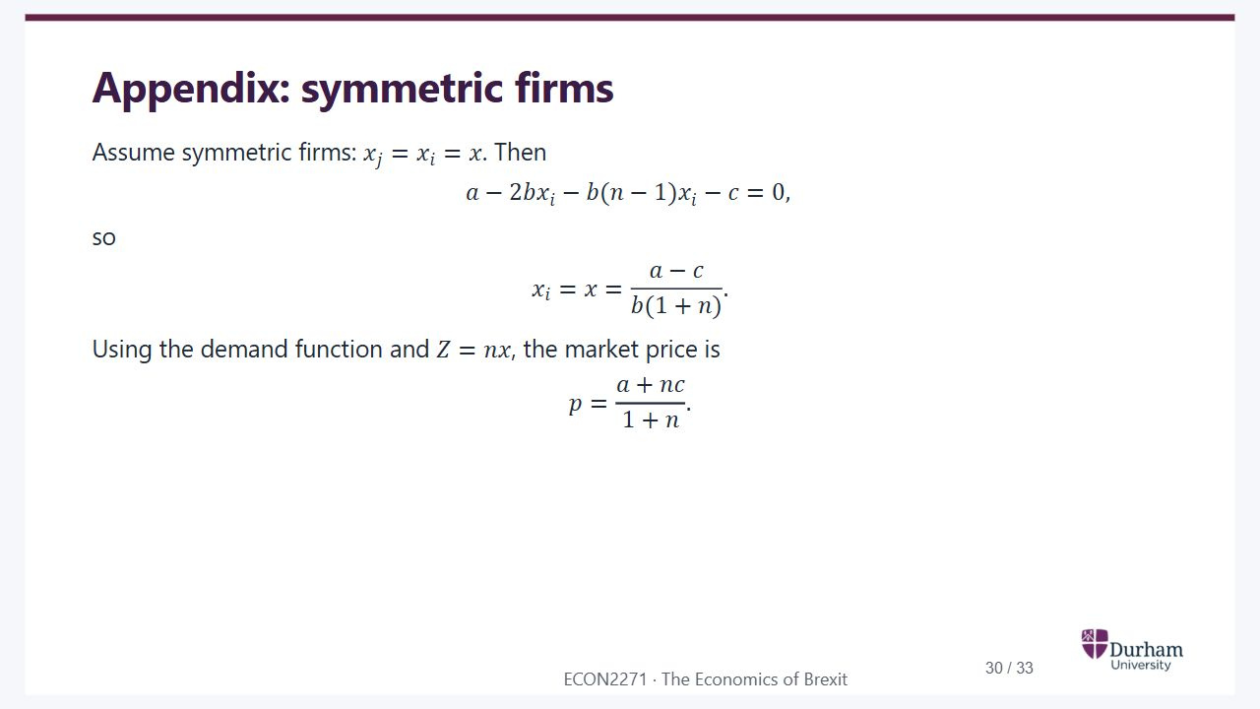
Notes:
Static student copy of the current web slide. Slide artwork is flattened; add personal notes here. Interactive explanations, playback and accessible HTML are available at:
https://davidchivers.co.uk/teaching/macro-applications/lecture_3.html#/l3-s30
Appendix: symmetric firms
Assume symmetric firms:
𝑥
𝑗
=
𝑥
𝑖
=
𝑥
. Then
𝑎
−
2
𝑏
𝑥
𝑖
−
𝑏
(
𝑛
−
1
)
𝑥
𝑖
−
𝑐
=
0
,
so
𝑥
𝑖
=
𝑥
=
𝑎
−
𝑐
𝑏
(
1
+
𝑛
)
.
Using the demand function and
𝑍
=
𝑛
𝑥
, the market price is
𝑝
=
𝑎
+
𝑛
𝑐
1
+
𝑛
.

Slide 31
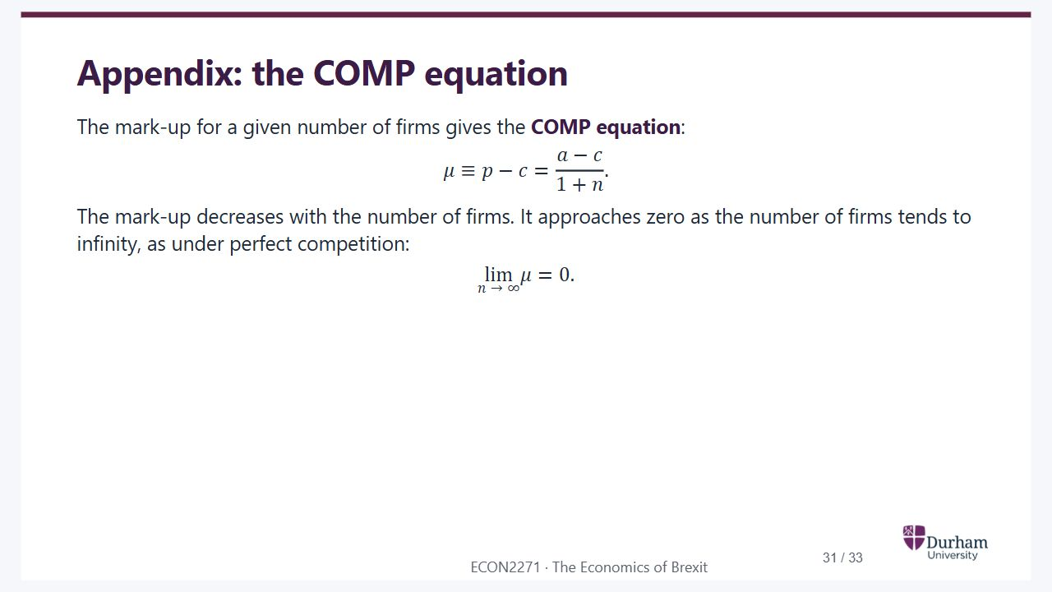
Notes:
Static student copy of the current web slide. Slide artwork is flattened; add personal notes here. Interactive explanations, playback and accessible HTML are available at:
https://davidchivers.co.uk/teaching/macro-applications/lecture_3.html#/l3-s31
Appendix: the COMP equation
The mark-up for a given number of firms gives the COMP equation:
𝜇
≡
𝑝
−
𝑐
=
𝑎
−
𝑐
1
+
𝑛
.
The mark-up decreases with the number of firms. It approaches zero as the number of firms tends to infinity, as under perfect competition:
lim
𝑛
→
∞
𝜇
=
0
.

Slide 32
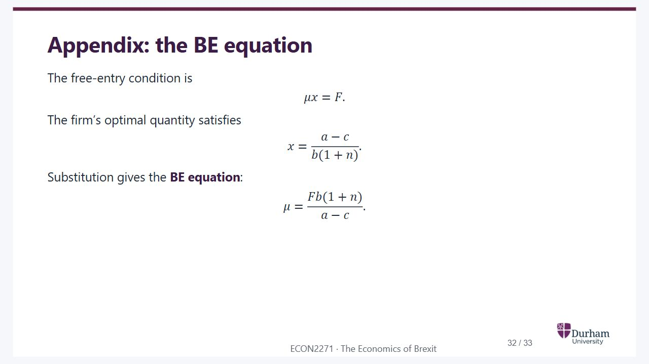
Notes:
Static student copy of the current web slide. Slide artwork is flattened; add personal notes here. Interactive explanations, playback and accessible HTML are available at:
https://davidchivers.co.uk/teaching/macro-applications/lecture_3.html#/l3-s32
Appendix: the BE equation
The free-entry condition is
𝜇
𝑥
=
𝐹
.
The firm’s optimal quantity satisfies
𝑥
=
𝑎
−
𝑐
𝑏
(
1
+
𝑛
)
.
Substitution gives the BE equation:
𝜇
=
𝐹
𝑏
(
1
+
𝑛
)
𝑎
−
𝑐
.

Slide 33
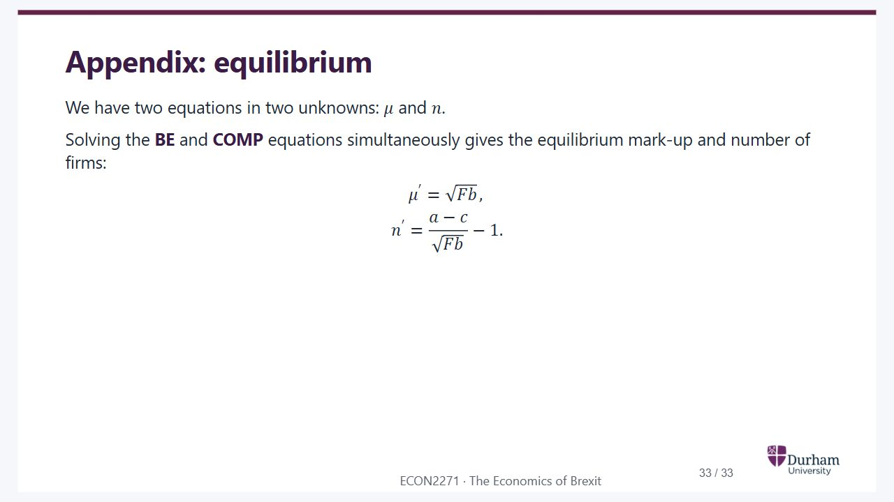
Notes:
Static student copy of the current web slide. Slide artwork is flattened; add personal notes here. Interactive explanations, playback and accessible HTML are available at:
https://davidchivers.co.uk/teaching/macro-applications/lecture_3.html#/l3-s33
Appendix: equilibrium
We have two equations in two unknowns:
𝜇
and
𝑛
.
Solving the BE and COMP equations simultaneously gives the equilibrium mark-up and number of firms:
𝜇
′
=
𝐹
𝑏
,
𝑛
′
=
𝑎
−
𝑐
𝐹
𝑏
−
1
.

