Slide 1
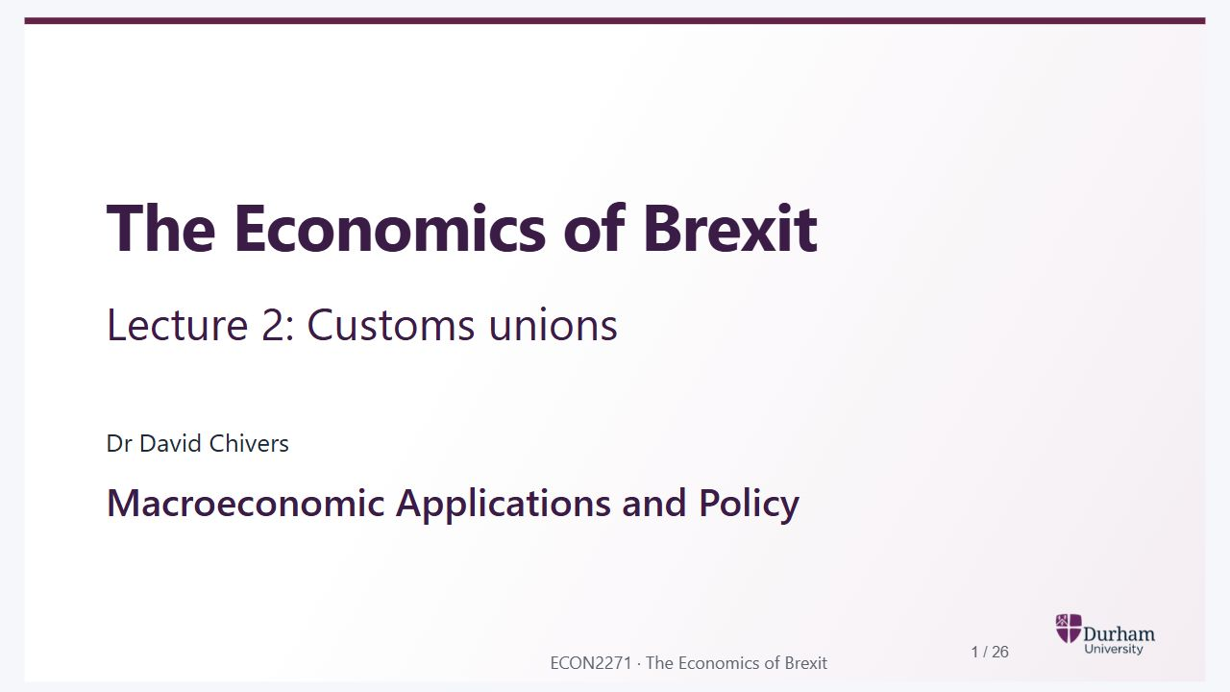
Notes:
Static student copy of the current web slide. Slide artwork is flattened; add personal notes here. Interactive explanations, playback and accessible HTML are available at:
https://davidchivers.co.uk/teaching/macro-applications/lecture_2.html#/title-slide
The Economics of Brexit
Lecture 2: Customs unions
Dr David Chivers
Macroeconomic Applications and Policy

Slide 2
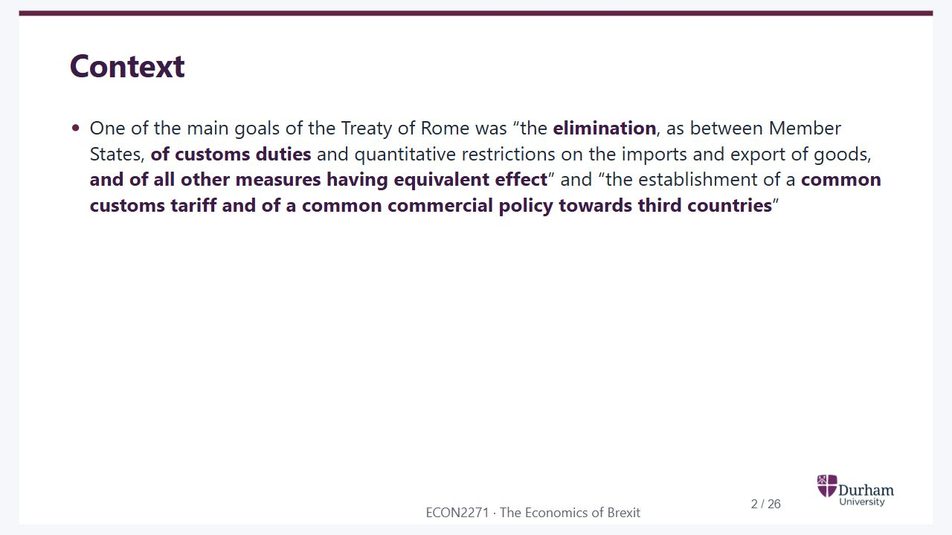
Notes:
Static student copy of the current web slide. Slide artwork is flattened; add personal notes here. Interactive explanations, playback and accessible HTML are available at:
https://davidchivers.co.uk/teaching/macro-applications/lecture_2.html#/l2-s02
Context
One of the main goals of the Treaty of Rome was “the elimination, as between Member States, of customs duties and quantitative restrictions on the imports and export of goods, and of all other measures having equivalent effect” and “the establishment of a common customs tariff and of a common commercial policy towards third countries”

Slide 3
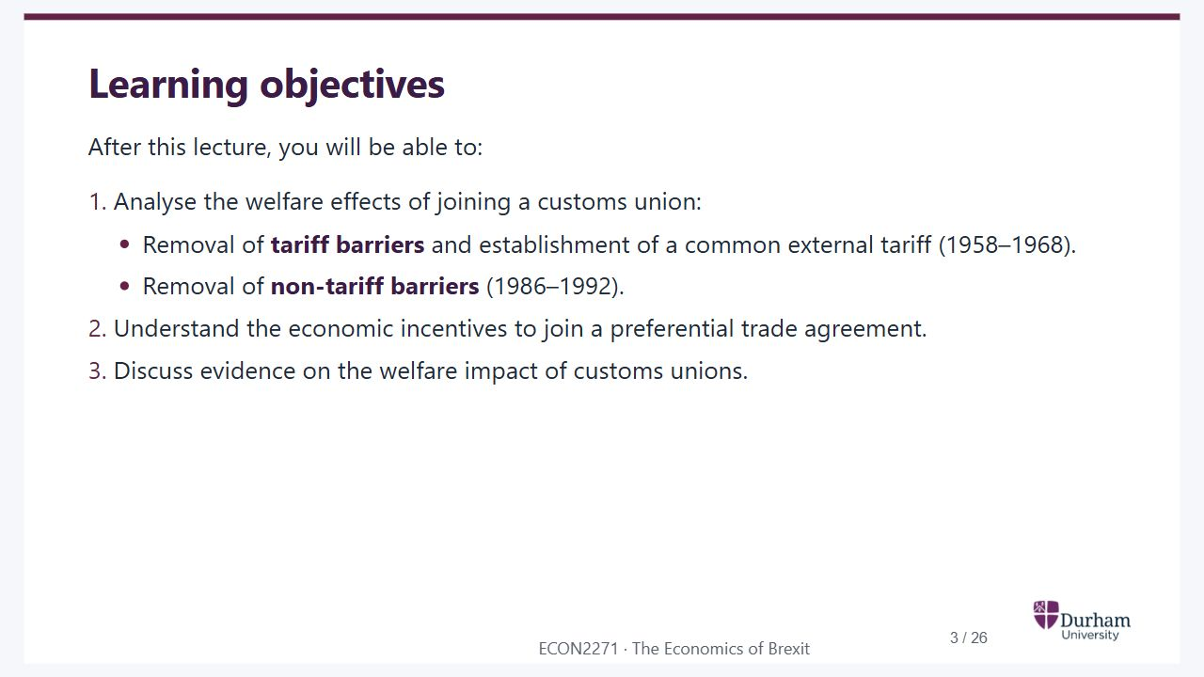
Notes:
Static student copy of the current web slide. Slide artwork is flattened; add personal notes here. Interactive explanations, playback and accessible HTML are available at:
https://davidchivers.co.uk/teaching/macro-applications/lecture_2.html#/l2-s03
Learning objectives
After this lecture, you will be able to:
Analyse the welfare effects of joining a customs union:
Removal of tariff barriers and establishment of a common external tariff (1958–1968).
Removal of non-tariff barriers (1986–1992).
Understand the economic incentives to join a preferential trade agreement.
Discuss evidence on the welfare impact of customs unions.

Slide 4
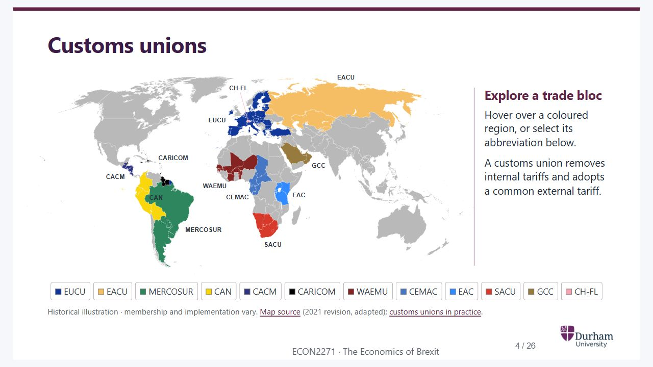
Notes:
Static student copy of the current web slide. Slide artwork is flattened; add personal notes here. Interactive explanations, playback and accessible HTML are available at:
https://davidchivers.co.uk/teaching/macro-applications/lecture_2.html#/l2-s04
Customs unions
MERCOSUR
CARICOM
CACM
CAN
CH-FL
EUCU
EACU
GCC
EAC
WAEMU
CEMAC
SACU
Explore a trade bloc
Hover over a coloured region, or select its abbreviation below.
A customs union removes internal tariffs and adopts a common external tariff.
EUCU
EACU
MERCOSUR
CAN
CACM
CARICOM
WAEMU
CEMAC
EAC
SACU
GCC
CH-FL
Historical illustration · membership and implementation vary. Map source (2021 revision, adapted); customs unions in practice.
Historical world map of customs unions and trade blocs. Named controls provide descriptions in the online slide.
https://commons.wikimedia.org/wiki/File:Customs_Unions_World.svg
https://www.uktpo.org/2018/03/29/what-can-the-uk-learn-from-existing-customs-unions/

Slide 5
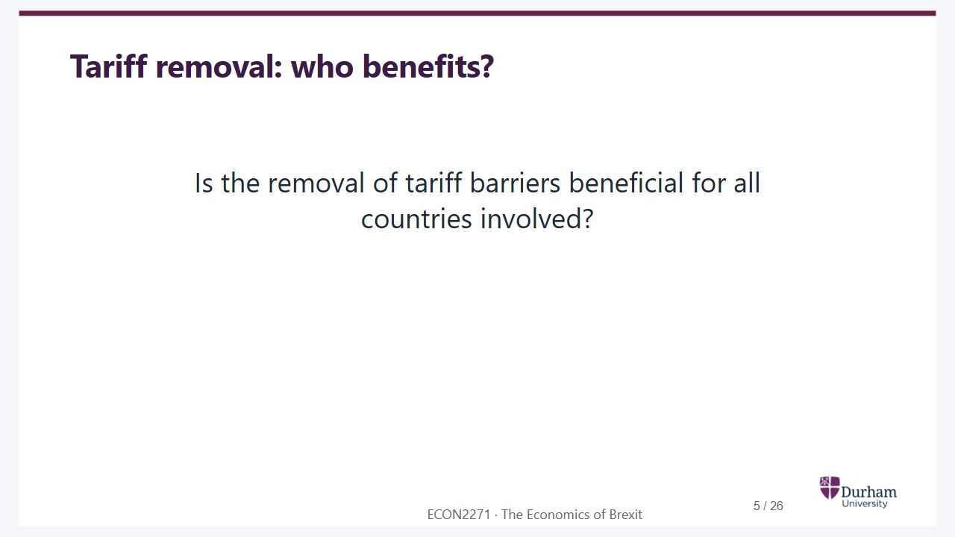
Notes:
Static student copy of the current web slide. Slide artwork is flattened; add personal notes here. Interactive explanations, playback and accessible HTML are available at:
https://davidchivers.co.uk/teaching/macro-applications/lecture_2.html#/l2-s05
Tariff removal: who benefits?
Is the removal of tariff barriers beneficial for all countries involved?

Slide 6
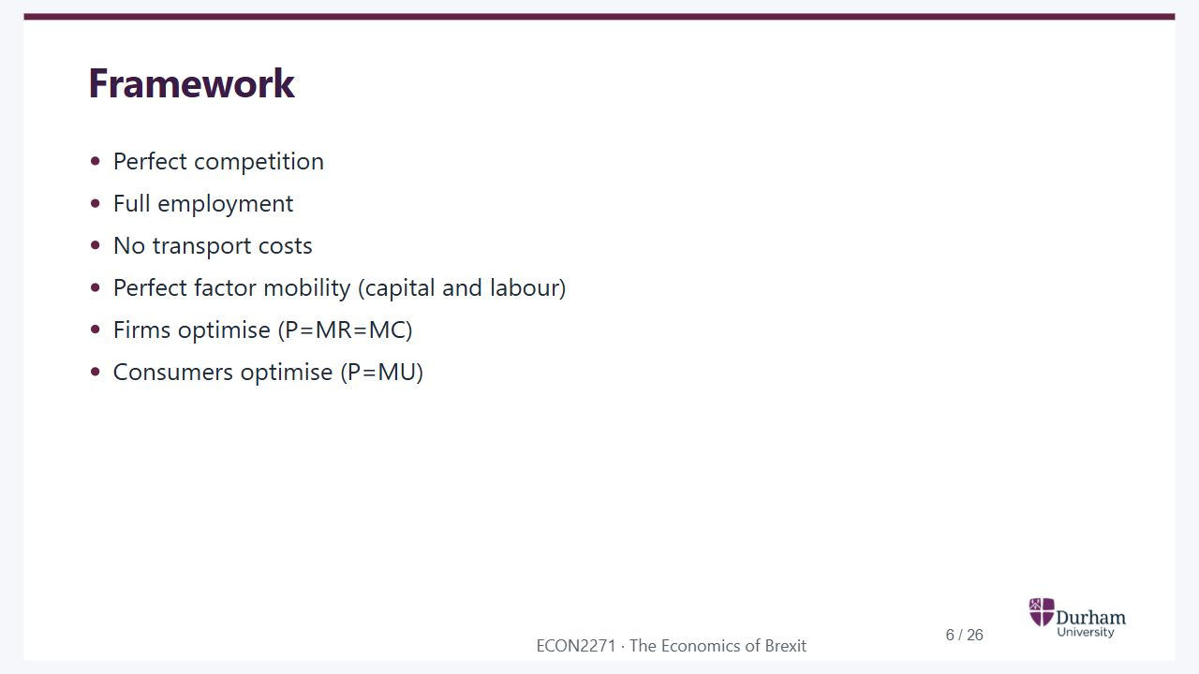
Notes:
Static student copy of the current web slide. Slide artwork is flattened; add personal notes here. Interactive explanations, playback and accessible HTML are available at:
https://davidchivers.co.uk/teaching/macro-applications/lecture_2.html#/l2-s06
Framework
Perfect competition
Full employment
No transport costs
Perfect factor mobility (capital and labour)
Firms optimise (P=MR=MC)
Consumers optimise (P=MU)

Slide 7
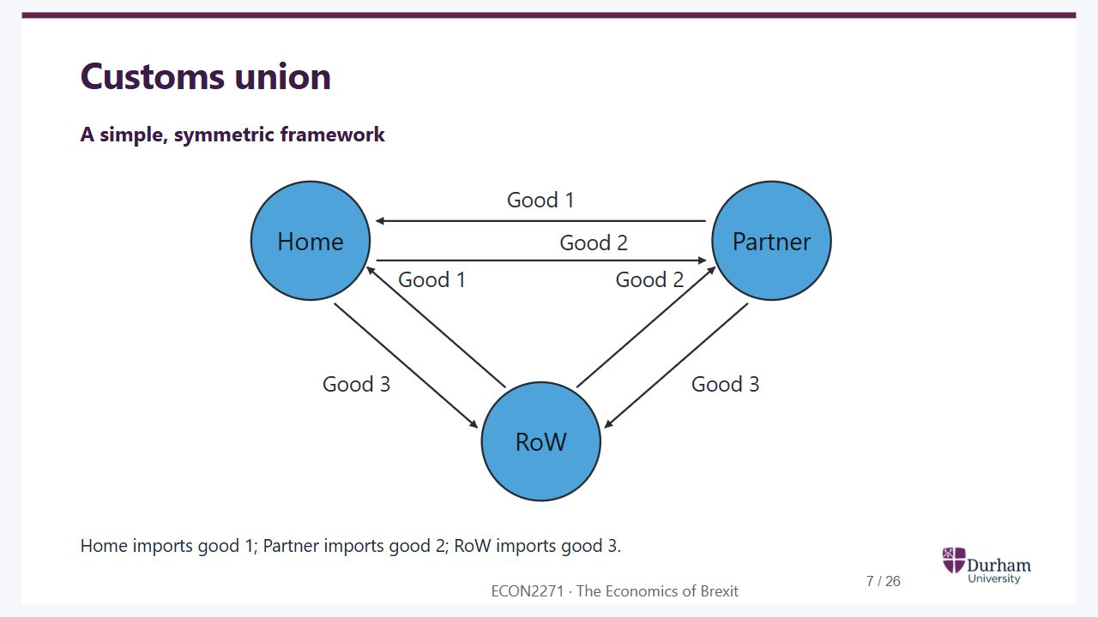
Notes:
Static student copy of the current web slide. Slide artwork is flattened; add personal notes here. Interactive explanations, playback and accessible HTML are available at:
https://davidchivers.co.uk/teaching/macro-applications/lecture_2.html#/l2-s07
Customs union
A simple, symmetric framework
Good 1
Good 1
Good 2
Good 2
Good 3
Good 3
Home
Partner
RoW
Home imports good 1; Partner imports good 2; RoW imports good 3.

Slide 8
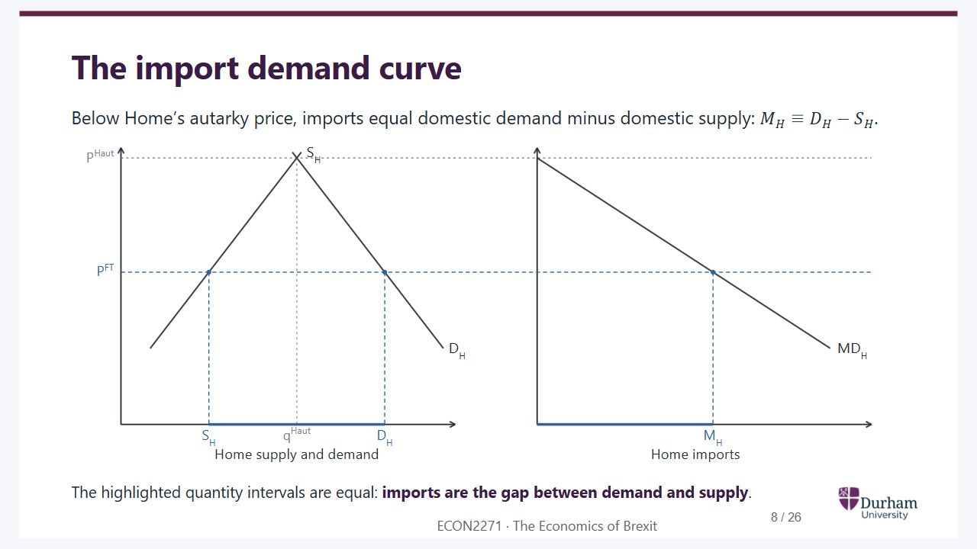
Notes:
Static student copy of the current web slide. Slide artwork is flattened; add personal notes here. Interactive explanations, playback and accessible HTML are available at:
https://davidchivers.co.uk/teaching/macro-applications/lecture_2.html#/l2-s08
The import demand curve
Below Home’s autarky price, imports equal domestic demand minus domestic supply:
𝑀
𝐻
≡
𝐷
𝐻
−
𝑆
𝐻
.
The highlighted quantity intervals are equal: imports are the gap between demand and supply.
Deriving Home import demand from domestic supply and demand. Continuous horizontal guides align Home's autarky and free-trade prices across both panels. At the autarky price, domestic supply equals demand and imports are zero. At the free-trade price, the highlighted gap between domestic supply and demand has exactly the same width as Home imports in the right panel. Import demand slopes downwards.

Slide 9
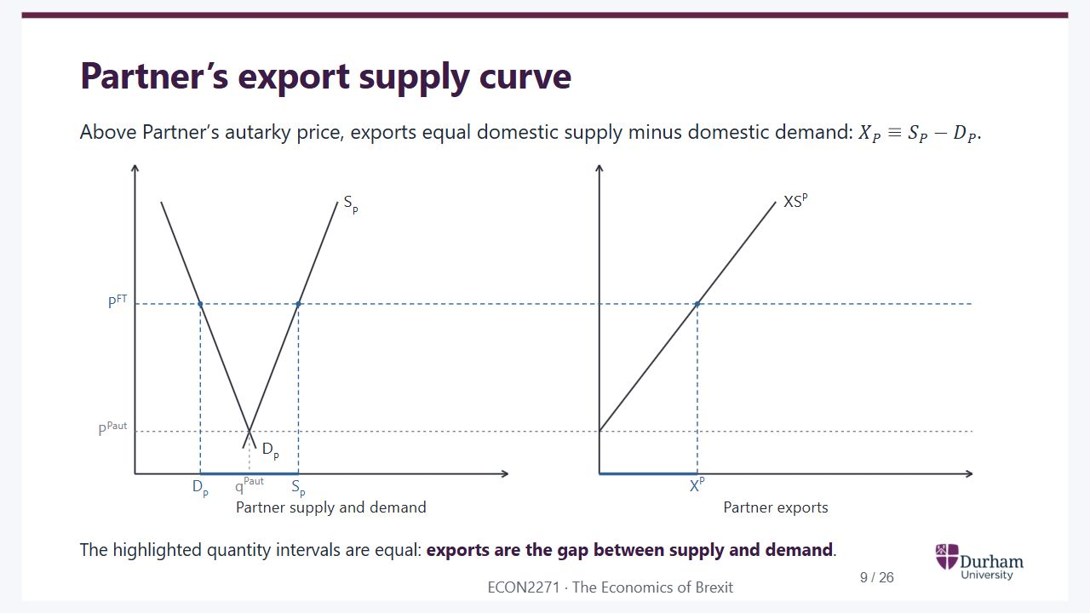
Notes:
Static student copy of the current web slide. Slide artwork is flattened; add personal notes here. Interactive explanations, playback and accessible HTML are available at:
https://davidchivers.co.uk/teaching/macro-applications/lecture_2.html#/l2-s09
Partner’s export supply curve
Above Partner’s autarky price, exports equal domestic supply minus domestic demand:
𝑋
𝑃
≡
𝑆
𝑃
−
𝐷
𝑃
.
The highlighted quantity intervals are equal: exports are the gap between supply and demand.
Deriving Partner export supply from domestic supply and demand. Continuous horizontal guides align the autarky and free-trade prices across both panels. At the autarky price, exports are zero. At the free-trade price, the highlighted gap between supply and demand is exactly as wide as exports in the right panel. Export supply slopes upwards.

Slide 10
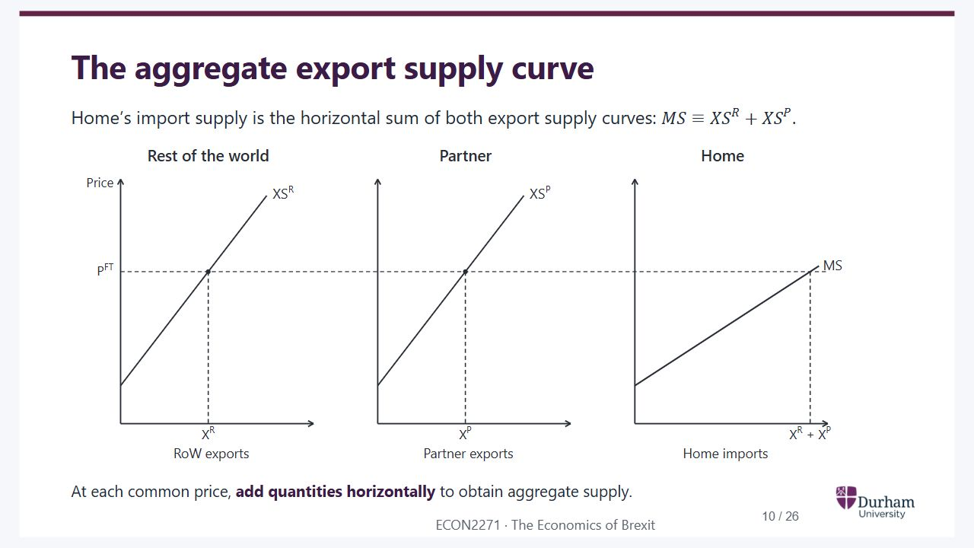
Notes:
Static student copy of the current web slide. Slide artwork is flattened; add personal notes here. Interactive explanations, playback and accessible HTML are available at:
https://davidchivers.co.uk/teaching/macro-applications/lecture_2.html#/l2-s10
The aggregate export supply curve
Home’s import supply is the horizontal sum of both export supply curves:
𝑀
𝑆
≡
𝑋
𝑆
𝑅
+
𝑋
𝑆
𝑃
.
At each common price, add quantities horizontally to obtain aggregate supply.
Three panels on common price and quantity scales. A continuous free-trade-price guide crosses both export supply panels and Home's import supply panel. The horizontal distance for aggregate supply equals the sum of the two exporter distances at that price.

Slide 11
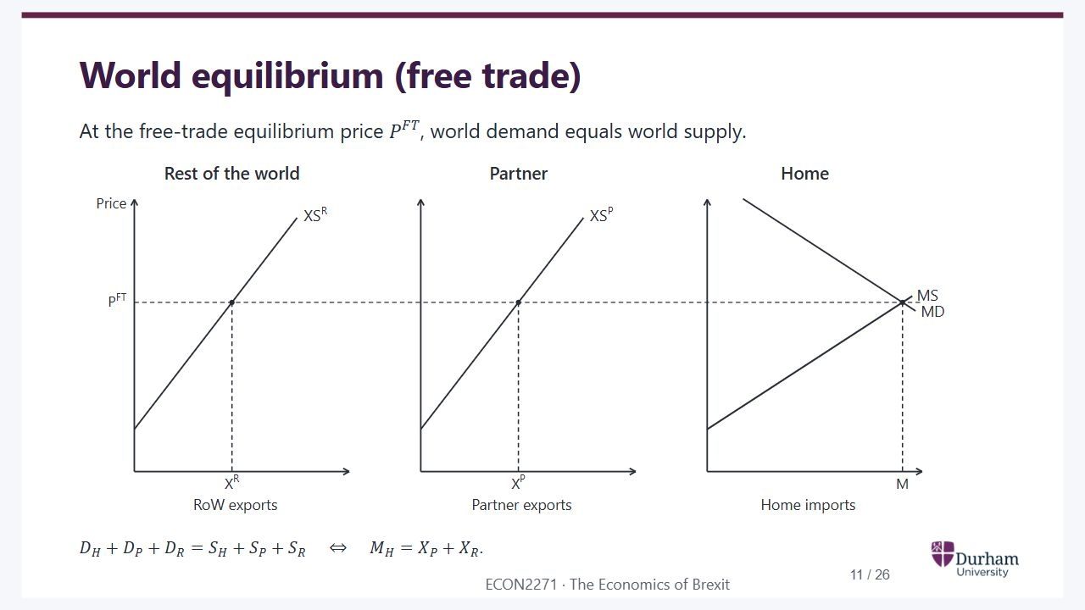
Notes:
Static student copy of the current web slide. Slide artwork is flattened; add personal notes here. Interactive explanations, playback and accessible HTML are available at:
https://davidchivers.co.uk/teaching/macro-applications/lecture_2.html#/l2-s11
World equilibrium (free trade)
At the free-trade equilibrium price
𝑃
𝐹
𝑇
, world demand equals world supply.
𝐷
𝐻
+
𝐷
𝑃
+
𝐷
𝑅
=
𝑆
𝐻
+
𝑆
𝑃
+
𝑆
𝑅
⇔
𝑀
𝐻
=
𝑋
𝑃
+
𝑋
𝑅
.
The same three panels and scales as aggregate supply. Home import demand intersects aggregate import supply at the free-trade price. The continuous horizontal price guide links that intersection to both exporters. Home's import quantity equals the sum of Partner and rest-of-world exports.

Slide 12
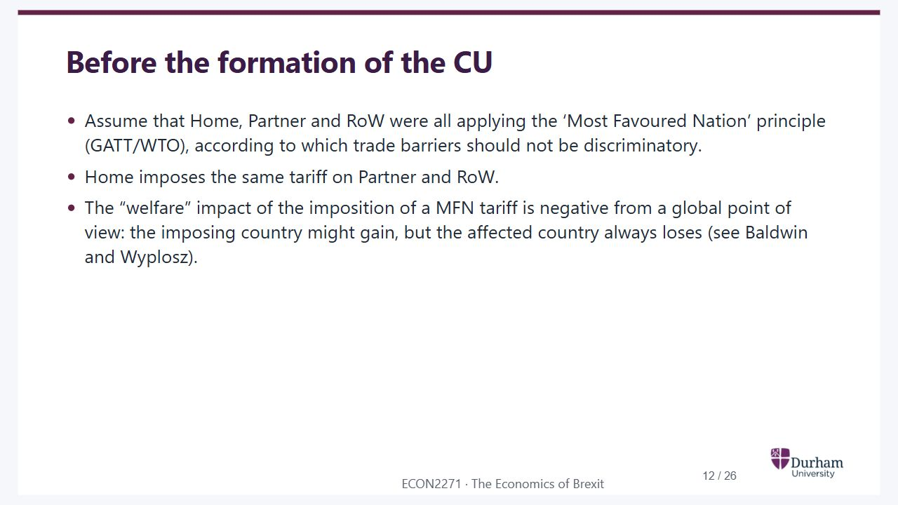
Notes:
Static student copy of the current web slide. Slide artwork is flattened; add personal notes here. Interactive explanations, playback and accessible HTML are available at:
https://davidchivers.co.uk/teaching/macro-applications/lecture_2.html#/l2-s12
Before the formation of the CU
Assume that Home, Partner and RoW were all applying the ‘Most Favoured Nation’ principle (GATT/WTO), according to which trade barriers should not be discriminatory.
Home imposes the same tariff on Partner and RoW.
The “welfare” impact of the imposition of a MFN tariff is negative from a global point of view: the imposing country might gain, but the affected country always loses (see Baldwin and Wyplosz).
CU: Customs union
RoW: Rest of the world
GATT: General Agreement on Tariffs and Trade
WTO: World Trade Organization
MFN: Most-favoured-nation

Slide 13
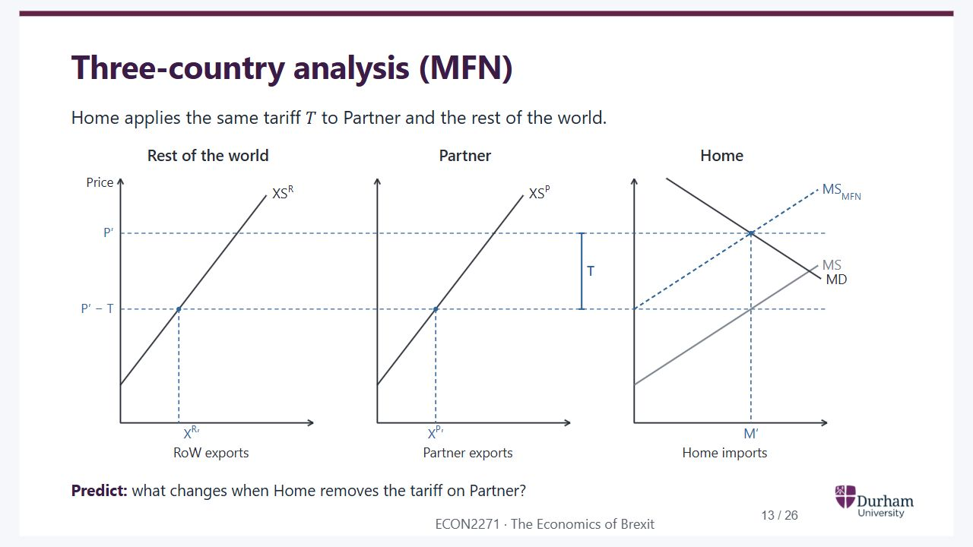
Notes:
Static student copy of the current web slide. Slide artwork is flattened; add personal notes here. Interactive explanations, playback and accessible HTML are available at:
https://davidchivers.co.uk/teaching/macro-applications/lecture_2.html#/l2-s13
Three-country analysis (MFN)
Home applies the same tariff
𝑇
to Partner and the rest of the world.
Predict: what changes when Home removes the tariff on Partner?
Three fixed panels: rest-of-world exports, Partner exports and Home imports. Blue dashed lines mark the initial MFN equilibrium. Home pays P prime; both exporters receive P prime minus T. Grey MS is aggregate supply under free trade.
MFN: Most-favoured-nation

Slide 14
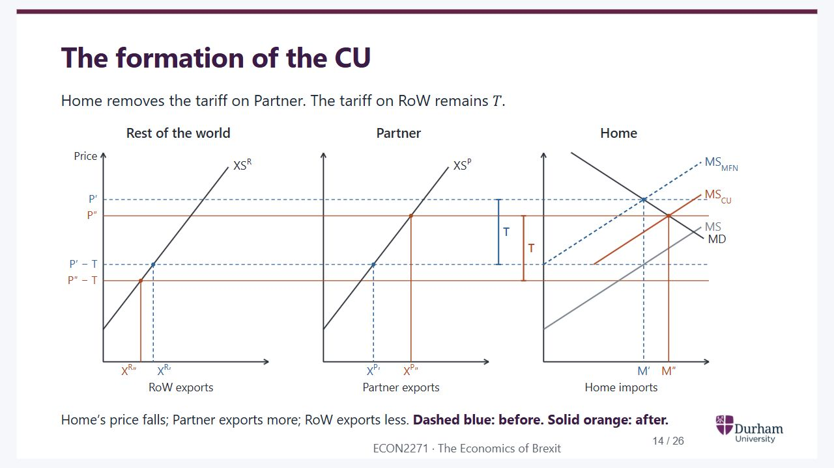
Notes:
Static student copy of the current web slide. Slide artwork is flattened; add personal notes here. Interactive explanations, playback and accessible HTML are available at:
https://davidchivers.co.uk/teaching/macro-applications/lecture_2.html#/l2-s14
The formation of the CU
Home removes the tariff on Partner. The tariff on RoW remains
𝑇
.
Home’s price falls; Partner exports more; RoW exports less. Dashed blue: before. Solid orange: after.
The same three panels, with axes and curves fixed. Blue dashed lines retain the MFN equilibrium; orange solid lines mark the customs-union equilibrium. Home's price falls to P double prime. Partner receives that price and exports more. RoW receives P double prime minus T and exports less. Home imports increase.
CU: Customs union
RoW: Rest of the world

Slide 15
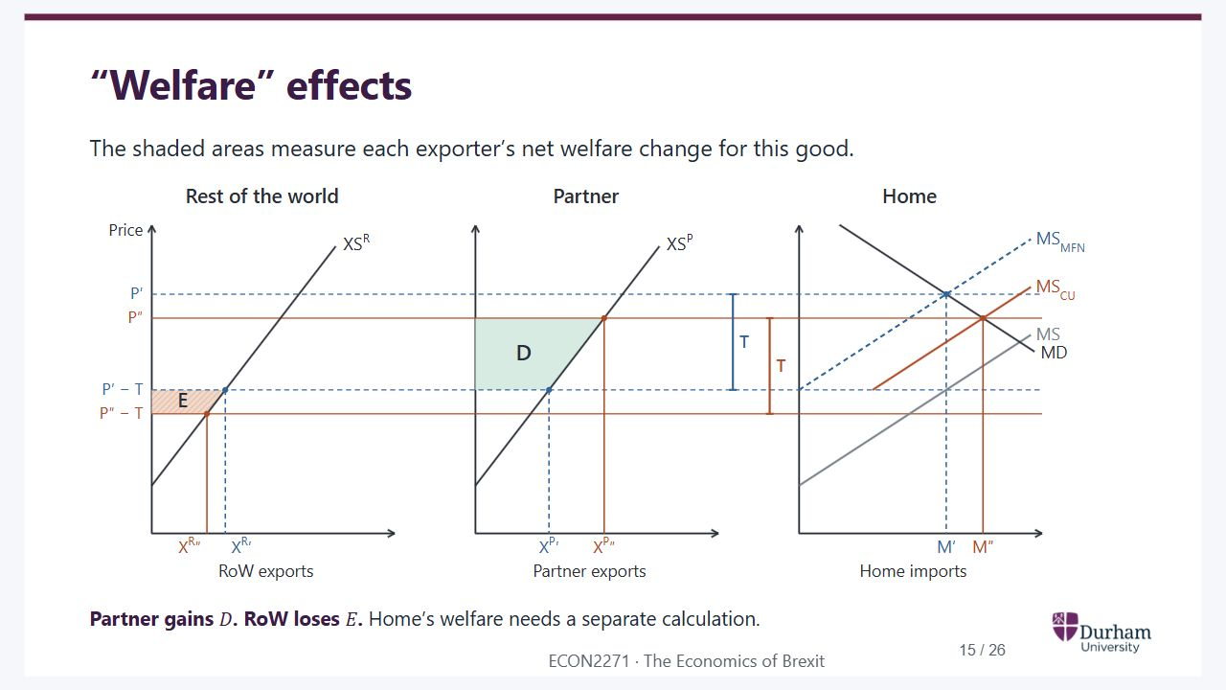
Notes:
Static student copy of the current web slide. Slide artwork is flattened; add personal notes here. Interactive explanations, playback and accessible HTML are available at:
https://davidchivers.co.uk/teaching/macro-applications/lecture_2.html#/l2-s15
“Welfare” effects
The shaded areas measure each exporter’s net welfare change for this good.
Rest of the world
RoW exports
Partner
Partner exports
Home
Home imports
Price
P′
P′ − T
P″
P″ − T
XSR
XR′
XSP
XP′
MS
MD
MSMFN
M′
T
XR″
XP″
MSCU
M″
T
E
D
Partner gains
𝐷
. RoW loses
𝐸
. Home’s welfare needs a separate calculation.
RoW: Rest of the world

Slide 16
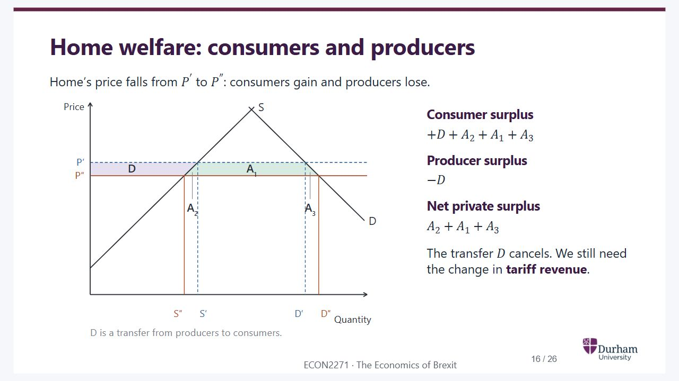
Notes:
Static student copy of the current web slide. Slide artwork is flattened; add personal notes here. Interactive explanations, playback and accessible HTML are available at:
https://davidchivers.co.uk/teaching/macro-applications/lecture_2.html#/l2-s16
Home welfare: consumers and producers
Home’s price falls from
𝑃
′
to
𝑃
″
: consumers gain and producers lose.
Price
Quantity
S
D
P′
P″
D
A1
A2
A3
S″
S′
D′
D″
D is a transfer from producers to consumers.
Consumer surplus
+
𝐷
+
𝐴
2
+
𝐴
1
+
𝐴
3
Producer surplus
−
𝐷
Net private surplus
𝐴
2
+
𝐴
1
+
𝐴
3
The transfer
𝐷
cancels. We still need the change in tariff revenue.

Slide 17
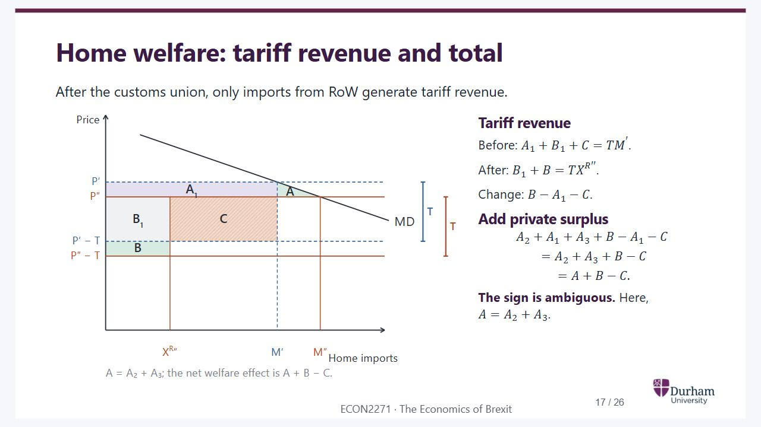
Notes:
Static student copy of the current web slide. Slide artwork is flattened; add personal notes here. Interactive explanations, playback and accessible HTML are available at:
https://davidchivers.co.uk/teaching/macro-applications/lecture_2.html#/l2-s17
Home welfare: tariff revenue and total
After the customs union, only imports from RoW generate tariff revenue.
Price
Home imports
MD
P′
P″
P′ − T
P″ − T
XR″
M′
M″
A1
B1
C
B
A
T
T
A = A₂ + A₃; the net welfare effect is A + B − C.
Tariff revenue
Before:
𝐴
1
+
𝐵
1
+
𝐶
=
𝑇
𝑀
′
.
After:
𝐵
1
+
𝐵
=
𝑇
𝑋
𝑅
′
′
.
Change:
𝐵
−
𝐴
1
−
𝐶
.
Add private surplus
𝐴
2
+
𝐴
1
+
𝐴
3
+
𝐵
−
𝐴
1
−
𝐶
=
𝐴
2
+
𝐴
3
+
𝐵
−
𝐶
=
𝐴
+
𝐵
−
𝐶
.
The sign is ambiguous. Here,
𝐴
=
𝐴
2
+
𝐴
3
.
RoW: Rest of the world

Slide 18
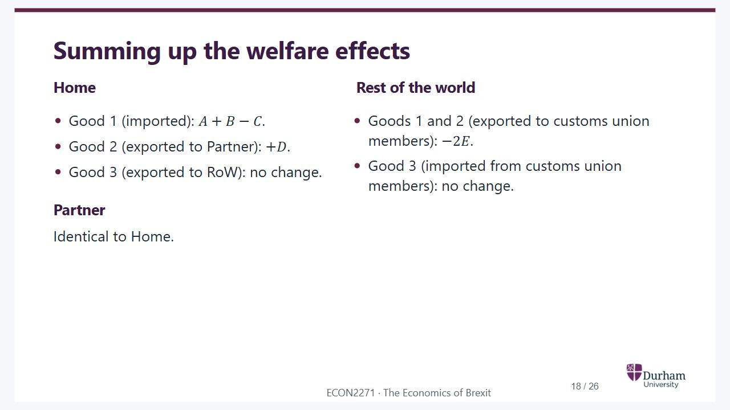
Notes:
Static student copy of the current web slide. Slide artwork is flattened; add personal notes here. Interactive explanations, playback and accessible HTML are available at:
https://davidchivers.co.uk/teaching/macro-applications/lecture_2.html#/l2-s18
Summing up the welfare effects
Home
Good 1 (imported):
𝐴
+
𝐵
−
𝐶
.
Good 2 (exported to Partner):
+
𝐷
.
Good 3 (exported to RoW): no change.
Partner
Identical to Home.
Rest of the world
Goods 1 and 2 (exported to customs union members):
−
2
𝐸
.
Good 3 (imported from customs union members): no change.
RoW: Rest of the world

Slide 19
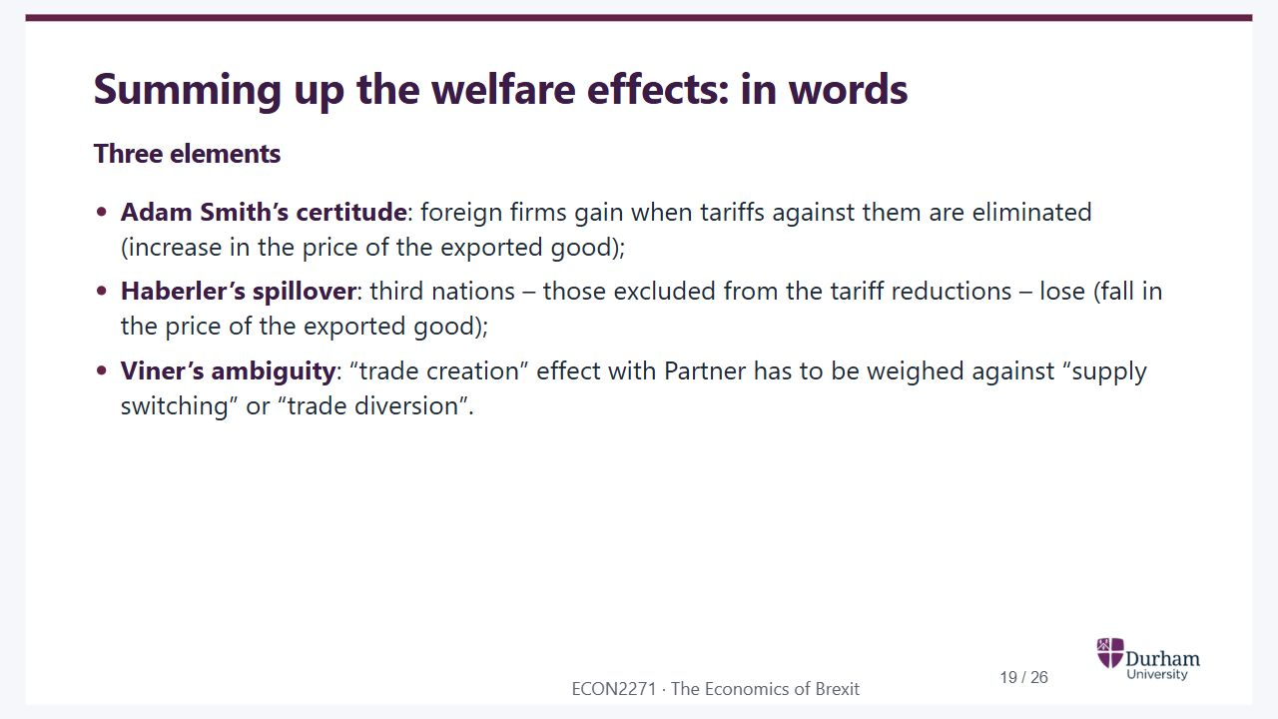
Notes:
Static student copy of the current web slide. Slide artwork is flattened; add personal notes here. Interactive explanations, playback and accessible HTML are available at:
https://davidchivers.co.uk/teaching/macro-applications/lecture_2.html#/l2-s19
Summing up the welfare effects: in words
Three elements
Adam Smith’s certitude: foreign firms gain when tariffs against them are eliminated (increase in the price of the exported good);
Haberler’s spillover: third nations – those excluded from the tariff reductions – lose (fall in the price of the exported good);
Viner’s ambiguity: “trade creation” effect with Partner has to be weighed against “supply switching” or “trade diversion”.

Slide 20

Notes:
Static student copy of the current web slide. Slide artwork is flattened; add personal notes here. Interactive explanations, playback and accessible HTML are available at:
https://davidchivers.co.uk/teaching/macro-applications/lecture_2.html#/l2-s20
What do we mean by welfare?

Slide 21
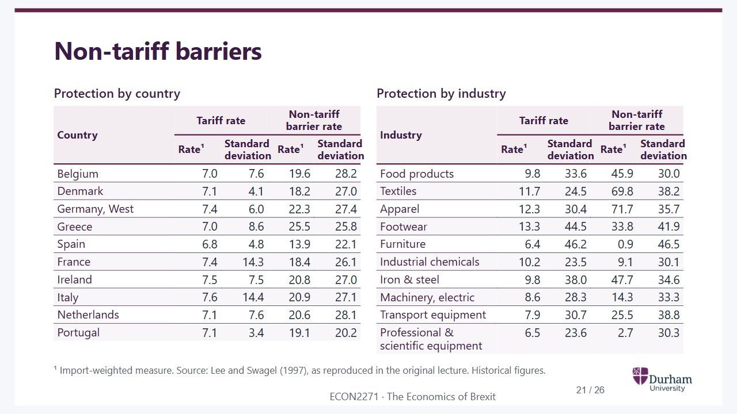
Notes:
Static student copy of the current web slide. Slide artwork is flattened; add personal notes here. Interactive explanations, playback and accessible HTML are available at:
https://davidchivers.co.uk/teaching/macro-applications/lecture_2.html#/l2-s21
Non-tariff barriers
Protection by country
Country Tariff rate Non-tariff barrier rate
Rate¹ Standard
deviation Rate¹ Standard
deviation
Belgium 7.0 7.6 19.6 28.2
Denmark 7.1 4.1 18.2 27.0
Germany, West 7.4 6.0 22.3 27.4
Greece 7.0 8.6 25.5 25.8
Spain 6.8 4.8 13.9 22.1
France 7.4 14.3 18.4 26.1
Ireland 7.5 7.5 20.8 27.0
Italy 7.6 14.4 20.9 27.1
Netherlands 7.1 7.6 20.6 28.1
Portugal 7.1 3.4 19.1 20.2
Protection by industry
Industry Tariff rate Non-tariff barrier rate
Rate¹ Standard
deviation Rate¹ Standard
deviation
Food products 9.8 33.6 45.9 30.0
Textiles 11.7 24.5 69.8 38.2
Apparel 12.3 30.4 71.7 35.7
Footwear 13.3 44.5 33.8 41.9
Furniture 6.4 46.2 0.9 46.5
Industrial chemicals 10.2 23.5 9.1 30.1
Iron & steel 9.8 38.0 47.7 34.6
Machinery, electric 8.6 28.3 14.3 33.3
Transport equipment 7.9 30.7 25.5 38.8
Professional & scientific equipment 6.5 23.6 2.7 30.3
¹ Import-weighted measure. Source: Lee and Swagel (1997), as reproduced in the original lecture. Historical figures.

Slide 22
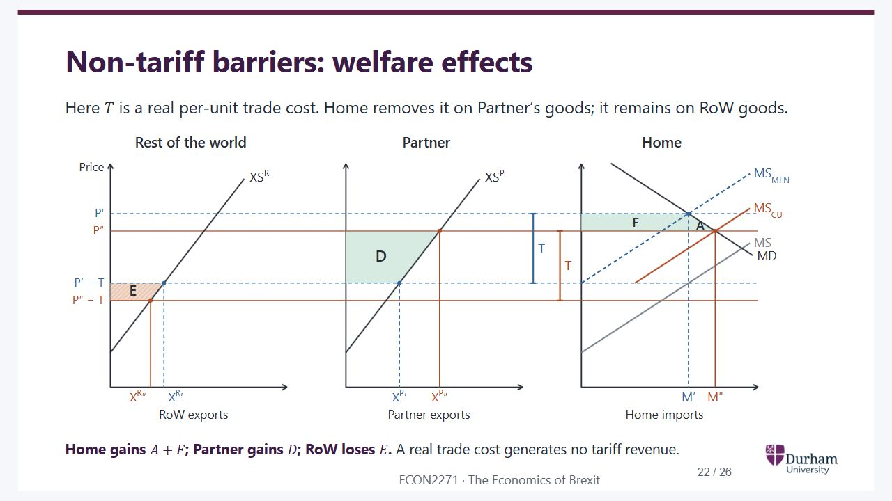
Notes:
Static student copy of the current web slide. Slide artwork is flattened; add personal notes here. Interactive explanations, playback and accessible HTML are available at:
https://davidchivers.co.uk/teaching/macro-applications/lecture_2.html#/l2-s22
Non-tariff barriers: welfare effects
Here
𝑇
is a real per-unit trade cost. Home removes it on Partner’s goods; it remains on RoW goods.
Rest of the world
RoW exports
Partner
Partner exports
Home
Home imports
Price
P′
P′ − T
P″
P″ − T
XSR
XR′
XSP
XP′
MS
MD
MSMFN
M′
T
XR″
XP″
MSCU
M″
T
E
D
F
A
Home gains
𝐴
+
𝐹
; Partner gains
𝐷
; RoW loses
𝐸
. A real trade cost generates no tariff revenue.
RoW: Rest of the world

Slide 23
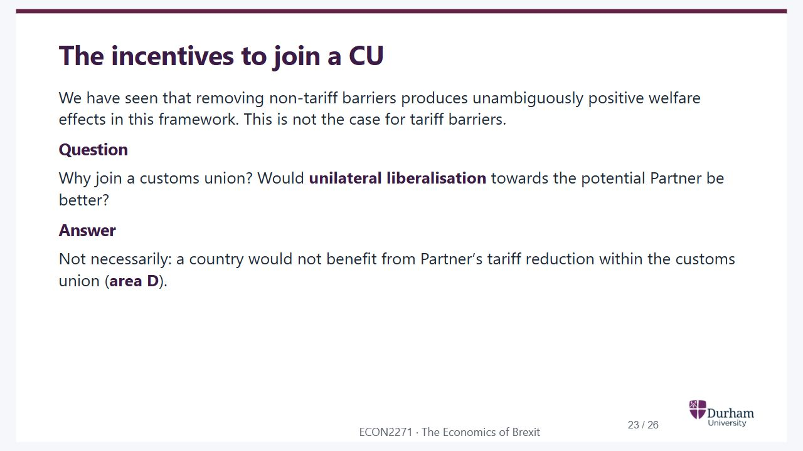
Notes:
Static student copy of the current web slide. Slide artwork is flattened; add personal notes here. Interactive explanations, playback and accessible HTML are available at:
https://davidchivers.co.uk/teaching/macro-applications/lecture_2.html#/l2-s23
The incentives to join a CU
We have seen that removing non-tariff barriers produces unambiguously positive welfare effects in this framework. This is not the case for tariff barriers.
Question
Why join a customs union? Would unilateral liberalisation towards the potential Partner be better?
Answer
Not necessarily: a country would not benefit from Partner’s tariff reduction within the customs union (area D).
CU: Customs union

Slide 24
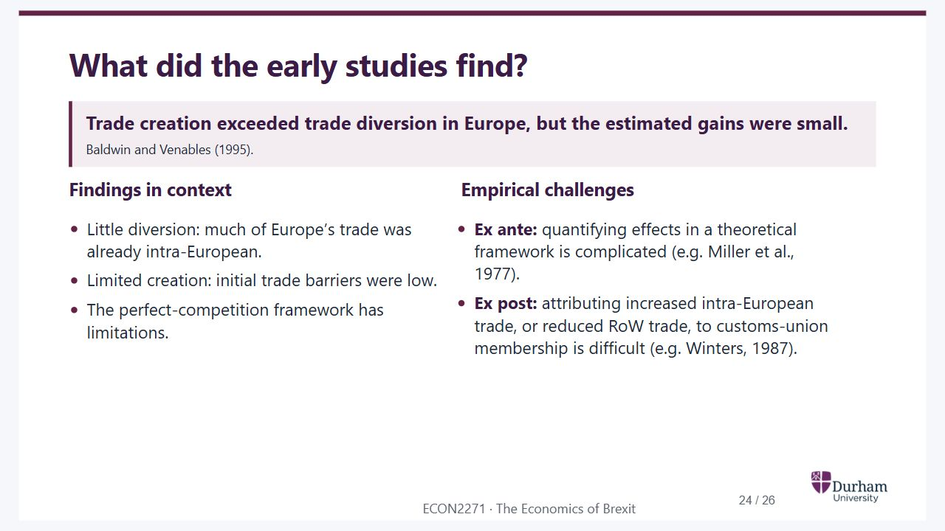
Notes:
Static student copy of the current web slide. Slide artwork is flattened; add personal notes here. Interactive explanations, playback and accessible HTML are available at:
https://davidchivers.co.uk/teaching/macro-applications/lecture_2.html#/l2-s24
What did the early studies find?
Trade creation exceeded trade diversion in Europe, but the estimated gains were small.
Baldwin and Venables (1995).
Findings in context
Little diversion: much of Europe’s trade was already intra-European.
Limited creation: initial trade barriers were low.
The perfect-competition framework has limitations.
Empirical challenges
Ex ante: quantifying effects in a theoretical framework is complicated (e.g. Miller et al., 1977).
Ex post: attributing increased intra-European trade, or reduced RoW trade, to customs-union membership is difficult (e.g. Winters, 1987).
RoW: Rest of the world

Slide 25
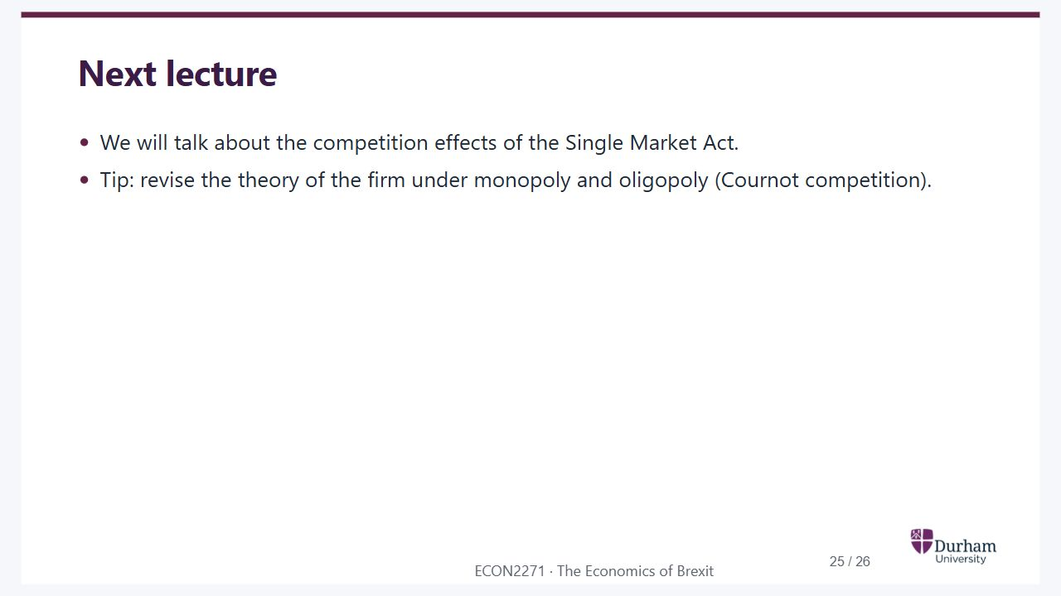
Notes:
Static student copy of the current web slide. Slide artwork is flattened; add personal notes here. Interactive explanations, playback and accessible HTML are available at:
https://davidchivers.co.uk/teaching/macro-applications/lecture_2.html#/l2-s25
Next lecture
We will talk about the competition effects of the Single Market Act.
Tip: revise the theory of the firm under monopoly and oligopoly (Cournot competition).

Slide 26
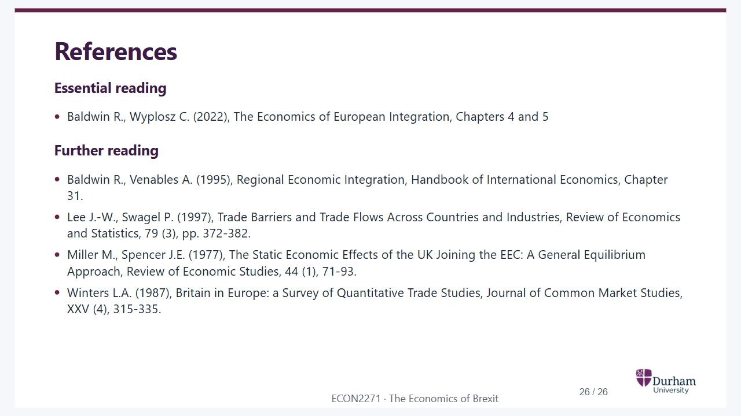
Notes:
Static student copy of the current web slide. Slide artwork is flattened; add personal notes here. Interactive explanations, playback and accessible HTML are available at:
https://davidchivers.co.uk/teaching/macro-applications/lecture_2.html#/l2-s26
References
Essential reading
Baldwin R., Wyplosz C. (2022), The Economics of European Integration, Chapters 4 and 5
Further reading
Baldwin R., Venables A. (1995), Regional Economic Integration, Handbook of International Economics, Chapter 31.
Lee J.-W., Swagel P. (1997), Trade Barriers and Trade Flows Across Countries and Industries, Review of Economics and Statistics, 79 (3), pp. 372-382.
Miller M., Spencer J.E. (1977), The Static Economic Effects of the UK Joining the EEC: A General Equilibrium Approach, Review of Economic Studies, 44 (1), 71-93.
Winters L.A. (1987), Britain in Europe: a Survey of Quantitative Trade Studies, Journal of Common Market Studies, XXV (4), 315-335.
EEC: European Economic Community

