Slide 1

Notes:
Static student copy of the current web slide. Slide artwork is flattened; add personal notes here. Interactive explanations, playback and accessible HTML are available at:
https://davidchivers.co.uk/teaching/macro-applications/lecture_5.html#/title-slide
The Economics of Brexit
Lecture 5: Regional disparities
Dr David Chivers
Macroeconomic Applications and Policy

Slide 2

Notes:
Static student copy of the current web slide. Slide artwork is flattened; add personal notes here. Interactive explanations, playback and accessible HTML are available at:
https://davidchivers.co.uk/teaching/macro-applications/lecture_5.html#/l5-s02
Learning objectives
After this topic, you will be able to:
Discuss evidence on differences between European countries and regions.
Explain why these differences exist, using the Solow model and New Economic Geography.
Explain how economic integration affects regional disparities.
Discuss the aims of EU regional policy.

Slide 3
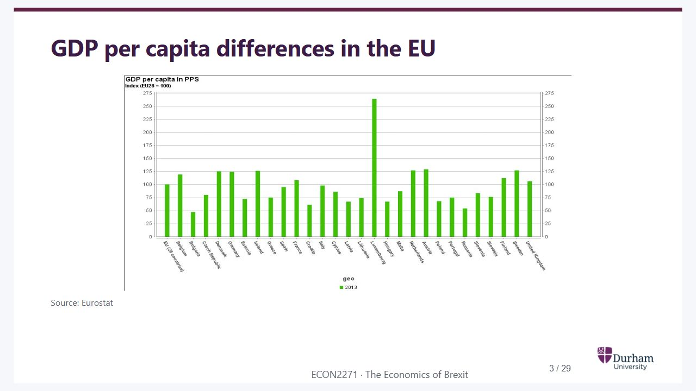
Notes:
Static student copy of the current web slide. Slide artwork is flattened; add personal notes here. Interactive explanations, playback and accessible HTML are available at:
https://davidchivers.co.uk/teaching/macro-applications/lecture_5.html#/l5-s03
GDP per capita differences in the EU
Source: Eurostat
Eurostat bars comparing GDP per capita in purchasing-power standards across EU countries. There are large differences, with Luxembourg particularly high. The historical dates and index definition are retained in the figure.

Slide 4
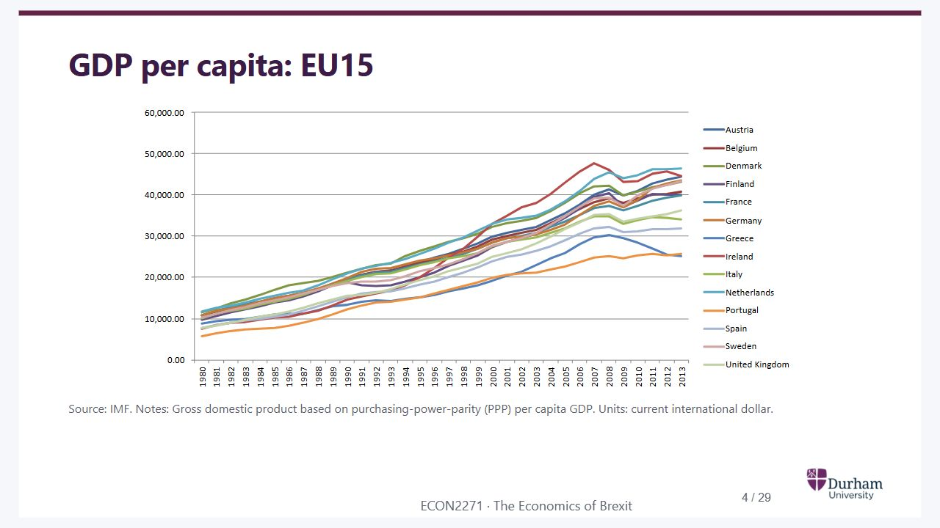
Notes:
Static student copy of the current web slide. Slide artwork is flattened; add personal notes here. Interactive explanations, playback and accessible HTML are available at:
https://davidchivers.co.uk/teaching/macro-applications/lecture_5.html#/l5-s04
GDP per capita: EU15
Source: IMF. Notes: Gross domestic product based on purchasing-power-parity (PPP) per capita GDP. Units: current international dollar.
IMF line chart showing GDP per capita at purchasing-power parity for EU15 countries over time. All series rise over much of the period, but substantial cross-country gaps remain.

Slide 5
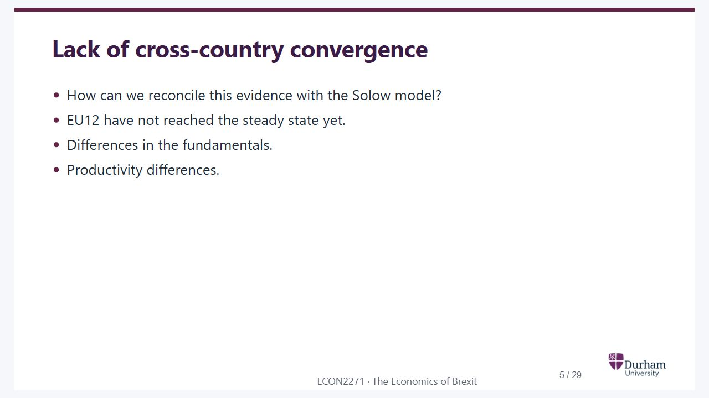
Notes:
Static student copy of the current web slide. Slide artwork is flattened; add personal notes here. Interactive explanations, playback and accessible HTML are available at:
https://davidchivers.co.uk/teaching/macro-applications/lecture_5.html#/l5-s05
Lack of cross-country convergence
How can we reconcile this evidence with the Solow model?
EU12 have not reached the steady state yet.
Differences in the fundamentals.
Productivity differences.

Slide 6
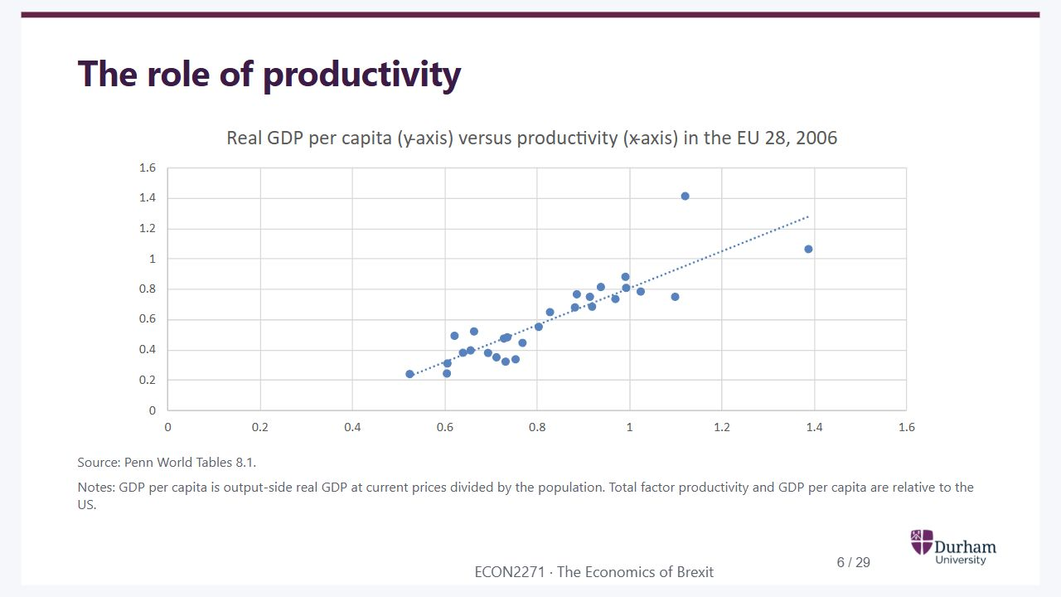
Notes:
Static student copy of the current web slide. Slide artwork is flattened; add personal notes here. Interactive explanations, playback and accessible HTML are available at:
https://davidchivers.co.uk/teaching/macro-applications/lecture_5.html#/l5-s06
The role of productivity
Source: Penn World Tables 8.1.
Notes: GDP per capita is output-side real GDP at current prices divided by the population. Total factor productivity and GDP per capita are relative to the US.
Scatter plot of real GDP per capita against total factor productivity in EU28 countries in 2006, both relative to the United States. Higher productivity is associated with higher GDP per capita.

Slide 7
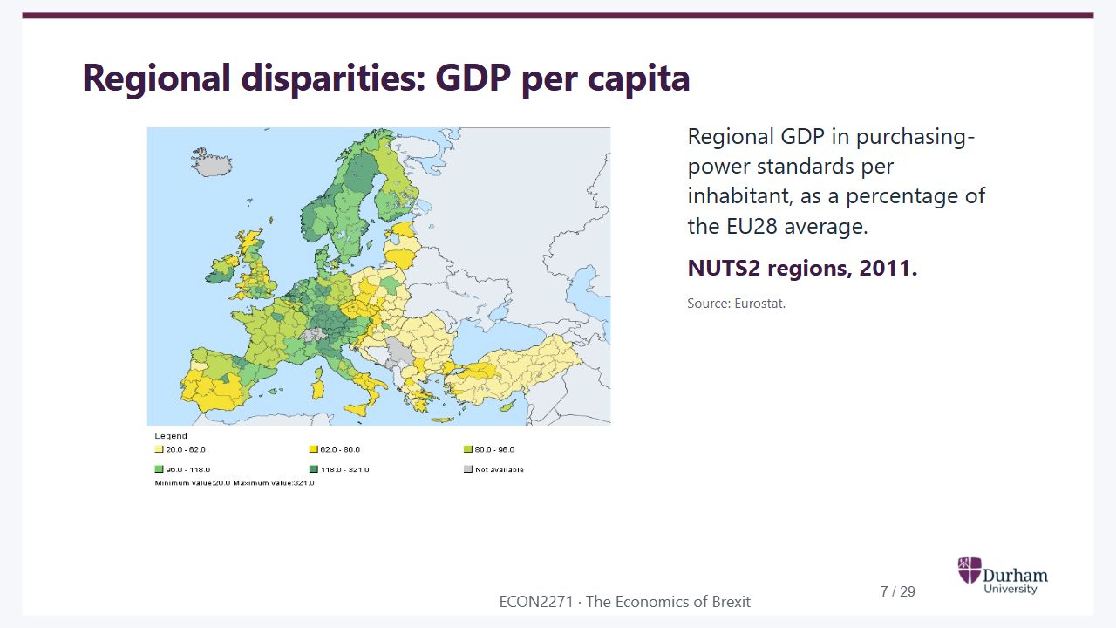
Notes:
Static student copy of the current web slide. Slide artwork is flattened; add personal notes here. Interactive explanations, playback and accessible HTML are available at:
https://davidchivers.co.uk/teaching/macro-applications/lecture_5.html#/l5-s07
Regional disparities: GDP per capita
Regional GDP in purchasing-power standards per inhabitant, as a percentage of the EU28 average.
NUTS2 regions, 2011.
Source: Eurostat.
Eurostat regional map of GDP per inhabitant in purchasing-power standards in 2011, as a percentage of the EU28 average. NUTS2 regions show large within-country and cross-country differences.

Slide 8
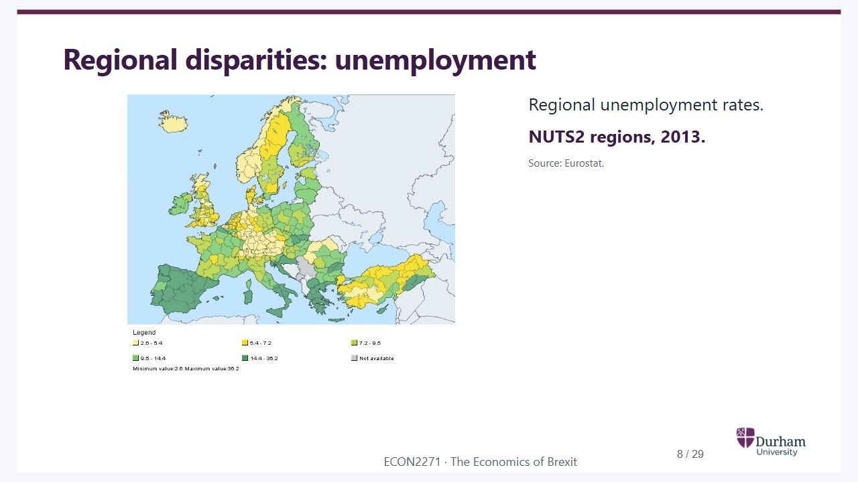
Notes:
Static student copy of the current web slide. Slide artwork is flattened; add personal notes here. Interactive explanations, playback and accessible HTML are available at:
https://davidchivers.co.uk/teaching/macro-applications/lecture_5.html#/l5-s08
Regional disparities: unemployment
Regional unemployment rates.
NUTS2 regions, 2013.
Source: Eurostat.
Eurostat map of unemployment rates by NUTS2 region in 2013. Rates differ substantially across Europe and within countries, with high unemployment in several southern regions.

Slide 9
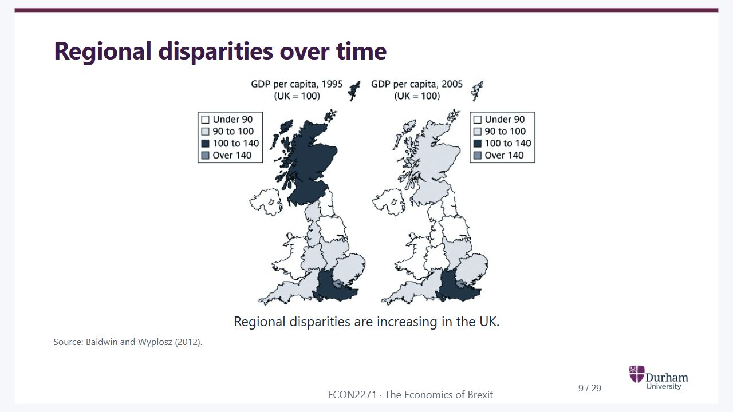
Notes:
Static student copy of the current web slide. Slide artwork is flattened; add personal notes here. Interactive explanations, playback and accessible HTML are available at:
https://davidchivers.co.uk/teaching/macro-applications/lecture_5.html#/l5-s09
Regional disparities over time
Regional disparities are increasing in the UK.
Source: Baldwin and Wyplosz (2012).
Two UK maps compare GDP per capita relative to the UK average in 1995 and 2005. Shading shows regional differences, including the relatively high level around London.

Slide 10

Notes:
Static student copy of the current web slide. Slide artwork is flattened; add personal notes here. Interactive explanations, playback and accessible HTML are available at:
https://davidchivers.co.uk/teaching/macro-applications/lecture_5.html#/l5-s10
Regional disparities: theory
Main questions
Which factors determine the location of economic activities within a country?
Does European integration affect the location of economic activities in any way?
“New Economic Geography”

Slide 11
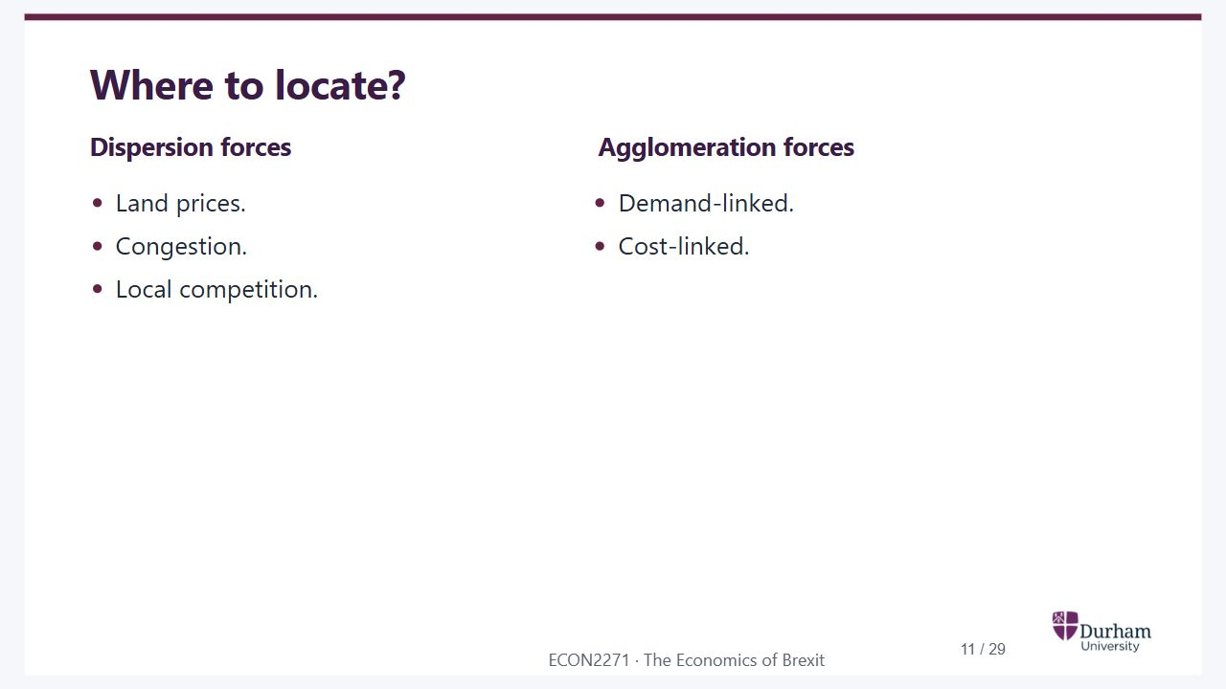
Notes:
Static student copy of the current web slide. Slide artwork is flattened; add personal notes here. Interactive explanations, playback and accessible HTML are available at:
https://davidchivers.co.uk/teaching/macro-applications/lecture_5.html#/l5-s11
Where to locate?
Dispersion forces
Land prices.
Congestion.
Local competition.
Agglomeration forces
Demand-linked.
Cost-linked.

Slide 12

Notes:
Static student copy of the current web slide. Slide artwork is flattened; add personal notes here. Interactive explanations, playback and accessible HTML are available at:
https://davidchivers.co.uk/teaching/macro-applications/lecture_5.html#/l5-s12
Two locations
The model has two possible locations for firms: North and South.

Slide 13
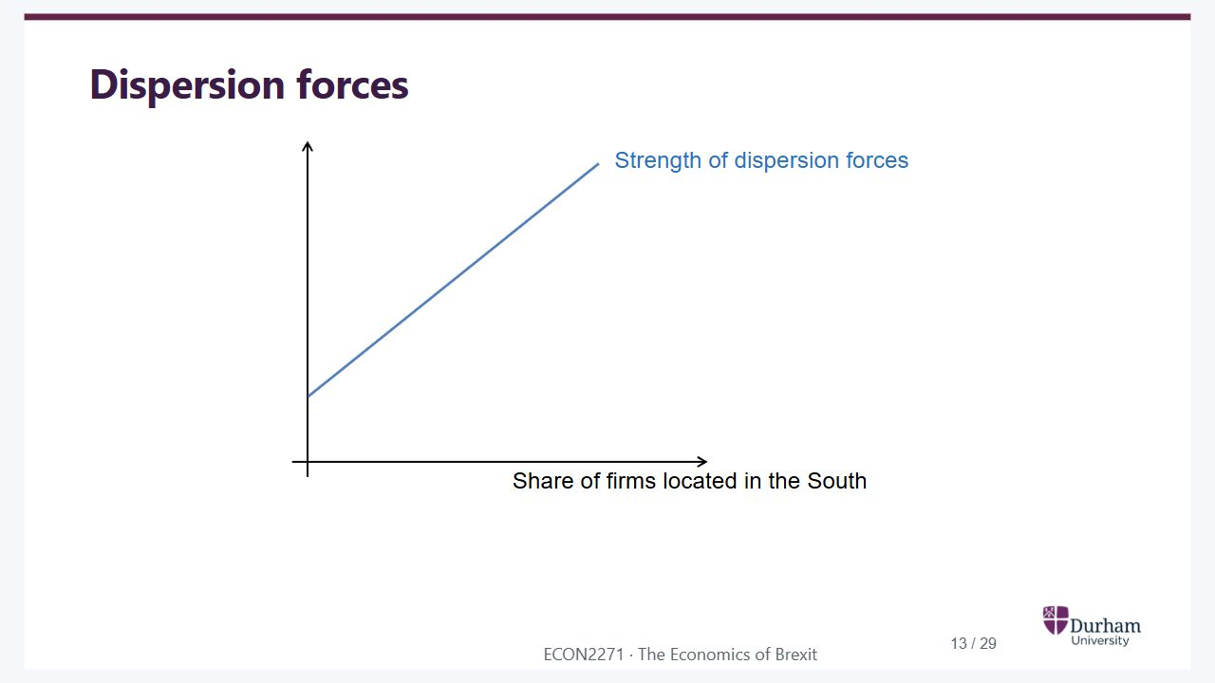
Notes:
Static student copy of the current web slide. Slide artwork is flattened; add personal notes here. Interactive explanations, playback and accessible HTML are available at:
https://davidchivers.co.uk/teaching/macro-applications/lecture_5.html#/l5-s13
Dispersion forces
Dispersion forces strengthen as the share of firms located in the South increases. The relationship slopes upwards.

Slide 14
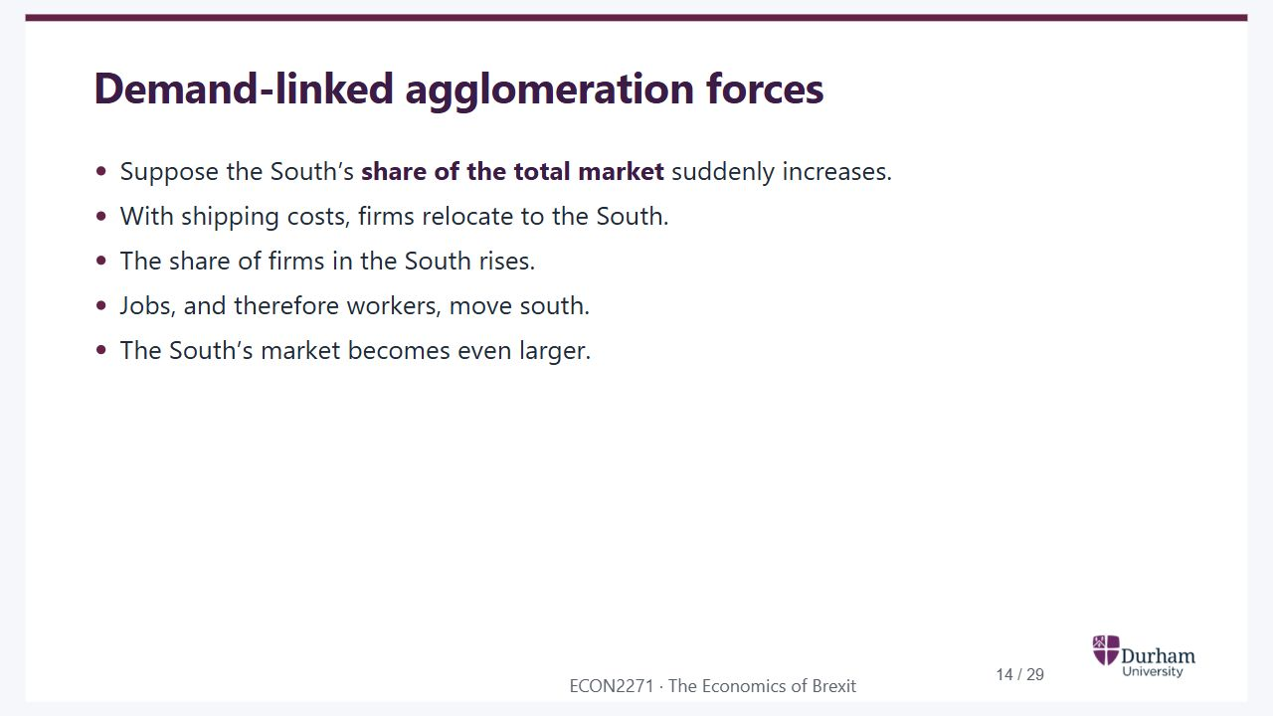
Notes:
Static student copy of the current web slide. Slide artwork is flattened; add personal notes here. Interactive explanations, playback and accessible HTML are available at:
https://davidchivers.co.uk/teaching/macro-applications/lecture_5.html#/l5-s14
Demand-linked agglomeration forces
Suppose the South’s share of the total market suddenly increases.
With shipping costs, firms relocate to the South.
The share of firms in the South rises.
Jobs, and therefore workers, move south.
The South’s market becomes even larger.

Slide 15
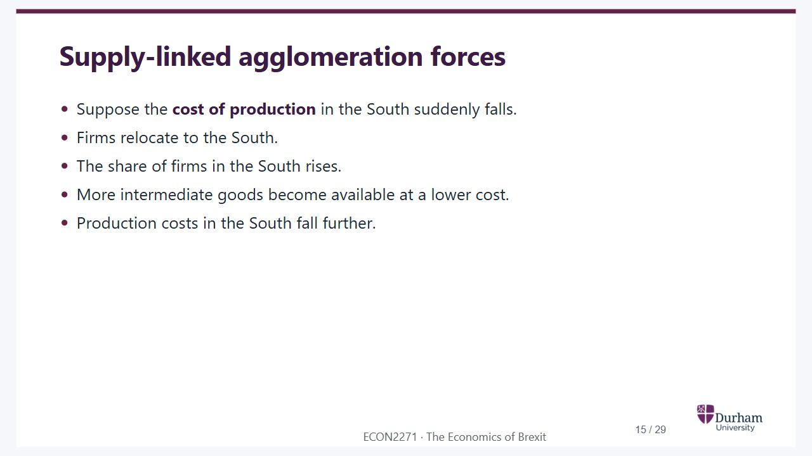
Notes:
Static student copy of the current web slide. Slide artwork is flattened; add personal notes here. Interactive explanations, playback and accessible HTML are available at:
https://davidchivers.co.uk/teaching/macro-applications/lecture_5.html#/l5-s15
Supply-linked agglomeration forces
Suppose the cost of production in the South suddenly falls.
Firms relocate to the South.
The share of firms in the South rises.
More intermediate goods become available at a lower cost.
Production costs in the South fall further.

Slide 16
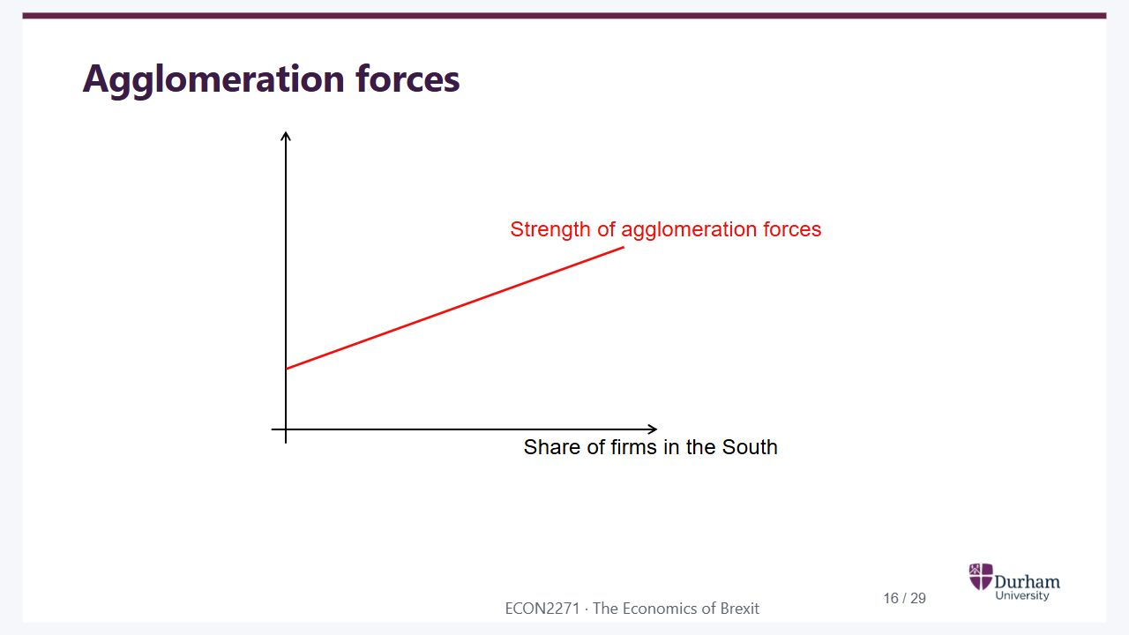
Notes:
Static student copy of the current web slide. Slide artwork is flattened; add personal notes here. Interactive explanations, playback and accessible HTML are available at:
https://davidchivers.co.uk/teaching/macro-applications/lecture_5.html#/l5-s16
Agglomeration forces
Agglomeration forces strengthen as the share of firms in the South increases. The relationship slopes upwards.

Slide 17
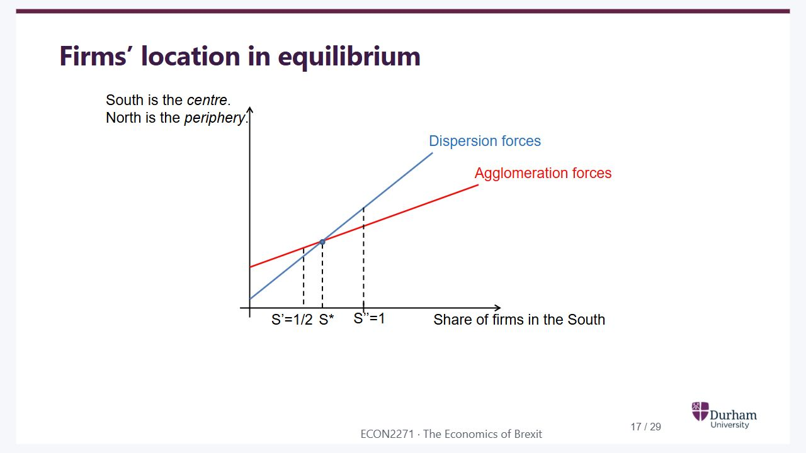
Notes:
Static student copy of the current web slide. Slide artwork is flattened; add personal notes here. Interactive explanations, playback and accessible HTML are available at:
https://davidchivers.co.uk/teaching/macro-applications/lecture_5.html#/l5-s17
Firms’ location in equilibrium
Equilibrium firm location occurs where dispersion and agglomeration forces intersect at S star. In the illustrated case, more than half of firms locate in the South, the centre; the North is the periphery.

Slide 18
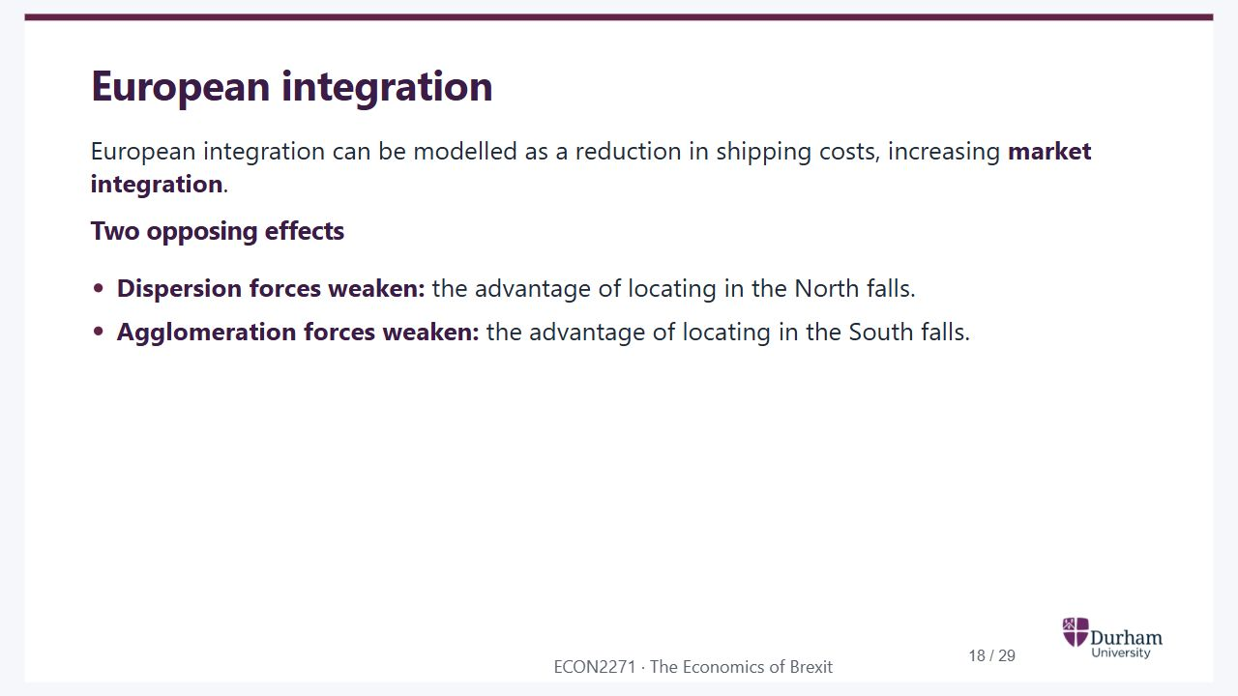
Notes:
Static student copy of the current web slide. Slide artwork is flattened; add personal notes here. Interactive explanations, playback and accessible HTML are available at:
https://davidchivers.co.uk/teaching/macro-applications/lecture_5.html#/l5-s18
European integration
European integration can be modelled as a reduction in shipping costs, increasing market integration.
Two opposing effects
Dispersion forces weaken: the advantage of locating in the North falls.
Agglomeration forces weaken: the advantage of locating in the South falls.

Slide 19
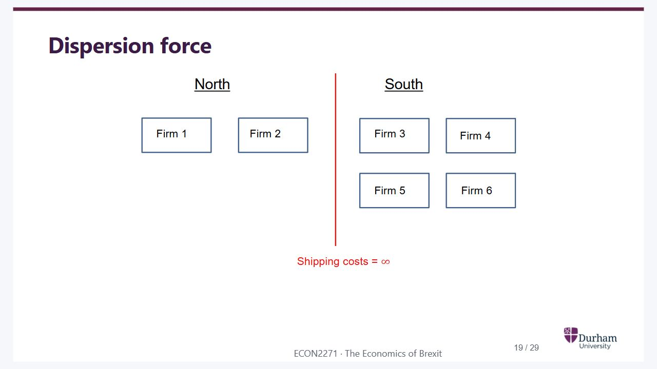
Notes:
Static student copy of the current web slide. Slide artwork is flattened; add personal notes here. Interactive explanations, playback and accessible HTML are available at:
https://davidchivers.co.uk/teaching/macro-applications/lecture_5.html#/l5-s19
Dispersion force
Six firms across two locations: firms 1 and 2 in the North, firms 3 to 6 in the South. A barrier represents infinite shipping costs between locations.

Slide 20
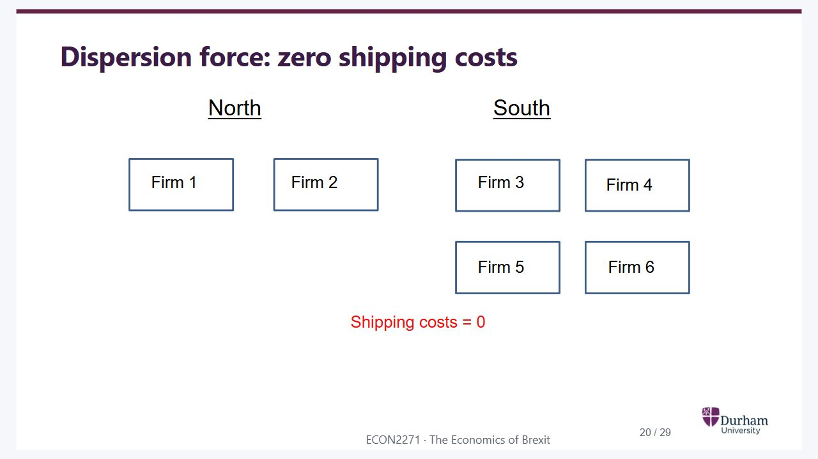
Notes:
Static student copy of the current web slide. Slide artwork is flattened; add personal notes here. Interactive explanations, playback and accessible HTML are available at:
https://davidchivers.co.uk/teaching/macro-applications/lecture_5.html#/l5-s20
Dispersion force: zero shipping costs
The same six firms and locations with shipping costs reduced to zero. The barrier between North and South is removed.

Slide 21
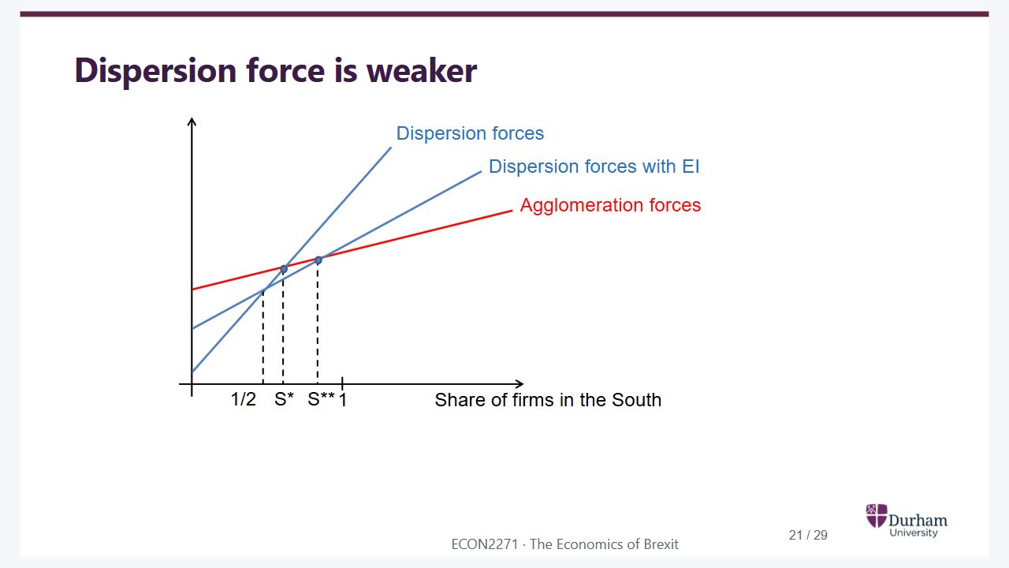
Notes:
Static student copy of the current web slide. Slide artwork is flattened; add personal notes here. Interactive explanations, playback and accessible HTML are available at:
https://davidchivers.co.uk/teaching/macro-applications/lecture_5.html#/l5-s21
Dispersion force is weaker
Integration weakens dispersion forces. The dispersion curve becomes flatter and the equilibrium share of firms in the South rises from S star to S double star.

Slide 22
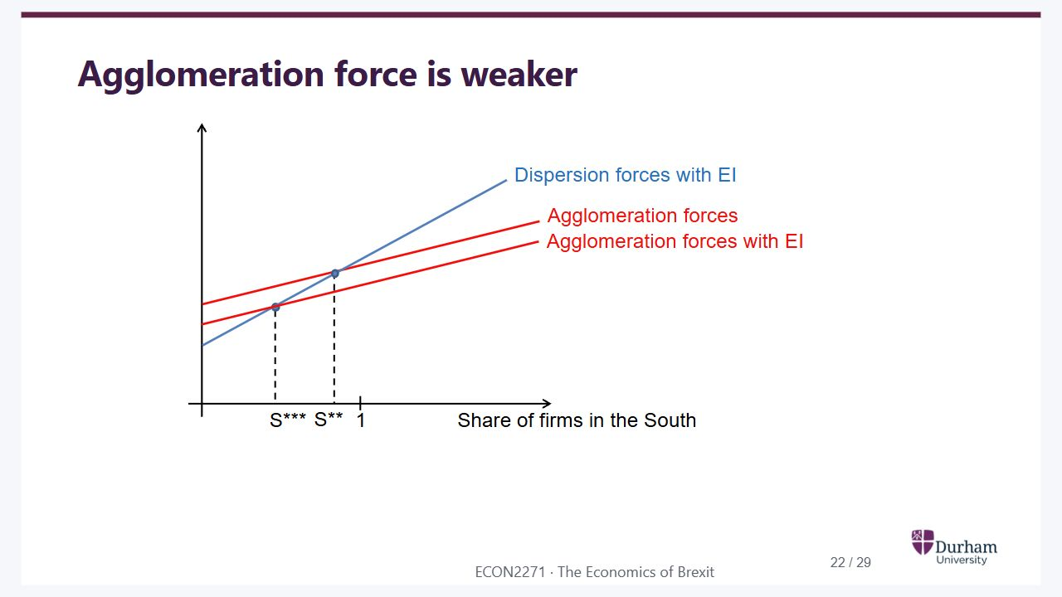
Notes:
Static student copy of the current web slide. Slide artwork is flattened; add personal notes here. Interactive explanations, playback and accessible HTML are available at:
https://davidchivers.co.uk/teaching/macro-applications/lecture_5.html#/l5-s22
Agglomeration force is weaker
Integration also weakens agglomeration forces. Relative to the previous diagram, the agglomeration curve flattens and the equilibrium share shifts to S triple star.

Slide 23
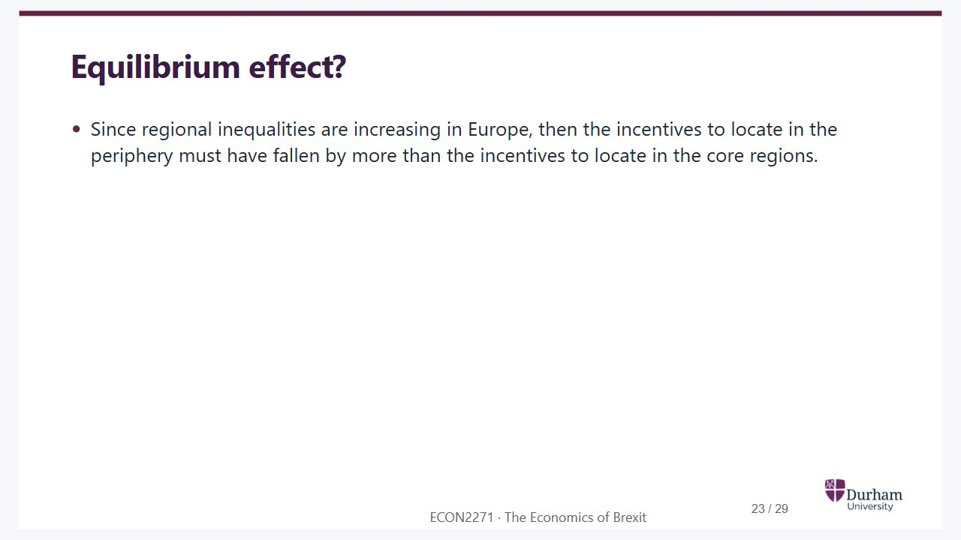
Notes:
Static student copy of the current web slide. Slide artwork is flattened; add personal notes here. Interactive explanations, playback and accessible HTML are available at:
https://davidchivers.co.uk/teaching/macro-applications/lecture_5.html#/l5-s23
Equilibrium effect?
Since regional inequalities are increasing in Europe, then the incentives to locate in the periphery must have fallen by more than the incentives to locate in the core regions.

Slide 24
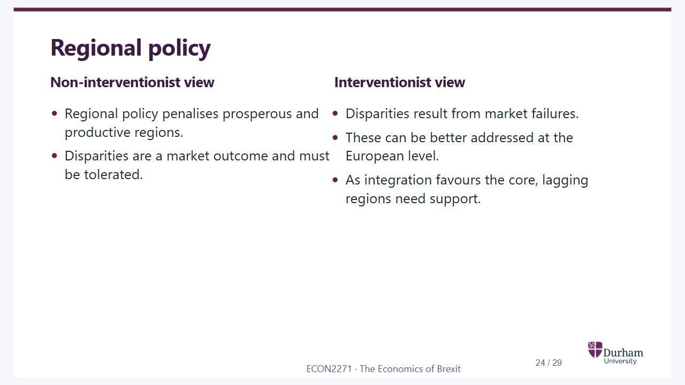
Notes:
Static student copy of the current web slide. Slide artwork is flattened; add personal notes here. Interactive explanations, playback and accessible HTML are available at:
https://davidchivers.co.uk/teaching/macro-applications/lecture_5.html#/l5-s24
Regional policy
Non-interventionist view
Regional policy penalises prosperous and productive regions.
Disparities are a market outcome and must be tolerated.
Interventionist view
Disparities result from market failures.
These can be better addressed at the European level.
As integration favours the core, lagging regions need support.

Slide 25
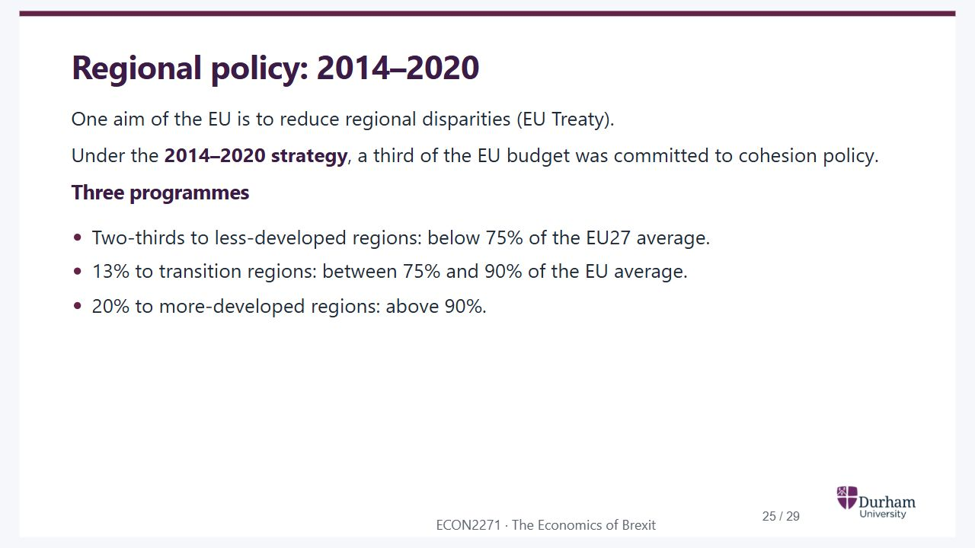
Notes:
Static student copy of the current web slide. Slide artwork is flattened; add personal notes here. Interactive explanations, playback and accessible HTML are available at:
https://davidchivers.co.uk/teaching/macro-applications/lecture_5.html#/l5-s25
Regional policy: 2014–2020
One aim of the EU is to reduce regional disparities (EU Treaty).
Under the 2014–2020 strategy, a third of the EU budget was committed to cohesion policy.
Three programmes
Two-thirds to less-developed regions: below 75% of the EU27 average.
13% to transition regions: between 75% and 90% of the EU average.
20% to more-developed regions: above 90%.

Slide 26

Notes:
Static student copy of the current web slide. Slide artwork is flattened; add personal notes here. Interactive explanations, playback and accessible HTML are available at:
https://davidchivers.co.uk/teaching/macro-applications/lecture_5.html#/l5-s26
The future of the EU
Should the EU pursue the agenda of completing the political union or not?
Is a federalist project for European countries a good idea to start with?

Slide 27
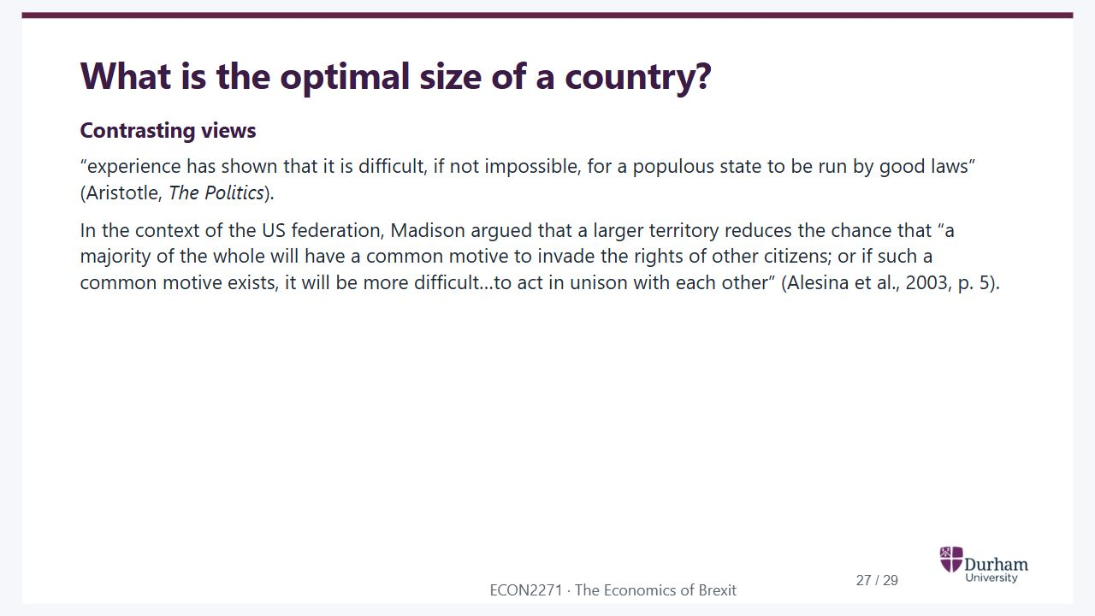
Notes:
Static student copy of the current web slide. Slide artwork is flattened; add personal notes here. Interactive explanations, playback and accessible HTML are available at:
https://davidchivers.co.uk/teaching/macro-applications/lecture_5.html#/l5-s27
What is the optimal size of a country?
Contrasting views
“experience has shown that it is difficult, if not impossible, for a populous state to be run by good laws” (Aristotle, The Politics).
In the context of the US federation, Madison argued that a larger territory reduces the chance that “a majority of the whole will have a common motive to invade the rights of other citizens; or if such a common motive exists, it will be more difficult…to act in unison with each other” (Alesina et al., 2003, p. 5).

Slide 28
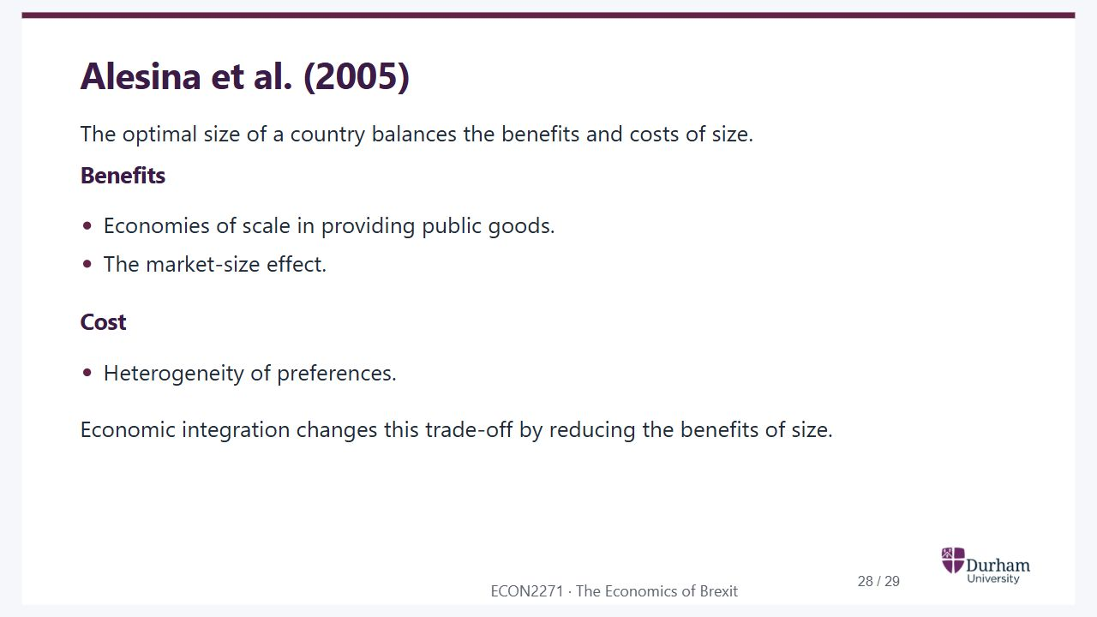
Notes:
Static student copy of the current web slide. Slide artwork is flattened; add personal notes here. Interactive explanations, playback and accessible HTML are available at:
https://davidchivers.co.uk/teaching/macro-applications/lecture_5.html#/l5-s28
Alesina et al. (2005)
The optimal size of a country balances the benefits and costs of size.
Benefits
Economies of scale in providing public goods.
The market-size effect.
Cost
Heterogeneity of preferences.
Economic integration changes this trade-off by reducing the benefits of size.

Slide 29

Notes:
Static student copy of the current web slide. Slide artwork is flattened; add personal notes here. Interactive explanations, playback and accessible HTML are available at:
https://davidchivers.co.uk/teaching/macro-applications/lecture_5.html#/l5-s29
References
Essential reading
Baldwin R. and Wyplosz C. (2022), Chapter 10.
Further reading
See the ECON2271 Talis reading list, also available through Blackboard.
https://durham.rl.talis.com/lists/d85d1ad3-e9ac-4daf-aa66-e3ddfcf902d7.html

