Slide 1

Notes:
Static student copy of the current web slide. Slide artwork is flattened; add personal notes here. Interactive explanations, playback and accessible HTML are available at:
https://davidchivers.co.uk/teaching/macro-applications/lecture_4.html#/title-slide
The Economics of Brexit
Lecture 4: Migration
Dr David Chivers
Macroeconomic Applications and Policy

Slide 2
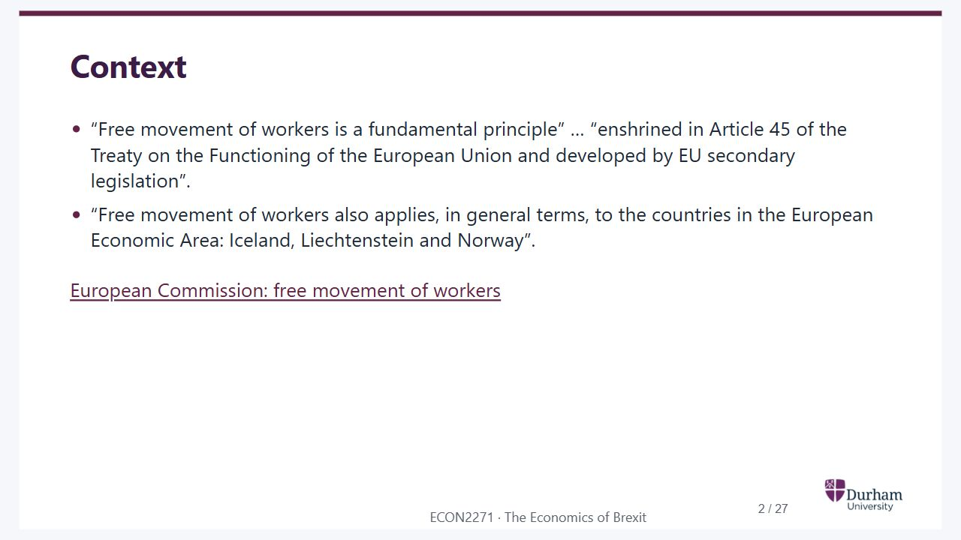
Notes:
Static student copy of the current web slide. Slide artwork is flattened; add personal notes here. Interactive explanations, playback and accessible HTML are available at:
https://davidchivers.co.uk/teaching/macro-applications/lecture_4.html#/l4-s02
Context
“Free movement of workers is a fundamental principle” … “enshrined in Article 45 of the Treaty on the Functioning of the European Union and developed by EU secondary legislation”.
“Free movement of workers also applies, in general terms, to the countries in the European Economic Area: Iceland, Liechtenstein and Norway”.
European Commission: free movement of workers
http://ec.europa.eu/social/main.jsp?catId=457

Slide 3

Notes:
Static student copy of the current web slide. Slide artwork is flattened; add personal notes here. Interactive explanations, playback and accessible HTML are available at:
https://davidchivers.co.uk/teaching/macro-applications/lecture_4.html#/l4-s03
Brexit and free movement of people
Theresa May · 2 October 2016
“I want it to give British companies the maximum freedom to trade with and operate in the Single Market – and let European businesses do the same here.”
“But let me be clear. We are not leaving the European Union only to give up control of immigration again.”
Angela Merkel · 6 October 2016
“Brexit negotiations won’t be easy. If we don’t say full access to the internal market is linked to full freedom of movement, then a movement will spread in Europe where everyone just does whatever they want.”
http://www.independent.co.uk/news/uk/politics/theresa-may-hard-brexit-soft-article-free-movement-deal-single-market-access-a7341886.html
http://www.bbc.co.uk/news/world-europe-37632305

Slide 4
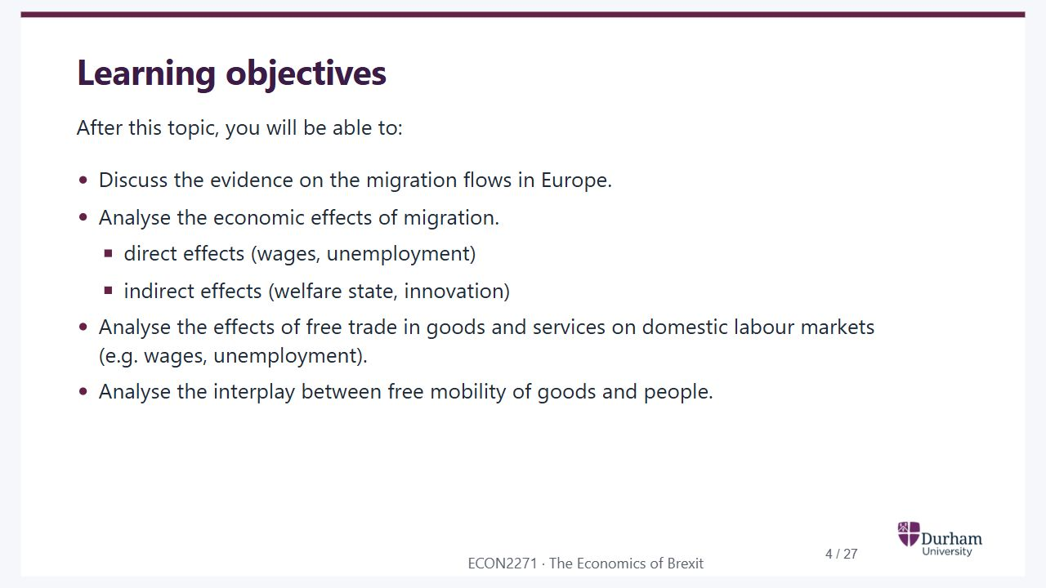
Notes:
Static student copy of the current web slide. Slide artwork is flattened; add personal notes here. Interactive explanations, playback and accessible HTML are available at:
https://davidchivers.co.uk/teaching/macro-applications/lecture_4.html#/l4-s04
Learning objectives
After this topic, you will be able to:
Discuss the evidence on the migration flows in Europe.
Analyse the economic effects of migration.
direct effects (wages, unemployment)
indirect effects (welfare state, innovation)
Analyse the effects of free trade in goods and services on domestic labour markets (e.g. wages, unemployment).
Analyse the interplay between free mobility of goods and people.

Slide 5
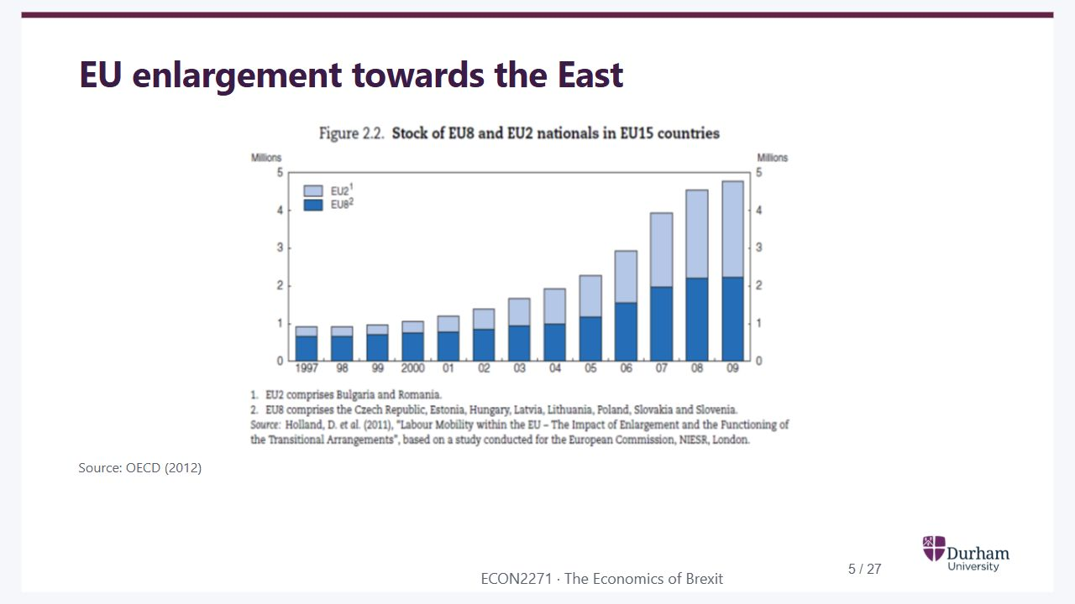
Notes:
Static student copy of the current web slide. Slide artwork is flattened; add personal notes here. Interactive explanations, playback and accessible HTML are available at:
https://davidchivers.co.uk/teaching/macro-applications/lecture_4.html#/l4-s05
EU enlargement towards the East
Source: OECD (2012)
OECD bar chart showing the stock of EU8 and EU2 nationals in EU15 countries increasing from the late 1990s to 2010, with faster growth after the 2004 enlargement.

Slide 6
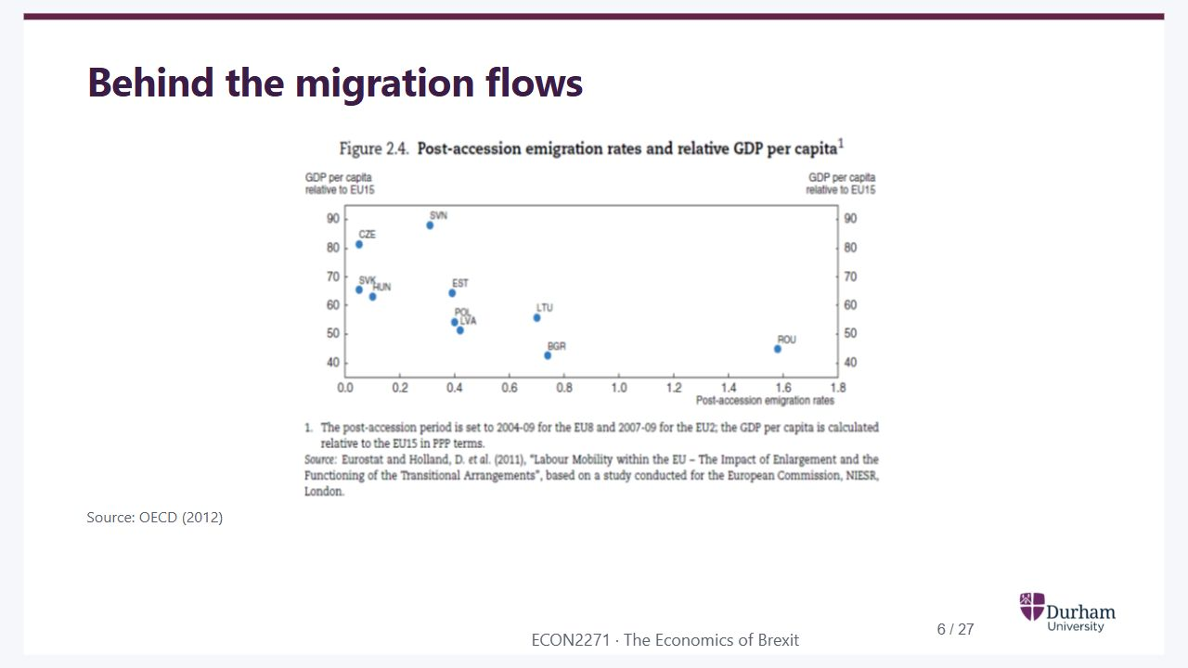
Notes:
Static student copy of the current web slide. Slide artwork is flattened; add personal notes here. Interactive explanations, playback and accessible HTML are available at:
https://davidchivers.co.uk/teaching/macro-applications/lecture_4.html#/l4-s06
Behind the migration flows
Source: OECD (2012)
OECD scatter plot relating post-accession emigration rates to relative GDP per capita for accession countries. The points show the cross-country relationship rather than a causal estimate.

Slide 7
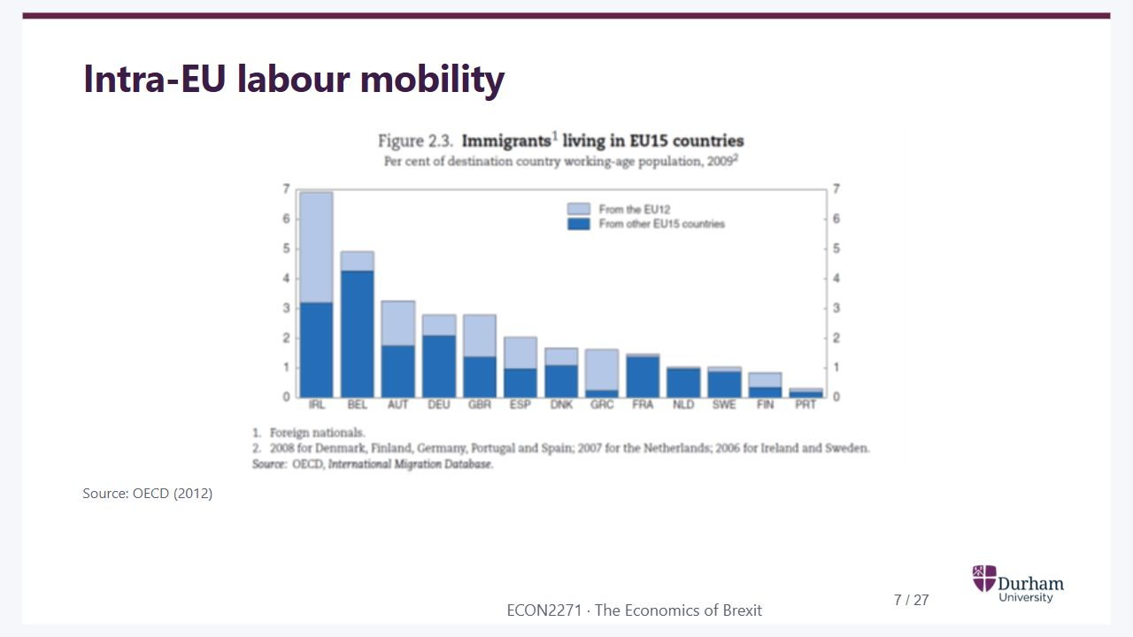
Notes:
Static student copy of the current web slide. Slide artwork is flattened; add personal notes here. Interactive explanations, playback and accessible HTML are available at:
https://davidchivers.co.uk/teaching/macro-applications/lecture_4.html#/l4-s07
Intra-EU labour mobility
Source: OECD (2012)
OECD bars showing EU immigrants living in EU15 countries as a percentage of the working-age population in 2009, separating EU12 from other EU15 origins.

Slide 8
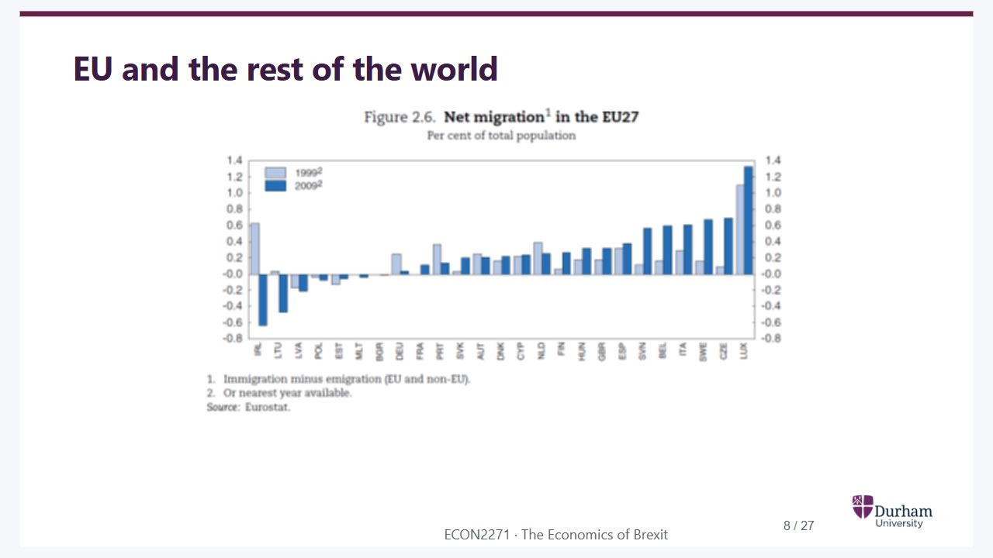
Notes:
Static student copy of the current web slide. Slide artwork is flattened; add personal notes here. Interactive explanations, playback and accessible HTML are available at:
https://davidchivers.co.uk/teaching/macro-applications/lecture_4.html#/l4-s08
EU and the rest of the world
Net migration rates in EU27 countries for 1998 and 2009. Countries differ in sign and magnitude; Luxembourg has a particularly high positive rate.

Slide 9
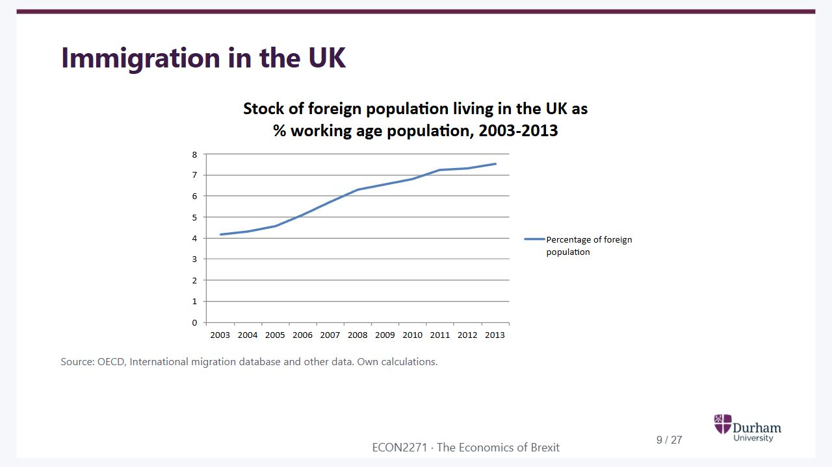
Notes:
Static student copy of the current web slide. Slide artwork is flattened; add personal notes here. Interactive explanations, playback and accessible HTML are available at:
https://davidchivers.co.uk/teaching/macro-applications/lecture_4.html#/l4-s09
Immigration in the UK
Source: OECD, International migration database and other data. Own calculations.
Line chart showing the stock of foreign population in the UK as a share of working-age population, rising from roughly 4 percent in 2003 to more than 7 percent in 2013.

Slide 10
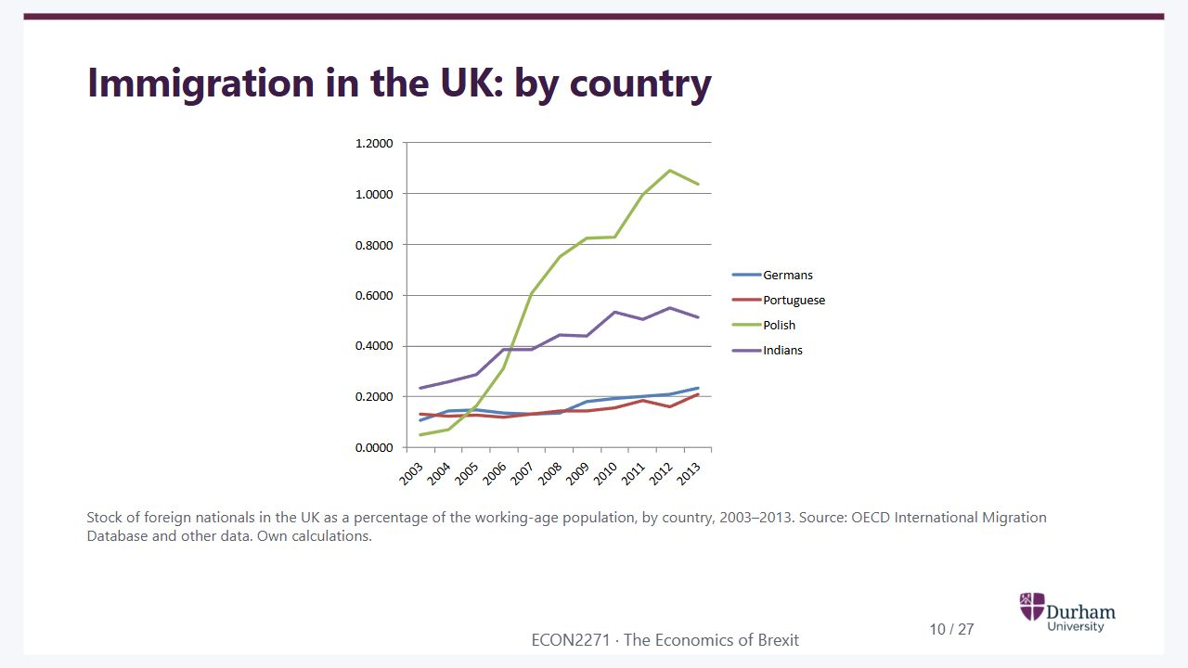
Notes:
Static student copy of the current web slide. Slide artwork is flattened; add personal notes here. Interactive explanations, playback and accessible HTML are available at:
https://davidchivers.co.uk/teaching/macro-applications/lecture_4.html#/l4-s10
Immigration in the UK: by country
Stock of foreign nationals in the UK as a percentage of the working-age population, by country, 2003–2013. Source: OECD International Migration Database and other data. Own calculations.
UK foreign-national population shares by origin, 2003 to 2013. Polish nationals show the largest increase; German, Portuguese, Irish and Indian series are also shown.

Slide 11
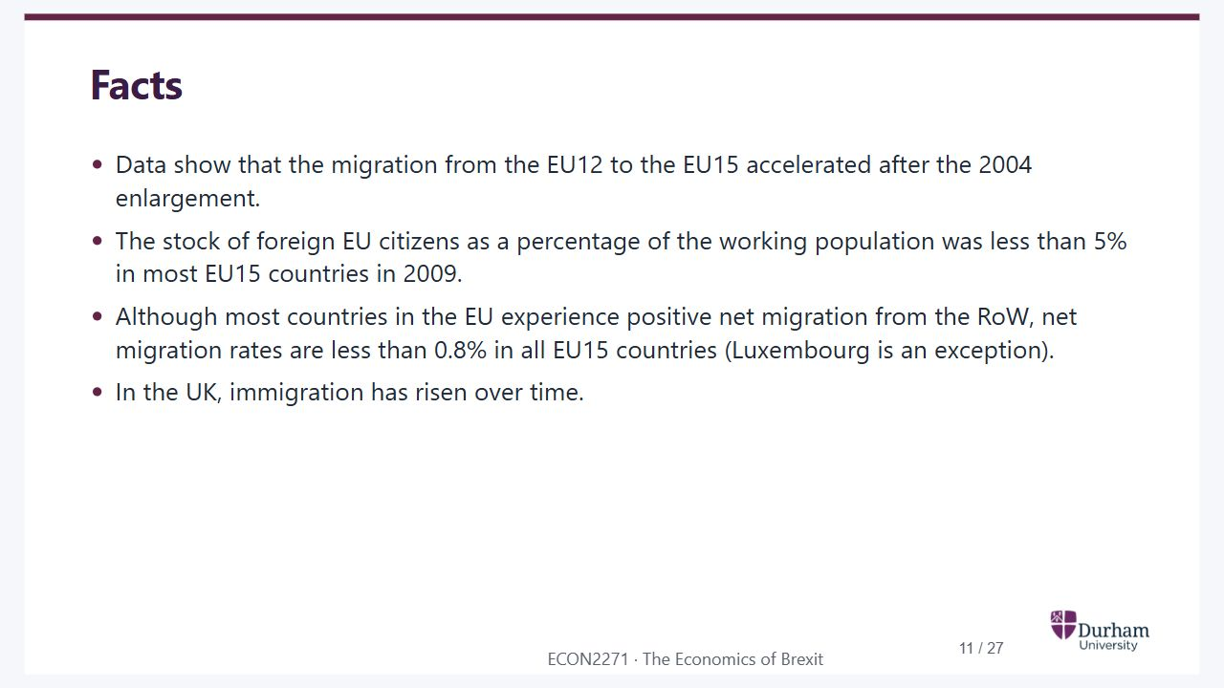
Notes:
Static student copy of the current web slide. Slide artwork is flattened; add personal notes here. Interactive explanations, playback and accessible HTML are available at:
https://davidchivers.co.uk/teaching/macro-applications/lecture_4.html#/l4-s11
Facts
Data show that the migration from the EU12 to the EU15 accelerated after the 2004 enlargement.
The stock of foreign EU citizens as a percentage of the working population was less than 5% in most EU15 countries in 2009.
Although most countries in the EU experience positive net migration from the RoW, net migration rates are less than 0.8% in all EU15 countries (Luxembourg is an exception).
In the UK, immigration has risen over time.

Slide 12
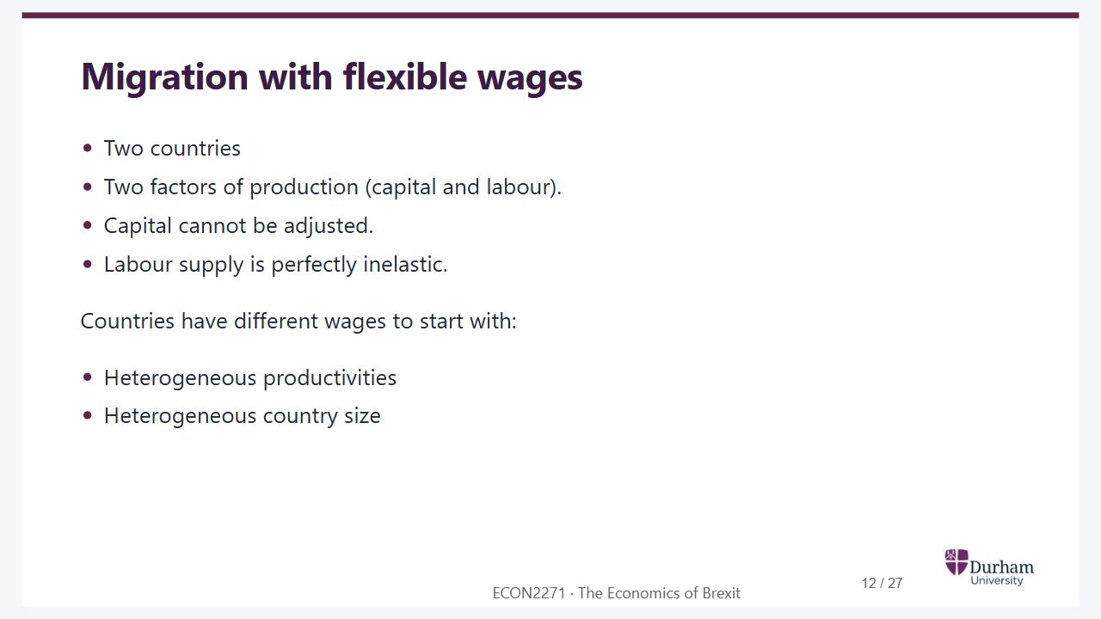
Notes:
Static student copy of the current web slide. Slide artwork is flattened; add personal notes here. Interactive explanations, playback and accessible HTML are available at:
https://davidchivers.co.uk/teaching/macro-applications/lecture_4.html#/l4-s12
Migration with flexible wages
Two countries
Two factors of production (capital and labour).
Capital cannot be adjusted.
Labour supply is perfectly inelastic.
Countries have different wages to start with:
Heterogeneous productivities
Heterogeneous country size

Slide 13
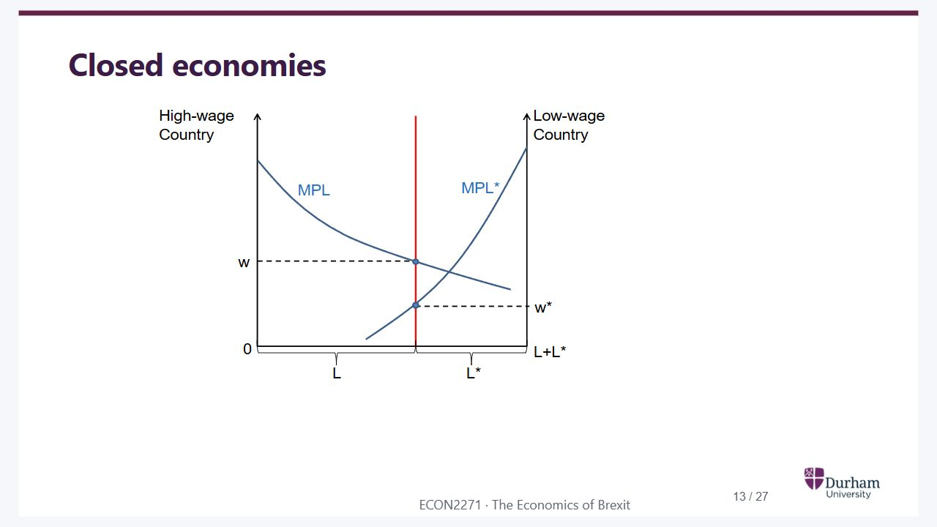
Notes:
Static student copy of the current web slide. Slide artwork is flattened; add personal notes here. Interactive explanations, playback and accessible HTML are available at:
https://davidchivers.co.uk/teaching/macro-applications/lecture_4.html#/l4-s13
Closed economies
Two-country labour allocation with fixed capital. Marginal product of labour falls as employment rises in each country. Initially the high-wage country has wage w and the low-wage country wage w star.

Slide 14
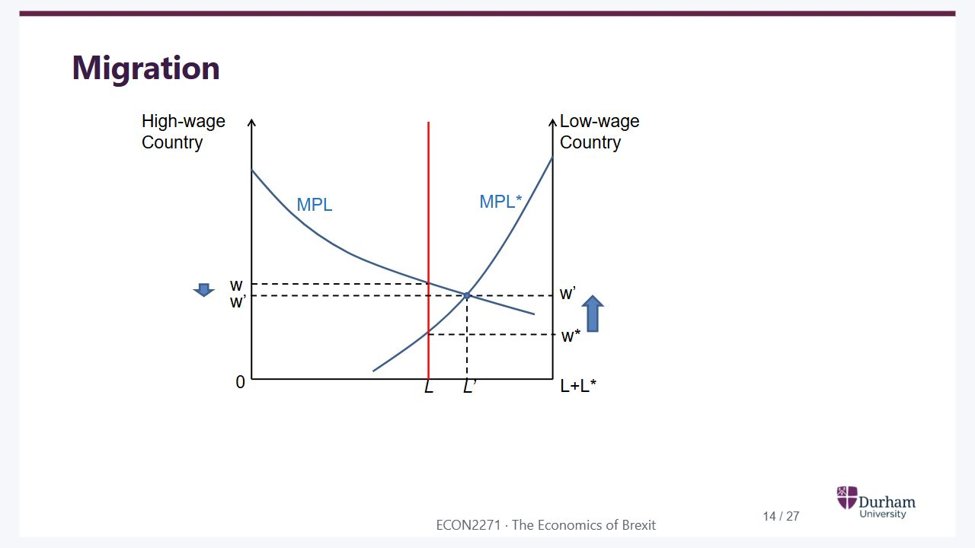
Notes:
Static student copy of the current web slide. Slide artwork is flattened; add personal notes here. Interactive explanations, playback and accessible HTML are available at:
https://davidchivers.co.uk/teaching/macro-applications/lecture_4.html#/l4-s14
Migration
Migration reallocates labour from the low-wage country to the high-wage country. Employment moves from L to L prime, lowering the high wage and raising the low wage towards a common wage.

Slide 15
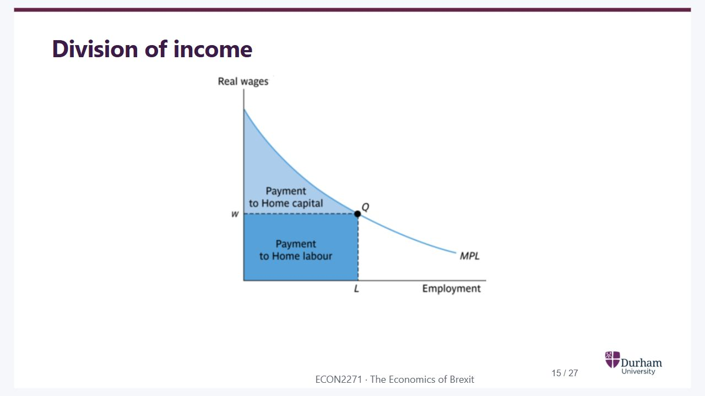
Notes:
Static student copy of the current web slide. Slide artwork is flattened; add personal notes here. Interactive explanations, playback and accessible HTML are available at:
https://davidchivers.co.uk/teaching/macro-applications/lecture_4.html#/l4-s15
Division of income
Division of income under the marginal-product curve. The wage times employment rectangle goes to labour; the area above the wage and below marginal product goes to capital.

Slide 16
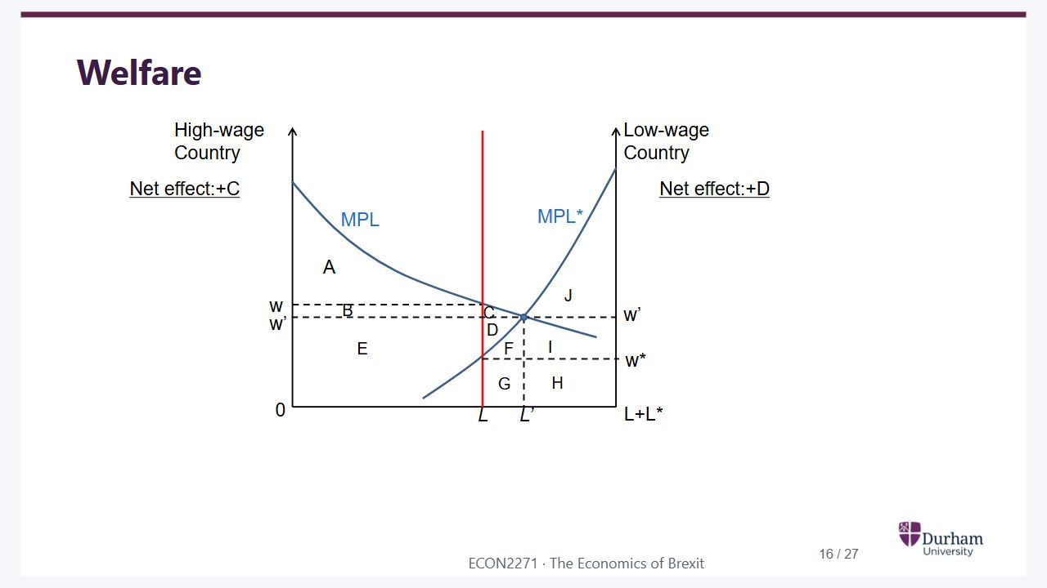
Notes:
Static student copy of the current web slide. Slide artwork is flattened; add personal notes here. Interactive explanations, playback and accessible HTML are available at:
https://davidchivers.co.uk/teaching/macro-applications/lecture_4.html#/l4-s16
Welfare
Two-country migration welfare diagram with areas A to J. The high-wage country’s net gain is C and the low-wage country’s net gain is D, although workers and capital owners are affected differently.

Slide 17
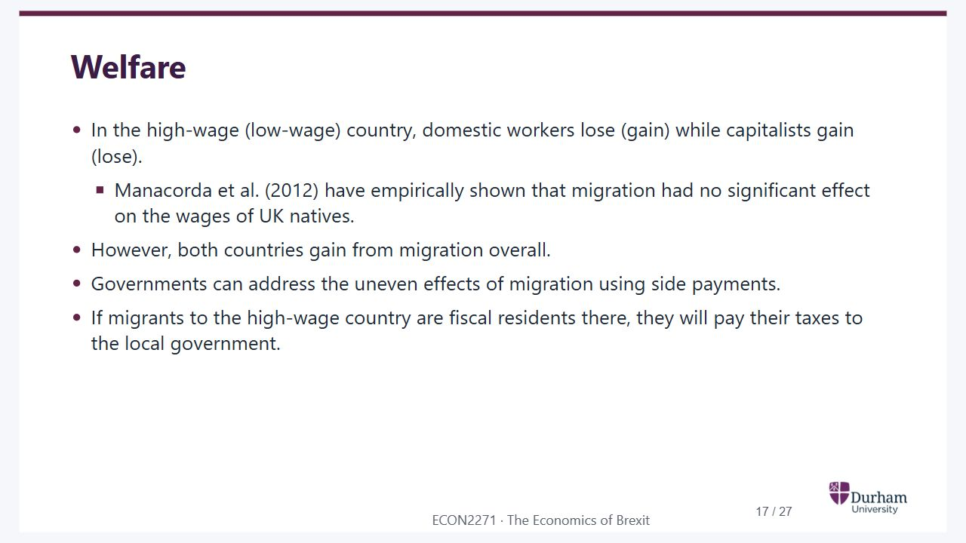
Notes:
Static student copy of the current web slide. Slide artwork is flattened; add personal notes here. Interactive explanations, playback and accessible HTML are available at:
https://davidchivers.co.uk/teaching/macro-applications/lecture_4.html#/l4-s17
Welfare
In the high-wage (low-wage) country, domestic workers lose (gain) while capitalists gain (lose).
Manacorda et al. (2012) have empirically shown that migration had no significant effect on the wages of UK natives.
However, both countries gain from migration overall.
Governments can address the uneven effects of migration using side payments.
If migrants to the high-wage country are fiscal residents there, they will pay their taxes to the local government.

Slide 18

Notes:
Static student copy of the current web slide. Slide artwork is flattened; add personal notes here. Interactive explanations, playback and accessible HTML are available at:
https://davidchivers.co.uk/teaching/macro-applications/lecture_4.html#/l4-s18
Skilled and unskilled migration
What about “skilled” and “unskilled” immigration?

Slide 19
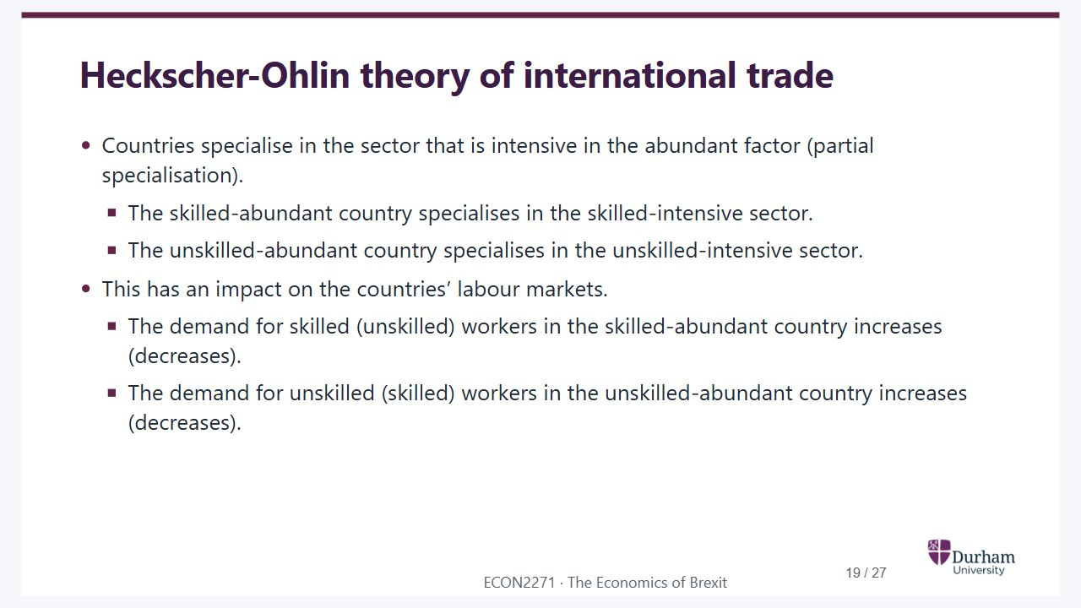
Notes:
Static student copy of the current web slide. Slide artwork is flattened; add personal notes here. Interactive explanations, playback and accessible HTML are available at:
https://davidchivers.co.uk/teaching/macro-applications/lecture_4.html#/l4-s19
Heckscher-Ohlin theory of international trade
Countries specialise in the sector that is intensive in the abundant factor (partial specialisation).
The skilled-abundant country specialises in the skilled-intensive sector.
The unskilled-abundant country specialises in the unskilled-intensive sector.
This has an impact on the countries’ labour markets.
The demand for skilled (unskilled) workers in the skilled-abundant country increases (decreases).
The demand for unskilled (skilled) workers in the unskilled-abundant country increases (decreases).

Slide 20
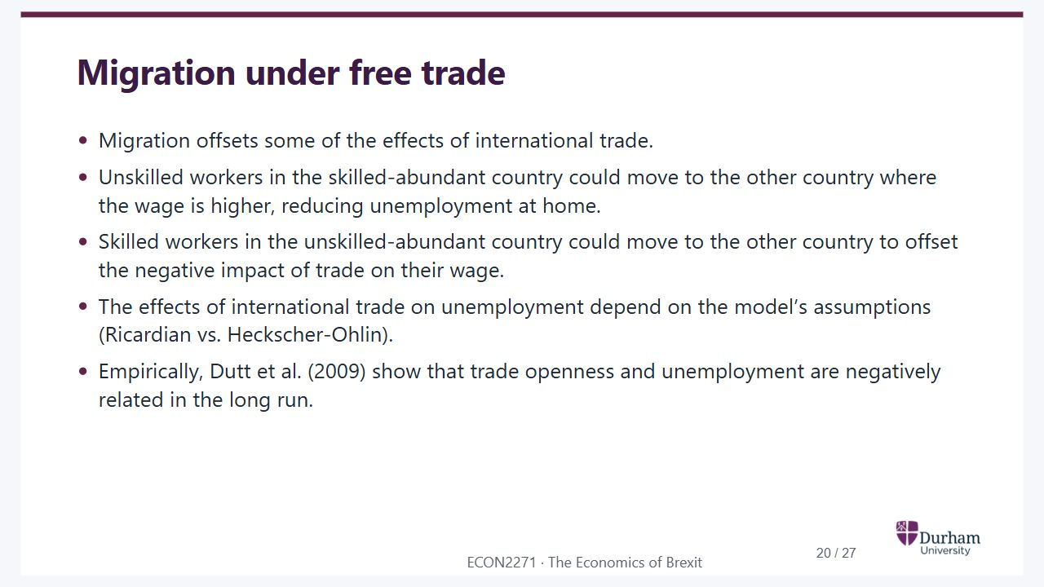
Notes:
Static student copy of the current web slide. Slide artwork is flattened; add personal notes here. Interactive explanations, playback and accessible HTML are available at:
https://davidchivers.co.uk/teaching/macro-applications/lecture_4.html#/l4-s20
Migration under free trade
Migration offsets some of the effects of international trade.
Unskilled workers in the skilled-abundant country could move to the other country where the wage is higher, reducing unemployment at home.
Skilled workers in the unskilled-abundant country could move to the other country to offset the negative impact of trade on their wage.
The effects of international trade on unemployment depend on the model’s assumptions (Ricardian vs. Heckscher-Ohlin).
Empirically, Dutt et al. (2009) show that trade openness and unemployment are negatively related in the long run.

Slide 21
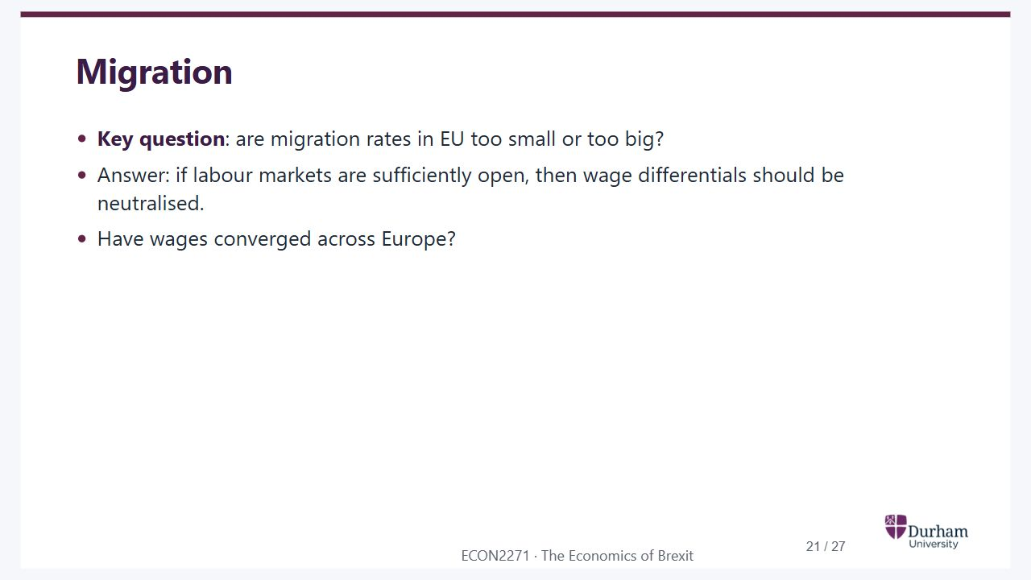
Notes:
Static student copy of the current web slide. Slide artwork is flattened; add personal notes here. Interactive explanations, playback and accessible HTML are available at:
https://davidchivers.co.uk/teaching/macro-applications/lecture_4.html#/l4-s21
Migration
Key question: are migration rates in EU too small or too big?
Answer: if labour markets are sufficiently open, then wage differentials should be neutralised.
Have wages converged across Europe?

Slide 22
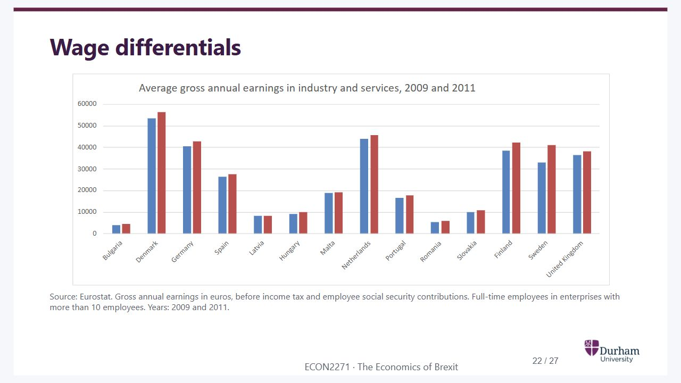
Notes:
Static student copy of the current web slide. Slide artwork is flattened; add personal notes here. Interactive explanations, playback and accessible HTML are available at:
https://davidchivers.co.uk/teaching/macro-applications/lecture_4.html#/l4-s22
Wage differentials
Source: Eurostat. Gross annual earnings in euros, before income tax and employee social security contributions. Full-time employees in enterprises with more than 10 employees. Years: 2009 and 2011.
Eurostat chart comparing average gross annual earnings in industry and services across European countries in 2009 and 2011. Substantial cross-country wage differences remain.

Slide 23
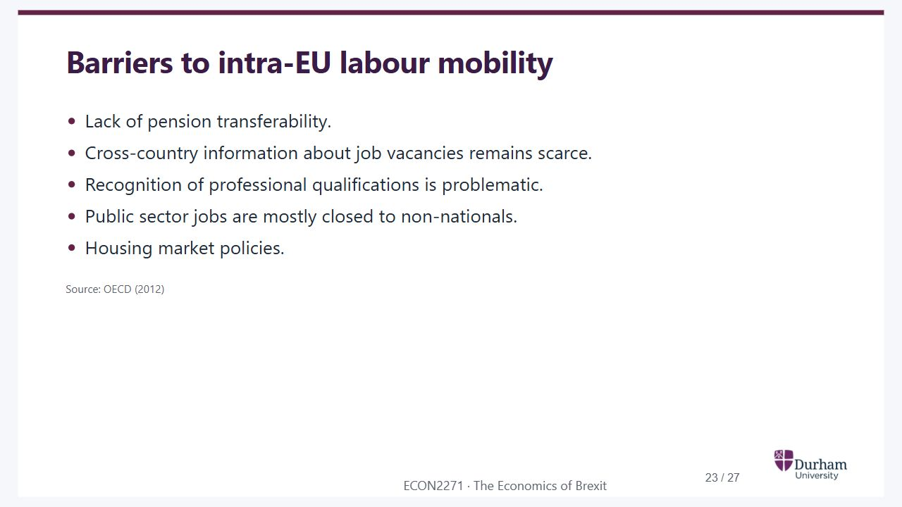
Notes:
Static student copy of the current web slide. Slide artwork is flattened; add personal notes here. Interactive explanations, playback and accessible HTML are available at:
https://davidchivers.co.uk/teaching/macro-applications/lecture_4.html#/l4-s23
Barriers to intra-EU labour mobility
Lack of pension transferability.
Cross-country information about job vacancies remains scarce.
Recognition of professional qualifications is problematic.
Public sector jobs are mostly closed to non-nationals.
Housing market policies.
Source: OECD (2012)

Slide 24
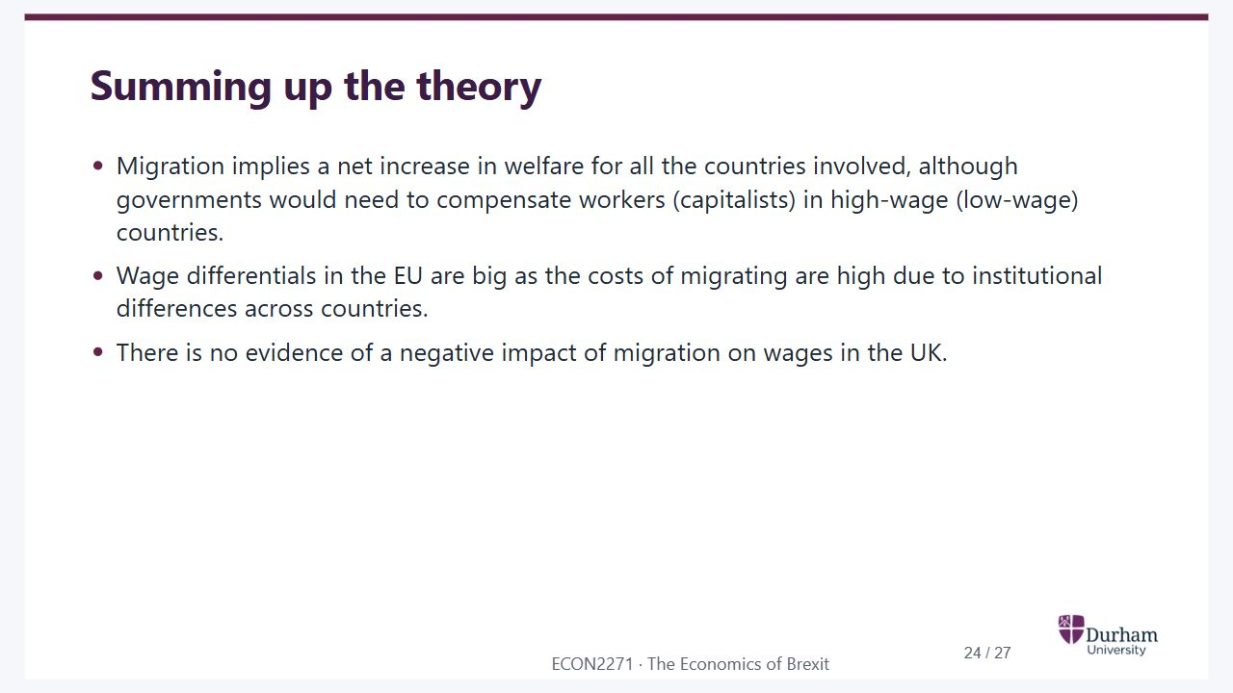
Notes:
Static student copy of the current web slide. Slide artwork is flattened; add personal notes here. Interactive explanations, playback and accessible HTML are available at:
https://davidchivers.co.uk/teaching/macro-applications/lecture_4.html#/l4-s24
Summing up the theory
Migration implies a net increase in welfare for all the countries involved, although governments would need to compensate workers (capitalists) in high-wage (low-wage) countries.
Wage differentials in the EU are big as the costs of migrating are high due to institutional differences across countries.
There is no evidence of a negative impact of migration on wages in the UK.

Slide 25
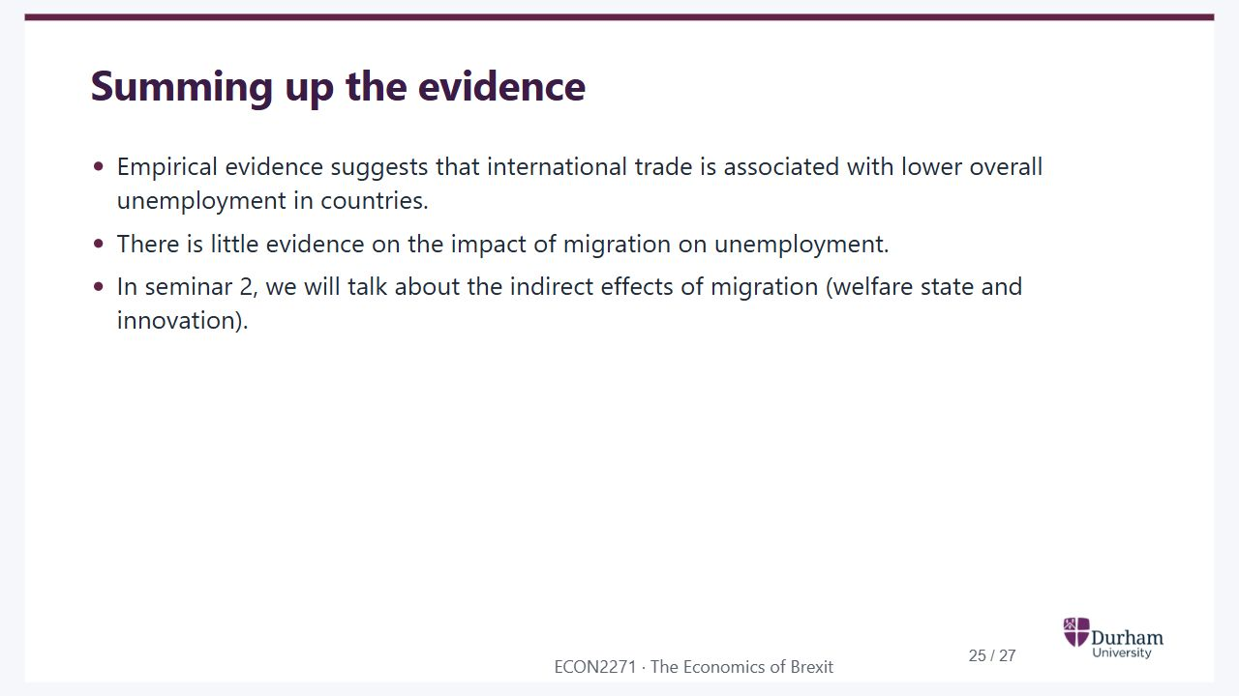
Notes:
Static student copy of the current web slide. Slide artwork is flattened; add personal notes here. Interactive explanations, playback and accessible HTML are available at:
https://davidchivers.co.uk/teaching/macro-applications/lecture_4.html#/l4-s25
Summing up the evidence
Empirical evidence suggests that international trade is associated with lower overall unemployment in countries.
There is little evidence on the impact of migration on unemployment.
In seminar 2, we will talk about the indirect effects of migration (welfare state and innovation).

Slide 26
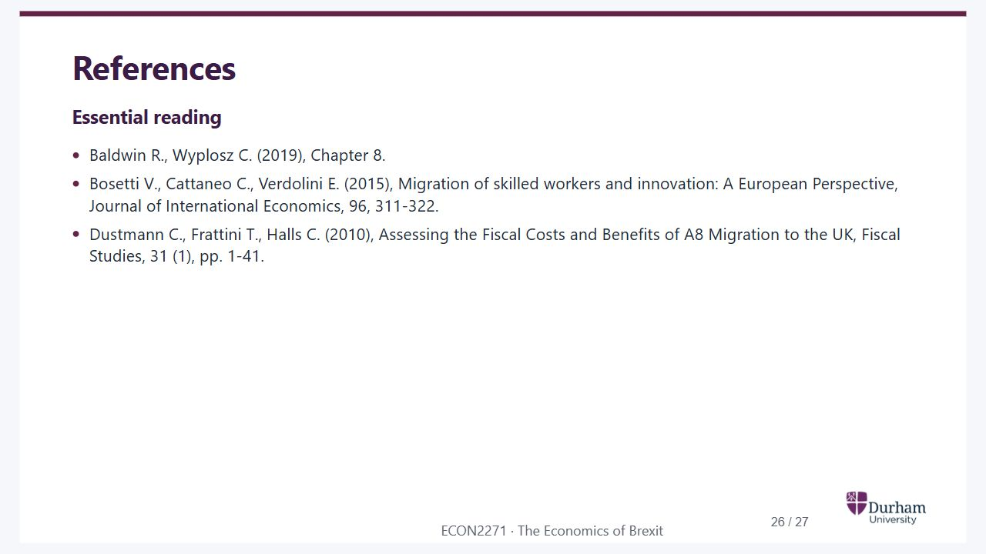
Notes:
Static student copy of the current web slide. Slide artwork is flattened; add personal notes here. Interactive explanations, playback and accessible HTML are available at:
https://davidchivers.co.uk/teaching/macro-applications/lecture_4.html#/l4-s26
References
Essential reading
Baldwin R., Wyplosz C. (2019), Chapter 8.
Bosetti V., Cattaneo C., Verdolini E. (2015), Migration of skilled workers and innovation: A European Perspective, Journal of International Economics, 96, 311-322.
Dustmann C., Frattini T., Halls C. (2010), Assessing the Fiscal Costs and Benefits of A8 Migration to the UK, Fiscal Studies, 31 (1), pp. 1-41.

Slide 27

Notes:
Static student copy of the current web slide. Slide artwork is flattened; add personal notes here. Interactive explanations, playback and accessible HTML are available at:
https://davidchivers.co.uk/teaching/macro-applications/lecture_4.html#/l4-s27
Further reading
See the ECON2271 Talis reading list, also available through Blackboard.
https://durham.rl.talis.com/lists/d85d1ad3-e9ac-4daf-aa66-e3ddfcf902d7.html

