Slide 1
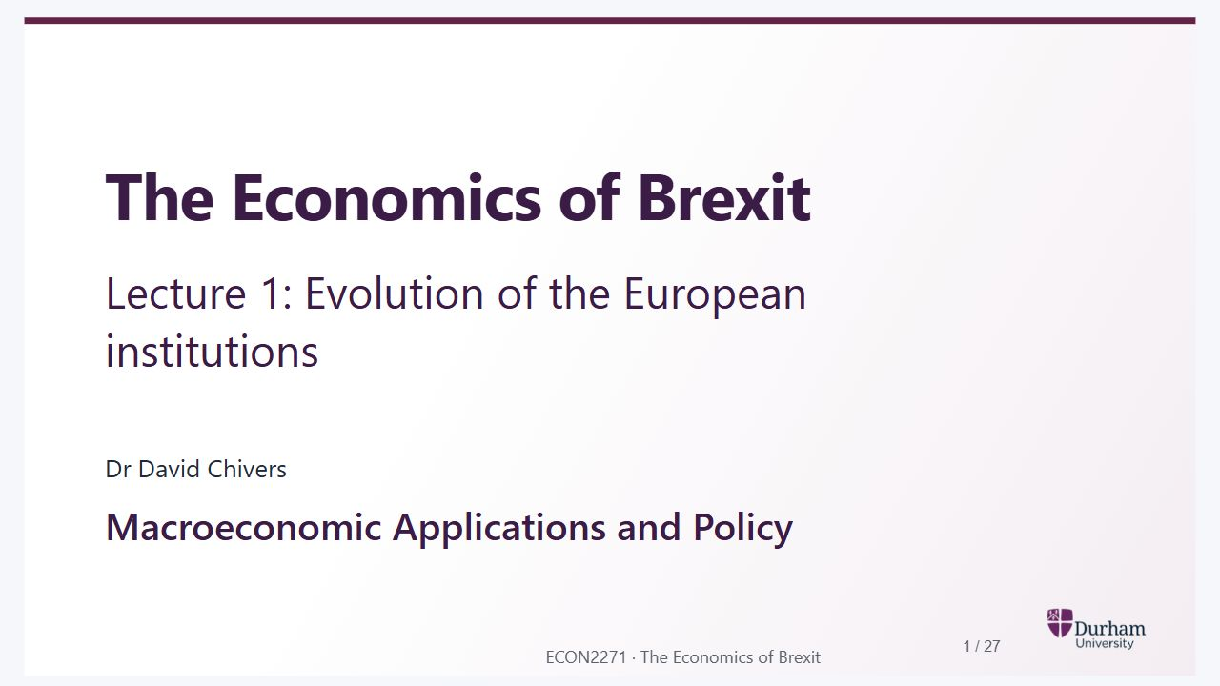
Notes:
Static student copy of the current web slide. Slide artwork is flattened; add personal notes here. Interactive explanations, playback and accessible HTML are available at:
https://davidchivers.co.uk/teaching/macro-applications/lecture_1.html#/title-slide
The Economics of Brexit
Lecture 1: Evolution of the European institutions
Dr David Chivers
Macroeconomic Applications and Policy

Slide 2
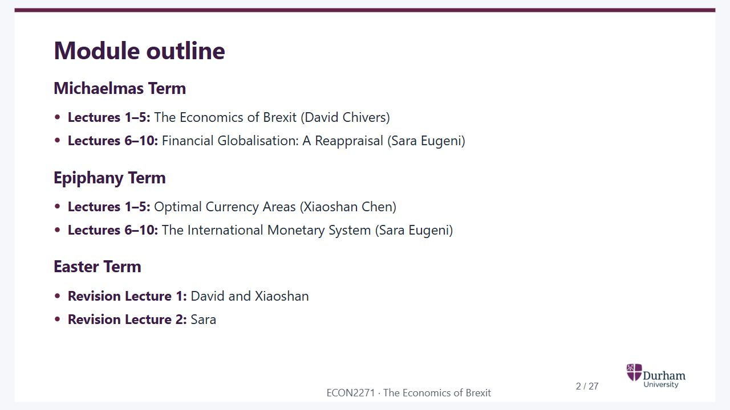
Notes:
Static student copy of the current web slide. Slide artwork is flattened; add personal notes here. Interactive explanations, playback and accessible HTML are available at:
https://davidchivers.co.uk/teaching/macro-applications/lecture_1.html#/module-outline
Module outline
Michaelmas Term
Lectures 1–5: The Economics of Brexit (David Chivers)
Lectures 6–10: Financial Globalisation: A Reappraisal (Sara Eugeni)
Epiphany Term
Lectures 1–5: Optimal Currency Areas (Xiaoshan Chen)
Lectures 6–10: The International Monetary System (Sara Eugeni)
Easter Term
Revision Lecture 1: David and Xiaoshan
Revision Lecture 2: Sara

Slide 3
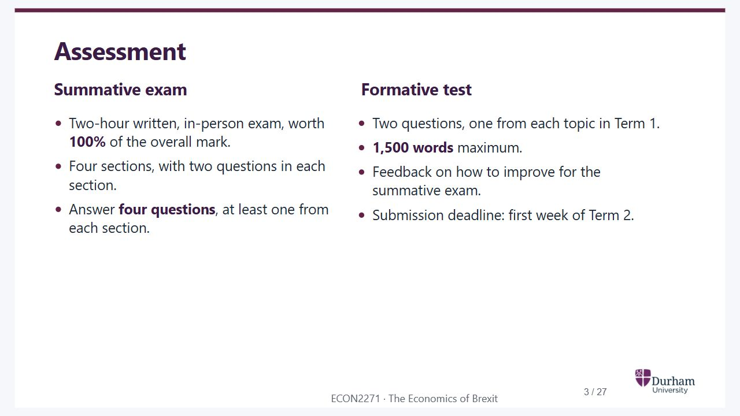
Notes:
Static student copy of the current web slide. Slide artwork is flattened; add personal notes here. Interactive explanations, playback and accessible HTML are available at:
https://davidchivers.co.uk/teaching/macro-applications/lecture_1.html#/assessment
Assessment
Summative exam
Two-hour written, in-person exam, worth 100% of the overall mark.
Four sections, with two questions in each section.
Answer four questions, at least one from each section.
Formative test
Two questions, one from each topic in Term 1.
1,500 words maximum.
Feedback on how to improve for the summative exam.
Submission deadline: first week of Term 2.

Slide 4
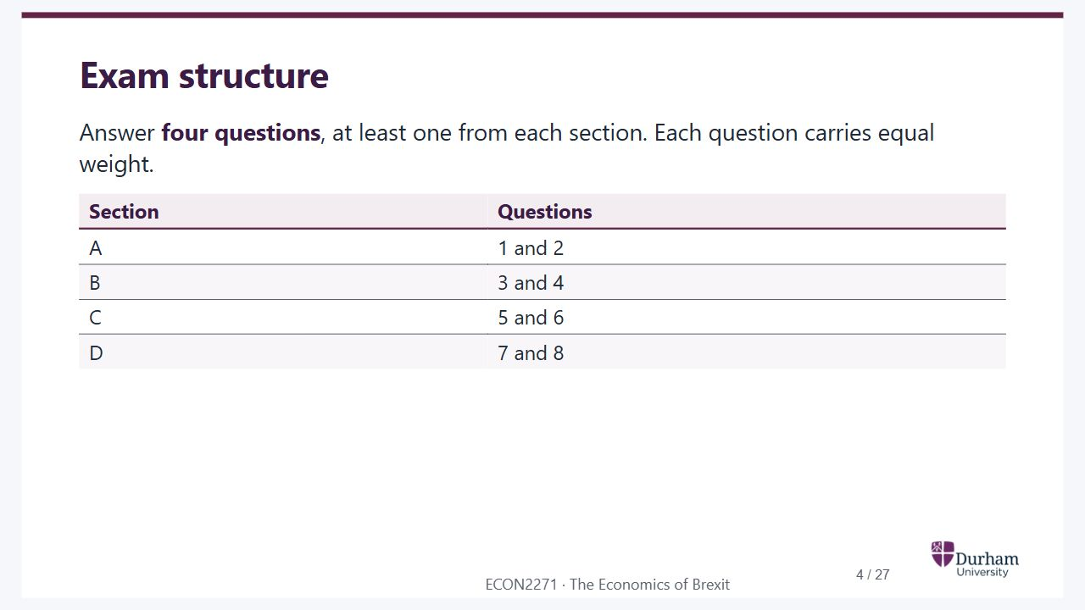
Notes:
Static student copy of the current web slide. Slide artwork is flattened; add personal notes here. Interactive explanations, playback and accessible HTML are available at:
https://davidchivers.co.uk/teaching/macro-applications/lecture_1.html#/exam-structure
Exam structure
Answer four questions, at least one from each section. Each question carries equal weight.
Section Questions
A 1 and 2
B 3 and 4
C 5 and 6
D 7 and 8

Slide 5
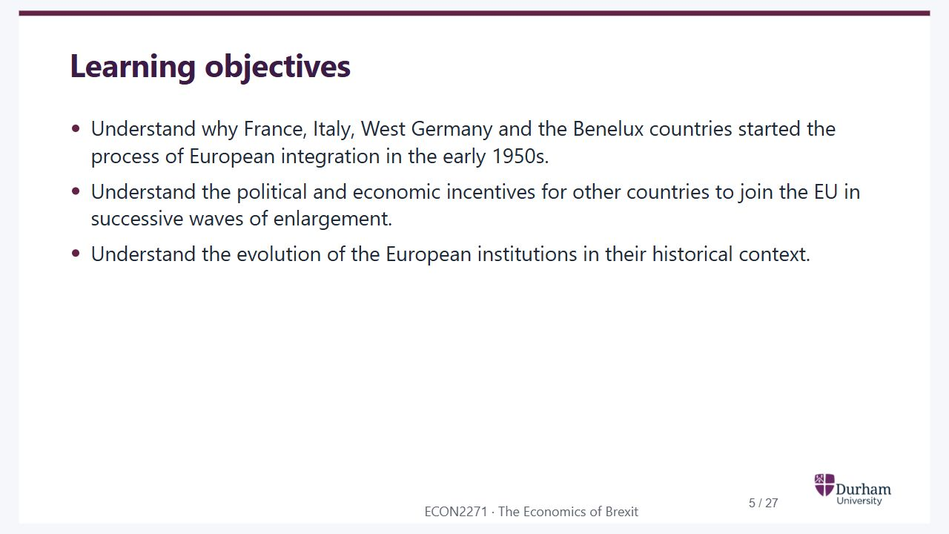
Notes:
Static student copy of the current web slide. Slide artwork is flattened; add personal notes here. Interactive explanations, playback and accessible HTML are available at:
https://davidchivers.co.uk/teaching/macro-applications/lecture_1.html#/learning-objectives
Learning objectives
Understand why France, Italy, West Germany and the Benelux countries started the process of European integration in the early 1950s.
Understand the political and economic incentives for other countries to join the EU in successive waves of enlargement.
Understand the evolution of the European institutions in their historical context.

Slide 6
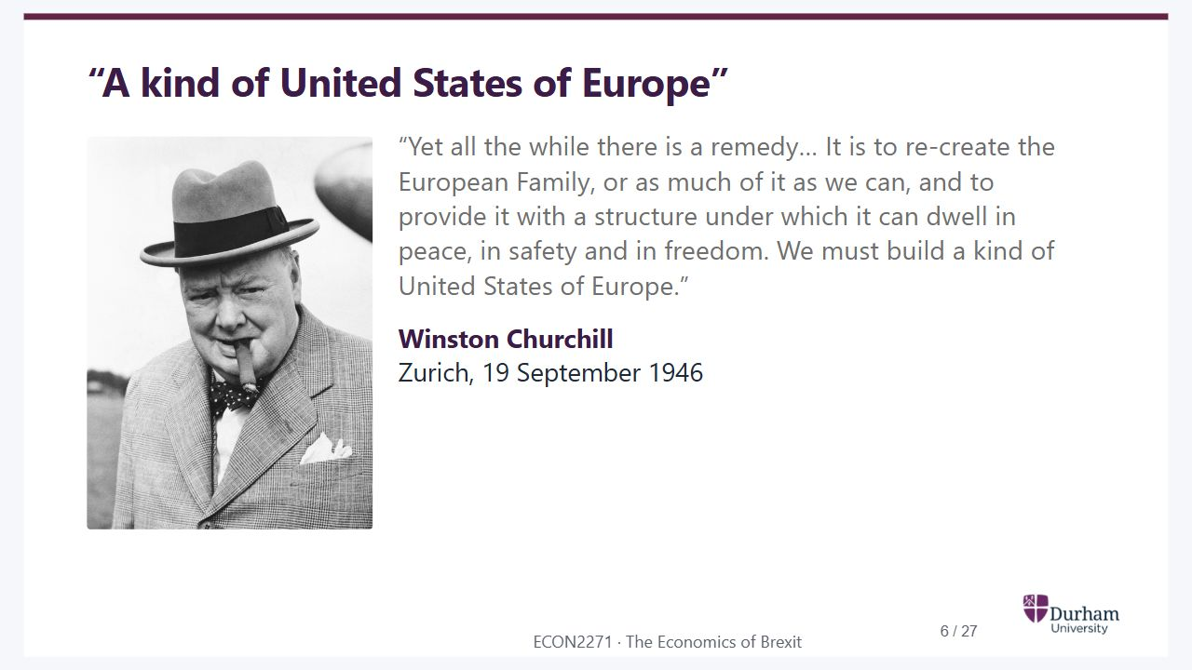
Notes:
Static student copy of the current web slide. Slide artwork is flattened; add personal notes here. Interactive explanations, playback and accessible HTML are available at:
https://davidchivers.co.uk/teaching/macro-applications/lecture_1.html#/a-kind-of-united-states-of-europe
“A kind of United States of Europe”
“Yet all the while there is a remedy… It is to re-create the European Family, or as much of it as we can, and to provide it with a structure under which it can dwell in peace, in safety and in freedom. We must build a kind of United States of Europe.”
Winston Churchill
Zurich, 19 September 1946
Black-and-white portrait of Winston Churchill wearing a hat and overcoat.

Slide 7
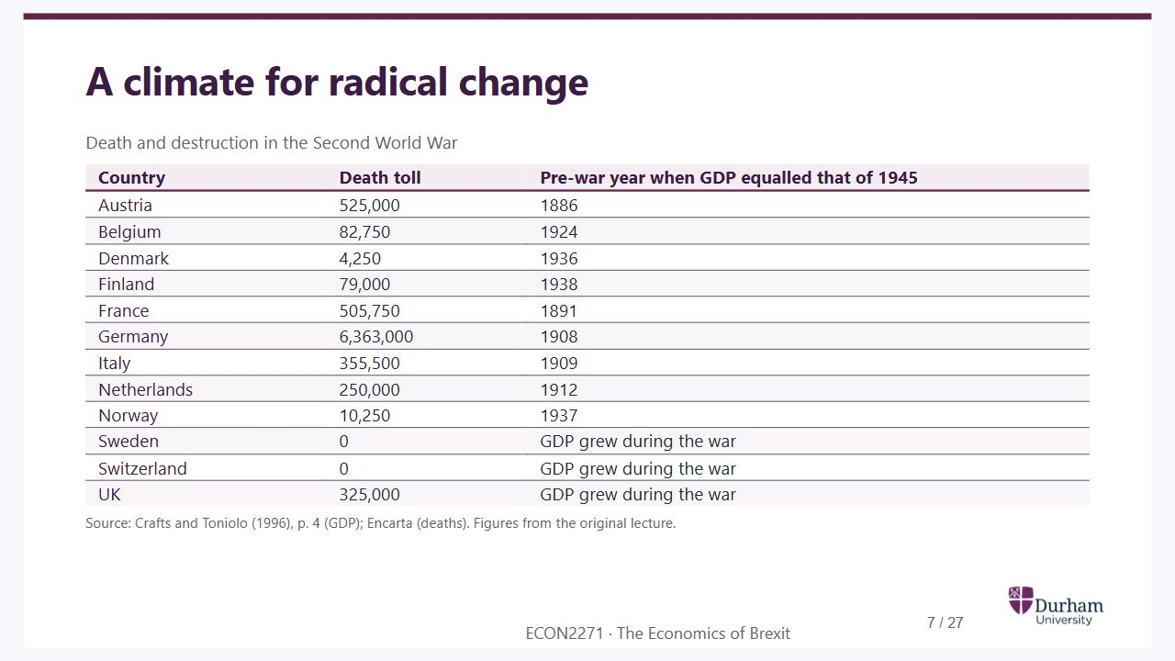
Notes:
Static student copy of the current web slide. Slide artwork is flattened; add personal notes here. Interactive explanations, playback and accessible HTML are available at:
https://davidchivers.co.uk/teaching/macro-applications/lecture_1.html#/a-climate-for-radical-change
A climate for radical change
Death and destruction in the Second World War
Country Death toll Pre-war year when GDP equalled that of 1945
Austria 525,000 1886
Belgium 82,750 1924
Denmark 4,250 1936
Finland 79,000 1938
France 505,750 1891
Germany 6,363,000 1908
Italy 355,500 1909
Netherlands 250,000 1912
Norway 10,250 1937
Sweden 0 GDP grew during the war
Switzerland 0 GDP grew during the war
UK 325,000 GDP grew during the war
Source: Crafts and Toniolo (1996), p. 4 (GDP); Encarta (deaths). Figures from the original lecture.

Slide 8
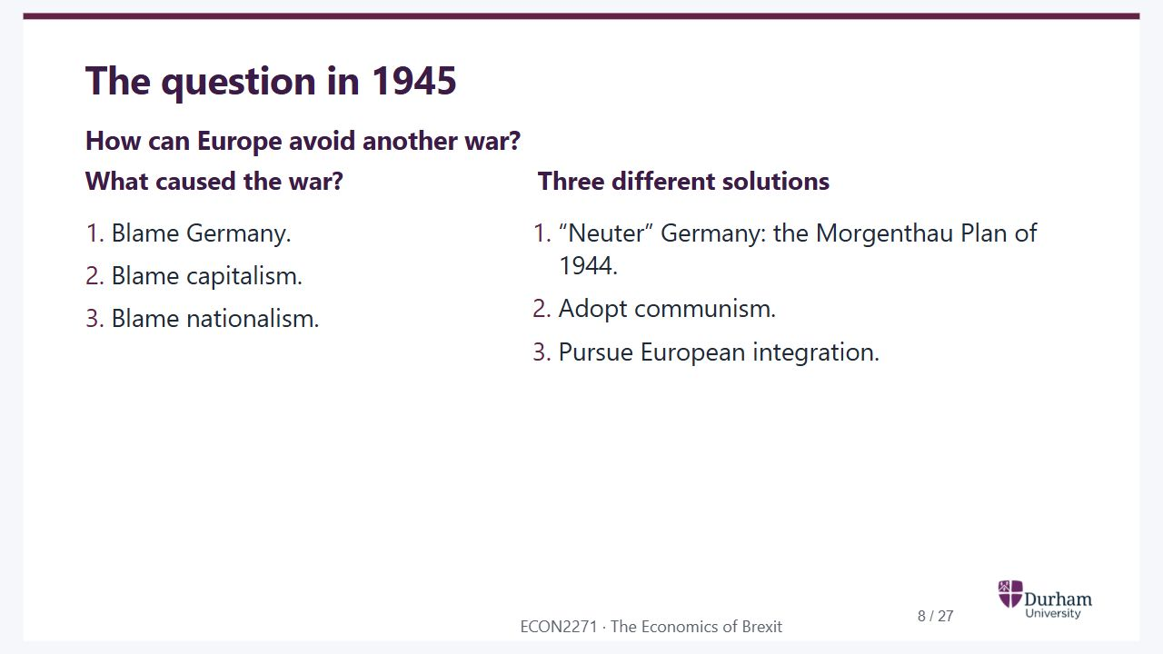
Notes:
Static student copy of the current web slide. Slide artwork is flattened; add personal notes here. Interactive explanations, playback and accessible HTML are available at:
https://davidchivers.co.uk/teaching/macro-applications/lecture_1.html#/the-question-in-1945
The question in 1945
How can Europe avoid another war?
What caused the war?
Blame Germany.
Blame capitalism.
Blame nationalism.
Three different solutions
“Neuter” Germany: the Morgenthau Plan of 1944.
Adopt communism.
Pursue European integration.

Slide 9
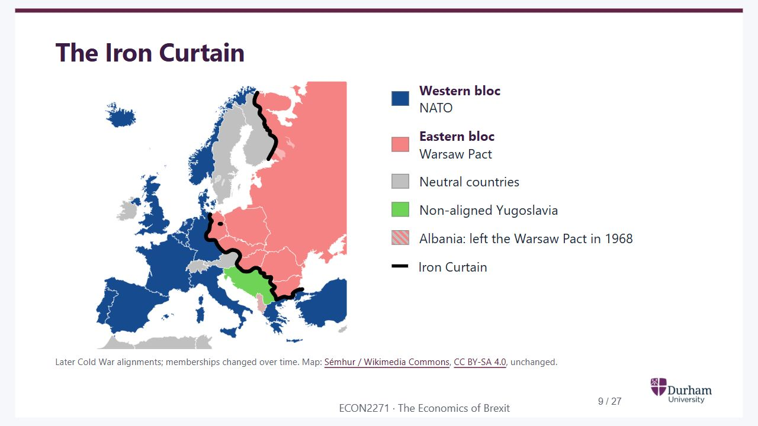
Notes:
Static student copy of the current web slide. Slide artwork is flattened; add personal notes here. Interactive explanations, playback and accessible HTML are available at:
https://davidchivers.co.uk/teaching/macro-applications/lecture_1.html#/the-iron-curtain
The Iron Curtain
Western bloc
NATO
Eastern bloc
Warsaw Pact
Neutral countries
Non-aligned Yugoslavia
Albania: left the Warsaw Pact in 1968
Iron Curtain
Later Cold War alignments; memberships changed over time. Map: Sémhur / Wikimedia Commons, CC BY-SA 4.0, unchanged.
Vector map of Cold War Europe. NATO countries are blue and Warsaw Pact countries pink, with the Iron Curtain marked by a thick black line. Neutral countries are grey and non-aligned Yugoslavia is green. Germany is divided. Albania is striped to reflect its withdrawal from the Warsaw Pact.
https://commons.wikimedia.org/wiki/File:Iron_Curtain_map.svg
https://creativecommons.org/licenses/by-sa/4.0/

Slide 10
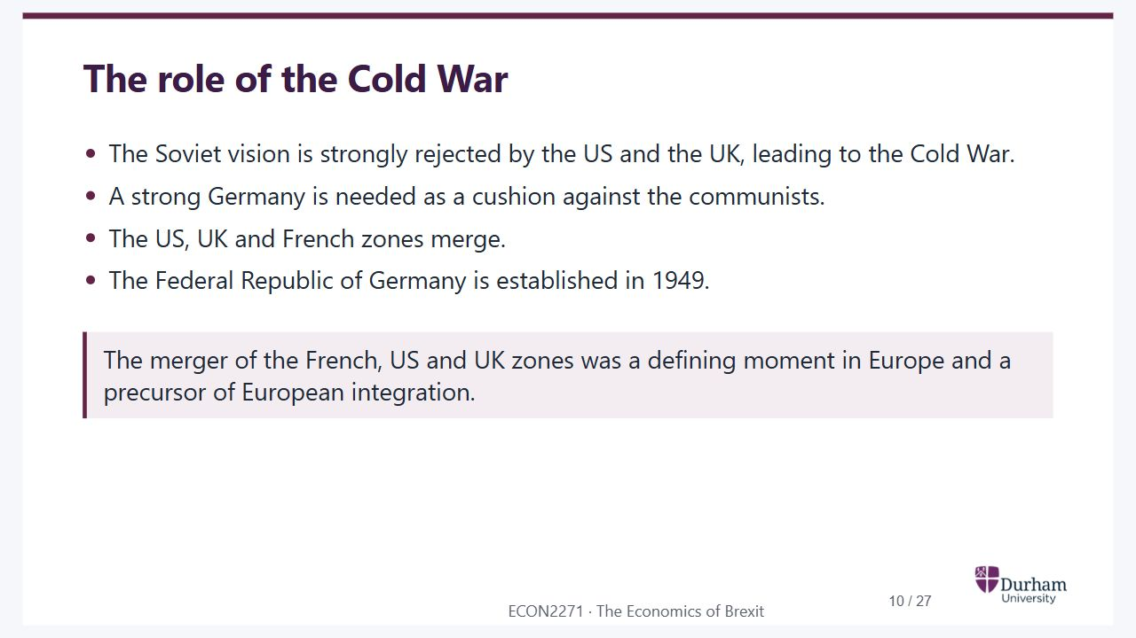
Notes:
Static student copy of the current web slide. Slide artwork is flattened; add personal notes here. Interactive explanations, playback and accessible HTML are available at:
https://davidchivers.co.uk/teaching/macro-applications/lecture_1.html#/the-role-of-the-cold-war
The role of the Cold War
The Soviet vision is strongly rejected by the US and the UK, leading to the Cold War.
A strong Germany is needed as a cushion against the communists.
The US, UK and French zones merge.
The Federal Republic of Germany is established in 1949.
The merger of the French, US and UK zones was a defining moment in Europe and a precursor of European integration.

Slide 11
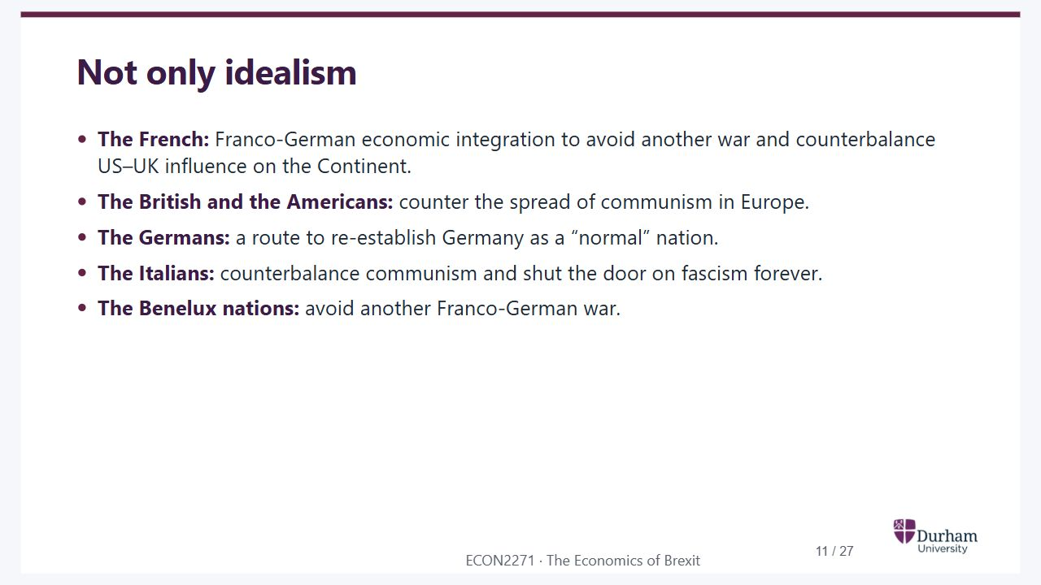
Notes:
Static student copy of the current web slide. Slide artwork is flattened; add personal notes here. Interactive explanations, playback and accessible HTML are available at:
https://davidchivers.co.uk/teaching/macro-applications/lecture_1.html#/not-only-idealism
Not only idealism
The French: Franco-German economic integration to avoid another war and counterbalance US–UK influence on the Continent.
The British and the Americans: counter the spread of communism in Europe.
The Germans: a route to re-establish Germany as a “normal” nation.
The Italians: counterbalance communism and shut the door on fascism forever.
The Benelux nations: avoid another Franco-German war.

Slide 12
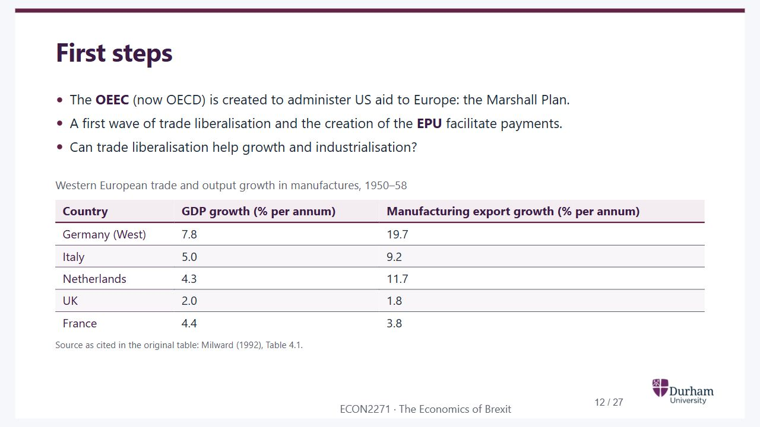
Notes:
Static student copy of the current web slide. Slide artwork is flattened; add personal notes here. Interactive explanations, playback and accessible HTML are available at:
https://davidchivers.co.uk/teaching/macro-applications/lecture_1.html#/first-steps
First steps
The OEEC (now OECD) is created to administer US aid to Europe: the Marshall Plan.
A first wave of trade liberalisation and the creation of the EPU facilitate payments.
Can trade liberalisation help growth and industrialisation?
Western European trade and output growth in manufactures, 1950–58
Country GDP growth (% per annum) Manufacturing export growth (% per annum)
Germany (West) 7.8 19.7
Italy 5.0 9.2
Netherlands 4.3 11.7
UK 2.0 1.8
France 4.4 3.8
Source as cited in the original table: Milward (1992), Table 4.1.

Slide 13
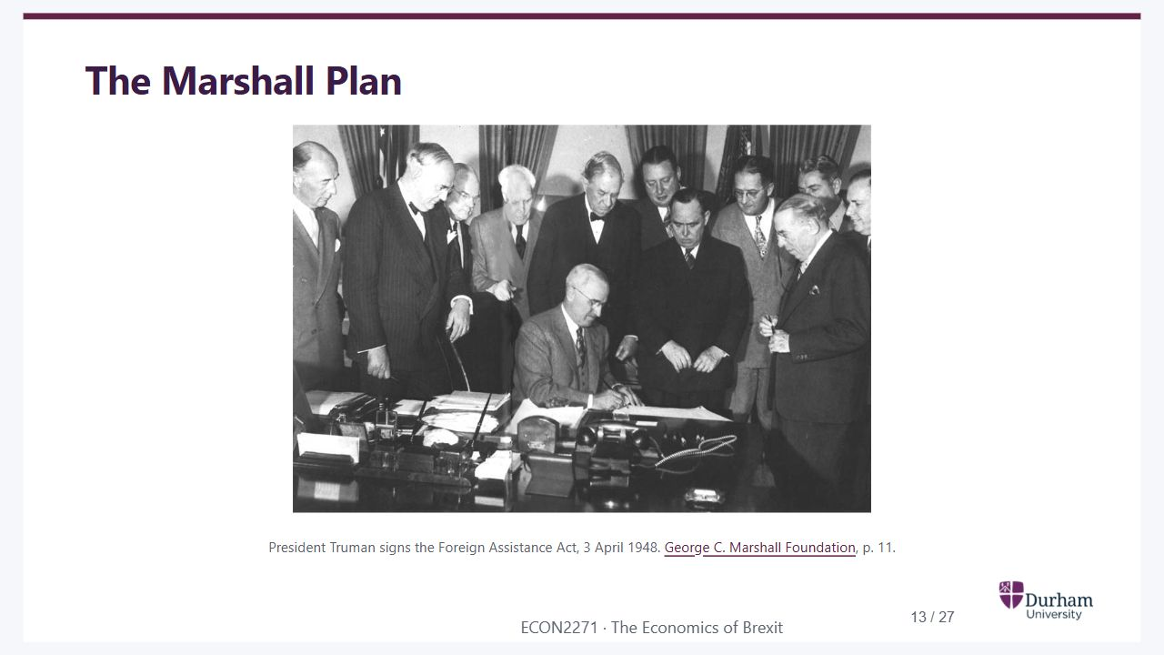
Notes:
Static student copy of the current web slide. Slide artwork is flattened; add personal notes here. Interactive explanations, playback and accessible HTML are available at:
https://davidchivers.co.uk/teaching/macro-applications/lecture_1.html#/the-marshall-plan
The Marshall Plan
President Truman signs the Foreign Assistance Act, 3 April 1948. George C. Marshall Foundation, p. 11.
President Harry Truman sits at a desk signing the Foreign Assistance Act, surrounded by officials.
https://www.marshallfoundation.org/wp-content/uploads/2014/05/Chapter_1.pdf

Slide 14
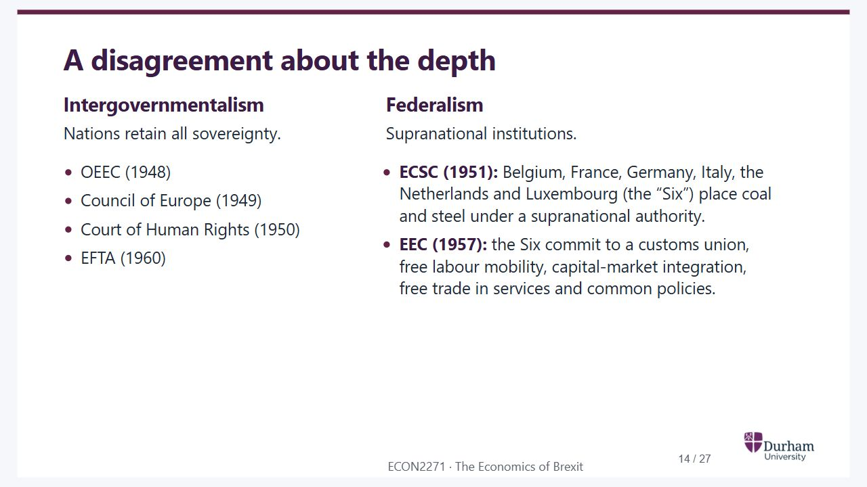
Notes:
Static student copy of the current web slide. Slide artwork is flattened; add personal notes here. Interactive explanations, playback and accessible HTML are available at:
https://davidchivers.co.uk/teaching/macro-applications/lecture_1.html#/a-disagreement-about-the-depth
A disagreement about the depth
Intergovernmentalism
Nations retain all sovereignty.
OEEC (1948)
Council of Europe (1949)
Court of Human Rights (1950)
EFTA (1960)
Federalism
Supranational institutions.
ECSC (1951): Belgium, France, Germany, Italy, the Netherlands and Luxembourg (the “Six”) place coal and steel under a supranational authority.
EEC (1957): the Six commit to a customs union, free labour mobility, capital-market integration, free trade in services and common policies.

Slide 15
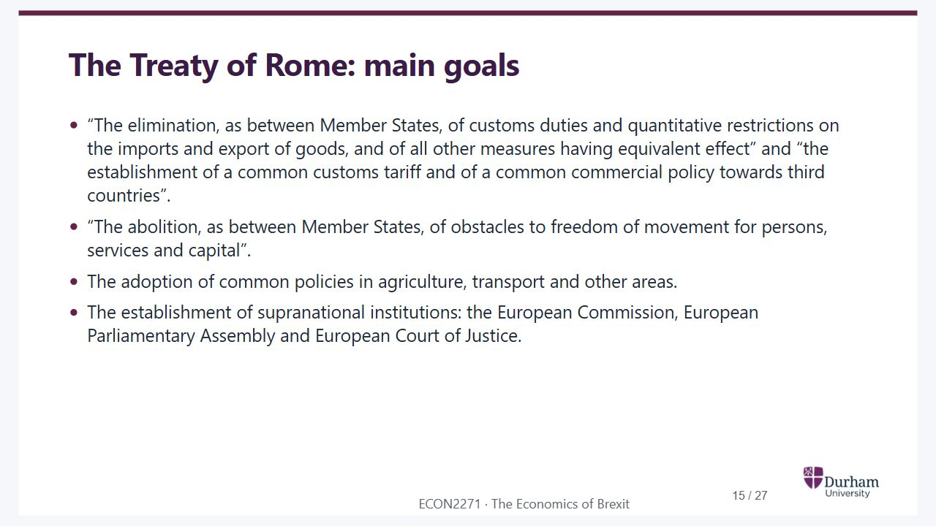
Notes:
Static student copy of the current web slide. Slide artwork is flattened; add personal notes here. Interactive explanations, playback and accessible HTML are available at:
https://davidchivers.co.uk/teaching/macro-applications/lecture_1.html#/the-treaty-of-rome-main-goals
The Treaty of Rome: main goals
“The elimination, as between Member States, of customs duties and quantitative restrictions on the imports and export of goods, and of all other measures having equivalent effect” and “the establishment of a common customs tariff and of a common commercial policy towards third countries”.
“The abolition, as between Member States, of obstacles to freedom of movement for persons, services and capital”.
The adoption of common policies in agriculture, transport and other areas.
The establishment of supranational institutions: the European Commission, European Parliamentary Assembly and European Court of Justice.

Slide 16
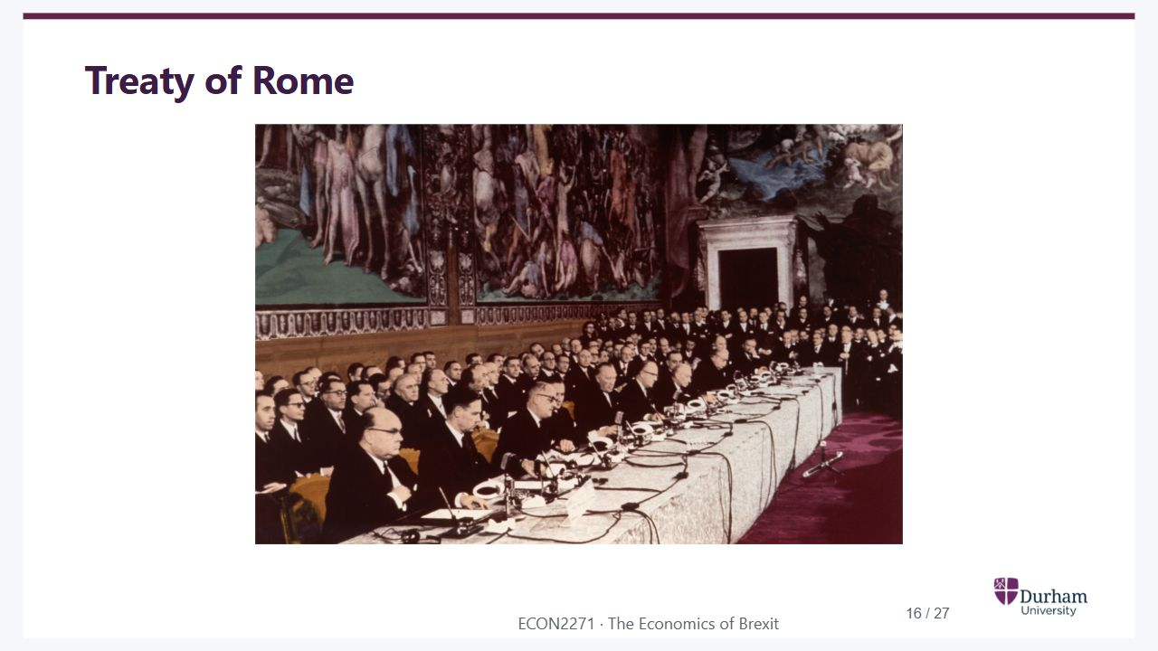
Notes:
Static student copy of the current web slide. Slide artwork is flattened; add personal notes here. Interactive explanations, playback and accessible HTML are available at:
https://davidchivers.co.uk/teaching/macro-applications/lecture_1.html#/treaty-of-rome
Treaty of Rome
Historical photograph of the Treaty of Rome signing ceremony, with delegates seated around a long table in a decorated hall.

Slide 17
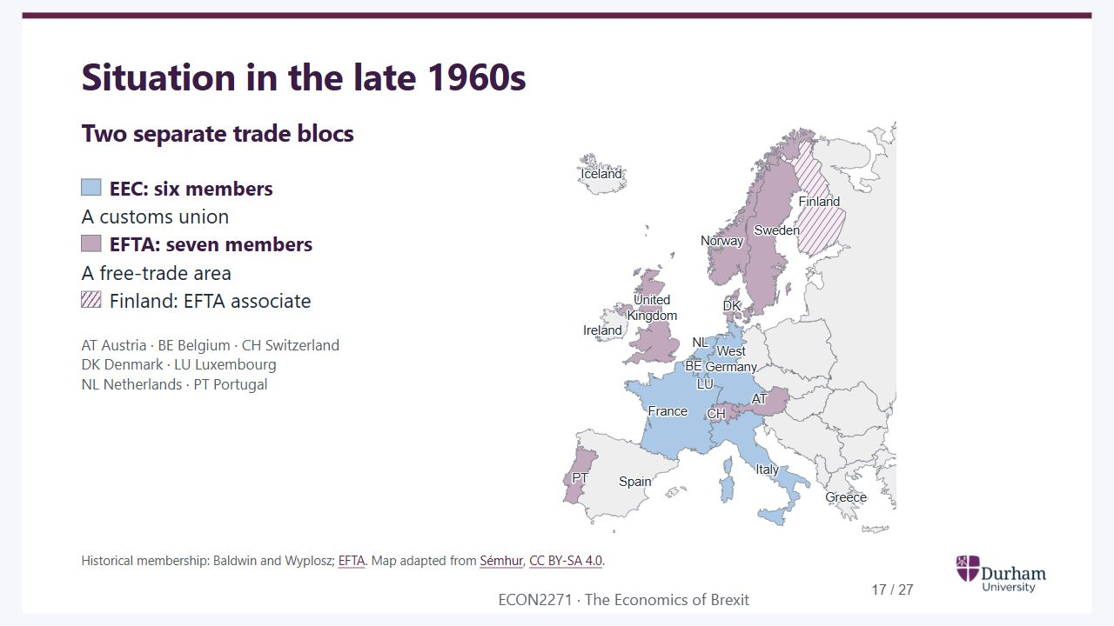
Notes:
Static student copy of the current web slide. Slide artwork is flattened; add personal notes here. Interactive explanations, playback and accessible HTML are available at:
https://davidchivers.co.uk/teaching/macro-applications/lecture_1.html#/situation-in-the-late-1960s
Situation in the late 1960s
Two separate trade blocs
EEC: six members
A customs union
EFTA: seven members
A free-trade area
Finland: EFTA associate
AT Austria · BE Belgium · CH Switzerland
DK Denmark · LU Luxembourg
NL Netherlands · PT Portugal
Historical membership: Baldwin and Wyplosz; EFTA. Map adapted from Sémhur, CC BY-SA 4.0.
Geographical map of Western Europe in the late 1960s. The EEC Six are blue: Belgium, France, West Germany, Italy, Luxembourg and the Netherlands. The EFTA Seven are purple: Austria, Denmark, Norway, Portugal, Sweden, Switzerland and the UK. Finland is hatched as an EFTA associate. The historical West/East German border is shown.
https://www.efta.int/about-efta/european-free-trade-association/history
https://commons.wikimedia.org/wiki/File:Iron_Curtain_map.svg
https://creativecommons.org/licenses/by-sa/4.0/

Slide 18
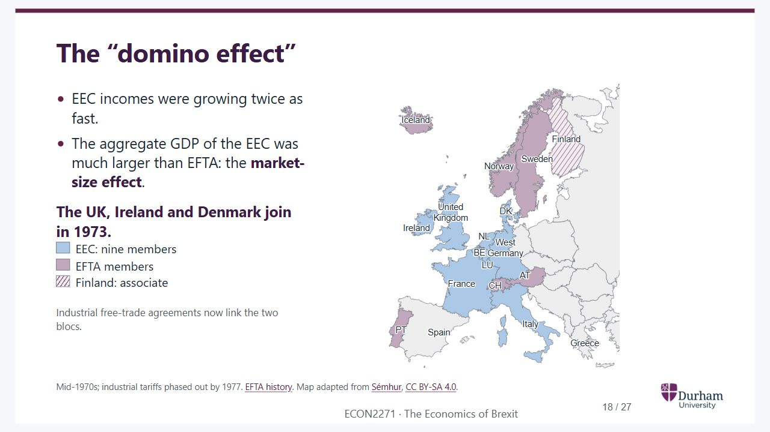
Notes:
Static student copy of the current web slide. Slide artwork is flattened; add personal notes here. Interactive explanations, playback and accessible HTML are available at:
https://davidchivers.co.uk/teaching/macro-applications/lecture_1.html#/the-domino-effect
The “domino effect”
EEC incomes were growing twice as fast.
The aggregate GDP of the EEC was much larger than EFTA: the market-size effect.
The UK, Ireland and Denmark join in 1973.
EEC: nine members
EFTA members
Finland: associate
Industrial free-trade agreements now link the two blocs.
Mid-1970s; industrial tariffs phased out by 1977. EFTA history. Map adapted from Sémhur, CC BY-SA 4.0.
The same geographical map in the mid-1970s. The UK, Denmark and Ireland are now blue as part of the EEC Nine. Iceland has joined EFTA, shown in purple with Austria, Norway, Portugal, Sweden and Switzerland. Finland remains an associate. Industrial free-trade agreements link EEC and EFTA countries.
https://www.efta.int/about-efta/european-free-trade-association/history
https://commons.wikimedia.org/wiki/File:Iron_Curtain_map.svg
https://creativecommons.org/licenses/by-sa/4.0/

Slide 19
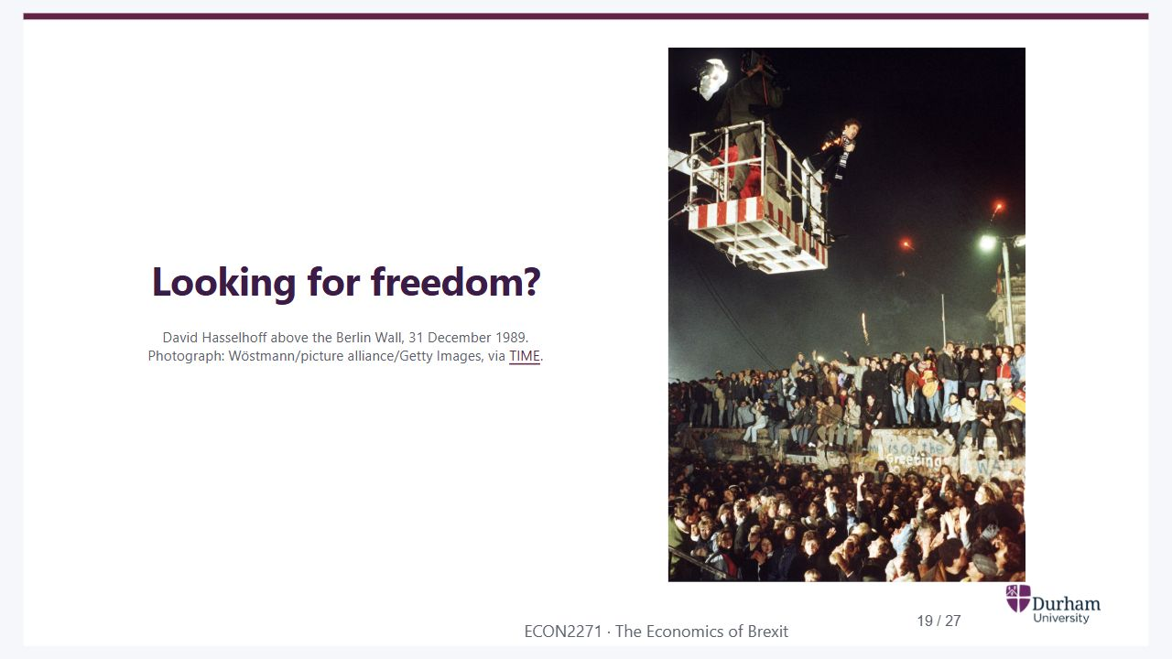
Notes:
Static student copy of the current web slide. Slide artwork is flattened; add personal notes here. Interactive explanations, playback and accessible HTML are available at:
https://davidchivers.co.uk/teaching/macro-applications/lecture_1.html#/looking-for-freedom
Looking for freedom?
David Hasselhoff above the Berlin Wall, 31 December 1989.
Photograph: Wöstmann/picture alliance/Getty Images, via TIME.
Wide historical photograph of David Hasselhoff singing from a crane above the Berlin Wall on New Year's Eve 1989. His light-up jacket, the camera platform, people standing on the Wall and the crowd below are all visible.
https://time.com/5714602/david-hasselhoff-berlin-wall-fall/

Slide 20
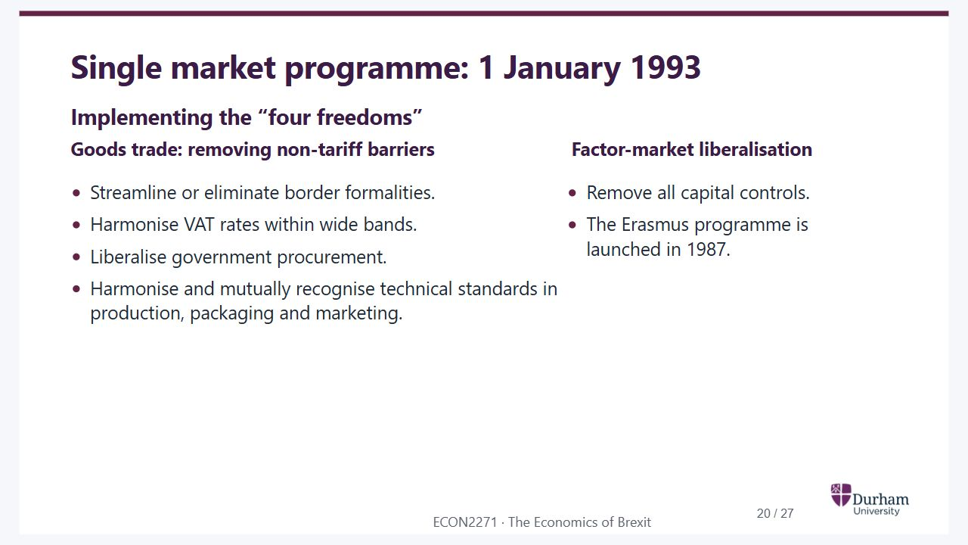
Notes:
Static student copy of the current web slide. Slide artwork is flattened; add personal notes here. Interactive explanations, playback and accessible HTML are available at:
https://davidchivers.co.uk/teaching/macro-applications/lecture_1.html#/single-market-programme-1-january-1993
Single market programme: 1 January 1993
Implementing the “four freedoms”
Goods trade: removing non-tariff barriers
Streamline or eliminate border formalities.
Harmonise VAT rates within wide bands.
Liberalise government procurement.
Harmonise and mutually recognise technical standards in production, packaging and marketing.
Factor-market liberalisation
Remove all capital controls.
The Erasmus programme is launched in 1987.

Slide 21
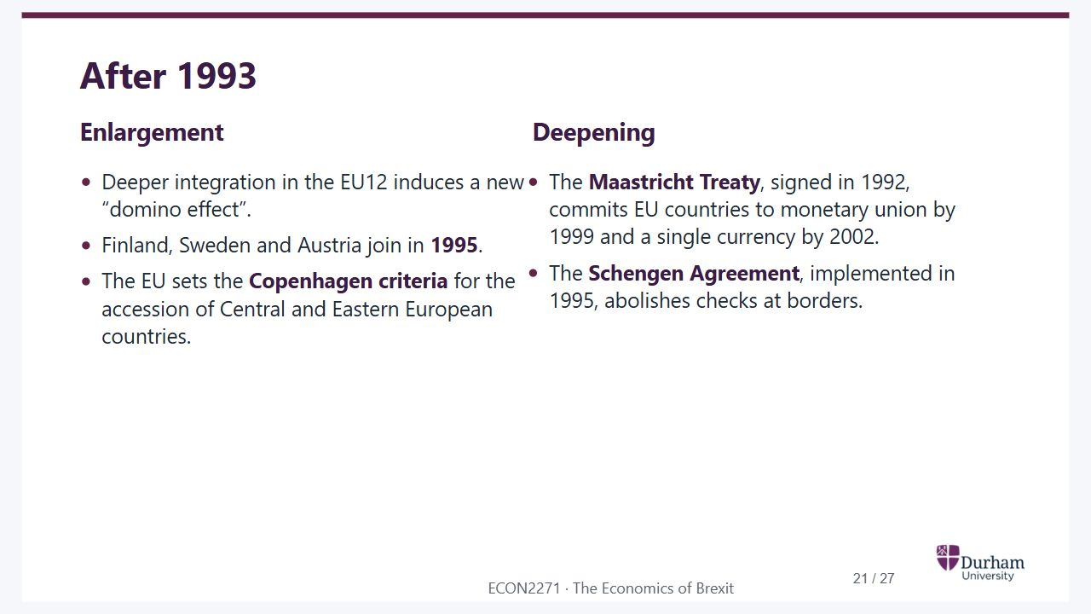
Notes:
Static student copy of the current web slide. Slide artwork is flattened; add personal notes here. Interactive explanations, playback and accessible HTML are available at:
https://davidchivers.co.uk/teaching/macro-applications/lecture_1.html#/after-1993
After 1993
Enlargement
Deeper integration in the EU12 induces a new “domino effect”.
Finland, Sweden and Austria join in 1995.
The EU sets the Copenhagen criteria for the accession of Central and Eastern European countries.
Deepening
The Maastricht Treaty, signed in 1992, commits EU countries to monetary union by 1999 and a single currency by 2002.
The Schengen Agreement, implemented in 1995, abolishes checks at borders.

Slide 22
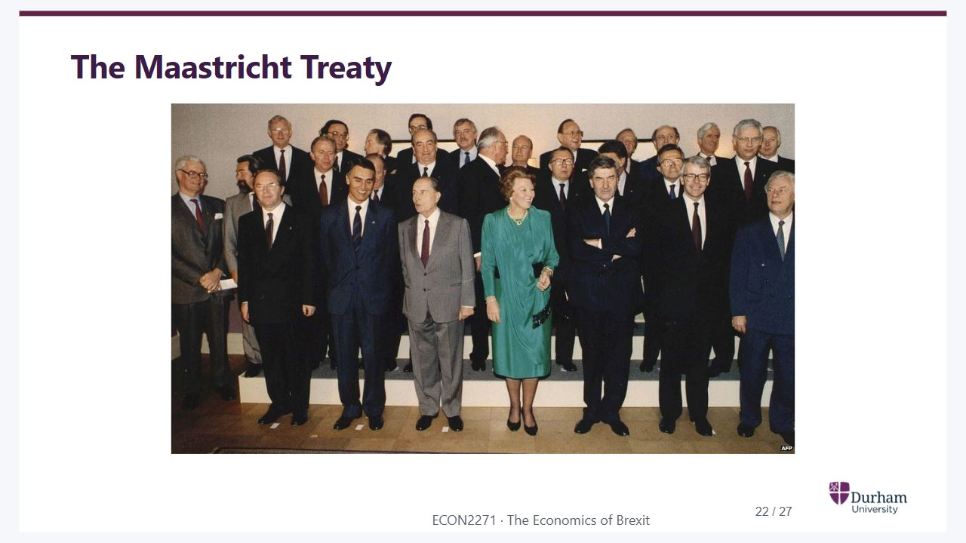
Notes:
Static student copy of the current web slide. Slide artwork is flattened; add personal notes here. Interactive explanations, playback and accessible HTML are available at:
https://davidchivers.co.uk/teaching/macro-applications/lecture_1.html#/the-maastricht-treaty
The Maastricht Treaty
Group photograph of European leaders and officials associated with the Maastricht Treaty.

Slide 23
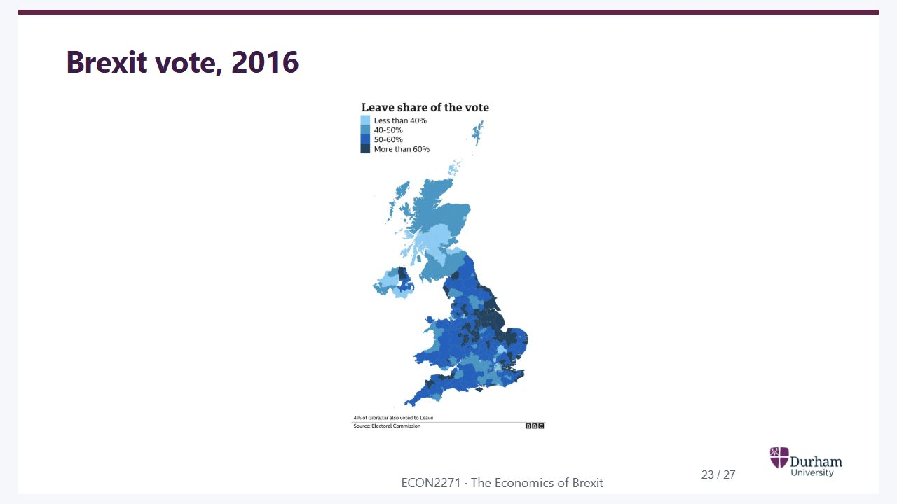
Notes:
Static student copy of the current web slide. Slide artwork is flattened; add personal notes here. Interactive explanations, playback and accessible HTML are available at:
https://davidchivers.co.uk/teaching/macro-applications/lecture_1.html#/brexit-vote-2016
Brexit vote, 2016
UK map showing the Leave share in the 2016 referendum: under 50%, 50–60%, and over 60%. Scotland and much of Northern Ireland are in the lower category, while much of England and Wales is above 50%. Local variation is visible within countries.

Slide 24
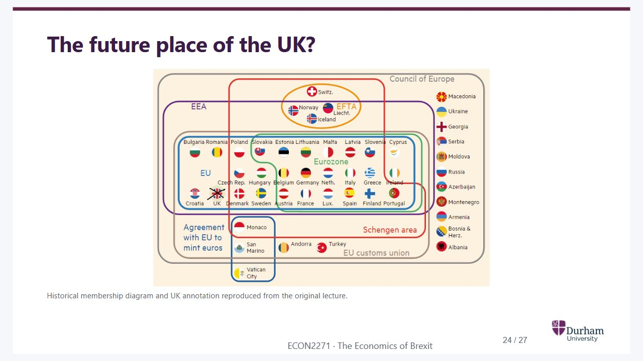
Notes:
Static student copy of the current web slide. Slide artwork is flattened; add personal notes here. Interactive explanations, playback and accessible HTML are available at:
https://davidchivers.co.uk/teaching/macro-applications/lecture_1.html#/the-future-place-of-the-uk
The future place of the UK?
Historical membership diagram and UK annotation reproduced from the original lecture.
Historical diagram of overlapping European memberships: the Council of Europe, EEA, EFTA, EU, eurozone, Schengen area and customs union. The UK's flag inside the EU is crossed out, as in the original lecture annotation. The diagram illustrates differing levels of integration rather than current membership.

Slide 25
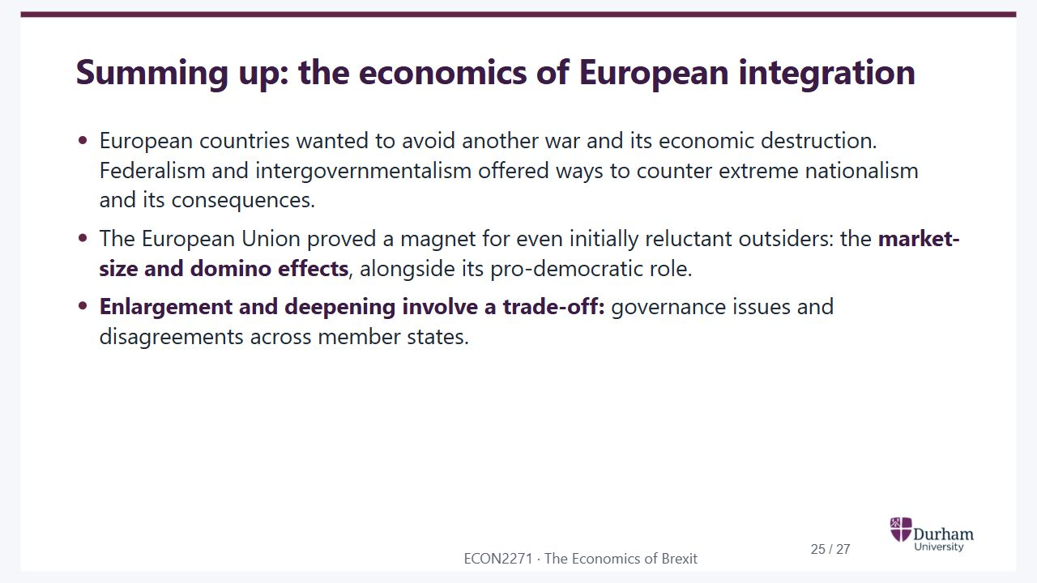
Notes:
Static student copy of the current web slide. Slide artwork is flattened; add personal notes here. Interactive explanations, playback and accessible HTML are available at:
https://davidchivers.co.uk/teaching/macro-applications/lecture_1.html#/summing-up-the-economics-of-european-integration
Summing up: the economics of European integration
European countries wanted to avoid another war and its economic destruction. Federalism and intergovernmentalism offered ways to counter extreme nationalism and its consequences.
The European Union proved a magnet for even initially reluctant outsiders: the market-size and domino effects, alongside its pro-democratic role.
Enlargement and deepening involve a trade-off: governance issues and disagreements across member states.

Slide 26
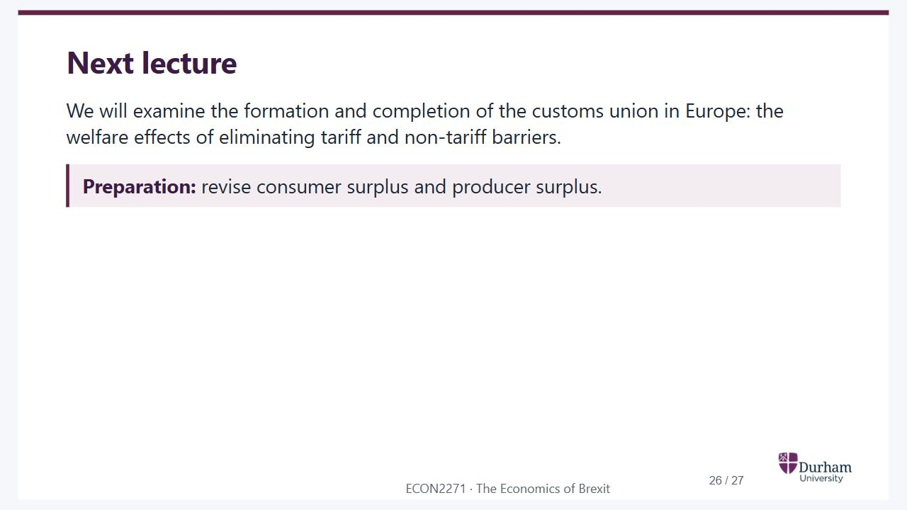
Notes:
Static student copy of the current web slide. Slide artwork is flattened; add personal notes here. Interactive explanations, playback and accessible HTML are available at:
https://davidchivers.co.uk/teaching/macro-applications/lecture_1.html#/next-lecture
Next lecture
We will examine the formation and completion of the customs union in Europe: the welfare effects of eliminating tariff and non-tariff barriers.
Preparation: revise consumer surplus and producer surplus.

Slide 27
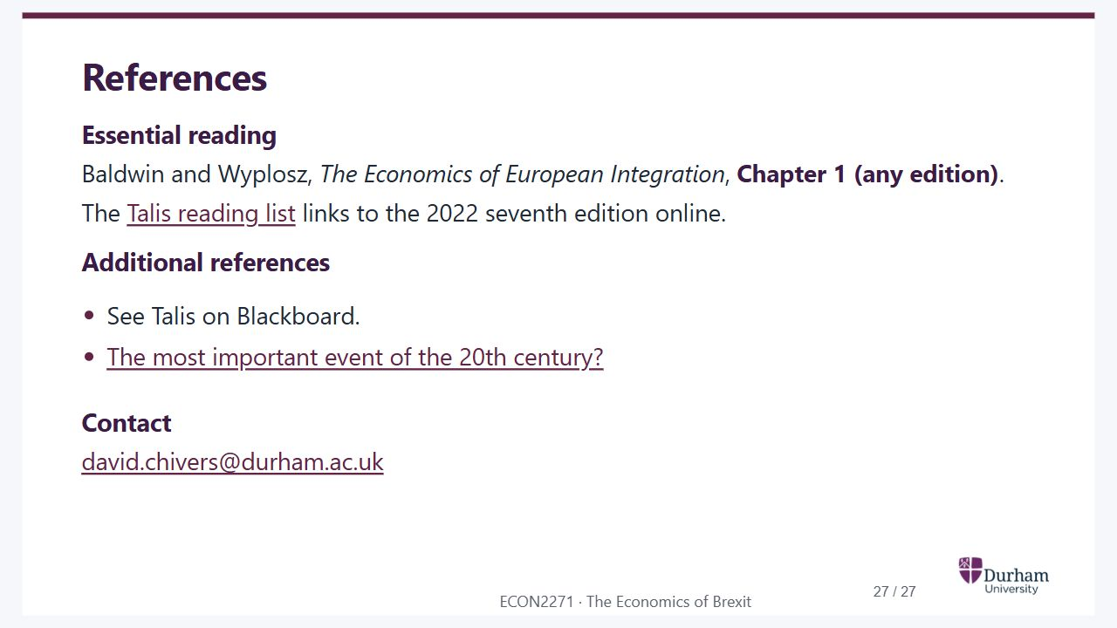
Notes:
Static student copy of the current web slide. Slide artwork is flattened; add personal notes here. Interactive explanations, playback and accessible HTML are available at:
https://davidchivers.co.uk/teaching/macro-applications/lecture_1.html#/references
References
Essential reading
Baldwin and Wyplosz, The Economics of European Integration, Chapter 1 (any edition).
The Talis reading list links to the 2022 seventh edition online.
Additional references
See Talis on Blackboard.
The most important event of the 20th century?
Contact
david.chivers@durham.ac.uk
https://durham.rl.talis.com/modules/econ2271.html
https://youtu.be/SNpCn0nAlR0?t=58

