Slide 1
IIIT - BANGALORE
LENDING CLUB CASE STUDY
BY
PENUMALA THOMSON

Slide 2
ABSTRACT
Lending Club is a lending platform that lends money to people in need at an interest rate based on their credit history and other factors.
Borrowers can easily access lower interest rate loans through a faster online interface.
Online lending services continue to grow and develop, investors behave like, and transform into, bank-like entities themselves.
Understanding the driving factors (or driver variables) behind the loan defaulters.

Slide 3
BUSINESS UNDERSTANDING
A consumer finance company which specializes in lending various types of loans to urban customers. When the company receives a loan application, the company has to make a decision for loan approval based on the applicant’s profile. Two types of risks are associated with the bank’s decision:
If the applicant is likely to repay the loan, then not approving the loan results in a loss of business to the company
If the applicant is not likely to repay the loan, i.e. he/she is likely to default, then approving the loan may lead to a financial loss for the company.

Slide 4
BUSINESS OBJECTIVE
The company wants to understand the driving factors (or driver variables) behind loan default, i.e. the variables which are strong indicators of default. The company can utilize this knowledge for its portfolio and risk assessment.
The case study focuses on EDA mainly, to understand which parameters are major to detect whether a customer will default loan or not.

Slide 5
PROBLEM SOLVING METHODOLOGY
DATA CLEANING
DATA ACKNOWLEDGEMENT
Removing the null valued columns, unnecessary variables and checking the null value percentage. And dropping all the respective columns.
Understanding and working with the data dictionary, gaining the knowledge of all the columns . And understanding the uses of specific domain.
DATA ANALYSIS
Analyzing each column, plotting the distributions of column while performing Univariate analysis.
Analyzing two variable behaviour with respect to the loan amount while performing Bivariate analysis.

Slide 6
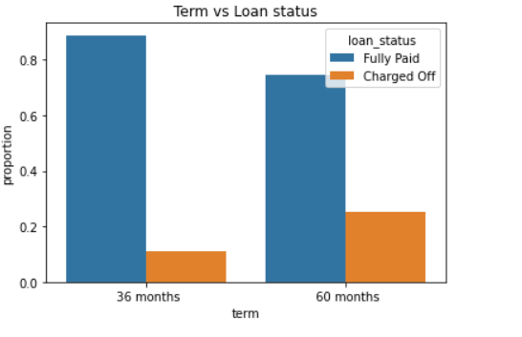
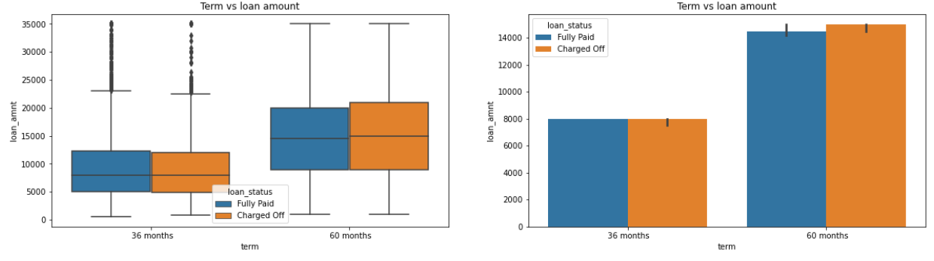
Analysis
Loan amount is not a decider for defaults in both 36 and 60 months. Borrowers have equal distribution is both default and non default for 36 and 60 months tenures.
More proportion of borrowers defaulted loan in 60 months term then 36 months. Also the Fully Paid rate is higher in 36 months tenure.

Slide 7
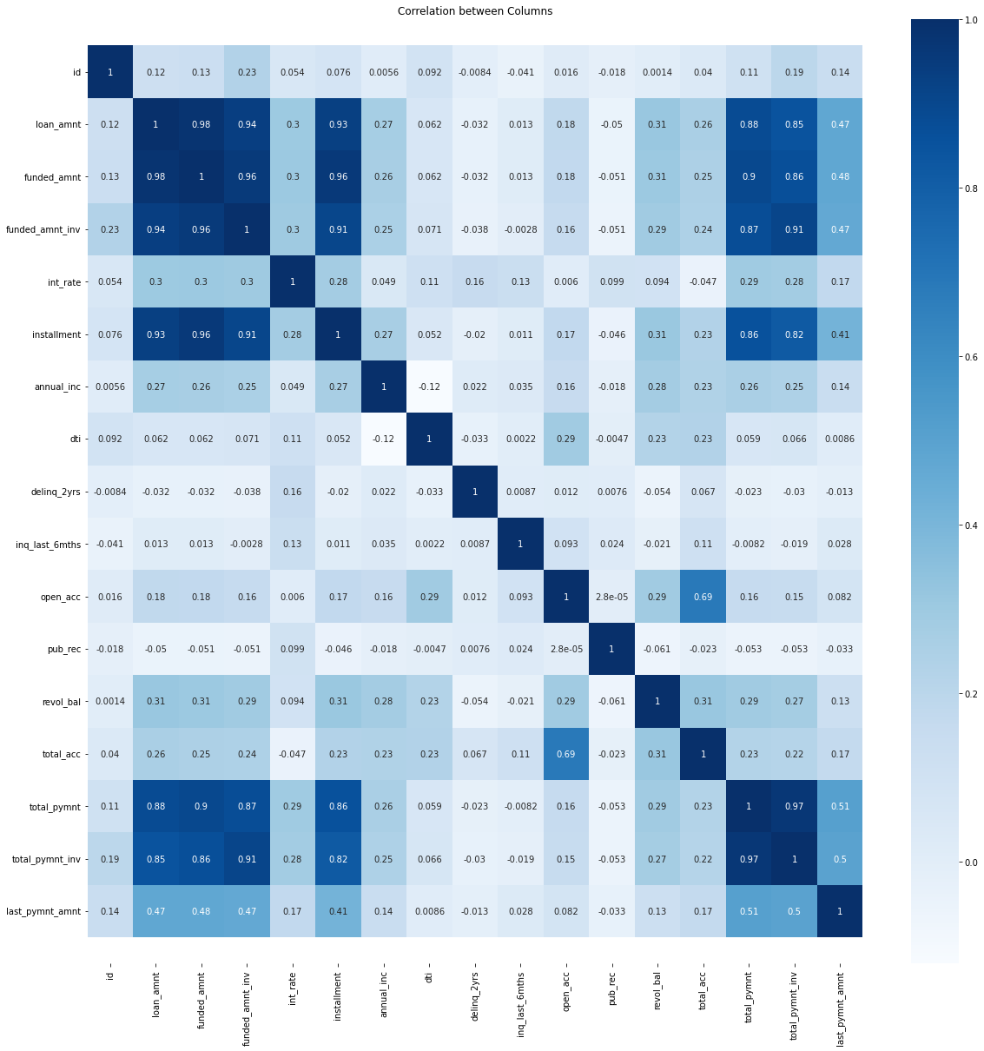

Slide 8
Conclusions
Minor Impact
Higher loan amount (above 16K)
Higher installment amount (above 327)
Lower annual income (below 37K)
Higher debt to income ratio (above 15%)
Applicant’s address state (NV, SD, AK, FL, etc.)
Loan issue month (Dec, May, Sep)
Higher interest rate (above 13%)
Higher revolving line utilization rate (above 58%)
Repayment term (5 years)
Loan grade & sub-grade (D to G)
Missing employment record
Loan purpose (small business, renewable energy, educational)
Derogatory public records (1 or 2)
Public bankruptcy records (1 or 2)
High loan amount & interest rate for lower income group
High installment and longer repayment term
Home ownership (other) and loan purpose (car, moving or small business)
Residential state and loan purpose
Income group and loan purpose
Heavy impact
Combined impact
Lending Club should reduce high interest loans for 60 months tenure, as they are prone to loan default

Slide 9
Thank you

