Slide 1
Welcome to Feed My Sheep Trust- Bangladesh
Feed my sheep is a Christian, non-denominational and non-profit organization based in Khulna, Bangladesh. It has been registered under the Office of the Registrar, Khulna, Government of People’s Republic of Bangladesh. The registration number is IV-12. It is a child-safe organization It has zero-tolerance against sexual exploitation and abuse. As a child-focused organization, it believes in Do No Harm to beneficiaries, especially children. We are dedicated to upholding the best interest of children. Jesus states Peter’s tasks in 3 words- “Feed my sheep” (John 21:17)”. Peter would understand that the “sheep” Jesus referred to were people. Peter was to lead people to the green pasture that gives everlasting life. The name (Feed My Sheep) was inspired by the Holy Bible. It was previously named J&S Building Lives and Education for children. It started its journey on January 12, 2020 with 35 children. Now we have 217 children in 4 areas.

Slide 2
Mission:
To connect people around the world to help children to thrive and excel in lives, and empower them to change their own lives and communities for a peaceful world.
Vision:
We envision all children live with equal opportunities and dignity irrespective of their caste, creed and culture.
Values:
We value the children as the best gift from God and dedicated to ensure a peaceful world for them. We are ready to response to any adversities arise.
Objectives:
The principal objective of the Trust shall be to promote compassion to children of all communities in Bangladesh also to promote spiritual and mental development, purity, integrity, holiness, Godliness and security. Besides, the Trust shall provide peaceful life to the poor people through God’s love. It’s purpose is to alleviate human suffering and distress and promote human development in all its forms.

Slide 3
Activities:
To support the poor children in their education through sponsorship programs in each of our working areas & help them to build a skillful life.
To build children home and orphanage for the children, vocational training center for the youths and old homes for the aged people.
To make hospital for the poor people so that they get medical care and facilities at lower cost, the hospital shall be named JD Hospital Private Ltd.
We encourage the youths and help them to set up clubs.
We work for adolescents to make them aware on health issues and support them through nutrition.
We engage womenfolk to make things of handicrafts through needle works.
We work for women empowerment and undertake activities which promote gender equality and disability inclusion in all aspects.
To work for the betterment of the sex worker and their children based in Dacope, Khulna.
To work for ensuring safe drinking water to the people of southern Bangladesh.
To work for food security and alternative livelihoods for coastal area people as they are the victim of climate change. We take initiatives of DRR & CCA.
To work for the marginalized farmers so that they get irrigation facilities and other supports in times of dry season.
We respond to any natural and manmade disasters occur.
We work for establishing peace.

Slide 4
Child Sponsorship Program Areas (CSPA):
Rose Child Sponsorship Program ( Aroshnagar, Dumuria, Khulna)-47 Children
Tulips Child Sponsorship Program ( Raghunathpur, Gabindaganj, Gaibandha)-47 Children
Orchids Child Sponsorship Program ( Kalinagar, Dacope, Khulna)-77 Children
Sunflower Child Sponsorship Program ( Bamandanga, Assasuni, Satkhira)- 46 Children
Supports:
Food support: A meal a day to 217 children, light Tiffin a day to 217 children
Hygiene support: Brush, Toothpaste, soap, shampoo, coconut oil, washing powder/detergent, sanitary napkin (if applicable) each month to 217 children
Educational materials: Exercise book, pen, pencil, eraser, cutter, each month to 217 children
Others: Scale, school uniform, school bag, shoes, school fee, umbrella, Christmas gift( dress), mosquito net, bed sheet one time a year to 217 children
Health screening/ check up one time a year to 217 children

Slide 5
Outcomes
The poor children will be fed. They get hygiene and educational support.
They will have better health with nutritious food.
They will have a solvent life when they finishes up their study.
They will support others the same way they have been supported.
We will establish peace in the family and in the community.

Slide 6
Budget Breakdown Child Sponsorship Program
Item: | Unit cost: | No. of Children | Cost Per Day | Cost Per Month | Cost Per Year | Remarks
Meal | $1 | 217 | $217 | $4882.50 | $58590 | 1 month=22 days(Rice, vegetables, fish, meat etc.)
Tiffin | $0.25 | 217 | $54.25 | $1220.63 | $14647.50 | Apple
Hygiene | $3.83 | 217 | - | $830 | $9960 | Brush, toothpaste, soap, shampoo, oil, detergent etc.
Educational materials | $1.38 | 217 | - | $299.46 | $3593.52 | Exercise book, pen, pencil, eraser, cutter etc.
Others | $95.38 | 217 | - | - | $20697.46 | Scale, school dress, bag, shoe, fee, umbrella, dress, mosquito et, bed cover etc.
Health screening | $3.75 | 217 | - | - | $813.75 | Check up
Grand Total |  |  | $271.25 | $7232.59 | $108302.23 | *1 US Dollar=80 BDT.

Slide 7
Youth Program
We have 10 youth groups. We preach the Bible to the youths, worship and engage them in social activities for peace building. We focus to leadership in them.
We focus to engage the womenfolk in income generating activities. This will enhance the economy and they will be empowered and come up with leadership skills and make a valuable contribution to the society.
Program Areas: Khulna-7, Satkhira-2 and Gaibandha-1
Kalinagar, Dhopadhi, Banishanta, Tildanga, Chalna in Dacope Upzilla, Khulna, Bangladesh.
Goroikhali, Paikgachha in Paikgachha Upazilla, Khulna, Bangladesh.
Borodol, Bamandanga in Assasuni Upazilla, Ssatkhira, Bangladesh
Raghunathpur in Gabindaganj Upazilaa, Gaibandha, Bangladesh
Supports:
Bible Study Center
IGA support
Needle work
Cows/goats/duck/chicken rearing
Disability Support for 3-5 youths in each groups

Slide 8
Outcomes
The youths will be good followers of Jesus Christ and future ministers, pastors will come out from there.
They will reach to the unreached who haven’t heard of Jesus Christ.
They will be solvent and help other youths in the community to be solvent.
Leadership and Entrepreneur skill will grow in them and they work relentlessly to ensure peace in the community.
Thus we will transform communities to peace, prosperity and solvency.

Slide 9
Budget Breakdown Youth Program/Ministry
Item | No. of youth groups | Unit Cost | Total Cost | Remarks
Bible Study Center | 10 | $7250 | $72500 | Semi pacca building with toilet, furniture and other facilities for 20 youths per group
IGA support | 10 | $1625 | $65000 | Crab farming/ vermi compost to 2 youths per group
Needle work (Sewing machine) | 10 | $300 | $6000 | 3 youths per group
Cow rearing | 10 | $1875 | $112500 | 3 youths per group
Disability support | 10 | $300 | $12000 | 2 disabled youths per group
Grand Total |  |  | $268000

Slide 10
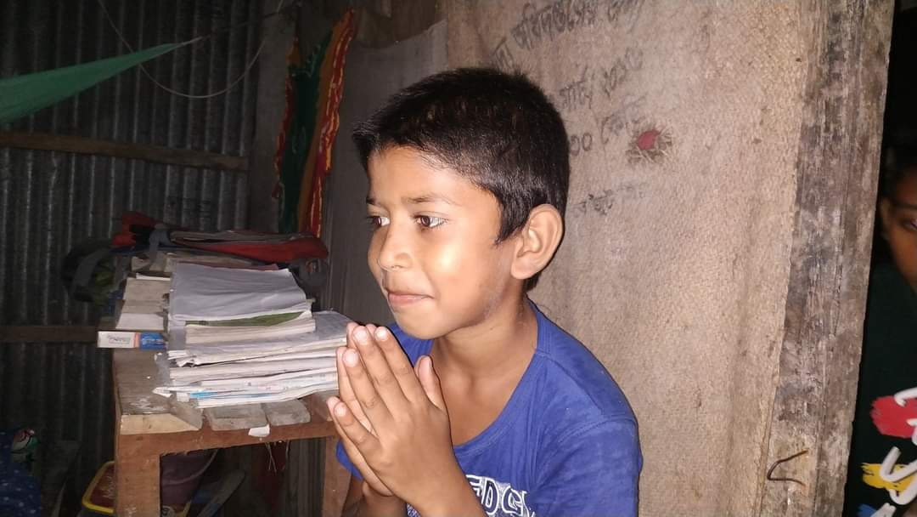
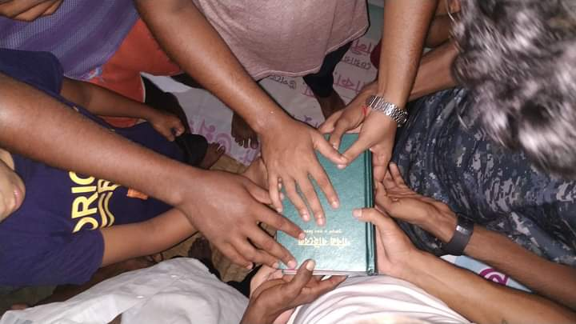
Thank you for your continuous prayer and support

