Slide 1
Bài 49
Project thực tế

Slide 2
Nội dung bài học
Viết Game bắn bóng bay, tính điểm

Slide 3
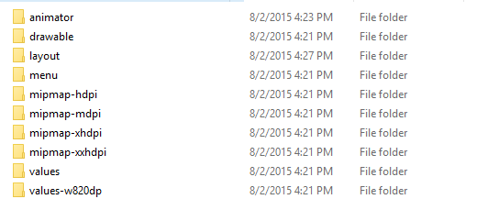
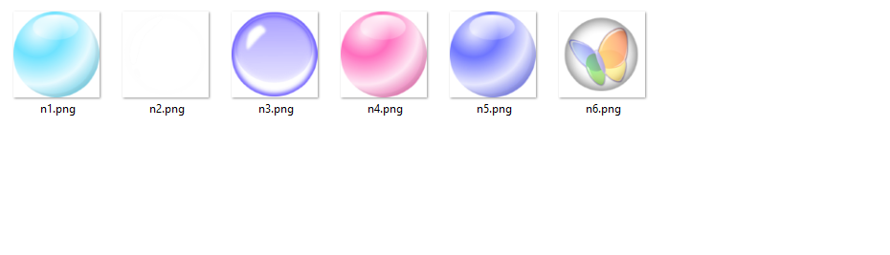
drawable

Slide 4
bubble_animation.xml (animator)
<?xml version="1.0" encoding="utf-8"?>
<objectAnimator xmlns:android="http://schemas.android.com/apk/res/android"
android:duration="3000"
android:propertyName="y"
android:repeatCount="1"
android:repeatMode="reverse"
android:valueFrom="1000"
android:valueTo="20"
>
</objectAnimator>

Slide 5
<LinearLayout xmlns:android="http://schemas.android.com/apk/res/android"
xmlns:tools="http://schemas.android.com/tools" android:layout_width="match_parent"
android:layout_height="match_parent" android:paddingLeft="@dimen/activity_horizontal_margin"
android:paddingRight="@dimen/activity_horizontal_margin"
android:orientation="vertical"
android:paddingTop="@dimen/activity_vertical_margin"
android:paddingBottom="@dimen/activity_vertical_margin" tools:context=".MainActivity">
<TextView
android:id="@+id/txtScore"
android:layout_width="match_parent"
android:layout_height="wrap_content"
android:gravity="center"
android:text="Score : 0"
android:textColor="#ffff00"
android:textAppearance="?android:attr/textAppearanceLarge"
tools:ignore="HardcodedText" />
<LinearLayout
android:id="@+id/layoutBubble"
android:layout_width="match_parent"
android:layout_height="wrap_content"
android:layout_weight="1"
android:orientation="vertical" >
</LinearLayout>
<Button
android:id="@+id/btnCreateBubble"
android:layout_width="wrap_content"
android:layout_height="wrap_content"
android:text="Create Bubble"
android:layout_gravity="center"
tools:ignore="HardcodedText" />
</LinearLayout>
MainLayout

Slide 6
public class MainActivity extends ActionBarActivity {
int score=0;
Random rd;
TextView txtscore;
LayoutParams params;
LinearLayout layoutBubble;
Button btnCreateBubble;
ObjectAnimator objectAnimator;
@Override
protected void onCreate(Bundle savedInstanceState) {
super.onCreate(savedInstanceState);
setContentView(R.layout.activity_main);
addControls();
addEvents();
}

Slide 7
private void addEvents() {
btnCreateBubble.setOnClickListener(new OnClickListener() {
@Override
public void onClick(View v) {
// TODO Auto-generated method stub
for (int i = 0; i <= rd.nextInt(5); i++) {
ProcessAnim();
}
}
});
}

Slide 8
private void addControls() {
txtscore = (TextView)
findViewById(R.id.txtScore);
rd = new Random();
layoutBubble = (LinearLayout)
findViewById(R.id.layoutBubble);
params = new LayoutParams
(
LinearLayout.LayoutParams.WRAP_CONTENT,
LinearLayout.LayoutParams.WRAP_CONTENT
);
btnCreateBubble = (Button)
findViewById(R.id.btnCreateBubble);
}

Slide 9
protected void ProcessAnim() {
// TODO Auto-generated method stub
//Drawing a bubble
ImageView img = getImageView();
img.setBackground(getDrawable());
img.setOnClickListener(new OnClickListener() {
@Override
public void onClick(View arg0) {
// TODO Auto-generated method stub
layoutBubble.removeView(arg0);
txtscore.setText("Score : "+(score+=1));
}
});
objectAnimator = (ObjectAnimator)
AnimatorInflater.
loadAnimator(MainActivity.this,
R.animator.bubble_animation);
objectAnimator.setDuration(rd.nextInt(1000)+2000);
objectAnimator.setTarget(img);
layoutBubble.addView(img,params);
objectAnimator.addListener(new Animator.AnimatorListener() {
@Override
public void onAnimationStart(Animator animation) {
// TODO Auto-generated method stub
}
@Override
public void onAnimationRepeat(Animator animation) {
// TODO Auto-generated method stub
}
@Override
public void onAnimationEnd(Animator animation) {
// TODO Auto-generated method stub
layoutBubble.removeView((View)
((ObjectAnimator)animation).getTarget());
}
@Override
public void onAnimationCancel(Animator animation) {
// TODO Auto-generated method stub
}
});
objectAnimator.start();
}

Slide 10
public ImageView getImageView()
{
ImageView img =
new ImageView(MainActivity.this);
img.setX(rd.nextInt(500));
return img;
}
public Drawable getDrawable()
{
Drawable draw;
int i = rd.nextInt(5);
switch (i) {
case 0:
draw = getResources().
getDrawable(R.drawable.n1);
break;
case 1:
draw = getResources().
getDrawable(R.drawable.n2);
break;
case 2:
draw = getResources().
getDrawable(R.drawable.n3);
break;
case 3:
draw = getResources().
getDrawable(R.drawable.n4);
break;
case 4:
draw = getResources().
getDrawable(R.drawable.n5);
break;
case 5:
draw = getResources().
getDrawable(R.drawable.n6);
break;
default:
draw = getResources().
getDrawable(R.drawable.n6);
break;
}
return draw;
}

Slide 11
Câu 1: Bổ sung chức năng Game Over khi có bất kỳ trái bóng nào rơi xuống màn hình mà ta chưa kịp nhấn vào
Câu 2: Thay thế nút createBubble thành Menu cho Level
(3 level : level 1 có 6 trái bóng, level 2 có 9, level 3 có 12)
Ứng với level thì số lượng ngẫu nhiên trái bóng sẽ khác nhau và thường chạy nhanh hơn các level thấp.
Câu 3: Hiệu chỉnh cho trái bong chạy mọi hướng trên màn hình (hiện nay chi có hướng đứng)

Slide 12


END

