Slide 1
Bài 46
Menu điều khiển tìm kiếm

Slide 2
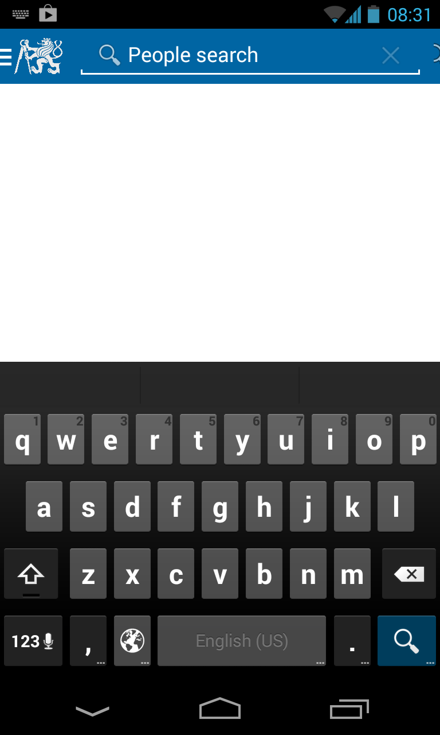
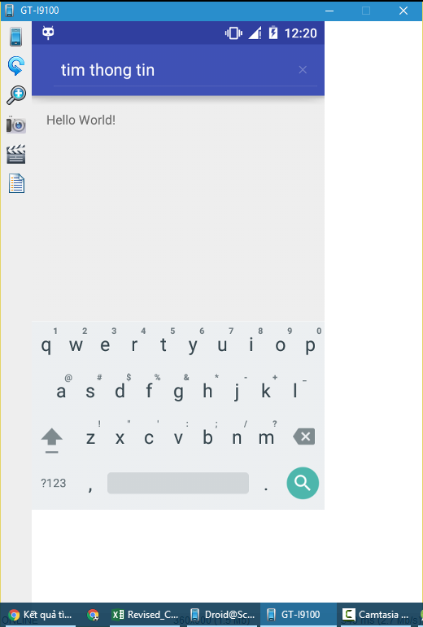
Nội dung bài học
Cách cấu hình menu về dạng điều khiển tìm kiếm SearchView

Slide 3
<menu xmlns:android="http://schemas.android.com/apk/res/android" xmlns:app="http://schemas.android.com/apk/res-auto"> <item android:id="@+id/mnu1" android:title="Test"></item> <item android:id="@+id/mnu2" android:title="Search" android:icon="@android:drawable/ic_menu_search" app:actionViewClass="android.widget.SearchView" app:showAsAction="always" ></item> </menu>

Slide 4
public boolean onCreateOptionsMenu(Menu menu) { MenuInflater inflater=getMenuInflater(); inflater.inflate(R.menu.menusearchview, menu); MenuItem item= menu.findItem(R.id.mnu2); SearchView a= (SearchView) item.getActionView(); a.setOnQueryTextListener(new SearchView.OnQueryTextListener() { @Override public boolean onQueryTextSubmit(String query) { return false; } @Override public boolean onQueryTextChange(String newText) { Toast.makeText(MainActivity.this,newText,Toast.LENGTH_LONG).show(); return false; } }); return super.onCreateOptionsMenu(menu); }

Slide 5


END

