Slide 1
Bài 62
Project thực tế

Slide 2
Nội dung bài học
Viết phần mềm tỉ giá hối đoái dựa vào dịch vụ web của vnexpress, ngân hàng đông á, vietcombank
Báo điện tử vnexpress
http://vnexpress.net/block/crawler?arrKeys[]=ty_gia
Ngân hàng Đông Á
http://dongabank.com.vn/exchange/export
Ngân hàng Vietcombank
https://www.vietcombank.com.vn/exchangerates/ExrateXML.aspx

Slide 3
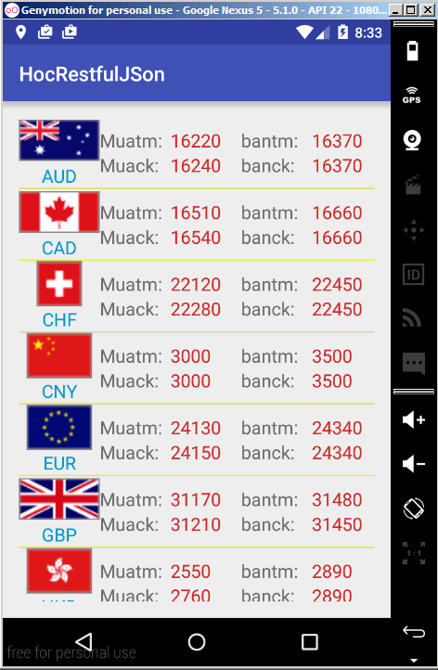

Slide 4
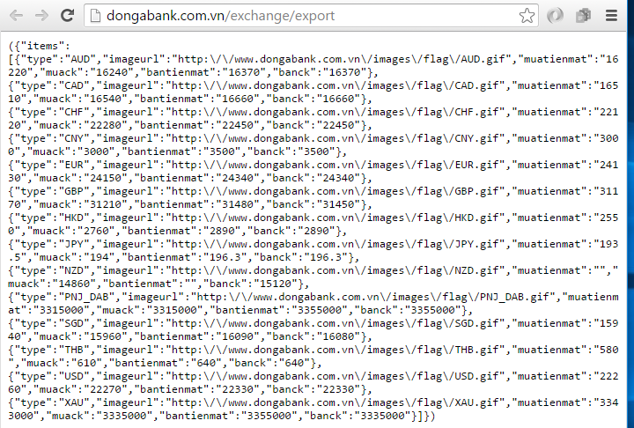

Slide 5
protected ArrayList<TiGia> doInBackground(Void... params) { ArrayList<TiGia> tiGias=new ArrayList<>(); try { URL url=new URL(Configuration.SERVER_URL); HttpURLConnection connection= (HttpURLConnection) url.openConnection(); connection.setRequestMethod("GET"); connection.setRequestProperty("Content-type", "application/json; charset=utf-8"); connection.setRequestProperty("User-Agent","Mozilla/5.0 ( compatible ) "); connection.setRequestProperty("Accept", "*/*"); //lấy dữ liệu mà server trả về InputStream is= connection.getInputStream(); InputStreamReader isr=new InputStreamReader(is,"UTF-8"); BufferedReader br=new BufferedReader(isr); String line=br.readLine(); StringBuilder builder=new StringBuilder(); while (line!=null) { builder.append(line); line=br.readLine(); } String json=builder.toString(); json=json.replace("(", ""); json=json.replace(")","");

Slide 6
JSONObject jsonObject=new JSONObject(json); JSONArray jsonArray= jsonObject.getJSONArray("items"); for (int i=0;i<jsonArray.length();i++) { JSONObject item=jsonArray.getJSONObject(i); TiGia tiGia=new TiGia(); if(item.has("type")) tiGia.setType(item.getString("type")); if(item.has("imageurl")) { tiGia.setImageurl(item.getString("imageurl")); url=new URL(tiGia.getImageurl()); connection= (HttpURLConnection) url.openConnection(); connection.setRequestMethod("GET"); connection.setRequestProperty("User-Agent","Mozilla/5.0 ( compatible ) "); connection.setRequestProperty("Accept", "*/*"); Bitmap bitmap = BitmapFactory.decodeStream(connection.getInputStream()); tiGia.setBitmapOfImageurl(bitmap); } if(item.has("muatienmat")) { tiGia.setMuatienmat(item.getString("muatienmat")); } if(item.has("muack")) { tiGia.setMuack(item.getString("muack")); } if(item.has("bantienmat")) { tiGia.setBantienmat(item.getString("bantienmat")); } if(item.has("banck")) { tiGia.setBanck(item.getString("banck")); } tiGias.add(tiGia); } Log.d("JSON_DONGA",json); } catch (Exception ex) { Log.e("LOI",ex.toString()); } return tiGias; }

Slide 7


END

