Slide 1
H2-2018 PLAN
Delivery Center 20

Slide 2
CONTENT
Introduce
Product
Future Plans

Slide 3
INTRODUCE
Learn about HTML, CSS.
Learn Javascript.
Learn basic git usage.
Study Reactjs.

Slide 4
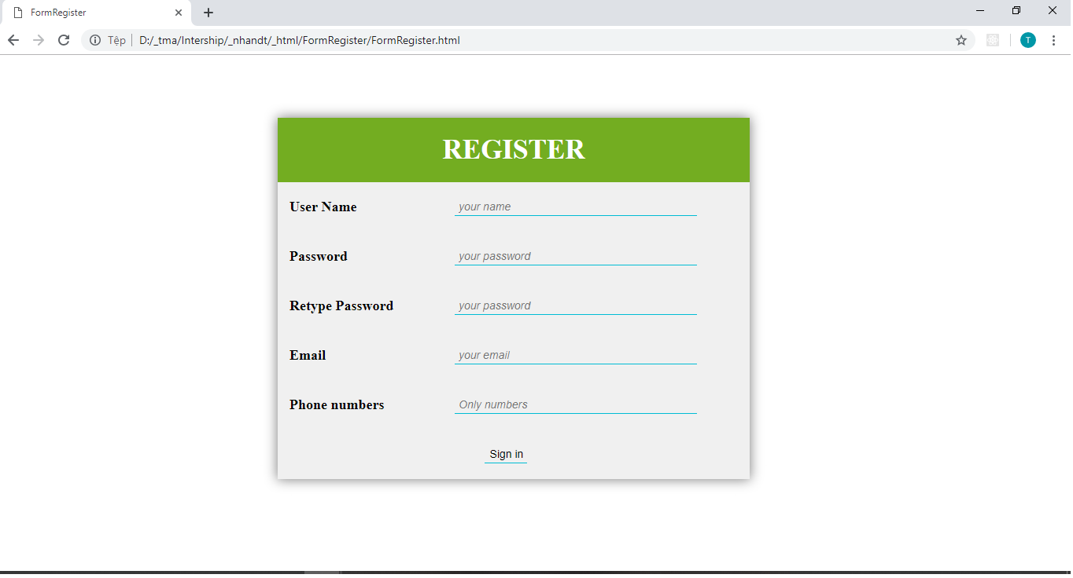
PRODUCT
The Form Register by HTML, CSS and Javascript.

Slide 5
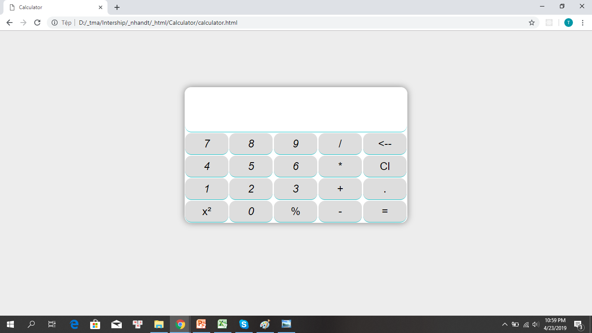
PRODUTION
The Calculator by HTML, CSS and Javascript.

Slide 6
FUTURE PLANS
In next month:
Learn more about Javascript.
Learn more about Reactjs :
Study Components and Props.
Handling event.
And more ….

