Slide 1
Form Validation

Slide 2
What is form validation?
validation: ensuring that form's values are correct
some types of validation:
preventing blank values (email address)
ensuring the type of values
integer, real number, currency, phone number, Social Security number, postal
address, email address, date, credit card number, ...
ensuring the format and range of values (ZIP code must be a 5-digit integer)
ensuring that values fit together (user types email twice, and the two must match)

Slide 3
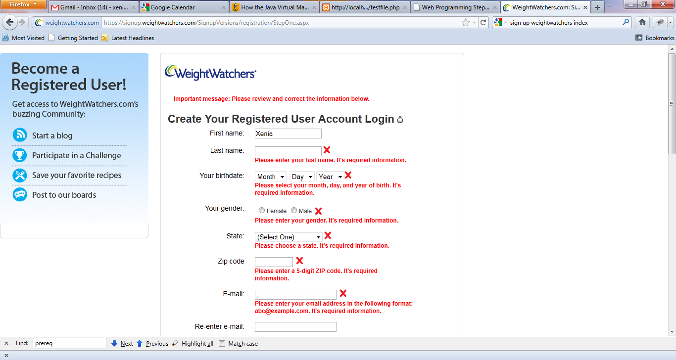
A real Form that uses validation

Slide 4
Client vs. server-side validation
Validation can be performed:
client-side (before the form is submitted)
can lead to a better user experience, but not secure (why not?)
server-side (in PHP code, after the form is submitted)
needed for truly secure validation, but slower
both
best mix of convenience and security, but requires most effort to program

Slide 5
An example form to be validated
<form action="http://foo.com/foo.php" method="get">
<div>
City: <input name="city" /> <br />
State: <input name="state" size="2" maxlength="2" /> <br />
ZIP: <input name="zip" size="5" maxlength="5" /> <br />
<input type="submit" />
</div>
</form> HTML
Let's validate this form's data on the server...

Slide 6
Basic server-side validation code
$city = $_REQUEST["city"];
$state = $_REQUEST["state"];
$zip = $_REQUEST["zip"];
if (!$city || strlen($state) != 2 || strlen($zip) != 5) {
?>
<h2>Error, invalid city/state submitted.</h2>
<?php
}
?> PHP
basic idea: examine parameter values, and if they are bad, show an error message and abort
Notes:
Maybe delete the comments that give out the output

Slide 7
Basic server-side validation code
validation code can take a lot of time / lines to write
How do you test for integers vs. real numbers vs. strings?
How do you test for a valid credit card number?
How do you test that a person's name has a middle initial?
How do you test whether a given string matches a particular complex format?

Slide 8
Regular expressions
[a-z]at #cat, rat, bat…
[aeiou]
[a-zA-Z]
[^a-z] #not a-z
[[:alnum:]]+ #at least one alphanumeric char
(very) *large #large, very very very large…
(very){1, 3} #counting “very” up to 3
^bob #bob at the beginning
com$ #com at the end PHPRegExp
Regular expression: a pattern in a piece of text
PHP has:
POSIX
Perl regular expressions
Notes:
regular expression ("regex"): a description of a pattern of text
can test whether a string matches the expression's pattern
can use a regex to search/replace characters in a string
regular expressions are extremely powerful but tough to read (the above regular expression matches email addresses)
regular expressions occur in many places:
Java: Scanner, String's split method (CSE 143 sentence generator)
supported by PHP, JavaScript, and other languages
many text editors (TextPad) allow regexes in search/replace

Slide 9
Delimiters
/[a-z]/at #cat, rat, bat…
#[aeiou]#
/[a-zA-Z]/
~[^a-z]~ #not a-z
/[[:alnum:]]+/ #at least one alphanumeric char
#(very) *#large #large, very very very large…
~(very){1, 3}~ #counting “very” up to 3
/^bob/ #bob at the beginning
/com$/ #com at the end
/http:\/\
// #http://# #better readability PHPRegExp
Used for Perl regular expressions (preg)
Notes:
Maybe delete the comments that give out the output

Slide 10
Basic Regular Expression
/abc/
in PHP, regexes are strings that begin and end with /
the simplest regexes simply match a particular substring
the above regular expression matches any string containing "abc":
YES: "abc", "abcdef", "defabc", ".=.abc.=.", ...
NO: "fedcba", "ab c", "PHP", ...

Slide 11
Wildcards
A dot . matches any character except a \n line break
"/.oo.y/" matches "Doocy", "goofy", "LooNy", ...
A trailing i at the end of a regex (after the closing /) signifies a case-insensitive match
"/xen/i" matches “Xenia", “xenophobic", “Xena the warrior princess", “XEN technologies” ...

Slide 12
Special characters: |, (), ^, \
| means OR
"/abc|def|g/" matches "abc", "def", or "g"
There's no AND symbol. Why not?
() are for grouping
"/(Homer|Marge) Simpson/" matches "Homer Simpson" or "Marge Simpson"
^ matches the beginning of a line; $ the end
"/^<!--$/" matches a line that consists entirely of "<!--"

Slide 13
Special characters: |, (), ^, \
\ starts an escape sequence
many characters must be escaped to match them literally: / \ $ . [ ] ( ) ^ * + ?
"/<br \/>/" matches lines containing <br /> tags

Slide 14
Quantifiers: *, +, ?
* means 0 or more occurrences
"/abc*/" matches "ab", "abc", "abcc", "abccc", ...
"/a(bc)*/" matches "a", "abc", "abcbc", "abcbcbc", ...
"/a.*a/" matches "aa", "aba", "a8qa", "a!?_a", ...
+ means 1 or more occurrences
"/a(bc)+/" matches "abc", "abcbc", "abcbcbc", ...
"/Goo+gle/" matches "Google", "Gooogle", "Goooogle", ...
? means 0 or 1 occurrences
"/a(bc)?/" matches "a" or "abc"

Slide 15
More quantifiers: {min,max}
{min,max} means between min and max occurrences (inclusive)
"/a(bc){2,4}/" matches "abcbc", "abcbcbc", or "abcbcbcbc"
min or max may be omitted to specify any number
{2,} means 2 or more
{,6} means up to 6
{3} means exactly 3

Slide 16
Character sets: []
[] group characters into a character set; will match any single character from the set
"/[bcd]art/" matches strings containing "bart", "cart", and "dart"
equivalent to "/(b|c|d)art/" but shorter
inside [], many of the modifier keys act as normal characters
"/what[!*?]*/" matches "what", "what!", "what?**!", "what??!",
What regular expression matches DNA (strings of A, C, G, or T)?
Notes:
"/[ACGT]+/"

Slide 17
Character ranges: [start-end]
inside a character set, specify a range of characters with -
"/[a-z]/" matches any lowercase letter
"/[a-zA-Z0-9]/" matches any lower- or uppercase letter or digit
an initial ^ inside a character set negates it
"/[^abcd]/" matches any character other than a, b, c, or d

Slide 18
Character ranges: [start-end]
inside a character set, - must be escaped to be matched
"/[+\-]?[0-9]+/" matches an optional + or -, followed by at least one digit
What regular expression matches letter grades such as A, B+, or D- ?
Notes:
"/[ABCDF][+\-]?/"

Slide 19
Escape sequences
special escape sequence character sets:
\d matches any digit (same as [0-9]); \D any non-digit ([^0-9])
\w matches any “word character” (same as [a-zA-Z_0-9]); \W any non-word
char
\s matches any whitespace character ( , \t, \n, etc.); \S any non-whitespace
What regular expression matches dollar amounts of at least $100.00 ?
Notes:
"/\$\d{3,}\.\d{2}/"

Slide 20
Regular expressions in PHP (PDF)
regex syntax: strings that begin and end with /, such as "/[AEIOU]+/"
function | description
preg_match(regex, string) | returns TRUE if string matches regex
preg_replace(regex, replacement, string) | returns a new string with all substrings that match regex replaced by replacement
preg_split(regex, string) | returns an array of strings from given string broken apart using the given regex as the delimiter (similar to explode but more powerful)

Slide 21
Regular expressions example
echo preg_match ('/test/', "a test of preg_match");
echo preg_match ('/tutorial/', "a test of preg_match");
$matchesarray[0] = "http://www.tipsntutorials.com/" $matchesarray[1] = "http://" $matchesarray[2] = "www.tipsntutorials.com/"
preg_match ('/(http://)(.*)/', "http://www.tipsntutorials.com/", $matchesarray) PHP
Notes:
What is the output?

Slide 22
Regular expressions example
# replace vowels with stars
$str = "the quick brown fox";
$str = preg_replace("/[aeiou]/", "*", $str);
# "th* q**ck br*wn f*x"
# break apart into words
$words = preg_split("/[ ]+/", $str);
# ("th*", "q**ck", "br*wn", "f*x")
# capitalize words that had 2+ consecutive vowels
for ($i = 0; $i < count($words); $i++) {
if (preg_match("/\\*{2,}/", $words[$i])) {
$words[$i] = strtoupper($words[$i]);
}
} # ("th*", "Q**CK", "br*wn", "f*x") PHP
Notes:
What is the output?
notice how \ must be escaped to \\

Slide 23
PHP form validation w/ regexes
$state = $_REQUEST["state"];
if (!preg_match("/[A-Z]{2}/", $state)) {
?>
<h2>Error, invalid state submitted.</h2>
<?php
} PHP
using preg_match and well-chosen regexes allows you to quickly validate query parameters against complex patterns
Notes:
What is the output?
notice how \ must be escaped to \\

Slide 24
Another PHP experiment
Write a PHP script that tests whether an e-mail address is input correctly. Test using valid and invalid addresses
Use array
Use function

