Slide 1
Global Migration of Refugees Since WWII
Ramsey Aweti, Jason Becker, Thong Bui, Haroon Choudery
Notes:
Final Presentations (Week 14)
You will give a demonstration of your visualization in action for your classmates during the discussion section. Like the mid-term presentations, you will have 15 minutes. This demonstration is your chance to show your fellow students how far your design has come since the mid-term milestone. Tell us what you changed and why. You must include details and conclusions from at least one round of usability testing (with at least three different subjects).Tell how your design changed (or will change) in response to your findings. Also address your choice of tools for building the final interactive visualization. All team members must participate in the presentation.

Slide 2
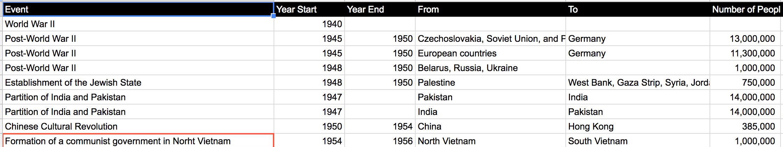
Dataset
Original data: 75 years of major refugee crises around the world https://www.washingtonpost.com/graphics/world/historical-migrant-crisis/
We extracted the data:
Notes:
Thong: Discussion points:
The dataset we are using are based on Ramsey’s recommendation of this Washington Post article which shows 75 years of major refugee crises around the world
The data in the article was extracted manually through UN archives and other historical documents. The benefit here is that much of the dirty work was already done for us. However, it is not always clear where the refugees ended up post-migration. Additionally, in instances when they spread to multiple countries or across a continent, the breakdown of what percentage ended up where is not specified.
This requires us to spend more time researching on these events.
Next, Ramsey will go through the iterations of design of our project

Slide 3
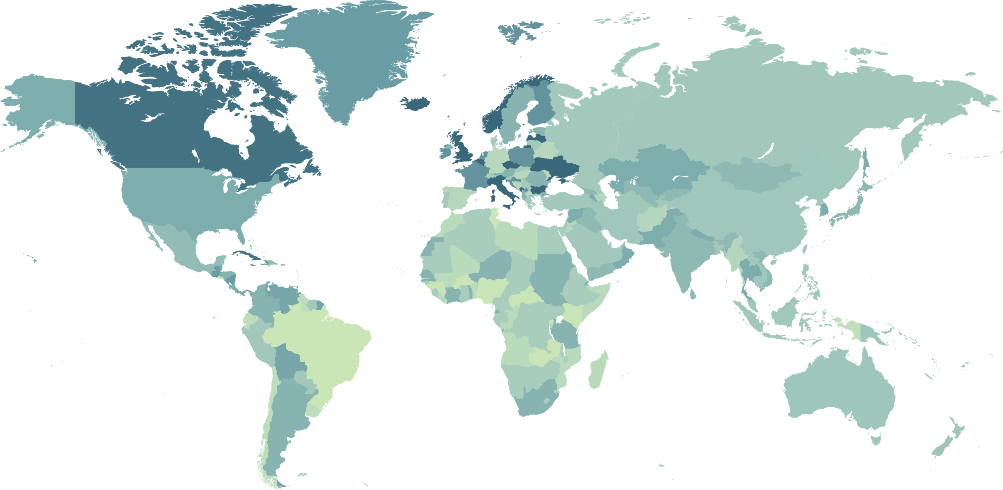

Design Mockup
Post WWII Migration
Sample US Migration
India-Pakistan Partition (1947) - Division of two provinces based on Hindu or Muslim majorities (wiki)
Refugee Count:
50,000
Event:
Uganda Expulsion Order
Uganda Expulsion Order
1940
Notes:
Map of globe
Timeline controls (stepwise vs continuous)
Arcs to show migration
Tool tips - to display more about a specific cause of migration
Conflict summary text box, link to background
TBD: This is just the initial design ideas. As we move into implementation,
Jason

Slide 4
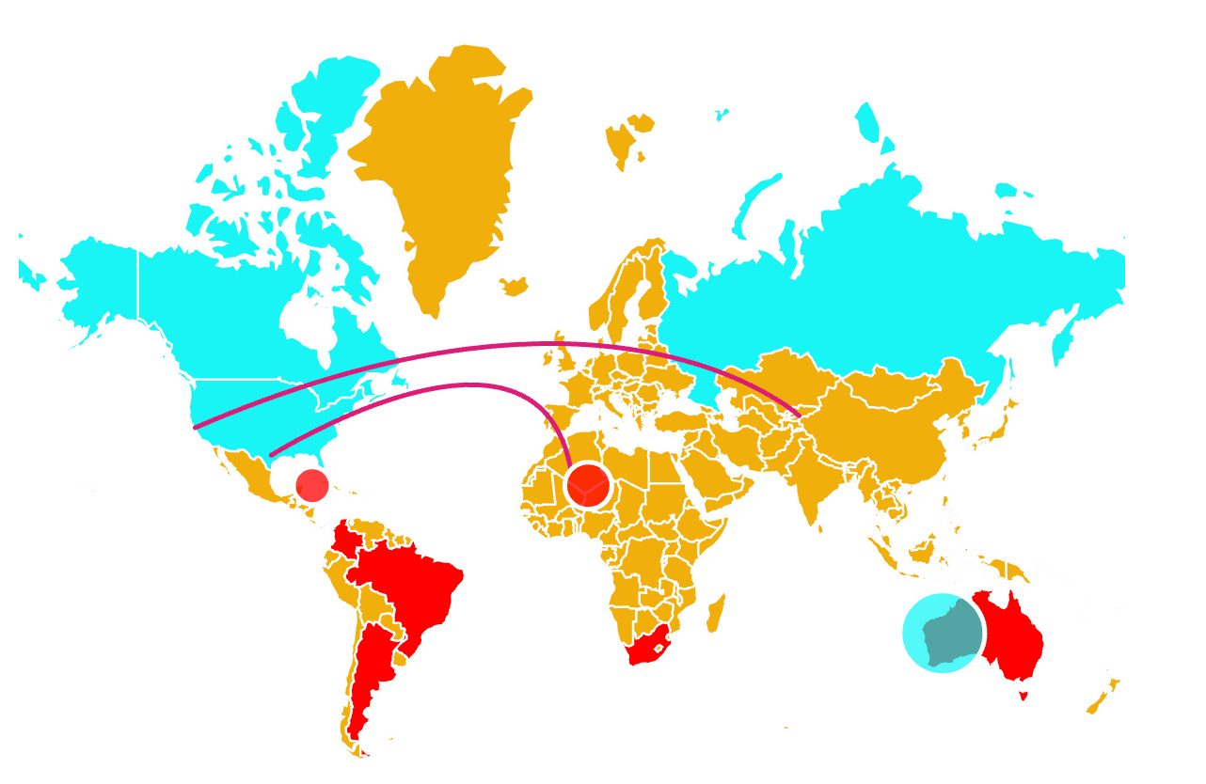
Iterations of Design
http://jsbin.com/nutawiboci/1/edit?html,js,output
Notes:
Example of easy to implement JS maps
Ramsey

Slide 5
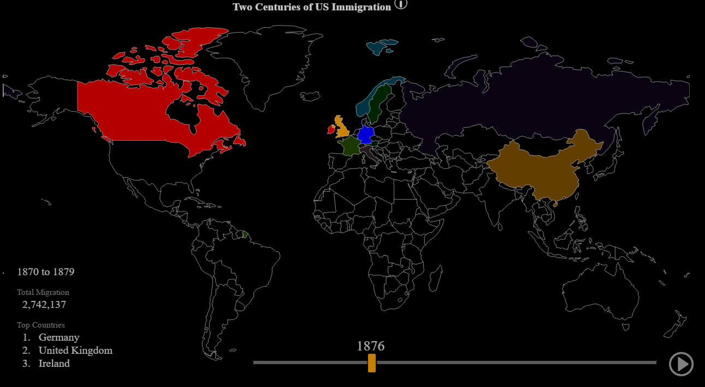
Iterations of Design
http://metrocosm.com/us-immigration-history-map.html
Notes:
https://docs.google.com/document/d/1mfZql-dMiPlm2TcQo7FjINxhgPs5oemLax_jwVVuEdM/edit
We are starting with the existing design from metrocosm.com
Pros:
Clean, elegant viz to tell story of US migration history since 1870
Informative with top countries
Cons:
US-only data viz
Only show top 3 countries
Doesn’t show the event details
Jason

Slide 6
Issues encountered
Since the midterm presentation, we had addressed many outstanding issues:
Difficulty understanding the existing code
How to draw multiple migration paths from a country
Linking events and the corresponding migration paths
How to control number of dots for migration
Solutions:
New implementations to address all these issues.
Follow minimalist coloring principle
More details are documented here
Code repo: https://github.com/ramseynoj/history_of_refugee_migration
Notes:
Thong: Since the midterm presentation, we had addressed many outstanding issues. Here are the major ones:
Difficulty understand the existing code, specifically how the data objects
How to draw multiple migration paths from a country
Linking events and the corresponding migration paths
How to control number of dots for migration
Solutions:
We have replaced the existing code with our new implementations to address all these issues:
code to generate the paths between 2 points in the map
multiple migration paths
Calculate dots to represent the migration population
Link and color-code the top 3 events and their corresponding migration paths
We follow the minimalist coloring principle: only use colors when necessary to draw attention to the migration paths and events
More details are documented here
Code repo: https://github.com/ramseynoj/history_of_refugee_migration
We also benefited a great deal from the feedback of the usability testing. On the next slide, Jason will talk more about it

Slide 7
Usability Feedback (Subject 1)
Difficulty to link top events to the actual dot movements
Any connections between India turning blue and other blue dots? US light up?
1970: Uganda dots stop in US or Canada?
Decades go by fast; it's hard to see all the migrations occur during that time
Total migration for the current decade?
Missing migration for "Jewish state establishment"
What's the visualization about?
Event texts mixed up with time slider
More details here

Slide 8
Addressing Usability Feedback
We slowed down the speed of the animations to 50%
Added hyperlinks to migration events for more info
Matched dot color to color of country on map and migration event text
More details here

Slide 9
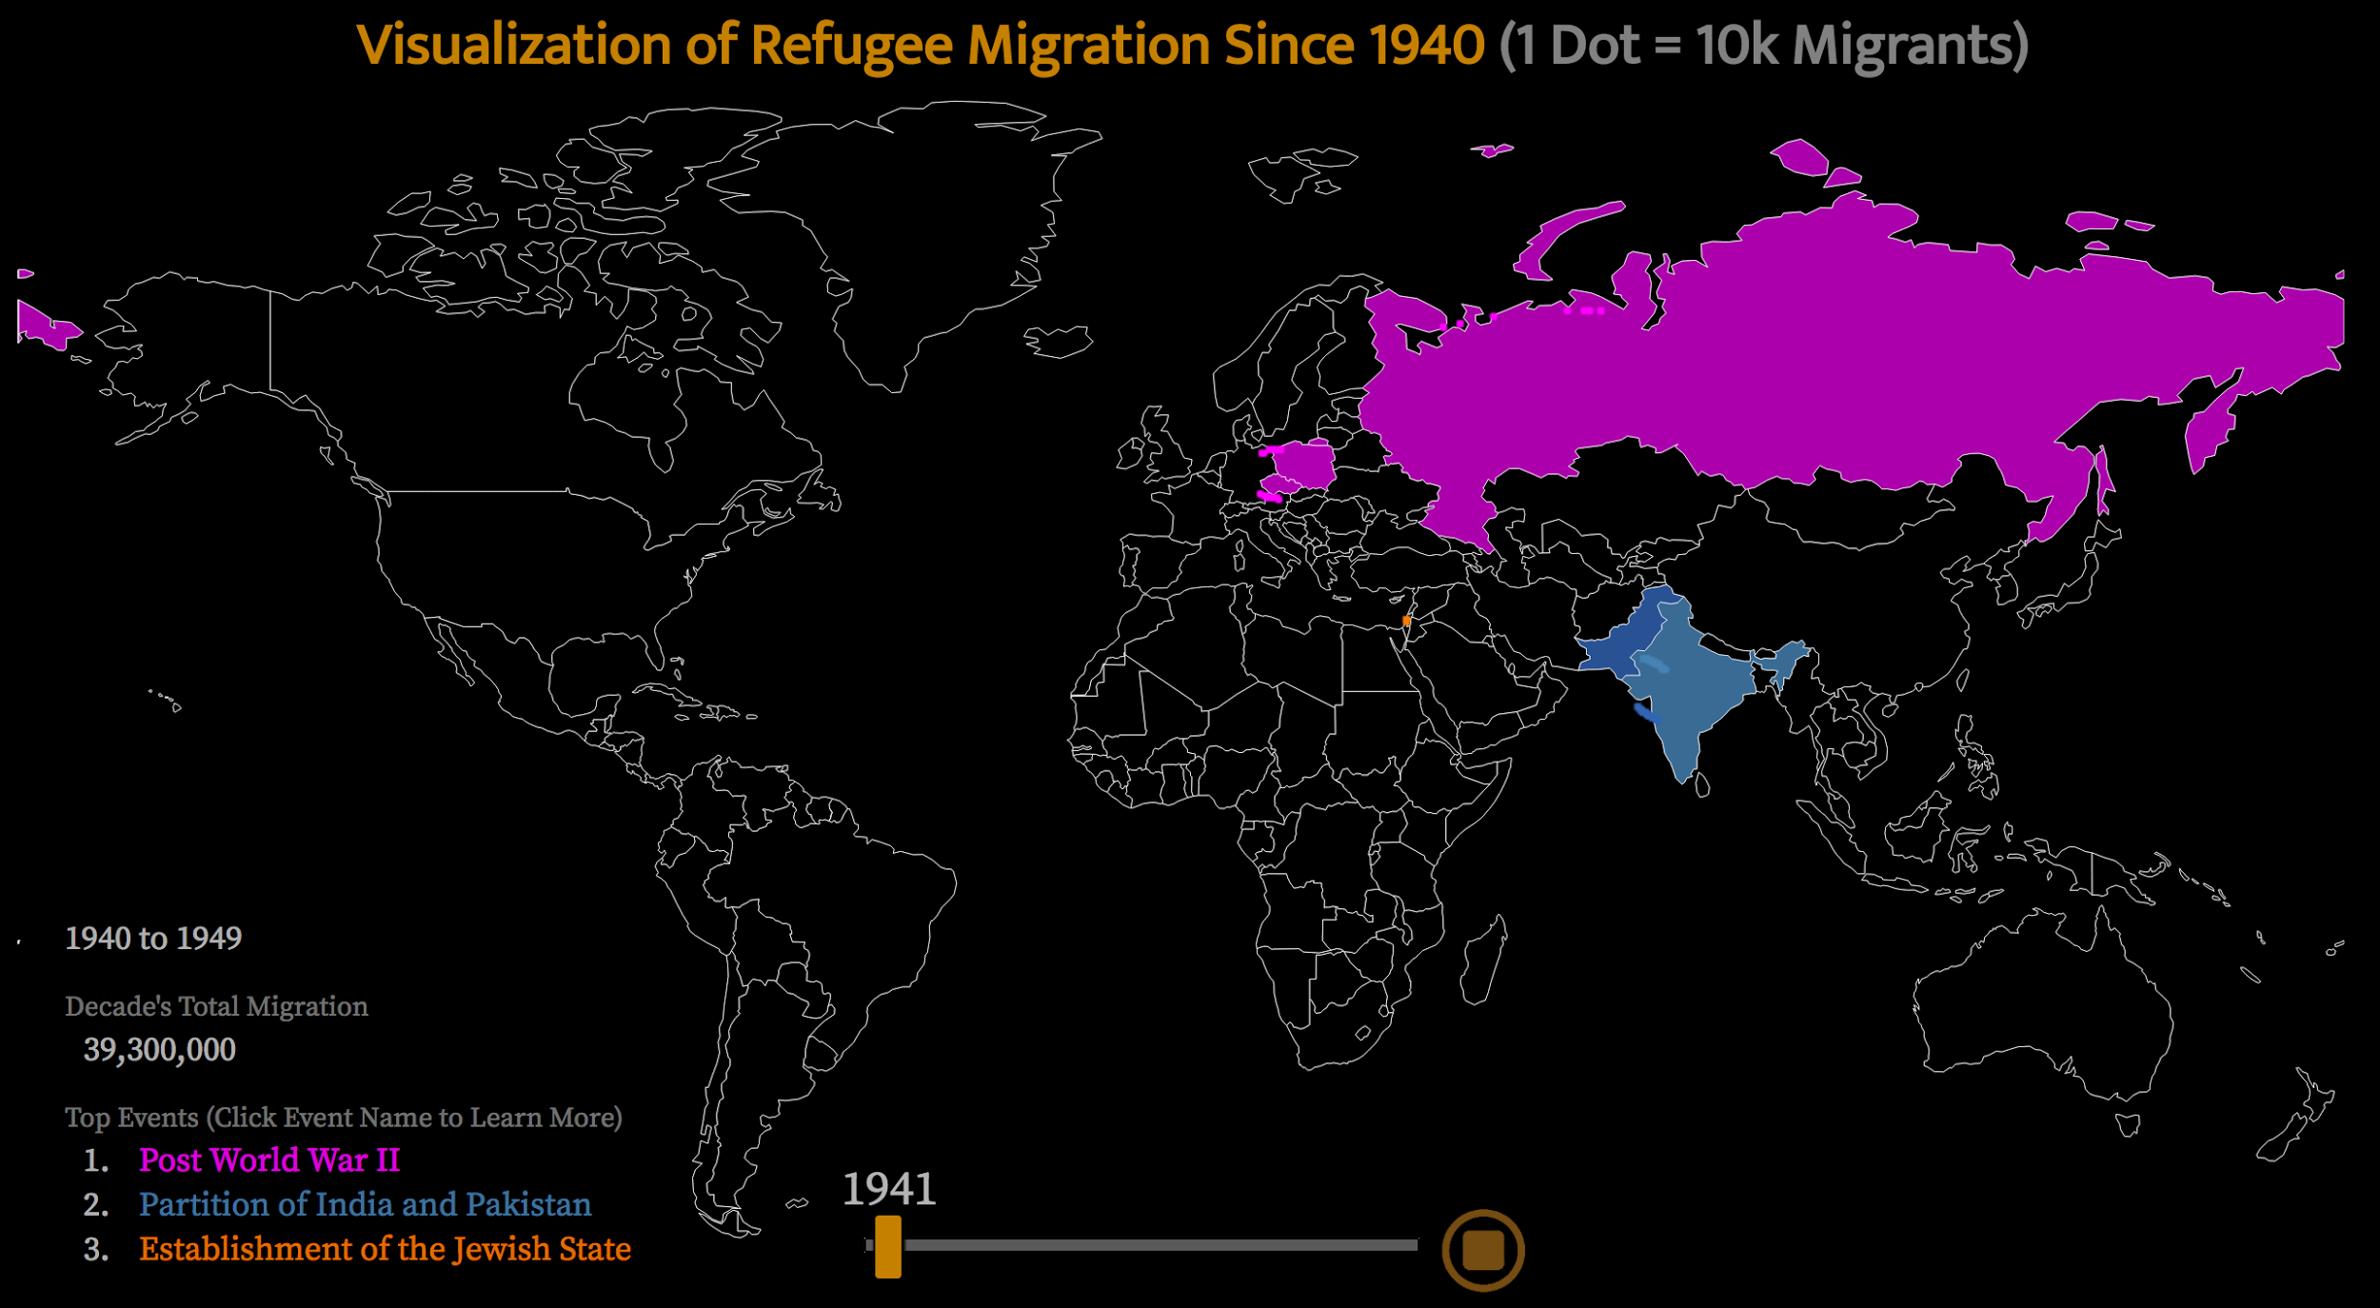
Final Product
https://ramseynoj.github.io/history_of_refugee_migration/metrocosm/imigration-paths.html

