Slide 1
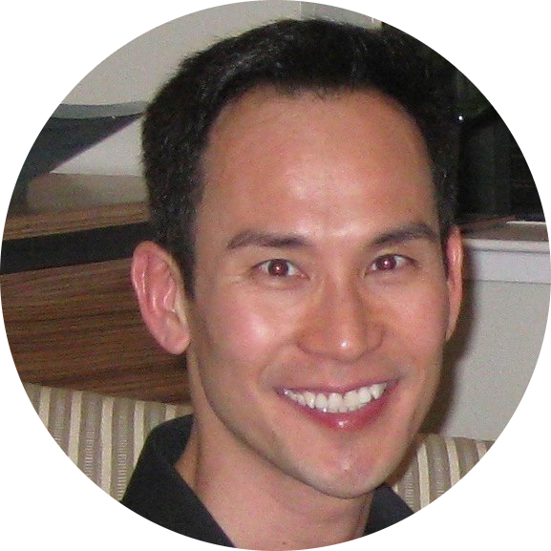

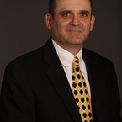
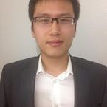

A Cloud Solution for Telemetry Data
Monday April 24th, 2017
Thong Bui
Roy Gvirtsman
Geoffrey Link
Zhongqiao Jin
Happiness Munedzimwe

Slide 2
What is Telemetry?
A collection of sensor reads over time
Regular or Irregular Reads (eg., storm outages)
Key-Value pairs: { “point”: 180, “epoch”: 1234567, “value”: 14.6}
Examples: Temperature, Wind Direction, Alerts, GPS Coordinates

Slide 3
How is Telemetry used?
Monitor and Control
SCADA or Supervisory Control and Data Acquisition
Alerts, Troubleshooting, Emergency Response
Operational efficiency: KPI, Decision Support
Predictive maintenance

Slide 4
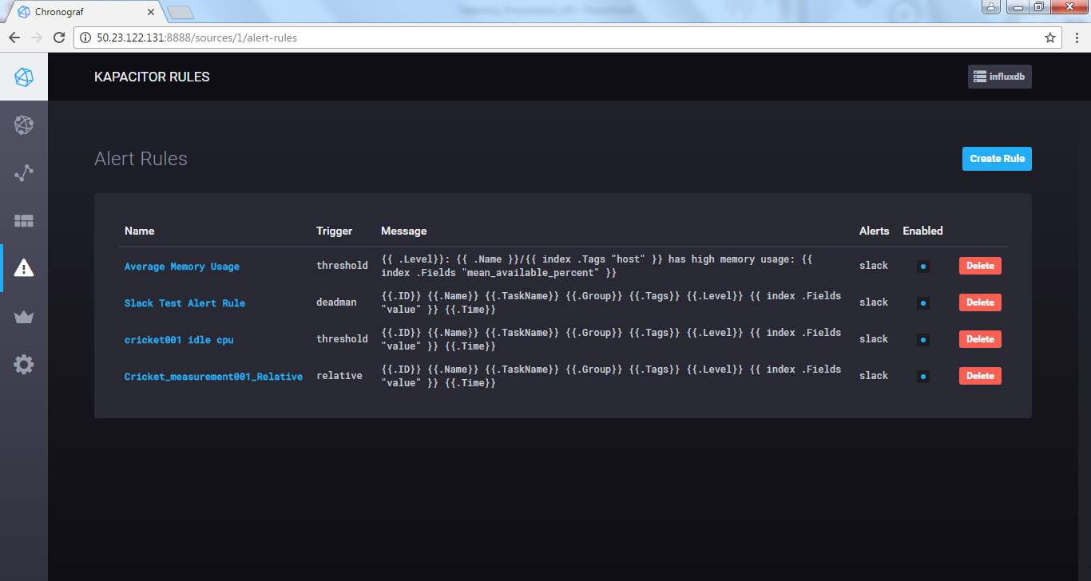
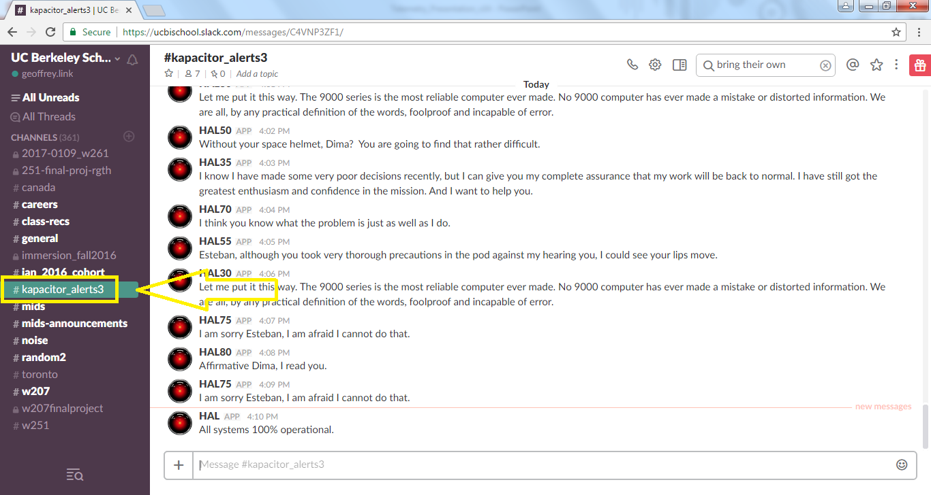
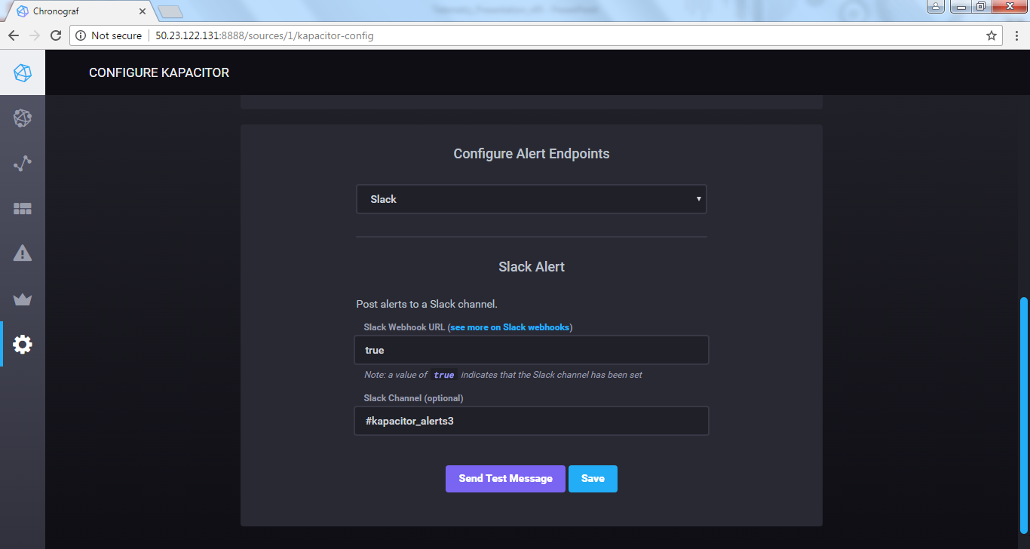
KAPACITOR & SLACK
Kapacitor Alerting Rules

Slide 5
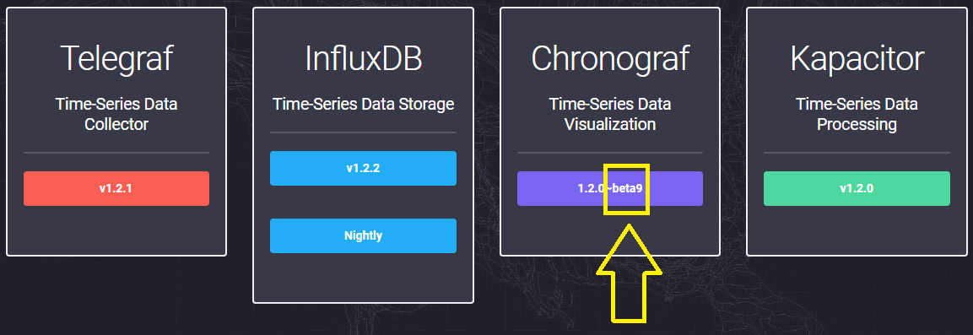
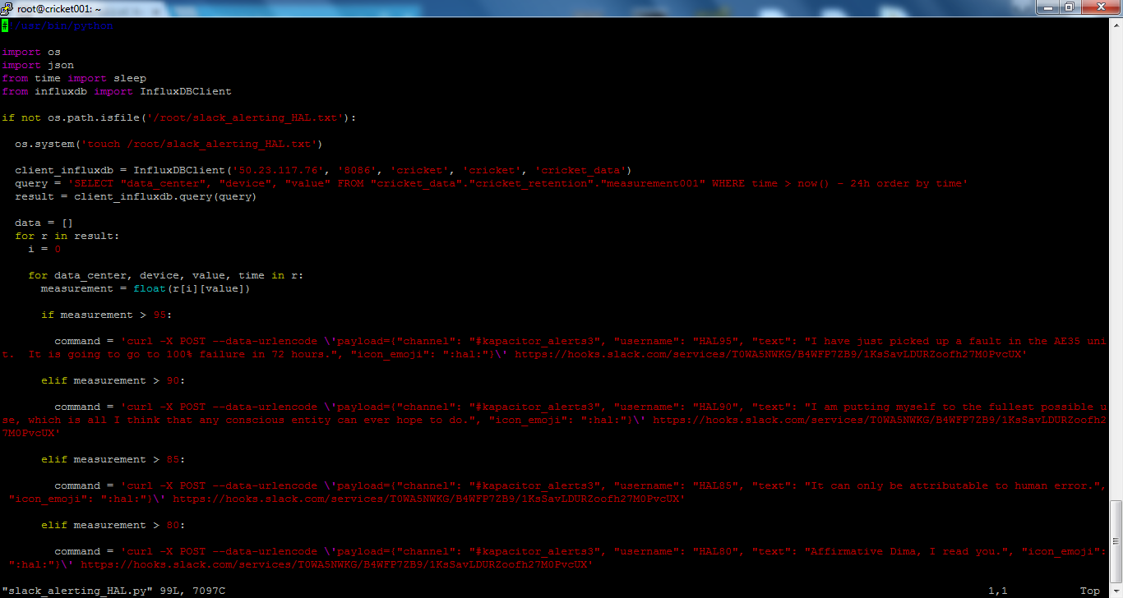
KAPACITOR & SLACK (OpenSource Lessons Learned)
Hence, build your own SLACK alerting:
kapacitor_alerts3 Slack Channel

Slide 6
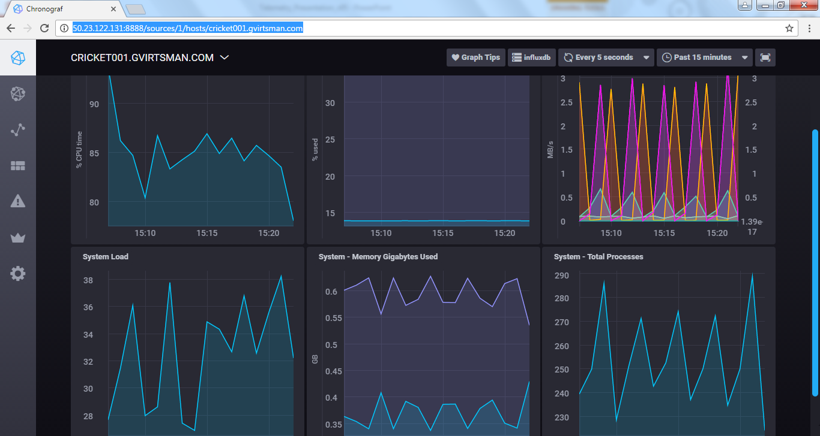
Target Audience & Usage
Chronograf Host List
Remote Operators
Respond to alerts
Troubleshoot and recover from equipment failures
Operations Manager
Monitor operator efficiency
Quantify lost opportunity
Preventative maintenance
Handle escalated operational issues
Market scheduler
Profitability
Respond to grid operator’s instructions
Cricket001

Slide 7
Project Objectives
Create a reporting framework that has the ability to ingest billions of reads from tens of thousands of devices (noisy crickets)
Easily scalable
Fully Hosted in the Cloud (Zero Cap-Ex Platform)
Use only open-source tools
Each device (or cricket) will emit a basic output that can be transmitted over Radio Frequency or Wi-Fi or Cellular

Slide 8
Data processing requirements
Data Generation (Python Crickets and Softlayer)
Data Summarization (Grafana)
Graphing and Reporting (Chronograf and D3.js)
Retention policy (InfluxDB, 365 Days)
Resilient and Scalable (InfluxDB, n-nodes)
Event Subscription (Slack instead of email)
Alerts and Notifications (Telegraf and Kapacitor)
Predictive Maintenance (K-Means and Neural Networks)

Slide 9

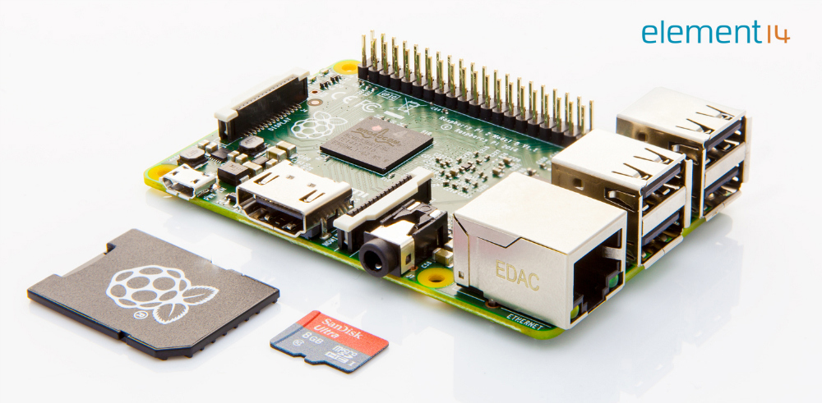
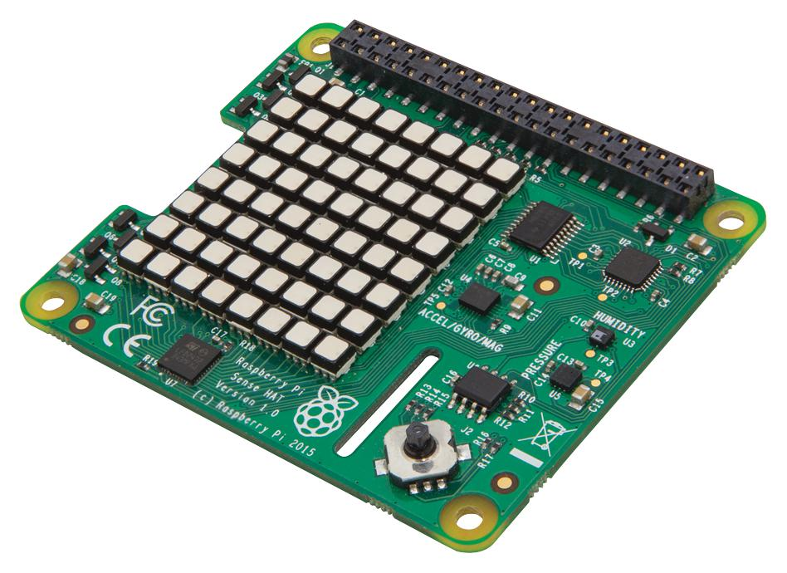
What is a cricket? Edge Computing!
A Cricket is a device that can transmit data over Radio Frequency or Wi-Fi or Cellular
A common example is the highly versatile Raspberry Pi ($30).
Raspberry Pi Sense HAT with Orientation, Pressure, Humidity, and Temperature Sensors ($30).
In a peer-to-peer network, adding more “load” – or participants in the network – does not require any additional resources as each participant brings their own resources.

Slide 10
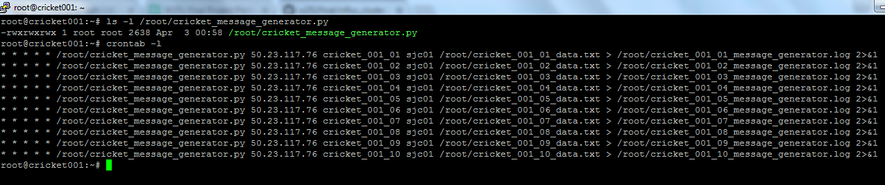
Did we buy 10,000 Raspberry Pi? No.
We used Softlayer Cloud to simulate crickets across the globe.
Amsterdam 01 ams01
Amsterdam 03 ams03
Chennai che01
Dallas 01 dal01
Dallas 02 dal02
Dallas 05 dal05
Dallas 06 dal06
Dallas 07 dal07
Dallas 09 dal09
Dallas 10 dal10
Dallas 12 dal12
Dallas 13 dal13
Frankfurt fra02
Hong Kong hkg02
Houston hou02
London lon02
Melbourne mel01
Milan mil01
Montreal mon01
Oslo osl01
Paris par01
Querétaro mex01
San Jose 01 sjc01
San Jose 03 sjc03
Sao Paulo sao01
Seattle sea01
Seoul 01 seo01
Singapore sng01
Sydney syd01
Tokyo tok02
Toronto tor01
Washington, D.C. 01 wdc01
Washington, D.C. 04 wdc04

Slide 11
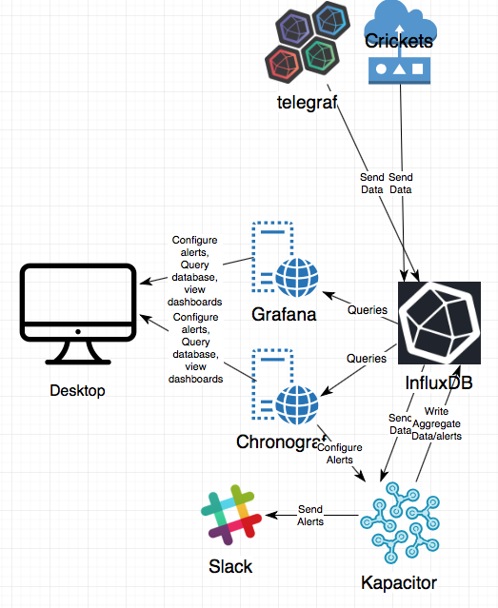
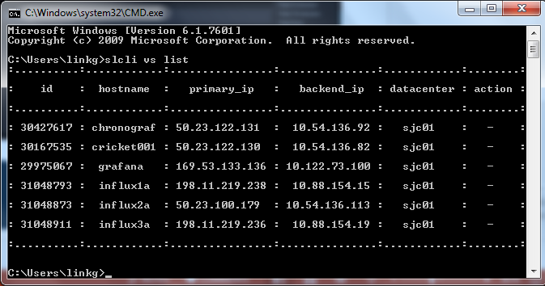
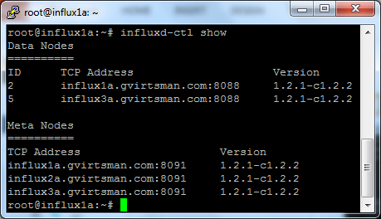
Architecture Overview

Slide 12
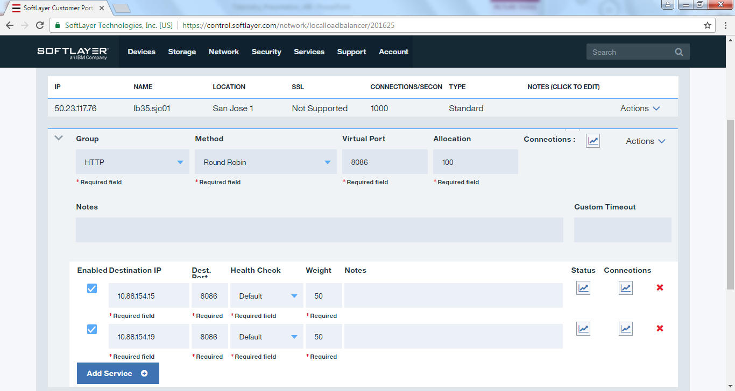
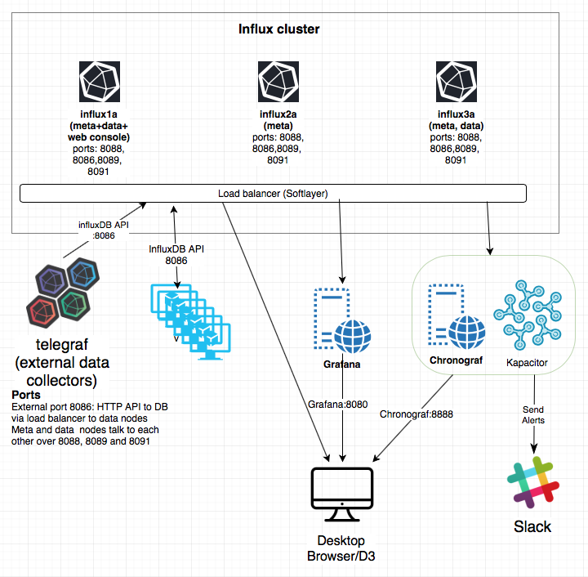
Technology Stack
A Load Balancer is a great way to control data flow to InfluxDB as long as the crickets can store data and recover independently

Slide 13
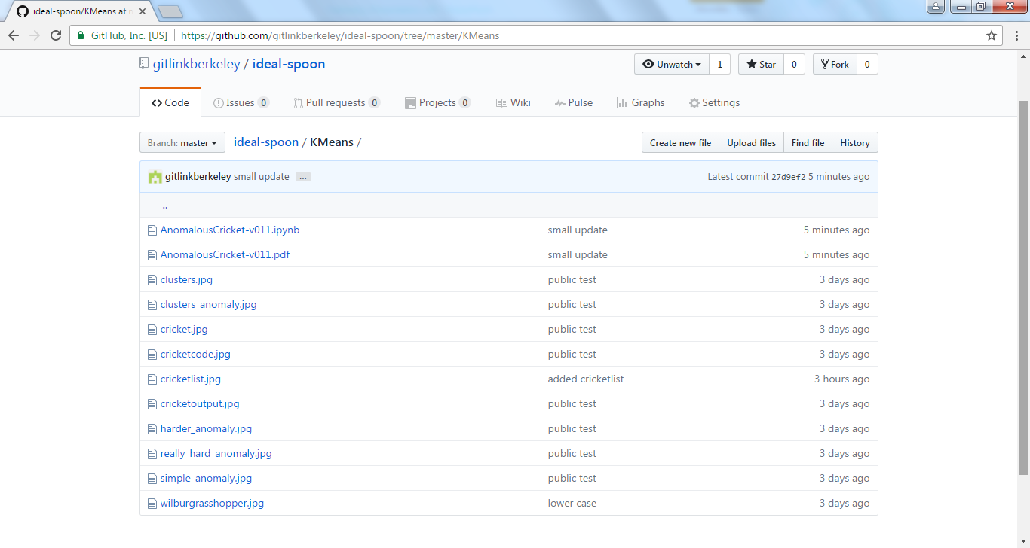
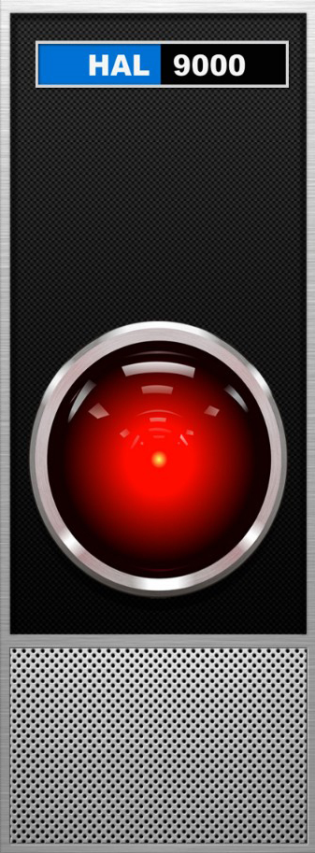
Predictive Maintenance using K-Means
NBViewer
If we had more time…
Realistic Data Construction (not randomized)
Spark Streaming K-Means in concert with live Projected Waveforms (D3)
Intelligent Crickets: Ex-ante Alerts followed by Self-Repair at the Edge
Analyze Clusters of Devices and their combined Waveforms
Bake-off Old School K-Means vs. New School Neural Networks

Slide 14
InfluxDB: time series database
TICK Stack
InfluxDB
Open source
TICK stack (Telegraf, Influxdb, Chronograf, Kapacitor)
Horizontally scalable (paid for product).
3 Meta nodes, 2+ data nodes.
~250,000 inserts/sec, ~25 queries/sec on a single node.
Retention policy + # replicated copies.
Quorum: Write: one copy, Read: choice per sessions. (biased towards heavy writes, light reads, AP)
SQL like syntax
Column store, compression, LSM tree (two component – memory + disk, defer index updates)

Slide 15
InfluxDB Query Performance
D3.js

Slide 16
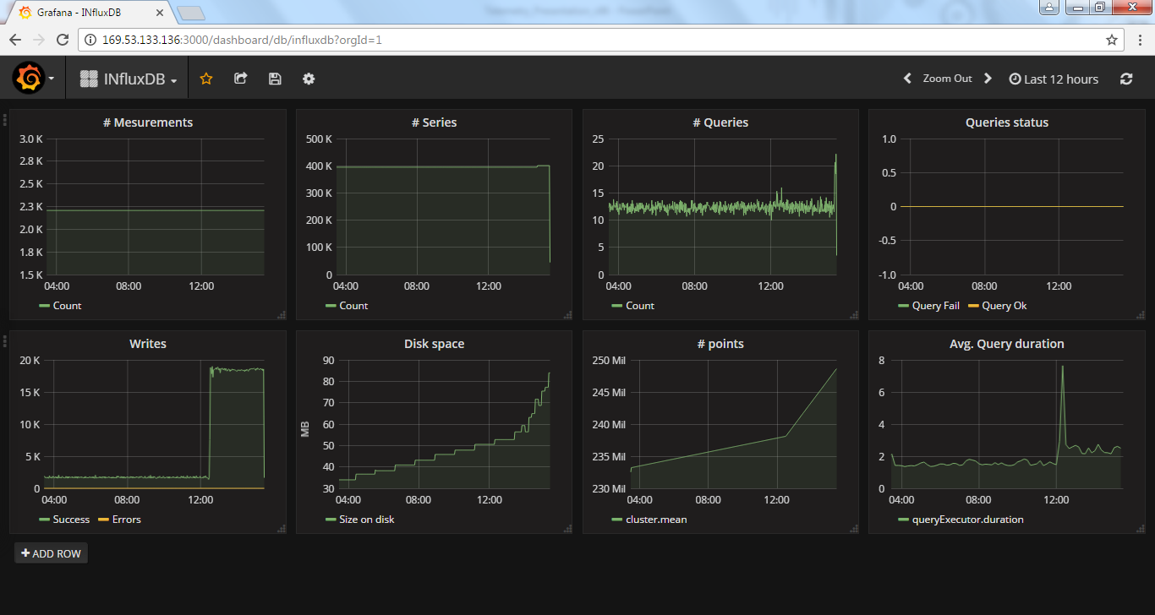
Grafana Dashboard
Grafana Dashboard

Slide 17


Questions?
Thong Bui
Roy Gvirtsman
Geoffrey Link
Zhongqiao Jin
Happiness Munedzimwe
Github Repository

