Slide 2

YPP 4th
bbv Software Services AG | Date

Slide 3




Presentation on Use Case InFlow
bbv Software Services AG | Date: 08/05/2025

Slide 4
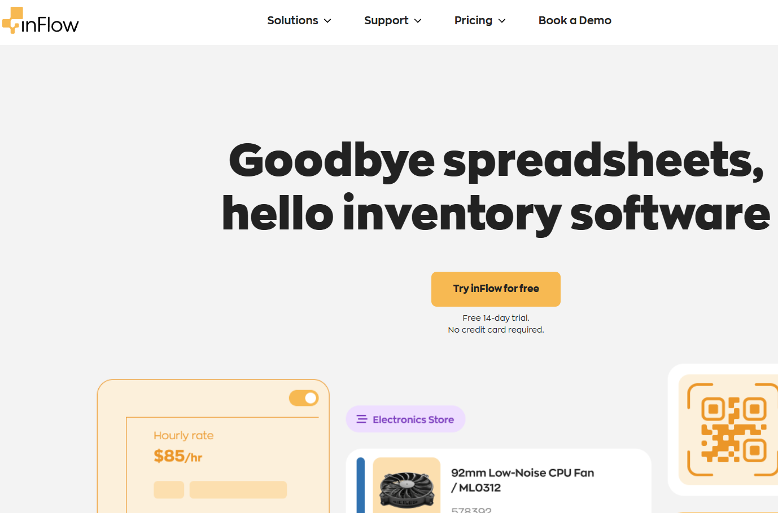
Agenda
Introduction
Module
UI Screens in the Inflowinventory
Usecase
Q&A

Slide 5

INTRODUCTION
What is Inflowinventory?

Slide 6

Introduction
What is InflowInventory
Inflow
Let’s users:
Create workspace boards

Slide 7

Key Functionalities

Slide 8
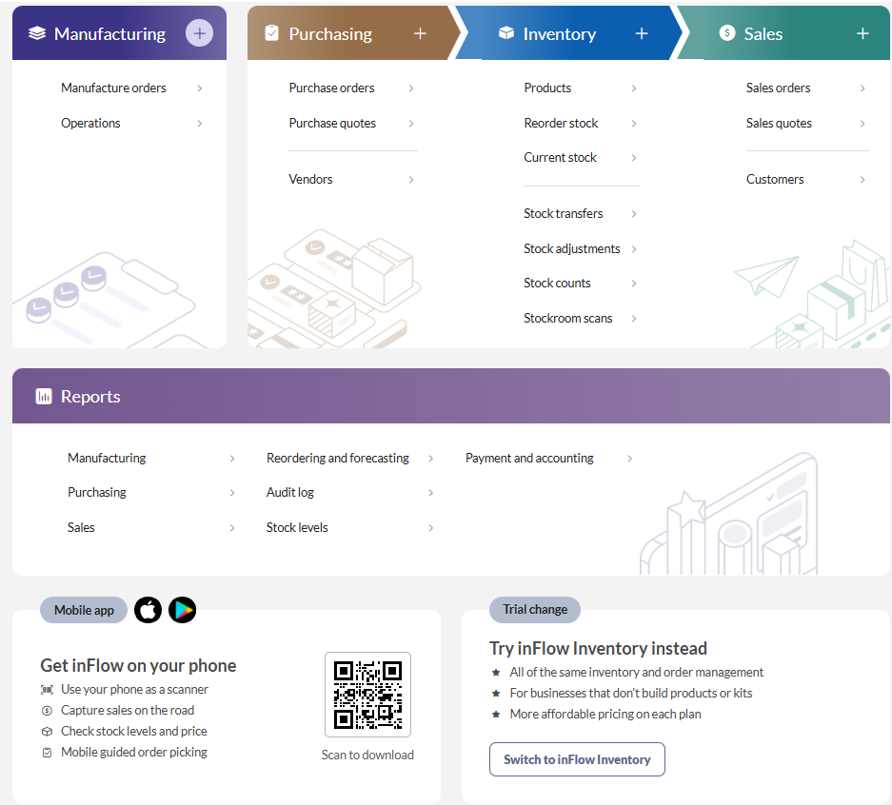
Key Functionalities
Create

Slide 9
Purchase module

Slide 10

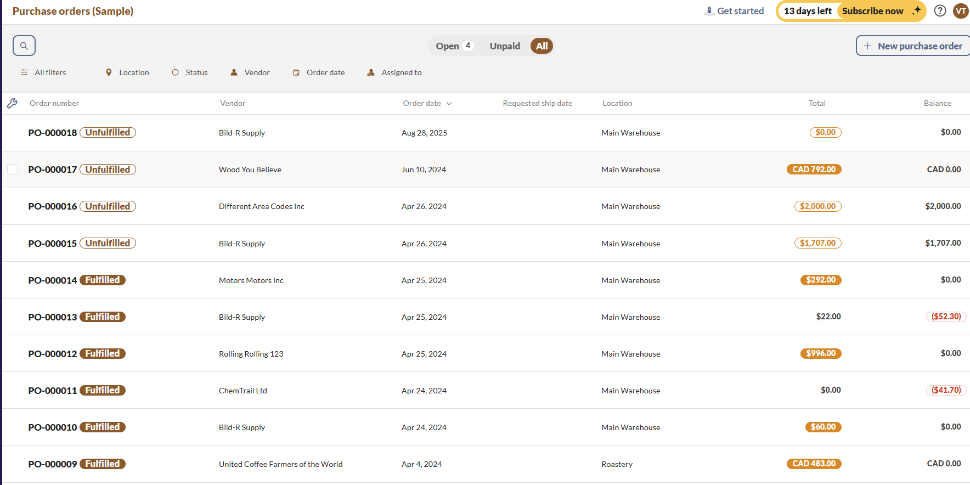
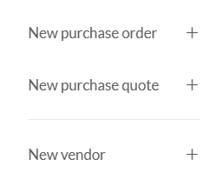
PURCHASE ORDER
Purchase
Click here

Slide 11
MANAGE PURCHASE ORDER

Slide 12
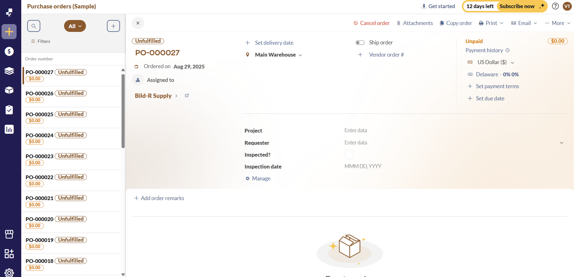

PURCHASE ORDER

Slide 13
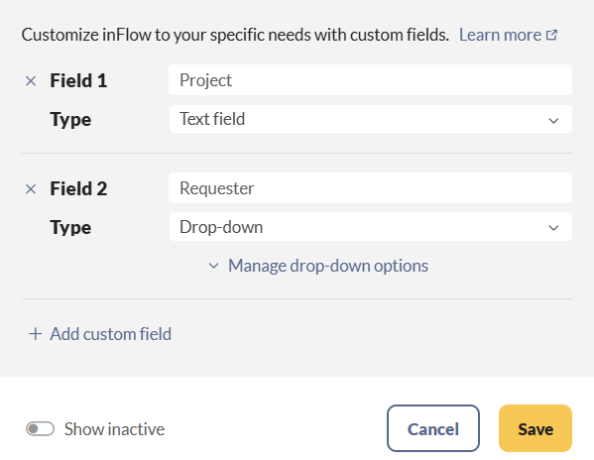
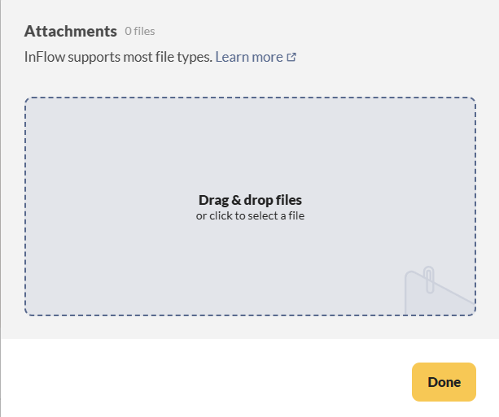
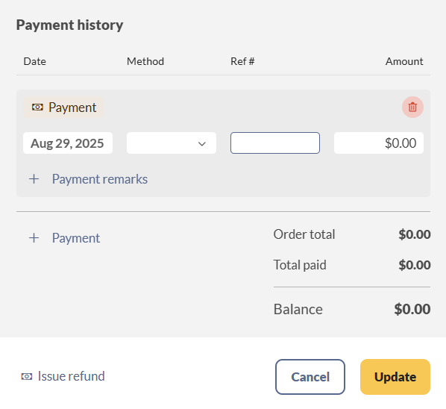
PURCHASE ORDER

Slide 14
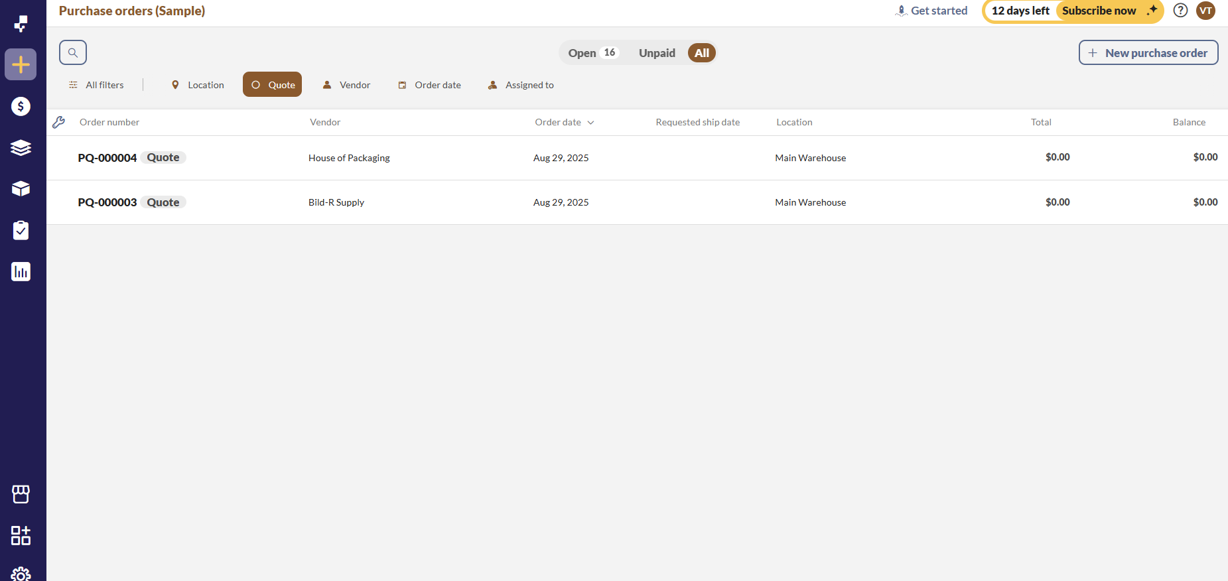
PURCHASE QUOTE

Slide 15
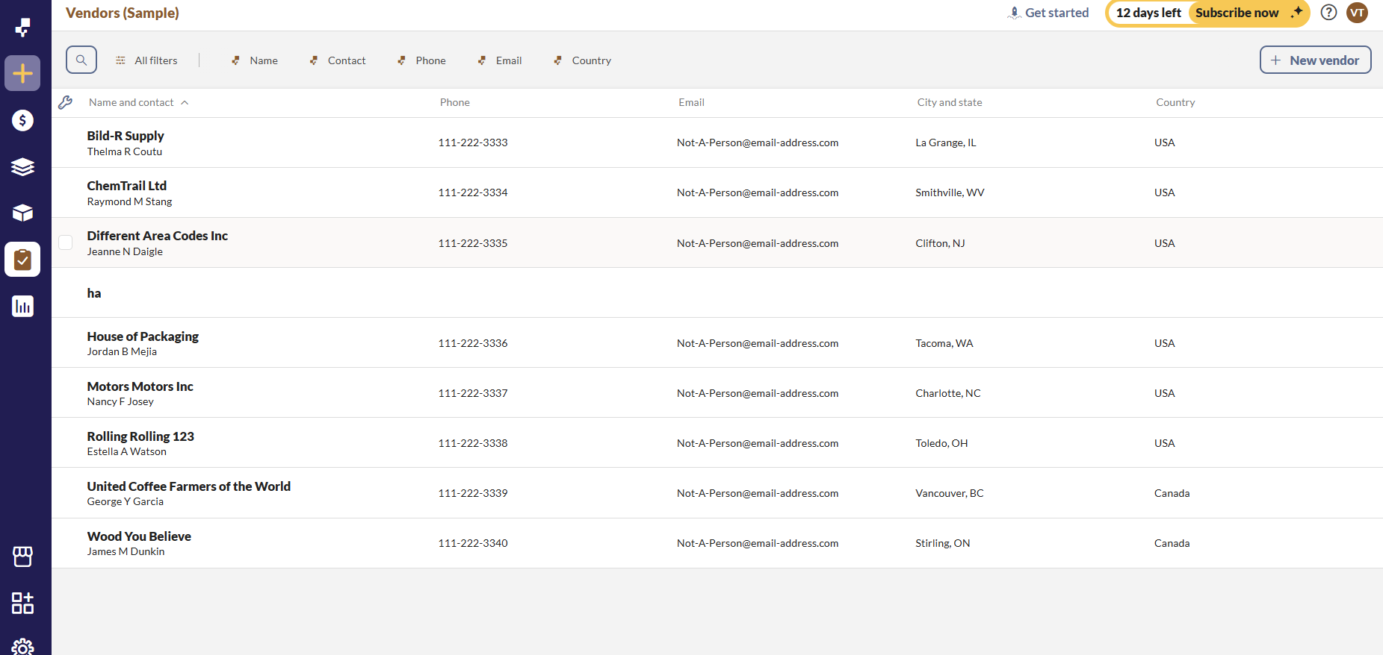
MANAGE VENDOR

Slide 16
MANAGE VENDOR

Slide 17
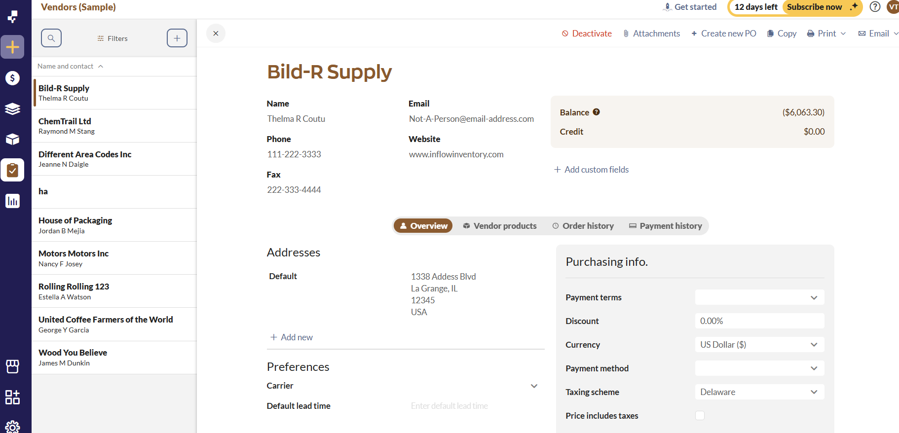
MANAGE VENDOR

Slide 18
INFOR VENDOR

Slide 19
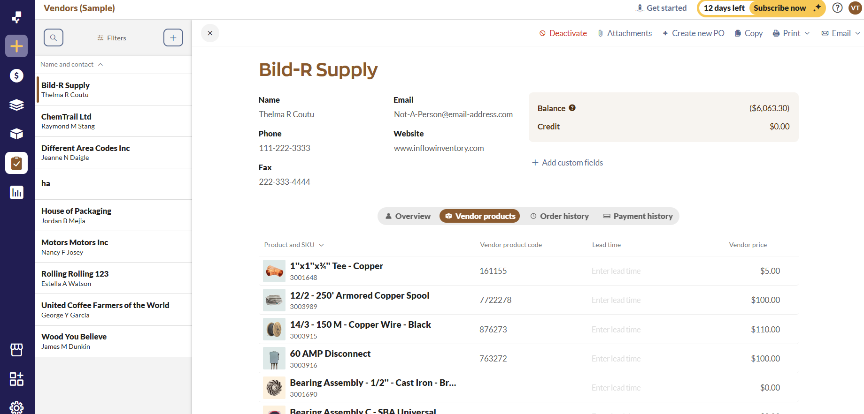
INFOR VENDOR

Slide 20
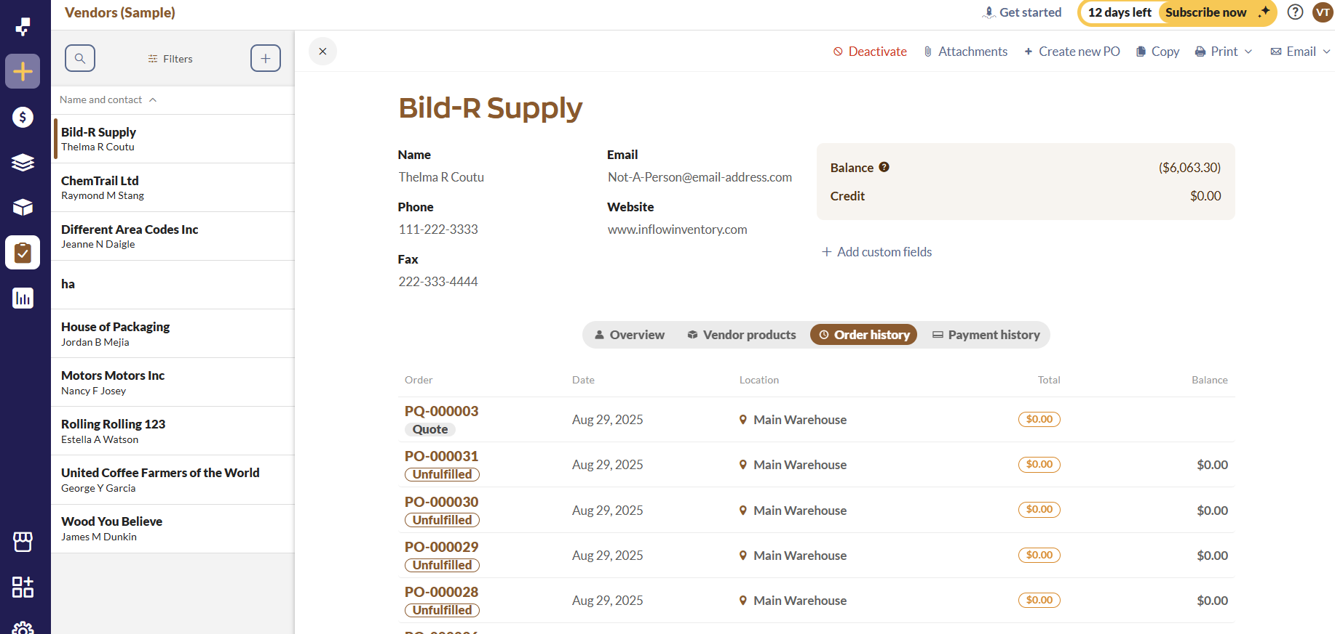
ORDER HISTORY

Slide 21
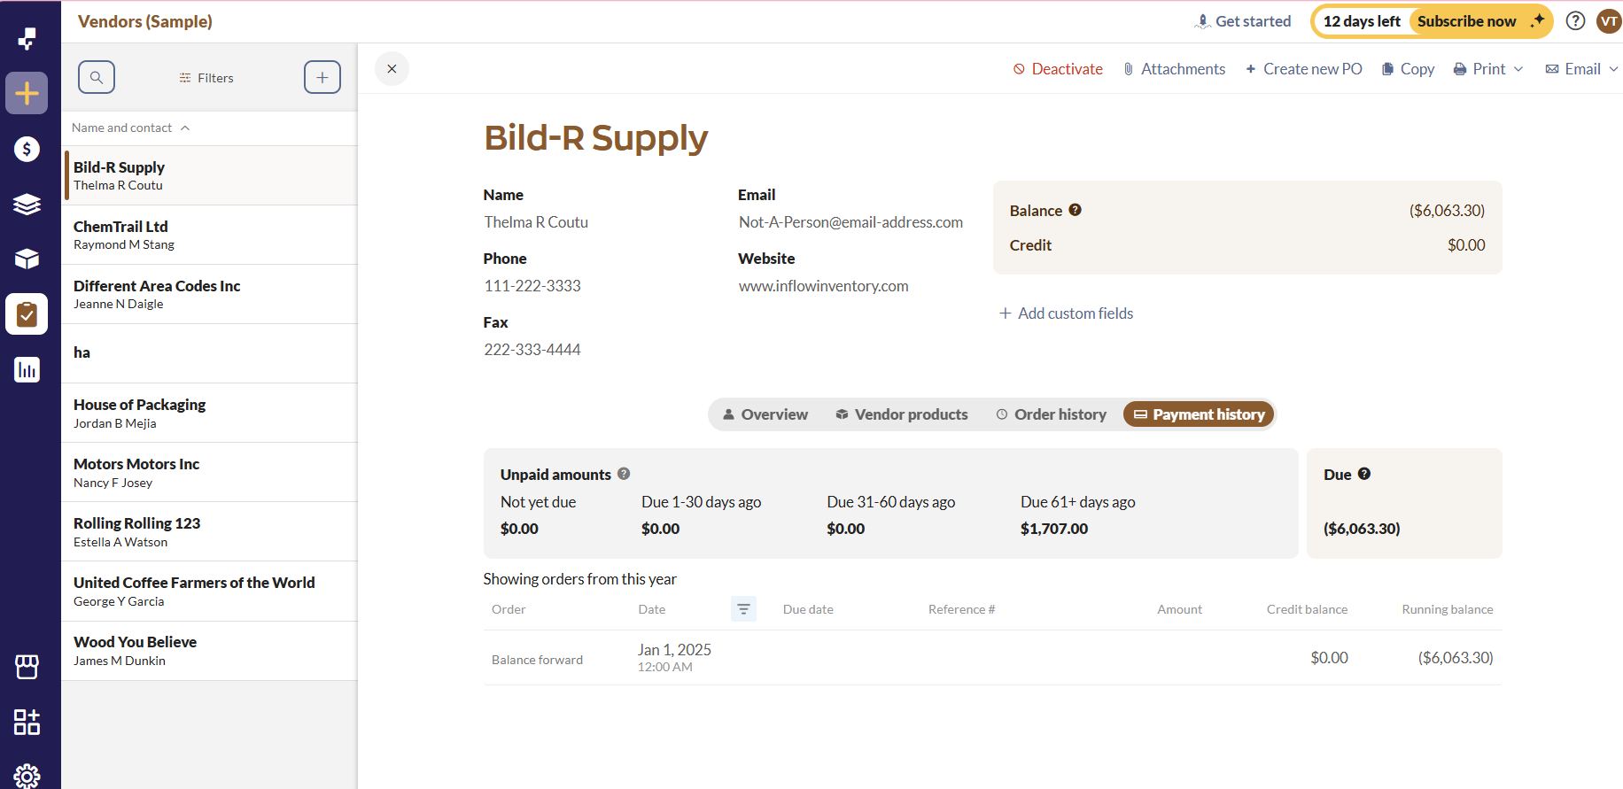
PAYMENT HISTORY

Slide 22
Manufactoring module

Slide 23
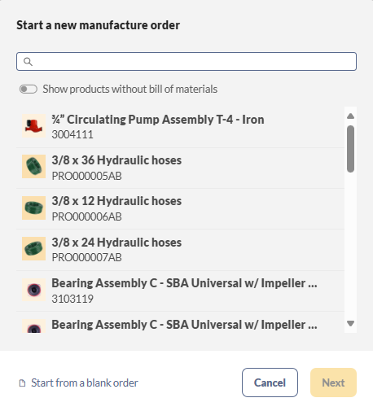
Create Manufacturing Order

Slide 24
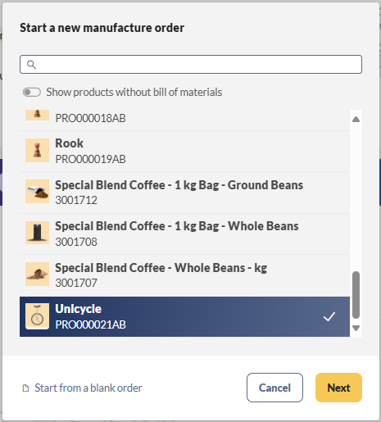
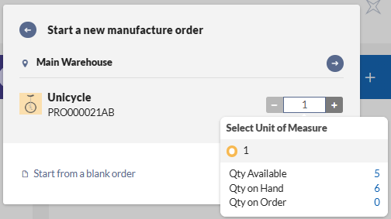
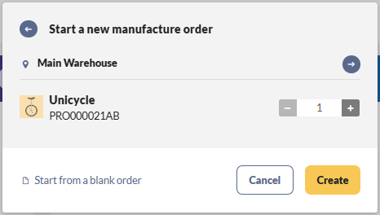
Create Manufacturing Order

Slide 25
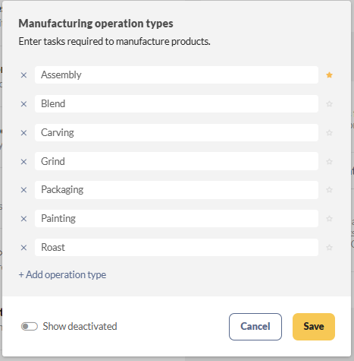
Manage Manufacturing Operations

Slide 26
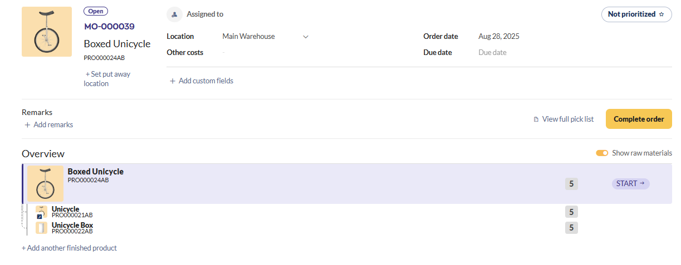
Manage Manufacturing Order

Slide 27
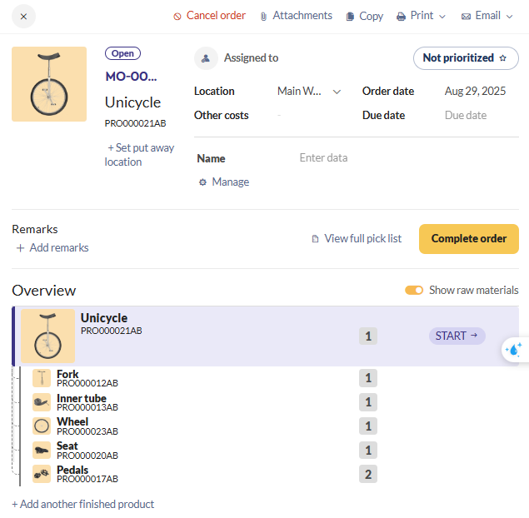
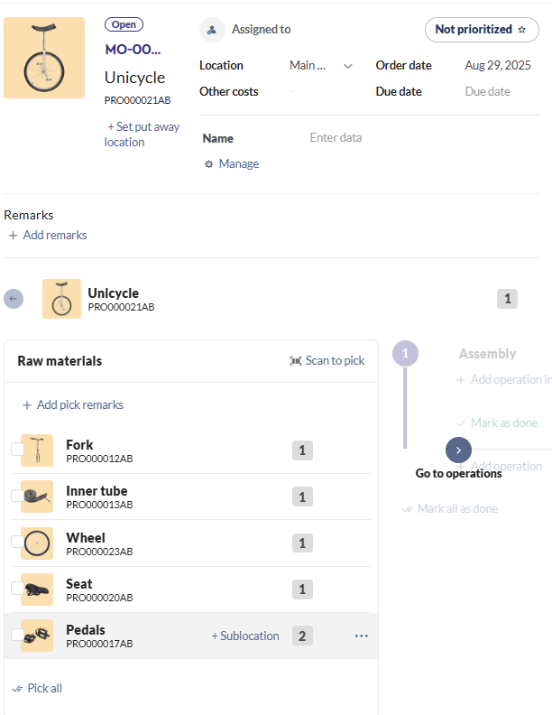
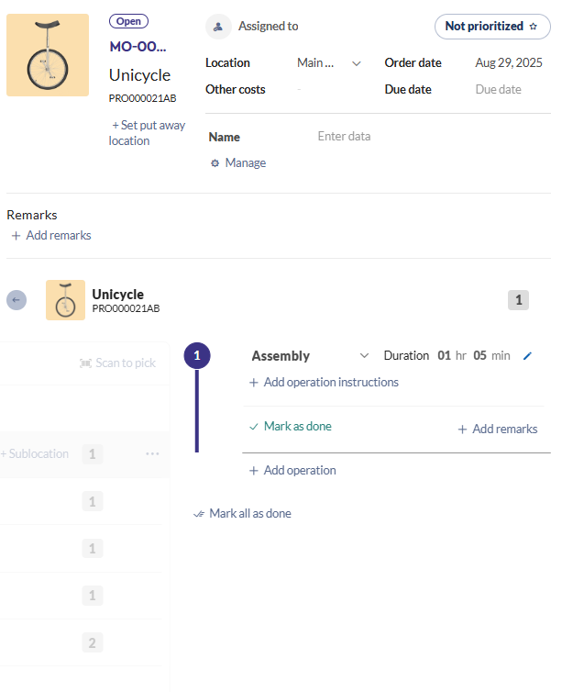
Manage Manufacturing Operations

Slide 28

Q&A
Thank you
Intern | Trello Team

Slide 30
bbv template EN
How-to guides

Slide 31
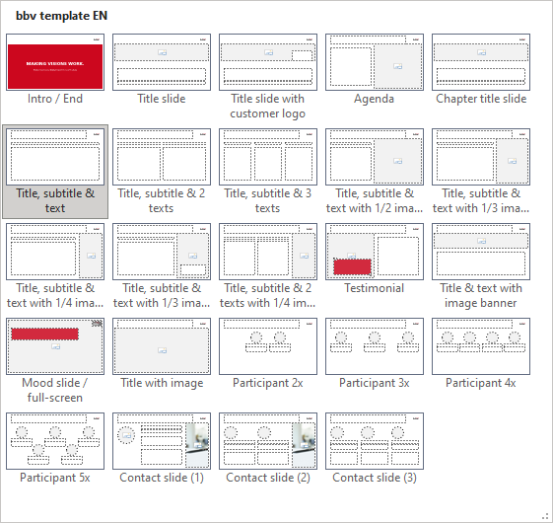
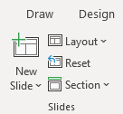
bbv Master layouts & slide library
Insert new slide
1
Click on «New Slide»
1
2
Select layout
Choose the desired layout from the pre-programmed master layouts.
2
🡪
Or select layout from slide library

Slide 32
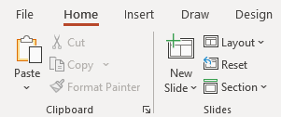
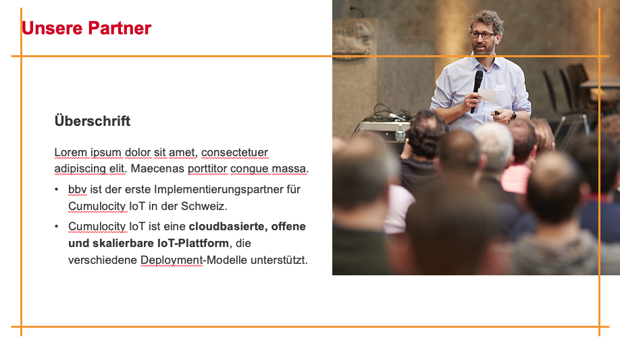
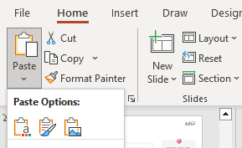

Transfer of existing slides into the new Master
1
2
3
4
Insert original slide
Copy slide in original presentation with Ctrl+C.
In the target presentation, select the slide after which the original slide is to be inserted.
Select in the tab «Home / Paste / Use Destination Theme».
Assign slide layout
Select the inserted slide
Select the desired layout in the tab «Home / Layout».
Adjust slide manually
Check all slide contents such as text blocks, images, etc. for position and size and manually adjust them to the new layout grid.
Check design
Independently check:
Font type, sizes and font colours
Colours of graphic elements
Text alignment
Coherence of the overall picture
Important:
When transferring existing slides, always carry out all four steps.

Slide 33
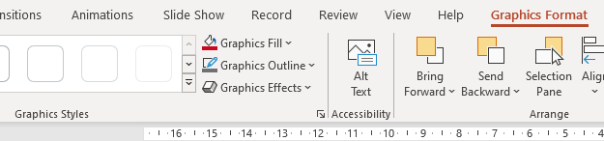

Change icon colour
Approach
Notes
Select icon
In the tab «Graphics Format» under «Graphics Styles», use «Graphics Fill» to change the colour
For some icons, the colour can be changed by using «Graphics Outline» instead of «Graphics Fill».
The colour cannot be changed if an icon is inserted as a picture. In this case, after selecting the icon, the tab «Picture Format» appears instead of «Graphics Format».
Best vector file format for icons: *.svg

Slide 34



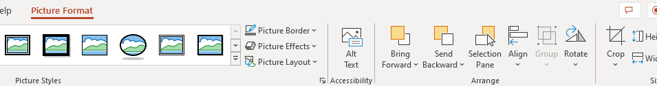


Insert image into placeholder
Insert image from external source
Click on the image icon, select image from Sharepoint or other source
The bbv image library is here locally located: C:\Users\Public\bbv_templates\Marketing\PPT-Bibliotheken\Bilder-Bibliothek
Or: copy image from external source with Ctrl+C, select the placeholder, then paste with Ctrl+V
Adjust
Select the image
Click in the tab «Picture Format» on «Crop»
Adjust the image composition by moving the image
Resize the image by clicking and dragging the outer circles.
Click again on «Crop» to finish the adjustments

Slide 35


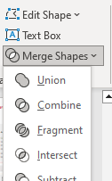

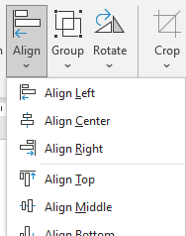

Insert image into mock-up screen (mobile/laptop)
Mock-up
Paste image
Copy image from external source with Ctrl+C and paste with Ctrl+V
Image mask
Adjust size & determine image area:
Place image behind image mask
Adjust image size and determine image area
Image mask
Crop image to image mask
Select image
Select image mask
Click in the tab «Shape Format / Merge Shapes» on «Intersect»
Combine image with mock-up
Place image behind mock-up
Activate image and mock-up and align both horizontally (Align Center) and vertically (Align Middle)
Group image and mock-up with Ctrl+G

Slide 36
bbv template EN
Style guide

Slide 37
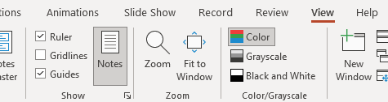

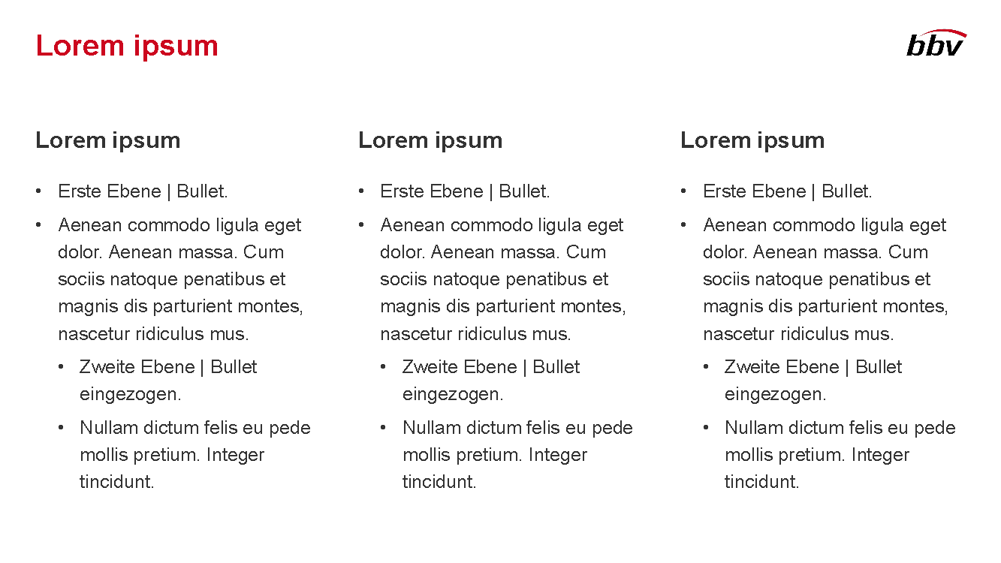
Working area, guides & ruler
Working area
Depending on the slide, a single-column layout, a 2-column or 3-column layout is used.
Display the ruler and guides in the «View» tab.

Slide 38
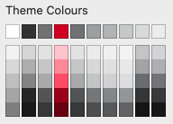
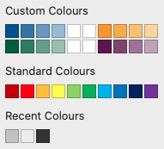
bbv colour theme
Always OK!
Never, please!
Default text colours
Main accent
Colours for diagrams, charts, graphs etc.
Use selectively and sparingly
Never, please!
Colours for diagrams, charts, graphs etc.
Colours for diagrams, charts, graphs etc.

