Slide 1
Predicting and Analyzing Census Income
Thong Tran and Hoa Pham
Department of Computer Science, Georgia State University

Slide 2
Introduction
Nowadays, people always dream of making good money for their lives and they want to make a plan of how they can achieve it
Based on the data that we collect from UCI machine learning, we can make a prediction for a person whether or not they can make more than 50 thousand dollars per year, and also we can make a recommendation or interesting patterns for those who make under 50 thousand dollars per year.

Slide 3
Table of Contents
Introduction
Objectives
Data Preprocessing:
Data Collection
Proposed Solutions for Mixing Values
Data Visualization
Encoding Data
Prediction Model:
Naïve Bayes Classifier
Logistic Regression
Cross-Validation
KNN
Boosting
Multi-layer-perceptron
Support Vector Machine
Trees Classifier
Association Rules:
Apirori Algorithm
Conclusion
Future Work
Refrences

Slide 4
Objectives
In this research, we aim to find the answers to the following questions:
1. What is the best way to tackle down mixing values?
2. What are some characteristics that highly impact the person's income? (For example, age, degree, race and so on)
3. How do we can make an accurate recommendation for a person who earn less than 50k?

Slide 5


Data Preprocessing

Slide 6
Data Preprocessing - Data Collection
We got our data from
https://archive.ics.uci.edu/ml/datasets/census+income
This set of data has 32561 rows, and 14 attributes
This set of data has 2399 rows that contain unknow values
The last attribute is binary classification label
Attributes: Age, workclass, fnlwgt, education, educationnum, marital-status, occupation, relationship, race, sex, capital-gain, capital-loss, hours-per-week, native-country, income

Slide 7
Data Preprocessing – Mixing Values
Truth data is important, so we have tried several ways to fix mixing values problems
1. Eliminate or delete every line of data that has unknow values
2. Replace every unknow values with the average values
3. Replace every unknow values with the mod values
4. Use SVM to predict the outcome of unknow values (This is our new proposed solution to fix mixing values)

Slide 8
Data Preprocessing – Use SVM for Mixing Values
SVM's task in this case is to predict the outcome class from multiple class labels for a one unknow value
SVM's library: https://www.csie.ntu.edu.tw/~cjlin/libsvm/
Algorithms:
Separate or filter complete data and mixing values into different files
Scan through mixing value files and filter mixing values into the same category of mixing value files
We will remove any row that has more than two mixing values
Scan through each category files and apply SVM algorithms, and replace any mixing value from prediction

Slide 9
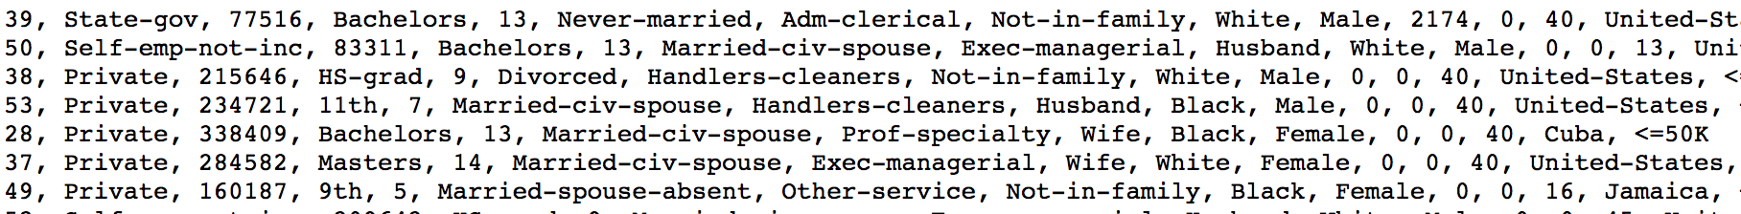
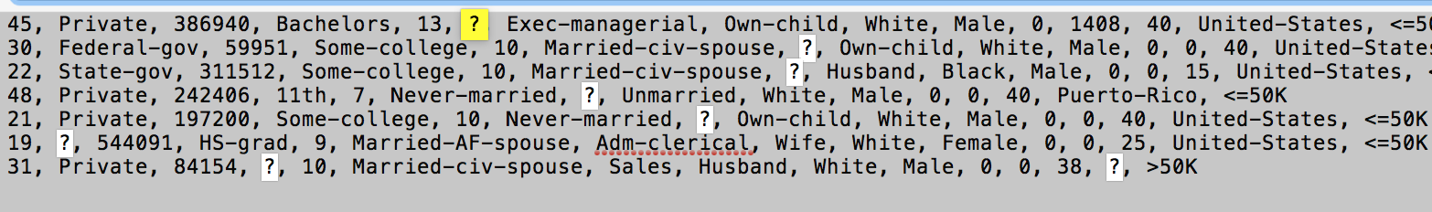
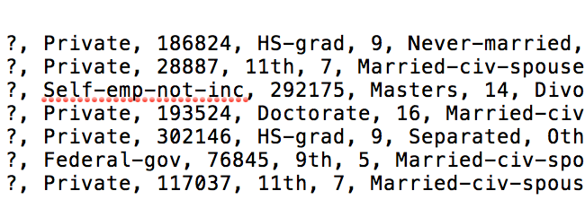
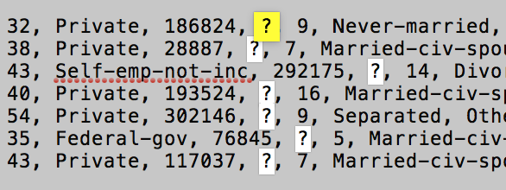
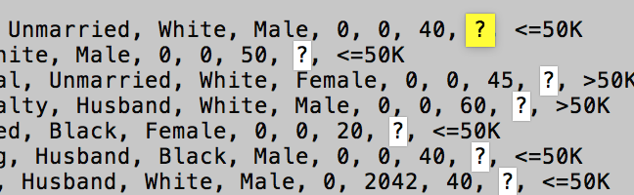
Data Preprocessing – Continued

Slide 10
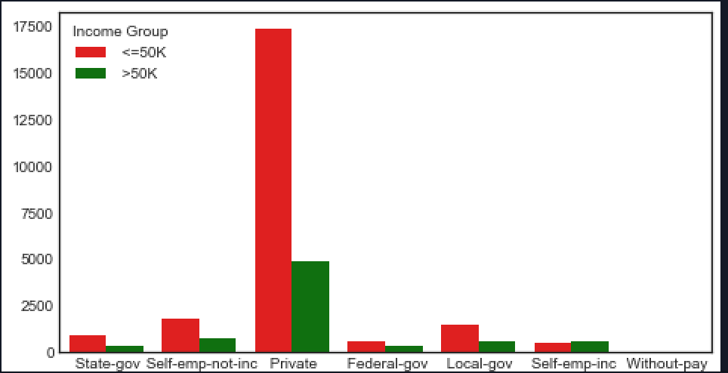
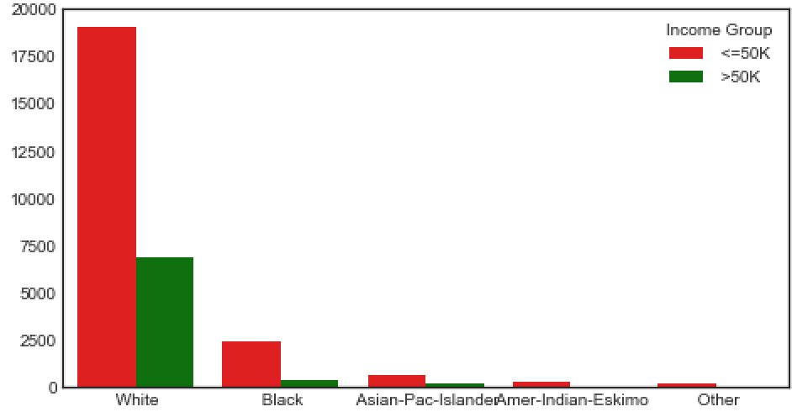
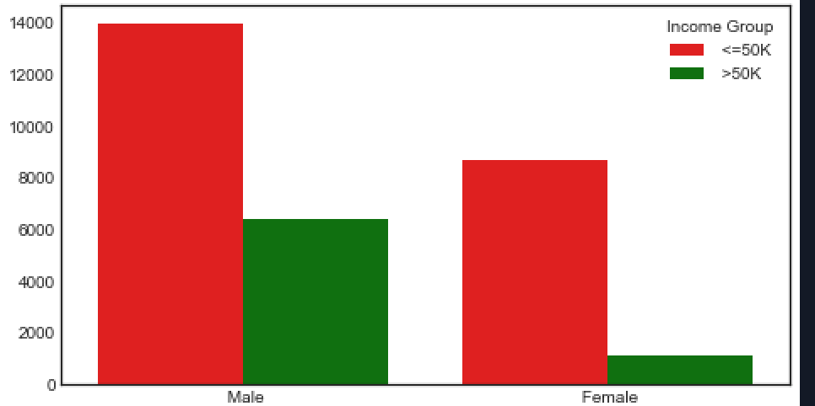
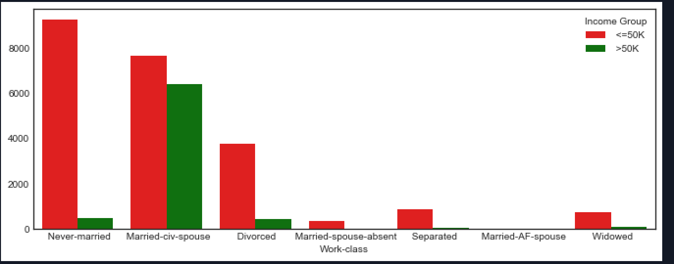
Data Preprocessing – Data Visualization

Slide 11
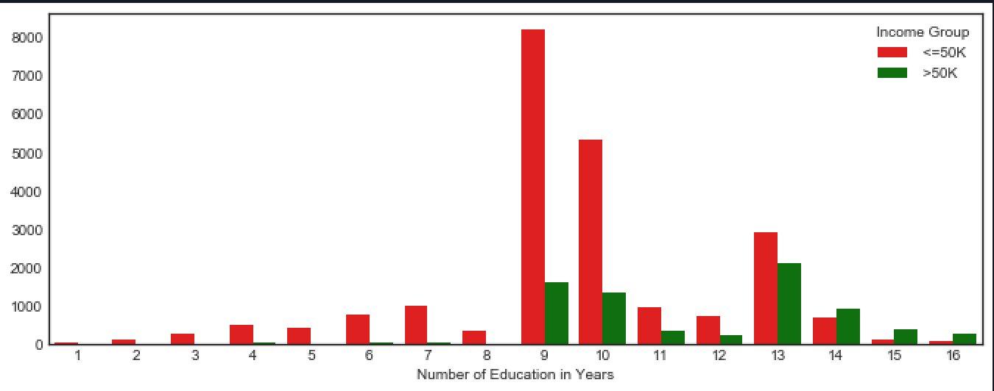
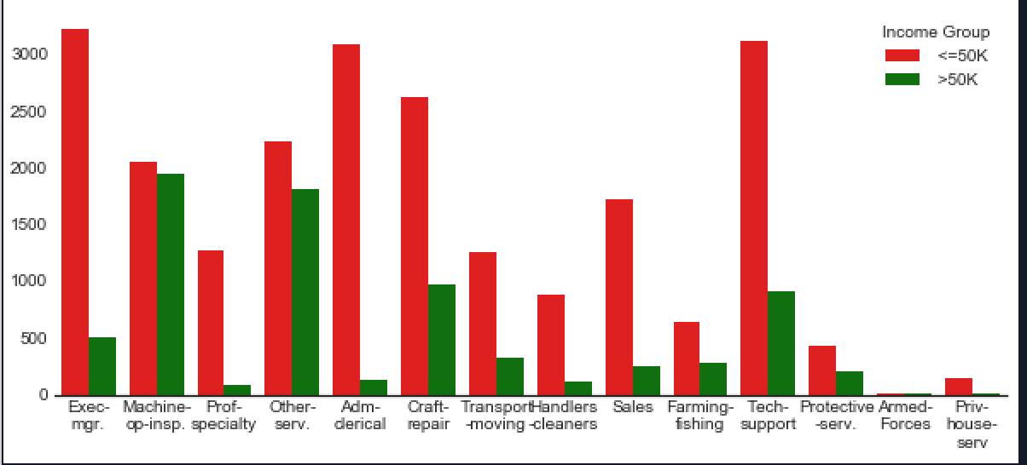
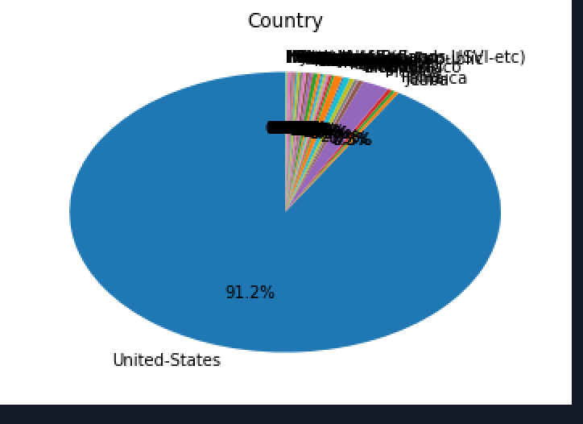
Data Preprocessing – Data Visualization

Slide 12
Data Preprocessing – Data Visualization
Fun Fact of Attributes
1. Country: There are 91% people live in the US
2. Relationship: 41% husband, 25% not in family
3. Marital Status: 46% are married with civilization, 32% are never married
4. Race: 85% white
5. Education: 32% have HS degree and 22% have some college degree
6. Sex : 67% male, 32% female
7. Work-class: 73.3% work as private

Slide 13
Data Preprocessing – Data Visualization
Short brief for Data Visualization:
1. Person who is never-married will likely to earn less than 50k
2. People who have a median of 9 years education tend to earn less than 50k, and people who have more than 13 years earn are likely to earn more than 50k
3. As you can see, 92% people are from the US

Slide 14
Data Preprocessing – Encoding data
One of the problem in applied machine learning model or data mining techniques is that some machine learning algorithms can recognize and interpret with categorized data such as Decision Trees. However, there are some algorithms that cannot operate with categorized data labels. As a result, for the purpose of this research, we should not limit the number of algorithms used for this project, so we need to convert all the categorized data into numeric data.
We will use LabelEncoder library in Sklearn as a tool to help us tackle down this task

Slide 15
Data Preprocessing – Encoding Data
Because later on this project, we will use association rule. As a result, we will denote some of the attributes in the data
Age: a1 for 0 – 25, a2 for 25 – 40, a3 for 40 – 60, a4 for >60
Years of Education: E1 for 1 – 12 , E2 for 12 – 14
Number of hours working: H1 for 0 – 20 , H2 for 20 – 40, H3 for >40

Slide 16

Prediction Model

Slide 17
Prediction Model - Naïve Bayer Classifier
Pros:
It is really fast, and easy to use
It is not sensitive for not relevant data
We used Naïve Bayer because it is easy to use and that is the very first classification to see how the model can behave to the dataset
Cons:
It assumes all the variables as independent.

Slide 18
Prediction Model – 9 Fold Cross Validation(SVM)
Pros:
It is convenient to handle large feature space
It can easily deal with non-linear data interactions
We used SVM for dividing data set into different partition to reinforce the training model and in hope of getting better accuarcy
Cons:
It is not rely for entire data, and it is hard to find kernal and parameters
It is not fast. In fact, with our machine, it will take more than 1 hour to complete the training

Slide 19
Prediction Model – Random Forests
Pros:
It is a set of decision-tree and it can help avoid over-fitting problem
It provides probabilities for outcome
It trains each tree independently
This can be used for regression and classification
There are six importance features: age, sex, occupation, marital status, work-class, relationship
We used Random Forest for dividing into many sub-decision tree to have the better idea of "voting" decision from each decision-tree

Slide 20
Prediction Model – Extra Tree Classifier
This is a variant of random forest
We used this method to select an alternative features importance that are occupation, years of education , age, race , marital status , sex
Surprisingly, number of hours working is not showed up. It could be the result of this data is interfered

Slide 21
Prediction Model – XG Boosting
We used boosting method to train data from weak learner to strong learner
Because Boosting creates one tree at a time and sequentially; as a result, it will take longer to train the data, and of course, we expect this model to predict a higher accuracy
However, this model is prone to overfitting

Slide 22
Prediction Model - KNN
We also experimented with KNN which is really simple and trivial classifier
01
However, because of its costly expensive computation and its lazy learner, this model cannot work well in a large data-set.It can only do well in a small input dimensions
02
We realized that this model is a worse model to apply
03
There are several algorithms we used with KNN: ball tree, kd tree, brute-force and auto
04

Slide 23
Prediction Model – Multi-layer Perceptron
We experimented neural network with hidden layer size of 10 to identify and work with non-linear separable data
This model work really well and this is one of the best model to perform the best accuracy

Slide 24
Prediction Model – Feature Selection (RFE)
We used this model to get a sense of what features are the most important predictors to the income result
We have figured out that there are sex, number years of education, marital status, relationship, race, hours working per work

Slide 25
Feature Selection
This is really important to finalize the best predictors for our data model. As a result, we have tried several regression algorithms and our statistic method to finalize the best predictors
Here are the top 6 predictors collected from following algorithms
Boosting:
Capital_Gain(1), Age(2), years of education(3), hoursperweek(4), occupation(5), relationship(6),work-class(7)
Extra Tree:
Occupation(1), years of education(2), age(3), race(4), marital-status (5), sex(6)
Random Forest:
Age(1), education(2), sex(3), occupation(4), marital-status(5), work-class(6)
RFE:
Sex(1), years of education(2), marital-status (3), relationship(4), race(5), work-class(6)

Slide 26
Prediction Model – Table of Summary
After trying several experiments, we have found the best model which is boosting with 86% accuarcy for the following feature selection: Capital_Gain, Age, years of education, hoursperweek, occupation, relationship,work-class, marital-status, education-num
Model/Algorithm Used | Accuracy on Test Set
SVM | 75.92%
9 fold cross validation | 81.047%
Multiple Layer Perceptron | 82.67%
KNN(Brute Force, (best)) | 80.0139%
Extra Tree Classifier | 82.67%
XG Boosting | 86.136%
Random-Forest (100 sub tree) | 81.173%

Slide 27
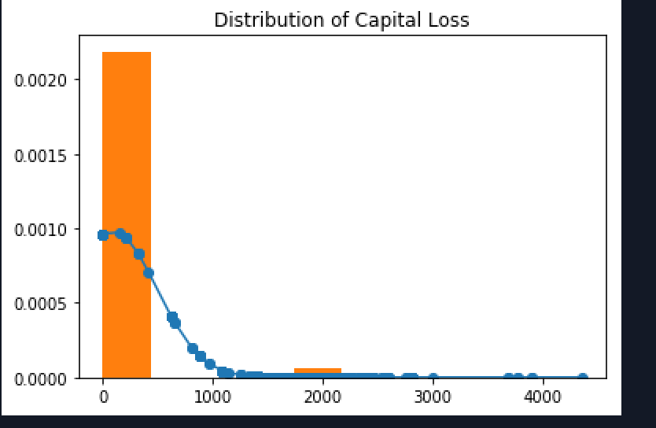
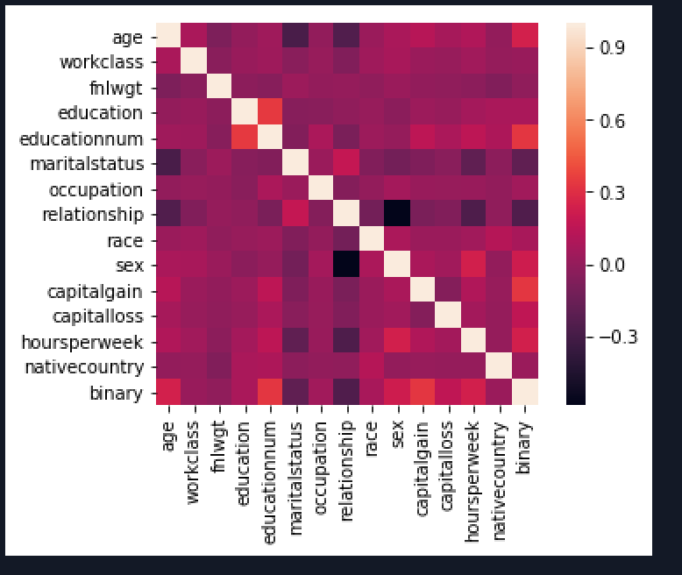
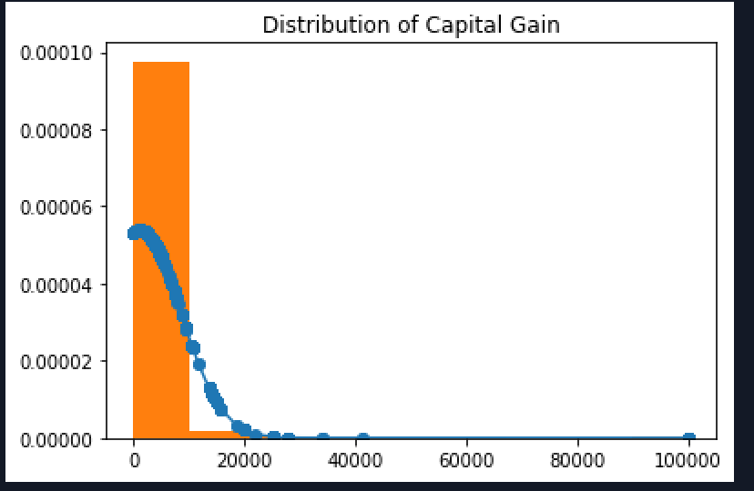
Association Rules
96.05 % data collected is the US in native country
Finalweight is dropped because it is not meaningful in association rules
Capital gain and capital is also dropped because they are also not meaningful
Education's degree and years of education has a correlation. As a result, education's degree is dropped

Slide 28
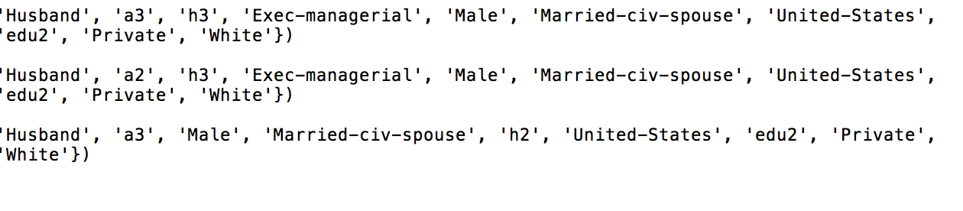
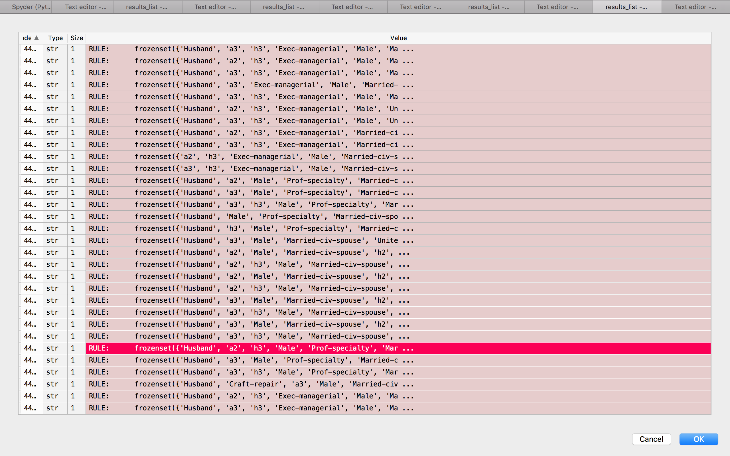
Association Rules – Best Rules for >50K

Slide 29
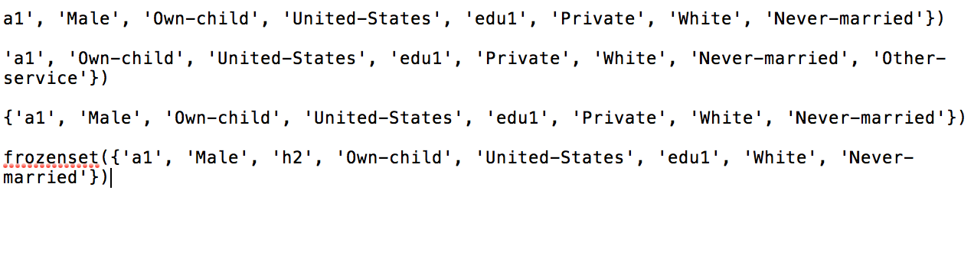
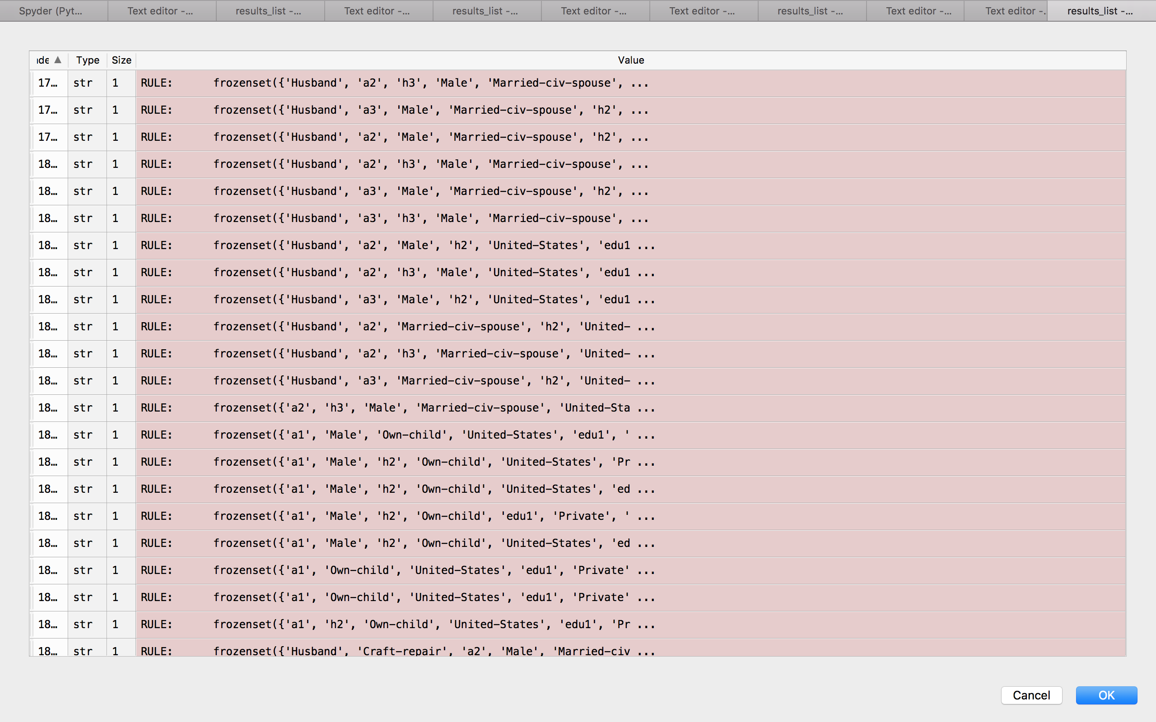
Association Rules – Best Rules for <=50K

Slide 30
Association Rules
After we found all the rules, we will do a little of engineering to build a search engine
First, we will use boosting model to predict whether or not the person earns less than 50k
We select top most efficient rules and store those into an array
We will then take inputs from the user and compare to our rules.
We will select the rule that has the most common with inputs from the user
As a result, that rule would be the recommendation for the user

Slide 31
Summary
From our point of view, the person who is likely to earn more than 50k will be the man, who lives in the United States, he has long years in education, he is a hard-worker, he is a husband and married with civilization , and finally he likely opens his own business (Maybe he is a boss)
The person who is likely to earn less than 50k will be the man, who lives in the US, he does not have long education, he is never married and young
Boosting method is going to be the best model to predict our data because it turns a weak learner to strong learner.
We also use AdaBoosting but the it brings to the same result

Slide 32
Future Work
We will then implement a backend rest-full API using Python django to build up a web application where you can go there and provide some of your background, get the prediction result and get some recommendation of what you can do to improve your income
We will also try to get a better result with Artificial Neural Network in which we can expect that will have more accuracy
We will also try to finish using SVM model to predict the mixing values

Slide 33
References
http://scikit-learn.org/stable/modules/generated/sklearn.feature_selection.RFE.html
https://archive.ics.uci.edu/ml/datasets/census+income
http://scikit-learn.org/stable/modules/generated/sklearn.neighbors.KNeighborsClassifier.html
https://ashokharnal.wordpress.com/2015/01/20/a-working-example-of-k-d-tree-formation-and-k-nearest-neighbor-algorithms/
https://en.wikipedia.org/wiki/AdaBoost
http://scikit-learn.org/stable/modules/generated/sklearn.ensemble.RandomForestClassifier.html
https://machinelearningmastery.com/feature-importance-and-feature-selection-with-xgboost-in-python/
http://www.blopig.com/blog/2017/07/using-random-forests-in-python-with-scikit-learn/

Slide 34
References
[1] “Census Income.” Data Mining with R, individual.utoronto.ca/zabet/census-income.html.
[2] https://cseweb.ucsd.edu/~jmcauley/cse190/reports/sp15/024.pdf , by Jim Cauley
[3] https://cseweb.ucsd.edu/classes/wi17/cse258-a/reports/a120.pdf , by Vidya Chockalingam, Sejal Shah, and Ronit Shaw
[4]Antonov, Anton Antonov. “Classification and Association Rules for Census Income Data.” Mathematica for Prediction Algorithms, 1 Apr. 2016, mathematicaforprediction.wordpress.com/2014/03/30/classification-and-association-rules-for-census-income-data/.
[5] “Sklearn.feature_selection.RFE¶.” Sklearn.feature_selection.RFE - Scikit-Learn 0.19.1 Documentation, scikit-learn.org/stable/modules/generated/sklearn.feature_selection.RFE.html.

